Slide 1

MASLD/MASH Screening and Diagnosis
Provided by Clinical Care Options, LLC, in partnership with the American Gastroenterological Association (AGA) and Practicing Clinicians Exchange (PCE)
Supported by an educational grant from Novo Nordisk.
Notes:
Clinical Pathways: Multidisciplinary Approach to Managing Metabolic Dysfunction-associated Steatohepatitis

Slide 2

About These Slides
Please feel free to use and share some or all of these slides in your noncommercial presentations to colleagues or patients
When using our slides, please retain the source attribution:
These slides may not be published, posted online, or used in commercial presentations without permission. Please contact permissions@clinicaloptions.com for details
Slide credit: clinicaloptions.com
Notes:
Disclaimer: The materials published on the Clinical Care Options website reflect the views of the authors of the CCO material, not those of Clinical Care Options, LLC, the CME providers, or the companies providing educational grants. The materials may discuss uses and dosages for therapeutic products that have not been approved by the United States Food and Drug Administration. A qualified healthcare professional should be consulted before using any therapeutic product discussed. Readers should verify all information and data before treating patients or using any therapies described in these materials.

Slide 3
Faculty
Arun B. Jesudian, MD
Associate Professor of Clinical Medicine
Division of Gastroenterology and Hepatology
Weill Cornell Medicine
New York, New York
Notes:
This slide lists the faculty who were involved in the production of these slides.

Slide 4
Disclosures
The faculty reported the following relevant financial relationships or relationships to products or devices they have with ineligible companies related to the content of this educational activity:
Arun B. Jesudian, MD: consultant/advisor/speaker: Dynavax, Salix.
Notes:
This slide lists the disclosure information of the faculty and staff involved in the development of these slides.

Slide 5
SLD: Inclusive Rather Than Exclusive Criteria
Steatotic Liver Disease (SLD)
Metabolic dysfunction–Associated Steatotic
Liver Disease
(MASLD)
MetALD
(MASLD and increased alcohol intake*)
Alcohol-associated (alcohol-related)
Liver Disease (ALD)
Specific etiology SLD
Cryptogenic
SLD
MASLD
predominant
ALD
predominant
Drug-Induced Liver Injury (DILI)
140/210
210
280
350/420
Weekly alcohol intake (g)
MASLD
predominant
ALD
predominant
Monogenic diseases†
20/30
30
40
50/60
Average daily alcohol intake (g)
Miscellaneous‡
*Weekly intake 140-350 g female, 210-420 g male (average daily: 20-50 g female, 30-60 g male).
†eg, lysosomal acid lipase deficiency, Wilson disease, hypobetalipoproteinemia, inborn errors of metabolism.
‡eg, hepatitis C virus, malnutrition, celiac disease.
Rinella. Hepatology, 2023;78:1966.
Notes:
ALD, alcohol-associated/related liver disease; DILI, drug-induced liver injury; MASLD, metabolic dysfunction–associated steatotic liver disease; MetALD, metabolic and alcohol-associated/related liver disease; SLD, steatotic liver disease.

Slide 6
Classification of Steatotic Liver Disease
Cardiometabolic Criteria
Steatotic Liver Disease
(hepatic steatosis identified by imaging or biopsy)
At least 1 of 5:
BMI ≥25 kg/m² (23 Asia) OR WC >94 cm (M) and
80 cm (F) OR ethnicity-adjusted equivalent
Fasting serum glucose ≥5.6 mmol/L
(100 mg/dL) OR 2-hr postload glucose levels ≥7.8 mmol/L (≥140 mg/dL) OR A1C ≥5.7%
(39 mmol/L) OR T2D OR treatment for T2D
Blood pressure ≥130/85 mm Hg OR specific antihypertensive drug treatment
Plasma triglycerides ≥1.70 mmol/L (150 mg/dL) OR lipid-lowering treatment
Plasma HDL cholesterol ≤1.0 mmol/L (40 mg/dL) (M) and ≤1.9 mmol/L (50 mg/dL) (F)
OR lipid-lowering treatment
Does the patient meet any of
the cardiometabolic criteria?
Yes
No
Are there any other causes of steatosis?
Are there any other causes of steatosis?
No
Yes
No
Yes
MASLD
MetALD or other combination etiology
Cryptogenic SLD
Other specific etiology SLD
(eg, ALD, DILI, monogenic diseases)
Rinella. Hepatology, 2023;78:1966.
Notes:
ALD, alcohol-associated/related liver disease; DILI, drug-induced liver injury; HDL, high-density lipoprotein; MASLD, metabolic dysfunction–associated steatotic liver disease; MetALD, metabolic and alcohol-associated/related liver disease; SLD, steatotic liver disease; T2D, type 2 diabetes; WC, waist circumference.

Slide 7
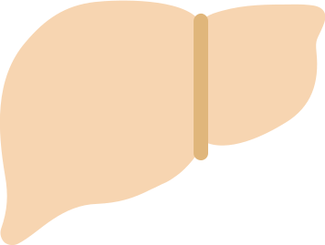

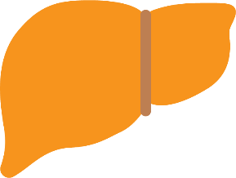
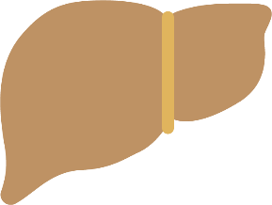
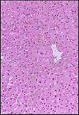
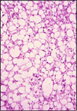

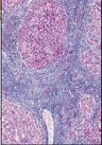
Prevalence of MASLD and MASH
MASLD
Normal Liver
Steatosis
“MASLD”
Steatohepatitis
“MASH”
Cirrhosis
Fatty liver with trivial or no inflammation and no hepatocyte ballooning
Fatty liver with significant inflammation and hepatocyte ballooning
Increasing fibrosis
leading to cirrhosis, hepatocellular carcinoma
Worldwide prevalence: 25%¹ 3%-5%¹ 1%-2% at risk*
*Based on analysis of NHANES data estimating 1.74% prevalence of MASH with advanced fibrosis.²
1. Younossi. J Hepatol. 2019;70:351. 2. Kabbany. Am J Gastroenterol. 2017;112:581.
Notes:
MASH, metabolic dysfunction–associated steatohepatitis; MASLD, metabolic dysfunction–associated steatotic liver disease; NHANES, National Health and Nutrition Examination Survey.

Slide 8
MASLD Presentation
Symptoms
Usually asymptomatic; majority discovered by chance
Fatigue frequently present
Right upper quadrant discomfort
Often an “Incidental Finding”
Incidental abnormal LFTs
Incidental “bright liver” on imaging
Incidental hepatomegaly
Common Scenarios
Statin monitoring
“Annual reviews” in T2D/lipid/ hypertension clinics
Medical insurance/occupational health checks
De Alwis. Dig Dis. 2016;34:19.
Notes:
LFT, liver function test; T2D, type 2 diabetes.

Slide 9
Pragmatic First Steps in Suspected MASLD
1. Risk Identification
  Metabolic syndrome or other
  high-prevalence group, such as:
    T2D
    Metabolic risk factors
    (eg, BMI >25 kg/m², lipids, PCOS, OSA)
    First-degree relative with MASLD cirrhosis or HCC
2. History
  Alcohol intake
  (<14/21 drinks/wk)
  No known preexisting liver disease
3. Tests
  Liver biochemistry (ALT, AST, etc)
  Exclude/identify other liver diseases
    Negative HBV and HCV serology
    Negative autoantibodies
    (ANA, AMA, SMA, LKM1, ANCA)
    Negative celiac serology
    Normal immunoglobulins,
    ferritin, A1AT, Cu2+, etc
  Liver ultrasound: increased echogenicity (steatosis)
Notes:
ALT, alanine aminotransferase; AST, aspartate aminotransferase; HBV, hepatitis B virus; HCC, hepatocellular carcinoma; HCV, hepatitis C virus; MASLD, metabolic dysfunction–associated steatotic liver disease; OSA, obstructive sleep apnea; PCOS, polycystic ovary syndrome; T2D, type 2 diabetes.

Slide 10
PRELHIN Study: Liver Fibrosis Associated With
Long-term Outcomes in Patients With MASLD
Retrospective analysis in patients with MASLD (N = 619); median follow-up: 12.6 yr (range: 0.3-35.1)
Multivariate Analysis of
Long-term Outcomes by Fibrosis Stage
1.0
100
80
Death/OLT
Liver-related complications
0.8
P = .238
60
0.6
Cumulative Survival (%)
Non-MASH, no fibrosis
MASH, no fibrosis
Non-MASH, with fibrosis
MASH, with fibrosis
HR Relative to Stage F0
0.4
P = .800
40
0.2
20
0
0
0
5
10
15
20
F1
F2
F3
F4
Follow-up (Yr)
Fibrosis Stage
Only fibrosis stage was associated with overall mortality, OLT, and liver-related events.
Presence of MASH, NAS (or any of its components) had no independent prognostic effect.
Angulo. Gastroenterology. 2015;149:389.
Notes:
MASH, metabolic dysfunction–associated steatohepatitis; MASLD, metabolic dysfunction–associated steatotic liver disease; NAS, Nonalcoholic Fatty Liver Disease Activity Score; OLT, orthotopic liver transplantation.

Slide 11

MASH Advanced Hepatic Fibrosis
May Quickly Progress to Cirrhosis
In n = 217 MASH patients with F3, after median 29 mo, 22% had bridging cirrhosis
In n = 258 MASH patients with F4,
after median 30.9 mo, 19% had
clinical event
  Death, ascites, hepatic encephalopathy, esophageal variceal bleed, new varices, ≥2-point increase in Child-Pugh score and or MELD ≥15
F3 MASH
F4 Cirrhosis
Clinical Event
22%
29 mo
19%
30.9 mo
Sanyal. Hepatology. 2019;70:1913.
Notes:
MASH, metabolic dysfunction–associated steatohepatitis; MELD, Model for End-Stage Liver Disease.

Slide 12



Identifying Advanced Hepatic Fibrosis
Need to identify individuals at risk of progression BEFORE bad outcomes occur
Clinical predictors
Risk stratification
Noninvasive tests
Patients with
MASLD
Patients with
advanced hepatic fibrosis
Notes:
MASLD, metabolic dysfunction–associated steatotic liver disease.

Slide 13

Case Finding and High-Risk Populations
Strong Clinical Predictors of MASH and Fibrosis
Age >50 yr
T2D
First-degree relative with MASLD cirrhosis
Other Risk Factors
Sedentary lifestyle/Western diet
(high fructose consumption)
Overweight/obese
Metabolic syndrome (≥3 features)
Ethnicity (Hispanic/Asian)
Dyslipidemia
Polycystic ovary syndrome
Endocrinopathies (panhypopituitarism)
Obstructive sleep apnea
Angulo. NEJM. 2002;346:1221. Caussy. J Clin Invest. 2017;127:2697. Chalasani. Hepatology. 2018;67:328.
Notes:
MASLD, metabolic dysfunction–associated steatotic liver disease; T2D, type 2 diabetes.

Slide 14
Guideline Recommendations:
Who Is at Risk for MASH and Advanced Fibrosis?
AASLD¹
In T2D, suspect MASLD and MASH and determine patient’s risk of advanced fibrosis
Increasing number of metabolic diseases = increasing risk of progressive liver disease
EASL/EASD/EASO²
MASH and advanced fibrosis screening recommended in persons at high risk (age >50 yr, T2D, metabolic syndrome)
ADA³
MASH and fibrosis screening recommended in persons with T2D or prediabetes and elevated ALT or fatty liver
AASLD, EASL, and ADA guidelines call out patients with T2D as warranting workup
1. Chalasani. Hepatology. 2018;67:328. 2. EASL/EASD/EASO. J Hepatol. 2016;64:1388. 3. ADA. Diabetes Care. 2019;42:S34.
Notes:
AASLD, American Association for the Study of Liver Diseases; ADA, American Diabetes Association; ALT, alanine aminotransferase; EASD, European Association for the Study of Diabetes; EASL, European Association for the Study of the Liver; EASO, European Association for the Study of Obesity; MASH, metabolic dysfunction–associated steatohepatitis; MASLD, metabolic dysfunction–associated steatotic liver disease; T2D, type 2 diabetes.

Slide 15
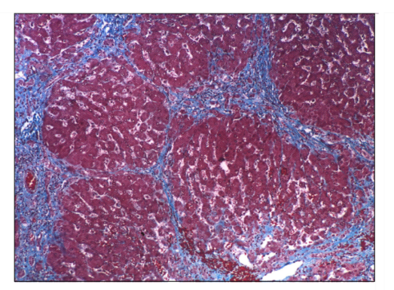
Liver Biopsy: The Imperfect Gold Standard
Limitations
  Invasive
  Painful
  Expensive
  Morbidity/mortality
  Sampling variability
  Observer variability
  Expertise to perform
  Impractical for population screening
Sampling variability:
Same biopsy may give
2 different grades of liver fibrosis
Rockey. Hepatology. 2009;49:1017. Kleiner. Hepatology 2005;41:1313.

Slide 16
Commonly Used Noninvasive Tests
Clinical or Laboratory Scores
Imaging
Simple
Proprietary
Elastography
FIB-4^{1,2}
MASLD fibrosis score^{1,2}
APRI¹
Enhanced Liver Fibrosis Test¹ (not available in US)
NIS4
ADAPT/Pro-C3³
(not available in US)
FibroSure¹
Hepascore
Transient elastography
(eg, FibroScan)^{1,2}
2D shear wave elastography⁴
Magnetic resonance elastography¹
Corrected T1 (Liver MultiScan)^{5,6}
MRI-PDFF⁷
FAST score⁸
1. EASL. J Hepatol. 2015;63:237. 2. Alkhouri. Gastroenterol Hepatol (N Y). 2012:8:661. 3. Daniels. Hepatology. 2019;69:1075.
4. Sigrist. Theranostics 2017;7:1303. 5. Jayaswal. AASLD 2018. Abstr 1042. 6. Jayaswal. Liver Int. 2020;40:3071.
7. Idilman. Radiology. 2013;267:767. 8. Newsome. Lancet Gastroenterol Hepatol. 2020;5:362.
Notes:
APRI, Aspartate-to-Platelet Ratio Index; AST, aspartate aminotransferase; FAST, FibroScan-AST; FIB-4, Fibrosis-4; PDFF, proton density fat fraction.

Slide 17
Commonly Used Noninvasive Tests
Clinical or Laboratory Scores
Imaging
Simple
Proprietary
Elastography
FIB-4^{1,2}
MASLD fibrosis score^{1,2}
APRI¹
Enhanced Liver Fibrosis Test¹ (not available in US)
NIS4
ADAPT/Pro-C3³
(not available in US)
FibroSure¹
Hepascore
Transient elastography
(eg, FibroScan)^{1,2}
2D shear wave elastography⁴
Magnetic resonance elastography¹
Corrected T1 (Liver MultiScan)^{5,6}
MRI-PDFF⁷
FAST score⁸
Good negative predictive value for ruling out fibrosis
Calculators freely available on Internet
1. EASL. J Hepatol. 2015;63:237. 2. Alkhouri. Gastroenterol Hepatol (N Y). 2012:8:661. 3. Daniels. Hepatology. 2019;69:1075.
4. Sigrist. Theranostics 2017;7:1303. 5. Jayaswal. AASLD 2018. Abstr 1042. 6. Jayaswal. Liver Int. 2020;40:3071.
7. Idilman. Radiology. 2013;267:767. 8. Newsome. Lancet Gastroenterol Hepatol. 2020;5:362.
Notes:
APRI, Aspartate-to-Platelet Ratio Index; AST, aspartate aminotransferase; FAST, FibroScan-AST; FIB-4, Fibrosis-4; PDFF, proton density fat fraction.

Slide 18
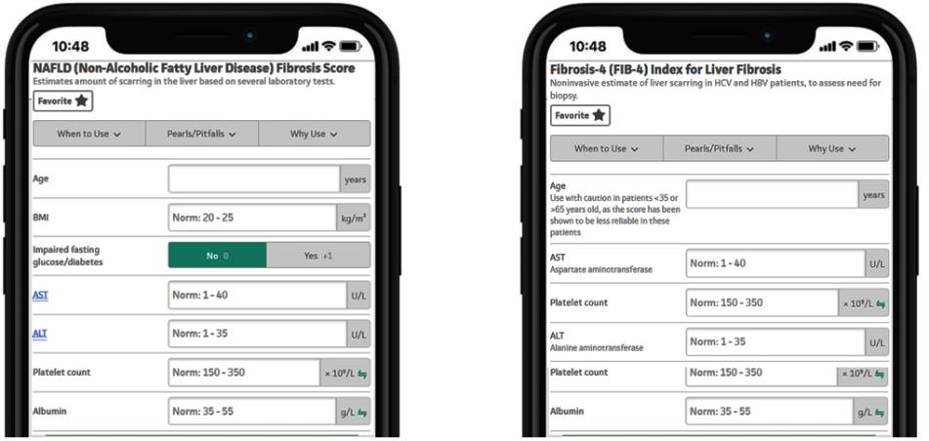
MASLD Fibrosis Score and FIB-4 Score:
Online Calculators Easily Interpret Noninvasive Tests
Based on age, platelet count, AST, ALT ± other lab values
mdcalc.com
Notes:
ALT, alanine aminotransferase; AST, aspartate aminotransferase; FIB-4, Fibrosis-4.

Slide 19
ELF Test in MASH: Validation
Prospective study of adults with MASH and bridging fibrosis (n = 219) or compensated cirrhosis (n = 258) enrolled in 2 phase IIb simtuzumab clinical trials
Liver biopsies staged according to Ishak scale at baseline, Wk 48, and Wk 96
ELF score calculated at baseline and every 12 wk
Harrison. AASLD 2017. Poster 2122.
Notes:
ELF, Enhanced Liver Fibrosis; MASH, metabolic dysfunction–associated steatohepatitis.

Slide 20
ELF Test in MASH Predicts Progression to Cirrhosis
More Accurately Than Biopsy
Progression to Cirrhosis by Baseline ELF
Predictors of Progression to Cirrhosis
100
Parameter | Adjusted HR (95% CI) | P Value
Baseline ELF | 3.20 (2.33-4.39) | <.001
Change in ELF | 1.60 (1.19-2.16) | <.01
Ishak stage 4 vs 3 | 0.87 (0.47-1.59) | .64
80
60
Patient Survival Free From Progression to Cirrhosis (%)
40
ELF <9.76
ELF ≥9.76
20
Log-rank P <.001
HR: 4.52 (95% CI: 2.30-8.88)
0
0
6
12
18
24
30
36
42
Mo of Follow-up
Optimal threshold of baseline ELF: 9.76 (sensitivity 77%, specificity 66%)
Higher baseline, greater change in ELF associated with increased risk of progression to cirrhosis
Harrison. AASLD 2017. Poster 2122.
Notes:
ELF, Enhanced Liver Fibrosis; MASH, metabolic dysfunction–associated steatohepatitis.

Slide 21
ELF Test in MASH Predicts Liver-Related Clinical Events More Accurately Than Biopsy
Liver-Related Clinical Events by Baseline ELF
Predictors of Liver-Related Clinical Events
100
Parameter | Adjusted HR (95% CI) | P Value
Baseline ELF | 2.40 (1.70-3.38) | <.001
Change in ELF | 1.53 (1.09-2.14) | .01
Ishak stage 6 vs 5 | 0.89 (0.47-1.68) | .71
80
60
Patient Survival Free From
Liver-Related Events (%)
40
ELF <11.27
ELF ≥11.27
20
Log-rank P <.001
HR: 2.93 (95% CI: 1.64-5.23)
0
0
6
12
18
24
30
36
42
Mo of Follow-up
Optimal threshold of baseline ELF: 11.27 (sensitivity 56%, specificity 75%)
Higher baseline ELF, greater change in ELF associated with liver-related clinical events
Harrison. AASLD 2017. Abstr 2122.
Notes:
ELF, Enhanced Liver Fibrosis; MASH, metabolic dysfunction–associated steatohepatitis.

Slide 22
Imaging

Slide 23
Vibration-Controlled Transient Elastography
Measures 1D velocity of low-frequency shear wave
Directly related to tissue stiffness (fibrosis)
  The stiffer the liver, the faster the shear wave propagates
Quick bedside test (~5 min)
Limited by obesity, abdominal ascites,
operator experience
Sigrist. Theranostics 2017;7:1303.

Slide 24
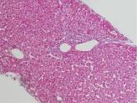
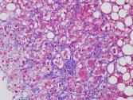
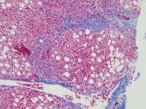
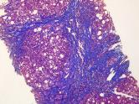
VCTE for MASH Fibrosis
Fibrosis Stage
Most reliable in ruling out advanced hepatic fibrosis (NPV > PPV)²
  Fibrosis unlikely with low value (<7 kPa)
Higher values increase likelihood of
more severe fibrosis, predict risk of decompensation and complications³
Overestimation of fibrosis can occur in cases of hepatitis, cholestasis, liver congestion, and obesity, and if mass lesions are present in liver^{1,3}
Correlates well with portal pressure
(20+ kPa)⁴
F0: Normal
F1/2: Perisinusoidal
± Portal
Increasing liver stiffness
FibroScan Liver Stiffness (kPa)^{1,2}
F3: Bridging
Fibrosis
F4: Cirrhosis
1. Vuppalanchi. Hepatology. 2018;67:134. 2. Hashemi. Caspian J Intern Med. 2016;7:242.
3. Kemp. Australian Family Physician. 2013;42:468. 4. Robic. J Hepatol. 2011;55:1017.
Notes:
MASH, metabolic dysfunction–associated steatohepatitis; NPV, negative predictive value; PPV, positive predictive value; VCTE, vibration-controlled transient elastography.

Slide 25
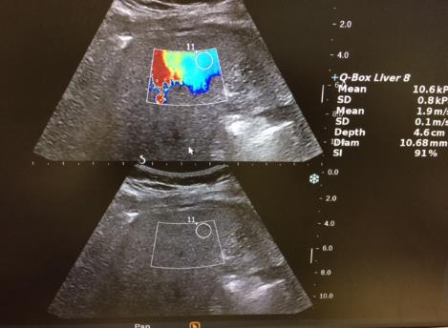
2D Shear Wave Elastography
Ultrasound system using real-time SWE map of liver elasticity to determine liver stiffness¹
  2D SWE color-coded map superimposed on B-mode image confirms readings are in liver, not in nearby vessels or kidneys¹
May require radiologist/sonographer¹
Liver elasticity measurements can be obtained in challenging cases of obesity¹
Cutoff for Detecting Advanced Hepatic Fibrosis ≥ F3 in HCV² | Sensitivity | Specificity | AUROC
2D-SWE stiffness >8.7 kPa | 0.973 | 0.951 | 0.98
1. Sigrist. Theranostics. 2017;7:1303. 2. Ferraiolo. Hepatology. 2012;56:2125.
Notes:
AUROC, area under the receiver operating characteristic curve; HCV, hepatitis C virus; SWE, shear wave elastography.

Slide 26
MRE: Detecting Advanced Hepatic Fibrosis in MASLD
Prospective, cross-sectional analysis of 2D MRE in N = 117 patients with
biopsy-proven MASLD
Cutoff for Detecting Advanced Hepatic Fibrosis ≥ F3 | Sensitivity | Specificity | AUROC
MRE stiffness >3.63 kPa | 0.86 | 0.91 | 0.924
Loomba. Hepatology. 2014;60:1920.
Notes:
AUROC, area under the receiver operating characteristic curve; MASLD, metabolic dysfunction–associated steatotic liver disease; MRE, magnetic resonance elastography.

Slide 27
Common Imaging Tests for Hepatic Fibrosis: Summary
Imaging | Comments
Vibration-controlled transient elastography—FibroScan | Can be point of care Most reliable in ruling out advanced hepatic fibrosis (great NPV)
MR elastography/MR spectroscopy/ LiverMultiScan | Requires radiology referral Most accurate of imaging modalities
2D shear wave elastography | May require radiology referral but can be point of care with minimal training
These imaging tests measure liver stiffness,
which is indirect measure of hepatic fibrosis
and not hepatic fat content
Notes:
MR, magnetic resonance; NPV, negative predictive value.

Slide 28
Sequential Tests

Slide 29
Use of Sequential Noninvasive Tests Could Reduce Number of Patients in Indeterminate Zone
NIT 1
Absence of advanced fibrosis
Indeterminate
Presence of advanced fibrosis
NIT 1 + NIT 2
Absence of advanced fibrosis
Indeterminate
Presence of advanced fibrosis
Sequential use of NITs maintains sensitivity and specificity
while enabling classification of larger proportion of patients
Younossi. AASLD 2018. Abstr LB-10.
Notes:
NIT, noninvasive test.

Slide 30
Sequential Algorithms to Detect Advanced
Hepatic Fibrosis due to MASH
Study of baseline data from STELLAR trials (N = 3202) to determine performance of sequential combinations of noninvasive tests in diagnosing F3/F4 hepatic fibrosis
  Single tests (either NFS, FIB-4,
  ELF, or VCTE) led to up to 51% indeterminate results
  Sequential tests (FIB-4, then
  ELF or VCTE) led to up to 24% indeterminate results
Outcome With Sequential Tests, % (95% CI)* | FIB-4, Then ELF (N = 3180) | FIB-4, Then VCTE (N = 3141)
Prevalence of F3/F4 | 71 | 71
Sensitivity | 69 (67-71) | 77 (75-78)
Specificity | 92 (90-94) | 89 (87-91)
PPV | 96 (94-97) | 95 (93-96)
NPV | 55 (53-58) | 60 (58-63)
Indeterminate | 24 (23-26) | 20 (18-21)
Misclassified | 24 (23-26) | 20 (18-21)
*Using published cutoffs: FIB-4 (1.30-2.67), ELF (9.8-11.3),
VCTE (9.9-11.4 kPa).
Anstee. Hepatology. 2019;70:1521.
Notes:
ELF, Enhanced Liver Fibrosis; FIB-4, Fibrosis-4; MASH, metabolic dysfunction–associated steatohepatitis; NFS, Nonalcoholic Fatty Liver Disease Fibrosis Score; NPV, negative predictive value; PPV, positive predictive value; VCTE, vibration-controlled transient elastography.

Slide 31
Goal of MASLD Treatment
“Holy grail”: resolution of MASH and reversal of hepatic fibrosis
Standard clinical trial outcomes
  Resolution of MASH with no worsening of fibrosis
  Improvement in fibrosis by ≥1 stage with no worsening of MASH
Patients targeted for pharmacotherapy: MASH with stage ≥2 fibrosis
Notes:
MASH, metabolic dysfunction–associated steatohepatitis.
Before we speak about specific treatment, it is important for us to consider what the goals of treatment are . . .

Slide 32





Treatment of MASLD: Dietary Changes and Exercise
Exercise alone reduces liver fat
  Aerobic >150-250 min/wk
  Resistance training 45 min/day x 3 days/wk
Avoid fructose-sweetened beverages, added sugars
Notes:
MASLD, metabolic dysfunction–associated steatotic liver disease.

Slide 33
Weight Loss Thresholds and Impact on MASLD
Fibrosis
(45%)
Weight loss ≥10%
MASH resolution
(64%-90%)
Weight loss ≥7%
Ballooning/inflammation
(41%-100%)
Weight loss ≥5%
Steatosis
(35%-100%)
Weight loss ≥3%
Hannah. Clin Liver Dis. 2016:20;339.
Notes:
MASLD, metabolic dysfunction–associated steatotic liver disease.
<10% will be able to achieve sustained weight loss needed to reverse fibrosis

Slide 34
Bariatric Surgery and MASLD
Improvement in liver histology reported in several studies
Lap sleeve gastrectomy can be performed in select patients with compensated cirrhosis at experienced centers (>100 cases/yr)
MASH Resolution Without Worsening Fibrosis (ITT)
Improvement of ≥1 Stage of Liver Fibrosis
Without Worsening of MASH (ITT)
100
100
60
56%
57%
37%
39%
40
40
30
Resolution (%)
Improvement (%)
23%
20
16%
20
n =
15/96
54/96
55/96
n =
22/96
35/95
37/94
0
0
Lifestyle
Modification
Roux-en-Y
Gastric Bypass
Sleeve Gastrectomy
Lifestyle
Modification
Roux-en-Y
Gastric Bypass
Sleeve Gastrectomy
Harrison. Hepatology. 2009;49:80. Promrat. Hepatology. 2010;51:121. Chalasani. Hepatology. 2012;142:1592.
Lassailly. Gastroenterology. 2020;159:1290. Verrastro. Lancet. 2023;401:1786. Boon-Bee Goh. World J Gastroenterol. 2018;24:3112.
Notes:
ITT, intention-to-treat; MASH, metabolic dysfunction–associated steatohepatitis; MASLD, metabolic dysfunction–associated steatotic liver disease.
As you know, it can be very challenging for our patients to lose weight. Bariatric surgery is an important tool to help our patients lose weight, with sleeve gastrectomy or RnY gastric bypass being the preferred surgery of choice. several studies have demonstrated improvement in fatty liver histology after surgery.
Patients who don’t lose weight and have persistence of MASH are less likely to have improvement in fibrosis
Resolution of MASH after 1 year, and fibrosis decrease starting at 1 year, continued at 5 years. Up to 84% resolved within 5 years. In looking at data from one of the most recent bariatric surgery series, I would like to call your attention to this graph demonstrating that about 25% of patients with advanced fibrosis (F3) had fibrosis regression down to lesser stages, with some having complete regression to F0

Slide 35
Histologic Improvement in MASH*
P = .001
P = .04
43%
34%
19%
Study included only patients without diabetes
*Decrease in MASH by ≥2 points with ≥1-point decrease in ballooning.
Sanyal. NEJM. 2010;362:1675.
Notes:
MASH, metabolic dysfunction–associated steatohepatitis.
However when you break down the results in terms of resolution of MASH, pioglitazone appeared to perform better

Slide 36
Semaglutide Resolves MASH and May Improve Fibrosis
Not approved for treatment of MASH
Resolution of MASH With No Worsening of
Liver Fibrosis (Primary Endpoint)
Improvement in Liver Fibrosis Stage With No Worsening of MASH (Confirmatory Secondary Endpoint)
OR: 3.36 (95% CI: 1.29-8.86)
OR: 1.96 (95% CI: 0.86-4.51)
OR: 2.71 (95% CI: 1.06-7.56)
OR: 1.00 (95% CI: 0.43-2.32)
100
100
OR: 6.87
(95% CI: 2.60-17.63; P <.001)
OR: 1.42
(95% CI: 0.62-3.28; P = .48)
80
80
60
59
60
Patients (%)
Patients (%)
49
43
40
40
36
40
32
33
20
17
20
0
Semaglutide 0.1 mg
(n = 57)
Semaglutide 0.2 mg
(n = 59)
Semaglutide 0.4 mg
(n = 56)
Placebo
(n = 58)
0
Semaglutide 0.1 mg
(n = 57)
Semaglutide 0.2 mg
(n = 59)
Semaglutide 0.4 mg
(n = 56)
Placebo
(n = 58)
Newsome. NEJM. 2021;384:1113.
Notes:
MASH, metabolic dysfunction–associated steatohepatitis; OR, odds ratio.
Results are similar to a smaller trial from 6 years prior (LEAN) with liraglutide
The mechanism of action of the GLP1RAs is appealing, due to the impact on weight loss, diabetes, and potentially CV and renal outcomes.
Results. . .
37% of patients had both MASH resolution and improvement in fibrosis stage in the higher dose of semaglutide
However, the drug is not yet FDA-approved for management of MASLD, with phase 3 trials still ongoing.
More recent study from June 2023 in cirrhosis with no sig improvement in fibrosis (actually less improvement than pbo group. More MASH resolution in semaglutide but not stat sig.

Slide 37
Summary
MASLD is highly prevalent, with variable rates of progression to MASH and advanced hepatic fibrosis
It is crucial to identify those with MASH advanced hepatic fibrosis because it can quickly progress to cirrhosis and HCC, liver transplant, and mortality
Patients with T2D warrant evaluation
  Other risk factors include obesity, metabolic syndrome, and first-degree relative with MASH cirrhosis
Noninvasive prognostic biomarkers may facilitate risk stratification
Lifestyle modification and weight loss are mainstays of management
Notes:
MASH, metabolic dysfunction–associated steatohepatitis; MASLD, metabolic dysfunction–associated steatotic liver disease; HCC, hepatocellular carcinoma; T2D, type 2 diabetes.

Slide 38
Go Online for More CCO Coverage of a Metabolic Approach to MASH Management!
Downloadable slidesets
ClinicalThought commentaries
clinicaloptions.com/CE-CME/gastroenterology

