Slide 1
Antibody‒Drug Conjugates Targeting
TROP-2 in NSCLC: A Look to the Future
Supported by educational grants from AstraZeneca;
Daiichi Sankyo, Inc.; and Gilead Sciences, Inc.
Notes:
NSCLC, non-small-cell lung cancer.

Slide 2
Faculty
Hossein Borghaei, MS, DO
Professor and Chief,
Thoracic Medical Oncology
The Gloria and Edmund M. Dunn Chair in Thoracic Oncology
Department of Hematology and Oncology
Fox Chase Cancer Center
Philadelphia, Pennsylvania
Rebecca S. Heist, MD MPH
Associate Professor of Medicine
Harvard Medical School
Massachusetts General Hospital
Cancer Center
Boston, Massachusetts
Notes:
This slide lists the faculty who were involved in the production of these slides.

Slide 3
Faculty
Melissa L. Johnson, MD
Director, Lung Cancer Research Program
Sarah Cannon Research Institute
Nashville, Tennessee
Stephen Liu, MD
Associate Professor of Medicine
Medical Oncology Director of Thoracic Oncology
Lombardi Comprehensive Cancer Center
Georgetown University
Washington, DC
Benjamin Levy, MD
Associate Professor
Johns Hopkins School of Medicine
Baltimore, Maryland
Notes:
This slide lists the faculty who were involved in the production of these slides.

Slide 4
Disclosures
The faculty reported the following relevant financial relationships or relationships to products or devices they have with ineligible companies related to the content of this educational activity:
Hossein Borghaei, MS, DO: consultant/advisor/speaker: Amgen, AstraZeneca, Axiom, Bayer, BeiGene, BerGenBio, BioNTech, Boehringer Ingelheim, Bristol Myers Squibb, Da Volterra, Daiichi Sankyo, EMD Serono, Genentech, Genmab, Guardant, Inspirna, IO Biotech, iTeos, Janssen, Jazz, Lilly, Merck, Mirati, Natera, Novartis, Nucleai, Oncocyte, Pfizer, PharmaMar, Puma, Regeneron, Sonnet BioTherapeutics, Takeda; researcher (clinical trials): Amgen, Bristol Myers Squibb, Lilly; data and safety monitoring board: Incyte, Novartis, SpringWorks, Takeda; stock options: Inspirna, Nucleai, Sonnet BioTherapeutics.
Rebecca S. Heist, MD, MPH: consultant/advisor/speaker: AbbVie, AstraZeneca,
Claim Therapeutics, Daiichi Sankyo, EMD Serono, Lilly, Novartis, Regeneron, Sanofi; researcher (paid to institution): AbbVie, Agios, Corvus, Daiichi Sankyo, Erasca, Lilly, Mirati, Novartis, Turning Point.
Notes:
This slide lists the disclosure information of the faculty and staff involved in the development of these slides.

Slide 5
Disclosures
Melissa L. Johnson, MD: researcher: AbbVie, Acerta, Adaptimmune, Amgen, Apexigen, Arcus Biosciences, Array BioPharma, Artios Pharma, AstraZeneca, Atreca, BeiGene, BerGenBio, BioAtla, Black Diamond, Boehringer Ingelheim, Bristol Myers Squibb, Calithera Biosciences, Carisma Therapeutics, Checkpoint Therapeutics, City of Hope National Medical Center, Corvus Pharmaceuticals, Curis, CytomX, Daiichi Sankyo, Dracen Pharmaceuticals, Dynavax, Elicio Therapeutics, EMD Serono, EQRx, Erasca, Exelixis, Fate Therapeutics, Genentech/Roche, Genmab, Genocea Biosciences, GlaxoSmithKline, Gritstone Oncology, Guardant Health, Harpoon, Helsinn Healthcare SA, Hengrui Therapeutics, Hutchison MediPharma, IDEAYA Biosciences, IGM Biosciences, Immunitas Therapeutics, Immunocore, Incyte, Janssen, Jounce Therapeutics, Kadmon Pharmaceuticals, Kartos Therapeutics, Lilly, Loxo Oncology, Lycera, Memorial Sloan Kettering, Merck, Merus, Mirati Therapeutics, Mythic Therapeutics, NeoImmune Tech, Neovia Oncology, Novartis, Numab Therapeutics, Nuvalent, OncoMed Pharmaceuticals, Palleon Pharmaceuticals, Pfizer, PMV Pharmaceuticals, Rain Therapeutics, RasCal Therapeutics, Regeneron Pharmaceuticals, Relay Therapeutics, Revolution Medicines, Ribon Therapeutics, Rubius Therapeutics, Sanofi, Seven and Eight Biopharmaceuticals/Birdie Biopharmaceuticals, Shattuck Labs, Silicon Therapeutics, Stemcentrx, Syndax Pharmaceuticals, Takeda Pharmaceuticals, Tarveda, TCR2 Therapeutics, Tempest Therapeutics, Tizona Therapeutics, Tmunity Therapeutics, Turning Point Therapeutics, University of Michigan, Vyriad, WindMIL Therapeutics, Y-mAbs Therapeutics.
Notes:
This slide lists the disclosure information of the faculty and staff involved in the development of these slides.

Slide 6
Disclosures
Benjamin Levy, MD: consultant/advisor/speaker: AstraZeneca, Daiichi Sankyo, Janssen, Merck, Mirati, Novartis, Pfizer.
Stephen Liu, MD: consultant/advisor: AstraZeneca, Bristol Myers Squibb, Catalyst, Daiichi Sankyo, Eisai, Elevation Oncology, Genentech/Roche, Gilead, Guardant Health, Janssen, Jazz Pharmaceuticals, Merck, Merus, Novartis, Regeneron, Sanofi, Takeda, Turning Point Therapeutics; researcher (paid to institution): Alkermes, Elevation Oncology, Genentech, Gilead, Merck, Merus, Nuvalent, RAPT, Turning Point Therapeutics; data safety monitoring board: Candel Therapeutics.
Notes:
This slide lists the disclosure information of the faculty and staff involved in the development of these slides.

Slide 7

About These Slides
Please feel free to use and share some or all of these slides in your noncommercial presentations to colleagues or patients
When using our slides, please retain the source attribution:
These slides may not be published, posted online, or used in commercial presentations without permission. Please contact permissions@clinicaloptions.com for details
Slide credit: clinicaloptions.com
Notes:
Disclaimer: The materials published on the Clinical Care Options website reflect the views of the authors of the CCO material, not those of Clinical Care Options, LLC, the CME providers, or the companies providing educational grants. The materials may discuss uses and dosages for therapeutic products that have not been approved by the United States Food and Drug Administration. A qualified healthcare professional should be consulted before using any therapeutic product discussed. Readers should verify all information and data before treating patients or using any therapies described in these materials.

Slide 8
What Are Antibody–Drug Conjugates?
Monoclonal antibody linked to cytotoxic drug designed to widen therapeutic window by focusing delivery to specific cells
Tumor Antigen
Monoclonal Antibody
Selective for antigen with high copy numbers on target tumor cell and with minimal immunogenic response
Antigen-Binding Site
Stable Linker
Releases payload
only in target cell
Cytotoxic Drug Payload With potent
subnanomolar activity
Drago. Nat Rev Clin Oncol. 2021;18:327.

Slide 9
Antibody–Drug Conjugates: Components
IgG1
IgG2
IgG3
IgG4
ANTIBODY: Chimeric/humanized monoclonal IgG antibody targeting a protein preferentially expressed on the tumor cell surface
Antibodies
Serum half-life
21 days
21 days
7-21 days
21 days
C1q binding
Yes
Yes
Yes
No
Fcγ avidity
High
Low
High
Moderate
Cleavable
Noncleavable
Cathepsin
MC*
LINKER: Ensures payload is attached to antibody in plasma but is efficiently released in tumor cells; linkers can be cleavable (via tumor-associated factors)
or noncleavable (lysosomal degradation)
H
R²
O
S
O
O
N
N
O
H
O
S
S
N
N
N
N
N
Linkers
H
O
R¹
H
O
H
Hydrazone
(acid cleavable)
Disulfide
(reducible)
Dipeptide
(protease cleavable)
MCC*
O
O
S
N
H
N
O
Payloads
Auristatins
(MoA:
antimicrotubule)
Maytansinoids
(MoA:
antimicrotubule)
Calicheamicins
(MoA:
DNA cleavage)
Camptothecins
(MoA:
topoisomerase 1
inhibition)
PAYLOAD: Enhances cytotoxicity, although variable drug:antibody ratio affects efficacy and clearance
*Noncleavable MC and MCC linkers typically used with monomethyl auristatin F and emtansine
payloads, respectively; can be cleavable when conjugated with some other payloads.
Drago. Nat Rev Clin Oncol. 2021;18:327.
Notes:
MoA, mechanism of action.

Slide 10
Antibody–Drug Conjugates: Mechanism of Action
Antibody binds target antigen → internalized → payload release + bystander effect
ADCs may circulate as dynamic mixture of intact conjugate, naked antibodies, and free payload
ADCs reach tumors via capillaries,
releasing some payload into tumor microenvironment as diffuse toward target
Antibody engagement →
payload-independent antitumor activity
NK cell
Disruption of receptor dimerization and/or function leads to disruption of downstream signaling
ADC
Tumor
cell
For stable ADCs, intact conjugate is predominant circulating form
Tumor
cell
Fc-mediated stimulation of immune cell effector function
Antigen
Cytoplasm
Most ADC–antigen complexes internalized, processed via antigen-dependent pathways
Nucleus
Payload release from endosomes and lysosomes (sometimes extracellularly) → apoptosis
Membrane-permeable payloads affect nearby cells regardless of target antigen expression
1. Clathrin-mediated
endocytosis of ADC
Cytoplasm
Lysosome
Microtubule
“Bystander effect”
2. Acidic, proteolytic, or redox conditions within endosomes and/or lysosomes cause ADCs to release payloads
Endosome
Lysosome
Cytoplasm
Tumor
cell
Nucleus
Dead
tumor cell
Payload acts on target substrates
Drago. Nat Rev Clin Oncol. 2021;18:327.
Notes:
ADC, antibody–drug conjugate.

Slide 11
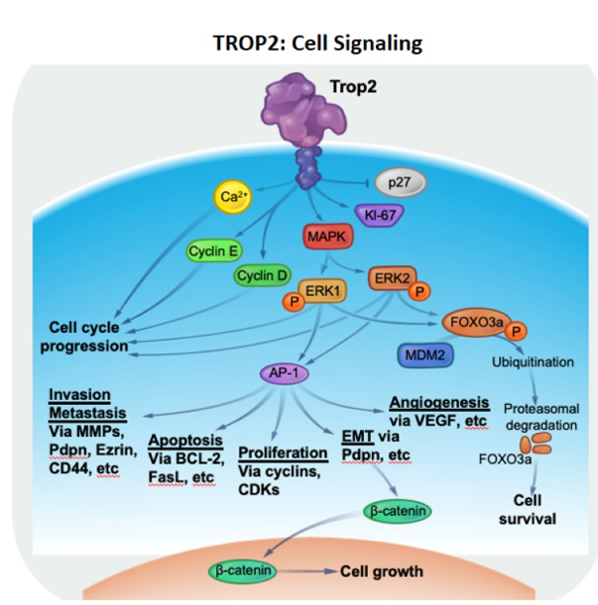
TROP-2 as a Therapeutic Target
TROP-2 is a transmembrane glycoprotein overexpressed in solid tumors including TNBC and NSCLC
TROP-2 is an epithelial adhesion molecule and regulates stem cell marker‒associated cell regeneration
Jiang. Oncol Lett. 2013;6:375. Shvartsur. Genes Cancer. 2015;6:84.
Figure modified from Shvartsur. Genes Cancer. 2015;6:84 under the terms and conditions of the Creative Commons Attribution 4.0 International license (CC BY 4.0 https://creativecommons.org/licenses/by/4.0/)
Notes:
NSCLC, non-small-cell lung cancer; TNBC, triple-negative breast cancer.

Slide 12
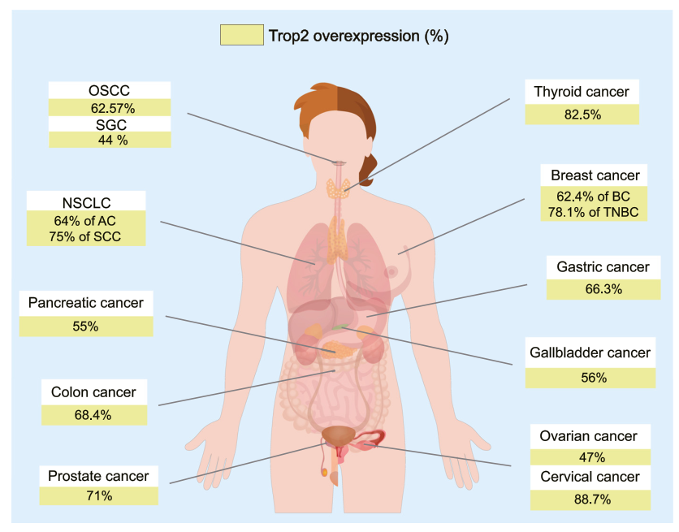
TROP-2 Overexpression in NSCLC and Other Cancers
Liu. Pharmacol Ther. 2022;239:108296. Figure 3 of given citation is used in its original form under the terms and conditions
of the Creative Commons Attribution 4.0 International license (CC BY 4.0 https://creativecommons.org/licenses/by/4.0/)
Notes:
AC, atypical carcinoid; BC, breast cancer; NSCLC, non-small-cell lung cancer; OSCC, oral squamous cell carcinoma; SCC, squamous cell carcinoma; SGC, salivary gland carcinoma; TNBC, triple-negative breast cancer.

Slide 13
Sacituzumab Govitecan: TROP-2‒Targeted ADC
HO
O
N
N
SN-38 Payload
Delivers 136-fold more to tumors than parent compound irinotecan
Unique chemistry improves solubility, selectively delivers
SN-38 to tumor
O
Humanized RS7 Antibody
Targets TROP-2
Type: hRS7 IgG1κ
O
O
O
O
[
]
H
H
O
N
O
Lys-N
CH₂O
7
O
O
N
N
N
O
H
O
N
N
S
Anti–TROP-2 mAb
Linker for SN-38
High DAR (7.6:1)
pH-sensitive linker for rapid release of payload at or inside tumor
O
Bystander effect: In acidic tumor microenvironment,
SN-38 is released from anti‒TROP-2 antibody and diffuses into neighboring TROP-2‒negative cells
Goldenberg. Oncotarget. 2015;6:22496. Goldenberg. MAbs. 2019;11:987. Sacituzumab govitecan PI.
Notes:
ADC, antibody‒drug conjugate; DAR, drug‒antibody ratio.

Slide 14
Datopotamab Deruxtecan: TROP-2‒Targeted ADC
Datopotamab
Humanized
anti‒TROP-2 mAb
High-potency, membrane-permeable payload with short systemic half-life
Optimized DAR: ~4:1
Stable linker‒payload
Tumor-selectable cleavable linker
Bystander killing effect
Tetrapeptide-Based
Cleavable Linker
O
HN
O
HN
O
HN
O
N
O
NH
NH
O
N
H
O
O
H
O
H
H
O
N
O
CH₃
N
O
OH
CH₃
Cysteine residue
Drug + linker
F
Topoisomerase I Inhibitor
Payload (DXd)
Exatecan derivative
Conjugation Chemistry
Drug + linker conjugated to
cysteine residues of mAb
Okajima. Mol Cancer Ther. 2021;20:2329. Shastry. Breast. 2022;66:169. Bardia. SABCS 2022. Abstr P6-10-03. Yasuda. AACR 2023. Abstr 4893.
Notes:
ADC, antibody‒drug conjugate; DAR, drug‒antibody ratio; DXd, deruxtecan; mAb, monoclonal antibody.

Slide 15
IMMU-132-01: Sacituzumab Govitecan in
Previously Treated Advanced NSCLC
Muticohort,* dose-escalation/dose-expansion phase I/II trial
Primary endpoints: ORR, safety
Secondary endpoints: DoR, CBR, PFS, OS, TTR, PK
21-day cycles
Dose Expansion
NSCLC Cohort:
Adults with R/R advanced/metastatic NSCLC
with PD after ≥1 line of tx
for stage IV disease;
unselected for TROP-2 expression;
ECOG PS 0-1
(N = 54)
Sacituzumab Govitecan
8 mg/kg IV on D1,8
(n = 8)
Until PD or unacceptable toxicity
Sacituzumab Govitecan
10 mg/kg IV on D1,8
(n = 46)
10 mg/kg chosen for future development
*Other epithelial cancer cohorts include TNBC, mUC, mBC, SCLC, CRC, CRPC, EOC, GBM, HNSCC, HCC, cervical cancer, clear cell RCC, esophageal carcinoma, endometrial carcinoma, pancreatic ductal adenocarcinoma, gastric adenocarcinoma.
Heist. JCO. 2017;35:2790. NCT01631552.
Notes:
CBR, clinical benefit rate; CRC, colorectal cancer; CRPC, castration-resistant prostate cancer; DoR, duration of response; ECOG, Eastern Cooperative Oncology Group; EOC, epithelial ovarian cancer; GBM, glioblastoma multiforme; HCC, hepatocellular carcinoma; HNSCC, head and neck squamous cell carcinoma; mBC, metastatic breast cancer; mUC, metastatic urothelial carcinoma; NSCLC, non-small-cell lung cancer; ORR, objective response rate; OS, overall survival; PD, progressive disease; PFS, progression-free survival; PK, pharmacokinetics; PS, performance status; R/R, relapsed/refractory; SCLC, small-cell lung cancer; TNBC, triple-negative breast cancer; TTR, time to response.

Slide 16
IMMU-132-01 NSCLC Cohort: Efficacy
Antitumor Response (n = 45)
PR
Efficacy Outcome | N = 54
ORR, % (95% CI) PR, n (%)* | 16.7 (7.9-29.3) 9 (16.7)
SD, n (%) | 22 (40.7)
Median DoR, mo (95% CI) | 6.0 (2.5-21.0)
Median PFS, mo (95% CI) | 4.4 (2.5-5.4)
Median OS, mo (95% CI) | 7.3 (5.6-14.6)
40
SD
30
PD
20
10
0
-10
Best Change In Target Lesions
From Baseline (%)
-20
-30
-40
Squamous cell histology
-50
8-mg/kg starting dose
-60
Prior ICI therapy
-70
Early CT assessment
after 2 doses
-80
Heist. JCO. 2017;35:2790. Bardia. Ann Oncol. 2021;32:746.
Notes:
DoR, duration of response; ICI, immune checkpoint inhibitor; NSCLC, non-small-cell lung cancer; ORR, overall response rate; OS, overall survival; PFS, progression-free survival; PR, partial response; SD, stable disease.

Slide 17
TROPION-PanTumor01 NSCLC Cohort
With Datopotamab Deruxtecan
Multicohort, dose-escalation/dose-expansion phase I trial
Dose Expansion‡
Dose Escalation†
8 mg/kg Q3W established as MTD
6 mg/kg Q3W chosen for future development
Dato-DXd
4 mg/kg Q3W
(n = 50)
Adults* with
R/R advanced/metastatic NSCLC; measurable disease by RECIST v1.1; stable, treated brain mets permitted; pretreatment biopsy required, but patients unselected for TROP-2 expression; ECOG PS 0/1
(N = 180)
Dato-DXd
0.27 mg/kg to 10 mg/kg Q3W
Dato-DXd
6 mg/kg Q3W
(n = 50)
Dato-DXd
8 mg/kg Q3W
(n = 80)
Primary objectives: MTD, safety, tolerability
Secondary objectives: efficacy, pharmacokinetics, antidrug antibodies
*In US, ≥18 yr of age; in Japan, ≥20 yr of age. †Dose levels 4, 6, and 8 mg/kg under further study for safety and efficacy.
‡Includes patients from dose-escalation and dose-expansion phases of trial.
Shimizu. JCO. 2023;[Epub].
Notes:
Dato-DXd, datopotamab deruxtecan; ECOG, Eastern Cooperative Oncology Group; mets, metastases; MTD, maximum tolerated dose; NSCLC, non-small-cell lung cancer; PS, performance status; RECIST, Response Evaluation Criteria in Solid Tumors; R/R, relapsed/refractory.

Slide 18
TROPION-PanTumor01—Updated NSCLC Cohort: Antitumor Activity
Best Overall Response by BICR per RECIST v1.1 | Datopotamab Deruxtecan
 | 4 mg/kg (n = 50) | 6 mg/kg (n = 50) | 8 mg/kg (n = 80)
ORR, n (%) CR PR | 11 (22) 0 11 (22) | 13 (26) 0 13 (26) | 19 (24) 1 (1) 18 (23)
SD, n (%) | 26 (52) | 20 (40) | 42 (53)
Non-CR/PD, n (%) | 1 (2) | 2 (4) | 2 (3)
PD, n (%) | 7 (14) | 10 (20) | 8 (10)
Not evaluable, n (%) | 5 (10) | 5 (10) | 9 (11)
Median DoR, mo (95% CI) | 12.7 (2.8-NE) | 10.5 (5.6-26.5) | 9.6 (5.8-NE)
Median PFS, mo (95% CI) | 4.3 (2.9-6.9) | 6.9 (2.7-8.8) | 5.2 (4.1-7.1)
Median OS, mo (95% CI) | 12.9 (9.4-NE) | 11.4 (7.1-20.6) | 10.5 (8-12)
Shimizu. JCO. 2023;[Epub].
Notes:
BICR, blinded independent central review; CR, complete response; DoR, duration of response; NE, not estimable; NSCLC, non-small-cell lung cancer; ORR, overall response rate; OS, overall survival; PD, progressive disease; PR, partial response; RECIST, Response Evaluation Criteria in Solid Tumors; SD, stable disease.

Slide 19
TROPION-Lung02: Datopotamab Deruxtecan + Pembrolizumab ± Platinum CT in Advanced NSCLC
Multicenter, open-label phase Ib study
Cohort 1 (n = 20)
Dato-DXd 4 mg/kg IV Q3W
Pembrolizumab 200 mg IV Q3W
Patients with advanced or metastatic NSCLC without actionable genomic alterations*; ≤2 prior lines of therapy (dose-escalation cohort) or ≤1 line of platinum-based CT (dose-expansion cohorts 1 and 2) or treatment naive (dose-expansion cohorts 2 [enrolled after June 30, 2022] and 3-6)
Cohort 2 (n = 44)
Dato-DXd 6 mg/kg IV Q3W
Pembrolizumab 200 mg IV Q3W
Dato-DXd 4 mg/kg IV Q3W
Pembrolizumab 200 mg IV Q3W
Carboplatin AUC 5
Cohort 3 (n = 20)
Safety of doublet regimens established prior to evaluation of triplets and of Dato-DXd 4 mg/kg prior to 6 mg/kg
Dato-DXd 6 mg/kg IV Q3W
Pembrolizumab 200 mg IV Q3W
Carboplatin AUC 5
Cohort 4 (n = 30)
*EGFR, ALK, ROS1, NTRK, BRAF, RET, or MET.
Dato-DXd 4 mg/kg IV Q3W
Pembrolizumab 200 mg IV Q3W
Cisplatin 75 mg/m²
Cohort 5 (n = 12)
Primary objectives: safety and tolerability
Secondary objectives: efficacy, pharmacokinetics, antidrug antibodies
Dato-DXd 6 mg/kg IV Q3W
Pembrolizumab 200 mg IV Q3W
Cisplatin 75 mg/m²
Cohort 6 (n = 10)
Goto. ASCO 2023. Abstr 9004.
Data cutoff: April 7, 2023.
Notes:
AUC, area under the curve; CT, chemotherapy; Dato-DXd, datopotamab deruxtecan; NSCLC, non-small-cell lung cancer.

Slide 20
TROPION-Lung02: Antitumor Activity
Investigator-Assessed Response | All Patients |  | First Line
Characteristic | Doublet (n = 61) | Triplet (n = 71) | Doublet (n = 34) | Triplet (n = 53)
Confirmed + pending ORR, n (%) [95% CI] | 23 (38) [26-51] | 35 (49) [37-61] | 17 (50) [32-68] | 30 (57) [42-70]
Confirmed + pending BOR, n (%) Confirmed CR Pending CR Confirmed PR Pending PR | 0 0 21 (34) 2 (3) | 1 (1) 0 34 (48) 0 | 0 0 15 (44) 2 (6) | 1 (2) 0 29 (55) 0
SD, n (%) | 30 (49) | 27 (38) | 16 (47) | 18 (34)
DCR, n (%) | 51 (84) | 62 (87) | 31 (91) | 48 (91)
Median DoR, mo (95% CI) | NE (8.8-NE) | NE (5.8-NE) | NE (5.5-NE) | NE (5.7-NE)
Preliminary median PFS, mo (95% CI) | 8.3 (6.8-11.8) | 7.8 (5.6-11.1) | -- | --
Goto. ASCO 2023. Abstr 9004.
Notes:
BOR, best overall response; CR, complete response; DCR, disease control rate; DoR, duration of response; NE, not estimable; PFS, progression-free survival; PR, partial response; SD, stable disease.

Slide 21
Select Ongoing Trials of Sacituzumab Govitecan in
Advanced or Metastatic NSCLC
Trial | Phase | Planned N | Treatment Arms | Population | Primary Endpoint
EVOKE-01 (NCT05089734) | III | 580 | Sacituzumab govitecan vs docetaxel | Advanced/metastatic NSCLC previously treated with platinum CT and PD-1/PD-L1 inhibitor; if AGA present, must also have received appropriate TKI | OS
EVOKE-03* (NCT05609968) | III | 614 | Sacituzumab govitecan + pembrolizumab vs pembrolizumab | 1L advanced/metastatic NSCLC without AGAs; PD-L1 ≥50% | PFS, OS
EVOKE-02* (NCT05186974) | II | 224 | Sacituzumab govitecan + pembrolizumab + platinum CT Sacituzumab govitecan + pembrolizumab | 1L advanced/metastatic NSCLC without AGAs | ORR by IRC, DLTs
*Recruiting as of July 2023.
Notes:
AGA, actionable genomic alteration; CT, chemotherapy; DLT, dose-limiting toxicity; IRC, independent review committee; NSCLC, non-small-cell lung cancer; ORR, overall response rate; OS, overall survival; PFS, progression-free survival; TKI, tyrosine kinase inhibitor.

Slide 22
Select Ongoing Trials of Datopotamab Deruxtecan in
Advanced or Metastatic NSCLC
Trial | Phase | Planned N | Treatment Arms | Population | Primary Endpoint
TROPION-Lung01* (NCT04656652) | III | 590 | Dato-DXd vs docetaxel | Adv/metastatic NSCLC: (1) without AGAs previously treated with platinum CT and PD-1/PD-L1 inhibitor or (2) with AGAs previously treated with 1-2 targeted therapies or CT and ≤1 PD-1/PD-L1 inhibitor (± CT) | PFS by BICR, OS
TROPION-Lung07† (NCT05555732) | III | 975 | Dato-DXd + pembrolizumab + platinum CT vs Dato-DXd + pembrolizumab vs pembrolizumab + platinum/pemetrexed CT | 1L adv/metastatic NSCLC without AGAs; PD-L1 <50% | PFS by BICR, OS
TROPION-Lung08† (NCT05215340) | III | 740 | Dato-DXd + pembrolizumab vs pembrolizumab | 1L adv/metastatic NSCLC without AGAs; PD-L1 ≥50% | PFS by BICR, OS
TROPION-Lung05* (NCT04484142) | II | 137‡ | Dato-DXd | Adv/metastatic NSCLC with AGAs previously treated with targeted tx and platinum CT | ORR by BICR
TROPION-Lung04† (NCT04612751) | Ib | 232 | Dato-DXd + durvalumab or AZD2936 or MEDI5752 ± carboplatin | Adv/metastatic NSCLC without AGAs; 1L or previously treated with platinum CT | DLT, safety
Status as of July 2023: *Active, not recruiting. †Recruiting. ‡Actual enrollment.
Notes:
1L, first-line; AGA, actionable genomic alteration; adv, advanced; BICR, blinded independent central review; CT, chemotherapy; Dato-DXd, datopotamab deruxtecan; DLT, dose-limiting toxicity; NSCLC, non-small-cell lung cancer; ORR, overall response rate; OS, overall survival; PFS, progression-free survival.

Slide 23
TROPION-PanTumor01: NSCLC With Actionable Genomic Alterations—Antitumor Activity
80
60
40
20
0
-20
-40
-60
-80
-100
Best Change in SOD
From Baseline (%)
c
d
d
d
Dose Level
4 mg/kg
6 mg/kg
8 mg/kg
Actionable
Genomic
Alterations
Ex19del
Ex20ins
G719S
Ex20ins
Ex19del
L858R
EX19del
ROS1
ALK
ALK
L858R
Ex19del
Negative
L861Q
Ex19del
L858R
Ex20ins
Ex19del
Ex19del
Ex19del
Ex19del
L858R
Ex19del
Ex19del
ALK
L858R
Unknown
Negative
Ex19del
L858R
Ex19del
Other EGFR
Mutations
E709K
T790M
T790M
LMGNR
T790M
T790M
T790M
T790M
T790M
T790M
T790M
T790M
K754N
BMG
T790M
TKI incl osimertinib
No prior TKI
TKI incl osimertinib
No prior TKI
TKI incl osimertinib
TKI incl osimertinib
TKI incl osimertinib
TKI
TKI
TKI
TKI w/o osimertinib
TKI incl osimertinib
TKI w/o osimertinib
TKI incl osimertinib
No prior TKI
TKI incl osimertinib
No prior TKI
TKI incl osimertinib
TKI w/o osimertinib
TKI incl osimertinib
TKI incl osimertinib
TKI incl osimertinib
TKI incl osimertinib
TKI incl osimertinib
TKI
TKI incl osimertinib
TKI incl osimertinib
TKI incl osimertinib
TKI incl osimertinib
TKI incl osimertinib
Prior TKI
Garon. ESMO 2021. Abstr LBA49.
Notes:
NSCLC, non-small-cell lung cancer; SOD, sum of diameters; TKI, tyrosine kinase inhibitor.

Slide 24
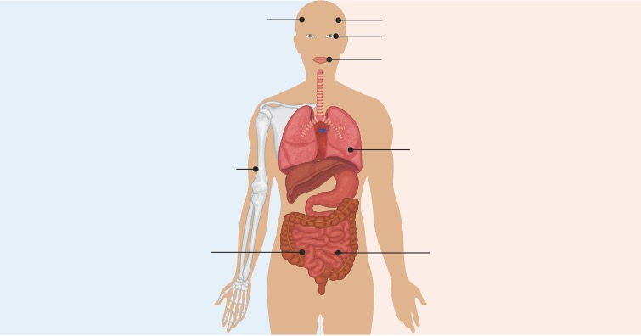
Common and Notable Toxicities
Associated With TROP-2‒Directed ADCs
Sacituzumab Govitecan
Datopotamab Deruxtecan
Alopecia: 39%
Alopecia: 40%
Dry eye: 22%
Stomatitis: 53%
Fatigue: 46%
Fatigue: 33%
Neutropenia*: 37%
Anemia: 31%
Interstitial lung disease: 11%
Nausea: 80%
Diarrhea: 61%
Vomiting: 35%
Constipation: 31%
Nausea: 55%
*Most common severe AE.
Heist. JCO. 2017;35:2790. Shimizu. JCO. 2023;[Epub].
Notes:
ADC, antibody‒drug conjugate.
The common AEs tend to occur at an incidence of >30% (all grades)
The notable AEs are unique to either of the ADCs and require concerted management

Slide 25
Management of Neutropenia
Associated With Sacituzumab Govitecan
ANC <1500/mm³ on Day 1 of any cycle, ANC <1000/mm³ on Day 8 of any cycle, or neutropenic fever
Hold treatment until improved
Severe Neutropenia | Occurrence | Dose Modification
Grade 4 neutropenia ≥7 days or Grade 3-4 febrile neutropenia or At time of scheduled treatment, grade 3-4 neutropenia, which delays dosing by 2-3 wk for recovery to grade ≤1 | First | 25% dose reduction and administer G-CSF
 | Second | 50% dose reduction and administer G-CSF
 | Third | Discontinue treatment and administer G-CSF
At time of scheduled treatment, grade 3-4 neutropenia, which delays dosing by >3 wk for recovery to grade ≤1 | First | Discontinue treatment and administer G-CSF
Sacituzumab govitecan PI.
Notes:
ANC, absolute neutrophil count; G-CSF, granulocyte colony-stimulating factor.

Slide 26

Management of Diarrhea Associated
With Sacituzumab Govitecan
Onset During/Shortly After Infusion
Atropine 0.2 mg IV every 15 min x 2 doses
Subsequent 0.2-mg atropine doses for
1 mg total
Atropine prophylaxis during future infusions
Resolution
Discontinue loperamide 12 hr after last diarrhea episode
Continue dietary management
Grade 1/2
Also consider infectious causes of diarrhea
Delayed Onset
Standard loperamide (4 mg + 2 mg after
each loose stool, up to 16 mg/day)
Dietary management
No Resolution
High-dose loperamide
(4 mg + 2 mg every
2 hr)
If Not Resolved
After 24 Hr
Octreotide 100-150 µg SC 3x/day
Fluid/electrolyte replacement
Consider hospital admission
Consider IV fluids
Octreotide 100-150 µg SC 3x/day
Consider antibiotic therapy, as indicated
Grade 3/4
Spring. Oncologist. 2021;26:827.

Slide 27
Management of Ocular Surface Toxicities
Associated With Datopotamab Deruxtecan
What to Look for
Dry eye
Eye redness
Stinging
Burning or scratchy sensation
Sensation of having something in eye
Keratitis
Eye pain
Excess tears or discharge from eye
Difficulty opening eyelid due to pain or irritation
Decreased vision
Sensitivity to light
Blurred vision
Grade and Description | Protocol Management Recommendations*
1: asymptomatic | Maintain dose Ensure use of artificial tears Consider ophthalmology assessment
2: symptomatic with moderate decrease in visual acuity | Obtain ophthalmology assessment Delay dose until resolved to grade ≤1
3: symptomatic with marked decrease in visual acuity limiting self-care ADLs | Obtain ophthalmology assessment Delay dose until resolved to grade ≤1, then reduce by 1 dose level
4: perforation; best-corrected visual acuity of 20/200 or worse in affected eye | Obtain ophthalmology assessment Discontinue drug
*Ensure that use of contact lenses is avoided.
Shimizu. JCO. 2023;[Epub].
Notes:
ADL, activity of daily living.

Slide 28
Management of Stomatitis/Mucositis
Associated With Datopotamab Deruxtecan
What to Look for
Lips and mucosa appear redder than usual
Visible sores on oral mucosa
Mouth pain, which may affect chewing and swallowing
Changes in ability to taste
Grade and Description | Protocol Management Recommendations*
1: asymptomatic or mild symptoms | Maintain dose
2: moderate pain/ulceration | Consider dose delay or reduction
3: severe pain/ulceration interfering with oral intake | Delay dose until resolved to grade ≤1 or baseline Consider dose reduction by 1 level if supportive medications are already optimized
4: oral intake not possible; life-threatening consequences | Discontinue drug
*In all levels, optimize supportive medications to provide pain relief (eg, viscous lidocaine rinses).
Shimizu. JCO. 2023;[Epub].

Slide 29
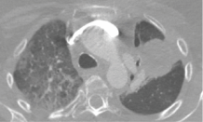
Management of Interstitial Lung Disease
Associated With Datopotamab Deruxtecan
What to Look for
Shortness of breath, particularly on exertion
Dry cough
Chest discomfort
Fatigue
Grade and Description | Protocol Management Recommendations in Addition to Holding or Discontinuing Agent
1: asymptomatic; clinical or diagnostic observations only | Consider observation Consider oral prednisone 0.5 mg/kg/day
2: symptomatic; limiting instrumental ADLs | Oral prednisone 1 mg/kg/day Increase to 2 mg/kg/day or switch to IV if no improvement after 5 days
3: severe symptoms; limiting self-care ADLs or life-threatening respiratory compromise | Hospitalization IV high-dose methylprednisolone for ≥14 days, followed by taper, if needed
For all grades | Oxygen supplementation for hypoxia Supportive treatment for prolonged corticosteroid use Consider infliximab, mycophenolate mofetil, IVIG, or other immunosuppressant if corticosteroid refractory
Image courtesy of Rebecca Heist, MD, MPH.
Shimizu. JCO. 2023;[Epub]. Tarantino. JAMA Oncol. 2021;7:1873.
Notes:
ADL, activity of daily living.

Slide 30
Acquired Resistance to TROP-2‒Directed ADCs:
3 Main Mechanisms
Downregulation of Antigen Expression by Tumor Cells
Altered Intracellular Trafficking Pathways or Drug Breakdown In Lysosomes
Payload Resistance by Upregulation of Drug Efflux Pumps
ADCs prevented from binding to tumor cells, thereby reducing release of payload within tumor cell
ADC
ADC
Antigen
Antigen
2. However, active efflux of payload by upregulation of ABC transporter protein protects tumor cells from cytotoxic damage
Target antigen degraded
ADC ejected from tumor cell via endosome recycling
prior to payload release
1. Linker cleaved in lysosome and payload released
into cytoplasm
Cytoplasm
Downregulation of target antigen
Nucleus
Gene encoding target antigen not expressed
Cytoplasm
Cytoplasm
Adequate payload release prevented by altered lysosomal environment
Drago. Nat Rev Clin Oncol. 2021;18:327.
Notes:
ADC, antibody‒drug conjugate.

Slide 31
Go Online for More CCO Coverage of
TROP-2 ADCs in Lung Cancer!
ClinicalThought commentaries with expert insights on TROP-2 ADCs in lung cancer
CME-certified text module capturing a Think Tank of 5 lung cancer experts discussing where TROP-2 ADCs fit into the current NSCLC treatment paradigm
PDF infographic with guided video focused on the management of adverse events associated with TROP-2 ADC therapy
clinicaloptions.com

