Slide 1
HER2CLIMB-05: Tucatinib vs Placebo Added to Trastuzumab + Pertuzumab as First-line Maintenance Therapy for HER2+ MBC
CCO Independent Conference Highlights* of the 2025 San Antonio Breast Cancer Symposium
*Clinical Care Options, LLC dba Decera Clinical Education is an independent medical education company that provides state-of-the-art medical information to healthcare professionals through conference coverage and other educational programs.
Provided by Clinical Care Options, LLC dba Decera Clinical Education.
Supported by educational grants from AstraZeneca, Daiichi Sankyo, Inc, Genentech, a member of the Roche Group, Gilead Sciences, Inc., Lilly, Novartis Pharmaceuticals Corporation, and Stemline Therapeutics, Inc.

Slide 2
About These Slides
Please feel free to use and share some or all of these slides in your noncommercial presentations to colleagues or patients
When using our slides, please retain the source attribution:
These slides may not be published, posted online, or used in commercial presentations without permission. Please contact permissions@deceraclinical.com for details
Slide credit: deceraclinical.com/education
formerly clinicaloptions.com
Notes:
Disclaimer: The materials published on the Decera Clinical Education website reflect the views of the authors of the Decera Clinical Education material, not those of Decera Clinical Education, the CME providers, or the companies providing educational grants. The materials may discuss uses and dosages for therapeutic products that have not been approved by the FDA. A qualified healthcare professional should be consulted before using any therapeutic product discussed. Readers should verify all information and data before treating patients or using any therapies described in these materials.

Slide 3
HER2CLIMB-05: Background
Recommended therapy for previously untreated HER2+ MBC has been induction with a taxane + trastuzumab and pertuzumab, followed by trastuzumab and pertuzumab (HP) maintenance therapy¹
  Disease progression occurs in most patients; second-line therapy may not always be an option^{2,3}
HER2CLIMB found that addition of tucatinib to capecitabine and trastuzumab significantly increased PFS and OS in patients with heavily treated HER2+ MBC, including patients with brain metastases^{4,5}
Use of dual inhibition of HER2 with anti-HER2 monoclonal antibodies and tucatinib may strengthen efficacy of first-line maintenance therapy⁶
Current analysis of phase III HER2CLIMB-05 trial reports efficacy and safety of adding tucatinib to first-line maintenance HP in patients with HER2+ MBC⁷
1. Gion. Am Soc Clin Oncol Educ Book. 2022;42:1. 2. Baselga. NEJM. 2012;366:109.
3. Swain. NEJM. 2015;372:724. 4. Murthy. NEJM. 2020;382:597.
5. Curigliano. Ann Oncol. 2022;33:321 . 6. Pernas. Ther Adv Med Oncol. 2019;11:1758835919833519.
7. Hamilton. SABCS 2025. Abstr GS1-01.

Slide 4
HER2CLIMB-05: Study Design
International, double-blind, randomized, placebo-controlled phase III trial
Primary endpoint: investigator-assessed PFS per RECIST v1.1
Secondary endpoints: OS, PFS per BICR, CNS-PFS, safety, health-related QoL, pharmacokinetics
Stratification by diagnosis (de novo vs recurrent); HR status (positive vs negative); past or current brain mets (yes vs no)
Patients with confirmed HER2+ MBC, no PD after 4-8 THP cycles, no or asymptomatic brain metastases at screening MRI, ECOG PS 0-1
(N = 654)
Tucatinib 300 mg PO BID + HP* Q21D ± ET
(n = 326)
Treatment continued until PD, unacceptable toxicity, withdrawal of consent, or study end
Placebo PO BID + HP* Q21D ± ET
(n = 328)
*Trastuzumab 6mg/kg IV or 600mg SC + pertuzumab 420mg IV, or fixed-dose combination of trastuzumab 600mg + pertuzumab 600mg and hyaluronidase 20,000 units.
Crossover between arms was not permitted.
Hamilton. SABCS 2025. Abstr GS1-01. Dieras. JCO. 2025;[Epub].

Slide 5
HER2CLIMB-05: Baseline Characteristics
Characteristic | Tucatinib + HP (n = 326) | Placebo + HP (n = 328)
Median age, yr (range) | 54.0 (24-82) | 54.0 (29-83)
Race, n (%) White Asian Black or African American Multiple or other Unknown | 147 (45.1) 119 (36.5) 10 (3.1) 10 (3.1) 40 (12.3) | 147 (44.8) 111 (33.8) 9 (2.7) 15 (4.6) 46 (14.0)
ECOG PS, n (%) 0 1 | 215 (66.0) 110 (33.7) | 204 (62.2) 123 (37.5)
HR status, n (%) Positive Received ET Negative | 168 (51.5) 74 (44.0) 158 (48.5) | 176 (53.7) 81 (46.0) 152 (46.3)
Prior/existing brain mets, n (%) | 41 (12.6) | 40 (12.2)
Visceral disease, n (%) | 194 (59.5) | 172 (52.4)
Characteristic | Tucatinib + HP (n = 326) | Placebo + HP (n = 328)
Disease status, n (%) De novo Recurrent | 227 (69.6) 99 (30.4) | 226 (68.9) 102 (31.1)
Prior (neo)adjuvant systemic therapy, n (%) Trastuzumab Pertuzumab | 87 (26.7) 60 (69.0) 16 (18.4) | 91 (27.7) 67 (73.6) 15 (16.5)
Median induction HP cycles (range) | 6 (4-10) | 6 (4-11)
Median induction taxane cycles (range) | 6 (4-9) | 6 (3-8)
Best response to induction THP, n (%) CR PR SD Non-CR/Non-PD | 30 (9.2) 204 (62.6) 77 (23.6) 15 (4.6) | 32 (9.8) 208 (63.4) 75 (22.9) 13 (4.0)
Hamilton. SABCS 2025. Abstr GS1-01. Dieras. JCO. 2025;[Epub].

Slide 6
HER2CLIMB-05: Investigator-Assessed PFS (Primary Endpoint)
100
Tucatinib + HP
(n = 326)
141
24.9
(21.3, -)
Placebo + HP
(n = 328)
191
16.3
(12.6, 18.7)
Events
Median (Mo)
(95% CI)
HR (95% CI); 2-sided P-value
80
60
0.641 (0.514, 0.799); <.0001
PFS Probability (%)
40
20
0
0
3
6
9
12
15
18
21
24
27
30
33
36
39
42
Tucatinib + HP
No. at Risk
No. Censored
Placebo + HP
No. at Risk
No. Censored
Mo
326
0
328
0
296
15
283
4
274
17
249
5
236
21
200
7
222
22
182
9
178
38
142
29
143
64
109
52
95
102
65
78
67
126
46
93
31
156
24
114
10
175
9
129
3
182
6
132
0
185
2
135
0
185
1
136
0
185
0
137
Median PFS was significantly longer in patients receiving tucatinib + trastuzumab and pertuzumab vs placebo + trastuzumab and pertuzumab (diff. 8.6 mo)
Hamilton. SABCS 2025. Abstr GS1-01. Dieras. JCO. 2025;[Epub].

Slide 7
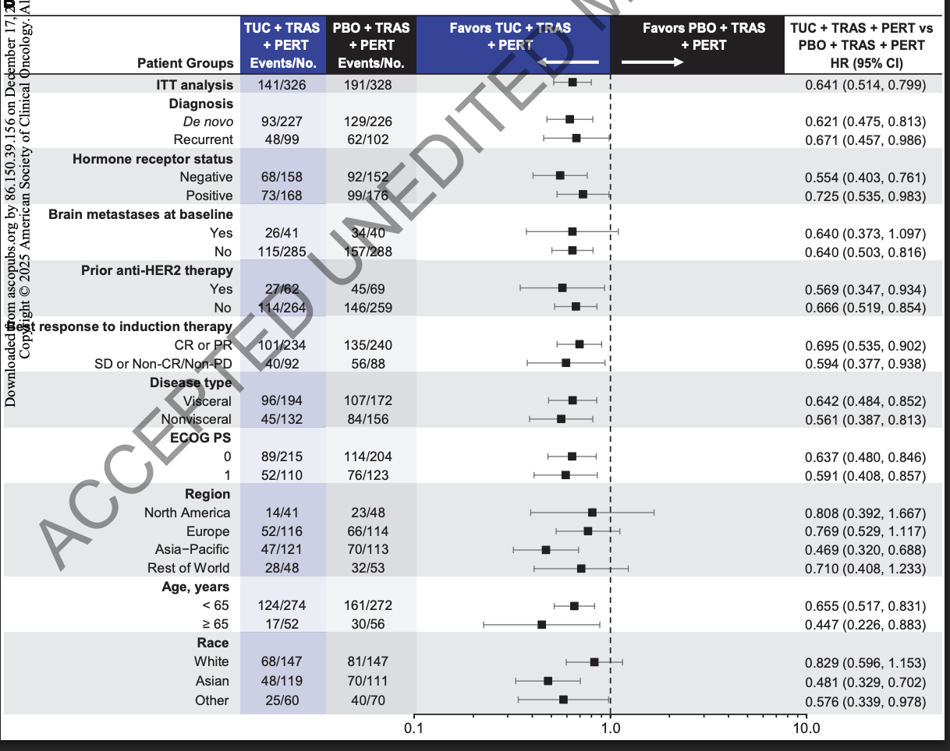
HER2CLIMB-05: PFS by Subgroup
Patient Groups | TUC + HP Events/n | PBO + HP Events/n | TUC + HP vs PBO + HP (95% CI)
ITT analysis | 141/326 | 191/328 | 0.641 (0.514-0.799)
Diagnosis De novo Recurrent | 93/227 48/99 | 129/226 62/102 | 0.621 (0.475-0.813) 0.671 (0.457-0.986)
HR-negative HR-positive | 68/158 73/168 | 92/152 99/176 | 0.554 (0.403-0.761) 0.725 (0.535-0.983)
Prior anti-HER2 tx Yes No | 27/62 114/264 | 45/69 146/259 | 0.569 (0.347-0.934) 0.666 (0.519-0.854)
Baseline brain mets Yes No | 26/41 115/285 | 34/40 157/288 | 0.640 (0.373-1.097) 0.640 (0.503-0.816)
Best response to induction therapy CR or PR SD or non-CR/-PD | 101/234 40/92 | 135/240 56/88 | 0.695 (0.535-0.902) 0.594 (0.377-0.938)
Visceral disease Nonvisceral disease | 96/194 45/132 | 107/172 84/156 | 0.642 (0.484-0.852) 0.561 (0.387-0.813)
ECOG PS 0 ECOG PS 1 | 89/215 52/110 | 114/204 76/123 | 0.637 (0.480-0.846) 0.591 (0.408-0.857)
Patient Groups | TUC + HP Events/n | PBO + HP Events/n | TUC + HP vs PBO + HP (95% CI)
Region North America Europe Asia-Pacific Rest of World | 14/41 52/116 47/121 28/48 | 23/48 66/114 70/113 32/53 | 0.808 (0.392-1.667) 0.769 (0.529-1.117) 0.469 (0.320-0.6888) 0.710 (0.408-1.233)
Age <65 ≥65 | 124/274 17/52 | 161/272 30/56 | 0.655 (0.517-0.831) 0.447 (0.226-0.883)
Race White Asian Other | 68/147 48/119 25/60 | 81/147 70/111 40/70 | 0.829 (0.596-1.153) 0.481 (0.329-0.702) 0.576 (0.339-0.978)
Hamilton. SABCS 2025. Abstr GS1-01. Dieras. JCO. 2025;[Epub].

Slide 8
HER2CLIMB-05: PFS by BICR and Hormone Receptor Status
PFS by BICR | Tucatinib + HP (n = 326) | Placebo + HP (n = 328)
PFS events, n | 126 | 162
mPFS, mo (95% CI) | 28.9 (24.3 to -) | 16.0 (12.3-22.9)
HR (95% CI) | .654 (0.517-0.828)
Treatment difference, mo | 12.9
PFS in HR-Negative Patients | Tucatinib + HP (n = 158) | Placebo + HP (n = 152)
PFS events, n | 68 | 92
Median PFS, mo (95% CI) | 24.9 (19.4 to -) | 12.6 (9.4-16.8)
HR (95% CI) | 0.554 (0.403-0.761); P = .0002
Treatment difference, mo | 12.3
PFS in HR-Positive Patients | Tucatinib + HP (n = 168) | Placebo + HP (n = 176)
PFS events, n | 73 | 99
Median PFS, mo (95% CI) | 25.0 (16.5 to -) | 18.1 (13.0-20.8)
HR (95% CI) | 0.725 (0.535-0.983); P = .0389
Treatment difference, mo | 6.9
Hamilton. SABCS 2025. Abstr GS1-01. Dieras. JCO. 2025;[Epub].

Slide 9
HER2CLIMB-05: OS and CNS-PFS
OS | Tucatinib + HP (n = 326) | Placebo + HP (n = 328)
Events, n | 18 | 33
Median, mo (95% CI) | - (- to -) | - (- to -)
HR (95% CI) | 0.539 (0.303-0.957); P = .0320
OS data were immature; OS events were numerically lower among patients receiving tucatinib
CNS-PFS in ITT Population | Tucatinib + HP (n = 326) | Placebo + HP (n = 328)
Events, n | 77 | 80
Median, mo (95% CI) | - (- to -) | - (- to -)
HR (95% CI) | 0.846 (0.616-1.162)
CNS-PFS in Patients With Brain Mets at Baseline | Tucatinib + HP (n = 41) | Placebo + HP (n = 40)
Events, n | 24 | 28
Median, mo (95% CI) | 8.5 (4.4-22.8) | 4.3 (2.3-10.6)
HR (95% CI) | 0.719 (0.406-1.273)
Treatment difference, mo | 4.2
Hamilton. SABCS 2025. Abstr GS1-01. Dieras. JCO. 2025;[Epub].

Slide 10
HER2CLIMB-05: Safety Summary
Safety Outcomes | Tucatinib + HP (n = 326) | Placebo + HP (n = 324)
Median duration of tucatinib or placebo treatment, mo (range) | 17.1 (0.4, 36.5) | 15.5 (0.5, 41.3)
TEAEs, n (%) Grade ≥3 Serious TEAE Leading to death | 323 (99.1) 138 (42.3) 55 (16.9) 1 (0.3) | 313 (96.6) 79 (24.4) 26 (8.0) 1 (0.3)
Discontinued study drug due to TEAEs, n (%) Tucatinib or placebo Trastuzumab or pertuzumab Trastuzumab + pertuzumab FDC | 45 (13.8) 44 (13.5) 2 (0.6) 9 (2.8) | 15 (4.6) 7 (2.2) 5 (1.5) 4 (1.2)
Most common TEAEs leading to discontinuations, n (%) Hepatic events Diarrhea | 25 (7.7) 5 (1.5) | 0 3 (0.9)
Dose modification due to TEAEs, n (%) Tucatinib or placebo dose hold Tucatinib or placebo dose reduction | 182 (55.8) 161 (49.4) 95 (29.1) | 112 (34.6) 82 (25.3) 36 (11.1)
Hamilton. SABCS 2025. Abstr GS1-01. Dieras. JCO. 2025;[Epub].

Slide 11
HER2CLIMB-05: Treatment-Emergent Adverse Events
TEAEs Occurring in ≥20% of Patients, n (%) | Tucatinib + HP (n = 326) |  |  | Placebo + HP (n = 324)
 | All | Grade 1-2 | Grade ≥3 | All | Grade 1-2 | Grade ≥3
Diarrhea | 72.7 | 66.6 | 6.1 | 51.2 | 47.2 | 4.0
Nausea | 33.1 | 32.2 | 0.9 | 23.5 | 22.6 | 0.9
ALT increase | 28.2 | 14.7 | 13.5 | 7.1 | 6.5 | 0.6
AST increase | 25.8 | 18.7 | 7.1 | 9.0 | 8.4 | 0.6
Arthralgia | 20.6 | 20.0 | 0.6 | 23.1 | 22.8 | 0.3
Fatigue | 20.6 | 20.0 | 0.6 | 12.7 | 11.5 | 1.2
Hamilton. SABCS 2025. Abstr GS1-01. Dieras. JCO. 2025;[Epub].

Slide 12
HER2CLIMB-05: Hepatic and Diarrhea Treatment-Emergent Adverse Events
Hepatic TEAEs, n (%) | TUC + HP (n = 326) | PBO + HP (n = 324)
Any, n (%) Grade 1 Grade 2 Grade 3 Grade 4 Grade 5 | 142 (43.6) 51 (15.6) 32 (9.8) 50 (15.3) 8 (2.5) 1 (0.3) | 51 (15.7) 35 (10.8) 12 (3.7) 4 (1.2) 0 0
Days to grade ≥3 onset, median | 40.0 | 386.5
Days to grade ≥3 resolution, median | 40.0 | 10.0
Dose modification due to any TUC/PBO dose hold TUC/PBO dose reduction TUC/PBO discontinuation | 63 (19.3) 53 (16.3) 25 (7.7) | 8 (2.5) 3 (0.9) 0
Diarrhea TEAEs, n (%) | TUC + HP (n = 326) | PBO + HP (n = 324)
Any, n (%) Grade 1 Grade 2 Grade 3 Grade 4 Grade 5 | 237 (72.7) 114 (35.0) 103 (31.6) 20 (6.1) 0 0 | 166 (51.2) 110 (34.0) 43 (13.3) 13 (4.0) 0 0
Days to grade 3 onset, median | 49.5 | 149.0
Days to grade ≥3 resolution, median | 8.0 | 14.0
Dose modification due to any TUC/PBO dose hold TUC/PBO dose reduction TUC/PBO discontinuation | 28 (8.6) 21 (6.4) 5 (1.5) | 11 (3.4) 10 (3.1) 3 (0.9)
Hamilton. SABCS 2025. Abstr GS1-01. Dieras. JCO. 2025;[Epub].

Slide 13
HER2CLIMB-05: Investigators’ Conclusions
In this phase III trial in patients with HER2+ metastatic breast cancer, adding tucatinib to first-line maintenance therapy with HP significantly increased PFS vs HP alone
  Risk of disease progression or death was reduced by 36%
  Median PFS: 24.9 vs 16.3 mo with tucatinib vs placebo, respectively
  PFS benefit was seen in all prespecified patient subgroups
OS data were immature with a trend favoring tucatinib
Tucatinib with HP was generally well tolerated, and most TEAEs were mild to moderate
The investigators concluded that HER2CLIMB-05 supports first-line maintenance therapy with tucatinib plus HP as an improved option for patients with HER2+ MBC potentially delaying disease progression and extending time off chemotherapy
Hamilton. SABCS 2025. Abstr GS1-01. Dieras. JCO. 2025;[Epub].

Slide 14
Go Online for More Coverage of SABCS 2025!
Capsule Summaries of all the key data
Additional CME/CE-certified analyses with expert faculty commentary on all the key studies in early and advanced stage breast cancers
deceraclinical.com/education

