Slide 1
Adoptive Cell Therapy With
Tumor-Infiltrating Lymphocytes:
Emerging Data and Potential Applications
Amod A. Sarnaik, MD, FACS
Professor
Department of Oncologic Sciences/Cutaneous Biology
H. Lee Moffitt Cancer Center and Research Institute
University of South Florida
Tampa, Florida
Supported by an educational grant from Iovance Biotherapeutics.

Slide 2

About These Slides
Please feel free to use and share some or all of these slides in your noncommercial presentations to colleagues or patients
When using our slides, please retain the source attribution:
These slides may not be published, posted online, or used in commercial presentations without permission. Please contact permissions@clinicaloptions.com for details
Slide credit: clinicaloptions.com
Notes:
Disclaimer: The materials published on the Clinical Care Options website reflect the views of the authors of the CCO material, not those of Clinical Care Options, LLC, the CME providers, or the companies providing educational grants. The materials may discuss uses and dosages for therapeutic products that have not been approved by the United States Food and Drug Administration. A qualified healthcare professional should be consulted before using any therapeutic product discussed. Readers should verify all information and data before treating patients or using any therapies described in these materials.

Slide 3
Timeline of Regulatory Approvals for Metastatic Melanoma Treatments
2014
2015
2018
2013
2011
2022 Nivolumab + Relatlimab¹³
2020
Atezolizumab + Vemurafenib + Cobimetinib¹²
Encorafenib + Binimetinib¹¹
Ipilimumab + Nivolumab,⁸ Vemurafenib + Cobimetinib,⁹ Talimogene laherparepvec¹⁰
Pembrolizumab,⁶ Nivolumab⁷
Dabrafenib,⁴ Trametinib⁵
Ipilimumab,² Vemurafenib³
1998 Interleukin-2¹
After more than 3 decades of little progress, there has been rapid regulatory
approval of at least a dozen single agents or combinations for metastatic melanoma
1975 Dacarbazine¹
1. Bhatia. Oncology (Williston Park). 2009;23:488. 2. Hodi. NEJM. 2010;363:711. 3. Chapman. NEJM. 2011;364:2507.
4. Hauschild. Lancet. 2012;380:358. 5. Long. NEJM. 2014:371:1877. 6. Robert: NEJM. 2015;372:2521. 7. Robert. NEJM. 2015;372:320. 8. Larkin. NEJM. 2015;373:23. 9. Larkin. NEJM. 2014;371:1867. 10. Andtbacka. JCO. 2015;33:2780.
11. Dummer. Lancet Oncol. 2018;19:603. 12. Gutzmer. Lancet. 2020;395:1835. 13. Tawbi. NEJM. 2022;386:24.

Slide 4
Tumor-Infiltrating Lymphocytes and Melanoma
UV damage¹
High mutational burden²
TIL Invasion Is Beneficial
TILs in primary melanomas are associated with improved survival³
Metastatic melanoma of unknown primary origin is associated with improved survival⁴
Response to immunotherapy for metastatic melanoma is associated with T-cell infiltrate⁵
Creates a
target-rich environment
Invasion
by tumor-infiltrating lymphocytes
1. Sun. Front Oncol. 2020;10:951. 2. Alexandrov. Nature. 2013;500:415. 3. Thomas. JCO. 2013;33:4252.
4. van der Ploeg. Ann Surg Oncol. 2014;21:3108. 5. Byrne. Cancer. 2017;123:2143.
Notes:
TIL, tumor-infiltrating lymphocyte; UV, ultraviolet.

Slide 5
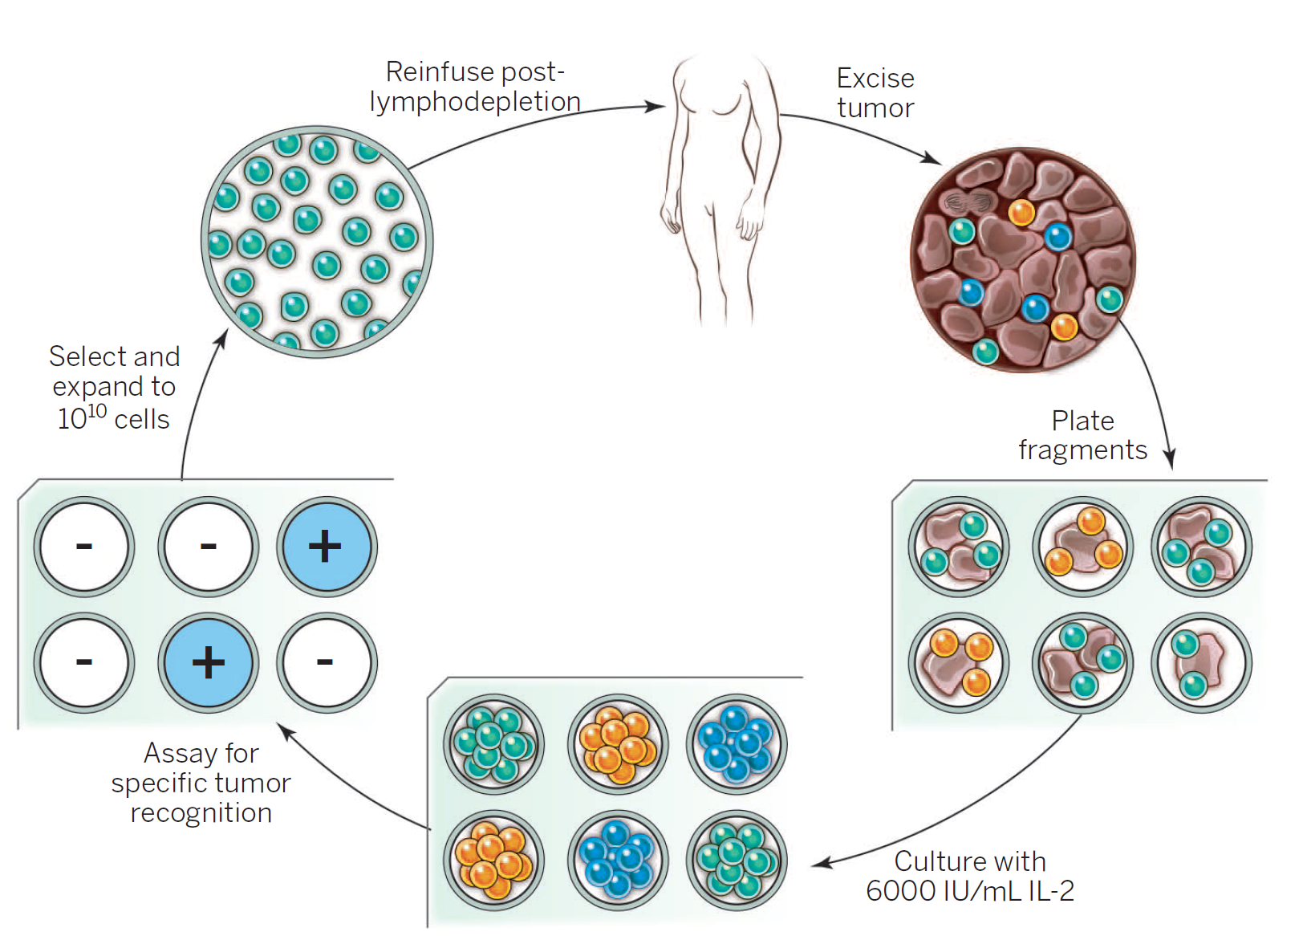
TIL Therapy Overview
Manufacturing
period ranges
from 3 to 8+ wk
TIL manufacturing involves in vitro culturing, and treatment involves lymphodepletion and posttransfer IL-2
Rosenberg. Science. 2015;348:62. Reproduced with permission.
Notes:
IL, interleukin; TIL, tumor-infiltrating lymphocyte.
TIL can be maintained fresh or cryopreserved at various points in the manufacturing process

Slide 6
Differences Between TIL and Other Cellular Therapies
TIL Therapy^{1,2}
TCR Therapy^{1,3}
CAR T-Cell Therapy^{1,4}
  Requires autologous
  tumor sample (typically resected in operating room)
  Requires preparative lymphodepleting chemotherapy and posttransfer IL-2
  Cellular product is polyclonal; targets of therapy are not defined
  Requires leukapheresis and viral-mediated introduction of TCR transgene
  Target of TCR may be cytoplasmic or extracellular; HLA restricted
  Requires preparative lymphodepleting chemotherapy (± IL-2)
  Cellular product is monoclonal; target of
  therapy is defined
  Requires leukapheresis and viral-mediated introduction of chimeric transgene
  CAR-T cell target is required to be expressed on cell surface; not HLA restricted
  Requires preparative lymphodepleting chemotherapy (± IL-2)
  Cellular product is monoclonal; target of
  therapy is defined
1. Rohaan. Virchows Arch. 2019;474:449. 2. Hinrichs. Immunol Rev. 2014;257:56.
3. Johnson. Blood. 2009;114:535. 4. Alcantara. Oncoimmunology. 2020;9:1.
Notes:
CAR, chimeric antigen receptor; HLA, human leukocyte antigen; IL, interleukin; TCR, transgenic T-cell receptor; TIL, tumor-infiltrating lymphocyte.

Slide 7
Comparison of AEs Between Cellular Therapies
TIL Therapy¹⁻³
TCR Therapy^{1,4}
CAR T-Cell Therapy^{1,5-6}
  Toxicities of lymphodepleting chemotherapy (fatigue, myelofibrosis, neuropathy, cytopenias)
  Serious on-target off-tumor toxicities are rare
  Toxicities of surgery
  Toxicities of high-dose
  IL-2 with associated rigors, cardiopulmonary insufficiency (hypotension and hypoxemia), possible multiorgan failure (renal failure is common)
  Toxicities of lymphodepleting chemotherapy (fatigue, myelofibrosis, neuropathy, cytopenias)
  Serious on-target off-tumor toxicities are possible, especially with high-avidity mutations engineered in TCR
  Toxicities of lymphodepleting chemotherapy (fatigue, myelofibrosis, neuropathy, cytopenias)
  Serious on-target off-tumor toxicities are possible
  Cytokine-release syndrome
  Immune effector cell‒associated
  neurotoxicity syndrome
1. Rohaan. Virchows Arch. 2019;474:449. 2. Hinrichs. Immunol Rev. 2014;257:56. 3. Poust. Anticancer Drugs. 2013;24:1.
4. Johnson. Blood. 2009;114:535. 5. Alcantara. Oncoimmunology. 2020;9:1. 6. Holtzman. Neuro Oncol. 2021;23:112.
Notes:
AE, adverse event; CAR, chimeric antigen receptor; HLA, human leukocyte antigen; IL, interleukin; TCR, transgenic T-cell receptor; TIL, tumor-infiltrating lymphocyte.

Slide 8
A Word About Lymphodepletion
Cyclophosphamide and fludarabine
Proposed mechanisms include:
  Depletion of immunoinhibitory cell populations
  Depletion of endogenous circulating immune cells—cytokine sink depletion
  Depletion of mucosal immune cells—disruption of GI immunity
Escalating intensity of lymphodepletion increases toxicity but
not efficacy
Rohaan. Virchows Arch. 2019;474:449. Muranski. Nature Clinical Practice Oncology. 2006;3:668. Goff. JCO. 2016;34:2389.
Notes:
GI, gastrointestinal.
Cy flu was previously shown to be required for optimal responses but mechanism for this requirement has not been established

Slide 9
Lymphodepletion Intensity: Outcomes and Safety
OS
PFS
100
100
NMA chemotherapy
NMA chemo + 1200 TBI
NMA chemotherapy
NMA chemo + 1200 TBI
80
80
60
+
60
OS (%)
+
+
+
+
+
+
+
+
+
PFS (%)
+
+
+
+
+
+
+
+
+
+
+
+
40
+
+
+
+
+
+
+
40
+
+
+
+
+
+
+
+
+
+
+
+
+
+
+
+
+
+
+
+
+
+
+
+
+
+
+
20
20
+
+
0
0
0
12
24
36
48
60
0
12
24
36
48
60
Mo
Mo
Variable | NMA (n = 51) | NMA + TBI (n = 48)
Grade 3/4 AEs Thrombotic microangiopathy | 0 | 13
ICU transfer on index admission Cytokine-related symptoms (no documented bacteremia) | 4 0 | 12 6
Goff. JCO. 2016;34:2389.
Notes:
NMA, nonmyeloablative; OS, overall survival; PFS, progression-free survival; TBI, total body irradiation.

Slide 10
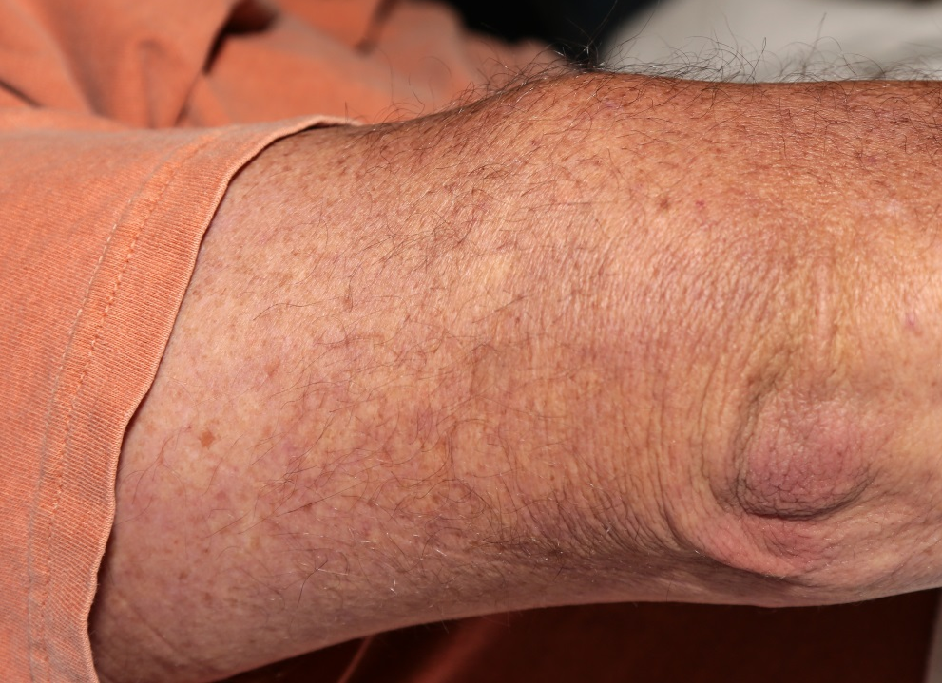
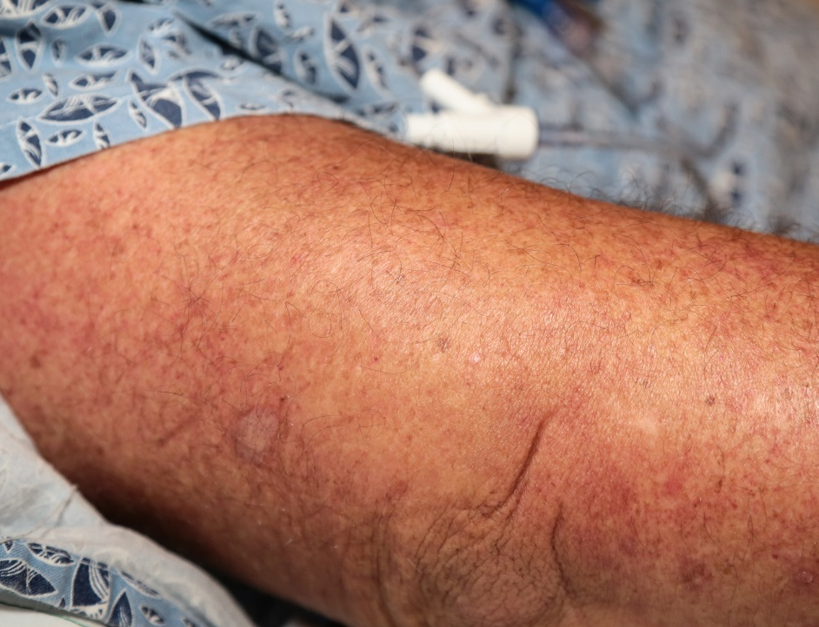
Rapid Response to TIL Therapy in Metastases
Before TIL Therapy
After TIL Therapy
Baseline
8 Days Post
Image courtesy of Dr Amod Sarnaik.
Notes:
TIL, tumor-infiltrating lymphocyte.

Slide 11
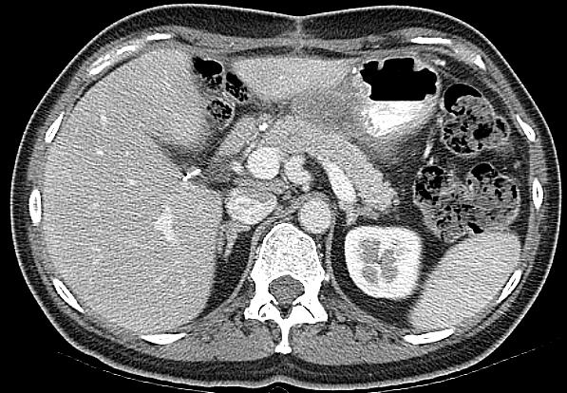
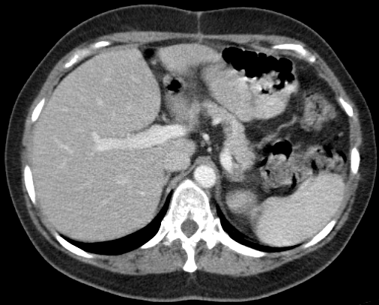
TILs Derived From SC Metastasis:
Visceral Metastases Response
Before TIL Therapy
After TIL Therapy
Baseline
5 Yr Post
2.8 x 6 cm
0 x 0 cm
Sarnaik. SITC 2015. Abstr P49.
Notes:
TIL, tumor-infiltrating lymphocyte.
TIL harvested from one site of disease can home to other sites of disease

Slide 12
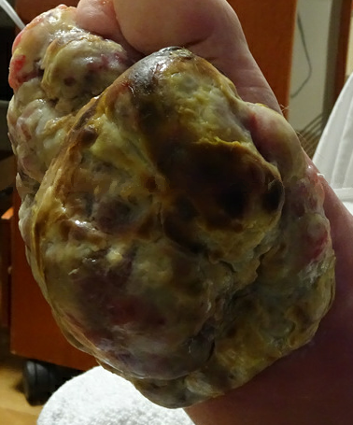
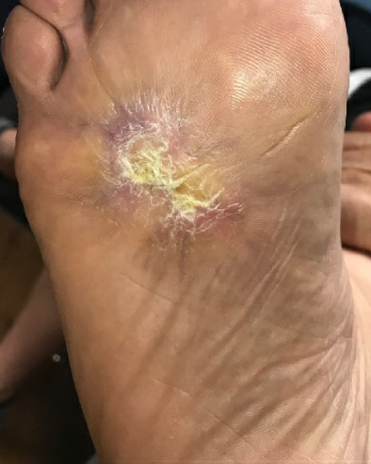
TIL Response: Bulky Metastases
Pre-TIL Therapy
Post-TIL Therapy
Baseline
5 Yr Post Infusion
Image courtesy of Dr Amod Sarnaik.
Notes:
TIL, tumor-infiltrating lymphocyte.

Slide 13
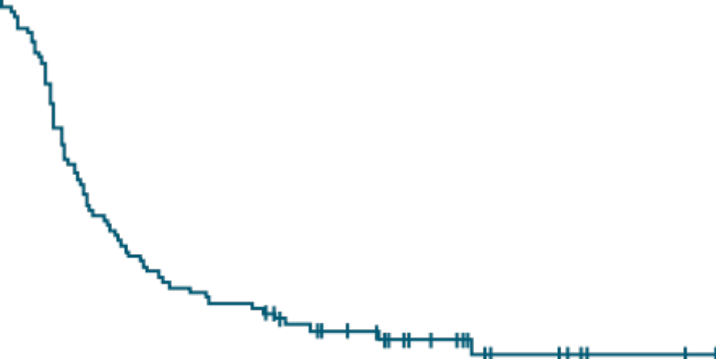
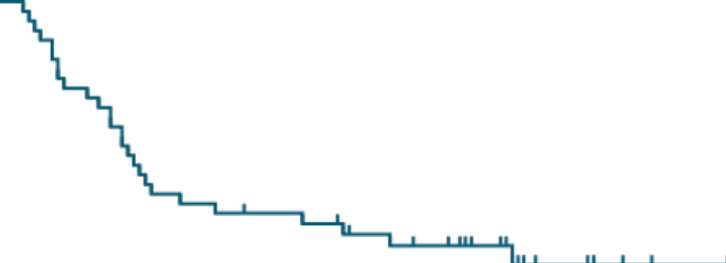
Overall Survival After TIL Therapy:
Outcomes From 2 Single US Institutions
The National Cancer Institute¹
Bethesda, Maryland
Moffitt Cancer Center²
Tampa, Florida
100
Median follow-up: 62 mo
100
Median follow-up: 52 mo
80
80
60
60
Overall Survival (%)
Overall Survival (%)
40
40
N = 49
20
All patients (N = 93)
20
0
0
6
12
18
24
30
36
42
48
54
60
66
72
78
84
90
96
102
0
0
6
12
18
24
30
36
42
48
54
60
66
72
78
84
90
96
102
108
114
120
126
Mo
Mo
1. Rosenberg. Clin Cancer Res. 2011;17:4550. 2. Sarnaik. Unpublished data.
Notes:
TIL, tumor-infiltrating lymphocyte.

Slide 14
M14TIL: TIL vs Ipilimumab as Second-line Therapy for Patients With Advanced Melanoma
Randomized, controlled phase III study at 2 centers (Denmark and Netherlands)
Stratification by BRAFV600 mutation status, line of treatment, and treatment center
TIL
Single infusion of 5 x 10⁹ - 2 x 10¹¹ cells*
(n = 84)
Patients aged 18-75 yr with unresectable stage IIIC-IV cutaneous melanoma with PD after ≤1 line of systemic treatment; no prior ipilimumab treatment;
RECIST v1.1 measurable disease;
LDH ≤2 X ULN; WHO PS 0-1
(N = 168)
Follow-up according to protocol
Ipilimumab
3 mg/kg IV Q3W, maximum 4 doses
(n = 84)
*TIL infusion was preceded by NMA-LD with cyclophosphamide 60 mg/kg/d IV x 2 d + fludarabine 25 mg/m²/d IV x 5 d and followed by up to 15 doses of IL-2 600,000 IU/kg IV Q8h.
Primary endpoint: investigator-assessed PFS (RECIST v1.1, ITT population)
Secondary endpoints: PFS (immune-related response criteria), ORR (RECIST v1.1 and immune-related response criteria),
CR, OS, HRQoL, safety
Rohaan. NEJM. 2022;387:2113.
Notes:
CR, complete response; HRQoL, health-related quality of life; IL, interleukin; LDH, lactate dehydrogenase; NMA-LD, nonmyeloablative lymphodepletion; ORR, overall response rate; OS, overall survival; PD, progressive disease; PFS, progression-free survival; PS, performance status; RECIST, Response Evaluation Criteria in Solid Tumors; TIL, tumor-infiltrating lymphocyte; ULN, upper limit of normal.

Slide 15
M14TIL: Baseline Characteristics
Characteristic | TIL (n = 84) | Ipilimumab (n = 84)
Gender, n (%) Male Female | 47 (56) 37 (44) | 53 (63) 31 (37)
Median age, yr (range) | 59 (26-74) | 59 (30-77)
WHO performance status score (%) 0 1 | 69 (82) 15 (18) | 70 (83) 14 (17)
BRAF V600 mutation, n (%) | 37 (44) | 36 (43)
Disease stage, n (%) Unresectable stage IIIC Stage IV | 2 (2) 82 (98) | 2 (2) 82 (98)
Serum lactate dehydrogenase, n (%) ≤ ULN 1-2x ULN | 67 (80) 17 (20) | 70 (83) 14 (17)
Majority of patients had normal LDH; patients with >2x ULN were excluded
Rohaan. NEJM. 2022;387:2113.
Notes:
LDH, lactate dehydrogenase; TIL, tumor-infiltrating lymphocyte; ULN, upper limit of normal.

Slide 16
M14TIL: Grade ≥3 Adverse Events in ≥5% of Patients
TIL (n = 80)
Ipilimumab (n = 82)
AE, n (%) | Chemotherapy
Neutropenia | 80 (100)
Thrombocytopenia | 71 (89)
Febrile neutropenia | 69 (86)
Leukopenia | 57 (71)
Hypophosphatemia | 20 (25)
Anemia | 16 (20)
Elevated ALT | 7 (9)
GGT increased | 6 (8)
Elevated AST | 4 (5)
Fatigue | 4 (5)
AE, n (%) | TIL + IL-2
Febrile neutropenia | 59 (74)
Hypophosphatemia | 48 (60)
Fever | 36 (45)
Dyspnea | 15 (19)
Hypertension | 11 (14)
CPK increased | 9 (11)
Rash | 9 (11)
Elevated AST | 8 (10)
Elevated ALT | 8 (10)
Fatigue | 7 (9)
Chills | 6 (8)
GGT increased | 6 (8)
Hypotension | 6 (8)
Hypoxia | 5 (6)
AE | n (%)
Colitis | 16 (20)
Diarrhea | 12 (15)
Elevated ALT | 8 (10)
Elevated AST | 7 (9)
Rash | 4 (5)
Elevated ALP | 4 (5)
Grade ≥3 AEs in 57% of patients receiving ipilimumab
Grade ≥3 AEs in 100% of patients receiving TIL therapy due to lymphodepletion
Rohaan. NEJM. 2022;387:2113.
Notes:
AE, adverse event; ALT, alanine aminotransferase; AST, aspartate aminotransferase; CPK, creatine phosphokinase; GGT, γ-glutamyltransferase; IL, interleukin; TIL, tumor-infiltrating lymphocyte.

Slide 17
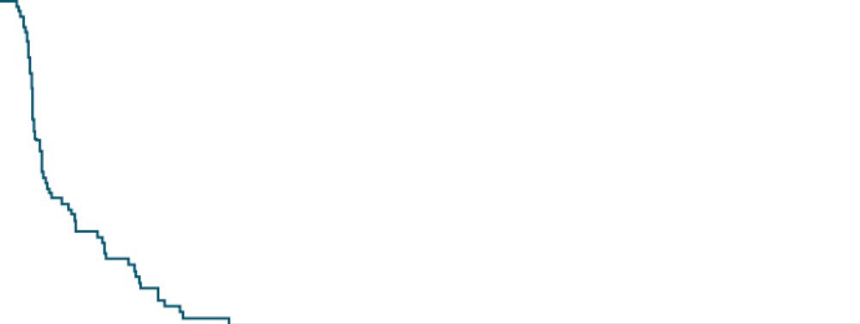
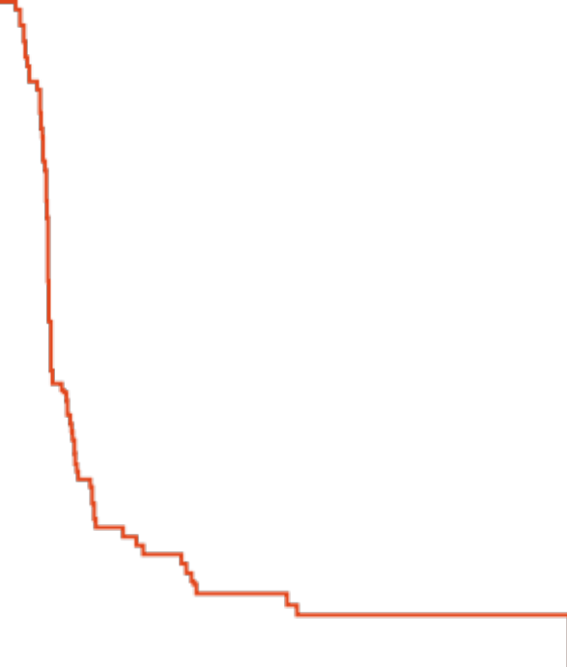
M14TIL: Progression-Free Survival (Primary Endpoint)
100
 | TIL (n = 84) | Ipilimumab (n = 84)
Median PFS, mo (95% CI) | 7.2 (4.2-13.1) | 3.1 (3.0-4.3)
HR (95% CI) | 0.50 (0.35-0.72; P <.001)
6-mo PFS, % (95% CI) | 52.7 (42.9-64.7) | 21.4 (14.2-32.2)
80
60
+
+
PFS (%)
+
40
+
+
+
+
+
+
+
+
+
+
+
+
+
+
+
+
+
+
+
+
20
+
+
+
+
Median follow-up: 33.0 mo
0
0
6
12
18
24
30
36
42
48
54
60
66
72
78
84
Patients at Risk, n
Mo Since Randomization
TIL
Ipilimumab
84
84
41
17
298
18
6
14
5
11
3
10
0
7
0
6
0
5
0
3
0
3
0
2
0
2
0
0
0
Rohaan. NEJM. 2022;387:2113.
Notes:
PFS, progression-free survival; TIL, tumor-infiltrating lymphocyte.

Slide 18
M14TIL: Best Overall Response
TIL
PD
SD
PR
CR
150
Response, n (%) | TIL (n = 84) | Ipilimumab (n = 84)
Best overall response
CR | 17 (20) | 6 (7)
PR | 24 (29) | 12 (14)
SD | 16 (19) | 15 (18)
PD | 24 (29) | 40 (48)
NE | 3 (4) | 11 (13)
ORR | 41 (49) | 18 (21)
CBR | 57 (68) | 33 (39)
125
100
75
50
Change in Tumor Size From Baseline (%)
25
0
-25
-50
-75
-100
Ipilimumab
150
125
100
75
50
Change in Tumor Size From Baseline (%)
25
0
-25
-50
-75
-100
Rohaan. NEJM. 2022;387:2113.
Notes:
CBR, clinical benefit rate; CR, complete response; NE, not evaluable; PD, progressive disease; PR, partial response; SD, stable disease; TIL, tumor-infiltrating lymphocyte.

Slide 19
C-144-01 Trial: Lifileucel in
Previously Treated Metastatic Melanoma
Multicenter, single-arm phase II study
TILs were manufactured at centralized facility, and patients received treatment at regional centers
Gen 2 TIL production time: 22 days
Patients with unresectable/metastatic melanoma; ≥1 prior systemic therapy including anti‒PD-1; prior BRAF ± MEK inhibitors if BRAF V600 mutation positive; RECIST v1.1 measurable disease; ECOG PS 0-1
(N = 189)
Noncryopreserved lifileucel (Gen 1)*
(cohort 1; n = 30)
Cryopreserved lifileucel (Gen 2)*
(cohort 2; n = 66)
Lifileucel retreatment*
(cohort 3; n = 10)
Cryopreserved lifileucel (Gen 2)*
(cohort 4; n = 87†)
* Lifileucel 1 x 10⁹ - 150 x 10⁹ cells preceded by cyclophosphamide 60 mg/kg/d IV x 2 d + fludarabine 25 mg/m²/d IV x 5 d and followed by to 6 doses of IL-2 600,000 IU/kg IV Q8-12h. †Planned n = 75 but rapid enrollment led to 87 patients receiving lifileucel and included in full analysis set (cohorts 2 + 4).
Primary endpoint: IRC-assessed ORR (RECIST v1.1)
Secondary endpoints: DoR, DCR, PFS, OS, safety
Sarnaik. JCO. 2021;39:2656. Chesney. J Immunother Cancer. 2022;10:e005755.
Notes:
DCR, disease control rate; DoR, duration of response; ECOG, Eastern Cooperative Oncology Group; Gen, generation; IL, interleukin; IRC, independent review committee; ORR, objective response rate; OS, overall survival; PFS, progression-free survival; PS, performance status; RECIST, Response Evaluation Criteria in Solid Tumors; TIL, tumor-infiltrating lymphocyte.

Slide 20
Lifileucel: Baseline Characteristics
Characteristic | Cohort 2 (n = 66) | Cohort 4 (n = 87) | Cohort 2 + 4 (n = 153)
Gender, n (%) Male Female | 39 (59.1) 27 (40.9) | 44 (50.6) 43 (49.4) | 83 (54.2) 70 (45.8)
Median age, yr (range) | 55 (20-79) | 58 (25-74) | 56 (20-79)
ECOG performance status, n (%) 0 1 | 42 (63.6) 24 (36.4) | 62 (71.3) 25 (28.7) | 104 (68.0) 49 (32.0)
BRAF V600 mutation, n (%) | 17 (25.8) | 24 (27.6) | 41 (26.8)
Disease stage, n (%) Unresectable stage IIIC Stage IV | 9 (13.6) 57 (86.4) | 1 (1.1) 86 (98.9) | 10 (6.5) 143 (93.5)
Serum lactate dehydrogenase, n (%) < ULN 1-2x ULN >2x ULN | 39 (59.1) 19 (28.8) 8 (12.1) | 31 (35.6) 35 (40.2) 21 (24..1) | 70 (45.8) 54 (35.3) 29 (19.0)
Prior therapies, median (range) | 3 (1-9) | 3 (1-8) | 3 (1-9)
Chesney. J Immunother Cancer. 2022;10:e005755.
Notes:
ECOG, Eastern Cooperative Oncology Group; ULN, upper limit of normal.

Slide 21
Lifileucel: Adverse Events
AEs | Safety Set (n = 156)
Preferred Term, n (%) | Any Grade | Grade 3/4
Thrombocytopenia | 129 (82.7) | 120 (76.9)
Chills | 117 (75.0) | 8 (5.1)
Anemia | 97 (62.2) | 78 (50.0)
Pyrexia | 81 (51.9) | 17 (10.9)
Neutropenia | 66 (42.3) | 45 (28.8)
Febrile neutropenia | 65 (41.7) | 65 (41.7)
Hypophosphatemia | 58 (37.2) | 41 (26.3)
Leukopenia | 54 (34.6) | 42 (26.9)
Hypotension | 52 (33.3) | 17 (10.9)
Fatigue | 51 (32.7) | 6 (3.8)
Lymphopenia | 49 (31.4) | 38 (24.4)
Diarrhea | 48 (30.8) | 2 (1.3)
6 deaths occurred within 30 days after infusion
  4 deaths were determined to be due to AEs
    3 assessed by investigator to be related to NMA-LD and/or IL-2 (pneumonia, arrhythmia, acute respiratory failure)
    1 assessed by investigator to be related to all components (intra-abdominal hemorrhage)
  2 deaths due to PD
TEAE were highest the first 2 wk post therapy, then rapidly decreased
Safety profile was consistent with underlying disease and known safety profiles of NMA-LD and IL-2 regimens and was similar between cohorts
Chesney. J Immunother Cancer. 2022;10:e005755.
Notes:
AE, adverse event; IL, interleukin; NMA-LD, nonmyeloablative lymphodepletion; PD, progressive disease; TEAE, treatment-emergent adverse event.

Slide 22
Lifileucel: Best Objective Response (Primary Endpoint)
Best % Change From Baseline in Target Lesion SOD
Response | Cohort 2 (n = 66) | Cohort 4 (n = 87) | Cohorts 2 + 4 (n = 153)
ORR, n (%) | 23 (34.8) | 25 (28.7) | 48 (31.4)
Best overall response, n (%)
CR | 5 (7.6) | 3 (3.4) | 8 (5.2)
PR | 18 (27.3) | 22 (25.3) | 40 (26.1)
SD | 24 (36.4) | 47 (54.0) | 71 (46.4)
Non-CR/non-PD* | 1 (1.5) | 0 | 1 (0.7)
PD | 15 (22.7) | 12 (13.8) | 27 (17.6)
NE | 3 (4.5) | 3 (3.4) | 6 (3.9)
Median DoR, mo (range) | NR (1.4+ to 45.0+) | 10.4 (1.4+ to 26.3+) | NR (1.4+ to 45.0+)
Median follow-up, mo | 36.6 | 23.5 | 27.6
60
PD
SD
PR
CR
n = 30
40
20
0
-20
Change From Baseline (%)
-40
-60
-80
-100
n = 110
*Patient did not have measurable target lesions by IRC and
best overall response of non-CR/non-PD per IRC assessment.
Chesney. J Immunother Cancer. 2022;10:e005755.
Notes:
CR, complete response; DoR, duration of response; IRC, independent review committee; NE, not estimable; NR, not reached; ORR, objective response rate; PD, progressive disease; PR, partial response; SD, stable disease; SOD, sum of diameter.

Slide 23


Lifileucel: DoR and PFS
DoR
PFS
100
+
+
100
+
+
+ Censored
+
+ Censored
+
80
80
+
+
+
+
60
+
+
+
60
+
+
+
+
+
+
+
+
+
+
+
+
+
+
+
+
+
+
DoR (%)
+
+
+
+
PFS (%)
+
+
+
40
40
+
+
+
+
+
+
+
+
+
+
+
+
+
+
+
+
+
+
+
+
+
+
+
+
+
+
+
20
20
+
+
+
+
0
0
0
3
6
9
12
15
18
21
24
27
30
33
36
39
42
45
48
51
0
3
6
9
12
15
18
21
24
27
30
33
36
39
42
45
48
51
Patients at Risk, n
Mo
Patients at Risk, n
Mo
48
38
30
27
26
24
20
15
12
11
10
7
3
2
1
1
0
153
72
44
34
31
26
24
19
15
12
10
9
5
2
1
1
0
  Median DoR for cohorts 2 + 4: NR (95% CI: 8.3 mo-NR)
  with median study follow-up 27.6 mo
    Cohort 2: NR (95% CI: NR-NR)
    Cohort 4: 10.4 mo (95% CI: 4.1-NR)
  DoR ≥18 mo: 41.7%
  39.6% of responses were ongoing at time of data cutoff
  Median PFS for cohorts 2 + 4: 4.1 mo (95% CI: 2.8-4.4)
  12-mo PFS: 28.3% (95% CI: 20.8%-36.3%)
Chesney. J Immunother Cancer. 2022;10:e005755.
Notes:
DoR, duration of response; NR, not reached; PFS, progression-free survival.

Slide 24
Select Ongoing TIL Therapy Clinical Trials
Trial | TIL | Phase | Indication | Locations
NCT05176470 | Lifileucel | I | Melanoma | Ohio State University
NCT03645928 | Lifileucel/LN-145 | II | Melanoma, head and neck, NSCLC | US, Canada, Europe
NCT04111510 | LN-145 | II | Triple-negative breast cancer | Yale University
NCT04614103 | LN-145 | II | NSCLC | US, Canada, Europe
NCT03108495 | LN-145 | II | Cervical | US, Europe
NCT03610490 | MDA-TIL | II | Ovarian, colorectal and pancreatic ductal adenocarcinoma | MD Anderson Cancer Center
NCT03997474 | ATL001 | I/II | Melanoma | UK
NCT04032847 | ATL001 | I/II | NSCLC | US, Europe
NCT05361174 | IOV-4001 | I/II | Melanoma, NSCLC | US
NCT05397093 | ITIL-306 | I | Ovarian, RCC, NSCLC | US
NCT05576077 | TBio-4101 | I | Breast, colorectal, uveal melanoma | Not available
NCT05470283 | OBX-115 | I | Melanoma | MD Anderson Cancer Center
NCT03296137 | In house | I/II | Any cancer | Herlev Hospital, Denmark
NCT03215810 | In house | I | NSCLC | Moffitt Cancer Center
NCT04052334 | In house | I | Soft tissue sarcoma | Moffitt Cancer Center
Notes:
NSCLC, non-small-cell lung cancer; RCC, renal cell carcinoma; TIL, tumor-infiltrating lymphocyte.

Slide 25
Conclusions
TIL cellular therapy is relatively complex but feasible with on-site and centralized manufacturing strategies
TIL therapy for metastatic melanoma in second or earlier line has extended PFS vs ipilimumab
TIL therapy is effective in salvaging patients with metastatic melanoma refractory to multiple lines of prior immune checkpoint blockade
Ongoing clinical trials are testing feasibility and efficacy in other
nonmelanoma tumor histologies around the world
TIL therapy may be coming to a site near you soon
Notes:
PFS, progression-free survival; TIL, tumor-infiltrating lymphocyte.

Slide 26
Go Online for More CCO
Coverage of Melanoma
Expert commentary on TIL therapy in melanoma
Expert-authored text module on TIL therapy in melanoma
Interactive Decision Support Tool for advanced melanoma with therapy recommendations from 5 experts (coming soon!)
clinicaloptions.com/oncology

