Slide 1
Taking the Patient-Centered Approach to Mycophenolate Risk Mitigation
Provided by Boston University Chobanian & Avedisian School of Medicine, in partnership with Clinical Care Options, LLC
This activity is supported by an independent educational grant from the Mycophenolate REMS Group. This activity is intended to be fully compliant with the Mycophenolate REMS education requirements issued by the US Food and Drug Administration (FDA).

Slide 2

Steering Committee and Faculty
Cara D. Dolin, MD, MPH
Maternal-Fetal Medicine
Obstetrics and Gynecology Institute
Assistant Professor of Obstetrics/Gynecology and Reproductive Biology
Cleveland Clinic Lerner College of Medicine
Case Western Reserve University School of Medicine
Cleveland, Ohio
Diana M. Girnita, MD, PhD
Scientific and Medical Consultant
Assistant Professor of Rheumatology (volunteer)
University of Cincinnati
CEA & Founder, Rheumatologist OnCall
Irvine, California
Jennifer Simpson, DNP
AZ Arthritis and Rheumatology Associates
Adjunct Clinical Faculty
Grand Canyon University
Arizona State University
Phoenix, Arizona

Slide 3
Steering Committee and Faculty
Monica Crespo-Bosque, MD
Rheumatologist
Boston Medical Center
Assistant Professor of Rheumatology
Boston University Chobanian & Avedisian School of Medicine
Boston, Massachusetts
Amanuel Kehasse PharmD, PhD
Manager, Clinical Programs
Clearway Health
Assistant Professor of Medicine
BU School of Medicine
Boston, Massachusetts
Shannon Ghizzoni, PA-C
Columbus Arthritis Center
Columbus, Ohio
Lisa
Patient Representative

Slide 4
Disclosures
Cara D. Dolin, MD, MPH, has no relevant financial relationships to disclose.
Diana Girnita, MD, PhD: consultant/advisor/speaker: Sigma MD; owner: Rheumatologist OnCall
Jennifer L. Simpson, DNP, has no relevant financial relationships to disclose.
Monica Crespo-Bosque, MD: researcher: Biogen
Amanuel Kehasse, PharmD, PhD, has no relevant financial relationships to disclose.
Shannon Ghizzoni, PA-C: consultant/advisor/speaker: AbbVie, Amgen
Lisa B. has no relevant financial relationships to disclose.

Slide 5
Disclosure Information
Boston University School of Medicine (BUSM) adheres to the policies and guidelines, including the Standards for Integrity and Independence in Accredited CE, set forth to providers by the Accreditation Council for Continuing Medical Education (ACCME) and all other relevant professional organizations, stating those activities where continuing education credits are awarded must be balanced, independent, objective, and scientifically rigorous.
All persons in a position to control the content of an accredited continuing education program provided by the Boston University School of Medicine and Potomac Center for Medical Education are required to disclose to BUSM and PCME all financial relationships with any ineligible company within the past 24 mo. All financial relationships reported are identified as relevant and mitigated by BUSM and PCME in accordance with the Standards for Integrity and Independence in Accredited CE in advance of delivery of the activity to learners. The content of this activity was vetted by BUSM and PCME to assure objectivity and that the activity is free of commercial bias. All relevant financial relationships have been mitigated by BUSM and PCME.
FDA Disclosure
The contents of some CME/CE activities may contain discussions of non-approved or off-label uses of some agents mentioned. Please consult the prescribing information for full disclosure of approved uses.

Slide 6
Learning Objectives
Identify the pregnancy and fetal risks associated with mycophenolate use in female patients of reproductive potential
Educate and counsel female patients of reproductive potential on the need for pregnancy prevention and planning during mycophenolate treatment
Select safe mycophenolate alternatives for female patients who are pregnant or considering pregnancy
Promptly report pregnancies that occur during mycophenolate treatment to the Mycophenolate Pregnancy Registry

Slide 7
Agenda
Getting Started With Mycophenolate Treatment
Navigating Family Planning With Mycophenolate Treatment
A Collaborative Approach to Caring for Mom and Baby

Slide 8
Getting Started With Mycophenolate Treatment
Notes:
Important discussion points
Mycophenolate product information
Indications and uses as an immunosuppressant
Checking pregnancy status prior to initiating mycophenolate and monitoring status during treatment
Other components of the Mycophenolate Risk Evaluation and Mitigation System
Educate women of reproductive potential about the increased risk of first-trimester pregnancy loss and birth defects associated with mycophenolate during pregnancy.
Provide or facilitate patient education about pregnancy prevention and planning during mycophenolate treatment
Acceptable methods of contraception
Appropriate duration of contraception
Consider alternative immunosuppressants with less potential for embryofetal toxicity for patients of reproductive potential
Report to the Mycophenolate Pregnancy Registry any pregnancies that occur during mycophenolate treatment or within 6 wk following discontinuation of treatment
Encourage pregnant patients to participate in the Mycophenolate Pregnancy Registry

Slide 9
Mycophenolate as Immunosuppressants: Indications
Mycophenolate mofetil: Indicated for prophylaxis of organ rejection in adult and pediatric recipients of allogeneic kidney, heart, and liver transplant in combination with other immunosupressants¹
    Available as an oral capsule, oral tablet, oral suspension, or injection
Mycophenolic acid: Indicated for prophylaxis of organ rejection in adult recipients of kidney transplants and in pediatric patients ≥5 yr of age who are ≥6 mo post kidney transplant; should be used in combination with cyclosporine and corticosteroids²
  Available as a delayed-release tablet containing enteric-coated mycophenolate sodium
1. Mycophenolate mofetil PI. 2. Mycophenolic acid PI.

Slide 10
Mycophenolate: Immunosuppressants in Autoimmunity
Used off label for multiple autoimmune conditions, including:
Uveitis
Bullous pemphigoid, pemphigus vulgaris
Dermatomyositis
Lupus, lupus nephritis
Systemic sclerosis
Focal segmental glomerulosclerosis
Graft-vs-host disease
Autoimmune hepatitis
Interstitial lung disease
Mendez. Ann Rheum Dis. 2017;76:1208. Jabs. JAMA;2019;322:; Werth. NEJM;2021:384:2295; Edge. Arch Dermatol. 2006;142:65; Lau. Ren Fail;2013;35:914; Martin PJ Blood. 2009;113:5074; Johtimani D. J Clin Exp Hepatol. 2014;4:221; Huapaya. 2019; 156:896.

Slide 11
Adverse Pregnancy Outcomes Associated With Mycophenolate Use During Pregnancy
FDA: Mycophenolate products are contraindicated for use in pregnancy or while breast feeding; refer to sections 8.1., 8.2, and 8.3 of prescribing information
In 2015, PLLR instituted gradual changes to labeling
8.1 Pregnancy
8.1 Pregnancy
Includes Labor and Delivery
8.2 Labor and Delivery
8.2 Lactation
Includes Nursing Mothers
8.3 Nursing Mothers
NEW
8.3 Females and Males of
Reproductive Potential
www.fda.gov/drugs/labeling-information-drug-products/pregnancy-and-lactation-labeling-drugs-final-rule. Leek. Pregnancy Medications. [Updated 2023 Jul 24]. In: StatPearls [Internet]. Treasure Island (FL): StatPearls Publishing; 2023 Jan-. Coscia .
J Pediatr Genet. 2015;4:42. Mycophenolate mofetil PI. Mycophenolic acid PI.

Slide 12
PLLR Pregnancy and Lactation Labeling
Use in Specific Populations
8.1 Pregnancy
8.2 Lactation
8.3 Females and Males
of Reproductive Potentials
Risk Summary*
Clinical Considerations
Data
Risk Summary*
Clinical Considerations
Data
Pregnancy Testing
Contraception
Infertility
*Required heading. See draft guidance. Pregnancy, Lactation, and Reproductive Potential:
Labeling for Human Prescription Drug and Biological Products-Content and Format.

Slide 13
Checking Pregnancy Status Prior to Initiating Mycophenolate and Monitoring Status During Tx
One pregnancy test with a sensitivity of at least 25 mIU/mL should be done immediately before starting mycophenolate
Another pregnancy test with the same sensitivity should be done
8-10 days later
Repeat pregnancy tests should be performed at routine follow-up visits
Results of all pregnancy tests should be discussed with the patient
www.mycophenolaterems.com

Slide 14
Pregnancy and Fetal Risks Associated With Mycophenolate Use During Pregnancy: Pregnancy Loss
National Transplantation Pregnancy Registry Report (NTPR) 2006¹: 24 female transplant patients reported 33 mycophenolate-exposed pregnancies
Post marketing data of 77 females exposed to systemic mycophenolate during pregnancy^{2,3}
45% spontaneous miscarriages
32% had spontaneous abortions
22% structural malformation
22% had a malformed fetus or infant
1. Armenti . Clin Transpl. 2006:57-70. 2. Mycophenolate mofetil PI. 3. Mycophenolic acid PI.

Slide 15
Pregnancy and Fetal Risks Associated With Mycophenolate Use During Pregnancy
Preconception and Postconception Discontinuation of Mycophenolate
60
Before conception
After conception
40
% Reported
20
0
Miscarriage
Birth Defect
King. Am J Transplant. 2017;17:151.

Slide 16
Mycophenolate Exposure in Female Kidney Transplant Recipients: Miscarriages
Retrospective and prospective cohort study using NTPR database
Pregnancy loss: total of 115 (30%) miscarriages reported for 382 pregnancies
  Patients who discontinued mycophenolate >6 wk prior to pregnancy did not show a significant difference in the risk of miscarriage vs patients who discontinued MPA <6 wk prior to pregnancy (P = .786)
Risk of Miscarriage
Mycophenolate D/c | Odds Ratio | 95% CI | P Value
D/c >6 WPtP | Reference
D/c <6 WPtP | 1.18 | 0.36-3.85 | .786
D/c during first trimester | 1.35 | 0.62-2.92 | .447
D/c during second trimester or later | 9.35 | 4.31-20.00 | <.001
King. Am J Transplant. 2017;17:151.
Notes:
D/c, discontinuation; NTPR, National Transplantation Pregnancy Registry; WPtP, wk prior to pregnancy.

Slide 17
Mycophenolate Exposure in Female Kidney Transplant Recipients: Birth Defects
Birth defects: 23 (9%) birth defects experienced out of 256 total relevant cases
Risk of Birth Defects
Mycophenolate D/c | Odds Ratio | 95% CI | P Value
D/c >6 WPtP | Reference
D/c <6 WPtP | 0.69 | 0.09-5.62 | .731
D/c during first trimester | 1.23 | 0.38-3.98 | .736
D/c during second trimester | 6.06 | 1.96-18.87 | .002
King. Am J Transplant. 2017;17:151.
Notes:
D/c, discontinuation; NTPR, National Transplantation Pregnancy Registry; WPtP, wk prior to pregnancy.

Slide 18
Pregnancy Outcomes Related to Mycophenolate Exposure in Female Kidney Transplant Recipients
Each subsequent pregnancy increases the risk of miscarriage by 1.23 (95% CI: 1.03 -1.47; P = .024)
80
-
Miscarriages
60
% Miscarriage Birth Defects
40
20
0
1
2
3
4
>/= 5
Number of Pregnancies
King. Am J Transplant. 2017;17:151.

Slide 19
Birth Defects Associated With Mycophenolate Use During Pregnancy
Characteristic Phenotype of Mycophenolate Mofetil Embryopathy
80
-
60
% Reported
40
20
0
Ear
Orofacial
Ocular
Visceral
Heart defects
Distal Limbs
CNS
Type of Defect
Perez-Aytes. Eur J Med Genet. 2017;60:16. King. Am J Transpl. 2017;17;151.

Slide 20

Fetal Risks Associated With Mycophenolate Use During Pregnancy: Cleft Lip
www.cdc.gov/ncbddd/birthdefects/cleftlip.html.

Slide 21
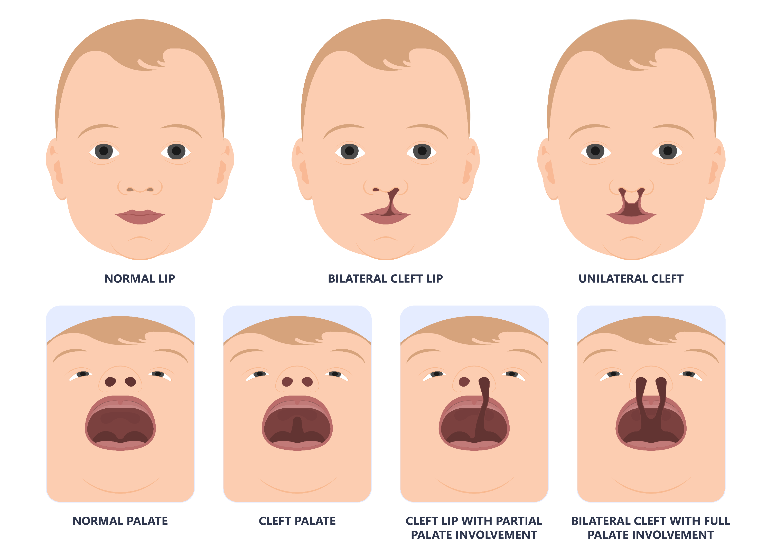
Fetal Risks Associated With Mycophenolate Use During Pregnancy: Cleft Palate
www.cdc.gov/ncbddd/birthdefects/cleftlip.html.

Slide 22
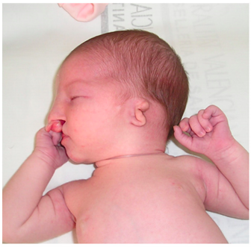
Fetal Risks Associated With Mycophenolate Use During Pregnancy: External Ear Abnormality
Perez-Aytes. Eur J Med Genet. 2017;60:16.

Slide 23
Patient Case: Lisa
Lisa: 26-yr-old woman, diagnosed with systemic lupus erythematosus as a teenager
Meeting with her rheumatologist as her lupus has flared even with steroids
  What are her options?

Slide 24

Pregnancy Loss and Birth Defects Associated With Mycophenolate During Pregnancy
Females of reproductive potential include girls who have entered puberty and all women who have a uterus and ovaries and have not passed through menopause
  Educate women of reproductive potential about increased risk of first trimester pregnancy loss and birth defects
  (eg, cleft palate and lip, external ear, and abnormalities of esophagus, eye, distal limbs, heart, kidney, and nervous system)
www.mycophenolaterems.com

Slide 25
Pregnancy Loss and Birth Defects Associated With Mycophenolate During Pregnancy: Patient Education
Refer to medication Prescribing Information, Section 8: Use in Special Populations, for most recent data on risk of pregnancy loss and congenital malformations
Provide patient education about pregnancy prevention and planning during mycophenolate treatment; discuss acceptable methods of contraception and appropriate duration of contraception
Advise patients to let providers know if they are considering pregnancy
www.mycophenolaterems.com

Slide 26

Mycophenolate REMS: Patient Counseling Materials
Educate patients about mycophenolate pregnancy risks and counsel patients on contraception and pregnancy planning
Provide treatment options for patients who are considering pregnancy
Provide immunosuppressive efficacies and safety profiles of available therapies
  Educational resources available through Mycophenolate REMS
  For Prescribers: Healthcare Provider Brochure
  For Patients: Patient Information Brochure: What You Need to Know About Mycophenolate
www.mycophenolaterems.com

Slide 27

Faculty Discussion
Discuss at every visit!
  Ask about adherence with therapy and contraception
  Ask about family planning
Patient perspective
  Navigating REMS programs
  Prescription refills
  Monitoring and follow-up visits

Slide 28
Navigating Family Planning With
Mycophenolate Treatment
Notes:
Adverse pregnancy outcomes associated with mycophenolate use during pregnancy
First-trimester pregnancy loss
Birth defects, eg, cleft palate and lip, external ear, and abnormalities of the esophagus, eye, distal limbs, heart, kidney, and nervous system
Use of MREMS Patient Counseling Materials to educate patients about mycophenolate pregnancy risks and counsel patients on contraception and pregnancy planning
Treatment options for patients who are considering pregnancy
Immunosuppressive efficacies and safety profiles of available therapies
HCP and patient educational resources available through the MREMS

Slide 29
Patient Case: Lisa (cont’d)
Lisa and her rheumatologist meet for a follow-up visit after starting mycophenolate for lupus management
Lisa tells her doctor that she is feeling very well with no lupus flares and would like to start a family

Slide 30







Contraception Counseling and Acceptable Contraceptive Methods
Acceptable Birth Control Options
Talk with your doctor and pick from the following birth control options during treatment with mycophenolate.
Counsel patients to let
HCPs know when they are considering pregnancy
Acceptable birth control is required if sexually active with a man for:
  Entire treatment course with mycophenolate
  6 wk AFTER stopping mycophenolate
A | Option1: Use Method Alone (pick one item from A) Most effective: Less than 1 pregnancy per 100 women in 1 yr
B | Option 2: Use Hormone Barrier (pick one from B and one from C1 or C2 shown below) 4-7 pregnancies per 100 women in 1 yr
C | Option 3: Use 2 Barriers (pick one from C1 and one from C2) Least effective: 13 or more pregnancies per 100 women in 1 yr
 | 1
 | 2
Intrauterine device (IUD)
Tubal sterilization
Vasectomy
Progesterone
only injection
Birth control
pill
Birth control (progesterone) patch
Vaginal ring
Progesterone
implant
Internal condom
External condom
Diaphragm with spermicide
Birth control sponge
Cervical cap
with spermicide
www.mycophenolaterems.com

Slide 31
Emergency Contraception: Oral Options
Oral EC options approved in the United States work by preventing ovulation if taken prior to LH peak; they will NOT prevent implantation
Levonorgestrel (LNG) 1.5 mg
Ulipristal (UPA) 30 mg
Effective until LH surge begins
Approved for use up to 72 hr after unprotected intercourse
Data for off-label use up to 120 hr after unprotected intercourse
Available over-the-counter without a prescription and without regard to age
Pregnancy risk: 1.7-2.6%, 5.8% if BMI ≥30
Effective until the LH peak
Use up to 120 hr after unprotected intercourse
Do NOT use with progestin contraceptives as UPA action may be decreased
Requires a prescription
Pregnancy risk: 1.2-1.8%, 2.6% if BMI ≥30
Glasier. Lancet. 2010;375:555. Shen. Cochrane Database Syst Rev. 2019;CD001324. Glasier. Contraception. 2011;84:363.
Notes:
LH, luteinizing hormone;

Slide 32
Emergency Contraception: Intrauterine Options
Best data support use up to 5 days after unprotected intercourse but may be effective at any time when urine pregnancy test is negative
Highly effective regardless of BMI and when used at any time within the menstrual cycle
Copper
Levonorgestrel 52 mg
Pregnancy risk: 0.0-0.1%
Pregnancy risk: 0.3%
Cleland. Hum Reprod. 2012;27:1994. Turok. NEJM. 2021;384:335. Turok. Hum Reprod. 2013;28:2672. Thompson. Contraception. 2019;100:219. Boraas. Obstet Gynecol. 2021. 137:623.
Notes:
EC: emergency contraception; LH, luteinizing hormone;

Slide 33
Birth Control Options
One method:
  IUD
  Sterilization surgery
  Partner has vasectomy
Acceptable Birth Control Options
Talk with your doctor and pick from the following birth control options during treatment with mycophenolate.
A | Option1: Use Method Alone (pick one item from A) Most effective: Less than 1 pregnancy per 100 women in 1 yr
B | Option 2: Use Hormone Barrier (pick one from B and one from C1 or C2 shown below) 4-7 pregnancies per 100 women in 1 yr
C | Option 3: Use 2 Barriers (pick one from C1 and one from C2) Least effective: 13 or more pregnancies per 100 women in 1 yr
 | 1
 | 2
Intrauterine device (IUD)
Tubal sterilization
Vasectomy
Progesterone
only injection
Birth control
pill
Birth control (progesterone) patch
Vaginal ring
Progesterone
implant
Internal condom
External condom
Diaphragm with spermicide
Birth control sponge
Cervical cap
with spermicide
www.mycophenolaterems.com

Slide 34
Birth Control Options
Acceptable Birth Control Options
Talk with your doctor and pick from the following birth control options during treatment with mycophenolate.
2 methods:
  1 hormone and
  1 barrier
  2 barriers
Why 2 methods?
  Mycophenolate reduces hormone levels in hormone-based birth control
A | Option1: Use Method Alone (pick one item from A) Most effective: Less than 1 pregnancy per 100 women in 1 yr
B | Option 2: Use Hormone Barrier (pick one from B and one from C1 or C2 shown below) 4-7 pregnancies per 100 women in 1 yr
C | Option 3: Use 2 Barriers (pick one from C1 and one from C2) Least effective: 13 or more pregnancies per 100 women in 1 yr
 | 1
 | 2
Intrauterine device (IUD)
Tubal sterilization
Vasectomy
Progesterone
only injection
Birth control
pill
Birth control (progesterone) patch
Vaginal ring
Progesterone
implant
Internal condom
External condom
Diaphragm with spermicide
Birth control sponge
Cervical cap
with spermicide
www.mycophenolaterems.com. www.fda.gov/media/86233/download#:~:text=Patients%20should%20be%20aware%20that,the%20availability%20of%20emergency%20contraception

Slide 35
Special Considerations
Women who have high risk
of thrombotic events
Women who have high risk
of osteoporosis
Women who have high risk
of flaring underlying disease*
Avoid estrogen-containing contraception and DMPA
Avoid DMPA
Avoid estrogen-containing
contraception
*Many patients with SLE have antiphospholipid antibodies. Estrogen-containing contraception is only appropriate for those with low lupus disease activity and no antiphospholipid antibodies. In addition, because of the decreased efficacy of hormone-based birth control because of mycophenolate, other methods of birth control, such as IUD, should be considered.
Sammaritano. 2020 American College of Rheumatology Guideline for the Management of Reproductive Health in Rheumatic and Musculoskeletal Diseases. Arthritis Rheumatol. 2020;72:529.
Notes:
DMPA, depo-medroxyprogesterone acetate; IUD, intrauterine device; SLE, systemic lupus erythematosus.

Slide 36

Confirming Menopause
Menopause should be clinically confirmed by a healthcare professional
Menopause defined as the permanent end of menstruation and fertility
  12 mo of spontaneous amenorrhea
  (not induced by a medical condition or medical therapy)
  Post surgical from bilateral oophorectomy
  Elevated FSH and LH
www.mycophenolaterems.com/Resources/Docs/PrescriberProgramBrochure.pdf
Notes:
FSH, follicle-stimulating hormone; LH, luteinizing hormone.

Slide 37
Monitoring Pregnancy
One pregnancy test with a sensitivity of at least 25 mIU/mL should be done immediately before starting mycophenolate
Another pregnancy test with the same sensitivity should be done
8-10 days later
Repeat pregnancy tests should be performed at routine follow-up visits
Results of all pregnancy tests should be discussed with the patient
www.mycophenolaterems.com

Slide 38

Patients Who Want to Get Pregnant
Counsel patients on mycophenolate to notify HCPs if they would like to become pregnant
Determine whether there are appropriate treatment options with less potential for embryofetal toxicity
Refer patients for preconception counseling and high-risk obstetrical care as needed with OB (consider Maternal Fetal Medicine or Fertility specialist)
Coordinate care among the patient’s established providers
www.mycophenolaterems.com

Slide 39
2020 ACR Guideline: Medications Use Before and During Pregnancy, and
During Breastfeeding
Maternal medication use: overview of medication use before and during pregnancy, and during breastfeeding
Medication | Preconception | During Pregnancy | Breastfeeding
Convention Medications
Hydroxychloroquine | ++ | ++ | ++
Sulfasalazine | ++ | ++ | ++
Colchicine | ++ | ++ | ++
Azathioprine, 6-mercaptopurine | ++ | ++ | + Low transfer
Prednisone | + Taper to <20 mg/day by adding pregnancy-compatible immunosuppressants | + Taper to <20 mg/day by adding pregnancy-compatible immunosuppressants | + After a dose of >20 mg, delay breastfeeding for 4 hr
Cyclosporine, tacrolimus | + Monitor blood pressure | + Monitor blood pressure | + Low transfer
Nonsteroidal anti-inflammatory drugs (cyclooxygenase 2 inhibitors not preferred) | + Discontinue if the woman is having difficulty conceiving | + Continue in first and second trimesters: discontinue in third trimester | + Ibuprofen preferred
Tumor necrosis factor inhibitors (tumor necrosis factor inhibitors are considered compatible with pregnancy)
Certolizumab | ++ | ++ | ++
Infliximab, etanercept, adalimumab, golimumab | + Continue through conception | + Continue in first and second trimester; discontinue in third trimester several half-lives prior to delivery | ++
Rituximab | + Discontinue through conception | + Life-/organ-threatening disease | ++
Other biologics (limited safety data; limited transfer in early pregnancy but high transfer in second half of pregnancy)
Anakinra, belimumab, abatacept, tocilizumab, secukinumab, ustekinumab | + Discontinue at conception | + Discontinue during pregnancy | + Expect minimal transfer due to large molecular size, but no available data
Not compatible with pregnancy
Methotrexate | XX Stop 1-3 mo prior to conception | XX Stop and give folic acid 5 mg/day | X Limited data suggest how transfer
Leflunomide | XX Cholestyramine washout if detectable levels | XX Stop and give cholestyramine | XX
Mycophenolate mofetil and mycophenolic acid | XX Stop >6 wk prior to conception | XX | XX
Cyclophosphamide | XX Stop 3 mo prior to conception | + Life-/organ-threatening disease in second and third trimesters | XX
Thalidomide | XX Stop 1-3 mo prior to conception | XX | XX
Tofacitinib, apremilast, baricitinib | Unable to determine due to lack of data; small molecular size suggests transfer across the placenta and into breast milk
++ Strongly recommended
+ Conditionally recommend
X Conditionally recommend against
XX Strongly recommend against
Sammaritano. Arthritis Rheumatol. 2020;72:529.
Notes:
ACR, American College of Rheumatology

Slide 40
Safe Alternatives
Medication | Pre-conception | During pregnancy | Breastfeeding
Convention Medications
Hydroxychloroquine | ++ | ++ | ++
Sulfasalazine | ++ | ++ | ++
Colchicine | ++ | ++ | ++
Azathioprine, 6-mercaptopurine | ++ | ++ | + Low transfer
Prednisone | + Taper to <20 mg/day by adding pregnancy-compatible immunosuppressants | + Taper to <20 mg/day by adding pregnancy-compatible immunosuppressants | + After a dose of >20 mg, delay breastfeeding for 4 hr
Cyclosporine, tacrolimus | + Monitor blood pressure | + Monitor blood pressure | + Low transfer
Nonsteroidal anti-inflammatory drugs (cyclooxygenase 2 inhibitors not preferred) | + Discontinue if the woman is having difficulty conceiving | + Continue in 1st and 2nd trimesters: discontinue in 3rd trimester | + Ibuprofen preferred
Tumor necrosis factor inhibitors (tumor necrosis factor inhibitors are considered compatible with pregnancy)
Certolizumab | ++ | ++ | ++
++ Strongly recommended
+ Conditionally recommend
X Conditionally recommend against
XX Strongly recommend against
Sammaritano. Arthritis Rheumatol. 2020;72:529.

Slide 41
Medications to Discontinue at Conception and to AVOID
Medication | Pre-conception | During pregnancy | Breastfeeding
Other biologics (limited safety data; limited transfer in early pregnancy but high transfer in second half of pregnancy)
Anakinra, belimumab, abatacept, tocilizumab, secukinumab, ustekinumab | + Discontinue at conception | + Discontinue during pregnancy | + Expect minimal transfer due to large molecular size, but no available data
Not compatible with pregnancy
Methotrexate | XX Stop 1-3 mo prior to conception | XX Stop and give folic acid 5 mg/day | X Limited data suggest how transfer
Leflunomide | XX Cholestyramine washed if detectable levels | XX Stop and give cholestyramine | XX
Mycophenolate mofetil and mycophenolic acid | XX Stop >6 wk prior to conception | XX | XX
Cyclophosphamide | XX Stop 3 mo prior to conception | + Life-/organ-threatening disease in second and third trimesters | XX
Thalidomide | XX Stop 1-3 mo prior to conception | XX | XX
Tofacitinib, apremilast, baricitinib | Unable to determine due to lack of data; small molecular size suggests transfer across the placenta and into breast milk
++ Strongly recommended
+ Conditionally recommend
X Conditionally recommend against
XX Strongly recommend against
Sammaritano. Arthritis Rheumatol. 2020;72:529.

Slide 42
Positive Pregnancy Test: Counseling Our Patients
If there is a risk of maternal mortality after stopping mycophenolate, one can consider continuing mycophenolate
Attempt to find an acceptable alternative so that you can stop mycophenolate
Discuss with the patient the potential hazards to the fetus
  In certain situations, HCP and patient may decide the benefits of mycophenolate therapy outweigh the risks to the fetus
Consider referral to Maternal Fetal Medicine for further counseling
www.mycophenolaterems.com

Slide 43
Faculty Discussion
What to do in the case of an unplanned pregnancy
  Communicate with providers: prescriber and OB/GYN maternal fetal medicine
  Enroll in Mycophenolate REMs Registry and report the pregnancy

Slide 44
A Collaborative Approach to
Caring for Mom and Baby
Notes:
Strategies for coordinating care among rheumatologist, OB/GYN, and other HCPs involved in the patient’s care
How and when to report pregnancies that occur during mycophenolate treatment to the Mycophenolate Pregnancy Registry
HCP and patient educational resources available through the MREMS, as well as the BU and CCO websites

Slide 45
Patient Case: Lisa (cont’d)
As per her rheumatologist’s recommendation, Lisa stopped taking mycophenolate mofetil and starting taking azathioprine
Lisa’s rheumatologist also referred her to an OB/GYN maternal fetal medicine specialist for preconception counseling and high-risk obstetrical care
Lisa has been receiving azathioprine for 4 wk at the time of her appointment
  She is feeling well with no lupus flares

Slide 46
Faculty Discussion
Strategies for coordinating care among care team
  Rheumatologist
  OB/GYN or maternal-fetal medicine
  NPs/PAs and nursing
  Pharmacists

Slide 47


Mycophenolate Pregnancy Registry
Report any pregnancy during mycophenolate treatment or
within 6 wk following discontinuation of treatment to the Mycophenolate Pregnancy Registry
  Inform patient that you may report pregnancies to the Mycophenolate Pregnancy Registry
  Encourage them to participate in the registry
  Reports are covered by HIPAA
Online
www.MycophenolatePregnancyRegistry.com
By Phone
1-800-617-8191

Slide 48
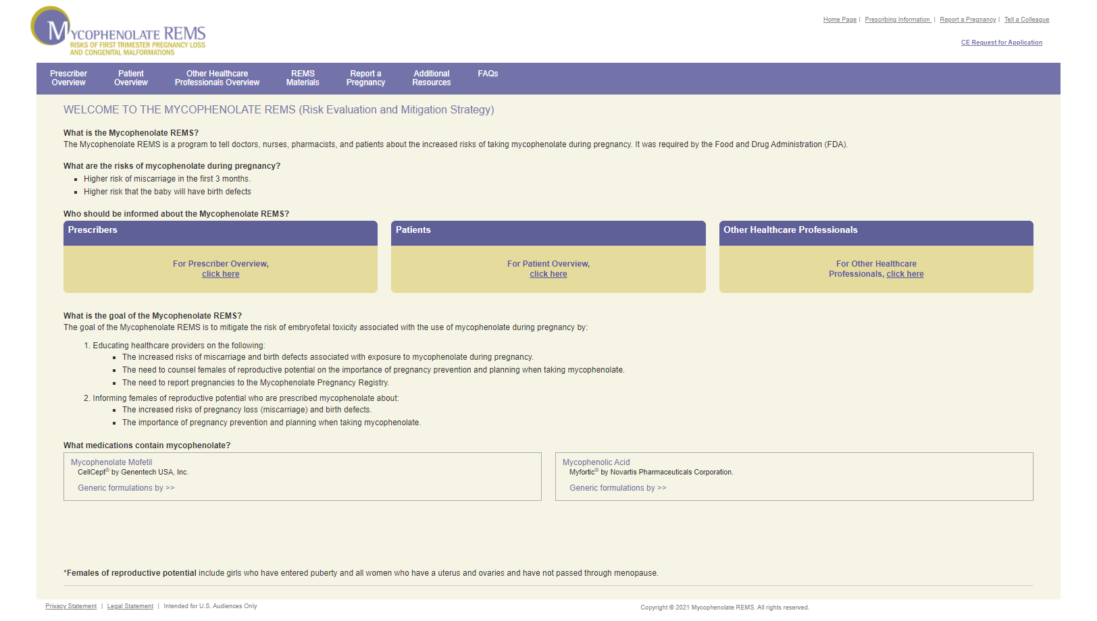
Additional HCP and Patient Educational Resources
Mycophenolate REMS: www.mycophenolaterems.com/#Main
Prescribers: complete online training, obtain patient signatures on patient prescriber acknowledgment form, and voluntarily report mycophenolate pregnancy exposures to the MPA Pregnancy Registry
www.mycophenolaterems.com

Slide 49
Go Online for More CCO
Coverage of a Patient-Centered Approach to Mycophenolate Risk Mitigation!
A downloadable PDF infographic communication guide about sharing family planning decision-making with patients who are prescribed mycophenolate
A downloadable PDF infographic handout for patient education on the topic, available in
5 languages (English, Chinese, French, Spanish, and Vietnamese)
An animated patient counseling video available in English and Spanish
Additional downloadable slideset with slidenotes of expert faculty commentary
clinicaloptions.com/activities/allergy-and-immunology

