Slide 1
Expanding Our Understanding of HER3 Expression, Implications, and Rationale for HER3-Targeted Therapy in Solid Tumors
Provided by Clinical Care Options, LLC
Misako Nagasaka, MD, PhD
Associate Clinical Professor
Division of Hematology/Oncology, Department of Medicine
University of California Irvine School of Medicine
Irvine, California
Supported by an educational grant from Daiichi Sankyo, Inc.

Slide 2

About These Slides
Please feel free to use and share some or all of these slides in your noncommercial presentations to colleagues or patients
When using our slides, please retain the source attribution:
These slides may not be published, posted online, or used in commercial presentations without permission. Please contact permissions@clinicaloptions.com for details
Slide credit: clinicaloptions.com
Notes:
Disclaimer: The materials published on the Clinical Care Options Web site reflect the views of the authors of the CCO material, not those of Clinical Care Options, LLC, the CME providers, or the companies providing educational grants. The materials may discuss uses and dosages for therapeutic products that have not been approved by the United States Food and Drug Administration. A qualified healthcare professional should be consulted before using any therapeutic product discussed. Readers should verify all information and data before treating patients or using any therapies described in these materials.

Slide 3
Disclosures
Misako Nagasaka, MD, PhD: consultant/advisor/speaker: AnHeart Therapeutics, AstraZeneca, Blueprint Medicine, Caris Life Sciences, Daiichi Sankyo, EMD Serono, Genentech, Janssen, Lilly, Mirati, Novartis, Pfizer, Regeneron, Takeda.

Slide 4
HER3: Biology and Role in Oncogenesis
EGFR/HER3
NRG
HER2/HER3
HER3 is a member of the ERBB/HER protein kinase family
  Widely expressed in epithelial, mesenchymal, and neuronal cells
HER3 itself has weak tyrosine kinase activity, but heterodimerizes with other RTKs to activate oncogenic signaling
  Most strongly, PI3K/AKT/mTOR pathway
  Also, MAPK, JAK, and SRC pathways
HER3/HER2 is the most potent heterodimer
  HER2-dependent breast cancers likely rely on HER3 to drive oncogenic signaling
P
P
p85
P
P
GRB2
JAK
SRC
P13K
p110β
SOS
GDP
GDP
RAS
RAS
STAT
AKT
RAF
MEK
P
ERK
P
Cell division, proliferation, differentiation, angiogenesis, and tumor progression
Uliano. ESMO Open. 2023;8:100790. Lyu. Acta Pharm Sin B. 2018;8:503. Mishra. Oncol Rev. 2018;12:355.
Notes:
RTK, receptor tyrosine kinase.

Slide 5
HER3 and Neuregulins
NRG1 ligand
Neuregulins 1 and 2 are the primary activating ligands for HER3, promoting heterodimerization with HER2 or EGFR and leading to oncogenic signaling
NRG1 gene fusions result in aberrant expression of the NRG1 ligand on the cell surface, leading to pathologic activation of downstream signaling
NRG1 fusions are rare, but found in multiple solid tumors:
  Colorectal cancer
  Pancreatic ductal adenocarcinoma
  Lung adenocarcinoma
  Cholangiocarcinoma
  Ovarian cancer
  Sarcoma
EGFR-
HER3
HER2-
HER3
NRG1 fusion protein
JAK
PI3K
PTEN
STAT
AKT
mTOR
BIM
Apoptosis
↑ transcription, ↑ protein synthesis, ↑ proliferation
Laskin. Ann Oncol. 2020;31:1693. Werr. Mol Cancer Ther. 2022;21:821. Schram. ASCO 2022. Abstr 105. Uliano. ESMO Open. 2023;8:100790.

Slide 6
HER3 Expression Across Cancer Types
HER3 is expressed ubiquitously in multiple solid tumors, with frequency of overexpression varying by tumor type
Oncogenic HER3 signaling has particularly been investigated in lung, breast, prostate, ovarian, pancreatic, and colorectal cancers
HER3 Expression Levels by IHC (Total N = 1367)
50
TPS ≥ 1
TPS ≥ 10
TPS ≥ 20
TPS ≥ 50
40
30
Patients (%)
20
10
0
Colorectal
Bladder
Stomach
Liver
Breast
Biliary tract
Esophageal
Ovarian
Prostate
Lung
Cervical
Pancreas
Thyroid
Renal cell
Endometrial
Head and neck
Uliano. ESMO Open. 2023;8:100790. Shin. ASCO 2023. Abstr 3135. Lyu. Acta Pharm Sin B. 2018;8:503.

Slide 7
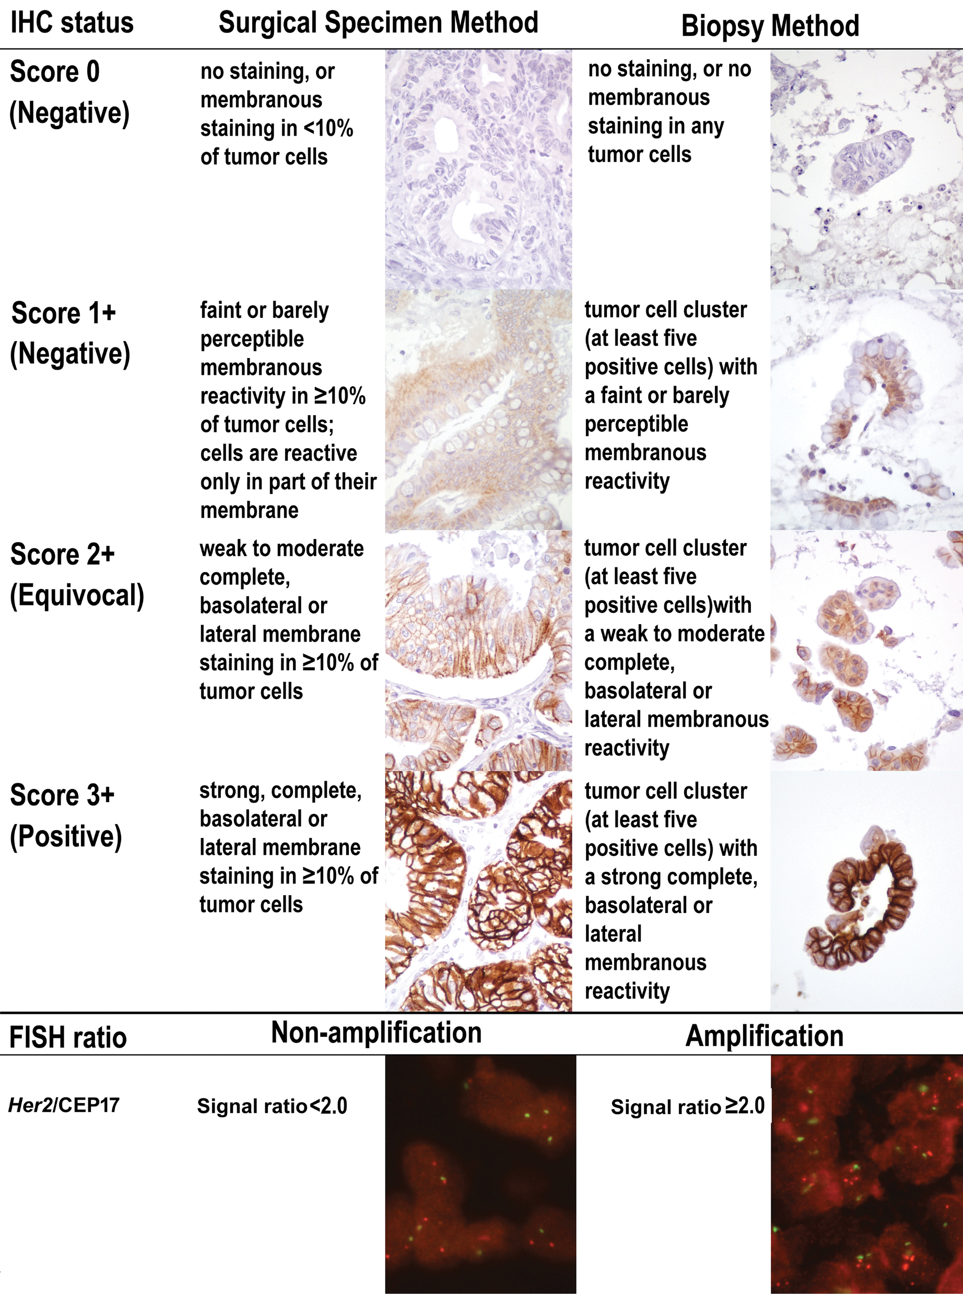
Assessment of HER3 Expression
0 | Completely negative staining or faint staining in < 10% of tumor cells
1+ | Faint or incomplete staining in >10% of tumor cells
2+ | Weak-to-moderate staining in >10% of tumor cells
3+ | Strong staining in >10% of tumor cells
HER3 expression level is typically determined using IHC (similar to HER2)
Definition of expression levels is not standardized and varies somewhat between tumor types
Clinical trials may quantitate using H-score rather than categorical grouping
HER3 testing is not currently recommended
Clinical trials of HER3-targeted agents vary in HER3 expression thresholds used as inclusion criteria
Low/Negative
High/Positive
Jänne. ASCO 2019. Abstr 9010. Li. Oncotarget. 2017;8:67140. Ye. Scientific Reports. 2022;12:12894. Images from Chao. PLoS ONE;2015:e0142135, under terms and conditions of the Creative Commons Attribution 4.0 International license (CC BY 4.0: https://creativecommons.org/licenses/by/4.0/).

Slide 8
Impact of HER3 Overexpression on Outcomes is Unclear
Combined meta-analysis across tumor types suggests a slight negative effect of HER3 overexpression on outcomes, although individual studies rarely show significance
Impact of HER3 Overexpression on 5-yr Survival
Disease Site or Study
Weight (%)
Odds Ratio [95% CI]
Breast Cancer
Spears (2011)
Witton (2003)
Colorectal Cancer
Baiocchi (2009)
Beji (2012)
Kountourakis (2006)
Gastric Cancer
Hayashi (2008)
Begnami (2011)
Other Cancers
Hirakawa (2011)
Lee (2005)
Reschke (2008)
Takikita (2011)
Tanner (2006)
Total
Test for overall effect: Z = 6.82 (P < 0.001)
10.8
10.8
16.9
2.5
6.4
4.7
12.9
6.5
7.5
3.7
10.0
7.3
100.0
4.00 [2.17 to 7.38]
1.78 [0.89 to 3.58]
0.34 [0.15 to 0.79]
5.61 [1.57 to 20.11]
1.19 [0.43 to 3.31]
5.80 [2.50 to 13.44]
1.97 [1.03 to 3.75]
2.04 [0.82 to 5.07]
2.18 [0.97 to 4.90]
3.58 [1.15 to 11.14]
1.73 [0.80 to 3.73]
2.36 [1.05 to 5.28]
2.20 [1.75 to 2.76]
0.01
0.1
1
10
100
Favors HER 3-high
Favors HER 3-low
Ocana. JNCI. 2012;105:266.

Slide 9
Proposed Role of HER3 in EGFR TKI Resistance
Acquired resistance to EGFR TKI therapy is frequently seen in NSCLC
Studies in cell culture suggest negative feedback from decreased AKT signaling leads to increased HER3 phosphorylation and reactivation of the PI3K pathway
Amplification of MET may be one contributing feedback mechanism
Pathogenic Signaling
EGFR-Targeted Therapy
Escape Mechanism
MET
EGFR
HER3
X
X
p85
p85
P
P
P
P
PI3K
p110
p85
PI3K
p110
EGFR TKI
PI3K
p110
EGFR TKI
Akt
Akt
Arteaga. Nat Med. 2007;13:675. Engelman. Science. 2007;316:1039. Sergina. Nature. 2007;445:437.

Slide 10
EGFR Inhibition Increases HER3 Activity in
Colon Cancer Cells
HER3 Phosphorylation Increases
Following EGFR Inhibition
HER3 Dimerization and HER3-PI3K Binding Increases Following EGFR Inhibition
LIM1215
Control
Cetuximab
P-EGFR
EGFR
HER3-PI3K
1.5
8
200
300
1.0
6
150
200
4
100
Fold Change
CU/μg
CU/μg
CU/μg
0.5
2
50
100
0.0
0
0
0
Reference Spots
P-EGFR
P-HER2
P-HER3
Cetuximab
Cetuximab
Cetuximab
Control
Control
Control
HCA7
Control
Cetuximab
HER2:HER3
EGFR:HER2
EGFR:HER3
1.5
1500
250
800
200
600
1.0
1000
150
Fold Change
CU/μg
400
CU/μg
100
CU/μg
0.5
500
200
50
0.0
0
0
0
Reference Spots
P-EGFR
P-HER2
P-HER3
Cetuximab
Cetuximab
Cetuximab
Control
Control
Control
Bosch-Vilaro. Oncotarget. 2017;8:4277.

Slide 11
HER3 is Involved in Treatment Resistance in Breast Cancer Cells
shRNA knockdown of HER3 restores ability of paclitaxel to inhibit MAPK and AKT signaling and induce apoptosis in resistant breast cancer cells
siRNA knockdown of HER3 restores ability of lapatinib (dual EGFR/HER2 TKI) to inhibit PI3K signaling in resistant HER2-overexpressing breast cancer cells
Apoptosis in Paclitaxel-Resistant Breast Cancer Cells
Inhibition of Cell Growth in
Lapatinib-Resistant Breast Cancer Cells
1.2
P = 0.003
35
rSKBR3
35
rBT474
1.0
P<0.017
0.8
P = 0.005
30
P<0.013
30
Apoptosis
(OD @ 405 mm)
25
25
0.6
0.4
20
20
Cell Growth Inhibition (%)
0.2
15
15
0
10
10
Paclitaxel
-
+
-
+
-
+
5
5
shRNA
-
Control
erbB3
0
0
MDA-435
435.eB1
NSC
siHER3
NSC
siHER3
Xia. Breast Cancer Res. 2013;15:R85. Wang. Oncogene. 2010;29:4225.
Notes:
NSC, nonspecific siRNA control; siRNA, short interfering RNA, shRNA, short hairpin RNA

Slide 12
HER3 Expression Increases With Acquired EGFR TKI Resistance in Patients with NSCLC
HER3 Expression in Tumor Samples Before and After EGFR Treatment Leading to Resistance (N = 48)
P = .0007
*
300
Pre treatment
Post treatment
300
200
200
IHC H-Score
HER3 H-Score
100
100
0
0
 | Pre | Post
Mean H-score | 100.8 | 155.9
Transcriptome analysis showed increase in HER3 associated with PI3K/AKT/mTOR signaling
Yonesaka. Clin Cancer Res. 2022;28:390.
Notes:
IHC, immunohistochemistry; TKI, tyrosine kinase inhibitor.

Slide 13
HER3 as a Therapeutic Target in Solid Tumors:
Key Takeaways
HER3 itself has weak tyrosine kinase activity but heterodimerizes with other RTKs to drive oncogenic signaling, primarily through the PI3K/AKT pathway
HER3 is widely expressed in multiple solid tumor types, including lung, breast, prostate, ovarian, pancreatic, and colorectal cancers
HER3 is hypothesized to play a role in a negative feedback cycle restoring PI3K/AKT signaling following EGFR inhibition
  Several cancer cell models support an essential role for HER3 in resistance to EGFR inhibition
  HER3 expression increases with acquired EGFR TKI resistance in paired tumor samples from patients with NSCLC
HER3 may be a beneficial therapeutic target in multiple solid tumors, particularly in acquired resistance settings

Slide 14
Go Online for More CCO Coverage of Targeted Cancer Therapies!
CME-certified microlearning text module associated with this downloadable slideset
ClinicalThought expert commentary and informative podcast featuring cross-specialty conversations between experts in breast and other solid tumor types
clinicaloptions.com

