Slide 1
Protection Beyond Outbreaks: Routine Mpox Vaccination for Vulnerable Populations
Provided by Clinical Care Options, LLC
Supported by an educational grant from Bavarian Nordic A/S.

Slide 2

About These Slides
Please feel free to use and share some or all of these slides in your noncommercial presentations to colleagues or patients
When using our slides, please retain the source attribution:
These slides may not be published, posted online, or used in commercial presentations without permission. Please contact permissions@clinicaloptions.com for details
Slide credit: clinicaloptions.com
Notes:
Disclaimer: The materials published on the Clinical Care Options website reflect the views of the authors of the CCO material, not those of Clinical Care Options, LLC, the CME providers, or the companies providing educational grants. The materials may discuss uses and dosages for therapeutic products that have not been approved by the United States Food and Drug Administration. A qualified healthcare professional should be consulted before using any therapeutic product discussed. Readers should verify all information and data before treating patients or using any therapies described in these materials.

Slide 3
Faculty
Carlos del Rio, MD
Distinguished Professor of Medicine (Infectious Diseases)
Emory University School of Medicine
Professor of Global Health and Epidemiology
Rollins School of Public Health
Atlanta, Georgia
Aniruddha (Anu) Hazra, MD (he/him)
Assistant Professor of Medicine,
Section of Infectious Disease and
Global Health
Director, Infectious Diseases
Fellowship Program
Medical Director,
UCM Sexual Wellness Clinic
University of Chicago
Chicago, Illinois
Notes:
This slide lists the faculty who were involved in the production of these slides.

Slide 4
Disclosures
The faculty reported the following relevant financial relationships or relationships to products or devices they have with ineligible companies related to the content of this educational activity:
Carlos del Rio, MD: consultant/advisor/speaker: Roche Diagnostics.
Aniruddha (Anu) Hazra, MD: consultant/advisor/speaker: Abbott Technologies, Gilead, ViiV; researcher: Gilead.
Notes:
This slide lists the disclosure information of the faculty and staff involved in the development of these slides.

Slide 5
Learning Objectives
Describe the burden of mpox and appropriately identify patients at high risk for infection
Implement ACIP recommendations for the routine use of mpox vaccination in eligible patients
Employ strategies to overcome barriers to mpox vaccination uptake such as vaccine hesitancy
Notes:
ACIP, Advisory Committee on Immunization Practices.
Disclaimer: The materials published on the Clinical Care Options Web site reflect the views of the authors of the CCO material, not those of Clinical Care Options, LLC, the CME providers, or the companies providing educational grants. The materials may discuss uses and dosages for therapeutic products that have not been approved by the United States Food and Drug Administration. A qualified healthcare professional should be consulted before using any therapeutic product discussed. Readers should verify all information and data before treating patients or using any therapies described in these materials.

Slide 6
What is mpox?

Slide 7
Mpox Classic Clinical Manifestations
Orthopoxvirus in Poxviridae family
  Same genus as variola virus (causes smallpox), vaccinia virus (used in
  smallpox vaccine), and cowpox virus
Incubation: 5-13 days
(range 3-17 days)
Illness: 2-4 wk
  Infectious from prodrome until scabs fall off and fresh layer of skin forms
Clinical presentation similar to smallpox
Prodrome: fever, malaise, headache, weakness, lymphadenopathy
Rash: appears shortly after prodrome
  Typically lesions develop simultaneously and evolve together
  Well-circumscribed, deep seated
  with umbilication, painful
  When disseminated, often centrifugal: arms, legs, hands, feet; can involve palms and soles
  4 stages (macular, papular, vesicular, pustular) before scabbing
who.int/news-room/fact-sheets/detail/monkeypox. cdc.gov/poxvirus/mpox/symptoms/index.html.

Slide 8
Mpox Symptoms in 2022-2024 Outbreak: Men
N = 34,350 cases with ≥1 symptom reported in country with ≥2 unique symptoms
Any rash
Fever
Systemic rash
Genital rash
Any lymphadenopathy
Headache
Muscle ache
General lymphadenopathy
Fatigue
Local lymphadenopathy
Sore throat
Rash, unknown location
Oral rash
Chills
Cough
Vomiting
Lymphadenopathy, location unknown
Anogenital pain and/or bleeding
Other
Asymptomatic
Conjunctivitis
Diarrhea
Genital edema
90.3
58.5
54.4
50.4
30.6
28.8
26.2
23.5
18.4
16.5
Symptom
13.0
9.9
8.1
7.4
2.3
2.1
1.3
1.1
0.7
0.7
0.5
0.3
0.1
0
25
50
75
100
Proportion of cases with reported symptom, %
worldhealthorg.shinyapps.io/mpx_global.

Slide 9
Mpox Symptoms in 2022-2024 Outbreak: Women
N = 1371 cases with ≥1 symptom reported in country with ≥2 unique symptoms
Any rash
Systemic rash
Fever
Headache
Muscle ache
Genital rash
Any lymphadenopathy
Sore throat
Fatigue
General lymphadenopathy
Local lymphadenopathy
Chills
Oral rash
Cough
Vomiting
Rash, unknown location
Asymptomatic
Lymphadenopathy, location unknown
Conjunctivitis
Other
Anogenital pain and/or bleeding
Diarrhea
Genital edema
84.2
70.2
50.5
37.4
29.1
28.4
16.6
15.9
11.1
10.7
Symptom
9.6
8.8
6.1
4.2
3.8
1.7
1.2
1.0
1.0
0.4
0.4
0.1
0.0
0
25
50
75
100
Proportion of cases with reported symptom, %
worldhealthorg.shinyapps.io/mpx_global.

Slide 10
Mpox Complications: 2022-2024 Outbreak
Characteristic, n (%) | Overall May 2022 - March 2024 (N = 88,513) | Recent October 2023 - April 2024 (N = 1692)
Hospitalized (for isolation or medical treatment) | 5785 (10.9) | 123 (15.3)
ICU | 48 (0.3) | 0 (0)
Died | 144 (0.3) | 3 (0.4)
worldhealthorg.shinyapps.io/mpx_global.
Notes:
ICU, intensive care unit.

Slide 11
Who is at highest risk for mpox infection?

Slide 12
Mpox 2022-2024 Outbreak:
Most Cases Are in Men Who Have Sex With Men
Proportion of cases who are men who have sex with men
100
75
50
Percentage of Cases
25
0
Jul 2022
Jan 2023
Jul 2023
Jan 2024
Wk of Report
Proportion of cases who are male
100
75
50
Percentage of Cases
25
0
Jul 2022
Jan 2023
Jul 2023
Jan 2024
Wk of Report
worldhealthorg.shinyapps.io/mpx_global.

Slide 13
Mpox Transmission
Direct contact with infectious rash, scabs, body fluids
Respiratory secretions during prolonged, face-to-face contact or intimate physical contact (kissing, cuddling, sex)
Indirect contact with lesion material such as clothing or linens
Placenta in infected pregnant person to fetus
cdc.gov/poxvirus/mpox/if-sick/transmission.html.

Slide 14
Mpox 2022-2024 Outbreak: Transmission
Most cases reported from Americas, Europe, Australia, where mpox is not endemic
Most cases were in men (79.4% in men aged 18-44 yr)
  Up to 29% had coinfections with STIs such as chlamydia, syphilis, HSV
Characteristic, n (%) | Overall May 2022 to March 2024 (N = 88,513) | Recent October 2023 to April 2024 (N = 1692)
Men | 85,324 (96.4) | 1667 (99.0)
Men who have sex with men | 29,560 (85.5) | 1030 (96.1)
Sexual transmission | 18,419 (83.4) | 692 (95.7)
Persons living with HIV | 18,335 (51.9) | 481 (48.3)
worldhealthorg.shinyapps.io/mpx_global. Wic. Perm J. 2024;28:42.
Notes:
HSV, herpes simplex virus; STI, sexually transmitted infection.

Slide 15
Who should be considered for the mpox vaccine?

Slide 16
Available Vaccines
Smallpox Vaccine,
live-attenuated replicating vaccine¹
Smallpox vaccine made from vaccinia
~85% efficacy against mpox²
Widespread vaccination in US ended 1972, not used in current mpox outbreak
MVA-BN Smallpox and Mpox Vaccine, live-attenuated nonreplicating vaccine³
Newer smallpox vaccine; modified vaccinia
86% real-world efficacy against mpox (2 doses)⁴
FDA approved 2019
1. cdc.gov/poxvirus/mpox/interim-considerations/overview.html. 2. Fine. Int J Epidemiol. 1988;17:643.
3. Smallpox and Monkeypox Vaccine, Live, Non-replicating PI. 4. cdc.gov/mmwr/volumes/72/wr/mm7220a3.htm.

Slide 17
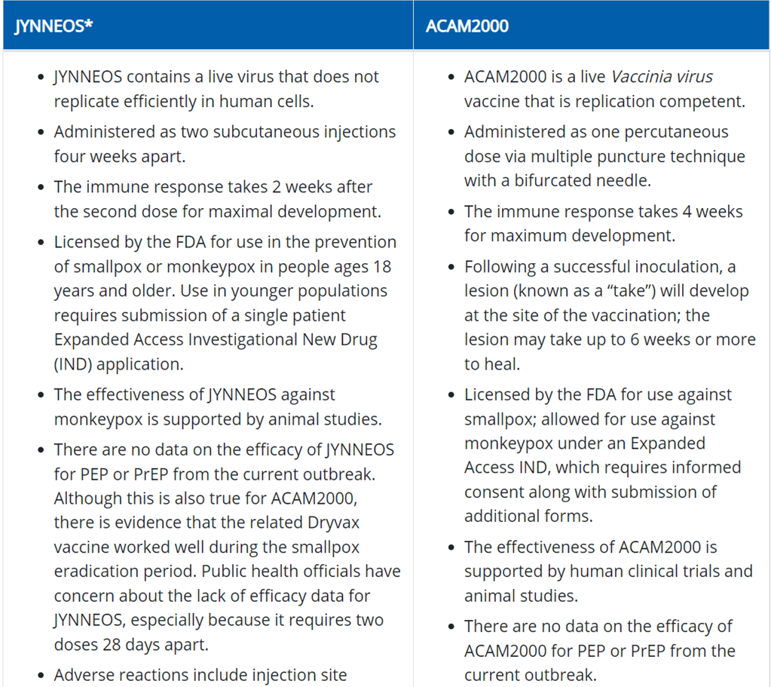
Mpox Vaccine
 | MVA-BN Smallpox and Mpox Vaccine, Live-Attenuated Nonreplicating Vaccine
Booster shots | “Booster dose is recommended Q2Y for people with high-virulent orthopoxvirus, and Q10Y for those in contact with low-virulent strains”
Time to immunity development | 2 wk after second dose
Contraindications | History of atopic dermatitis, allergy to one of the vaccine components
Adverse events | Local: pain, redness, swelling, itching, hyperpigmentation, skin discoloration Systemic: fatigue, headache, myalgias, nausea, chills, fever
Meo. Vaccines (Basel). 2022;10:1971.

Slide 18
Mpox Vaccine: Intradermal vs SC Injection
August 2022: To increase vaccine access, the FDA issued an EUA for the intradermal injection of MVA-BN vaccine
Standard Administration:
SC
Alternative Administration:
Intradermal
Injection volume: 0.5 mL
Injection volume: 0.1 mL
Increased number of doses by
5-fold
Lower intradermal dose immunologically noninferior to standard SC dose
  cdc.gov/poxvirus/mpox/files/interim-considerations/guidance-jynneos-prep-admin-alt-dosing.pdf.
  Brooks. NEJM. 2022;387:1151.

Slide 19
Summary of Mpox Vaccine Dosing Regimens by Age
Recommendation by Age | Route of Administration | Injection Volume | Recommended No. of Doses | Recommended Interval Between First and Second Dose
Standard regimen ≥18 yr <18 yr | SC SC | 0.5 0.5 | 2 2 | 28 days (4 wk) 28 days (4 wk)
Alternative regimen ≥18 yr | Intradermal | 0.1 | 2 | 28 days (4 wk)
Infants <6 mo: vaccinia immune globulin IV should be considered in lieu of vaccine
Dosing routes of administration are interchangeable
ACIP’s general best practices on dosing intervals
  Minimal interval: 4 days before minimal interval of 28 days
  Maximum interval: administer ASAP; no need to restart or add doses to series if dosing interval extended
cdc.gov/poxvirus/mpox/interim-considerations/overview.html#anchor_1660077319531.
Notes:
ACIP, Advisory Committee on Immunization Practices.

Slide 20
Coadministration With Other Vaccines
May be administered without regard to timing of most other vaccines, including simultaneous administration
  Administer at different anatomic sites, if possible
Additional considerations with COVID-19 vaccine:
  For most patients: No required minimum interval between vaccines
  For adolescent or young adult males: Consider waiting 4 wk between vaccines (hypothetical risk based on prior observed risk of myocarditis and pericarditis after receipt of smallpox vaccine and COVID-19 vaccines)
  If patient is at increased risk for mpox or severe disease due to COVID-19:
  Do not delay administration of vaccines
cdc.gov/poxvirus/mpox/interim-considerations/overview.html#anchor_1660077319531.

Slide 21
Mpox Vaccine: ACIP Recommendations
2-dose MVA-BN vaccine series, administered 28 days apart,
for persons aged ≥18 yr at risk for mpox
Persons at Risk
People at risk for occupational exposure to orthopoxviruses
Gay, bisexual, and other men who have sex with men, transgender or nonbinary people who...
Sexual partners of persons who...
...in the past 6 mo have had, or anticipate experiencing, any one
of the following risks:
  A new diagnosis of ≥1 STI
  >1 sex partner
  Sex at a commercial sex venue
  Sex in association with a large public event in a geographic area where mpox transmission is occurring
cdc.gov/vaccines/acip/recommendations.html.
Notes:
ACIP, Advisory Committee on Immunization Practices; STI, sexually transmitted infection.

Slide 22


Who Should Be Vaccinated Against Mpox?
Asking for the vaccine is enough to receive it!
≥1 STI, >1 sex partner in last 6 mo
Sex at sex venues or large events, or in a geography with mpox transmission
Other immunocompromise with recent or anticipated exposure
Sex partners of people who have indication for vaccine (eg, sex worker)
Or anticipate experience any of the above scenarios
cdc.gov/poxvirus/mpox/vaccines/vaccine-recommendations.html. cdc.gov/poxvirus/mpox/clinicians/people-with-HIV.html.
Notes:
STI, sexually transmitted infection.

Slide 23
How effective is the mpox vaccine?

Slide 24
Epic Cosmos: Mpox Vaccine Effectiveness
Case-control of persons with any gender identify and age with either
an mpox diagnosis or positive orthopoxvirus or mpox virus lab result
(8/15/2022 - 11/19/2022)
  Compared with control patients with incident diagnosis of HIV infection or new
  or refill order for HIV PrEP; each case patient matched with up to 4 control patients
Persons Seeking Healthcare, n | Case Patients | Control Patients | Vaccine Effectiveness, % (95% CI)
 |  |  | Unadjusted | Adjusted
Unvaccinated, reference | 2022 | 6984
Partially vaccinated, 1 dose | 146 | 1000 | 52.0 (42.1-60.1) | 35.8 (22.1-47.1)
Fully vaccinated, 2 doses | 25 | 335 | 77.2 (65.0-85.1) | 66.0 (47.4-78.1)
Deputy. NEJM. 2023;388:2434.
Notes:
PrEP, pre-exposure prophylaxis.

Slide 25
Epic Cosmos: Effectiveness in Various Subpopulations
Persons Seeking Healthcare, n | Case Patients | Control Patients | Vaccine Effectiveness, % (95% CI)
 |  |  | Unadjusted | Adjusted
Men only Unvaccinated, reference Partially vaccinated, 1 dose Fully vaccinated, 2 doses | 1792 136 25 | 6075 983 335 | 54.5 (45.0-62.5) 77.3 (65.3-85.2) | 35.9 (21.6-47.6) 64.8 (45.2-77.3)
Men only, aged 18-49 yr and without smallpox vaccination Unvaccinated, reference Partially vaccinated, 1 dose Fully vaccinated, 2 doses | 1561 119 23 | 4632 787 247 | 56.9 (46.7-65.2) 73.4 (58.3-83.0) | 35.5 (19.1-48.6) 58.7 (33.9-74.3)
Not immunocompromised Unvaccinated, reference Partially vaccinated, 1 dose Fully vaccinated, 2 doses | 1151 102 14 | 5368 932 312 | 47.0 (33.2-58.0) 80.6 (65.5-89.1) | 40.8 (24.8-53.4) 76.3 (57.7-86.8)
Deputy. NEJM. 2023;388:2434.

Slide 26
New York 2022 Data: Mpox Vaccine Effectiveness
Case-control study of men aged ≥18 yr who received an mpox diagnosis during 7/24/2022 - 10/31/2022
  Matched with STI controls: diagnosed with rectal gonorrhea or primary syphilis,
  and a history of male-to-male contact, without mpox
Vaccination Status, n (%) | Mpox Case Patients (n = 252) | All STI Controls (n = 255)
 |  | n (%) | Vaccine Effectiveness, % (95% CI)
Unvaccinated | 230 (91.3) | 204 (80.0) | Ref
0-13 days after first dose | 10 (4.0) | 9 (3.5) | -36.2 (<-100 to 56.3)
≥14 days after first dose | 10 (4.0) | 23 (9.0) | 68.1 (24.9 to 86.5)
≥0 days after second dose | 2 (0.8) | 19 (7.5) | 88.5 (44.1 to 97.6)
≥14 days after first dose or ≥0 days after second dose | 12 (4.8) | 42 (16.5) | 75.7 (48.5 to 88.5)
Rosenberg. MMWR Morb Mortal Wkly Rep. 2023;72:559.
Notes:
STI, sexually transmitted infection.

Slide 27
Multijurisdictional Case-Control Study:
Mpox Vaccine Effectiveness
309 adults 18-49 yr who self-identified as men who have sex with men or transgender with confirmed or probable mpox or orthopoxvirus diagnosis (8/19/2022 - 3/31/2023)
  Matched with 608 control patients (visited sexual health, HIV care, or HIV PrEP clinic;
  did not receive mpox diagnosis); each case-patient matched with up to 4 control patients
Characteristic, n | Case Patients | Control Patients | Vaccine Effectiveness, % (95% CI)
 |  |  | Unadjusted | Adjusted
Full vaccination SC Intradermal Heterologous | 28 7 5 16 | 178 27 25 125 | 87.4 (78.6-92.6) 88.7 (60.9-96.7) 80.7 (37.6-94.0) 88.3 (75.7-94.4) | 85.9 (73.8-92.4) 88.9 (56.0-97.2) 80.3 (22.9-95.0) 86.9 (69.1-94.5)
Partial vaccination SC Intradermal | 58 38 18 | 237 159 76 | 75.7 (64.5-83.3) 75.6 (61.2-84.6) 77.4 (57.4-88.1) | 75.2 (61.2-84.2) 77.0 (59.7-86.8) 80.6 (56.1-91.4)
Dalton. MMWR Morb Mortal Wkly Rep. 2023;72:553.
Notes:
PrEP, pre-exposure prophylaxis.

Slide 28
Multijurisdictional Case-Control Study: Mpox Vaccine Effectiveness in Immunocompromised Persons
Characteristic, n | Case Patients | Control Patients | Vaccine Effectiveness, % (95% CI)
 |  |  | Unadjusted | Adjusted
Full vaccination Immunocompromised Immunocompetent | 9 14 | 31 126 | 72.9 (-11.8 to 93.4) 86.2 (64.8 to 94.6) | 70.2 (-37.9 to 93.6) 87.8 (57.5 to 96.5)
Partial vaccination Immunocompromised Immunocompetent | 22 27 | 52 162 | 55.5 (4.3 to 79.3) 68.9 (38.2 to 84.4) | 51.0 (-27.6 to 81.2) 72.1 (36.2 to 87.8)
Dalton. MMWR Morb Mortal Wkly Rep. 2023;72:553.

Slide 29
Mpox Vaccine Effectiveness: Summary of Studies
Adjusted Vaccine Effectiveness of Vaccine Against Mpox by Study and Number of Doses
Full (2 Doses) Vaccination
Multijurisdictional
New York state
Epic cosmos
VE (95% CI)
86% (74%-92%)
89% (44%-98%)
66% (47%-78%)
Partial (1 Dose) Vaccination
Multijurisdictional
New York state
Epic cosmos
75% (61%-84%)
68% (25%-87%)
36% (22%-47%)
0
20
40
60
80
100
Vaccine Effectiveness (%)
cdc.gov/poxvirus/mpox/cases-data/JYNNEOS-vaccine-effectiveness.html.

Slide 30
How effective is the mpox vaccine for postexposure prophylaxis?

Slide 31
Mpox Vaccination: Postexposure Prophylaxis
Indications for PEP:
Persons with ongoing risk should be offered vaccination, even if previously exposed, as long as without signs or symptoms of mpox
People with known or presumed mpox exposure
Those with certain risk factors and recent experiences that might make them more likely to have been exposed to mpox
cdc.gov/poxvirus/mpox/clinicians/people-with-HIV.html. www.cdc.gov/poxvirus/mpox/interim-considerations/overview.html.
Notes:
PEP, postexposure prophylaxis.

Slide 32
Mpox Vaccination: PEP Timing
Vaccine should be given ASAP, ideally within 4 days of exposure
No benefit expected after onset of mpox signs or symptoms, after mpox diagnosis, or after recovery from mpox
  Naturally acquired mpox believed to confer immune protection; duration of immunity unknown
Days 4-14 postexposure:
Days 15+ postexposure:
May still receive some protection against mpox
Consider benefits on a case-by-case basis
cdc.gov/poxvirus/mpox/clinicians/people-with-HIV.html. cdc.gov/poxvirus/mpox/interim-considerations/overview.html.
Notes:
PEP, postexposure prophylaxis.

Slide 33
NYC Real-world Effectiveness of PEP Against Mpox
MVA-BN administered as PEP in exposed individuals aged ≥18 yr from 5/22/2022 - 8/24/2022
  Evaluated through Day 21; analysis based on last (PEP_{L}) and first (PEP_{F}) exposure date
  Median time to PEP receipt: 7 days (range 0-14)
PEP_{L} effectiveness when received PEP Days 15-21 post exposure: 85% (95% CI: 65%-94%)
Timeframe | N | Received PEP, n |  | Did Not Receive PEP, n |  | PEP Effectiveness, % (95% CI)
 |  | Mpox | No Mpox | Mpox | No Mpox | Method 1 Multivariable Regression | Method 2 Target Trial
0-14 days after last exposure (PEP_{L}) | 594 | 10 | 323 | 29 | 232 | 78 (50 to 91) | 19 (-54 to 57)
0-14 days after first exposure (PEP_{F}) | 471 | 6 | 177 | 29 | 259 | 73 (31 to 91) | -7 (-144 to 53)
Rosen. Vaccines. 2024;42:548.
Notes:
PEP, postexposure prophylaxis.

Slide 34
Mpox Reinfection
May 2022
May 2023
Jan 2024
2 individuals with potential mpox reinfection in Italy (8/2022 - 9/2022)¹
Unvaccinated man with reinfection with different hMPX in France (3/2023)²
Cluster of 15 cases of mpox at University Hospital of Tours in France (5/11/2022 - 6/30/2023)³
All men who have sex with men with reported sexual contact with confirmed mpox case or unsafe sex with multiple partners
1. Raccagni. Lancet Infect Dis. 2023;23:522. 2. Zeggagh. Lancet. 2023;401:1610. 3. Jamard. Infect Dis Now. 2023;53:104714.
Notes:
hMPX, human mpox.

Slide 35
The 2023 Chicago Cluster
March 18 - June 12, 2023
40 laboratory-confirmed mpox cases identified in Chicago
22 people (55%) received
2 doses of MVA-BN vaccine or 1 dose of smallpox vaccine
5 people (13%) received
1 dose of MVA-BN vaccine
13 people (33%)
received no vaccines
for mpox
Faherty. MMWR Morb Mortal Wkly Rep. 2023;72:696.

Slide 36
Mpox After Previous Infection and/or Vaccination:
Global Case Series
Observational, retrospective, global case series of 37 gay and bisexual men who have sex with men with mpox infections
  7 individuals with mpox reinfections
  29 individuals received 2 appropriately spaced mpox vaccine courses
  1 individual met criteria for both reinfection and infection after vaccination
Clinical presentation postvaccination
  Anogenital area still most involved site
  Solitary lesions instead of multiple
  Majority managed in outpatient setting
Hazra. Lancet Infect Dis. 2024;24:57.

Slide 37
Continued Need for Mpox Prevention Efforts
Raises concerns about levels of
mucosal immunity after vaccination
Clinical vigilance for mpox is important in vaccinated people, as well as in those with prior infection
Even when infection is not prevented, vaccine has other benefits:
  May reduce systemic symptoms
  May prevent hospitalizations
Mpox boosters
  Occupational risk exposure: receive an MVA-BN booster Q2-10 yr
  Nonoccupational exposure risk: no recommendations
Mpox vaccination =
powerful tool to protect personal and public health
cdc.gov/poxvirus/mpox/interim-considerations/overview.html.

Slide 38
What are current epidemiologic trends in the United States?

Slide 39
Mpox 2022-2024 Outbreak: Cumulative Cases
Total mpox cases from January 1, 2022, as of March 31, 2024
Confirmed cases
Cases
0
1-9
10-99
100-999
1000-9999
10000+
Not applicable
No data
1-10
11-50
51-100
101-500
>500
Most US cases continue to be in people with ≤1 mpox vaccine dose
worldhealthorg.shinyapps.io/mpx_global. cdc.gov/poxvirus/mpox/response/2022/us-map.html.

Slide 40
What strategies can overcome barriers to mpox vaccination uptake?

Slide 41
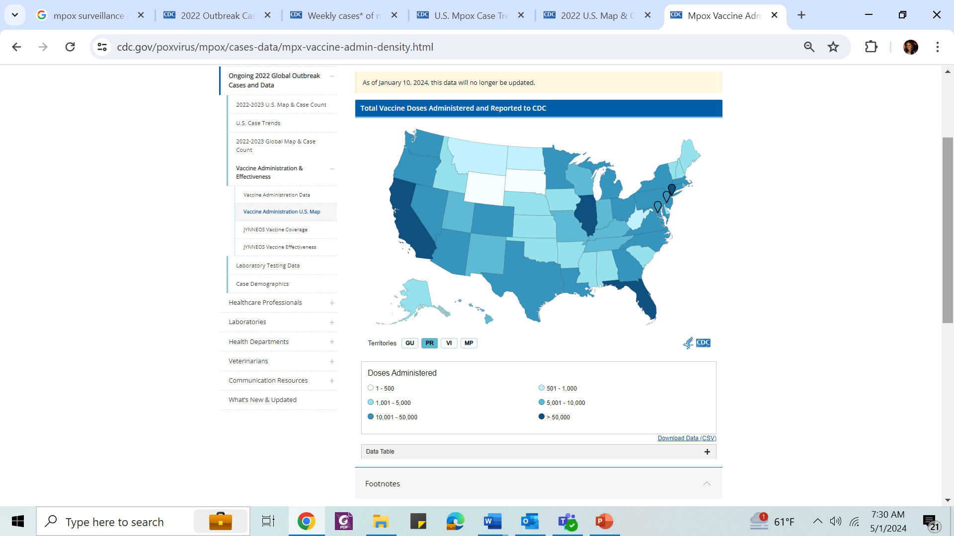
CDC: Mpox Vaccines Administered in United States
(as of 1/10/2024)
cdc.gov/poxvirus/mpox/cases-data/mpx-vaccine-admin-density.html.

Slide 42
Comparing Mpox Vaccination Uptake
With HIV PrEP-to-Need Ratio
Vaccination-to-Case Ratios
PrEP-to-Need Ratio by Race/Ethnicity Over Time, 2012-2021
100
Overall
White
Hispanic or Latino
Black or African American
100
80
80
White
Hispanic or Latino
Black or African American
60
60
Percent
40
40
20
20
0
May-Jun
Jul
Aug
Sep
Oct-Dec
0
2012
2013
2014
2015
2016
2017
2018
2019
2020
2021
Mo
Yr
To examine disparities in Mpox vaccination, rate ratios for incidence and vaccination were calculated from
May 10 - December 31, 2022
Lower vaccination-to-case ratio among Black and Hispanic males vs White males indicates higher unmet vaccination need
Similarly, lower PrEP-to-Need Ratio (ratio of PrEP users to people newly diagnosed with HIV) demonstrates higher unmet need for PrEP in Black and Hispanic communities
Kota. MMWR Morb Mortal Wkly Rep. 2023;72:398. aidsvu.org/resources/deeper-look-hiv-in-black-communities.
Notes:
PrEP, pre-exposure prophylaxis.

Slide 43
Barriers to Mpox Vaccine Uptake
Decreased knowledge of mpox
Low vaccine confidence
Low perceived susceptibility to and severity of mpox
Vaccine availability
  Prior use of screening questionnaires to ration vaccines
Stigma
Vaccine hesitancy
  Distrust in healthcare
  Misinformation
  (eg, conspiracy beliefs)
  Change in dosing
Social determinants of health
  Challenges with transportation
  Mental health disorders
Huang. Vaccines (Basel). 2024;23:332. Turpin. Int J Environ Res Public Health. 2023;20:6324. Ogaz. Emerg Infect Dis. 2024;30:916.

Slide 44
Strategies to Promote Mpox Vaccine Uptake:
Meeting People Where They Are
Use of pop-up clinics or mobile vaccine units located outside of bars, night clubs, festivals, etc
Colocating services
(eg, HIV and STI screening
and prevention services,
syringe service programs)
Lo Piccolo. Vaccines (Basel). 2023;11:1138. archive.cdc.gov/www_cdc_gov/poxvirus/mpox/resources/toolkits/organizer.html.
Notes:
STI, sexually transmitted infection.

Slide 45
Strategies to Promote Mpox Vaccine Uptake:
Other Interventions
Prioritize those at high risk
RISK
Collaborating with others in community
eg, LGBTQ+ community clinics and organizations
Leveraging preexisting structures from other vaccine programs (eg, COVID-19)
Expansion of accurate education to patients and HCPs
Lo Piccolo. Vaccines (Basel). 2023;11:1138. archive.cdc.gov/www_cdc_gov/poxvirus/mpox/resources/toolkits/organizer.html.
Notes:
HCP, healthcare professional.

Slide 46
Mpox Vaccine Hesitancy: Best Practices
Activism and engagement from the community
Equity outreach programs
Public awareness campaigns (eg, GLAAD’s “Facts and Vax” initiative); aimed to provide accurate information
cdc.gov/vaccines/covid-19/downloads/sovc-mpox-052223.pdf.

Slide 47
Go Online for More CCO
Coverage of Mpox Vaccination!
Expert Insights Clinical Module of key aspects of mpox infections and prevention
Podcasts with expert faculty discussions on common questions regarding mpox
ClinicalThought commentary on practical insights on implementing mpox vaccine recommendations
clinicaloptions.com

