Slide 1
New Systemic Therapies for Mycosis Fungoides and Sézary Syndrome
Supported by an educational grant from Kyowa Kirin, Inc.

Slide 2

About These Slides
Please feel free to use, update, and share some or all of these slides in your noncommercial presentations to colleagues or patients
When using our slides, please retain the source attribution:
These slides may not be published, posted online, or used in commercial presentations without permission. Please contact permissions@clinicaloptions.com for details
Slide credit: clinicaloptions.com
Notes:
Disclaimer: The materials published on the Clinical Care Options Web site reflect the views of the authors of the CCO material, not those of Clinical Care Options, LLC, the CME providers, or the companies providing educational grants. The materials may discuss uses and dosages for therapeutic products that have not been approved by the United States Food and Drug Administration. A qualified healthcare professional should be consulted before using any therapeutic product discussed. Readers should verify all information and data before treating patients or using any therapies described in these materials.

Slide 3
Program Directors
Francine Foss, MD
Professor of Medicine and Dermatology
Yale Cancer Center
Yale University School of Medicine
New Haven, Connecticut
Francine Foss, MD, has disclosed that she has received consulting fees from Mallinkrodt and Miragen and fees for non-CME/CE services from Seattle Genetics and Spectrum.
Notes:
This slide lists the faculty who were involved in the production of these slides.

Slide 4
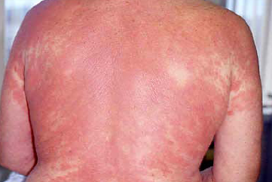
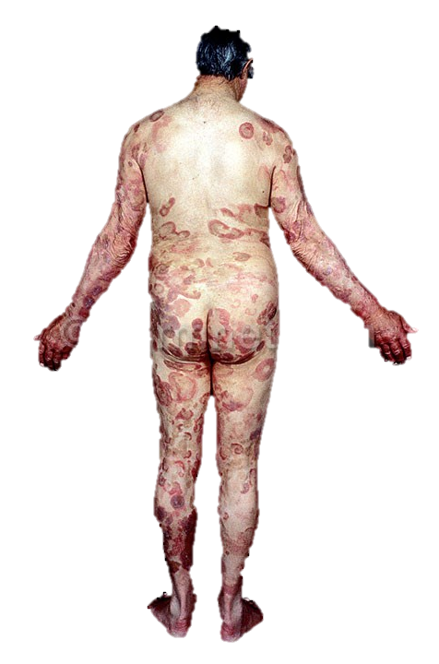

WHO-EORTC Classification of Cutaneous T-Cell and
NK-Cell Lymphomas
Cutaneous T-Cell and NK-Cell Lymphomas
Mycosis fungoides
MF variants and subtypes
Folliculotropic MF
Pagetoid reticulosis
Granulomatous slack skin
Sézary syndrome
Adult T-cell leukemia/lymphoma
Primary cutaneous CD30⁺ lymphoproliferative disorders
Primary cutaneous anaplastic large cell lymphoma
Lymphomatoid papulosis
Subcutaneous panniculitis-like T-cell lymphoma
Extranodal NK/T-cell lymphoma, nasal type
Primary cutaneous peripheral T-cell lymphoma, unspecified
Primary cutaneous aggressive epidermotropic CD8⁺ T-cell lymphoma (provisional)
Cutaneous γ/δ T-cell lymphoma (provisional)
Primary cutaneous CD4⁺ small/medium-sized pleomorphic T-cell lymphoma (provisional)
Willemze. Blood. 2005;105:3768.
Slide credit: clinicaloptions.com
Notes:
CTCL, cutaneous T-cell lymphoma; MF, mycosis fungoides; NK, natural killer; WHO-EORTC, World Health Organization/European Organisation for Research and Treatment of Cancer.

Slide 5
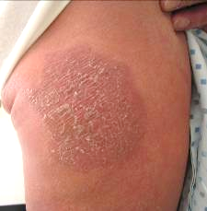
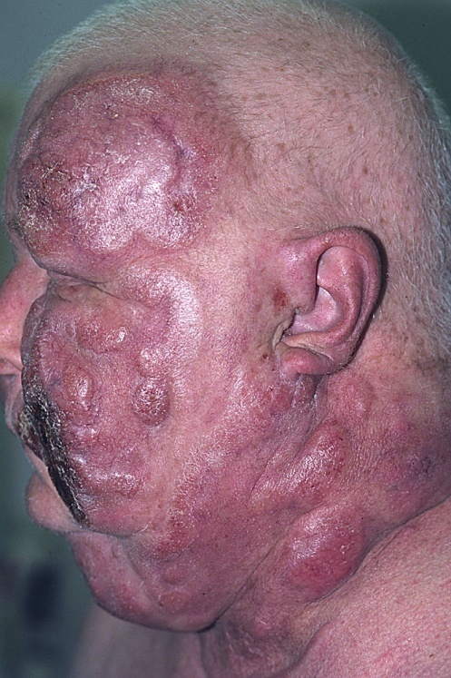
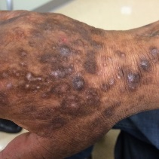
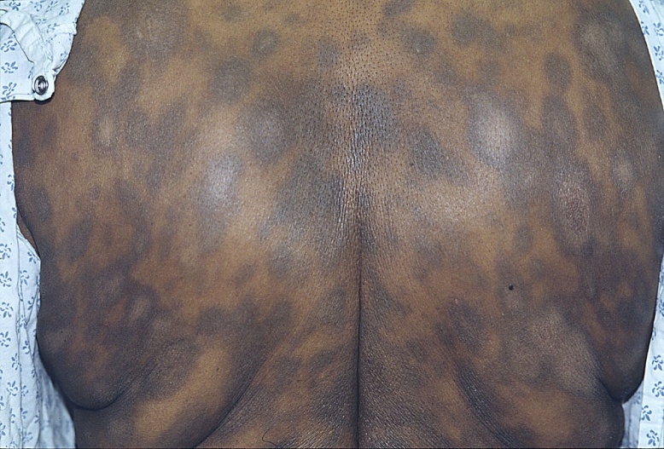
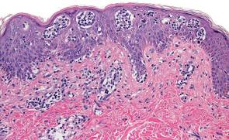
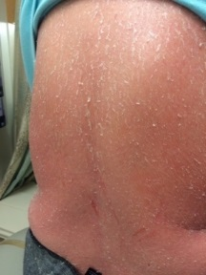
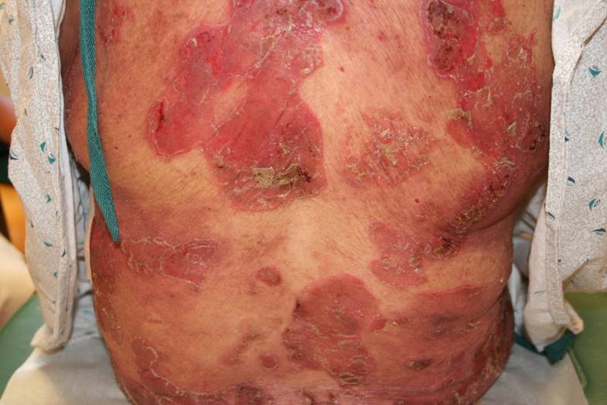
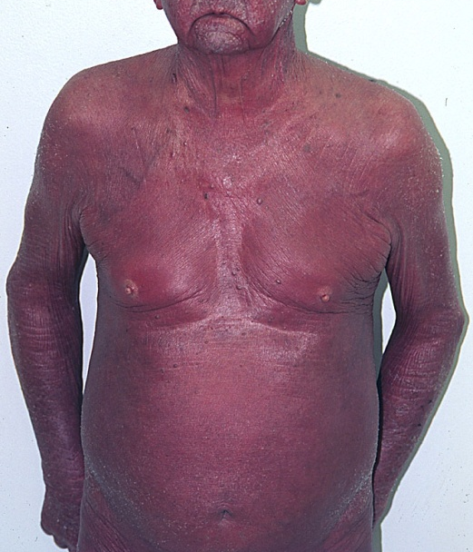
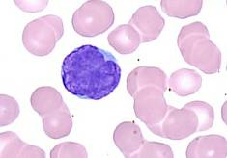
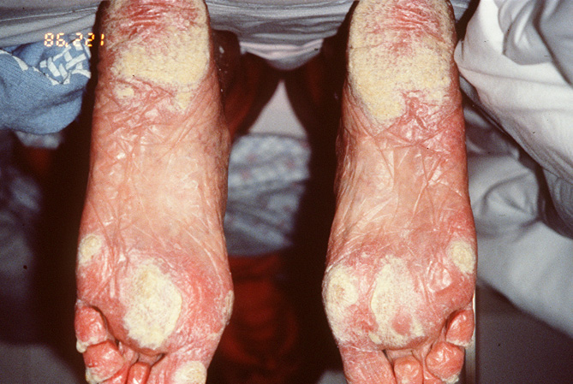
CTCL: A Myriad of Clinical Manifestations
Skin Stage | Description | 10-Yr Relative Survival, %
T1 | Patches, papules, or plaques covering < 10% of the skin surface | 100
T2 | Patches, papules, or plaques covering ≥ 10% of the skin surface | 67.4
T3 | Tumors (≥ 1) | 39.2
T4 | Generalized erythroderma | 41.0
T1
T3
T2
T4
Sézary cell
Zackheim. J Am Acad Dermatol. 1999;40:418.
Slide credit: clinicaloptions.com
Notes:
CTCL, cutaneous T-cell lymphoma.

Slide 6
CTCL: Staging of Disease by Sites
TNMB Stages |  | Description
Skin* | T1 | Limited patches, papules, and/or plaques covering < 10% of the skin surface
 | T2 | Patches, papules, or plaques covering ≥ 10% of the skin surface
 | T2a | Patch only
 | T2b | Plaque ± patch
 | T3 | ≥ 1 tumors (≥ 1 cm diameter)
 | T4 | Confluence of erythema covering ≥ 80% body surface area
Node† | N0 | No clinically abnormal LNs; biopsy not required
 | N1 | Clinically abnormal LNs; histopathology Dutch grade 1 or NCI LN₀₋₂
 | N2 | Clinically abnormal LNs; histopathology Dutch grade 2 or NCI LN₃
 | N3 | Clinically abnormal LNs; histopathology Dutch grade 3/4 or NCI LN₄; clone positive or negative
 | NX | Clinically abnormal LNs without histologic confirmation or inability to fully characterize the histologic subcategories
TNMB Stages |  | Description
Visceral | M0 | No visceral involvement
 | M1 | Visceral involvement (must have pathology confirmation and organ involved should be specified)
 | MX | Abnormal visceral site; no histologic confirmation
Blood | B0 | Absence of significant blood involvement: ≤ 5% of peripheral blood lymphocytes are atypical (Sézary) cells or < 250/μL are atypical (Sézary) cells or < 15% CD4⁺CD26⁻ or CD4⁺CD7⁻ cells of total lymphocytes
 | B1 | Low blood tumor burden: > 5% of peripheral blood lymphocytes are atypical (Sézary) cells or ≥ 15% CD4⁺CD26⁻ or CD4⁺CD7⁻ cells of total lymphocytes but do not meet the criteria of B0 or B2
 | B2 | High blood tumor burden: positive clone‡ with ≥ 1000/μL Sézary cells, CD4⁺CD26⁻ cells, or CD4⁺CD7⁻ cells or CD4/CD8 ≥ 10, CD4⁺CD7⁻ cells ≥ 40%, or CD4⁺CD26⁻ cells ≥ 30%
*Patch defined as any-size lesion without induration or significant elevation above surrounding uninvolved skin; pokiloderma may be present. Plaques defined as any-size lesion that is elevated or indurated; crusting or pokiloderma may be present. Tumor defined as any solid or nodular lesion ≥ 1 cm in diameter with evidence of deep infiltration in skin and/or vertical growth. †LNs considered abnormal if > 1.5 cm in diameter. ‡Clone in blood should match that of skin. Relevance of isolated clone in blood or one not matching clone in skin still to be determined.
Olsen. Blood. 2007;110:1713. Olsen. JCO. 2011;29:2598. Scarisbrick. Eur J Cancer. 2018;93:47.
Slide credit: clinicaloptions.com
Notes:
CTCL, cutaneous T-cell lymphoma; LN, lymph nodes; NCI, National Cancer Institute.

Slide 7
TNM Staging for CTCL
Clinical Stage | T (Skin) | N (Node) | M (Visceral) | B (Blood Involvement)
IA (limited skin involvement) | T1 (patches, papules, and/or plaques covering < 10% of the skin surface) | N0 | M0 | B0-1
IB (skin-only disease) | T2 (patches, papules, or plaques covering ≥ 10% of the skin surface) | N0 | M0 | B0-1
IIA | T1-2 | N1-2 | M0 | B0-1
IIB (tumor-stage disease) | T3 (≥ 1 tumors [≥ 1 cm diameter]) | N0-2 | M0 | B0-1
IIIA (erythrodermic disease) | T4 (confluence of erythema covering ≥ 80% body surface area) | N0-2 | M0 | B0
IIIB (erythrodermic disease) | T4 | N0-2 | M0 | B1
IVA₁ | T1-4 | N0-2 | M0 | B2
IVA₂ | T1-4 | N3 | M0 | B0-2
IVB | T1-4 | N0-3 | M1 | B0-2
Any | Large-cell transformation
7
Olsen. Blood. 2007;110:1713.
Slide credit: clinicaloptions.com
Notes:
CTCL, cutaneous T-cell lymphoma.

Slide 8
Outcomes in Advanced-Stage MF and SS:
CLIC Retrospective Study to Identify Prognostic Factors
100
OS by Stage
100
OS by Risk Group
80
80
60
60
OS (%)
OS (%)
40
III (n = 320), P = .624
IIB (n = 457)
IVA (n = 463), P = .003
IVB (n = 35), P = .008
40
20
20
Risk Group No. Variables* P Value
Low (n = 327) 0-1
Intermediate (n = 329) 2 < .001
High (n = 201) 3-4 < .001
0
0
0
20
40
60
80
0
20
40
60
80
Mos
Mos
Prognostic factors associated with OS
  Stage IV
  Elevated LDH
*Variables: stage IV, elevated LDH, age > 60 yrs, large-cell transformation in skin.
  Age > 60 yrs
  Large-cell transformation in skin
Scarisbrick. JCO. 2015;33:3766.
Slide credit: clinicaloptions.com
Notes:
LDH, lactate dehydrogenase; MF, mycosis fungoides; SS, Sézary syndrome.

Slide 9
Management of CTCL and Risk for Progression
MF is immunologically responsive
Multiple therapies necessary over disease
course
Although FDA has approved multiple
therapies, there is an unmet need for many
patients because most progress over time
SD is a meaningful endpoint because
provides relief of pruritus, improvement in
skin symptoms
Infections a major cause of morbidity and
mortality
  Immunosuppressive therapy should be avoided if feasible
Risk for Progression in MF and SS by
T Classification at Diagnosis (N = 525)
100
T3 (n = 96)
80
T4 (n = 78)
60
Probability (%)
40
T2 (n = 192)
20
T1 (n = 159)
0
0
2
4
6
8
10
12
14
16
18
20
Yrs
Kim. Arch Dermatol. 2003;139:857.
Slide credit: clinicaloptions.com
Notes:
CTCL, cutaneous T-cell lymphoma; MF, mycosis fungoides; SD, stable disease; SS, Sézary syndrome.

Slide 10
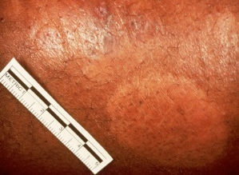
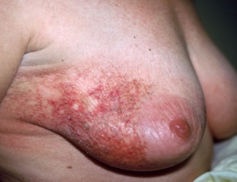
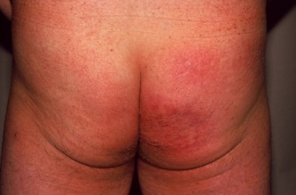
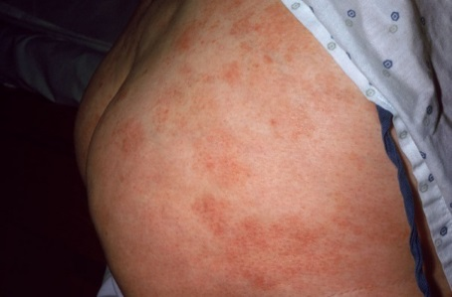
Patch/Plaque-Stage Disease
Skin lesions can be hypopigmented, hyperpigmented, or erythematous^{[1,2]}
  Patches: flat lesions
  Plaques: raised/scaling lesions
Generally distributed in areas not exposed to sun^{[3]}
Should perform biopsy off topical steroids^{[4]}
Differential diagnosis: tinea corporis, eczema, drug reaction, psoriasis^{[5]}
Skin involvement based on % of BSA^{[2]}
  T1: < 10% BSA
  T2: ≥ 10% BSA
1. NCI. Mycosis Fungoides (Including Sézary Syndrome) Treatment (PDQ®)–Health Professional Version. Updated September 20, 2019. 2. Willemze. Ann Oncol. 2018;29(suppl 4):iv30. 3. Mycosis fungoides. Cutaneous Lymphoma Foundation. July 2018.
4. Poligone. Semin Cutan Med Surg. 2012;31:25. 5. Nashan. Br J Dermatol. 2007;156:1.
Slide credit: clinicaloptions.com
Notes:
BSA, body surface area.

Slide 11
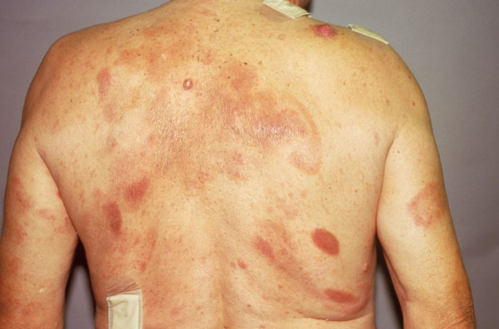
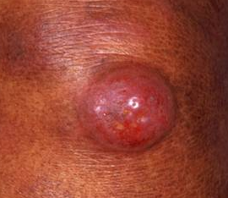
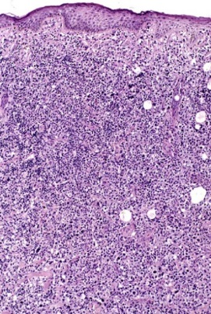
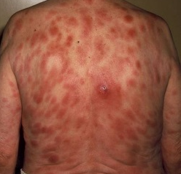
Tumor-Stage Disease
Tumor stage (T3): ≥ 1 nodular lesion > 1 cm
Biopsy: representative nonulcerated tumor
If large cells, record % for large cell transformation
Perform both T and B clonality studies
Differential diagnosis includes primary cutaneous lymphoma, pseudolymphoma
(B-cell) or lymphocytoma cutis (T-cell), secondary cutaneous lymphoma, leukemic lesions, and for single lesions, metastatic cancer
NCI. Mycosis Fungoides (Including Sézary Syndrome) Treatment (PDQ®)–Health Professional Version.
Updated September 20, 2019.
Slide credit: clinicaloptions.com

Slide 12
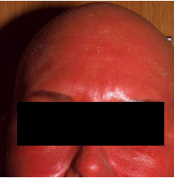
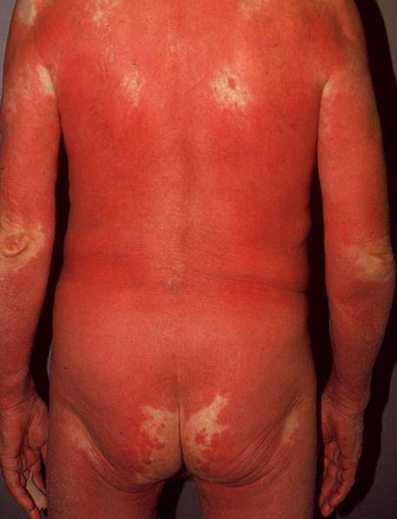
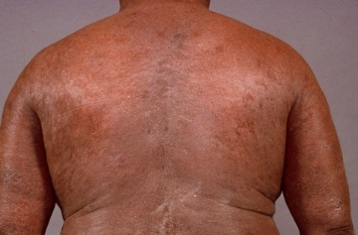
Erythrodermic Disease
Erythroderma (T4) defined as ≥ 80% BSA with erythematous confluence of lesions
May be infiltrated or flat
Hair loss in areas of involvement
Scaling of palms and soles of feet
Diagnosis often difficult by skin biopsy alone; must be off topical steroids, may require multiple biopsies
  Immunophenotyping, TCR GR analysis in blood and LN is critical
Differential diagnosis includes atopic dermatitis, hyper IgE, psoriasis, drug reaction
NCI. Mycosis Fungoides (Including Sézary Syndrome) Treatment (PDQ®)–Health Professional Version.
Updated September 20, 2019. Swerdlow. Blood. 2016;127:2375.
Slide credit: clinicaloptions.com
Notes:
BSA, body surface area; LN, lymph node; TCR GR, T-cell receptor gene rearrangement.

Slide 13
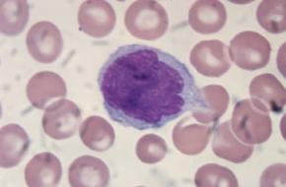
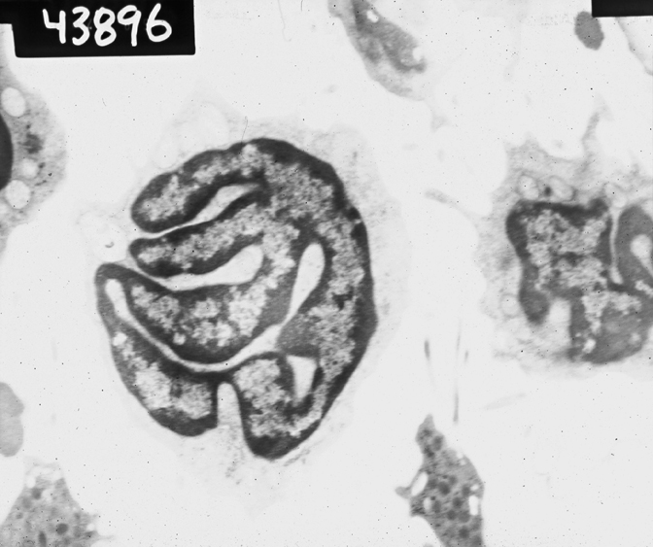
Sézary Syndrome
Systemic and aggressive variant of erythroderma
Exfoliative erythroderma, ectropion, alopecia, palmoplantar keratoderma
Severe pruritus often associated
High incidence of infections due to poor skin integument
Circulating, atypical, malignant T lymphocytes
  Sézary cells: CD3⁺, CD4⁺, CD5⁺, CD7^{+/-}, CD8⁻, CD25^{+/-}, CD26–, CD30⁻, CD45RO⁺, CD52⁺, CD158⁺
Querfeld. Management of Hematologic Malignancies. 2011.
Slide credit: clinicaloptions.com

Slide 14
ISCL Recommended Staging Evaluation for CTCL
Recommendation
Physical exam: Identify abnormal peripheral LNs ≥ 1.5 cm, organ involvement
Radiologic tests: CT scans of chest, abdomen, pelvis except in stages IA or limited IB. PET scans may be helpful to identify which LN to biopsy
LN biopsy: Complete LN biopsy preferred over core LN biopsy, no FNA
Immunophenotyping: CD2, CD3, CD4, CD5, CD7, CD8, CD20, CD26, CD30
Molecular genetics: T-cell receptor rearrangement or V-beta by flow cytometry
BM biopsy: Not routine except for stage B2 blood involvement or hematologic abnormalities
Olsen. Blood 2007; 110:1713.
Slide credit: clinicaloptions.com
Notes:
BM, bone marrow; CTCL, cutaneous T-cell lymphoma; FNA, fine needle aspiration; ISCL, International Society for Cutaneous Lymphomas; LN, lymph node.

Slide 15
MF/SS: Skin-Related Therapies
Limited/local skin involvement
  Local radiation
  Phototherapy
  Topical
    Carmustine
    Corticosteroids
    Mechlorethamine
    Retinoids
Widespread skin involvement
  Phototherapy
  Topical
    Corticosteroids
    Mechlorethamine
  TSEBT
NCI. Mycosis Fungoides (Including Sézary Syndrome) Treatment (PDQ®)–Health Professional Version. Accessed February 12, 2020.
Tarabadkar. Front Oncol. 2019;11:260.
Slide credit: clinicaloptions.com
Notes:
MF, mycosis fungoides; SS, Sézary syndrome; TSEBT, total skin electron beam therapy.

Slide 16
Mycosis Fungoides Combination Skin + Systemic Therapies
Topical + systemic regimens
  Phototherapy + ECP
  Phototherapy + IFN
  Phototherapy + retinoid
  TSEBT + ECP
Systemic regimens
  ECP + IFN
  ECP + retinoid
  ECP + retinoid + IFN
  Retinoid + IFN
NCI. Mycosis Fungoides (Including Sézary Syndrome) Treatment (PDQ®)–Health Professional Version. Accessed February 12, 2020.
Tarabadkar. Front Oncol. 2019;11:260.
Slide credit: clinicaloptions.com
Notes:
ECP, extracorporeal photopheresis; IFN, interferon; TSEBT, total skin electron beam therapy.

Slide 17
Advanced MF/SS Systemic Therapies
Brentuximab vedotin
Bexarotene
ECP
Interferons
Methotrexate
Mogamulizumab
Romidepsin
Vorinostat
Large-cell transformation
  Brentuximab vedotin
  Gemcitabine
  Liposomal doxorubicin
  Pralatrexate
  Romidepsin
NCI. Mycosis Fungoides (Including Sézary Syndrome) Treatment (PDQ®)–Health Professional Version. Accessed February 12, 2020.
Tarabadkar. Front Oncol. 2019;11:260. Kempf. Hematol Oncol. 2019;37(suppl 1):43. Van-de-Velde. J Cutan Med Surg. 2019;23:327.
Slide credit: clinicaloptions.com
Notes:
ECP, extracorporeal photopheresis; MF, mycosis fungoides; SS, Sézary syndrome.

Slide 18
Systemic Therapies for Relapsed/Refractory MF
Alemtuzumab^{[1]}
Bortezomib^{[2]}
Chlorambucil^{[3]}
Cyclophosphamide^{[3]}
Etoposide^{[4]}
Pembrolizumab^{[5]}
Pentostatin^{[6]}
Temozolomide^{[7]}
1. Querfeld. Leuk Lymphoma. 2009;50:1969. 2. Zinzani. JCO. 2007;25:4293. 3. NCI. Mycosis Fungoides (Including Sézary Syndrome) Treatment (PDQ®)–Health Professional Version. Accessed February 12, 2020. 4. Purnak. Dermatol Ther. 2018;31:e12586. 5. Khodadoust. JCO. 2019. [Epub]. 6. Cummings. JCO. 1991;9:565. 7. Tani. Haematologica. 2005;90:1283.
Slide credit: clinicaloptions.com
Notes:
ECP, extracorporeal photopheresis.

Slide 19
Treatment Options for Erythrodermic Disease/Sézary Syndrome
Low/intermediate burden
  Combination therapies*
  Systemic† ± skin-directed‡ therapies
*Phototherapy + ECP, IFN, or retinoid; TSEBT + ECP; ECP + IFN or retinoid; ECP + retinoid + IFN; retinoid + IFN.
†Brentuximab vedotin, bexarotene, ECP, interferons, methotrexate, mogamulizumab, romidepsin, vorinostat
‡Local radiation; phototherapy; topical carmustine, corticosteroids, mechlorethamine, or retinoids; TSEBT.
High burden
  Combination therapies*
  Mogamulizumab ±
  skin-directed‡ therapies
  Romidepsin ± skin-directed‡ therapies
NCI. Mycosis Fungoides (Including Sézary Syndrome) Treatment (PDQ®)–Health Professional Version. Accessed February 12, 2020. Tarabadkar. Front Oncol. 2019;11:260. Kempf. Hematol Oncol. 2019;37 Suppl 1:43. Van-de-Velde. J Cutan Med Surg. 2019;23:327.
Slide credit: clinicaloptions.com
Notes:
ECP, extracorporeal photopheresis; IFN, interferon; TSEBT, total skin electron beam therapy.

Slide 20
FDA Approved Agents for Relapsed/Refractory CTCL
Agent (Class) | CTCL Indication | Trial Description | N* | ORR, % | DoR, Mos
Romidepsin^{[1]} | CTCL with ≥ 1 prior systemic therapy | Pivotal | 96 | 34 | 15
 |  | Supportive | 71 | 35 | 11
Denileukin diftitox^{[2]} (Fusion protein) | Resistant/recurrent CTCL with cells that express CD25 | Pivotal | 71 | 30 | 4
Bexarotene^{[3]} (Retinoid x-receptor activator) | Cutaneous lesions in patients with CTCL refractory to ≥ 1 prior systemic therapy | Pivotal | 62 | 32 | > 5
Vorinostat^{[4]} (HDAC inhibitor) | Persistent/recurrent CTCL with cutaneous manifestations on or after 2 prior systemic therapies | Pivotal | 74 | 30 | > 6
 |  | Supportive | 33 | 24 | 3.5
Brentuximab vedotin^{[5]} | CD30+ CTCL after prior systemic therapy | Randomized trial vs methotrexate or bexarotene | 64 | 67 | 17 (PFS)
Mogamulizumab^{[6]} | Relapsed/refractory CTCL after ≥ 1 systemic therapy | Randomized trial vs vorinostat | 186 | 28 | 14
*Patients treated with listed drug only.
1. Romidepsin PI. 2. Denileukin diftitox PI. 3. Bexarotene PI. 4. Vorinostat PI. 5. Brentuximab vedotin PI. 6. Mogamulizumab PI.
Slide credit: clinicaloptions.com
Notes:
CTCL, cutaneous T-cell lymphoma; DoR, duration of response.

Slide 21
Brentuximab Vedotin
CD30 expressed on activated B-cells, T-cells, and NK cells; activated monocytes in hematopoietic tissues
Brentuximab vedotin
  Chimeric anti-CD30 mAb conjugated to MMAE (cytotoxic antitubulin agent)
  Infusion every 3 wks
  Recurrent sALCL: ORR of 86%; CR of 57%
Brentuximab vedotin PI.
Slide credit: clinicaloptions.com
Notes:
MMAE, monomethyl auristatin E, sALCL, systemic anaplastic large-cell lymphoma.

Slide 22
ALCANZA: Brentuximab Vedotin vs Investigator’s Choice for Relapsed or Refractory CTCL
Wk 48
(16 x 21-day cycles)
International, randomized, open-label, phase III trial
Primary endpoint: ORR4 (objective global response lasting ≥ 4 mos)
Secondary endpoints: CR, PFS, QoL, PN
Not prespecified endpoints: TTNT, ORR
Brentuximab Vedotin
1.8 mg/kg IV Q3W
(n = 64)
Patients followed every 12 wks for 2 yrs and then every
6 mos
Adults with previously treated CD30-positive MF or pcALCL and ECOG PS 0-2*
(N = 128)
Physician’s Choice
Methotrexate 5-50 mg PO weekly or
Bexarotene 300 mg/m² (target dose) PO daily
(n = 64)
* ≥ 1 previous systemic therapy required for MF patients; previous radiotherapy or ≥ 1 previous systemic therapy for pcALCL patients.
Prince. Lancet. 2017;390:555.
Slide credit: clinicaloptions.com
Notes:
ECOG, Eastern Cooperative Oncology Group; MF, mycosis fungoides; ORR4, ORR lasting ≥ 4 months; pcALCL, primary cutaneous anaplastic large-cell lymphoma; PN, peripheral neuropathy; PS, performance status; QoL, quality of life; TTNT, time to next therapy.

Slide 23
ALCANZA: Baseline Characteristics
Baseline Characteristics | Brentuximab Vedotin (n = 64) | Physician’s Choice (n = 64)
Median age, yrs (range) | 62 (51-70) | 59 (48-69)
Male, n (%) | 33 (52) | 37 (58)
ECOG PS 0/1, n (%) | 61 (95) | 62 (97)
Median CD30 expression, % (range) | 32.5 (12.5-67.5) | 31.3 (12.0-47.5)
MF, n (%) Early stage (IA-IIA) Advanced stage (IIB-IVB) | 48 (75) 15 (31) 32 (67) | 49 (77) 18 (37) 30 (61)
pcALCL, n (%) Skin only Extracutaneous disease | 16 (25) 9 (56) 7 (44) | 15 (23) 11 (73) 4 (27)
Median previous therapies, n (range) | 4.0 (2.0-7.0) | 3.5 (2.0-5.5)
Median previous systemic therapies, n (range) | 2.0 (1.0-4.0) | 2.0 (1.0-3.0)
Prince. Lancet. 2017;390:555.
Slide credit: clinicaloptions.com
Notes:
ECOG, Eastern Cooperative Oncology Group; MF, mycosis fungoides; pcALCL, primary cutaneous anaplastic large-cell lymphoma; PS, performance status;

Slide 24
ALCANZA: Response
CR
PR
Stable disease
Progressive disease
No best global response
No postbaseline assessment
Indicates percentage change in mSWAT is 0
Brentuximab Vedotin
Physician’s Choice of Methotrexate or Bexarotene
100
Mycosis fungoides
pcALCL
100
Mycosis fungoides
pcALCL
50
50
0
0
Best Response (% Change in mSWAT)
-50
-50
-100
-100
Individual Patients (n = 48)
Individual Patients
(n = 16)
Individual Patients (n = 49)
Individual Patients
(n = 15)
Prince. Lancet. 2017;390:555.
Slide credit: clinicaloptions.com
Notes:
mSWAT, modified severity-weighted assessment tool; pcALCL, primary cutaneous anaplastic large-cell lymphoma.

Slide 25
ALCANZA: Clinical Benefit in Skin and Quality of Life
Mean Change in Skindex-29 Symptom Domain Score From Baseline
Patient-Reported Burden of Symptoms | Brentuximab Vedotin (n = 64) | Physician’s Choice (n = 64) | P Value
Mean max reduction | -27.96 | -8.62 | < .0001
Brentuximab vedotin
Methotrexate or bexarotene
40
20
0
-20
-40
-60
C2D1
C4D1
C6D1
C8D1
C10D1
C12D1
C14D1
C16D1
EOT
Cycle/Day
Prince. Lancet. 2017;390:555.
Slide credit: clinicaloptions.com

Slide 26
ALCANZA: Clinical Outcome and CD30 Expression in
MF Patients With Large-Cell Transformation
Patients with MF benefitted from brentuximab vedotin regardless of
LCT status
CD30 expression levels
variable in patients with MF
and LCT (n = 17)
  High baseline CD30
  expression generally
  predictive of good response
  to treatment with
  brentuximab vedotin
  However, meaningful responses were
  observed in patients with lower CD30 expression
ORR4 (response lasting ≥ 4 mos) achieved
ORR4 not achieved
10% cutoff for enrollment
100
80
60
Baseline CD30 Expression (% Positive)
40
20
0
Individual Patients (n = 50)
Kim. ASH 2018. Abstr 1646.
Slide credit: clinicaloptions.com
Notes:
LCT, large-cell transformation; MF, mycosis fungoides; ORR4, ORR lasting ≥ 4 months.

Slide 27
ALCANZA: Response by Stage
 | Brentuximab Vedotin (n = 64) |  |  |  | Physician’s Choice (n = 64)
 | Total, n (%) | ORR4, n (%) | ORR, n (%) | CR, n (%) | n (%) | ORR4, n (%) | ORR, n (%) | CR, n (%)
ITT population | 64 (100) | 36 (56) | 43 (67) | 10 (16) | 64 (100) | 8 (13) | 13 (20) | 1 (2)
Mycosis fungoides* | 48 (75) | 24 (50) | 31 (65) | 5 (10) | 49 (77) | 5 (10) | 8 (16) | 0
IA-IIA | 15 (31) | 6 (40) | 8 (53) | 1 (7) | 18 (37) | 4 (22) | 5 (28) | 0
IIB | 19 (40) | 12 (63) | 13 (68) | 3 (16) | 19 (39) | 1 (5) | 3 (16) | 0
IIIA-IIIB | 4 (8) | 2 (50) | 3 (75) | 0 | 2 (4) | 0 | 0 | 0
IVA | 2 (4) | 2 (100) | 2 (100) | 1 (50) | 9 (18) | 0 | 0 | 0
IVB | 7 (15) | 2 (29) | 4 (57) | 0 | 0 | NA | NA | NA
pcALCL | 16 (25) | 12 (75) | 12 (75) | 5 (31) | 15 (23) | 3 (20) | 5 (33) | 1 (7)
Disease involvement
Skin only | 9 (56) | 8 (89) | 8 (89) | 4 (44) | 11 (73) | 3 (27) | 5 (45) | 1 (9)
Extracutaneous | 7 (44) | 4 (57) | 4 (57) | 1 (14) | 4 (27) | 0 | 0 | 0
*1 patient in each stage omitted due to incomplete staging.
Prince. Lancet. 2017;390:555.
Slide credit: clinicaloptions.com
Notes:
ITT, intention-to-treat; NA, not applicable; ORR4, ORR lasting ≥ 4 months; pcALCL, primary cutaneous anaplastic large-cell lymphoma.

Slide 28
ALCANZA: PFS
1.0
+
Log-rank test P < .001
HR: 0.270 (95% CI: 0.169-0.430)
Median, mos: BV: 16.7; MTX/Bex: 3.5
Events, n: BV: 36; MTX/Bex: 50
+
0.9
+
+
0.8
+
+
+
+
+
+
+
0.7
+
+
+
+
+
+
Brentuximab vedotin
Methotrexate or bexarotene
Censored
Censored
0.6
+
+
Probability of PFS
0.5
+
+
+
+
+
+
0.4
+
+
+
+
0.3
0.2
+
+
+
+
0.1
+
+
1
0
1
2
3
4
5
6
7
8
9
10
11
12
13
14
15
16
17
18
19
20
21
21
22
23
24
25
26
27
28
29
30
31
32
33
34
35
Mos
Patients at Risk, n
Brentuximab vedotin
Methotrexate or bexarotene
64
64
59
54
58
42
54
34
51
24
50
17
48
13
47
12
46
11
43
8
38
8
38
7
29
7
27
6
27
6
23
5
19
5
17
5
13
3
12
4
12
4
11
3
10
1
8
1
7
7
7
6
3
3
3
1
1
Prince. Lancet. 2017;390:555.
Slide credit: clinicaloptions.com
Notes:
Bex, bexarotene; BV, brentuximab vedotin; MTX, methotrexate.

Slide 29
ALCANZA: Adverse Events Occurring in ≥ 10% of Patients
Brentuximab Vedotin
Physician’s Choice*
Peripheral neuropathy
67
6
Nausea
36
13
Diarrhea
29
6
Fatigue
29
27
Grade 1
Grade 2
Grade 3/4
Vomiting
17
5
Alopecia
15
3
Pruritus
17
13
Pyrexia
17
18
Decreased appetite
15
5
Hypertriglyceridemia*
2
18
70
60
50
40
30
20
10
0
10
20
30
40
50
60
70
Incidence (%)
*Methotrexate or bexarotene.
Prince. Lancet. 2017;390:555.
Slide credit: clinicaloptions.com

Slide 30
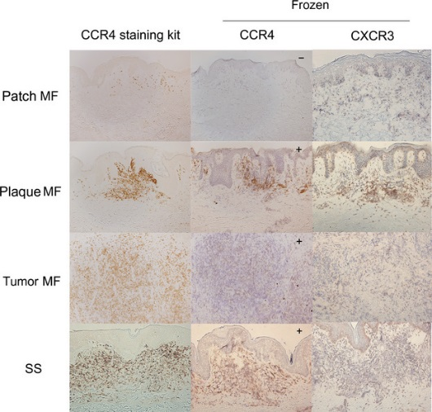
Targeting CCR4 in CTCL
CCR4 is expressed on malignant T-cells in patients with MF/SS^{[1]}
Mogamulizumab: humanized monoclonal antibody that binds to CCR4 and is active
in MF/SS
Mogamulizumab was FDA approved in 2018 for patients with relapsed/ refractory MF or SS after ≥ 1 prior systemic therapy^{[2]}
(Cells/HPF)
**
**
*
**
500
**
400
300
200
100
0
Patch
Plaque
Tumor
MF
SS
AD
Psoriasis
1. Sugaya. J Dermatol. 2015;42:613. 2. Mogamulizumab PI.
Slide credit: clinicaloptions.com
Notes:
AD, atopic dermatitis; CTCL, cutaneous T-cell lymphoma; MF, mycosis fungoides; SS, Sézary syndrome.

Slide 31
MAVORIC: Mogamulizumab vs Vorinostat in Previously Treated CTCL
Multicenter, international, open-label, randomized phase III trial
Stratified by disease type
and stage IB/II vs III/IV
Mogamulizumab
1 mg/kg IV QW for first 28-day cycle;
Days 1, 15 for subsequent cycles
(n = 186)
Patients with histologically confirmed mycosis fungoides or Sézary syndrome and failure on ≥ 1 systemic therapy
(N = 372)
Followed until disease progression or
intolerable toxicity
(crossover to mogamulizumab from vorinostat allowed)
Vorinostat
400 mg PO QD
(n = 186)
Primary endpoint: PFS, using global composite response score based on skin, blood, lymph nodes, and viscera
Secondary endpoints: ORR, DoR, QoL, ORR in crossover group, safety
Slide credit: clinicaloptions.com
Kim. Lancet Oncol. 2018;19:1192.
Notes:
DoR, duration of response; QoL, quality of life.

Slide 32
MAVORIC: Response by Investigator Assessment
Response | Mogamulizumab (n=186) | Vorinostat (n=186)
ORR by global assessment,* n/N (%) | 52/186 (28) | 9/186 (5)
Overall responses in patient subgroups, n/N (%)
Mycosis fungoides | 22/105 (21) | 7/99 (7)
Sézary syndrome | 30/81 (37) | 2/87 (2)
Stage IB or IIA | 7/36 (19) | 5/49 (10)
Stage IIB | 5/32 (16) | 1/23 (4)
Stage III | 5/22 (23) | 0/16 (0)
Stage IV | 35/96 (36) | 3/98 (3)
Duration of response, months (range) | 14.1 (8.4-19.2) | 9.1 (5.6-NE)
Mycosis fungoides | 13.1 (4.7-18.0) | 9.1 (5.6-NE)
Sézary syndrome | 17.3 (9.4-19.9) | 6.9 (6.9-6.9)
*P < .0001
Slide credit: clinicaloptions.com
Kim. Lancet Oncol. 2018;19:1192.
Notes:
NE, not estimable.

Slide 33
MAVORIC: Response by Investigator Assessment
CR
PR
Stable disease
Progressive disease
Mogamulizumab
Response Rate by Compartment, n (%) | Mogamulizumab | Vorinostat
Skin ORR (CR + PR) CR | (n = 186) 78 (42) 8 (4) | (n = 186) 29 (16) 1 (1)
Blood ORR (CR + PR) CR | (n = 122) 83 (68) 54 (44) | (n = 123) 23 (19) 5 (4)
Lymph node ORR (CR + PR) CR | (n = 124) 21 (17) 10 (8) | (n = 122) 5 (4) 2 (2)
Viscera ORR (CR + PR) CR | (n = 3) 0 0 | (n = 3) 0 0
100
No best global response
No postbaseline assessment
Percentage change in mSWAT is 0
50
0
-50
-100
Best Percentage Change in mSWAT
Vorinostat
100
50
0
-50
-100
Individual Patients (n = 186)
Slide credit: clinicaloptions.com
Kim. Lancet Oncol. 2018;19:1192. Kim. ASH 2017. Abstr 817.
Notes:
mSWAT, modified severity-weighted assessment tool.

Slide 34
MAVORIC: PFS
100
+
+
 | Mogamulizumab (n = 186) | Vorinostat (n = 186)
Median PFS, mos (95% CI) | 7.7 (5.7-10.3) | 3.1 (2.9-4.1)
HR (95% CI) | 0.53 (0.41-0.69); P < .0001
+
+
90
+
+
+
80
+
+
+
+
70
+
+
+
+
+
+
+
60
+
+
PFS (%)
+
50
+
+
+
40
+
+
+
+
+
+
+
+
+
+
+
+
+
30
+
+
+
+
+
+
+
+
20
+
+
+
+
+
+
+
+
+
10
+
+
+
+
+
+
+
0
0
2
4
6
8
10
12
14
16
18
20
22
24
26
28
30
32
34
36
Mos Since Randomization
Patients at Risk, n
Mogamulizumab
Vorinostat
186
186
138
111
100
61
77
36
65
23
50
18
39
13
32
8
22
5
16
4
14
3
7
2
5
2
3
2
2
1
1
1
1
1
0
1
0
0
Slide credit: clinicaloptions.com
Kim. Lancet Oncol. 2018;19:1192.

Slide 35
MAVORIC: Patient-Reported Outcomes
Significant symptom improvement with mogamulizumab vs vorinostat (P < .05)
Median time to symptom worsening: 27 mos with mogamulizumab vs 7 mos with vorinostat
CDF Curve of Skindex-29 Symptoms
Scale Score at Cycle 5
Time to Symptom Worsening of Skindex-29 Symptoms Scale Score
1.0
1.0
+
+
+
+
Mogamulizumab
Vorinostat
+
Mogamulizumab
Vorinostat
0.9
+
+
0.8
+
+
0.8
+
+
+
+
+
+
+
0.7
+
+
+
+
0.6
+
+
0.6
+
+
+
+
+
+
+
+
0.5
0.4
+
+
+
+
Cumulative Proportion of Patients
Probability of Survival
+
+
+
+
+
0.4
0.3
0.2
0.2
0
0.1
171
174
100
60
68
35
48
16
33
11
21
4
16
4
6
1
3
1
1
0
1
0
-90
-80
-70
-60
-50
-40
-30
-20
-10
0
10
20
30
40
0
3
6
9
12
15
18
24
30
36
30
Change From Baseline in Skindex Symptoms Scale Score
Mos to Symptom Worsening
Slide credit: clinicaloptions.com
Kim. ASH 2017. Abstr 817. Kim. Lancet Oncol. 2018;19:1192.
Notes:
CDF, cumulative distribution function.

Slide 36
MAVORIC: Safety
Commonly Reported Treatment-Emergent Adverse Events
(≥ 20% of Patients in Either Group)
Infusion-related reaction
Drug eruption
Diarrhea
Fatigue
Nausea
Thrombocytopenia
Decreased appetite
Mogamulizumab
Vorinostat
Dysgeusia
Blood creatinine increased
0
10
20
30
40
50
60
70
Incidence (%)
Slide credit: clinicaloptions.com
Kim. Lancet Oncol. 2018;19:1192. Kim. Blood. 2019;134(Suppl1). Abstract 624.

Slide 37
MAVORIC: Final Safety Analysis by Grade, ≥ 20% of Patients
TRAE | Mogamulizumab (n = 184) |  | Vorinostat (n = 186)
 | All Grades, % | Grades ≥ 3, % | All Grades, % | Grades ≥ 3, %
Diarrhea | 26.1 | 0.5 | 61.8 | 4.8
Nausea | 16.3 | 0.5 | 42.5 | 1.6
Fatigue | 23.9 | 1.6 | 37.6 | 5.9
Infusion-related reaction | 33.2 | 1.6 | 0.5 | 0
Thrombocytopenia | 12.0 | 0 | 31.2 | 7.0
Dysgeusia | 4.3 | 0 | 29.6 | 0.5
Increased blood creatinine | 3.3 | 0 | 28.0 | 0
Drug eruption | 25.0 | 4.9 | 1.1 | 0
Decreased appetite | 8.7 | 1.1 | 24.7 | 1.1
Kim. Blood. 2019;134(Suppl1). Abstract 624.

Slide 38
New Agents in Clinical Trials for MF/SS
E7777: interleukin-2/diphtheria toxin fusion protein^{[1]}
Cobomarsen: microRNA 155 inhibitor^{[2,3]}
ASTX660: XIAP inhibitor^{[4]}
Lacutamab (IPH4102): humanized anti-KIR3DL2 monoclonal antibody^{[5,6]}
Checkpoint inhibitors^{[7]}
PI3 kinase inhibitors^{[8,9]}
Selinexor: nuclear export inhibitor
CAR T-cell constructs^{[10]}
1. NCT01871727. 2. NCT03713320. 3. NCT02580552. 4. NCT02503423. 5. NCT02593045.
6. NCT03902184. 7. NCT03385226. 8. NCT02567656. 9. Horwitz. Blood. 2018;131:888. 10. NCT03602157
Slide credit: clinicaloptions.com
Notes:
MF, mycosis fungoides; SS, Sézary syndrome

Slide 39
Go Online for More CCO Coverage of
Mycosis Fungoides, Sézary Syndrome, and
Other Lymphomas!
Text module associated with this downloadable slideset
Downloadable slidesets from MF/SS, CLL, and other lymphoma studies
clinicaloptions.com/oncology

