Slide 1
Recent Therapeutic Advances in Advanced SCLC
Provided by Clinical Care Options, LLC
Carl M. Gay, MD, PhD
Assistant Professor
Department of Thoracic/Head & Neck Oncology
University of Texas MD Anderson Cancer Center
Houston, Texas
Supported by an educational grant from Amgen and AstraZeneca Pharmaceuticals.

Slide 2

About These Slides
Please feel free to use and share some or all of these slides in your noncommercial presentations to colleagues or patients
When using our slides, please retain the source attribution:
These slides may not be published, posted online, or used in commercial presentations without permission. Please contact permissions@clinicaloptions.com for details
Slide credit: clinicaloptions.com
Notes:
Disclaimer: The materials published on the Clinical Care Options website reflect the views of the authors of the CCO material, not those of Clinical Care Options, LLC, the CME providers, or the companies providing educational grants. The materials may discuss uses and dosages for therapeutic products that have not been approved by the United States Food and Drug Administration. A qualified healthcare professional should be consulted before using any therapeutic product discussed. Readers should verify all information and data before treating patients or using any therapies described in these materials.

Slide 3
Faculty Disclosures
Carl M. Gay, MD, PhD: consultant/advisor/speaker: Abdera, AstraZeneca, Catalyst, Daiichi Sankyo, G1 Therapeutics, Jazz Pharmaceuticals, Monte Rosa, ST Cube.

Slide 4
Outline
Transcription Factor Subtypes in SCLC
Potential for Biomarker-Driven Therapies in SCLC
Recent Data for Novel Targeted Therapies in SCLC
Notes:
SCLC, small-cell lung cancer.

Slide 5
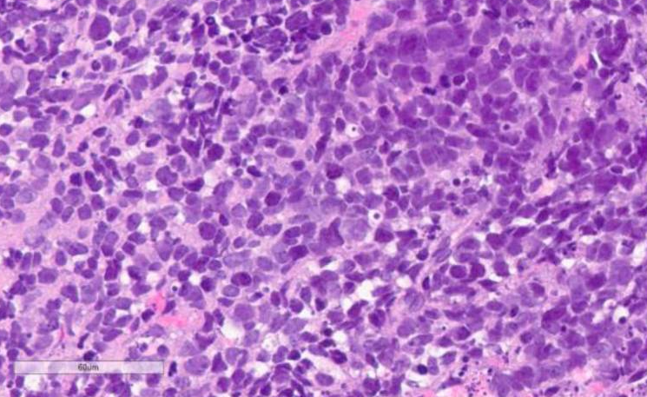
SCLC: One-Size-Fits-All Diagnosis
Small cells, high N-C ratio
High mitotic rate, transcriptionally active cancer
Majority express TTF-1, neuroendocrine markers
(ie, synaptophysin, chromogranin, CD56)
SCLC H&E Micrograph
Raso. Cancers (Basel). 2021;13:820. Figure used without changes per CC BY 4.0 DEED Attribution 4.0 International license (https://creativecommons.org/licenses/by/4.0/).
Notes:
H&E, hematoxylin and eosin stain; N-C, nuclear-cytoplasmic; SCLC, small-cell lung cancer.

Slide 6
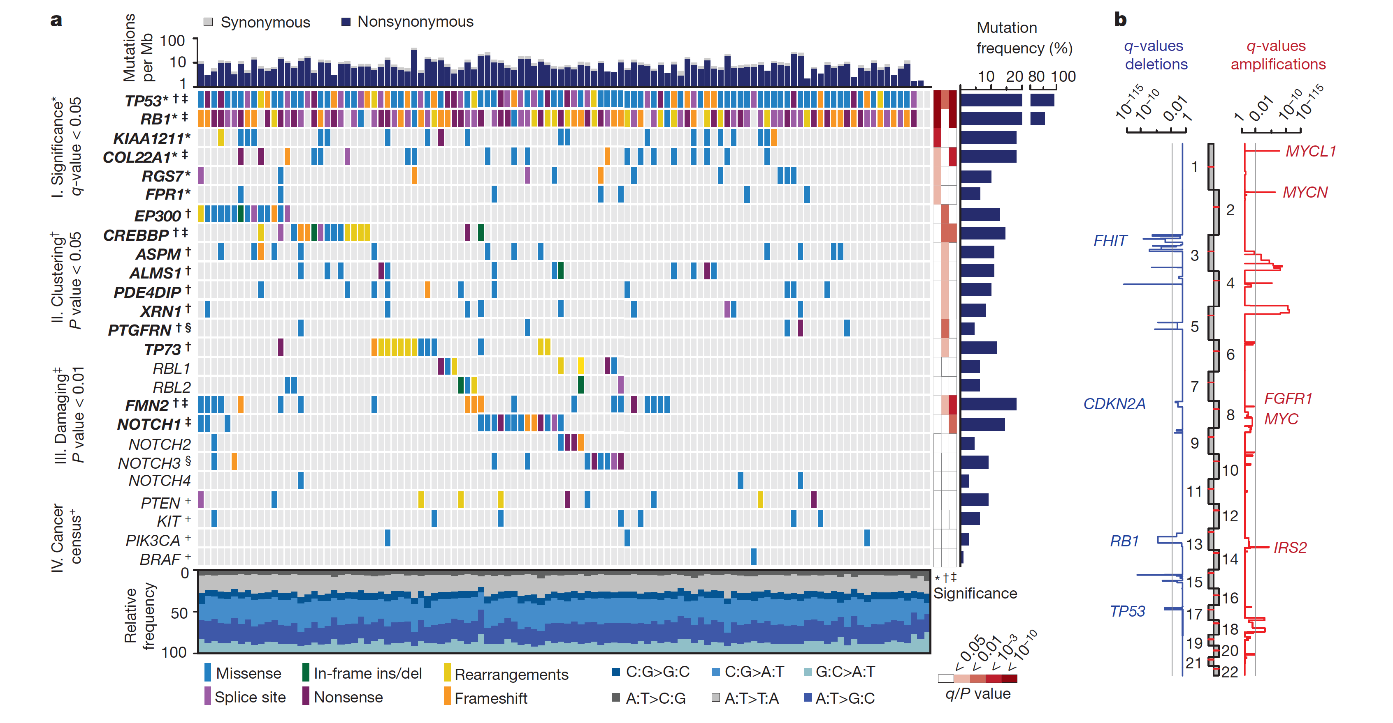
Genomic Profiles of SCLC: Summary
Nearly universal functional loss of TP53 and RB1
Frequent MYC amplification
Frequent mutations in known epigenetic regulators (EP300, CREBBP, MLL), Notch family members
Activating mutations in oncogenic drivers are rare (compared with NSCLC)
No consistent co-occurrence or mutual exclusivity of recurrent mutations
Genomic Alterations in SCLC
Rudin. Nat Rev Dis Primers. 2021;7:3. George. Nature. 2015;524:47.
Notes:
NSCLC, non-small-cell lung cancer; SCLC, small-cell lung cancer.

Slide 7
Lineage-Defining Transcription Factor Subsets of SCLC
Transcriptional Subtypes of SCLC*
Summary: OS With Chemo-IO by SCLC Subtype
SCLC-N
SCLC-A
SCLC-P
SCLC-I
SCLC-I
SCLC-P
SCLC-A
SCLC-N
↑ NEUROD1,
NE-Genes
↑ ASCL1,
NE-Genes
↑ POU2F3,
Immune
Genes
↑ Immune
Genes
↓ ASCL1,
POU2F3,
Immune
Genes
↓POU2F3,
NEUROD1,
Immune
Genes
↓ ASCL1,
NEUROD1,
NE-Genes
↓ ASCL1,
POU2F3,
NEUROD1,
NE-Genes
OS (%)
EMT, IFN Signaling, and Immune Cell† Infiltrate
ASCL1, NEUROD1, and POU2F3 expression defines SCLC subtypes with unique therapeutic vulnerabilities
  Subtype switching associated with acquired resistance to CT
Mo
Inflamed, mesenchymal subtype predicts
benefit with IO addition to CT
*NMF analysis of RNA-Seq data from 81 resected tumors, mostly LS-SCLC. Width of box depicts relative incidence. †T-cells, macrophages, NK cells, etc.
Gay. Cancer Cell. 2021;39:346.
Notes:
CT, chemotherapy; I-O, immuno-oncology; NK, natural killer; NMF, non-negative matrix factorization; OS, overall survival; SCLC, small-cell lung cancer.

Slide 8


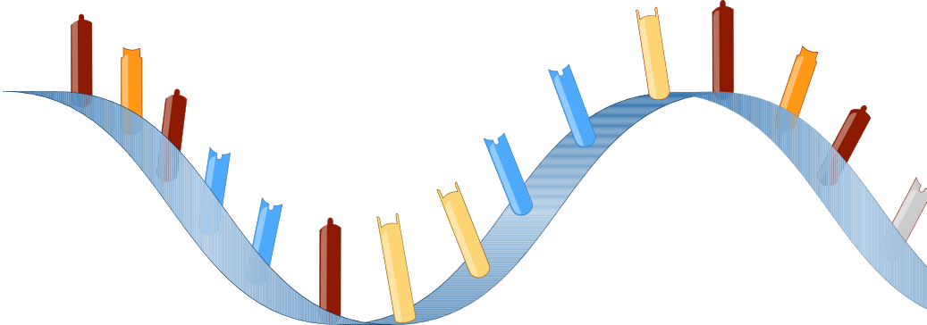
SCLC Subtypes Defined by DNA Methylation Patterns in Tumor and Circulating Free DNA Samples
Tumor Biopsy
Liquid Biopsy
RNA
DNA or cfDNA Methylation
cfDNA Methylation
Gene Ratio Classifier
DNA Methylation Classifier
Tracking of SCLC Subtype Evolution
SCLC-A
SCLC-N
SCLC-P
SCLC-I
SCLC-A
SCLC-N
SCLC-P
SCLC-I
Time
SCLC subtypes defined by RNA-Seq and predictive models have distinct methylation profiles that can be used for subtyping from both tissue and liquid biopsies
Heeke. Cancer Cell. 2024;42:225.
Notes:
SCLC, small-cell lung cancer.

Slide 9
Emerging Targets for Biomarker-Driven Therapies in SCLC
DLL3¹
  Inhibitory Notch pathway ligand highly upregulated and aberrantly expressed on surface of SCLC (upwards of 80%) and other high-grade neuroendocrine tumors
B7-H3²
  Member of B7 family of immune checkpoint proteins, highly expressed in cancer cells, approximately two thirds of SCLC
TROP-2³
  Trophoblast antigen 2, cell surface protein highly expressed in cancer cells, approximately one third of SCLC
1. Owen. J Hematol Oncol. 2019;12:61. 2. Carvajal-Hausdorf. J Immunother Cancer. 2019;7:65.
3. Inamura. Oncotarget. 2017;8:28725.
Notes:
SCLC, small-cell lung cancer.

Slide 10
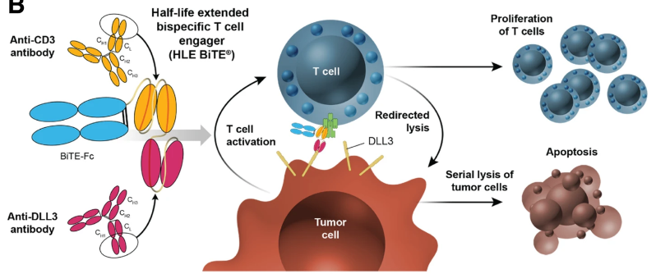
Emerging Therapies: Tarlatamab, a DLL3-targeted BiTE
Tarlatamab (AMG 757) is a bispecific T-cell engager immune therapy that binds DLL3 and CD3, leading to T-cell–mediated tumor lysis^{1,2}
1. Giffin. Clin Cancer Res. 2021;27:1526. 2. Owen. J Hematol Oncol. 2019;12:61. Figure used without changes
per CC BY 4.0 DEED Attribution 4.0 International license (https://creativecommons.org/licenses/by/4.0/).
Notes:
BiTE, bispecific T-cell engager.

Slide 11
DeLLphi-301: Tarlatamab in Relapsed ES-SCLC
Open-label phase II study
  Patients required to have received 1 platinum-based regimen and ≥1 other line of tx; median lines of tx: 2 (range: 1-8)
Part 1: Dose Evaluation
Part 2: Dose Expansion
Part 3: Reduced Inpatient Monitoring Period
Patients with ES-SCLC; ≥2 prior lines of tx, including
platinum-based CT; treated, stable
brain mets allowed; ECOG PS 0-1
(N = 222)
Tarlatamab 10 mg*
D8, D15, Q2W thereafter
(n = 88)
Tarlatamab 10 mg*
D8, D15, Q2W thereafter
(n = 12)
Tarlatamab 10 mg*
D8, D15, Q2W thereafter
(n = 34)
Tarlatamab 100 mg*
D8, D15, Q2W thereafter
(n = 88)
*1 mg on D1.
Primary endpoints: ORR per RECIST v1.1 by BICR
Secondary endpoints: DoR, DCR, PFS, OS, safety, drug serum concentration
Ahn. NEJM. 2023;389:2063. NCT05060016.
Notes:
BICR, blinded independent central review; CT, chemotherapy; DCR, disease control rate; DoR, duration of response; ECOG, Eastern Cooperative Oncology Group; ES-SCLC, extensive-stage small-cell lung cancer; mets, metastases; ORR, objective response rate; OS, overall survival; PFS, progression-free survival; PS, performance status; RECIST, Response Evaluation Criteria in Solid Tumors; SCLC, small-cell lung cancer; tx, therapy.

Slide 12
DeLLphi-301: Response
Outcome | Tarlatamab 10 mg (n = 100) | Tarlatamab 100 mg (n = 88)
ORR, % (97.5% CI) Confirmed CR, n (%) Confirmed PR, n (%) | 40 (29-52) 1 (1) 39 (39) | 32 (21-44) 7 (8) 21 (24)
SD, n (%) | 30 (30) | 27 (31)
PD, n (%) | 20 (20) | 13 (15)
Death before post-BL scan, n (%) | 6 (6) | 13 (15)
No post-BL scan, n (%) | 2 (2) | 3 (3)
Observed DoR, n/N (%) ≥3 mo ≥6 mo ≥9 mo | 35/40 (88) 23/40 (58) 10/40 (25) | 25/28 (89) 17/28 (61) 10/28 (36)
Median time to response, mo (range) | 1.4 (1.1-2.8) | 1.4 (1.2-9.6)
Ongoing response at data cutoff, n/N (%) | 22/40 (55) | 16/28 (57)
DCR, % (95% CI) | 70 (60-79) | 63 (52-73)
Median duration of disease control, mo (95% CI) | 6.9 (5.4-9.7) | 6.7 (4.2-NE)
Antitumor Activity With Tarlatamab 10 mg (n = 91)
Response
CR
PR
SD
PD
NE
DLL3 Expression
NE/unavailable
Undetectable
(All other detectable)
120
100
80
60
40
Best Change From BL in SoD (%)
20
0
-20
-40
-60
-80
-100
Ahn. NEJM. 2023;389:2063.
Notes:
BL, baseline; CR, complete response; DCR, disease control rate; DoR, duration of response; NE, not evaluable; ORR, objective response rate; PD, progressive disease; PR, partial response; SD, stable disease; SoD, sum of diameters.

Slide 13
DeLLphi-301: Onset and Duration of Response
Tarlatamab 10 mg (n = 40)
First response (≥ PR)
PD
Treatment ongoing
Death
Patients
0
10
20
30
40
50
60
70
80
Duration of Treatment (Wk)
Ahn. NEJM. 2023;389:2063.
Notes:
PD, progressive disease; PR, partial response.

Slide 14
DeLLphi-301: Survival
PFS
OS
Median OS,
Mo (95% CI)
14.3 (10.8-NE)
NE (12.4-NE)
Median PFS,
Mo (95% CI)
4.9 (2.9-6.7)
3.9 (2.6-4.4)
Tarlatamab 10 mg
Tarlatamab 100 mg
100
Tarlatamab 10 mg
Tarlatamab 100 mg
100
80
80
73
68
PFS (%)
60
OS (%)
60
71
66
40
40
28
40
20
34
20
27
0
0
0
3
6
Mo
9
12
15
0
3
6
Mo
9
12
15
18
Patients at Risk, n
Tarlatamab 10 mg
Tarlatamab 100 mg
100
88
53
41
35
26
18
15
2
3
0
0
100
88
84
62
67
53
44
39
17
16
3
2
0
0
Ahn. NEJM. 2023;389:2063.
Notes:
OS, overall survival; PFS, progression-free survival.

Slide 15
DeLLphi-301: Safety
CRS and ICANS During Treatment With Tarlatamab 10 mg (n = 133)
Cycle 1
Cycle 2
Cycle 3
Tarlatamab Dose
Timing of AE
D1: 1 mg
D1-7
D8: 10 mg
D8-14
D15: 10 mg
D15-27
D1: 10 mg
D1-14
D15: 10 mg
D15-27
D1: 10 mg
D1-14
100
Patients (%)
50
45
40
Any grade
Grade 3 or 4
40
35
30
28
25
20
15
10
6
5
1
1
0
0
2
0
0
2
0
2
0
3
0
2
0
1
0
1
0
0
0
0
CRS
ICANS
CRS
ICANS
CRS
ICANS
CRS
ICANS
CRS
ICANS
CRS
ICANS
Event
Ahn. NEJM. 2023;389:2063.
Notes:
AE, adverse event; CRS, cytokine-release syndrome; ICANS, immune effector cell‒associated neurotoxicity syndrome.

Slide 16
Emerging Therapies: BI 764532, a DLL3-targeted BiTE
BI 764532 is a bispecific T-cell engager that binds DLL3 and CD3, leading to
T-cell–mediated lysis of DLL3-expressing tumor cells
Cytolytic synapse
Anti-CD3
Anti-DLL3
CD3
DLL3
Activated T cell
Cancer cell lysis
Human IgG-like structure
Inactive
T cell
Cancer
cell
CD3
DLL3
BI 764532
Wermke. WCLC 2023. Abstr OA01.05.
Notes:
BiTE, bispecific T-cell engager.

Slide 17
Phase I Study of BI 764532: Study Design
First-in-human phase I dose escalation trial of BI 764532 IV
  Initially Q3W switched to QW1 based on emerging PK data, then finally included step-up dosing during first
  3 cycles to reduce risk of CRS and IRR
  Given until PD, clinical deterioration, or 36 mo
Primary endpoints: MTD, DLTs in MTD evaluation period
Key secondary endpoints: ORR by RECIST v1.1, PK parameters
Key inclusion criteria: patients with adv SCLC, epNEC, or LCNEC ineligible for or with relapse on standard tx (including ≥1 line of platinum CT for SCLC); DLL3 positive on tissue*; stable, asymptomatic brain mets allowed; ECOG PS 0/1 with adequate liver, bone marrow, renal function
Baseline Characteristic | All Patients (N = 107†)
Median age, yr (range) | 60 (32-79)
Male/female, n (%) | 61 (57)/46 (43)
ECOG PS 0/1, n (%) | 28 (26)/78 (73)
Brain/liver metastases | 41 (38)/60 (56)
SCLC/epNEC/LCNEC, % | 53/38/8
Prior lines tx 1-2/≥3, n (%) | 72 (67)/33 (31)
Prior anti–PD-1/PD-L1, n (%) | 52 (49)
*Archived or in-study biopsy; Ventana DLL3 SP347 IHC by central review. †≥1 dose BI 764532 (safety population). Data cutoff: March 26, 2023.
Wermke. WCLC 2023. Abstr OA01.05. NCT04429087.
Notes:
Adv, advanced; CRS, cytokine-release syndrome; CT, chemotherapy; DLT, dose-limiting toxicity; ECOG, Eastern Cooperative Oncology Group; epNEC, extrapulmonary neuroendocrine carcinoma; IRR, infusion-related reaction; LCNEC, large-cell neuroendocrine carcinoma; mets, metastases; MTD, maximum tolerated dose; ORR, objective response rate; PD, progressive disease; PK, pharmacokinetic; PS, performance status; RECIST, Response Evaluation Criteria in Solid Tumors; SCLC, small-cell lung cancer; tx, therapy.

Slide 18
Phase I Study of BI 764532: Overall Efficacy
Antitumor Activity With BI 764532 (N = 99*)
150
Response, n (%) | BI 764532
 | All (N = 99)* | SCLC (n = 54)* | LCNEC (n = 8)*
PR | 18 (18) | 10 (19) | 3 (38)
SD | 23 (23) | 11 (20) | 3 (38)
PD | 45 (45) | 23 (43) | 2 (25)
DCR | 41 (41) | 21 (39) | 6 (75)
NE† | 13 (13) | 10 (19) | 0
Best Change from BL in SOD (%)
120
Dose Level
Response
<90 µg/kg
≥90 µg/kg
90
PD
SD
PR
Ongoing
60
30
0
-30
-60
*≥1 post BL or d/c prior to tumor assessment (efficacy population).
†d/c prior to tumor assessment.
-90
-120
Efficacy observed predominantly at doses ≥90 µg/kg
Wermke. WCLC 2023. Abstr OA01.05.
Notes:
BL, baseline; d/c, discontinued; DCR, disease control rate; LCNEC, large-cell neuroendocrine carcinoma; NE, not evaluable; PD, progressive disease; PR, partial response; SCLC, small-cell lung cancer; SD, stable disease; SOD, sum of diameters.

Slide 19
Phase I Study of BI 764532: Efficacy in SCLC and LCNEC
Best Change From BL in SOD (%)
Antitumor Activity With BI 764532 at ≥90 µg/kg (n = 44)
Response, n (%) | BI 764532 ≥90 µg/kg
 | SCLC (n = 39)* | LCNEC (n = 5)*
PR | 10 (26) | 3 (60)
SD | 10 (26) | 2 (40)
PD | 12 (31) | 0
DCR | 20 (51) | 5 (100)
NE† | 7 (18) | 0
100
LCNEC
SCLC
Ongoing
PD
PD
50
PD
PD
PD
PD
PD
SD
SD
PD
SD
PD
SD
SD
PD
0
SD
SD
SD
PD
SD
SD
SD
PD
SD
PR
PR
-50
PR
PR
PR
PR
*≥1 post BL or d/c prior to tumor assessment (efficacy population). †d/c prior to tumor assessment.
PR
PR
PR
PR
PR
PR
100
PR
Wermke. WCLC 2023. Abstr OA01.05.
Notes:
BL, baseline; d/c, discontinued; DCR, disease control rate; LCNEC, large-cell neuroendocrine carcinoma; NE, not evaluable; PD, progressive disease; PR, partial response; SCLC, small-cell lung cancer; SD, stable disease; SOD, sum of diameters.

Slide 20
Phase I Study of BI 764532: DoR
DoR, Mo*
6.6
10.6
9.2
2.8
4.6
4.0
3.9
4.5
3.0
4.2
1.2
1.2
<1
LCNEC
SCLC
Patients
Tumor Response and Status
Response ongoing
PR
SD
PD
0
1
2
3
4
5
6
7
8
9
10
11
12
13
14
15
Treatment Duration (Mo)
Responses ongoing in majority of responding patients (10 of 13)
*Data cutoff: April 21, 2023.
Wermke. WCLC 2023. Abstr OA01.05.
Notes:
DoR, duration of response; LCNEC, large-cell neuroendocrine carcinoma; PD, progressive disease; PR, partial response; SCLC, small-cell lung cancer; SD, stable disease.

Slide 21
Emerging Therapies: Ifinatamab Deruxtecan, a B7-H3–Targeted Antibody–Drug Conjugate
Humanized Anti–B7-H3
IgG1 mAb
Deruxtecan
High-potency, membrane-permeable payload with short systemic half-life
Optimized DAR: ~4:1
Stable linker payload
Tumor-selectable cleavable linker
Bystander killing effect
O
HN
O
HN
O
HN
O
N
O
NH
NH
O
N
H
O
O
H
O
H
H
O
N
O
H₃C
N
OH
O
CH₃
Tetrapeptide-Based
Cleavable Linker
F
Topoisomerase I Inhibitor
Payload (DXd)
Exatecan derivative
​​Johnson. WCLC 2023. Abstr OA05.05.
Notes:
DAR, drug:antibody ratio; DXd, deruxtecan; mAb, monoclonal antibody.

Slide 22
Phase I/II Study of I-DXd in Refractory SCLC:
Study Design
Multicenter, open-label, first-in-human phase I/II study (DS7300-A-J101; data cutoff: Jan 31, 2023)
  Cohort of patients with SCLC received median of 2 prior systemic tx (range: 1-7), 81.8% chemo-IO
Dose Escalation (Patients With SCLC Shown)
Dose Expansion
Patients with advanced/unresectable or metastatic solid tumors*;
no prospective selection for
B7-H3 expression†
(N ≈ 205 overall;
N = 22 with SCLC)
I-DXd IV Q3W
I-DXd IV 12 mg/kg Q3W
Efficacy-evaluable patients with SCLC dosed at
≥6.4 mg/kg
(n = 21)
16.0 mg/kg (n = 2)
Cohort 1: ESCC (n = 25)
12.0 mg/kg (n = 8)
8.0 mg/kg (n = 10)
Cohort 2: mCRPC (n = 40)
6.4 mg/kg (n = 1)
Cohort 3: sqNSCLC (n = 20)
*Tumor types: HNSCC, ESCC, mCRPC, sqNSCLC, SCLC, bladder cancer, sarcoma, endometrial cancer, melanoma, and breast cancer. †BL tumor biopsies retrospectively examined for B7-H3 by IHC.
‡Minimum effective dose. §n = 1 not evaluable for efficacy.
4.8 mg/kg‡ (n = 0)
3.2 mg/kg (n = 1§)
1.6 mg/kg (n = 0)
0.8 mg/kg (n = 0)
Primary endpoints: dose escalation: DLTs, SAEs, TEAEs, AESIs; dose expansion: ORR, DoR, DCR, PFS, OS
Key secondary endpoints: PK, immunogenicity
Johnson. WCLC 2023. Abstr OA05.05. NCT04145622.
Notes:
AESI, adverse event of special interest; BL, baseline; DCR, disease control rate; DLT, dose-limiting toxicity; DoR, duration of response; ESCC, esophageal squamous cell carcinoma; HNSCC, head and neck squamous cell carcinoma; I-DXd, ifinatamab deruxtecan; IHC, immunohistochemistry; mCRPC, metastatic castration-resistant prostate cancer; ORR, objective response rate; PK, pharmacokinetics; PFS, progression-free survival; ORR, objective response rate; OS, overall survival; SAE, serious adverse event; SCLC, small-cell lung cancer; sqNSCLC, squamous non-small-cell lung cancer; TEAE, treatment-emergent adverse event.

Slide 23
Phase I/II Study of I-DXd in Refractory SCLC:
Antitumor Activity
Confirmed Responses by RECIST v1.1 | I-DXd ≥6.4 mg/kg (n = 21)
ORR, % (95% CI) | 52.4 (29.8-74.3)
CR, % | 4.8
PR, % | 47.6
40
Active
Off treatment
100
20
80
60
0
40
-20
20
% Change in Sum of Diameters
from BL in Target Lesions
Best % Change in Sum of Diameters From BL in Target Lesions
-40
0
-20
-60
-40
-80
-60
-80
-100
-100
0
10
20
30
40
50
Wk Since Start of Treatment
Starting Dose Level:
6.4 mg/kg
8.0 mg/kg
12.0 mg/kg
16.0 mg/kg
Median follow-up: 11.7 mo (95% CI: 4.6-12.9)
Median time to response: 1.2 mo (95% CI: 1.2-1.4)
Median DoR: 5.9 mo (95% CI: 2.8-7.5)
2 patients remain on treatment
Johnson. WCLC 2023. Abstr OA05.05.
Notes:
BL, baseline; CR, complete response; DoR, duration of response; I-DXd, ifinatamab deruxtecan; ORR, objective response rate; PR, partial response; RECIST, Response Evaluation Criteria in Solid Tumors; SCLC, small-cell lung cancer.

Slide 24
Phase I/II Study of I-DXd in Refractory SCLC:
Safety
Most Common TEAEs (Incidence ≥10%), n (%) | SCLC* (N = 22)
Most Common TEAEs (Incidence ≥ 10%) | Any Grade | Grade ≥ 3
Nausea | 13 (59.1) | 1 (4.5)
Fatigue | 11 (50.0) | 0
Anemia | 6 (27.3) | 1 (4.5)
Vomiting | 6 (27.3) | 0
Decreased appetite | 5 (22.7) | 1 (4.5)
Pyrexia | 4 (18.2) | 0
Constipation | 4 (18.2) | 1 (4.5)
IRR | 3 (13.6) | 0
Diarrhea | 3 (13.6) | 0
Dehydration | 3 (13.6) | 0
Dyspnea | 3 (13.6) | 0
Platelet count decreased | 3 (13.6) | 0
Arthralgia | 3 (13.6) | 0
Hyponatremia | 3 (13.6) | 0
Primary prophylaxis for nausea, vomiting, and IRR not permitted during cycle 1 of dose escalation
3 patients (13.6%) experienced ILD or pneumonitis (grade 1,
n = 2; grade 2, n = 1)
  All events adjudicated by ILD adjudication committee
  1 adjudicated as drug-related (grade 2, 8.0 mg/kg), and I-DXd was discontinued per protocol
  ILD considered recovered for n = 1 grade 1, not recovered for n = 1 each grade 1, grade 2
*I-DXd 3.2-16.0 mg/kg.
Johnson. WCLC 2023. Abstr OA05.05.
Notes:
I-DXd, ifinatamab deruxtecan; ILD, interstitial lung disease; IRR, infusion-related reaction; SCLC, small-cell lung cancer; TEAE, treatment-emergent adverse event.

Slide 25
Phase I/II Study of I-DXd in Refractory SCLC:
Correlative Biomarker Analyses
B7-H3 Level by BOR Status Among
Biomarker-Evaluable Patients (n = 17)
Outcome | B7-H3 < Median (n = 8) | B7-H3 ≥ Median (n = 9)
H-score range | 10-105 | 115-190
ORR, % | 62.5 | 55.6
Median PFS, mo (95% CI) | 5.8 (0.7-NA) | 5.3 (1.4-NA)
Median OS, mo (95% CI) | 12.2 (5.8-NA) | 6.9 (2.8-NA)
300
200
B7-H3 Expression Level
(Membrane/Cytosol H-Score)
100
0
Median B7-H3 membrane/cytosol H-score at
BL among biomarker-evaluable patients dosed at ≥6.4 mg/kg (n = 17): 115 (range: 10-190)
No correlation between B7-H3 membrane/
cytosol H-score with BOR, PFS, or OS
 | CR | PR | SD | PD | NE
 | (n = 1) | (n = 9) | (n = 4) | (n = 2) | (n = 1)
Median H-score | 170 | 105 | 157.5 | 89 | 90
H-score range | 170 | 70-150 | 66-190 | 10-168 | 90
Johnson. WCLC 2023. Abstr OA05.05.
Notes:
BL, baseline; BOR, best overall response; CR, complete response; I-DXd, ifinatamab deruxtecan; NA, not applicable; NE, not evaluable; ORR, objective response rate; OS, overall survival; PD, progressive disease; PFS, progression-free survival; PR, partial response; SCLC, small-cell lung cancer; SD, stable disease.

Slide 26
Emerging Therapies: Sacituzumab Govitecan, a TROP-2–Targeted Antibody–Drug Conjugate
HO
O
N
N
SN-38 Payload
Delivers 136-fold more to tumors than parent compound irinotecan
Unique chemistry improves solubility, selectively delivers
SN-38 to tumor
O
Humanized RS7 mAb
Targets TROP2
Type: hRS7 IgG1κ
O
O
O
O
[
]
H
H
O
N
O
Lys-N
CH₂O
7
O
O
N
N
N
O
H
O
N
N
S
Anti–TROP2 mAb
Linker for SN-38
High DAR (7.6:1)
pH-sensitive linker for rapid release of payload at or inside tumor
O
Bystander effect: In acidic tumor microenvironment,
SN-38 is released from anti‒TROP-2 antibody and diffuses into neighboring TROP-2‒negative cells
Goldenberg. Oncotarget. 2015;6:22496. Goldenberg. MAbs. 2019;11:987. Sacituzumab govitecan PI.
Notes:
DAR, drug:antibody ratio; mAb, monoclonal antibody.

Slide 27
TROPiCS-03: Sacituzumab Govitecan in
Relapsed ES-SCLC
Open-label, multicohort phase II basket trial in LA/metastatic solid tumors, including
ES-SCLC (data cutoff: July 27, 2023; median f/u: 5.1 mo)
ES-SCLC Cohort
Patients with ES-SCLC with PD after
1 prior line of platinum-based chemotherapy and anti‒PD-1/PD-L1 therapy; measurable disease;
ECOG PS 0-1; no known active
CNS metastases and/or
carcinomatous meningitis
(N = ~40)
Sacituzumab Govitecan 10 mg/kg IV
on Day 1, 8 of 21-day cycles
Until PD or
unacceptable toxicity
Primary endpoint: ORR by investigator*
Secondary endpoints: DoR, CBR, PFS by investigator*; ORR, DoR, CBR, PFS by BICR*; OS; safety
*Per RECIST v1.1.
Dowlati. ESMO 2023. Abstr 199MO.
Notes:
BICR, blinded independent central review; CBR, clinical benefit rate; CNS, central nervous system; DCR, disease control rate; DoR, duration of response; ECOG, Eastern Cooperative Oncology Group; ES-SCLC, extensive-stage small-cell lung cancer; f/u, follow-up; LA, locally advanced; ORR, objective response rate; OS, overall survival; PD, progressive disease; PFS, progression-free survival; PS, performance status.

Slide 28
TROPiCS-03: Response
Antitumor Activity With SG (n = 29*)
Outcome | ES-SCLC (n = 30)
ORR,† % (95% CI) | 37 (20-56)
Best overall response, n (%) PR (confirmed) SD PD | 11 (37) 15 (50) 3 (10)
CBR‡, % (95% CI) | 40 (23-59)
Median DoR, mo (95% CI) 6-mo DoR, % (95% CI) | 6.3 (2.7-NR) 63 (14-89)
100
Best Overall Response
Confirmed PR (n = 11)
SD (n = 15)
PD (n = 3)
50
0
Best Change From BL (%)
-50
*n = 1 without post-BL assessment.
-100
Patient
†Confirmed CR + PR. ‡Confirmed CR + PR + SD ≥6 mo.
77% of patients (23/30) had any tumor reduction
43% of patients (13/30) had >30% tumor reduction
Dowlati. ESMO 2023. Abstr 199MO.
By investigator per RECIST v1.1. Includes patients enrolled on or before April 27, 2023.
Notes:
BL, baseline; CBR, clinical benefit rate; CR, complete response; DoR, duration of response; ES-SCLC, extensive-stage small-cell lung cancer; ORR, objective response rate; PD, progressive disease; PR, partial response; SD, stable disease; SG, sacituzumab govitecan.

Slide 29
Go Online for More CCO
Coverage of Small-Cell Lung Cancer!
CME-certified text module with associated downloadable slideset
Expert-authored commentary on emerging novel therapies for management of ES-SCLC
clinicaloptions.com

