Slide 1
Spectrum of HER2 Expression and Its Clinical Implications in Breast Cancer
Provided by Clinical Care Options, LLC
Sara M. Tolaney, MD, MPH
Associate Professor of Medicine
Division of Breast Oncology
Harvard Medical School
Chief, Division of Breast Oncology
Breast Oncology Program
Dana-Farber Cancer Institute
Boston, Massachusetts
Supported by educational grants from AstraZeneca and Daiichi Sankyo, Inc.

Slide 2

About These Slides
Please feel free to use and share some or all of these slides in your noncommercial presentations to colleagues or patients
When using our slides, please retain the source attribution:
These slides may not be published, posted online, or used in commercial presentations without permission. Please contact permissions@clinicaloptions.com for details
Slide credit: clinicaloptions.com
Notes:
Disclaimer: The materials published on the Clinical Care Options website reflect the views of the authors of the CCO material, not those of Clinical Care Options, LLC, the CME providers, or the companies providing educational grants. The materials may discuss uses and dosages for therapeutic products that have not been approved by the United States Food and Drug Administration. A qualified healthcare professional should be consulted before using any therapeutic product discussed. Readers should verify all information and data before treating patients or using any therapies described in these materials.

Slide 3
Faculty Disclosures
The faculty reported the following relevant financial relationships or relationships to products or devices they have with ineligible companies related to the content of this educational activity:
Sara M. Tolaney, MD, MPH: consultant/advisor: 4D Pharma, Aadi Biopharma, ARC Therapeutics, Artios Pharma, AstraZeneca, Bayer, BeyondSpring Pharmaceuticals, Blueprint Medicines, Bristol Myers Squibb, CytomX Therapeutics, Daiichi Sankyo, Eisai, Ellipses Pharma, Genentech/Roche, Gilead, Incyte Corp, Infinity Therapeutics, Jazz Pharmaceuticals, Lilly, Menarini/Stemline, Merck, Myovant, Novartis, OncoSec Medical Inc., OncXerna, Pfizer, Reveal Genomics, Sanofi, Seattle Genetics, Umoja Biopharma, Zentalis, Zetagen, Zymeworks; researcher (paid to institution): AstraZeneca, Bristol Myers Squibb, Eisai, Exelixis, Genentech/Roche, Gilead, Gilead, Lilly, Merck, NanoString Technologies, Novartis, OncoPep, Pfizer, Seattle Genetics.
Notes:
This slide lists the disclosure information of the faculty and staff involved in the development of these slides.

Slide 4
Overview of HER2 in Breast Cancer
~15% of breast cancers
are considered HER2 “positive”
HER2 gene amplification
and/or HER2 protein overexpression is linked to a more aggressive phenotype
HER2 is a validated
therapeutic target
4%
7%
10%
HR+/HER2- (68%)
HR-/HER2- (10%)
HR+/HER2+ (10%)
HR-/HER2+ (4%)
Unknown (7%)
10%
68%
Ran. Onco Targets Ther. 2020;13:4385. seer.cancer.gov/statfacts/html/breast-subtypes.html. Slamon. Science. 1987;235:177.

Slide 5
Traditional View of HER2+ Breast Cancer
HER2+
Tumors lacking ERBB2 overexpression or amplification are collectively defined as HER2- tumors
HER2-
Wolff. J Clin Oncol. 2018;36:2105.

Slide 6
Evolving Spectrum of HER2 Expression in Breast Cancer
ERBB2-amplified
With benefit from the therapeutic inhibition of the HER2 pathway
ERBB2 nonamplified
Without benefit from HER2 inhibition -Targetable with novel ADCs
HER2+
HER2+
DESTINY-Breast01 Trial
HER2-
HER2-0
HER2-low
DESTINY-Breast04 Trial
Adapted from: Tarrantino. Cancer Discov. 2022;12:2026.
Notes:
ADC, antibody–drug conjugate.

Slide 7
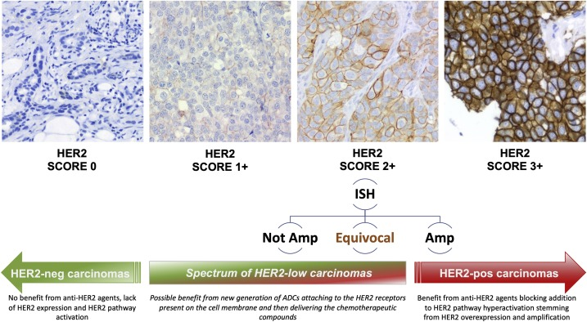
Classification of HER2 in Breast Cancer
No staining observed OR
Incomplete and faint/barely perceptible membrane staining in ≤10% tumor cells
Incomplete membrane staining that is faint/barely perceptible and in >10% tumor cells
Weak to moderate complete membrane staining observed in >10% of tumor cells
Circumferential membrane staining; complete; intense; in >10% of tumor cells
HER2 Score 0
HER2 Score 1+
HER2 Score 2+
HER2 Score 3+
ISH
Not Amp
Equivocal
Amp
HER2-: No approved anti-HER2 agent between 2000 and 2021
HER2+
Marchiò. Semin Cancer Biol. 2021:72:123. Wolff. JCO. 2023;41:3867.
Notes:
ISH, in situ hybridization.

Slide 8
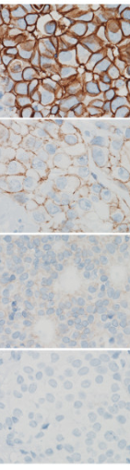
ASCO/CAP Guidelines for HER2 Classification
Immunohistochemistry | Interpretation | Recommendation
HER2+ | IHC 3+ = circumferential membrane staining that is complete, intense and in >10% of tumor cells | Should recommend HER2-targeted therapy if there is no apparent histopathologic discordance and if clinically appropriate
HER2 equivocal | IHC 2+ = weak to moderate complete membrane staining observed in >10% of tumor cells | Must order a reflex test of same specimen using ISH or order a new test (new specimen if available, using IHC or ISH)
HER2- | IHC 1+ = incomplete membrane staining that is faint/barely perceptible and in >10% of tumor cells IHC 0 = no staining is observed or membrane staining that is incomplete and is faint/barely perceptible and in ≤10% of tumor cells | Do not recommend HER2-targeted therapy if the HER2 test result is negative and if there is no apparent histopathologic discordance
health.ucdavis.edu/blog/lab-best-practice/current-challenges-for-her2-immunohistochemistry-testing-in-diagnostic-pathology/2019/05. Wolff. JCO. 2023;41:3867. Image from Nitta. Diagn Pathol 2012;7:60. Licensed under Creative Commons Attribution 3.0 Unported License (CC BY 3.0).
Notes:
ASCO, American Society of Clinical Oncology; CAP, College of American Pathologists; IHC, immunohistochemistry; ISH, in situ hybridization.

Slide 9
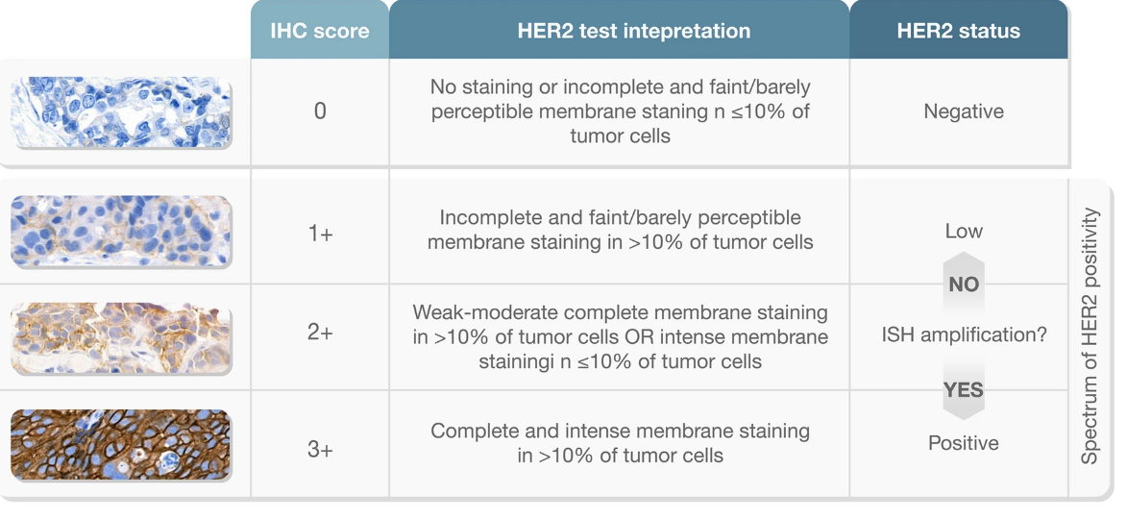
HER2 Positivity Based on the DESTINY-Breast04 Trial
IHC score | Interpretation of HER2 test | HER2 status
0 | No staining or incomplete and faint/barely perceptible membrane staining in ≤10% of TCs | Negative
1+ | Incomplete and faint/barely perceptible membrane staining in >10% of TCs | Low
2+ | Weak to moderate complete membrane staining in >10% of TCs or intense membrane staining in ≤10% of TCs | ISH amplification?
3+ | Complete and intense membrane staining in >10% of TCs | Positive
NO
Spectrum of HER2 Positivity
YES
Ivanova. Virchows Arch. 2023;[Epub].
Notes:
IHC, immunohistochemistry; ISH, in situ hybridization; TC, tumor cell.

Slide 10
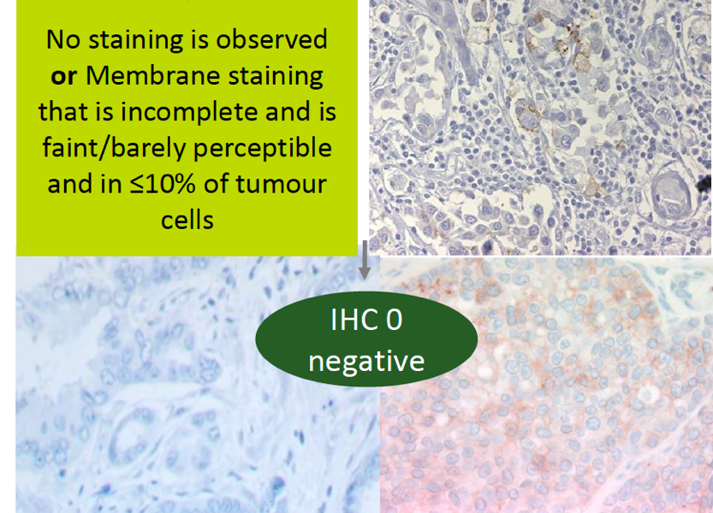
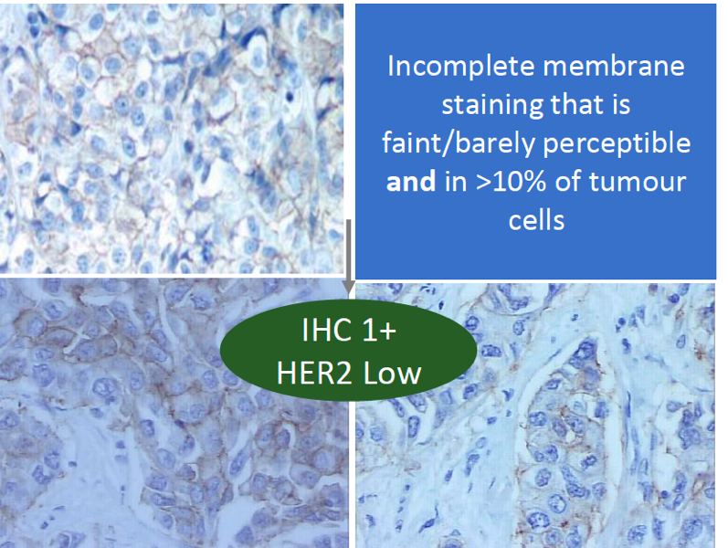
Low Concordance Among Pathologists Between HER2 IHC 0 and HER2 IHC 1+
In a recent study, among 18 experienced pathologists there was only 26% concordance between the diagnoses of HER2 IHC 0 and HER2 IHC 1+
Of importance, HER2 0 does not mean absence of HER2, as it also includes tumors with “ultralow” expression
No staining observed
or
Membrane staining
is incomplete and faint/barely perceptible and in ≤10% of
TCs
Incomplete membrane staining that is faint/barely perceptible and in >10% of
TCs
IHC 0
(HER2-)
IHC 1+
(HER2-low)
Fernandez. JAMA Oncol. 2022;8:1.
Notes:
IHC, immunohistochemistry; TC, tumor cell.

Slide 11
Discordance Even Within 1 Organ Within a Patient
HER2-2+, ISH negative
HER2-1+
HER2-ultralow
HER2-absent
NE
A
Patient ID #
1
D1
B
G
H
2
C
3
E
D2
F
4
5
Results: 5/6 of the patients had heterogeneity in HER2 status from different segments of the liver
6
A
B
C
D1
D2
E
F
G
H
0
5
10
Samples per patient, n
Segment of the Liver
Geukens. Eur J Cancer 2023;188:152.
Notes:
ISH, in situ hybridization; NE, not evaluated.

Slide 12
Instability of HER2-low Breast Cancer
Primary BC vs Matched Biopsy¹
Primary BC to Relapse²
Matched Paired Primary mTNBC³
HER2- low
or HER2+
HER2-low
HER2 0
HER2 0
HER2 IHC 0
HER2 IHC 0
PRIMARY BC
HER2-low
RELAPSE
HER2-low
HER2 0
HER20
HER2 IHC 1+
HER2+
HER2+
HER2 IHC 1+
HER2 status on primary tumor
K = .33
HER2 status on matched biopsy
HER2 IHC 2+
HER2 IHC 2+
Multiple studies have demonstrated instability of HER2-low expression from primary to metastatic breast cancer
Although the reason for this is unclear, it may be multifactorial involving:
  (Pre)analytical factors; heterogeneity in HER2 expression; biologic disease evolution
1. Tarantino. Eur J Cancer. 2022;163:35. 2. Miglietta. NPJ Breast Cancer. 2021;7:137. 3. Garrido-Castro. SABCS 2022; Abstr HER2-10.
Notes:
BC, breast cancer; mTNBC, metastatic triple-negative breast cancer

Slide 13
Prognostic Significance of HER2-low Breast Cancer
S
T
U
D
Y
N
S
E
T
T
I
N
G
H
R
+
T
N
B
C
A multitude of studies conducted to evaluate the prognostic role of HER2-low expression
Most studies found no OS difference in HER2-low vs HER2-0 BC, regardless of HR expression
Warning: retrospective studies; differences in populations, sample sizes, f/u duration; and most of the studies lack central pathology review
W
o
n
e
t
a
l
.
B
r
e
a
s
t
C
a
n
R
e
s
2
0
2
2
3
0
,
4
9
1
E
A
R
L
Y
T
a
n
e
t
a
l
.
B
M
C
M
e
d
2
0
2
2
2
8
,
2
8
0
E
A
R
L
Y
T
a
r
a
n
t
i
n
o
e
t
a
l
.
E
S
M
O
.
B
r
e
a
st
2022
2
5
,
2
3
5
E
A
R
L
Y
H
o
r
i
s
a
w
a
e
t
a
l
.
B
r
e
a
s
t
C
a
n
2
0
2
2
4
,
9
1
8
E
A
R
L
Y
D
e
n
k
e
r
t
e
t
a
l
.
L
a
n
c
O
n
c
2
0
2
1
2
,
3
1
0
E
A
R
L
Y
G
a
m
p
e
n
r
i
e
d
e
r
e
t
a
l
.
B
C
R
2
0
2
1
1
,
3
7
8
A
D
V
A
N
C
E
D
S
c
h
e
t
t
i
n
i
e
t
a
l
.
B
r
e
a
s
t
N
P
J
2
0
2
1
1
3
0
4
A
D
V
A
N
C
E
D
H
e
i
n
e
t
a
l
.
E
u
r
J
C
a
n
c
e
r
2
0
2
1
1
,
0
2
2
A
D
V
A
N
C
E
D
D
e
M
o
u
r
a
L
e
i
t
e
e
t
a
l
.
B
C
R
T
2
0
2
1
8
5
5
E
A
R
L
Y
A
g
o
s
t
i
n
e
t
t
o
e
t
a
l
.
C
a
n
c
e
r
s
2
0
2
1
8
0
4
E
A
R
L
Y
M
u
t
a
i
e
t
a
l
.
T
h
e
B
r
e
a
s
t
2
0
2
1
6
0
8
E
A
R
L
Y
J
a
c
o
t
e
t
a
l
.
C
a
n
c
e
r
s
2
0
2
1
2
9
6
E
A
R
L
Y
= no OS difference
= significant OS
difference
= not evaluated
T
a
r
a
n
t
i
n
o
e
t
a
l
.
E
u
r
3
2
A
D
V
A
N
C
E
D
J
C
a
n
c
e
r
2
0
2
1
2
Viale et al. SABCS 2022 | 574 | ADVANCED
Peiffer et al. SABCS 2022 | 1,136,016 | EARLY/ ADVANCED
P
r
o
g
n
o
s
i
s
e
v
a
l
u
a
t
e
d
i
n
t
e
r
m
s
o
f
O
v
e
r
a
l
l
S
u
r
v
i
v
a
l
Schlam. Breast 20223;67:116.
Notes:
BC, breast cancer; f/u, follow-up; HR, hormone receptor; OS, overall survival; TNBC, triple-negative breast cancer.

Slide 14
Definition of HER2-low Breast Cancer
Static Definition
Dynamic Definition (Real Life)
Testing HER2 by validated IHC assay
HER2-low status changes over time
  What is the appropriate timepoint to use in defining a tumor as HER2-low?
Circumferential membrane staining; complete, intense, and in >10% of TCs
IHC 3+
Weak to moderate complete membrane staining in >10% of TCs
IHC 2+
Incomplete membrane staining that is faint/barely perceptible and in >10% of TCs
IHC 1+
No staining observed
OR
Membrane staining that is incomplete, faint/barely perceptible, and in <10% of TCs
IHC 0+
Primary tumor HER2 IHC 1+
Rebiopsy After ET
HER2 IHC 0
Most Recent Biopsy
HER2 IHC 0
HER2+
Reflex ISH test positive
Reflex ISH test negative
HER2-low
HER2-
HER2+ BC 15%
HER2-low BC 45%-55%
Biopsy of Metastatic Recurrence
HER2 IHC 0
Rebiopsy After Chemotherapy
HER2 IHC 1+
HER2- BC
30%-40%
Tarantino. JCO.2020;38:1951.
Notes:
BC, breast cancer; ET, endocrine therapy; IHC, immunohistochemistry; TCs, tumor cells.

Slide 15
DESTINY-Breast04: Median PFS by Tumor Sample Characteristics
No. of Events
mPFS, Mo (95% Cl)
Subgroup
T-DXd
TPC
T-DXd
TPC
Hazard Ratio (95% Cl)
Tumor location
Primary (n = 196)
Metastases (n = 359)
96/136
145/235
43/60
84/124
9.6 (7.1-11.3)
10.9 (9.5-12.3)
4.2 (1.6-6.4)
5.4 (4.3-7.1)
0.47 (0.32-0.70)
0.50 (0.38-0.66)
Specimen Type
Biopsy (n = 448)
Excision/resection (n = 108)
189/299
53/73
103/149
24/35
10.9 (9.6-12.0)
7.5 (5.7-9.9)
5.3 (4.2-6.9)
3.0 (1.4-11.0)
0.46 (0.35-0.59)
0.57 (0.33-1.0)
Archival tissue (n = 482)
203/324
109/158
10.3 (8.6-12.0)
5.3 (4.2-7.0)
0.48 (0.37-0.61)
Newly obtained tissue (n = 75)
40/49
18/26
9.7 (5.6-10.9)
4.8 (2.8-6.9)
0.57 (0.30-1.1)
Tumor specimen collection date
2013 and earlier (n = 29)
2014-2018 (n = 175)
2019 or later (n = 310)
Missing (n = 43)
11/19
76/126
137/203
19/25
9/10
33/49
75/107
10/18
7.0 (2.8-NE)
11.4 (9.5-15.1)
9.8 (8.4-11.3)
6.6 (2.8-10.8)
6.8 (1.4-11.1)
4.3 (1.6-7.0)
5.1 (4.1-7.1)
2.8 (1.2-8.3)
0.78 (0.24-2.54)
0.44 (0.28-0.70)
0.49 (0.37-0.66)
0.54 (0.20-1.4)
Of the 555 samples, 35% were from the primary tumor site, 65% from metastatic sites (10% new biopsy)
Efficacy of T-DXd compared with TPC was consistent regardless of tumor sample characteristics
0
1
2
3
4
Hazard Ratio (T-DXd vs TPC)
Prat. SABCS 2022; Abstr HER2-18.
Notes:
m, median; PFS, progression-free survival; T-DXd, trastuzumab deruxtecan; TPC, treatment of physician’s choice.

Slide 16
Phase II DAISY Trial: Best Overall Response According to HER2 Expression Levels With T-DXd in Metastatic BC
Activity Seen in HER2 IHC 0 Cohort
HER2 IHC3+ or IHC2+/ISH+ (n = 68)
HER2 IHC 0 (n = 37)
ORR: 30%
HER2-Low (n = 72)
ORR: 37.5%
ORR: 71%
200
100
Progressive disease
Stable disease
Partial response
Complete response
180
80
160
Progressive disease
Stable disease
Partial response
Complete response
Progressive disease
Stable disease
Partial response
80
140
60
60
120
40
40
100
20
HR-
HR+
20
80
Best Change From BL in Target Lesion (%)
Best Change From BL in Target Lesion (%)
Best Change From BL in Target Lesions (%)
60
HR-
HR+
0
0
40
-20
20
-20
-40
0
-40
-20
-60
-40
-60
-80
-60
-80
-80
mDoR: 6.8 mo
mPFS: 4.2 mo
-100
-100
-100
Decreasing ORR by degree of HER2 IHC expression
Dieras. SABCS 2021. Abstr PD8-02. Trastuzumab deruxtecan PI.
Notes:
BC, breast cancer; HR+, hormone-receptor positive; HR-, hormone receptor negative; IHC, immunohistochemistry; in-situ hybridization; mDoR, median duration of response; mPFS, median progression-free survival; immunohistochemistry; ORR, overall response rate.

Slide 17
DESTINY-Breast06: T-DXd in Chemotherapy-Naive and HER2-ultralow Advanced/Metastatic Breast Cancer
Randomized, open-label phase III study
Stratified by: prior CDK4/6 inhibitor; HER2 IHC 2+ vs 1+ vs 0; prior taxane in nonmetastatic setting.
Patients with advanced/metastatic breast cancer with progression on 2 previous endocrine therapies; restricted to HR+ disease; HER2 low (IHC1+, or 2+) or HER2 ultralow (IHC* >0 <1+) based on central IHC assessment at diagnosis of first metastatic disease or later
(N = 850)
T-DXd
(n = 425)
Until PD or toxicity
Chemotherapy†
(n = 425)
†Investigator’s choice chemotherapy may consist of capecitabine, paclitaxel, or nab-paclitaxel.
Primary endpoint: PFS (per BICR) in HER2 IHC 1+/2+
Key secondary endpoint: OS in HER2 IHC 1+/2+ population, PFS and OS in ITT
Secondary endpoints: PFS (per INV) in HER2 1+/2+, ORR and DoR in HER2 1+/2+and ITT, safety and tolerability, symptoms, functioning and QoL
Exploratory: OS in HER2 IHC 1+/2+ population
*HER2 IHC >0 defined by any IHC staining up to 10% of tumor cells. Futility analysis in HER2 IHC 0+ cohort will be done.
NCT04494425.
Notes:
BC, breast cancer; BICR, blinded independent central review; DoR, duration of response; HR, hormone receptor positive; IHC, immunohistochemistry; ITT, intention to treat; ORR, objective response rate; OS, overall survival; PD, progressive disease; PFS, progression-free survival; QoL, quality of life; T-DXd, trastuzumab deruxtecan.

Slide 18
Past, Present, and Future of HER2-low Breast Cancer
ERBB2-amplified
With benefit from the therapeutic inhibition of the HER2 pathway
ERBB2 nonamplified
Without benefit from HER2 inhibition -Targetable with novel ADCs
HER2+
HER2+
HER2-
HER2-0
HER2-low
DESTINY-Breast04 Trial
?
HER2+
HER2+
HER2-0
HER2-0
Targetability with ADCs under investigation
HER2- ultralow
HER2-low
Continuous spectrum of HER2-low expression
?
DESTINY-Breast06 Trial
Adapted from: Tarrantino. Cancer Discov. 2022;12:2026.
Notes:
ADC, antibody–drug conjugate.

Slide 19



Potential Novel Avenues for HER2 Detection
More accurate and reproducible methods are needed to facilitate the identification of patients with HER2-low breast cancer
Current methods in development include:
Digital pathology¹
Quantitative methods²
RT-qPCR³
A recent study found that an automated AI-based solution scored HER2 accurately (82.1% agreement between AI HER2 score and scoring by pathologists)
One study developed an assay using quantitative IF coupled with a mass spectrometry standardized HER2 array to measure absolute amounts of HER2 protein, with higher sensitivity within the lower range of HER2 expression
In another study, a “one step”
RT-qPCR method to determine HER2 status by measuring HER2 RNA expression of tumor samples was investigated and compared to IHC/FISH results
Concordance between RT-qPCR and IHC/FISH was 95.53% and 100%, respectively
1. Globerson. SABCS. 2022. Abstr P6-04-05. 2. Moutafi. Lab Invest. 2022;102. 3. Al Banyahyati. ESMO Breast. 2020. Abstr 164P.
Notes:
AI, artificial intelligence; BC, breast cancer; FISH, fluorescence in situ hybridization; HER2, human epidermal growth factor receptor 2; IF, immunofluorescence; IHC, immunohistochemistry; RT-qPCR, reverse transcriptase quantitative polymerase chain reaction.

Slide 20
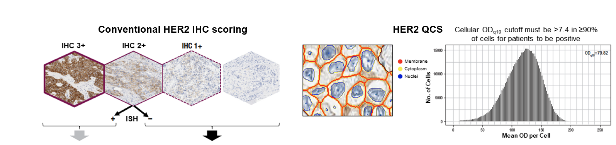
Efficacy Outcomes by Conventional HER2 IHC Scoring and HER2 QCS
Conventional HER2 IHC Scoring
HER2 QCS
IHC 3+
IHC 2+
IHC 1+
Cellular OD_{q10} cutoff must be >7.4 in ≥90% of cells for patients to be positive
15000
OD_{q10} = 79.82
10000
No. of Cells
+
-
5000
ISH
0
0
50
100
150
200
250
Mean OD per Cell
With T-DXd | HER2-positive (IHC 3+ or 2+/ISH) (n = 72) | HER2-negative (IHC 2+/ISH-, IHC 1+/0) (n = 65)
ORR, % | 56 | 42
mPFS, mo | 14.1 | 11.0
With T-DXd | HER2 QCS-high (OD_{q10} >7.4) (n = 40) | HER2 QCS-low (OD_{q10} <7.4) (n = 25)
ORR, % | 53 | 24
mPFS, mo | 14.5 | 8.6
Results demonstrate that HER2 QCS can potentially enhance the prediction of outcomes with T-DXd
by increasing the sensitivity and specificity of identifying patients with high and low HER2 expression
Gustavson. SABCS 2020. Abstr PD6-01.
Notes:
HER2, human epidermal growth factor receptor 2; IHC, immunohistochemistry; ISH, in situ hybridization; mPFS, median progression-free survival; OD, optical density; ORR, objective response rate; QCS, quantitative continuous score; T-DXd, trastuzumab deruxtecan.

Slide 21

Reverse Phase Protein Array
A novel quantitative HER2-based assay that uses FFPE samples
ER- Cohort (n = 107)
ER+ Cohort (n = 68)
1%
(n = 1)
4%
(n = 3)
Laser capture microdissection of slides
Lysate printing onto RPPA
Tissue lysis and protein extraction
29%
(n = 31)
37%
(n = 25)
71%
(n = 76)
57%
(n = 39)
Data generation via algorithm
Protein signal measurement
Ab staining for protein of interest
HER2 Score by RPPA
No/Extremely Low Expression
Low Expression
Moderate Expression
High Expression
Approximately 30% of ER- and 40% of ER+ HER2 IHC 0 classified tumors actually expressed modest amounts of HER2
Corgiat. SABCS. 2022. Abstr HER2-17.
Notes:
ER, estrogen receptor; IHC immunohistochemistry.

Slide 22
PROTEIN: Automated Quantitative Analysis (AQUA) of HER2
Investigators at Yale University are currently developing a mass spectrometry-based assay able to quantitatively assess the HER2 expression tumor tissue
The amount of HER2 protein is determined in combination with a display in array format for standardization
HER2 expression is measured in attomols (amol)/mm², supported by the AQUA™ method of analysis
Out of 364 cases, 67% previously reported as IHC 0 showed high HER2 expression (above the limit of quantification) using AQUA™ method of quantitative immunofluorescence
If clinically validated, it could serve as reflex test for IHC 0
HER2 quantification by LC-MS/MS (amol/µg of total protein)
HER2 expression determination
Breast TMA
Cell microarray of quantified cell lines
Epithelial tumor masking by binarizing CK signals
IF staining
Image acquisition
Image analysis
Cell area in mm² → transformation of HER2 expression
10000
8000
Visual assessment; cases with staining artifacts or <2% CK staining excluded from analysis
AQUA Score
6000
4000
2000
0
0
5
10
15
20
25
amol/µg to amol/mm²
Amol/mm²
Moutafi. Laboratory Investigation. 2022;102:1101.
Notes:
CK, cytokeratin; IF, immunofluorescence; IHC, immunohistochemistry; TMA, tissue microarray.

Slide 23
Go Online for More CCO
Coverage of Breast Cancer!
Downloadable slides
Other expert-authored text-based modules
Podcast
clinicaloptions.com/oncology

