Slide 1
MajesTEC-1 Update: Phase I/II Study of Teclistamab in Patients With R/R MM
CCO Independent Conference Highlights*
of the 2023 ASCO Annual Meeting, June 2-6, 2023, Chicago, Illinois
*CCO is an independent medical education company that provides state-of-the-art medical information to healthcare professionals through conference coverage and other educational programs.
Supported by educational grants from AbbVie, Geron, Jazz Pharmaceuticals, Lilly,
Merck Sharp & Dohme Corp., and Novartis.
Notes:
MM, multiple myeloma; R/R, relapsed/refractory.

Slide 2

About These Slides
Please feel free to use and share some or all of these slides in your noncommercial presentations to colleagues or patients
When using our slides, please retain the source attribution:
These slides may not be published, posted online, or used in commercial presentations without permission. Please contact permissions@clinicaloptions.com for details
Slide credit: clinicaloptions.com
Notes:
Disclaimer: The materials published on the Clinical Care Options website reflect the views of the authors of the CCO material, not those of Clinical Care Options, LLC, the CME providers, or the companies providing educational grants. The materials may discuss uses and dosages for therapeutic products that have not been approved by the United States Food and Drug Administration. A qualified healthcare professional should be consulted before using any therapeutic product discussed. Readers should verify all information and data before treating patients or using any therapies described in these materials.

Slide 3
MajesTEC-1 Update: Background
Teclistamab: first off-the-shelf anti-BCMA x CD3 bispecific antibody approved
for use in patients with R/R MM who have received ≥4 prior lines of therapy including a PI, IMiD, and anti-CD38 mAb¹
The pivotal phase I/II MajesTEC-1 trial evaluated the safety and efficacy of teclistamab in patients with R/R MM who were triple-class exposed (PI, IMiD,
and anti-CD38 mAb)²
  Primary analysis after median follow-up of 14.1 mo: ORR, 63.0% (≥ CR 39.4%); mDoR, 18.4 mo; mPFS, 11.3 mo; mOS, 18.3 mo²
Current analysis reports updated results of MajesTEC-1 after a median follow-up of
23 mo³
1. Teclistamab PI. 2. Moreau. NEJM. 2022;387:495. 3. van de Donk. ASCO 2023. Abstr 8011.
Notes:
BCMA, B-cell maturation antigen; IMiD, immunomodulatory drug; mAb, monoclonal antibody; mDoR, median duration of response; MM, multiple myeloma; mPFS, median progression-free survival; mOS, median overall survival; ORR, overall response rate; PI, proteasome inhibitor; R/R, relapsed/refractory.

Slide 4
MajesTEC-1 Update: Study Design
Open-label, dose-escalation/dose-expansion phase I/II trial (data cutoff: Jan 4, 2023)
Phase I
Phase II: Cohort A
Patients with R/R MM; triple-class exposed (IMiD,
PI, and anti-CD38 mAb);
no prior BCMA therapy; ECOG PS 0-1
(N = 165)
Option for responders to switch to Q2W/Q4W dosing†
Teclistamab
IV and SC escalation dosing
RP2D: 1.5 mg/kg SC QW*
Teclistamab
1.5 mg/kg SC QW*
*Step-up dosing: 0.06 and 0.3 mg/kg, 2-4 days between each dose.
Hospitalization and premedication with dexamethasone 16 mg, acetaminophen, and diphenhydramine.
†Q2W option if ≥ PR after ≥4 cycles (phase I) or ≥ CR for ≥6 mo (phase II); Q4W option if continued response on Q2W schedule.
Primary endpoint: ORR
Key secondary endpoints: PK/PD, DoR, PFS, OS, undetectable MRD, safety, and HRQoL
van de Donk. ASCO 2023. Abstr 8011.
Notes:
BCMA, B-cell maturation antigen; CR, complete response; DoR, duration of response; ECOG, Eastern Cooperative Oncology Group; IMiD, immunomodulatory drug; mAb, monoclonal antibody; MM, multiple myeloma; MRD, measurable residual disease; ORR, overall response rate; OS, overall survival; PFS, progression-free survival; PI, proteasome inhibitor; PK/PD, pharmacokinetics/pharmacodynamics; PR, partial response; PS, performance status; R/R, relapsed refractory; RP2D, recommended phase II dose.

Slide 5

MajesTEC-1 Update: Baseline Characteristics
Characteristic | Teclistamab (N = 165)
Median age, yr (range) | 64.0 (33.0-84.0)
Male, n (%) | 96 (58.2)
Race, n (%) White Black/African American Asian Other | 134 (81.2) 21 (12.7) 3 (1.8) 7 (4.2)
Extramedullary disease, n (%)* | 28 (17.0)
High-risk cytogenetics, n/N (%) | 38/148 (25.7)
ISS stage, n/N (%) I II III | 85/162 (52.5) 57/162 (35.2) 20/162 (12.3)
Characteristic | Teclistamab (N = 165)
Median time since diagnosis, yr (range) | 6.0 (0.8-22.7)
Median prior lines of therapy, no. (range) | 5 (2-14)
Prior SCT, n (%) | 135 (81.8)
Exposure status, n (%) Triple-class exposed† Penta-drug exposed‡ | 165 (100) 116 (70.3)
Refractory status, n (%) Anti-CD38 mAb Triple-class refractory† Penta-drug refractory‡ | 148 (89.7) 128 (77.6) 50 (30.3)
*Included soft-tissue plasmacytomas not associated with bone.
†≥1 each: PI, IMiD, and anti-CD38 mAb.
‡≥2 PIs, ≥2 IMiDs, and ≥1 anti-CD38 mAb.
At median follow-up of 23 mo, 47 patients remain on treatment (42 Q2W; 9 Q4W)
van de Donk. ASCO 2023. Abstr 8011.
Slide credit: clinicaloptions.com
Notes:
IMiD, immunomodulatory drug; ISS, International Staging System; mAb, monoclonal antibody; PI, proteasome inhibitor; SCT, stem cell transplant.

Slide 6
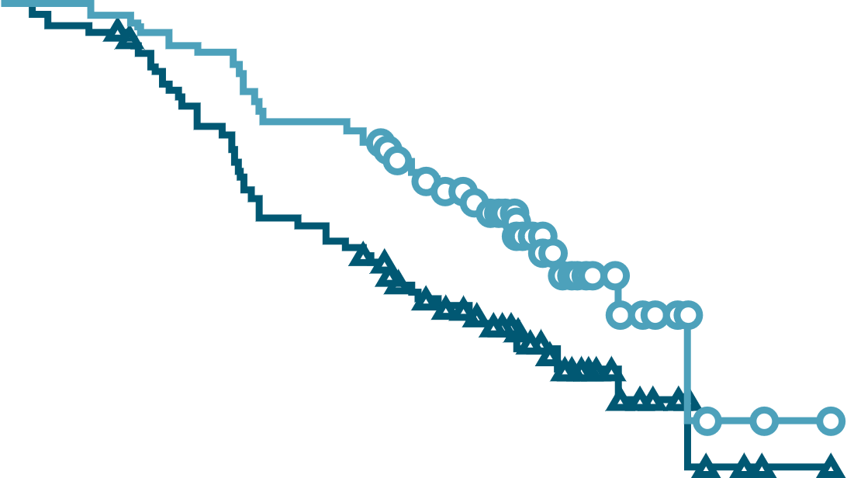
MajesTEC-1 Update: Response and Duration of Response
ORR: 63.0% (104/165)
DoR
100
80
≥ CR:
45.5%
60
Patients (%)
≥ VGPR:
59.4%
Patients (%)
40
20
Median (95% CI)
Overall: 21.6 (16.2-NE)
≥CR: 26.7 (21.6-NE)
0
Patients at Risk, n
0
75
104
3
75
101
6
72
92
9
70
82
12
63
71
15
58
61
18
50
51
21
30
32
24
12
13
27
3
4
30
1
1
33
0
0
36
0
0
Patient Subgroup | ORR, % (n/N)
≤3 prior lines of treatment | 74.4 (32/43)
>3 prior lines of treatment | 59.0 (72/122)
High-risk cytogenetics and/or EMD | 53.3 (32/60)
DoR (Mo)
≥CR
Overall
Median time to ≥ CR: 4.6 mo (range: 1.6-18.5)
van de Donk. ASCO 2023. Abstr 8011.
Slide credit: clinicaloptions.com
Notes:
CR, complete response; DoR, duration of response; EMD, extramedullary disease; NE, not estimable; ORR, overall response rate; PR, partial response; sCR, stringent complete response; VGPR, very good partial response.

Slide 7
MajesTEC-1 Update: Efficacy Summary
Parameter, Mo (95% CI) | All Patients (N = 165) | Patients With ≥ CR (n = 75)
Median PFS | 11 (9-16) | 27 (23-NE)
Median OS | 22 (15-NE) | NR (NE-NE)
Parameter, % (n/N) | Undetectable MRD (10⁻⁵ Threshold)
At Day 100 | 81.0 (32/42)
At any point | 81.5 (44/54)
van de Donk. ASCO 2023. Abstr 8011.
Slide credit: clinicaloptions.com
Notes:
CR, complete response; MRD, measurable residual disease; OS, overall survival; PFS, progression-free survival; NE, not estimable.

Slide 8
MajesTEC-1 Update:
Safety
AEs, n (%) | All Patients (N = 165)
AEs in ≥20% of Patients, n (%) | Any | Grade 3/4
Hematologic (≥20% of patients) Neutropenia Anemia Thrombocytopenia Lymphopenia Leukopenia | 118 (71.5) 90 (54.5) 70 (42.4) 60 (36.4) 33 (20.0) | 108 (65.5) 62 (37.6) 37 (22.4) 54 (34.5) 15 (9.1)
Nonhematologic (≥20% of patients) Infections CRS Diarrhea Pyrexia Fatigue COVID-19 Nausea Cough Injection-site erythema Arthralgia Headache Constipation Hypogammaglobulinemia | 132 (80.0) 119 (72.1) 56 (33.9) 52 (31.5) 48 (29.1) 48 (29.1) 45 (27.3) 44 (26.7) 43 (26.1) 42 (25.5) 40 (24.2) 36 (21.8) 34 (20.6) | 91 (55.2) 1 (0.6) 6 (3.6) 1 (0.6) 4 (2.4) 35 (21.2) 1 (0.6) 0 0 1 (0.6) 1 (0.6) 0 3 (1.8)
Special interest ICANS | 5 (3.0) | 0
Median treatment duration:
8.5 mo (range: 0.2-24.4)
Median relative dose intensity: 93.7%
1 AE led to dose reduction
8 AEs led to discontinuation (5 due to infection)
7 treatment-related deaths
(4 due to COVID-19)
All cases of ICANS resolved
No new safety signals
van de Donk. ASCO 2023. Abstr 8011.
Notes:
AE, adverse event; CRS, cytokine-release syndrome; ICANS, immune effector cell–associated neurotoxicity syndrome.

Slide 9

MajesTEC-1 Update: Rate of New-Onset Grade ≥3 Infections
30
20
Patients with new-onset grade ≥3
infections, % (95% CI)
10
Total RP2D
0
≤3
(N = 165)
>6 to ≤9
(N = 99)
>12 to ≤15
(N = 71)
>18 to ≤21
(N = 54)
>24
(N = 19)
>3 to ≤6
(N = 113)
>9 to ≤12
(N = 84)
>15 to ≤18
(N = 66)
>21 to ≤24
(N = 44)
Mos
van de Donk. ASCO 2023. Abstr 8011. Reproduced with permission.
Notes:
AE, adverse event; CRS, cytokine-release syndrome; ICANS, immune effector cell–associated neurotoxicity syndrome.

Slide 10
MajesTEC-1: Investigators’ Conclusions
With a median follow-up of ~2 yr, continued deep/durable responses with teclistamab were observed in patients with R/R MM, including in patients switching to a reduced dosing schedule¹
  ORR was 63% (≥ CR, 45.5%)
  >80% achieved undetectable MRD by Day 100 (evaluable patients)
  Median DoR was 22 mo (if ≥ CR, 27 mo)
Rates of new grade ≥3 infections decreased over time, corresponding with switch to less frequent teclistamab dosing¹
  No new safety signals were identified²
1. van de Donk. ASCO 2023. Abstr 8011. 2. Moreau. NEJM. 2022;387:495.
Notes:
CR, complete response; DoR, duration of response; MRD, measurable residual disease; MM, multiple myeloma; ORR, overall response rate; R/R, relapsed/refractory.

Slide 11
Go Online for More CCO
Coverage of ASCO 2023!
Capsule Summaries of all the key data
Additional CME/CE-certified analyses with expert faculty commentary on key studies in:
Breast cancer
Gastrointestinal cancers
Gynecologic cancers
Hematologic malignancies
Lung cancer
Skin cancer
clinicaloptions.com

