Slide 1
Rationales for Using Immunotherapy-Based Regimens in Advanced Endometrial Cancer
Provided by Clinical Care Options, LLC
Lauren Prescott, MD, MPH
Assistant Professor, Obstetrics and Gynecology
Division of Gynecologic Oncology
Vanderbilt University Medical Center
Nashville, Tennessee
Supported by an educational grant from GSK.

Slide 2

About These Slides
Please feel free to use and share some or all of these slides in your noncommercial presentations to colleagues or patients
When using our slides, please retain the source attribution:
These slides may not be published, posted online, or used in commercial presentations without permission. Please contact permissions@clinicaloptions.com for details
Slide credit: clinicaloptions.com
Notes:
Disclaimer: The materials published on the Clinical Care Options website reflect the views of the authors of the CCO material, not those of Clinical Care Options, LLC, the CME providers, or the companies providing educational grants. The materials may discuss uses and dosages for therapeutic products that have not been approved by the United States Food and Drug Administration. A qualified healthcare professional should be consulted before using any therapeutic product discussed. Readers should verify all information and data before treating patients or using any therapies described in these materials.

Slide 3
Faculty Disclosures
Lauren Prescott, MD, MPH, has no relevant financial relationships to disclose.
Notes:
This slide lists the disclosure information of the faculty and staff involved in the development of these slides.

Slide 4
Endometrial Cancer Overview
Endometrial cancer is most common gynecologic malignancy in US and developed nations¹
Incidence has increased by 1% per yr since mid-2000s for women aged ≥50 yr²
Median age at diagnosis is 63 yr³
Most individuals are diagnosed with early-stage disease¹
Historically, treatment options have
been limited for advanced and recurrent disease
FIGO Stage^{2,4} | 5-Yr OS, %
I/II | 74-91
III | 57-66
IV | 20-26
1. seer.cancer.gov/statfacts/html/corp.html. 2. Siegel. CA Cancer J Clin. 2013;63:11.
3. NCCN. Clinical practice guidelines in oncology: uterine cancer. v.1.2024. nccn.org.
4. Creasman. Int J Gynecol Obstet. 2006;95:S105.
Notes:
EC, endometrial cancer; FIGO, International Federation of Gynecology and Obstetrics; OS, overall survival.

Slide 5
TCGA Molecular Classification and Outcomes
Molecular Subtyping: Prognostic and Predictive Value
Patients Divided Into TCGA Subgroups¹
100 hypothetical patients with newly diagnosed EC
Outcomes by TCGA Subgroup in High-Risk EC²
100
100
POLE sequencing
75
95
OS Probability (%)
POLE hotspot or exonuclease domain mutation
2-marker IHC
(PMS2 and MSH6)
50
POLE (~5%)
25
POLEmut
dMMR
NSMP
p53abn
PMS2 or MSH6 loss
70
TP53 sequencing or IHC
Log-rank P <.001
MSI (~25%)
0
Patients at
Risk, n
POLEmut
dMMR
NSMP
p53abn
0
1
2
3
4
5
TP53
wild-type
TP53
mutant
Yr Since Random Assignment
51
137
129
93
51
136
125
87
50
128
122
71
49
115
118
61
48
108
110
52
37
85
85
37
Copy number low/ NSMP (~40%)
Copy number high (~30%)
Prognostic value of molecular classification of high-risk endometrial cancer for benefit from chemotherapy
83% and 17% of endometrial cancers can be classified as endometrioid and nonendometrioid, respectively
410 patients with successful molecular testing
  12% POLEmut: POLE ultramutated
  33% dMMR: mismatch repair deficient
  32% NSMP: no specific molecular profile
  23% p53abn: p53 abnormal
1. MacKay. Oncotarget. 2017;8:84579. 2. León-Castillo. JCO. 2020;38:3388.
Notes:
dMMR, mismatch repair deficient; EC, endometrial cancer; IHC, immunohistochemistry; MSI, microsatellite instability; NSMP, p53-mutant and non-specific molecular profile; OS, overall survival; TCGA, The Cancer Genome Atlas.

Slide 6
Immune Checkpoint Inhibition: Mechanism of Action
Priming Phase: Lymph Node
Effector Phase: Tumor Microenvironment
T-cell
Activation
Dendritic cell
Activated
T-cell
Tumor
Activating signals
Antigen
TCR
TCR
Antigen
MHC
MHC
B7
CD28
B7
CTLA-4
PD-1
PD-L1
Inhibitory signal blocked
by antibody binding
Negative regulation blocked
by antibody binding
Adapted from Ribas. NEJM. 2012;366:2517.

Slide 7






Rationale for Using Immune Checkpoint Inhibitors in Endometrial Cancer
High rates of PD-1 and
PD-L1 overexpression¹⁻³
High levels of TILs and neoantigens in POLE-ultramutated and
dMMR/MSI-H disease^{1,2,4}
Immunologically “hot” tumor microenvironment amenable
to immunotherapy⁴
“Cold” Tumor⁴
“Hot” Tumor⁴
Cancer cell
Fibroblast
Treg
Dying
cancer cell
CD8+ T-cell
NK cell
1. Cao. Biomarker Res. 2021;9:49. 2. Tinker. Ther Adv Med Oncol. 2023;15:17588359231157633.
3. Margul. Cancers. 2023;14:3849. 4. Rizzo. J Clin Med. 2022;11:3912. https://creativecommons.org/licenses/by/4.0/.
Notes:
dMMR, mismatch repair deficient; MSI-H, microsatellite instability–high.

Slide 8
High Prevalence of Somatic Mutations in
Endometrial Cancer
Pilocytic astrocytoma
ALL
Medulloblastoma
AML
Kidney chromophobe
Thyroid
CLL
Neuroblastoma
Glioblastoma
Pancreas
Breast
Gliona low grade
Lymphoma B-cell
Myeloma
Prostate
Ovary
Kidney papillary
Kidney clear cell
Liver
Uterus
Stomach
Head and neck
Cervix
Colorectum
Esophagus
Lung small cell
Bladder
Lung adenocarcinoma
Lung squamous
Melanoma
1000
100
10
Somatic Mutation Prevalence
(Number Mutations per Megabase)
1.0
0.1
0.01
0.001
Alexandrov. Nature. 2013;500:415.
Notes:
ALL, acute lymphoblastic leukemia; AML, acute myeloid leukemia; CLL, chronic lymphocytic leukemia.

Slide 9
ICIs in Current Management of Advanced Endometrial Cancer
Initial Diagnosis
Colposcopy/Biopsy
1L
Newly Diagnosed*: Treatments¹⁻³
Local Recurrence^{1,2}
Systemic Recurrence^{1,2}
Stage I
Endometrioid
Stage II
Stage IIIA-IIIC
(lymph node involvement)
Stage IVA-IVB
(spread into bladder or
lymph nodes outside pelvis)
Surgery or RT
Surgical removal of isolated or locoregional recurrence
Surgery only if macroscopic disease removal can be achieved
Palliative RT
Reduce bleeding/pain from pelvic disease or metastases
Hormonal therapy
  Progestogens
  Aromatase inhibitor (letrozole ± everolimus, fulvestrant)
  Estrogen modulators (tamoxifen)
  Other: IO + SoC chemotherapy
  CP + pembrolizumab†§
  CP + dostarlimab‡
Surgery ± RT
Frail/comorbidities: external RT and/or vaginal brachytherapy is recommended
Fertility-sparing hormonal tx
Surgery (to remove uterus, connective tissue, upper part of vagina, both fallopian tubes, and ovaries) + external RT and/or vaginal brachytherapy
Surgery, platinum-based chemotherapy* ± RT
Frail/comorbidities: external RT and/or vaginal brachytherapy recommended
Hysterectomy to prevent excessive bleeding ± RT
Hormone tx in endometrioid type (progestin, tamoxifen, LHRH agonist, aromatase inhibitors)
IO + SoC chemotherapy
    CP + pembrolizumab†§
    CP + dostarlimab‡
2L+
Other systemic treatments
  Platinum tx rechallenge
  Doxorubicin + paclitaxel
  Anti−PD-1 mAb: pembrolizumab
  in MSI-high/dMMR tumors or dostarlimab in dMMR tumors
  Lenvatinib + pembrolizumab in MSI-stable/pMMR tumors
  Paclitaxel + carboplatin + trastuzumab^{4,5}
  Lenvatinib
  Bevacizumab⁵
  Temsirolimus⁵
  EBRT ± chemotherapy + brachytherapy
  Systemic tx can be considered before/after RT
  Oligometastatic: radical local tx
*Paclitaxel, carboplatin, doxorubicin or liposomal doxorubicin, and docetaxel. †NCCN category 1 (excluding carcinosarcoma): for stage III or IVA with measurable disease or stage IVB with or without measurable disease. ‡NCCN category 1: for stage IIIA, IIIB, or IIIC1 with measurable disease; stage IIIC1 with carcinosarcoma, clear-cell, serous, or mixed histology, regardless of the presence of measurable disease; and stage IIIC2 or stage IV, regardless of presence of measurable disease. §Not FDA approved for this indication.
1. cancer.org/cancer/endometrial-cancer/treating/by-stage.html. 2. Concin. Int J Gynecol Cancer. 2021;31:12.
3. Miller. JCO. 2020;38:3841. 4. Fader. Clin Cancer Res. 2020;26:3928.
5. NCCN. Clinical practice guidelines in oncology: uterine cancer. v.1.2024. nccn.org.
Notes:
CP, carboplatin/paclitaxel; dMMR, mismatch repair deficient; EBRT, external beam radiation therapy; EC, endometrial cancer; IO, immuno-oncology; LHRH, luteinizing hormone‒releasing hormone; mAb, monoclonal antibody; MSI, microsatellite instability; pMMR, mismatch repair proficient; RT, radiation therapy; SoC, site of care; tx, therapy.

Slide 10
Novel Immunotherapy Approaches Under Investigation in Endometrial Cancer

Slide 11
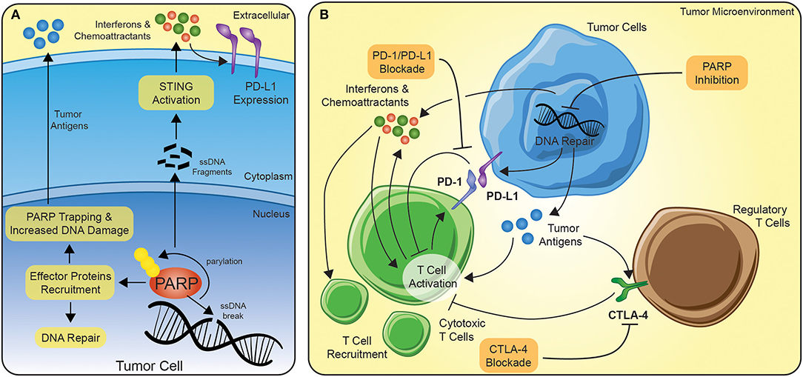
Rationale for Combining ICIs and PARP Inhibition
DNA damage caused by PARP inhibition in presence of BRCAm leads to expression of more immunogenic tumor antigens¹
PARP inhibition upregulates type I interferon pathway and PD-1 expression¹
Preclinical data indicate that PARP inhibition and immune checkpoint inhibition act synergistically²
Potential Mechanisms Behind Synergistic Activity of PARPi and ICI¹
1. Vikas. Front Oncol. 2020;10:570. https://creativecommons.org/licenses/by/4.0/. 2. Bhamidipati. Br J Cancer. 2023;129:904.
Notes:
ICI, immune checkpoint inhibitor; PARPi, PARP inhibitor.

Slide 12
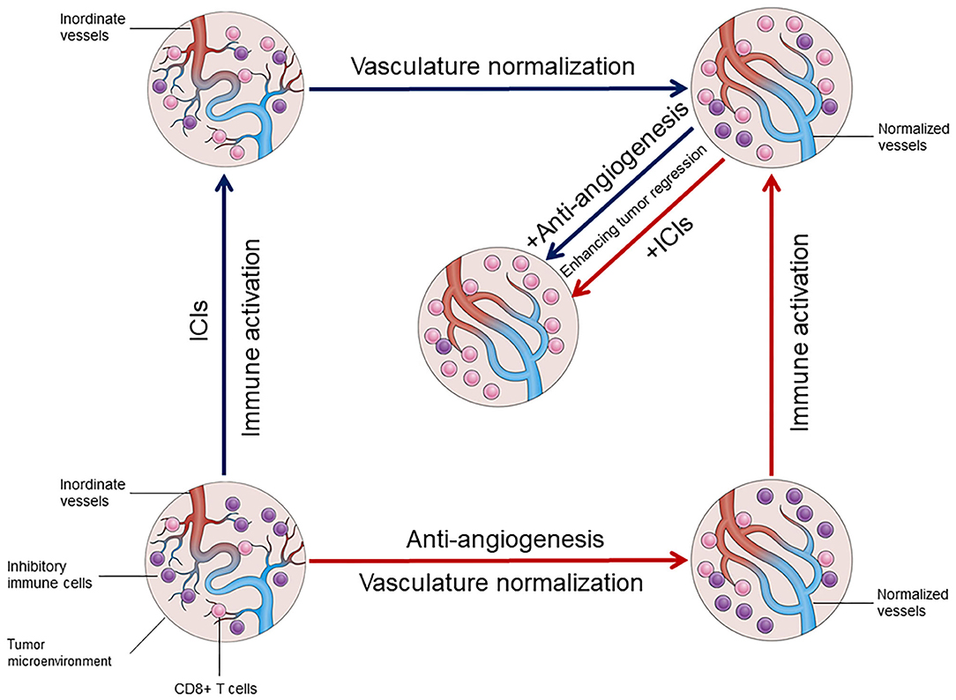
Rationale for Combining ICIs and Anti-VEGF Agents
Song. Front Immunol. 2020;11:1956. https://creativecommons.org/licenses/by/4.0/.
Notes:
ICI, immune checkpoint inhibitor.

Slide 13
ICIs + PARP and/or VEGF Inhibitors: Select Ongoing Trials
Study | Setting | Treatment | N | Status* | 1° Endpoint
Ph III LEAP-001/ENGOT-EN9 (NCT03884101) | 1L | Lenvatinib + pembrolizumab vs carboplatin + paclitaxel | 875 | Not recruiting | PFS, OS
Ph III DUO-E/GOG 3041/ ENGOT-EN10 (NCT04269200) | 1L, maintenance | Durvalumab + carboplatin/paclitaxel → maintenance durvalumab ± olaparib | 699 | Recruiting | PFS
Ph III RUBY part 2 (NCT03981796) | 1L, maintenance | Carboplatin + paclitaxel ± dostarlimab → maintenance dostarlimab + niraparib vs placebo + carboplatin + paclitaxel | 787 | Not recruiting | PFS
Ph II (NCT03367741) | 2L | Nivolumab ± cabozantinib | 84 | Not recruiting | PFS
Ph II (NCT03016338) | ≥2L | Niraparib + dostarlimab | 51 | Not recruiting | CBR
Ph II (NCT02912572) | ≥2L | Avelumab + talazoparib or axitinib vs avelumab monotherapy | 106 | Not recruiting | PFS6, ORR
Ph II (NCT03660826) | ≥2L | Cediranib; olaparib ± either cediranib, capivasertib, or durvalumab; durvalumab + cediranib | 288 | Not recruiting | PFS
Ph II (NCT05156268) | 2L/3L | Pembrolizumab + olaparib | 25 | Recruiting | ORR
*As of October 2023.
Notes:
1°, primary; 1L, first-line; 2L, second-line; 3L, third-line; CBR, clinical benefit rate; ORR, objective response rate; OS, overall survival; PFS, progression-free survival; PFS6, progression-free survival at 6 months; Ph, phase.

Slide 14
Rationale for Combining ICIs
With Other Targeted Therapies
FGFR¹
FGFR signaling is involved in cell proliferation and angiogenesis
FGFR alterations are oncogenic drivers
Preclinical models suggest that inhibition of aberrant FGFR reduces cell proliferation and promotes
cell death
FGFR2 alterations are common in EC (12.5%)
IDO1
Catalyzes initial rate-limiting step in pathway converting L-tryptophan into L-kynurenine²
  L-kynurenine exerts immunosuppressive effects
IDO1 is overexpressed in EC, especially dMMR tumors^{2,3}
IDO1 expression is mechanism of resistance to ICIs²
1. Zhu. J Cancer. 2020;11:7264. 2. Passarelli. Front Immunol. 2022;13:953115. 3. Cao. Biomarker Res. 2021;9:49.
Notes:
dMMR, mismatch repair deficient; EC, endometrial cancer; ICI, immune checkpoint inhibitor.

Slide 15
ICIs + FGFR or IDO1 Inhibitors: Select Ongoing Trials
Study | Setting | Treatment | N | Status* | 1° Endpoint
Ph II (NCT05036681) | ≥1L (MSS) | Pembrolizumab + futibatinib (FGFRi) | 30 | Recruiting | ORR, safety
Ph II POD1UM-204 (NCT04463771) | ≥2L | Retifanlimab + pemigatinib (FGFRi; if FGFR1/2/3 altered); retifanlimab + epacadostat (IDO1i) | 300 | Recruiting | ORR
*As of October 2023.
Notes:
1°, primary; 1L, first-line; 2L, second-line; FGFRi, FGFR inhibitor; ICI, immune checkpoint inhibitor; IDO1i, IDO1 inhibitor; MSS, microsatellite stability; ORR, objective response rate; Ph, phase.

Slide 16

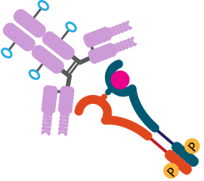
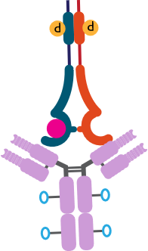








MoA for Investigating Antibody–Drug Conjugates and Immune-Stimulating Antibody Conjugates in EC
ADC Mechanisms of Action³
Antibody–drug conjugate: selectively target tumor cells, deliver cytotoxic drug¹
Immune-stimulating antibody conjugates selectively target tumor cells, promote innate
and adaptive immune response²
Targeted delivery of cytotoxic payload
Antibody-dependent cellular cytotoxicity
Cleavable linker
Microtubule
inhibition
Cell death
Noncleavable linker
DNA cross-linking adduct formation
Topoisomerase
inhibitor
“Bystander effect”—payload diffuses to neighboring cells
Proliferative
signaling cascades
1. Karpel. Am Soc Clin Oncol Educ Book. 2023;43:e390772. 2. Li. ASCO 2023. Abstr 2538.
3. Hurwitz. Pharmaceutics. 2023;15:2017. https://creativecommons.org/licenses/by/4.0/.
Notes:
ADC, antibody–drug conjugate; EC, endometrial cancer.

Slide 17
Potential Targets of ADCs/ISACs in EC
HER2: overexpression/gene amplification seen in 25%-30% of
serous EC cases^{1,2}
  High ORR (57.5%) in EC cohort treated with trastuzumab deruxtecan
  on phase II trial³
  1/10 patients with EC had durable SD with ISAC BDC-1001 in
  phase I/II trial⁴
TROP-2: overexpression seen in >95% of endometrioid EC cases⁵
Folate receptor α: highly expressed in ~50% of EC cases⁶
1. Buza. Arch Pathol Lab Med. 2020;145:687. 2. Fader. Clin Cancer Res. 2020;26:3928. 3. Meric-Bernstam. ASCO 2023. Abstr LBA300. 4. Li. ASCO 2023. Abstr 2538. 5. Bignotti. Int J Gynecol Cancer. 2011;21:1613. 6. Senol. Int J Clin Exp Pathol. 2015;8:5633.
Notes:
ADC, antibody–drug conjugate; EC, endometrial cancer; ISAC, immune-stimulating antibody conjugate; ORR, objective response rate; SD, stable disease.

Slide 18
ADCs and ISACs: Select Ongoing Trials
Study | Setting | Treatment | N | Status* | 1° Endpoint
Antibody–Drug Conjugate
Ph I (NCT04585958) | ≥2L (HER2+) | HER2-directed trastuzumab deruxtecan + olaparib | 55 | Recruiting | RP2D, safety
Ph II DESTINY-PanTumor02 (NCT04482309) | ≥2L (HER2+) | HER2-directed trastuzumab deruxtecan | 468 | Active, not enrolling | ORR
Ph II (NCT03835819) | 1L/recurrent (FRα+ MSS serous) | FRα-directed mirvetuximab soravtansine + pembrolizumab | 35 | Recruiting | ORR, PFS
Ph II TROPION-PanTumor03 (NCT05489211) | ≥1L | TROP-2–directed datopotamab deruxtecan ± durvalumab ± AZD5305 (PARP inhibitor) | 670 | Recruiting | ORR, safety, PSA50
Ph II (NCT04251416) | ≥2L | TROP-2–directed sacituzumab govitecan | 50 | Recruiting | ORR
Immune-Stimulating Antibody Conjugate
Ph I/II (NCT04278144) | ≥2L (HER2+) | BDC-1001 (HER2-directed antibody conjugated to TLR7/8 agonist) ± nivolumab | 390 | Recruiting | Safety, ORR
*As of October 2023.
Notes:
1°, primary; 1L, first-line; 2L, second-line; ADC, antibody–drug conjugate; FRα, folate receptor α; ISAC, immune-stimulating antibody conjugate; MSS, microsatellite stable; ORR, objective response rate; PFS, progression-free survival; Ph, phase; PSA50, ≥50% decrease in prostate-specific antigen from baseline; RP2D, recommended phase II dose.

Slide 19
MoAs for Adoptive T-Cell Transfer,
Bispecific Antibodies, and Cancer Vaccines
Adoptive T-Cell Transfer
Bispecific Antibody
IFN- γ and granzyme B
TAAs
CAR
Recruitment
IFN-γ and granzyme B
TAAs
CXCL9/10
Tumor Cells
CAR T-Cell
TAAs
Dendritic Cell
Stimulated ex vivo
IFN-γ and granzyme B
Active
Naive
CD8+ T-cell
Cancer Vaccine
Liu. Front Immunol. 2022;13:961805. https://creativecommons.org/licenses/by/4.0/.
Notes:
IFN, interferon; TAA, tumor-associated antigen.

Slide 20
Rationales for Investigating Cancer Vaccines,
Adoptive T-Cell Transfer, and Bispecific Antibodies in EC
Cancer vaccines: designed to spur immune system into attacking tumor cells¹
  Adjuvant pembrolizumab + mRNA-4157, a personalized vaccine, prolonged distant metastasis–free survival in melanoma²
  mRNA-4157 now under investigation in EC³
Adoptive T-cell transfer: data show improved response, OS when T-cells in
tumor islets⁴
  Ongoing studies evaluating TILs, CAR T-cells
  CAR T-cells SoC for some hematologic cancers⁵
Bispecific antibodies: target 2 antigens; can bridge tumor cells with T-cells or engage 2 targets on same cell^{1,5}
1. Cao. Biomarker Res. 2021;9:49. 2. Khattak. ASCO 2023. Abstr LBA9503. 3. NCT03313778.
4. Levinson. Am Soc Clin Oncol Educ Book. 2019;39:e126. 5. Khan. Eur J Haematol. 2023;[Epub].
Notes:
EC, endometrial cancer; OS, overall survival; SoC, standard of care.

Slide 21
Cancer Vaccines, Adoptive Cell Transfer, and
Bispecific Antibodies in EC: Select Ongoing Trials
Study | Setting | Treatment | N | Status* | 1° Endpoint
Cancer Vaccine
Ph I KEYNOTE-603 (NCT03313778) | ≥1L (dMMR, MSI-H, or TMB-H) | mRNA-4157 vaccine ± pembrolizumab | 108 | Not recruiting | Safety
Ph I PNeoVCA (NCT05269381) | ≥2L | Neoantigen peptide vaccine + pembrolizumab + cyclophosphamide | 36 | Recruiting | Safety
Adoptive Cell Transfer
Ph II (NCT01174121) | 3L | TIL + pembrolizumab | 332 | Recruiting | ORR
Ph I (NCT04660929) | ≥2L (HER2+) | HER2-directed CAR macrophages | 48 | Recruiting | Safety
Bispecific Antibody
Ph II (NCT05032040) | ≥2L (MSS) | Vudalimab (PD-1 x CTLA-4 bispecific antibody) | 150 | Recruiting | ORR
*As of October 2023.
Notes:
1°, primary; 1L, first-line; 2L, second-line; 3L, third-line; dMMR, mismatch repair deficient; EC, endometrial cancer; MSI-H, microsatellite instability–high; ORR, objective response rate; Ph, phase; TIL, tumor-infiltrating lymphocytes; TMB-H, tumor mutational burden–high.

Slide 22
Go Online for More CCO
Coverage of Endometrial Cancer!
CME/ABIM MOC‒certified “micro” text modules and downloadable slidesets on key clinical considerations in advanced endometrial cancer, from molecular testing to irAE care
“Call to Action” ClinicalThought commentary with expert perspectives and survey data on key gaps in endometrial cancer care
Podcast featuring a patient advocate and HCP discussing how to work together for equitable care
Updates to Interactive Decision Support Tool providing expert recommendations tailored to specific scenarios for patients with advanced endometrial cancer
clinicaloptions.com/EndometrialThinkTank

