Slide 1
Current Challenges and Emerging Treatments for the Management of Severe Hypertriglyceridemia
Provided by Clinical Care Options, LLC
Michael Miller, MD, FACC, FAHA
Professor of Medicine
Hospital of the University of Pennsylvania
Philadelphia, Pennsylvania
Supported by an educational grant from Ionis Pharmaceuticals, Inc.

Slide 2

About These Slides
Please feel free to use and share some or all of these slides in your noncommercial presentations to colleagues or patients
When using our slides, please retain the source attribution:
These slides may not be published, posted online, or used in commercial presentations without permission. Please contact permissions@clinicaloptions.com for details
Slide credit: clinicaloptions.com
Notes:
Disclaimer: The materials published on the Clinical Care Options Web site reflect the views of the authors of the CCO material, not those of Clinical Care Options, LLC, the CME providers, or the companies providing educational grants. The materials may discuss uses and dosages for therapeutic products that have not been approved by the United States Food and Drug Administration. A qualified healthcare professional should be consulted before using any therapeutic product discussed. Readers should verify all information and data before treating patients or using any therapies described in these materials.

Slide 3
Disclosures
The faculty reported the following relevant financial relationships or relationships to products or devices they have with ineligible companies related to the content of this educational activity:
Michael Miller, MD, MHSc: consultant/advisor/speaker: Amarin, Ionis, 89Bio.
Notes:
This slide lists the disclosure information of the faculty and staff involved in the development of these slides.

Slide 4
Hypertriglyceridemia in the United States (2009-2012)
American Adults Aged ≥20 Yr With Elevated Triglycerides ≥150 mg/dL
34.9
35
Age, Yr
20 and older
20-39
40-59
60 or older
30.9
30
28.8
28.2
28.7
25.1
25.1
24.8
25
23.0
21.5
19.9
20
Persons (%)
15
14.7
10
5
0
Both Sexes
Men
Women
www.cdc.gov/nchs/products/databriefs/db198.htm.

Slide 5
Elevated Triglycerides Convey Cardiovascular Risk
Time to CVD Event by Quartile of Average TG
16
Q1: ≤81.8 mg/dL
Q2: 81.8 to <110.2 mg/dL
Q3: 110.2 to <153.5 mg/dL
Q4: ≥153.5 mg/dl
12
Event Probability (%)
8
4
0
0
2
4
6
8
10
Yr From Baseline
Aberra. J Clin Lipidol. 2020;14:438.
Notes:
CVD, cardiovascular disease; TG, triglyceride.

Slide 6
Defining Hypertriglyceridemia and Cut Points
 | 1984 NIH Consensus | 1993 NCEP Guidelines | 2001 NCEP Guidelines | 2014 NLA (2011 AHA)
Optimal | N/A |  |  | <100 mg/dL
Desirable/Normal | <250 mg/dL | <200 mg/dL | <150 mg/dL | <150 mg/dL
Borderline | 250-499 mg/dL | 200-399 mg/dL | 150-199 mg/dL | 150-199 mg/dL
High | 500-999 mg/dL | 400-999 mg/dL | 200-499 mg/dL | 200-499 mg/dL
Very High | ≥1000 mg/dL | ≥1000 mg/dL | ≥500 mg/dL | ≥500 mg/dL
Lowering Blood Cholesterol to Prevent Heart Disease. NIH Consensus Statement. 1984;5:1. Grundy. JAMA. 1993;269:3015. Lauer. JAMA. 2001;285:2508. Jacobson. J Clin Lipidol. 2015;9:129. Miller M. Circulation. 2011;123:2292.

Slide 7
Fasting vs Nonfasting Lipid Panels
In individuals with TG at goal, postprandial rise in TG is small
(12-27 mg/dL)
For adults aged ≥20 yr not on lipid-lowering drug therapy, either a fasting or nonfasting lipid profile may be used to estimate ASCVD risk and document baseline LDL-C
For those with nonfasting triglycerides ≥200 mg/dL, a repeat fasting lipid profile is recommended to assess fasting triglycerides and baseline LDL-C
Miller. Circulation 2011;123:2292. Virani. J Am Coll Cardiol. 2021;78:960.
Notes:
ASCVD, atherosclerotic cardiovascular disease; LDL-C, low-density lipoprotein cholesterol; TG, triglyceride.

Slide 8


Fasting Lipid Panels:
Preferred for Assessing Specific Populations
Used to establish a diagnosis of metabolic syndrome
(TG ≥150 mg/dL)
Used to identify lipid disorders in individuals without clinical ASCVD
but a family history
Used to assess adherence in individuals being treated for ASCVD risk reduction
Used to identify individuals
at risk of HTG-induced pancreatitis (TG ≥500 mg/dL)
Virani. J Am Coll Cardiol. 2021;78:960.
Notes:
ASCVD, atherosclerotic cardiovascular disease; HTG, hypertriglyceridemia; TG, triglyceride.

Slide 9




Primary and Secondary Causes of Hypertriglyceridemia
PRIMARY CAUSES
SECONDARY CAUSES
Genetic
Suboptimally Controlled Diabetes
Major Medications/Lifestyle
Type 1 or 2
Prediabetes/insulin resistance
  Central obesity
  Metabolic syndrome
  Fatty liver (NAFLD/NASH)
Alcohol
Oral estrogens
Protease inhibitors
Corticosteroids
Retinoids
Other Medical Conditions
Misc. Medications
CKD
HIV
Pregnancy
Systemic inflammation (lupus, rheumatoid arthritis)
Cushing syndrome
Atypical antipsychotics
Tamoxifen
Sirolimus
Bile acid binding resins
β-blockers
L-asparaginase
Brahm. Nat Rev Endocrinol. 2015;11:352. Miller. Circulation. 2011;123:2292. Hegele. Curr Opin Lipidol. 2015;26:103.
Notes:
CKD, chronic kidney disease HTG, hypertriglyceridemia; NAFLD, nonalcoholic fatty liver disease; NASH, nonalcoholic steatohepatitis.

Slide 10

Consider Chylomicronemia Syndrome if TG >880 mg/dL
Number of People
Chylomicronemia
(0.17% of the population, includes FCS)
100
200
300
400
500
600
700
800
900
1000
1100
1200
1300
Nonfasting Plasma TG (mg/dL)
Adapted from Hegele. Lancet Diabetes Endocrinol. 2014;2:655. Paragh. Lipids Health Dis. 2022;21:21.
Notes:
FCS, familial chylomicronemia syndrome; TG, triglycerides.

Slide 11
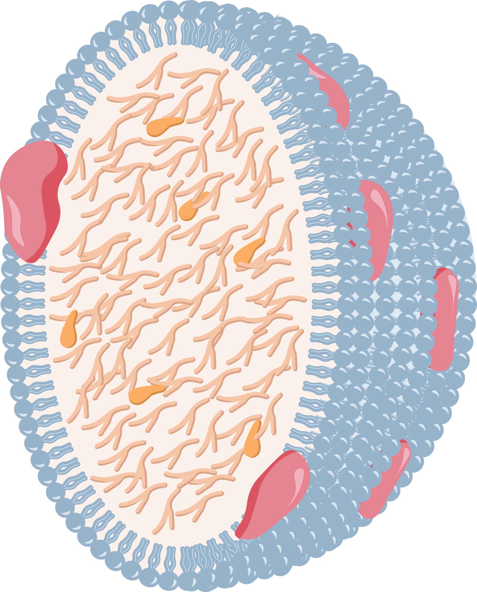
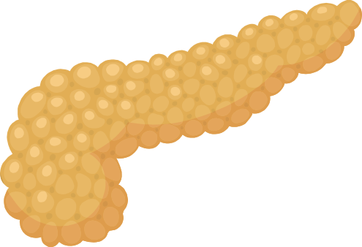

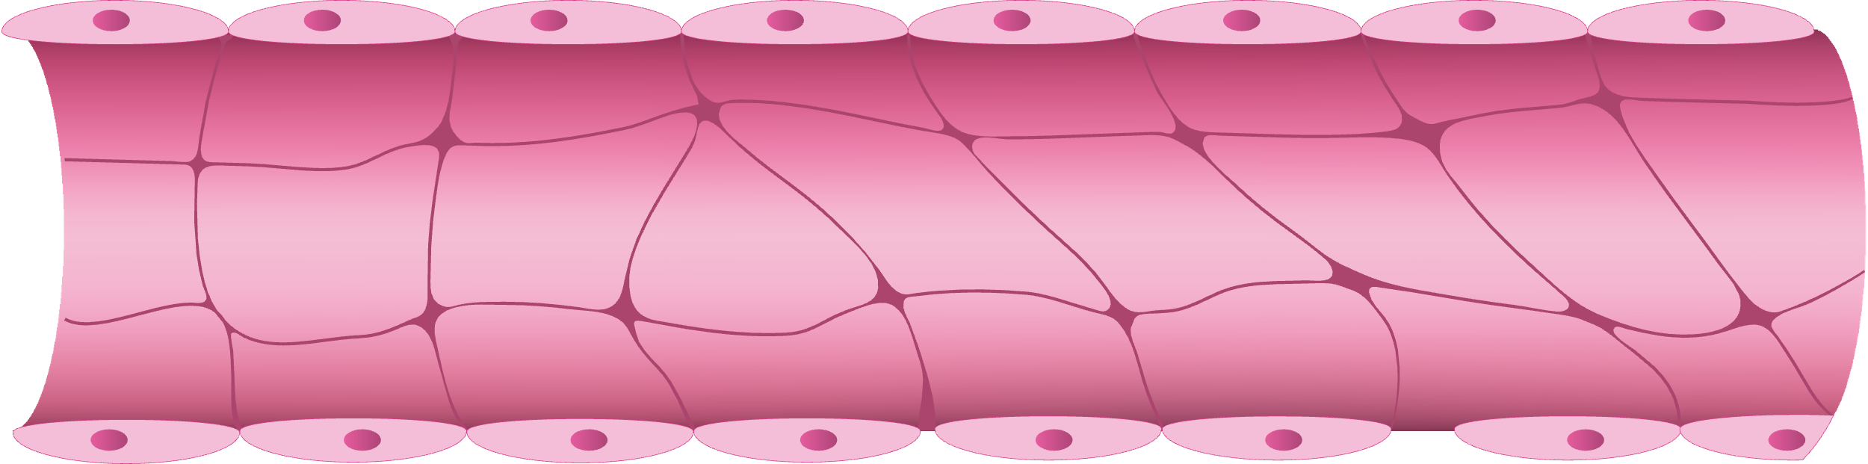
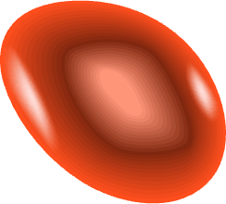
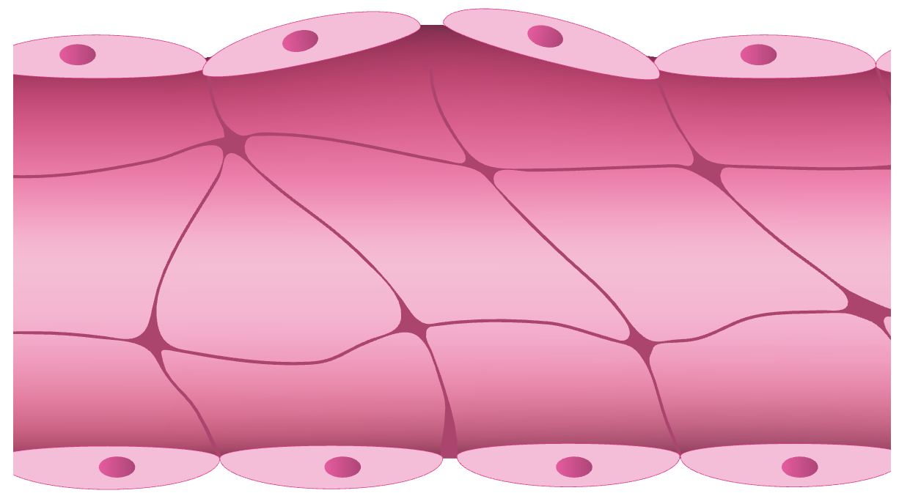
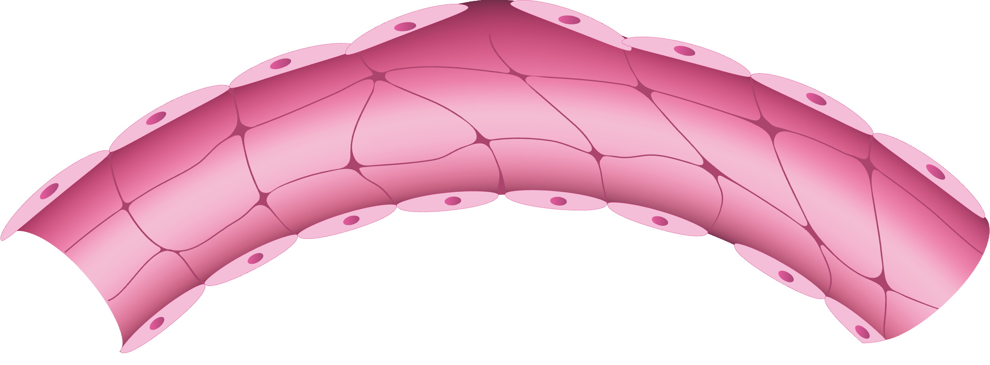
Chylomicrons May Cause Injury, Leading to Acute Pancreatitis
Pancreatic lipase
Large TG-rich chylomicron
Chylomicrons block capillary blood flow
TG
Pancreas
Fatty
acids
Generation of Free Fatty Acids by Pancreatic Lipase
Impaired Blood Flow
Rupture of pancreatic capillaries
Capillary ischemia
Inflammation
of pancreas
Inflammation
Necrosis of acinar cells
Acute Pancreatitis
Ischemia/Acidosis
Adapted from www.lipid.org/media/2015003/1//handout.pdf.
Notes:
TG, triglycerides.

Slide 12
Pancreatitis Caused by Severe HTG: Greater Morbidity and Mortality
Clinical Outcomes in Acute Pancreatitis: Normal vs Severe TG Levels
100
80
60
Days
40
20
0
Need for Intensive Care
Pancreatic
Necrosis
Persistent Organ Failure
Mortality
Median Hospital Stay
O’Dea. J Endocr Soc. 2019;3:2397. Adapted from Nawaz. Am J Gastroenterol. 2015;110:1497.
Notes:
HTG, hypertriglyceridemia; TG, triglycerides.

Slide 13
Patient Populations and Considerations
Adults with ASCVD and fasting TG ≥150 mg/dL or nonfasting TG ≥175 mg/dL and TG <500 mg/dL
Adults with diabetes mellitus aged ≥40 yr, no ASCVD, and fasting TG ≥150 mg/dL or nonfasting TG ≥175 mg/dL and TG <500 mg/dL
Adults aged ≥20 yr with no ASCVD or diabetes mellitus and fasting TG ≥150 mg/dL or nonfasting TG ≥175 mg/dL and TG <500 mg/dL
Adults aged ≥20 yr with
TG ≥500 mg/dL
Factors to Consider
      Evaluate and manage secondary causes
      Optimize diet and lifestyle interventions for hypertriglyceridemia
      Implement guideline-directed statin therapy and optimize statin adherence
      Optimize glycemic control
      Monitor response to therapy and adherence
      Conduct HCP–patient discussion of potential benefits, potential harms, and patient preferences
Persistent Fasting Hypertriglyceridemia
Optional Interventions to Consider
      Referral to registered dietitian nutritionist
      Addition of a triglyceride risk-based pharmacologic agent
Virani. J Am Coll Cardiol. 2021;78:960.
Notes:
ASCVD, atherosclerotic cardiovascular disease; HCP, healthcare professional; TG, triglycerides.

Slide 14
For Patients Aged ≥20 Yr With sHTG
Adults aged ≥20 yr with TG ≥500 mg/dL
TG 500-999 mg/dL
TG ≥1000 mg/dL
Rule out secondary causes
Optimize diet and lifestyle
Optimize glycemic control (in diabetes)
Rule out secondary causes
Implement very low-fat diet and optimize lifestyle
Optimize glycemic control (in diabetes)
Consider fibrate* or prescription omega-3 fatty acids (icosapent ethyl or omega-3 acid ethyl esters) to reduce risk of pancreatitis
Consider statin initiation or intensification in appropriate patient management groups
Adults aged 20-39 yr or aged 40-75 yr with TG 500-999 mg/dL and 10-yr ASCVD risk <5%, or with TG ≥500-999 mg/dL without ASCVD or diabetes mellitus
Adults aged 40-75 yr with TG 500-999 mg/dL and with 10-yr ASCVD risk ≥5%, ASCVD, or diabetes mellitus
Initiate or increase intensity of statin therapy and optimize statin adherence
Persistent fasting hypertriglyceridemia 500-999 mg/dL
Emphasize low-fat diet. Reasonable to consider very low–fat diet in select patients
Consider fibrate* or prescription omega-3 fatty acids (icosapent ethyl or omega-3 acid ethyl esters) to reduce risk of pancreatitis
Emphasize low-fat diet. Reasonable to consider very low–fat diet in select patients
Increase intensity of statin therapy and optimize statin adherence
Consider fibrate* or prescription omega-3 fatty acids (icosapent ethyl or omega-3 acid ethyl esters) to reduce risk of pancreatitis
*Fenofibrate is the preferred fibric acid derivative due to better safety profile and fewer drug interactions compared to gemfibrozil.
Virani. J Am Coll Cardiol. 2021;78:960.
Notes:
ASCVD, atherosclerotic cardiovascular disease; TG, triglycerides.

Slide 15
Common Medication Therapies for sHTG
Therapy | TG Reduction, % | Mortality Reduction? | Comments
Fibrates | 25 to 50 | No | First line therapy to reduce risk of pancreatitis; fenofibrate preferred.
Omega-3 | 20 to 50 | Yes; Icosapent ethyl. NNT = 111 to prevent 1 cardiovascular death over 5 years | OTC supplements have variable amounts of EPA and DHA. Icosapent ethyl reduces CV events in individuals with established CVD on statin therapy.
Statins | 10 to 20 | Yes NNT = 83 to prevent one all cause death over 5 years in patients with known ASCVD | Not first line therapy to reduce the risk of pancreatitis in individuals with severe hypertriglyceridemia.
Niacin | 10 to 35 | No | Generally not recommended
Oh. Am Fam Physician. 2020;102:347.
Notes:
NNT, number needed to treat; sHTG, severe hypertriglyceridemia; TG, triglycerides.

Slide 16
Emerging sHTG Therapies
Evinacumab
Monoclonal antibody that binds to and inhibits ANGPTL3
Volanesorsen*
Antisense oligonucleotide targeting APOC3
Olezarsen
N-acetyl-galactosamine–conjugated antisense oligonucleotide targeted to hepatic APOC3 mRNA to inhibit apolipoprotein C-III
Pegozafermin
Long-acting glycopegylated analog of human fibroblast growth factor 21
*FDA denied approval because of thrombocytopenia and bleeding risks; authorized in EU.
Esan. Drug Des Devel Ther. 2020;14:2623. Volanesorsen EU PI. Wolska. Curr Opin Lipidol. 2020;31:331.
Notes:
mRNA, messenger RNA; sHTG, severe hypertriglyceridemia.

Slide 17
Evinacumab in sHTG With or Without Lipoprotein Lipase Pathway Mutations: A Phase II Randomized Trial
DBTP (12 wk)
SBTP (12 weeks)
Safety follow-up period (20 wk)
Screening period (up to 37 days)
n = 35
n = 32
Evinacumab 15 mg/kg Q4W x 3
Evinacumab 15 mg/kg Q4W x 3
Randomized 2:1
n = 17
Placebo
Q4W x 3
n = 15
Evinacumab 15 mg/kg Q4W x 3
Placebo run-in (4 wk)
0
4
8
12
16
20
Evinacumab or placebo administered visits (wk)
Evinacumab administered visits (wk)
Rosenson. Nature. 2023;29:729.
Notes:
DBTP, double-blind treatment period; FCS, familial chylomicronemia syndrome; LOF, loss of function; MCM, multifactorial chylomicronemia, SBTP, single-blind treatment period; sHTG, severe hypertriglyceridemia; TG, triglycerides.

Slide 18
Pegozafermin in Severe HTG: A Phase II Randomized Trial of a FGF21 Analogue
QW
Q2W
PGZ pooled
n = 64
Placebo
n = 17
9 mg
n = 16
18 mg
n = 16
27 mg
n = 16
36 mg
n = 16
0
-20
-12%
Triglycerides
(Median % Change From Baseline)
-40
-36%
P = .017
-60
-57%
P <.001
-57%
P <.001
-56%
P <.001
-63%
P <.001
-80
Bhatt. Nature Medicine. 2023;29:1782.
Notes:
PGZ, pegozafermin; sHTG, severe hypertriglyceridemia

Slide 19
COMPASS: Volanesorsen in Patients With Multifactorial Chylomicronemia
Change in TG Concentrations at 3 Mo
100
10
20
-0.9
5
0.83
0
0
-20
Change From Baseline (%)
Change from Baseline (mmol/L)
-5
-40
-10
-60
-9.82
-15
-80
-71.2
-100
-20
Placebo
Volanesorsen
Placebo
Volanesorsen
Gouni-Berthold. Lancet Diabetes Endocrinol. 2021;9:264.
Notes:
TG, triglycerides.

Slide 20
Effect of Olezarsen in Lowering TG Levels in Patients With High Risk or Established CVD: A Phase II Randomized Trial
40
6
20
0
Least Squares Mean Percent
Change From Baseline in TG
-20
-40
-23
P = .004
-60
-56
P <.0001
-60
P <.0001
-60
P <.0001
-80
Pooled Placebo
10 mg
Every 4 Wk
15 mg
Every 2 Wk
10 mg
Every Wk
50 mg
Every 4 Wk
Tardif. Eur Heart J. 2022;43:1401.
Notes:
CVD, cardiovascular disease; TG, triglycerides.

Slide 21
Ongoing: Olezarsen Phase III Trial for sHTG
CORE
Evaluate the efficacy of olezarsen vs placebo on the percent change in fasting TG from baseline
NCT05079919.
Notes:
sHTG, severe hypertriglyceridemia; TG, triglycerides.

Slide 22
Selecting Optimal Medical Therapy
ASCVD risk
Risk of pancreatitis
Notes:
ASCVD, atherosclerotic cardiovascular disease.

Slide 23
Monitoring Recommendations
Frequency of TG monitoring
Safety monitoring
Notes:
TG, triglycerides.

Slide 24
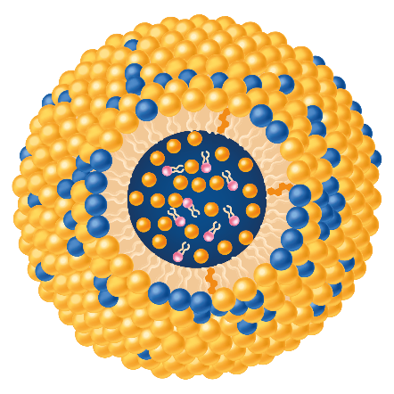
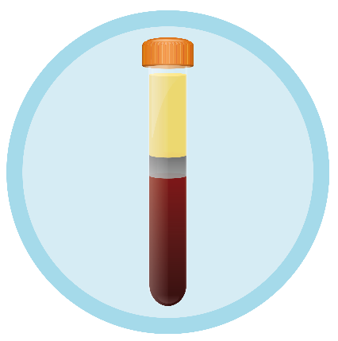
FCS: Fasting Chylomicronemia (TG >880 mg/dL)
Chylomicrons are lipoproteins rich in TG
90% of chylomicron content is TG
Gaudet. NEJM. 2014;371:2200. Gotto. Am J Cardiol. 1990;66:20A.
Notes:
FCS, familial chylomicronemia syndrome; TG, triglycerides.

Slide 25
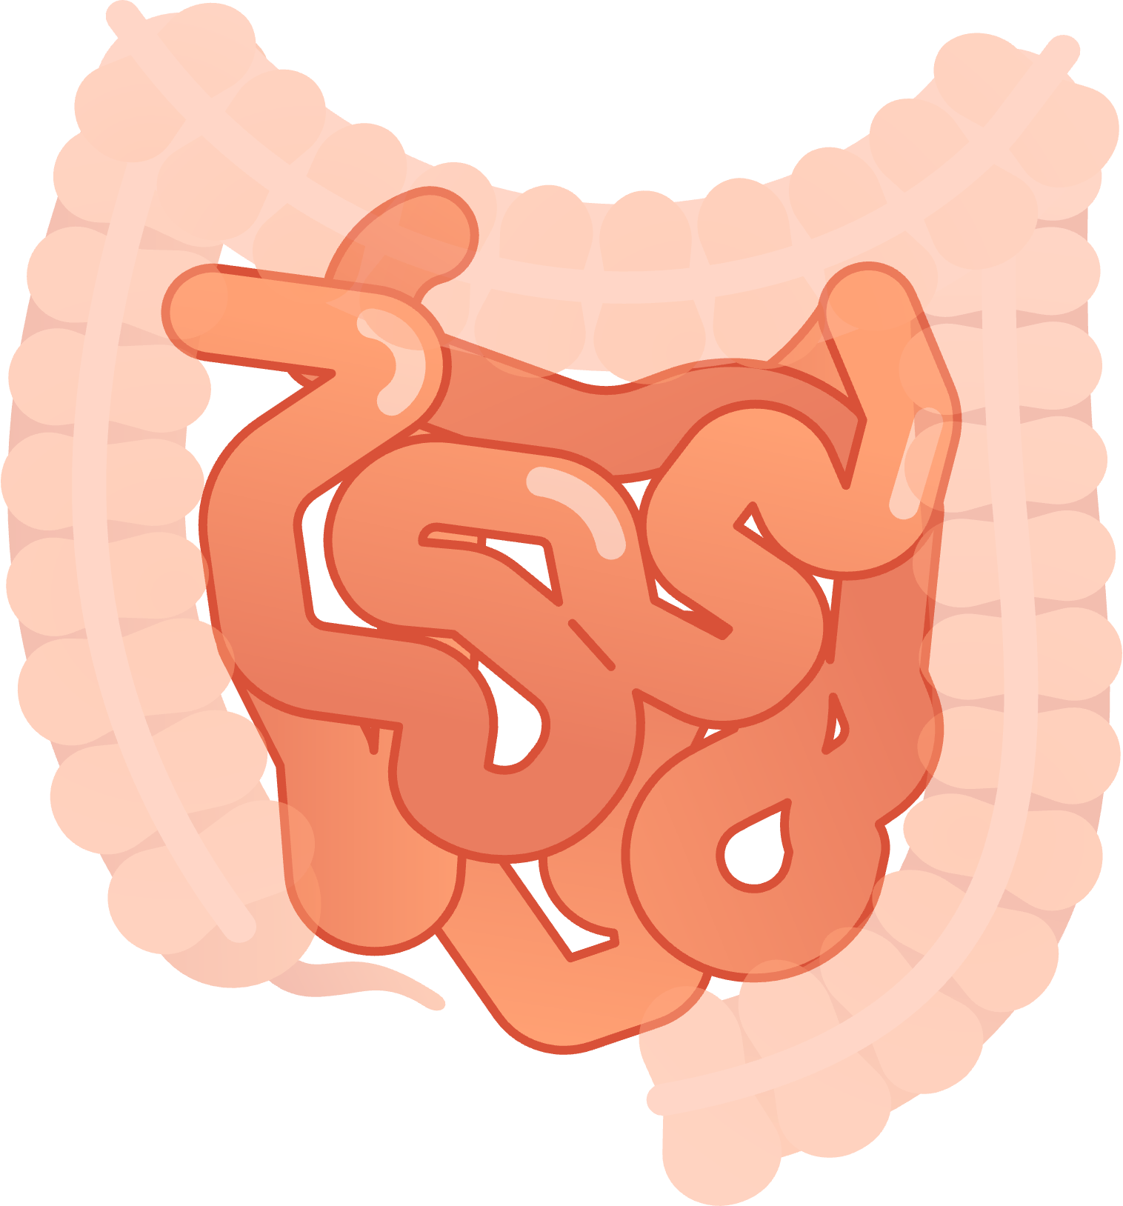
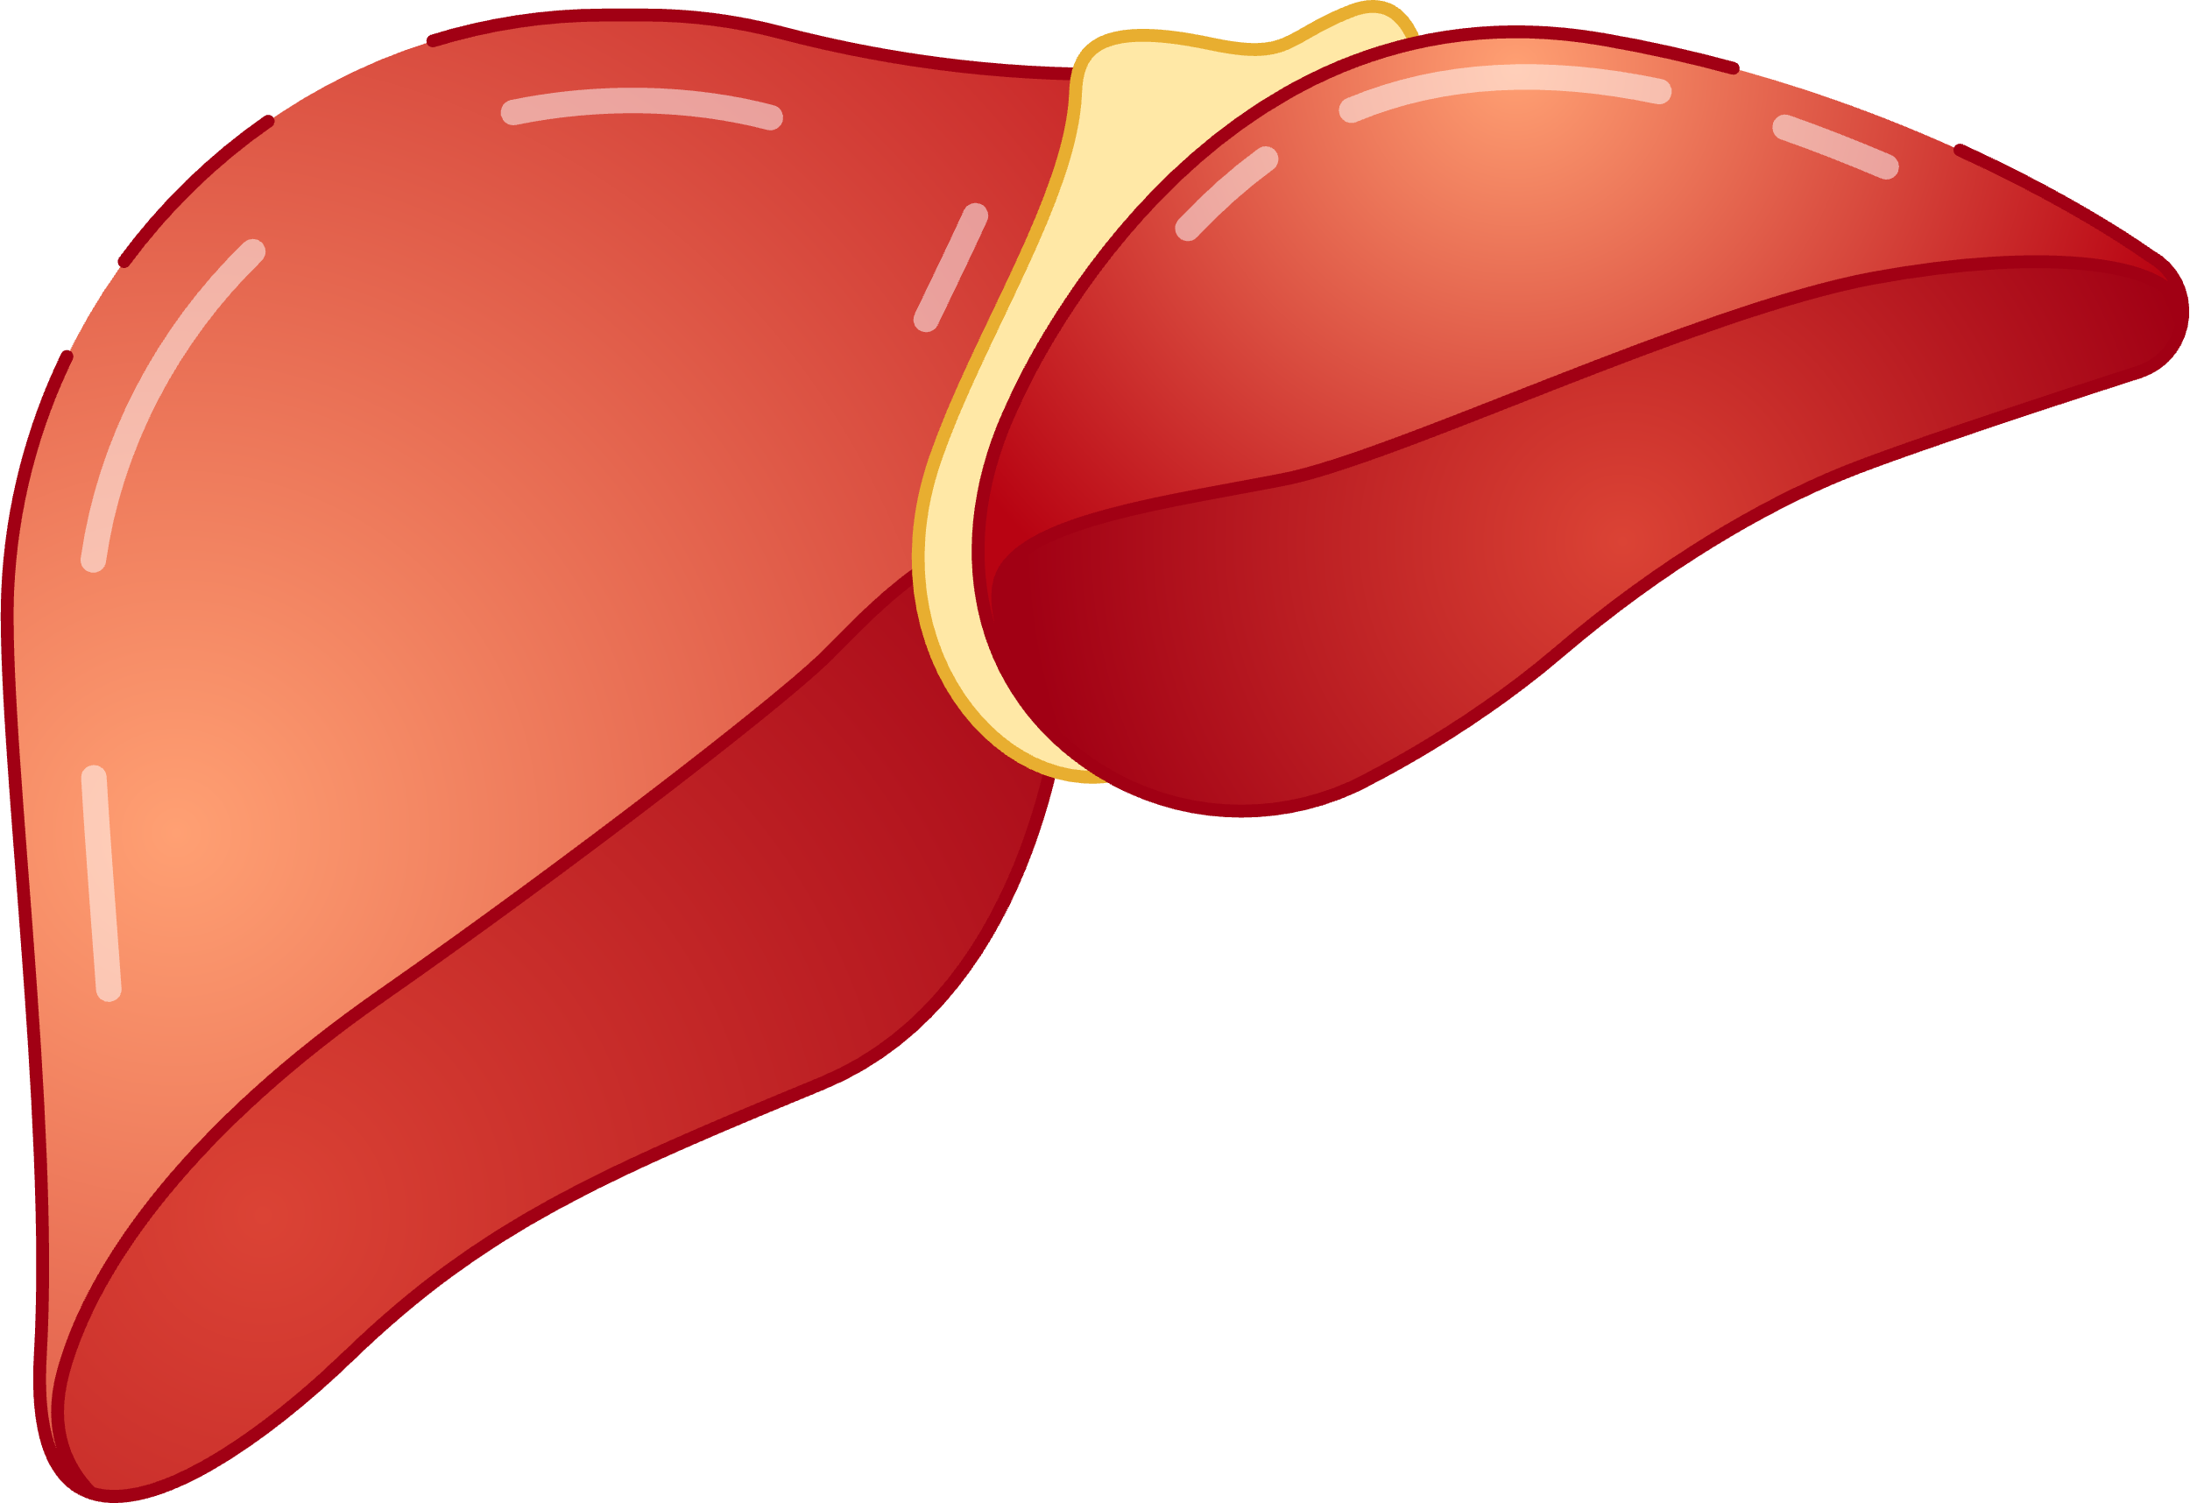
FCS: Impaired Function of LPL Enzyme
Dietary fat causes chylomicron release from the intestine
For patients without FCS, LPL rapidly hydrolyzes TG in chylomicrons
LPL activity is essential to prevent chylomicronemia
Mutations of LPL or LPL-related factors may ⬇ LPL activity, therefore, ⬆ chylomicrons
  Known gene mutations may include LPL, APOC2, GPIHBP1, APOA5, LMF1
LPL Activity and Chylomicron Metabolism
Chylomicron
Fatty Acids
LPL (TG hydrolysis)
Chylomicron remnant
Adapted from Brahm. Nat Rev Endocrinol. 2015;11:352. Hall. Guyton and Hall Textbook of Medical Physiology (Guyton Physiology). 13th ed; 2015.
Bijvoet. Neth J Med. 1993;42:36. Gaudet D. NEJM. 2014;371:2200. Brahm. Nat Rev Endocrinol. 2015;11:352. Hall. Guyton and Hall Textbook of Medical Physiology (Guyton Physiology). 13th ed; 2015.
Notes:
FCS, familial chylomicronemia syndrome; LPL, lipoprotein lipase; TG, triglycerides.
Gene products and their functions: LPL: Hydrolysis of TGs and peripheral uptake of FFA; ApoC-II: Required cofactor of LPL; GPI-HBP1: Stabilizes the binding of chylomicrons near LPL; apoA-V: Enhancer of LPL activity; LMF1: Chaperone molecule required for proper LPL folding5

Slide 26
FCS: Clinical Signs and Symptoms
Severely elevated TG (>880 mg/dL or >10 mmol/L), generally unresponsive to
lipid-lowering therapies
Abdominal pain: mild to severely incapacitating
Acute pancreatitis: ~65%-80% of patients with FCS will experience ≥1 acute pancreatitis episode, with the majority experiencing recurrent episodes
Additional symptoms
  Eruptive xanthoma
  Lipemia retinalis
  Hepatosplenomegaly
  Cognitive impairment
  Other emotional symptoms (depression, social isolation)
Gaudet. NEJM. 2014;371:2200. Moulin. Atherosclerosis. 2018;275:265. Gotoda. J Atheroscler Thromb. 2012;19:1. Gaudet. Lipids Health Dis. 2020;19:120.
Notes:
FCS, familial chylomicronemia syndrome; TG, triglycerides.

Slide 27
FCS: Lack of Lipoprotein Lipase Activity Increases Risk of Pancreatitis
Acute Pancreatitis Risk
361
Risk is 360x higher in
patients with LPL deficiency*
56
Referent comparator:
normolipidemic individuals
(TG: <440 mg/dL; n = 364)
16
n = 487
n = 354
n = 28
(TG: ~440-800 mg/dL)
Severe HTG (TG: >800 mg/dL)
*Patients with <5% LPL activity.
Adapted from Gaudet. Atheroscler Suppl. 2010;11:55.
Notes:
FCS, familial chylomicronemia syndrome; HTG, hypertriglyceridemia; LPL, lipoprotein lipase; LPLD, lipoprotein lipase deficiency; TG, triglycerides.

Slide 28
FCS Leads to Recurrent Abdominal Pain and Acute Pancreatitis
In a survey of 251 patients with FCS, the majority had a history of recurrent abdominal pain and
one half had recurrent acute pancreatitis
100
80
60
Episodes (%)
40
20
0
Adapted from Gaudet. J Clin Lipidol. 2016;10:680.
Notes:
FCS, familial chylomicronemia syndrome.

Slide 29
Women May Face Additional Risks: Pregnancy
Before, During, and After Pregnancy
Conception
Delivery
2.6x Increase in TG
TG
Total Cholesterol
LDL
HDL
Wild. Cardiol Clin. 2015;33:217. Wiznitzer. Am J Obstet Gynecol. 2009;201:482.e1. Liebeskind. Reproductive health and its impact on lipid management in adolescent and young adult females. www.ncbi.nlm.nih.gov/books/NBK588296/.
Notes:
HDL, high-density lipoprotein; LDL, low-density lipoprotein; TG, triglycerides.

Slide 30
FCS Manifestations Affect Daily Living:
Cognitive, Emotional, and Physical Impairments
Patients reported an average of 30 sick days taken per yr because of their disease
65% of those who reported being unemployed said it was due to their FCS
Symptoms and Complications of Chylomicron Buildup
Cognitive Symptoms
Emotional Symptoms
Physical Symptoms
Frequency
Daily or Weekly
Every 1-3 Days
2-3 Times per Wk
Symptom
Difficulty concentrating
Brain fog
Forgetfulness
Impaired judgement
Recent memory loss
Constant uncertainty about an imminent pain or acute pancreatitis attack
Anxiety, fear, or worry about health
Feel out of control or powerless
Anxiety, fear, or worry about planning what to eat or how much to eat
Feel sad to depressed
Feel socially withdrawn or isolated
Bloating
Generalized abdominal pain
Asthenia
Fatigue
Indigestion
Davidson. Expert Rev Cardiovasc Therapy. 2017;15:415.
Notes:
FCS, familial chylomicronemia syndrome.

Slide 31
Diagnosis Is Critical to Care for Patients With FCS
67% of patients with FCS reported their symptoms being previously misdiagnosed
Patients also reported seeing an average of 5 HCPs before receiving an FCS diagnosis
Essential to enable care coordination across all HCPs involved, including support from registered dietitians/nutritionists
Davidson. Expert Rev Cardiovasc Ther. 2017;15:415. Stroes. Atheroscler Suppl. 2017;23:1.
Notes:
FCS, familial chylomicronemia syndrome; HCP, healthcare professionals.

Slide 32
FCS Can Be Clinically Recognized or Diagnosed
*¹⁻⁶
1
2
3
Severe,
Refractory HTG
Clinical History
Absent Secondary
Causes
TG >10 mmol/L
or >880 mg/dL
Minimal/no response
to standard TG therapies
History of acute or recurrent pancreatitis
History of abdominal pain without other known causes
Alcohol, uncontrolled diabetes, or other medications or medical conditions known to cause HTG
Patients may still have severe HTG even after the above conditions are discontinued or resolved
Hyperchylomicronemia ICD-10-CM Code: E78.3
Gaudet. NEJM. 2014;371:2200. Tremblay. J Clin Lipidol. 2011;5:37. Christian. J Cardiovasc Med (Hagerstown). 2011;12:714. Goldberg. Front Endocrinol (Lausanne). 2020;11:593931. Rygiel. Curr Cardiol Rev. 2018;14:67. www.icd10data.com/ICD10CM/Codes/E00-E89/E70-E88/E78-/E78.3.
Notes:
FCS, familial chylomicronemia syndrome; HTG, hypertriglyceridemia; TG, triglycerides.
a. For example, atypical antipsychotic agents, beta-blockers, bile acid binding resins, corticosteroids, L-asparaginase, protease inhibitors, retinoids, sirolimus, oral estrogens, tamoxifen7
b. For example, chronic renal failure, Cushing syndrome, diabetes mellitus, HIV infection, insulin resistance, metabolic syndrome, nonalcoholic fatty liver disease, systemic lupus erythematosus.7

Slide 33
Tailored and Stringent Diets for Patients With FCS Are Critical
Highly specialized, restrictive, low-fat diet:
  15-20 g fat per day
Restrict simple and refined carbohydrates
  Sugar, syrup, honey
Avoid alcohol
Prescription-grade MCT (medium chain TG) oil, as desired
  Medium-chain saturated fatty acids (caprylic, capric)
  MCT oil that is sold over the counter may contain lauric acid and is not recommended
Frequent follow-up with registered dietitian/nutritionist
Rahalkar. Mol Genet Metab. 2008;93:282. Williams. J Clin Lipidol. 2018;12:908.
Notes:
FCS, familial chylomicronemia syndrome; TG, triglycerides.

Slide 34
Case 1
Case 2
Sex: Female
Age: 35 yr
Height: 5’3”
Weight: 120 lbs
BMI: 21.3
LABS
Fasting TG: 2500-3000 mg dL
A1C: 5.2%
Note: last blood draw showed creamy
Sex: Male
Age: 45 yr
Height: 6’1”
Weight: 250 lbs
BMI: 30
LABS
Fasting TG: 942 mg/dL
A1C: 6.5% (controlled diabetes)
Drugs: Fenofibrate, EPA/DHA, niacin
Lifestyle: Marketing exec, healthy eater, and avoids high-fat foods mostly
Hospitalizations: 6 since childhood (abdominal pain/ pancreatitis)
Gallbladder removed on May 12, 2014
Alcohol use: Never/rare
Note: Skin rash, looks like blistering, comes and goes
Drugs: Fenofibrate, EPA/DHA, rosuvastatin
Lifestyle: Construction worker, complains of stomach pain frequently, pancreatitis x4
Alcohol use: Often, 4-5 drinks a day
Diagnosis: Possible FCS
Diagnosis: Likely cause is alcohol use disorder, with TG and pancreatitis secondary
Notes:
FCS, familial chylomicronemia syndrome; TG, triglycerides.

Slide 35
Emerging FCS Therapies
Volanesorsen*
Olezarsen
Antisense oligonucleotide targeting APOC3
Antisense oligonucleotide targeting APOC3
Plozasiran
Small interfering RNA targeting APOC3
*FDA denied approval because of thrombocytopenia and bleeding risks; authorized in EU.
Esan. Drug Des Devel Ther. 2020;14:2623. Volanesoren EU PI. Wolska. Curr Opin Lipidol. 2020;31:331.
Notes:
FCS, familial chylomicronemia syndrome; sHTG, severe hypertriglyceridemia.

Slide 36
APPROACH Trial: Volanesorsen for sHTG in FCS
Change in Triglyceride Levels over Time
100
80
60
40
20
Placebo
Percentage Change From Baseline
0
-20
-40
-60
-80
Volanesorsen
-100
Baseline
4
8
13
19
26
32
38
44
52
Wk
Volanesorsen resulted in a 77% decrease in mean TG levels, whereas patients receiving placebo had an 18% increase in mean triglyceride levels (P <.001)
15 of 33 patients in the volanesorsen group experienced platelet counts <100,000 per microliter, whereas none in the placebo group experienced platelet decline → NOT approved by the FDA, but approved in the EU
Witztum. NEJM. 2019; 381:531.
Notes:
FCS, familial chylomicronemia syndrome; sHTG, severe hypertriglyceridemia; TG, triglycerides.

Slide 37
Olezarsen: Phase III Trial for the Treatment of FCS
BALANCE
Evaluate the efficacy of olezarsen vs placebo on the percent change in fasting TG
Topline results: statistically significant reduction in TG levels with
olezarsen 80 mg q mo vs placebo
NCT04568434. www.prnewswire.com/news-releases/ionis-announces-positive-olezarsen-topline-results-from-phase-3-study-in-people-with-familial-chylomicronemia-syndrome-301938328.html
Notes:
FCS, familial chylomicronemia syndrome; TG, triglycerides.

Slide 38
PALISADE: Phase III Study to Evaluate Efficacy and Safety of ARO-APOC3 in Individuals With FCS
ARO-POC3 Injection
≥18 yr of age, diagnosis of FCS, fasting TG ≥10 mmol/L (≥880 mg/dL) at screening refractory to standard lipid-lowering therapy
(N ~ 72)
Normal Saline (Placebo) Injection
Multicenter, prospective, randomized, blinded, parallel assignment study
Primary endpoints: % change from baseline in fasting TG at Mo 10
Select secondary endpoints: % change from baseline in fasting TG at Mo 10 and Mo 12, % change from baseline in apolipoprotein C-III (APOC3) at Mo 10 and Mo 12, % change from baseline in
non–HDL-C and HDL-C
NCT05089084.
Notes:
FCS, familial chylomicronemia syndrome; HDL-C, high-density lipoprotein cholesterol; TG, triglycerides.

Slide 39
Patients Can Benefit From Multidisciplinary Care
Gastroenterologists, pancreatologists
Endocrinologists, cardiologists, lipid Specialists
Engaged patient
Stroes. Atheroscler Suppl. 2017;23:1.

Slide 40




FCS Foundation: Patient Advocacy Organization Committed to Supporting Those Affected by FCS
www.livingwithfcs.org
facebook.com/fightFCS
@livingwithfcs
Notes:
FCS, familial chylomicronemia syndrome.

Slide 41
Go Online for More CCO
Coverage of Hypertriglyceridemia!
CME Accredited Text Module covering current and emerging treatment recommendations
Additional ClinicalThought Commentaries on the patient impact and emerging strategies to address the unmet need of sHTG and FCS
clinicaloptions.com

