Slide 1
Immune-Related Adverse Event Management and Supportive Care for Advanced Endometrial Cancer
Lauren Prescott, MD, MPH
Assistant Professor, Obstetrics and Gynecology
Division of Gynecologic Oncology
Vanderbilt University Medical Center
Nashville, Tennessee
Supported by an educational grant from GSK.

Slide 2

About These Slides
Please feel free to use and share some or all of these slides in your noncommercial presentations to colleagues or patients
When using our slides, please retain the source attribution:
These slides may not be published, posted online, or used in commercial presentations without permission. Please contact permissions@clinicaloptions.com for details
Slide credit: clinicaloptions.com
Notes:
Disclaimer: The materials published on the Clinical Care Options website reflect the views of the authors of the CCO material, not those of Clinical Care Options, LLC, the CME providers, or the companies providing educational grants. The materials may discuss uses and dosages for therapeutic products that have not been approved by the United States Food and Drug Administration. A qualified healthcare professional should be consulted before using any therapeutic product discussed. Readers should verify all information and data before treating patients or using any therapies described in these materials.

Slide 3
Faculty Disclosures
Lauren Prescott, MD, MPH, has no relevant financial relationships to disclose.
Notes:
This slide lists the disclosure information of the faculty and staff involved in the development of these slides.

Slide 4
Managing irAEs With ICI Monotherapy and in Combination With Chemotherapy

Slide 5
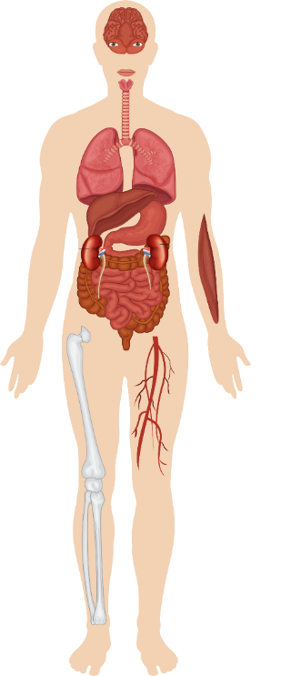
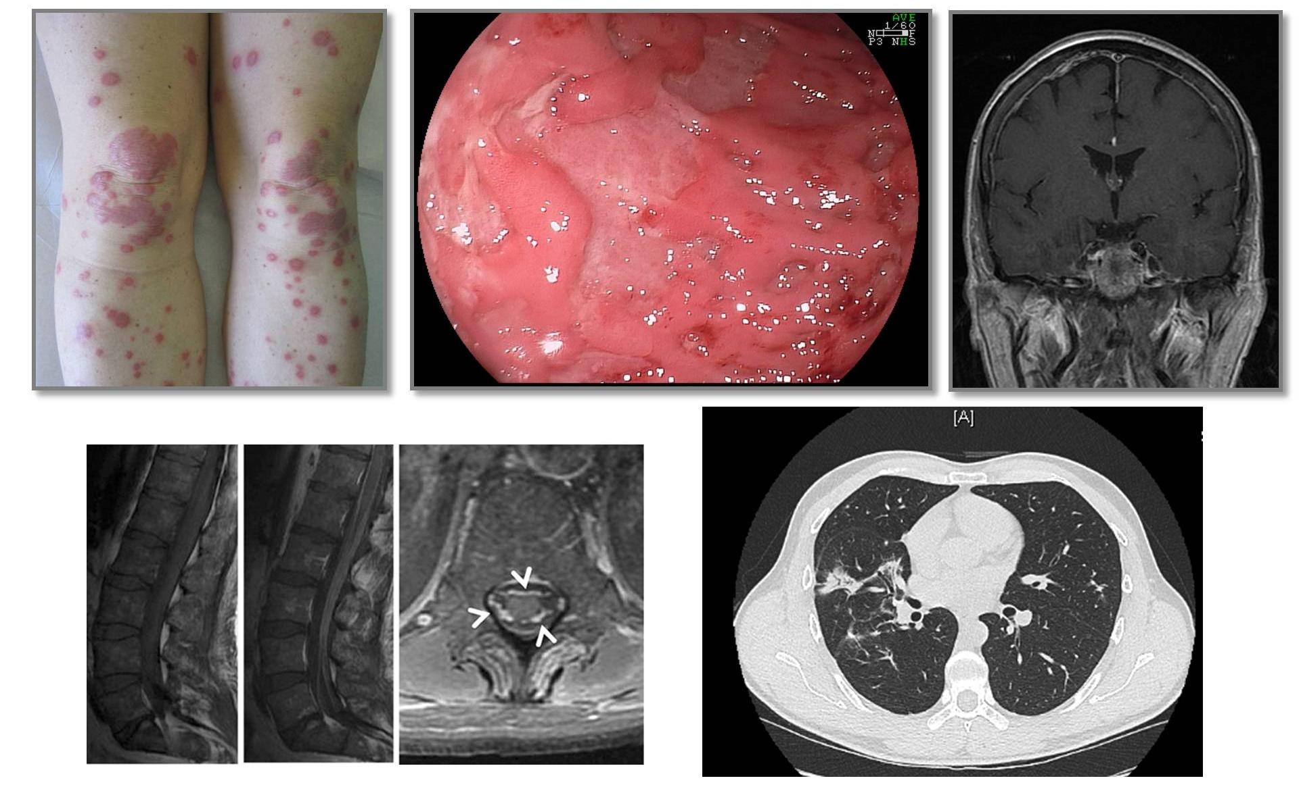
Overview of Immune-Related Adverse Events
Encephalitis
Aseptic meningitis
Hypophysitis
Dry mouth
Uveitis
Orbital inflammation
Hypothyroidism
Pneumonitis
Hepatitis
Cardiotoxicity
Pancreatitis
Autoimmune diabetes
Adrenal
insufficiency
Rash and vitiligo
Enterocolitis
Pruritus
Myalgia/myositis
Arthralgia
Michot. Eur J Cancer. 2016;54:139. Albarrán-Artahona. Diagnostics (Basel). 2022;12:2091. Winer. J Thorac Dis. 2018;10(suppl 3):S480. Steven. Rheumatology (Oxford). 2019;58(suppl 7):vii29. Robert. ASCO 2017. Education session: checkpoint inhibitor immunotherapy.
Clinical images reproduced with permission of Caroline Robert, MD, PhD.

Slide 6
Safety of Single-Agent Immunotherapies in EC
Common TRAEs, % | KEYNOTE-158: Pembrolizumab in MSI-H EC (n = 90)¹ |  | GARNET: Dostarlimab in dMMR EC (n = 129)²
 | Any Grade | Grade ≥3 | Any Grade | Grade ≥3
Pruritus | 24 | 0 | 8.5 | --
Fatigue | 21 | 0 | 13.2 | 0
Diarrhea | 16 | 0 | 16.3 | 1.6
Arthralgia | 14 | 0 | 8.5 | --
Nausea | 14 | 0 | 12.4 | 0
Hypothyroidism | 13 | 0 | 7.0 | --
Rash | 11 | 1 | 5.4 | --
irAEs, %
Hypothyroidism | 14 | 0 | 6.2 | --
Hyperthyroidism | 8 | 0 | 2.3 | --
Infusion reactions | 4 | 0 | 0 | 0
Diarrhea/colitis | --/3 | --/1 | 4.7/2.3 | 1.6/1.6
Severe skin reactions or rash | 2 | 2 | 0 | --
T1DM | 2 | 1 | -- | --
Amylase increased | -- | -- | 2.3 | 0.8
ALT increased | -- | -- | 2.3 | 1.6
Lipase increased | -- | -- | 3.1 | 2.3
1. O’Malley. JCO. 2022;40:752. 2. Oaknin. J Immunother Cancer. 2022;10:e003777.
Notes:
ALT, alanine aminotransferase; dMMR, mismatch repair deficient; EC, endometrial cancer; irAE, immune-related adverse event; MSI-H, microsatellite instability‒high; T1DM, type 1 diabetes mellitus; TRAE, treatment-related adverse event.

Slide 7
Safety of Immunotherapies + CT:
ENGOT-EN6/GOG-3031/RUBY
Parameter, n (%) | Dostarlimab + CT (n = 241) | Placebo + CT (n = 246)
Any TEAE | 241 (100) | 246 (100)
Any grade ≥3 TEAE | 170 (70.5) | 147 (59.8)
Serious TEAE | 91 (37.8) | 68 (27.6)
Any treatment-related irAE | 92 (38.2) | 38 (15.4)
Any TEAE leading to d/c of dostarlimab or placebo | 42 (17.4) | 23 (9.3)
Any TEAE leading to d/c of carboplatin | 24 (10.0) | 19 (7.7)
Any TEAE leading to d/c of paclitaxel | 24 (10.0) | 23 (9.3)
Any TEAE leading to death Any TEAE related to dostarlimab leading to death | 5 (2.1)* 2 (0.8)† | 0 --
Median duration of overall treatment, wk (range) | 43.0 (3.0-150.9) | 36.0 (2.1-165.1)
*3 deaths were not related to study treatment (opiate overdose, COVID-19, and general physical health deterioration).
†1 death (myelosuppression) was considered by investigator to be related to dostarlimab + carboplatin/paclitaxel within first 6 cycles;
1 death (hypovolemic shock) was related to dostarlimab within 90-day safety follow-up.
Powell. ASCO 2023. Abstr 5503. Mirza. NEJM. 2023;388:2145.
Notes:
CT, chemotherapy; d/c, discontinuation; irAE, immune-related adverse event; TEAE, treatment-emergent adverse event.

Slide 8
Immune-Related AEs With Immunotherapy + CT:
ENGOT-EN6/GOG-3031/RUBY
Treatment-Related irAEs, n (%) | Dostarlimab + CT (n = 241) | Placebo + CT (n = 246)
Grade ≥3 irAE | 40 (16.6) | 15 (6.1)
Occurring in ≥5% of patients Hypothyroidism Rash Arthralgia ALT increased | 27 (11.2) 16 (6.6) 14 (5.8) 14 (5.8) | 7 (2.8) 5 (2.0) 16 (6.5) 2 (0.8)
Mirza. NEJM. 2023;388:2145.
Notes:
AE, adverse event; ALT, alanine aminotransferase; CT, chemotherapy; irAE, immune-related adverse event.

Slide 9
Workup for More Common irAEs
 | Colitis | Hepatitis | Nephritis | Pneumonitis
Imaging | Grade ≥2 and high suspicion for complications: Consider abdominal/pelvic CT with contrast | Abdominal contrast enhanced CT/MRI Grade ≥3: Abdominal ultrasound |  | Consider chest CT with contrast if not contraindicated
Labs | Consider stool evaluation to rule out infectious etiology Consider fecal lactoferrin/calprotectin | Rule out: Viral etiology Disease-related hepatic dysfunction Drug-induced ALT/AST elevations Grade ≥3: Consider other causes, including myositis | Spot urine protein/creatinine ratio Microalbumin: creatinine ratio and urinalysis | Grade ≥2: Consider infectious workup Grade ≥3: Bronchoscopy with BAL and consider transbronchial lung biopsy if feasible/indicated Immunocompromised panel
Other | Grade ≥2: Consider GI consultation | Grade ≥3: Consider GI/hepatology consultation Limit/stop hepatotoxic meds Assess acetaminophen, dietary supplement, and alcohol use | Evaluate potential causes Recent IV contrast Meds Fluid status UTI Medical review and testing for pre/postrenal causes Limit/stop nephrotoxic meds Dose adjust meds to CrCl | Grade ≥2: Consider pulmonary consultation Grade ≥3: Consider cardiac evaluation
NCCN. Clinical practice guidelines in oncology: management of immunotherapy-related toxicities. v.2.2023. nccn.org.
Notes:
ALT, alanine aminotransferase; AST, aspartate aminotransferase; BAL, bronchoalveolar lavage; CrCl, creatinine clearance; CT, chemotherapy; GI, gastrointestinal; irAE, immune-related adverse event; UTI, urinary tract infection.

Slide 10
Workup for Rare and/or Serious irAEs
 | Hypophysitis | Myasthenia Gravis | Myocarditis | Myositis
Imaging | If symptomatic: Brain MRI ± contrast with pituitary/sellar cuts | Consider MRI brain and/or spine to rule out CNS disease | Cardiac MRI | Consider MRI
Labs | Blood workup If polyuria/polydipsia present with elevated serum Na: Consider workup for diabetes insipidus | Blood workup | Cardiac biomarkers Inflammatory biomarkers Consider viral titers, especially COVID-19 | Blood workup EMG muscle biopsy and myositis antibodies if clinically indicated
Other |  | Neurology consultation Pulmonary function assessment with NIF and VC Perform cardiac exam, check ECG, test troponin, and consider transthoracic echocardiogram for possible concomitant myocarditis EMG with repetitive stimulation and NCS | Immediate cardiology or cardio-oncology consultation ECG Telemetry monitoring if inpatient or topical patch monitor if outpatient Echocardiogram with LV strain measurement, if possible Consider cardiac catheterization and/or myocardial biopsy | Muscle strength testing of proximal muscles, including neck flexors, and distal muscles Evaluate for myasthenia gravis and myocarditis
NCCN. Clinical practice guidelines in oncology: management of immunotherapy-related toxicities. v.2.2023. nccn.org.
Notes:
CNS, central nervous system; EMG, electromyography; irAE, immune-related adverse event; NCS, nerve conduction study; NIF, negative inspiratory force; VC, vital capacity.

Slide 11
General Principles for Managing AEs
With Immunotherapy in EC
Educate patients about toxicities and to contact you immediately if they occur
Let other healthcare professionals know
that they are receiving immunotherapy
(wallet card)
Assess for irAEs at each cycle for the first
3 mo, including laboratory tests
Thyroid tests every 4-6 wk
Maintain low threshold for steroids or immunosuppression if irAE is concerning
Biologic agents for steroid-refractory AEs
  Infliximab for toxicities lasting 48-72 hr
Grade | Management
1 (mild) | Symptomatic management Continue therapy Immunosuppression not needed
2 (mild to moderate) | Symptomatic management Consider discontinuing until resolution to grade 1 Consider immunosuppression if intolerable or persistent Involve consultants as needed
3 or 4 (severe) | Discontinue therapy Start immunosuppression Refer/involve consultants At resolution, gradually taper off immunosuppression Educate patients to recognize potential toxicities and to contact you if they occur
Schneider. JCO. 2021;39:4073.
Notes:
AE, adverse event; EC, endometrial cancer; irAE, immune-related adverse event.

Slide 12

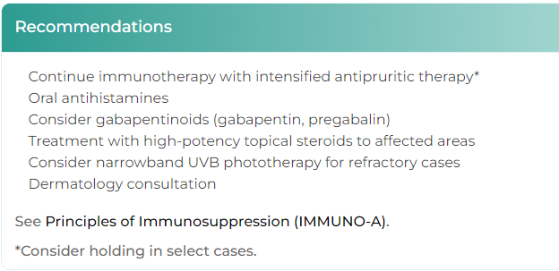




NCCN Clinical Practice Guidelines in Oncology (NCCN Guidelines®) for Managing Immune Checkpoint Inhibitor–Related Toxicities
Enter specific organ system affected and severity by answering a series of multiple-choice questions to gain management recommendations
Tool is based on
NCCN Guidelines® (v.2.2023)
NCCN Guidelines® for Managing Immune Checkpoint Inhibitor–Related Toxicities: Interactive Decision
Support Tool available at: clinicaloptions.com/immuneAEtool or on our app: AliCEA Mobile
Notes:
AE, adverse event; NCCN, National Comprehensive Cancer Network.

Slide 13
Multidisciplinary Tools for Optimizing
Team Communication and Patient Education
Patient Checklist | Provides ongoing education, including: Signs and symptoms to watch for When to call the oncology care team
Nursing Checklist | Helps structure patient assessments during infusion intake and at triage
Lab Tracker | Global document accessible by all HCPs for irAE management, including: ICI holds Steroid initiation, escalation, taper
Immunotherapy Wallet Card | Includes information to share with other HCPs if patient is experiencing emergent irAEs: Current therapy Oncology HCPs to contact
Electronic Health Records | Includes information on current tx available across specialties
CTCAE v5 | Educates HCPs involved in direct patient care on changes in toxicity grading
ACCC Immuno-Oncology Institute. Best practices for implementing
cancer immunotherapy in the community. November-December 2018.
Notes:
CTCAE, Common Terminology Criteria for Adverse Events; HCP, healthcare professional; ICI, immune checkpoint inhibitor; irAE, immune-related adverse event.

Slide 14
Managing AEs With Combination
ICI and VEGF-Targeted Therapy

Slide 15
Study 309/KEYNOTE-775: Adverse Events
TEAEs, % | Lenvatinib + Pembrolizumab (n = 406) |  | Doxorubicin or Paclitaxel (n = 388)
 | Any Gr | Gr ≥3* | Any Gr | Gr ≥3*
Hypertension | 65.0 | 39.2 | 5.2 | 2.6
Hypothyroidism | 58.9 | 1.5 | 0.8 | 0
Diarrhea | 55.7 | 8.1 | 20.4 | 2.1
Nausea | 51.7 | 3.4 | 46.4 | 1.3
Decreased appetite | 46.6 | 7.6 | 21.4 | 0.5
Vomiting | 37.7 | 3.0 | 21.1 | 2.6
Weight decrease | 35.5 | 10.8 | 5.9 | 0.3
Fatigue | 34.0 | 5.4 | 27.6 | 3.1
Arthralgia | 32.3 | 1.7 | 8.0 | 0
TEAEs, % | Lenvatinib + Pembrolizumab (n = 406) |  | Doxorubicin or Paclitaxel (n = 388)
 | Any Gr | Gr ≥3* | Any Gr | Gr ≥3*
Proteinuria | 30.5 | 5.2 | 3.4 | 0.3
Constipation | 28.3 | 0.7 | 24.5 | 0.5
Anemia | 28.1 | 6.9 | 48.7 | 15.5
UTI | 27.6 | 4.2 | 10.3 | 1.0
Headache | 26.4 | 0.5 | 9.0 | 0.3
Neutropenia | 9.1 | 2.0 | 34.0 | 26.0
Alopecia | 5.9 | 0 | 30.9 | 0.3
*In lenvatinib and pembrolizumab arm, 6.4% of patients suffered grade 5 AEs; in TPC arm, 5.2% of patients suffered grade 5 AEs.
Makker. JCO. 2023;41:2904.
Notes:
AE, adverse event; Gr, grade; TEAE, treatment-emergent adverse event; TPC, treatment of physician's choice; UTI, urinary tract infection.

Slide 16
General Management of AEs
With Lenvatinib/Pembrolizumab
AE Severity | Lenvatinib Dose Modification
Persistent/ intolerable grade 2/3 | Withhold until severity improved to grade ≤1 or baseline Resume at reduced dose
Grade 4 | Permanently discontinue
Manage most AEs with supportive care
plus withholding 1 or both agents as per prescribing information; discontinue if necessary
  Can dose reduce lenvatinib
  Do NOT dose reduce pembrolizumab
Many key TRAEs managed as outlined here
  Fatigue, nausea/vomiting, diarrhea, decreased appetite/weight, PPES, musculoskeletal pain, stomatitis
More specific recommendations for hypertension, hypothyroidism, proteinuria will be discussed
Dose PO QD | Starting Dosage | Lenvatinib Dose Reduction
 |  | First | Second | Third
EC | 20 mg | 14 mg | 10 mg | 8 mg
RCC | 20 mg | 14 mg | 10 mg | 8 mg
Makker. NEJM. 2022;386:437. Makker. Oncologist. 2021;26:e1599. Motzer. NEJM. 2021;384:1289.
Motzer. Oncologist. 2023;28:501. Lenvatinib PI. Pembrolizumab PI.
Notes:
AE, adverse event; EC, endometrial cancer; PPES, palmar‒plantar erythrodysesthesia syndrome; RCC, renal cell carcinoma; TRAE, treatment-related adverse event.

Slide 17
Managing AEs With Lenvatinib/Pembrolizumab: Hypertension
Hypertension Severity | Lenvatinib Dose Modification per Prescribing Information
Grade 3 | Withhold if persists despite optimal antihypertensive treatment When grade ≤2, resume at reduced dose
Grade 4 | Permanently discontinue
Hypertension Scenario | Management per KEYNOTE-755 Protocol
Elevated BP (systolic ≥140 mm Hg or diastolic ≥90 mm Hg) confirmed on 2 assessments ≥30 min apart | Start antihypertensive medications If already receiving antihypertensives, modify dose or medication
BP still elevated despite optimized antihypertensive therapy | Interrupt lenvatinib Resume at lower dose after patient has controlled BP on stable dose of antihypertensive therapy for ≥48 hr
Control BP before initiating treatment
Monitor BP regularly during treatment
  Monitoring schedule: At 1 wk →
  Q2W for first 2 mo → at least monthly thereafter
Optimize medical management before withholding/dose reducing lenvatinib
  Exceptions: Withhold if:
    At imminent risk of hypertensive crisis
    Significant risk factors for complications present
Makker. NEJM. 2022;386:437. Makker. Oncologist. 2021;26:e1599. Lenvatinib PI.
Notes:
AE, adverse event; BP, blood pressure.

Slide 18
Managing AEs With Lenvatinib/Pembrolizumab: Hypothyroidism
Hypothyroidism Severity | Pembrolizumab Administration Recommendation
Grade 2 | Continue pembrolizumab Initiate thyroid replacement hormones (levothyroxine or liothyronine) Monitor for thyroid disorders
Grade 3/4 | Manage as per grade 2 Withhold pembrolizumab until clinically stable on replacement hormones, then continue Can discontinue pembrolizumab depending on severity
Manage hypothyroidism per institutional practice
Withhold/discontinue pembrolizumab as needed
Lenvatinib dose modifications rarely necessary
Makker. NEJM. 2022;386:437. Makker. Oncologist. 2021;26:e1599. Motzer. NEJM. 2021;384:1289.
Motzer. Oncologist. 2023;28:501. Lenvatinib PI. Pembrolizumab PI.
Notes:
AE, adverse event.

Slide 19
Managing AEs With Lenvatinib/Pembrolizumab: Proteinuria
Assess regularly for proteinuria
Perform 24-hr urine collection to grade proteinuria within 72 hr of:
  Initial occurrence of proteinuria on
  urine dipstick ≥2+
  Subsequent increase in severity of
  urine dipstick proteinuria while receiving same dose level of lenvatinib
  Following lenvatinib dose reduction,
  urine protein dipstick was 2+/3+/4+
Withhold, dose reduce, or permanently discontinue lenvatinib as appropriate
Proteinuria Severity | Lenvatinib Dose Modification
≥2 g/24 hr | Withhold until ≤2 g/24 hr Resume at reduced dose
Nephrotic syndrome | Permanently discontinue
Makker. NEJM. 2022;386:437. Makker. Oncologist. 2021;26:e1599. Motzer. NEJM. 2021;384:1289.
Motzer. Oncologist. 2023;28:501. Lenvatinib PI. Pembrolizumab PI.
Notes:
AE, adverse event.

Slide 20
Key Takeaways
ICIs essential to standard of care for frontline and later-line treatment of
advanced endometrial cancer
Most irAEs are low grade and manageable
Managing irAEs essential to optimizing patient outcomes
  Patient and caregiver education
    Potential irAEs
    Importance of reporting any symptoms
  Workup and differential diagnosis—especially important if ICI given with CT or lenvatinib
  Management generally depends on supportive care, ICI holds, immunosuppressive tx, and specialist consults as needed
Notes:
CT, chemotherapy; ICI, immune checkpoint inhibitor; irAE, immune-related adverse event; tx, treatment.

Slide 21
Go Online for More CCO
Coverage of Endometrial Cancer!
CME/ABIM MOC‒certified “micro” text modules and downloadable slidesets on key clinical considerations in advanced endometrial cancer, from molecular testing to irAE care
“Call to Action” ClinicalThought commentary with expert perspectives and survey data on key gaps in endometrial cancer care
Podcast featuring a patient advocate and HCP discussing how to work together for equitable care
Updates to Interactive Decision Support Tool providing expert recommendations tailored to specific scenarios for patients with advanced endometrial cancer
clinicaloptions.com/EndometrialThinkTank

