Slide 1
Radioligand Therapy for Metastatic Castration-Resistant Prostate Cancer
Provided by Clinical Care Options, LLC
Supported by an educational grant from Novartis Pharmaceuticals Corporation.

Slide 2

About These Slides
Please feel free to use and share some or all of these slides in your noncommercial presentations to colleagues or patients
When using our slides, please retain the source attribution:
These slides may not be published, posted online, or used in commercial presentations without permission. Please contact permissions@clinicaloptions.com for details
Slide credit: clinicaleducationalliance.com
Notes:
Disclaimer: The materials published on the Clinical Care Options website reflect the views of the authors of the CCO material, not those of Clinical Care Options, LLC, the CME providers, or the companies providing educational grants. The materials may discuss uses and dosages for therapeutic products that have not been approved by the FDA. A qualified healthcare professional should be consulted before using any therapeutic product discussed. Readers should verify all information and data before treating patients or using any therapies described in these materials.

Slide 3
Faculty
Tanya B. Dorff, MD
Professor of Medicine
Division Chief, Genitourinary Cancer Program
Department of Medical Oncology and Therapeutics Research
City of Hope
Duarte, California
Phillip H. Kuo, MD, PhD, FACR
Vice Chair of Clinical Research for Department of Radiology
Professor and Division Chief of Nuclear Medicine
City of Hope National Medical Center
Duarte, California

Slide 4
Faculty Disclosures
The faculty reported the following relevant financial relationships or relationships to products or devices they have with ineligible companies related to the content of this educational activity:
Tanya B. Dorff, MD: consultant/advisor/speaker: AstraZeneca, Bayer, Janssen, Novartis, Pfizer.
Phillip H. Kuo, MD, PhD, FACR: consultant/advisor/speaker: Attralus, Bayer, Blue Earth Diagnostics, dGenThera, Fusion Pharma, GE Healthcare, Global Medical Solutions, Invicro/Perceptive, Life Molecular Imaging, Lilly, Merck, Navidea, Novartis, Radionetics, Telix, United Imaging.

Slide 5
Learning Objectives
Assess current and emerging clinical data and evidence-based radioligand prostate cancer treatment guidelines
Apply PSMA PET/CT to predict response to PSMA-targeted radioligand therapy, chemotherapy-inclusive treatment regimens, and first and second-line androgen deprivation therapies
Employ PSMA PET as a prognostic biomarker for biochemical recurrence of prostate cancer
Formulate and employ multidisciplinary care strategies to guide the personalization of treatment regimens that include radioligand therapies for patients with mCRPC
Develop multidisciplinary clinical care strategies to optimally manage the associated risks of treatment with radioligand therapies in patients with prostate cancer

Slide 6
Standard of Care in mCRPC

Slide 7
Background: Metastatic Castration-Resistant Prostate Cancer (mCRPC)
mCRPC remains incurable
  ~70% of patients die from mCRPC within 5yr
Androgen receptor pathway inhibitors (ARPIs) and CT had been the mainstay of treatment for mCRPC
NCCN. Clinical practice guidelines in oncology: Prostate cancer. v2.2025. nccn.org.

Slide 8
Clinical Course of Prostate Cancer
De Novo
Rising PSA despite castrate levels of testosterone
Identification of Metastases
mHSPC
Start
ADT
mCRPC remains incurable and the cause of death for patients who die of prostate cancer
Localized/Locally Advanced
Prostate Cancer
Rising PSA
nmHSPC
Definitive
Therapy
Rising PSA despite castrate levels of testosterone and Identification of Metastases
mCRPC
Biochemical recurrence
Start
ADT
nmCRPC
Rising PSA despite castrate levels of testosterone
Identification of Metastases
Adapted from Saad. Prostate Cancer and Prostatic Diseases. 2021; 24:323.

Slide 9
Available Options for mCRPC
Local
Disease
Biochemically
Recurrent
Radiographic Metastatic Disease
Castration Sensitive
Castration Resistant
Surgery/
Radiation
ADT
ADT
Abiraterone
Cabazitaxel
Olaparib
Enzalutamide
Docetaxel
Rucaparib
Apalutamide
Sipuleucel-T
Pembrolizumab
m0 CRPC
Doce + Abiraterone
Radium-223
Olaparib + Abiraterone
Apalutamide
Doce + Darolutamide
¹⁷⁷-Lu-PSMA-617
Talazoparib + Enza
Enzalutamide
Abiraterone
Niraparib + Abi
Darolutamide
Enzalutamide
NCCN. Clinical practice guidelines in oncology: Prostate Cancer. v2.2025. nccn.org.

Slide 10
mCRPC: Unmet Needs and Current Status
mCRPC: Prostate cancer that progresses clinically, radiographically, or biochemically despite castrate levels of serum testosterone (<50 ng/dL)
  Unmet needs¹:
    Incurable despite multiple therapeutic options including AR pathway inhibitors, chemotherapy, immunotherapy, targeted therapy, radiotherapy
    Limited treatment options in later lines of therapy
  Recent developments and future directions^{2,3}:
    Research and recent approvals directed toward understanding patient and tumor biology to direct therapy
mCRPC Survival By Site of Metastasis⁴
35
31.6
30
25
21.3
20
19.4
Overall Survival (Mo)
13.5
15
10
5
0
Lymph
node
(n = 565)
Bone
(n = 6356)
Lung
(n = 791)
Liver
(n = 752)
Site of Metastasis
1. Sartor. NEJM. 2018;378:645. 2. El Fakiri. Cancers (Basel). 2021;13:3967. 3. Scher. JCO. 2008;26:1148.
4. Halabi. JCO. 2016;34:1652.

Slide 11
Available Radioligand Therapies

Slide 12
FDA-Approved Radioligand Therapies
Radium-223 approved in 2013 for mCRPC with bone metastases and no known visceral metastatic disease
Lutetium Lu 177 vipivotide tetraxetan (¹⁷⁷Lu-PSMA-617): first PSMA-targeted radionuclide
  Approved in March 2022 after previous treatment with ARPI therapy and taxane-based CT
  Expanded approval on March 28, 2025 for patients who have previously undergone treatment with ARPI therapy and are suitable candidates for delaying taxane-based chemotherapy
Radium-223 PI. Lu177 PI.

Slide 13
Radium-223 (Ra-223 Dichloride)
Pharmacology
  Dosing and administration: 55 kBq (1.49 microcurie) per kg body weight, Q4W x 6 injections
  Exposure: radium-223 can also be absorbed by other organs (ie, bone marrow and digestive system) which may result in adverse effects in healthy tissues
  Distribution: GI tract, liver, lungs, kidneys, heart wall, bone marrow, and salivary glands
Safety considerations
  Cautions: radiation exposure management required per institutional policy
  Anemia, lymphocytopenia, leukopenia, thrombocytopenia, nausea, diarrhea, vomiting, neutropenia, peripheral edema
Relative contraindications:
  Hb <9.0 g/dL
  Cytopenias (thrombocytopenia; neutropenia less so)
Radium-223 PI.

Slide 14

Radium-223: Mechanism of Action
Radium-223
New abnormal bone formation (woven bone)
Range of alpha particle
Osteoblastic factors
Radium-223 binds with hydroxyapatite and is incorporated into the bone matrix
Bone marrow
Growth factors
Osteoblasts
Bone
Metastatic Prostate Cancer Cells
Gupta. Proc (Bayl Univ Med Cent). 2017;30:424.

Slide 15
¹⁷⁷Lu-PSMA-617: Pharmacology and Other Considerations
Pharmacology
  Dosing and administration:
    Single-dose vial for IV injection:
    1000 MBq/mL (27 mCi/mL)
    7.4 GBq (200 mCi/mL) Q6W x 6 doses
    ¹⁷⁷Lu-PSMA-617 exposure may increase in patients with moderate renal impairment (ie, CrCl 30-50 mL/min)
  Potential exposure to bystanders beyond patient use
Safety considerations
  Cautions: radiation exposure management with good institutional radiation safety practices and procedures
  Adverse effects and toxicity: myelosuppression, renal toxicity, dry mouth, GI toxicity, fatigue, electrolyte or metabolic abnormalities, elevated AST/ALT, other nonhematologic toxicity
Relative contraindications:
  <50 GFR, hemodialysis, kidney obstructions, or severe cytopenias
Lu177 PI.

Slide 16

¹⁷⁷Lu-PSMA-617–Targeted Radioligand Therapy
¹⁷⁷Lu-PSMA-617 binds with
high affinity to PSMA on cell membranes
¹⁷⁷Lu is a radioactive atom that emits β particles, resulting in prostate cancer cell death
¹⁷⁷Lu
¹⁷⁷Lu-PSMA-617
PSMA
PSMA-617
¹⁷⁷Lu
Endocytosis
PSMA-617
Prostate cancer cell
DNA damage
Morris. ASCO 2021. Abstr LBA4. Lu177 PI. Kuo. Target Oncol. 2025;20:597.

Slide 17
Visual Estimation of PSMA+ Status in mCRPC
Nodes (N) and Metastases (M)
LOCALIZE regions
RATE lesions
PSMA-expression score*
miN1
miN2
II
Internal Iliac (LR)
Benign/not eligible for RLT
VS
Malignant/
eligible for RLT
EI
External Iliac (LR)
OB
Obturator (LR)
PS
Presacral
3
OP
Other pelvic
Parotid
miM1a
miM1c
2
hep
Liver
CI
Common Iliac (L/R)
pul
1
RP
Retroperitoneal
adr
SD
Supradiaphragm
brain
Blood
OE
Inguinal/Other
other
0
miM1b (uni)
miM1b (oligo)
miM1b (diss)
miM1b (dmi)
Score | Pattern
0 | Equal to/lower than blood pool
1 | Equal to/lower than liver + higher than blood pool
2 | Equal to/lower than parotid gland + higher than liver
3 | Higher than parotid gland
*Score 2+ lesions are regarded as malignant: patients with only 2+ lesions are deemed as eligible for PSMA-RLT.
Seifer. Eur Urol. 2023;83:405.

Slide 18
Selecting Patients for PSMA-Targeted Therapy
Assess MIP or coronal images for PSMA-positive lesion
(“PSMA-positive” is activity greater than liver by visual assessment)
No positive lesions
Exclude
1 or more positive lesions in any organ and of any size
Review diagnostic imaging (CT/MR) to identify lesions that fulfill size criteria for evaluation
No lesions meeting size criteria
Lymph node:
≥2.5 cm in short axis
anywhere in body
Solid organ/parenchymal:
Metastasis(es) ≥1 cm in short axis
Bone metastasis with soft tissue component:
soft tissue ≥1 cm in short axis
Include
Yes
Yes
Yes
≥1 PSMA-negative lesion(s)
Assess if lesions that meet size criteria are PSMA-negative.
(“PSMA-negative” is activity equal to or less than liver by visual assessment)
Only soft tissue component of bone metastasis is assessed for level of uptake.
If lesion has necrosis, only assess viable component ≥1 cm in short axis.
Exclude
No PSMA-negative lesion(s)
Include
Kuo. J. Nucl Med. 2022;63:816.

Slide 19
The Evolving Radioligand Treatment Landscape: Updates on Clinical Studies and Integrating Data Into Clinical Practice

Slide 20
Radium-223

Slide 21
Phase III ALSYMPCA Trial of Efficacy and Safety of Radium-223 in mCRPC
Treatment with radium-223 improved OS in patients with mCRPC
OS, Previous Docetaxel Use
OS, No Previous Docetaxel Use
 | Radium-223 (n = 352) | Placebo (n = 174)
Median OS, mo (95% CI) | 14.4 (12.5-15.5) | 11.3 (10.0-12.9)
 | HR: 0.70 (95% CI: 0.56-0.88)
 | P = .002
 | Radium-223 (n = 262) | Placebo (n = 133)
Median OS, mo (95% CI) | 16.1 (13.9-17.8) | 11.5 (9.5-14.1)
 | HR: 0.69 (95% CI: 0.52-0.92)
 | P = .01
100
100
80
80
60
60
Radium-223
Placebo
Radium-223
Placebo
OS (%)
OS (%)
40
40
20
Treatment period
20
Treatment period
0
0
0
4
8
12
16
20
24
28
32
36
40
0
4
8
12
16
20
24
28
32
36
Mo
Mo
May 2013: FDA approved radium-223 for mCRPC based on the phase III ALSYMPCA trial
Hoskin. Lancet Oncol. 2014;15:1397. Radium-223 dichloride PI.

Slide 22
PEACE-3: Enzalutamide ± Radium-223 in mCRPC
International, open-label, randomized phase III trial
Stratified by country, baseline pain (BPI worst pain 0/1 vs 2/3), prior docetaxel (yes vs no), use of BPAs (yes vs no), prior abiraterone (yes vs no)
Enzalutamide 160 mg PO QD +
Radium-223 55 kBq/kg IV Q4W x 6
(n = 222)
Adults with confirmed prostate adenocarcinoma; ≥4 bone mets ± lymph node mets; asymptomatic or mildly symptomatic; WHO PS 0/1; no known CNS or visceral mets; no prior or concomitant treatment with CYP17 inhibitors
(N = 446)
Enzalutamide 160 mg PO QD
(n = 224)
Primary endpoint: rPFS
Key secondary endpoints: OS, prostate cancer-specific survival; first symptomatic skeletal event; time and incidence of first skeletal PFS, rate of skeletal fractures, QoL, safety
NCT02194842. Gillessen. ESMO 2024. Abstr LBA1. Tombal. Ann Oncol. 2025;36:1058.

Slide 23
PEACE-3: Fracture Rates by Mandating Use of BPAs With Enzalutamide ± Radium-223
BPA and treatment
Enza with BPA
Enza without BPA
Enza + Rad with BPA
Enda + Rad without BPA + Censor
Without a BPA (zoledronic acid or denosumab), fracture risk is increased
  Fracture rates:
  Enzalutamide: 13.4%
  Enzalutamide + radium-223: 24.3%
With a BPA, the cumulative fracture incidence is low for patients treated with either combination therapy or enzalutamide alone
Grade 3 TEAEs in >3% of patients in the enzalutamide group vs enzalutamide + radium-223
  Hypertension: 34.4% vs 33.5%
  Bone pain: 4.9% vs 4.1%
100
80
60
Cumulative incidence (%)
+
40
+
+
+
+
20
+
+
+
+
+
+
+
+
+
+
+
+
+
+
+
+
+
+
+
+
+
+
+
+
+
+
+
+
+
+
+
+
+
+
+
+
+
+
+
+
+
0
+
+
+
+
+
+
+
+
+
+
+
+
+
+
+
+
+
+
+
+
+
+
+
+
+
+
+
+
+
+
+
+
+
+
+
+
+
+
0
6
12
18
24
30
36
38
Mo Since Randomization
Patients at Risk, n
Enza with BPA
Enza without BPA
Enza + Rad with BPA
Enda + Rad without BPA
97
32
87
35
83
29
74
31
68
26
59
18
48
21
46
12
36
13
36
6
21
5
18
4
14
5
12
3
Gillessen. Eur Urol. 2025;87:285. Tombal. Ann Oncol. 2025;36:1058.

Slide 24




PEACE-3: rPFS and OS
Primary Endpoint: rPFS*
OS at Interim Analysis (80% of OS Events)†
Outcome | Enza + Radium-223 (n = 222) | Enza (n = 224)
Median rPFS, mo (95% CI) | 19.4 (17.1-25.3) | 16.4 (13.8-19.2)
Events, n | 139 | 160
 | HR: 0.69 (95% CI: 0.54-0.87)
 | Log-rank P = .0009
Outcome | Enza + Radium-223 (n = 222) | Enza (n = 224)
Median OS, mo (95% CI) | 42.3 (36.8-49.1) | 35 (28.8-38.9)
Events, n | 110 | 129
 | HR: 0.69 (95% CI: 0.52-0.90)
 | Log-rank P <.0034
100
+
100
+
Enzalutamide
+ radium-223
Enzalutamide
Censored
+
+
+
+
Enzalutamide
+ radium-223
Enzalutamide
Censored
+
+
+
+
+
+
+
+
+
80
+
80
+
+
73%
+
+
+
+
+
+
+
+
+
+
+
+
+
+
+
+
+
+
+
24-mo rPFS
+
+
+
60
+
+
+
60
+
+
+
+
+
+
+
+
+
+
+
+
rPFS (%)
+
+
+
+
45%
+
+
+
+
+
OS (%)
67%
+
+
+
+
40
+
+
+
40
+
+
+
+
+
+
+
+
+
+
+
+
+
+
+
+
+
+
+
+
+
+
+
+
+
+
+
+
+
+
+
+
+
20
+
+
+
+
+
20
+
+
+
36%
+
+
+
+
+
+
+
+
+
+
+
+
+
0
+
0
0
6
12
18
24
30
36
42
48
54
60
66
72
0
6
12
18
24
30
36
42
48
54
60
66
72
Mo
Mo
*Assumption of proportional hazard achieved. †Preset level of significance for interim analysis was ≤.0034. Due to nonproportional hazards plus lack of unequivocal significance for restricted mean survival time sensitivity analysis, study will continue to final OS analysis.
Gillessen. ESMO 2024. Abstr LBA1. Tombal. Ann Oncol. 2025;36:1058.

Slide 25
REASSURE: Long-term Safety From a Real-world Observational Study of Radium-223 in mCRPC
Parameter, n (%) | Patients (n = 1465)
Any AE of interest* | 701 (48)
Treatment-emergent AEs occurring during treatment or ≤30 days after last radium-223 dose Serious AE Serious AE leading to death Drug-related AE Any Grade ≥3 Led to radium-223 d/c Led to death | 311 (21) 92 (6) 510 (35) 155 (11) 82 (6) 9 (1)
Parameter, n (%) | Patients (n = 1465)
Posttreatment AEs occurring >30 days after completion of radium-223 Grade 3/4 hematologic AE ≤6 mo after completion of radium-223 Grade 3 Grade 4 Drug-related serious AE ≤7 yr after completion of radium-223 Any serious AE Resulting in death | 203 (14) 26 (2) 28 (2) 2 (<1)
*AEs of interest included treatment-emergent serious AEs and drug-related AEs during and ≤30 days after radium-223 completion, grade 3/4 hematologic AEs ≤6 mo after last radium-223 dose, and drug-related serious AEs after radium-223 therapy completion.
Higano. EClinicalMedicine. 2023;[Epub].

Slide 26
REASSURE: Hematologic Outcomes and Treatments
After Start of Radium-223 in Patients ± Previous Chemotherapy
After Completion of Radium-223 in Patients ± Previous Chemotherapy
Patients with ≥1 bone marrow suppression–relevant treatment
21%
23%
37%
41%
Patients who received blood transfusion(s)
19%
22%
34%
37%
Patients who received erythropoiesis-stimulating drugs
3%
2%
3%
No prior chemotherapy
(n = 897)
With prior chemotherapy
(n = 568)
4%
No subsequent chemotherapy
(n = 1149)
With subsequent chemotherapy
(n = 316)
Patients who received colony-stimulating drugs
1%
1%
3%
6%
0
5
10
15
20
25
30
35
40
45
50
0
5
10
15
20
25
30
35
40
45
50
Patients (%)
Patients (%)
Higano. EClinicalMedicine. 2023;[Epub].

Slide 27
COMRADE: Olaparib + Radium-223 vs Radium-223 Alone in mCRPC With Bone Metastases
Multicenter, randomized, phase I/II trial
Stratified by prior docetaxel (yes vs no), disease extent (≤ vs 20 bone lesions)
Phase II
Patients with progressive mCRPC, with ≥2 bone metastases, no visceral metastases and previous docetaxel permitted
  (N = 133)
Radium-223 55 kBq/kg Q4W IV x 6 +
Olaparib 200 mg PO BID
Phase I: 3+3 Dose Escalation
Radium-223 55 kBq/kg Q4W x 6 +
Olaparib at 4 dose levels of 100/150/200/300 mg PO BID
(n = 12)
Radium-223 55 kBq/kg Q4W IV x 6
Primary endpoint: rPFS
Secondary endpoints: rPFS (by disease extent and prior docetaxel), HRR mutation status, PSA50, ALK30, ORR, PSA progression, time to ALK progression, TFST, SSE, and OS
Current analysis
NCT03317392. McKay ASCO 2025. Abstr 5007.

Slide 28
COMRADE: rPFS (Primary Endpoint)
rPFS in ITT (Primary Endpoint)
rPFS Outcomes With Radium-223 + Olaparib vs Radium-223 alone
By prior docetaxel use:
  No prior docetaxel: 13.7 vs 5.7 mo
  (HR: 0.24; 90% CI: 0.15-0.40)
  Prior docetaxel: 6.6 vs 3.3 mo
  (HR: 0.73; 90% CI: 0.48-1.11)
By extent of bone metastases:
  ≤20 bone metastases: 13.4 vs 4.2 mo
  (HR: 0.21; 90% CI: 0.13-0.33)
  >20 bone metastases: 4.7 vs 4.8 mo
  (HR: 1.17; 90% CI: 0.75-1.84)
By HRR gene status:
  HRR-positive: 5.5 vs 4.7 mo
  (HR: 0.47; 90% CI: 0.22-1.01)
  HRR-negative: 11.5 vs 4.5 mo
  (HR: 0.49; 90% CI: 0.34-0.71)
Parameter | Radium-223 + Olaparib (n = 61) | Radium-223 (n = 59)
Median rPFS, mo | 8.9 | 4.7
HR (90% CI) | 0.47 (0.34- 0.65)
P value | .0013
10
0.8
0.6
Proportion
0.4
0.2
0.0
0
3
6
9
12
15
18
21
24
27
30
Time From Randomization (Mo)
Radium-223 + Olaparib
Radium-223
61
59
42
36
30
16
19
9
15
3
8
1
2
1
1
1
1
1
0
1
0
0
McKay. ASCO 2025. Abstr 5007.

Slide 29
Key Ongoing Trials Assessing Radium-223 in mCRPC
Trial* | Phase | Status | Estimated N | Patient Population | Treatment Arm(s)
RAPSON (NCT03230734) | II | Active, not recruiting | 70 | Symptomatic bone-only mCRPC | Radium-223 followed by docetaxel Docetaxel followed by radium-223
DORA (NCT03574571) | III | Active, recruiting | 738 | Documented progressive mCRPC with ≥2 bone lesions | Radium-223 + docetaxel Docetaxel
AlphaBet (NCT05383079) | I/II | Active, not recruiting | 36 | mCRPC after progression on ≥1 second-generation AR-targeted agent | Radium-223 + ¹⁷⁷Lu-PSMA-I&T
Rad2Nivo (NCT04109729) | I | Active, not recruiting | 39 | mCRPC without evidence of visceral metastases and symptomatic bone metastases | Radium-223 + nivolumab
BAT-RAD (NCT04704505) | II | Active, recruiting | 47 | Adenocarcinoma mCRPC with bone metastases and asymptomatic or minimally symptomatic | Radium-223 + bipolar androgen therapy
NCT04071236 | II | Active, recruiting | 90 | Advanced hormone-unresponsive prostate cancer | Radium-223 + adiation-enhancing medication (M3814; nedisertib) Radium-223 + avelumab
clinicaltrials.gov.​
*As of September 2025.

Slide 30
Lu 177 Vipivotide Tetraxetan

Slide 31
Phase III VISION: ¹⁷⁷Lu-PSMA-617 + SoC vs SoC Alone
International, open-label, randomized phase III trial
PSMA+ mCRPC defined as ≥1 PSMA+ metastatic lesion with ⁶⁸Ga uptake > liver and
no PSMA- lesions in bone with soft tissue component ≥1 cm, lymph nodes ≥2.5 cm,
or solid organ ≥1 cm
Of 1003 patients who underwent scanning for VISION, 12.6% did not meet PSMA+ criteria
¹⁷⁷Lu-PSMA-617 7.4 GBq (200 mCi) Q6W x 4-6 cycles +
Protocol-Permitted SoC*
(n = 551)
Patients with PSMA+ mCRPC on PET/CT with ⁶⁸Ga-PSMA-11; ≥1 prior AR pathway inhibitor and ≥1 prior taxane; ECOG PS 0-2
(N = 831)
Coprimary endpoints:
rPFS and OS
Key secondary endpoints: objective response, disease control, time to symptomatic skeletal events
2:1
Protocol-Permitted SoC*
(n = 280)
*Excludes CT, immunotherapy, systemic radioisotopes, and investigational drugs.
Sartor. NEJM. 2021;385:1091. NCT03511664.

Slide 32
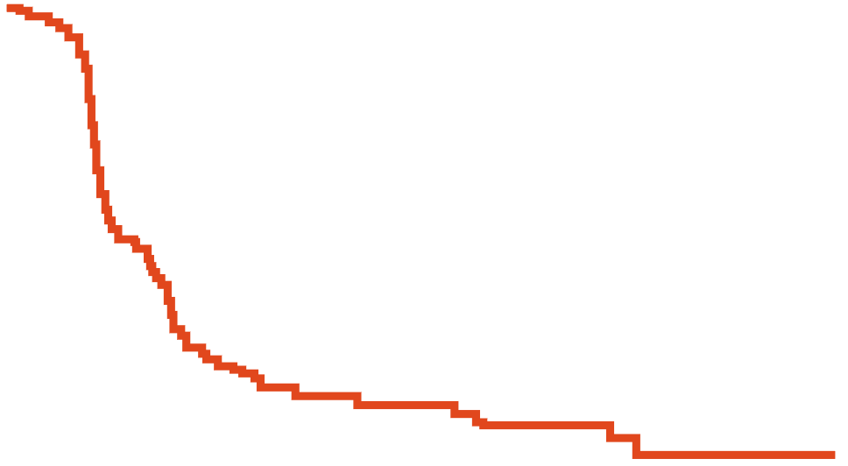



VISION: Efficacy of ¹⁷⁷Lu-PSMA-617 + Best SoC in mCRPC
Outcome | ¹⁷⁷Lu-PSMA-617 + SoC (n = 551) | SoC (n = 280)
mOS, mo | 15.3 | 11.3
HR (95% CI): 0.62 (0.52-0.74); P <.001
Outcome | ¹⁷⁷Lu-PSMA-617 + SoC (n = 385) | SoC (n = 196)
mrPFS, mo | 8.7 | 3.4
HR (95% CI): 0.40 (0.29-0.57); P <.001
100
¹⁷⁷Lu-PSMA-617 Improved OS
100
¹⁷⁷Lu-PSMA-617 Improved rPFS
+
+
+
+
+
+
+
+
+
+
+
+
¹⁷⁷Lu-PSMA-617 + SoC (n = 551)
SoC (n = 280)
Censored
+
+
¹⁷⁷Lu-PSMA-617 + SoC (n = 385)
SoC (n = 196)
Censored
+
+
+
+
+
+
+
80
+
80
+
+
+
+
+
+
+
+
+
+
+
+
+
+
+
+
+
+
+
+
+
+
60
+
+
60
+
+
+
+
+
+
+
+
+
Patients Without Disease Progression (%)
+
+
+
+
+
Patients Alive (%)
+
+
+
+
+
+
+
+
+
+
+
+
+
+
+
40
+
+
+
+
+
+
+
+
40
+
+
+
+
+
+
+
+
+
+
+
+
+
+
+
+
+
+
+
+
+
+
+
+
+
+
+
+
+
+
+
+
+
+
+
+
+
+
+
+
+
+
+
+
+
+
+
+
+
+
+
+
+
+
+
+
+
+
20
+
+
+
+
+
+
+
+
+
+
20
+
+
+
+
+
+
+
+
+
+
+
+
+
+
+
+
+
+
+
+
+
+
+
+
+
+
+
+
+
+
+
+
+
+
+
+
+
+
+
+
+
+
+
+
+
+
+
+
+
+
0
+
+
0
+
+
+
0
4
8
12
16
20
24
28
32
0
3
6
9
12
15
18
21
Mo From Randomization
Mo From Randomization
Both primary endpoints met: improved OS and rPFS
in patients receiving ¹⁷⁷Lu-PSMA-617 + best SoC vs best SoC alone
Delayed time to worsening HRQoL and time to skeletal events
March 23, 2022:
FDA approved for ¹⁷⁷Lu-PSMA-617 for patients with PSMA-positive mCRPC who have been treated with ARPI and taxane-based chemotherapy
Sartor. NEJM. 2021;385:1091. Lutetium Lu 177 dotatate PI .

Slide 33
PSMAfore: ¹⁷⁷Lu-PSMA-617 vs ARPI in Taxane-Naive PSMA+ mCRPC
International, open-label, randomized phase III trial
Primary endpoint: rPFS per BICR (RECIST v1.1)
Key secondary endpoints: OS, rPFS2, PFS by investigator
Stratified by prior ARPI setting (castration-resistant vs hormone-sensitive), BPI-SF worse pain intensity score (0-3 vs >3)
Adults with taxane-naive confirmed mCRPC that progressed once on prior ARPI; ≥1 PSMA+ metastasis on ⁶⁸Ga-PSMA-11 PET/CT with no exclusionary PET- lesions; ineligible for PARP inhibitor; ECOG PS 0/1
(N = 468)
¹⁷⁷Lu-PSMA-617 7.4 GBq (200 mCi) IV ± 10% Q6W x 6 cycles
(n = 234)
Crossover permitted at radiographic PD per BICR
ARPI switch to abiraterone or enzalutamide
(n = 234)
Morris. Lancet. 2024;404:1227. NCT04689828.

Slide 34
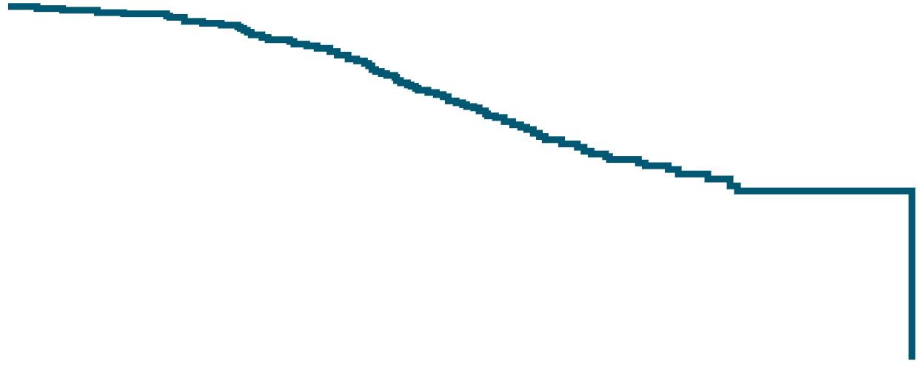



PSMAfore: rPFS and OS
Outcome | ¹⁷⁷Lu-PSMA-617 (n = 234) | ARPI Change (n = 234)
mrPFS, mo | 11.6 | 5.59
HR: 0.49 (95% CI: 0.39-0.61)
Outcome | ¹⁷⁷Lu-PSMA-617 (n = 234) | ARPI Change (n = 234)
mOS, mo | 23.66 | 23.85
HR: 0.98 (95% CI: 0.75-1.28; P = .44)
rPFS by BICR*
OS in ITT Population†
100
¹⁷⁷Lu-PSMA-617
ARPI change
Censored
100
+
+
+
¹⁷⁷Lu-PSMA-617
ARPI change
Censored
+
+
+
+
+
+
+
+
+
+
+
+
+
+
+
+
+
+
+
+
+
80
+
+
80
+
+
+
+
+
+
+
+
+
+
+
+
+
+
+
+
+
+
+
+
+
+
+
60
60
+
+
+
+
+
+
+
Patients
Without Event (%)
+
+
+
+
+
+
+
Patients
Without Event (%)
+
+
+
+
+
+
+
+
+
+
+
+
+
+
+
+
+
+
+
+
+
+
+
+
+
+
+
+
+
+
+
+
+
+
+
+
+
+
+
+
+
+
+
+
+
+
+
+
+
+
+
+
+
+
+
+
+
+
+
+
+
+
+
+
+
+
+
+
+
+
40
+
+
40
+
+
+
+
+
+
+
+
+
+
+
+
+
+
+
+
+
+
+
+
+
+
+
+
+
+
+
+
+
+
+
+
+
20
+
+
+
+
20
+
+
+
+
+
+
+
+
+
+
+
+
+
+
+
+
+
+
+
+
+
+
+
+
+
+
+
+
+
+
+
+
0
+
+
+
0
0
2
4
6
8
10
12
14
16
18
20
22
24
26
28
30
0
2
4
6
8
10
12
14
16
18
20
22
24
26
28
30
32
Mo
Mo
*Median follow-up: 8.77 mo (¹⁷⁷Lu-PSMA-617 group)
vs 4.27 mo (ARPI change group).
†Median follow-up: 17.94 mo (¹⁷⁷Lu-PSMA-617 group)
vs 18.45 mo (ARPI change group.
March 28, 2025:
FDA expanded the indication for ¹⁷⁷Lu-PSMA-617 to include adults with PSMA+ mCRPC who have been treated with ARPI therapy and are considered appropriate to delay taxane-based chemotherapy
Morris. Lancet. 2024;404:1227.

Slide 35
Key Ongoing Trials Assessing ¹⁷⁷Lu-PSMA-617 in mCRPC
48 | Phase | Status | Estimated N | Patient Population | Treatment Arm(s)
PSMAddition (NCT04720157) | III | Active, not recruiting | 1144 | Previously untreated or minimally treated PSMA+ mCRPC | ¹⁷⁷Lu-PSMA-617 + SoC (ADT and ARI) SoC followed by docetaxel
PSMA-DC (NCT05939414) | III | Active, recruiting | 450 | Oligometastatic, PSMA-positive PC | ¹⁷⁷Lu-PSMA-617 vs observation
NCI-2023-01660 (NCT05766371) | II | Active, recruiting | 48 | Patients with confirmed adenocarcinoma mCRPC that progressed on second-generation ARPI (ie, abiraterone, apalutamide, darolutamide, or enzalutamide) | ¹⁷⁷Lu-PSMA-617 + pembrolizumab
PRODIGY-2 (NCT06943495) | I | Active, not yet recruiting | 60 | Patients with mCRPC adenocarcinoma with ≥1 previous ARPI | Personalized vs fixed-activity of ¹⁷⁷Lu-PSMA-617
21-158 (NCT05079698) | I | Active, recruiting | 27 | Patients with mCRPC adenocarcinoma previously treated with surgery or definitive radiation; previous salvage tx to prostate bed or pelvis allowed | ¹⁷⁷Lu-PSMA-617 + SBRT
clinicaltrials.gov.​
*As of September 2025.

Slide 36
Guideline-Recommended Treatment of mCRPC
No Prior Docetaxel/Novel Hormone Tx
Preferred Abiraterone* Enzalutamide* Certain Circumstances Niraparib/abiraterone*† or olaparib/abiraterone*† Talazoparib/enzalutamide*† Disease State Specific: Radium-223 + enzalutamide (if bone metastases)*†
Progression on Novel Hormone Tx/Docetaxel
Preferred Cabazitaxel* Docetaxel rechallenge Certain circumstances Olaparib*† Rucaparib† Olaparib (if HRRm other than BRCA1/2) Disease State Specific Lutetium-¹⁷⁷-PSMA-617† (if PSMA+ metastases)* Cabazitaxel/carboplatin (aggressive disease) Palliation for symptomatic patients‡ (mitoxantrone)
Progression on Novel Hormone Tx/No Prior Docetaxel
Preferred Docetaxel* Certain Circumstances (biomarker directed) Olaparib*† Rucaparib* Niraparib/abiraterone† Talazoparib/enzalutamide† Disease State Specific Lutetium-¹⁷⁷-PSMA-617 (if PSMA+ metastases) Cabazitaxel/carboplatin (aggressive disease)
Options Irrespective of Prior Docetaxel and Novel Hormone Tx
Disease State Specific Sipuleucel-T (if asymptomatic and no visceral metastases) Oligometastatic/ Oligoprogressive disease Systemic therapy for mCRPC Symptomatic bone-predominant metastases Radium-223* Molecular Biomarker-Directed Therapy Pembrolizumab (if MSI-H/dMMR status)
Other Recommended Docetaxel*
Other recommended FDA-approved agents for tissue agnostic indications
*Category 1. †BRCA mutation or HRRm (other than BRCA1/2 for talazoparib). ‡Unable to tolerate other therapies.
NCCN. Clinical practice guidelines in oncology: Prostate cancer. v1.2026. nccn.org.

Slide 37
Mechanism of Action of ¹⁷⁷Lu-PNT2002
¹⁷⁷Lu-PNT2002 is a PSMA-targeted small molecule radioligand linked to a DOTAGA radiometal chelator
  Delivers PSMA-targeted radiation to prostate cancer cells, causing DNA damage and ultimately leading to cancer cell death
¹⁷⁷Lu-PNT2002
¹⁷⁷Lu-PNT2002
Lutetium-177
O
O
OH
O
O
HO₂C
O
CO₂H
H
H
H
O
N
N
N
N
N
N
N
N
N
CO₂H
¹⁷⁷Lu³⁺
O
H
O
CO₂H
O
H
H
H
Chelator
PSMA-I&T
N
N
O
Linker
PSMA
Prostate
cancer cell
O
O
O
OH
I
Sartor. ESMO 2024. Abstr LBA65. Hansen. ESMO 2022. Abstr 1400P.

Slide 38
SPLASH: ¹⁷⁷Lu-PNT2002 vs ARPI in mCRPC
International, open-label, randomized phase III study
Primary endpoint: rPFS
Key secondary endpoints: ORR, DoR, OS, PSA response, HRQoL
Stratified by prior taxane for CSPC (yes vs no); prior use of bisphosphonates (yes vs no); metastatic status on prior ARPI (M0 vs M1); measurable disease at entry (yes vs no)
Patients with progressive mCRPC following previous tx with 1 ARPI; PSMA-avid PET by central reader;
CT naive for mCRPC (taxane for CSPC allowed if >1 yr prior to consent); adequate bone marrow and end-organ reserve; ECOG PS 0/1
(estimated N = 411)
¹⁷⁷Lu-PNT2002 6.8 GBq (±10%)
Q8W up to 4 cycles
Crossover permitted at radiographic PD per central review
Abiraterone 1000 mg PO QD*
or
Enzalutamide 160 mg PO QD
*Plus prednisone 5 mg BID or dexamethasone 0.5 mg QD.
NCT04647526. Hansen. Front Oncol. 2025;14:1483953. Sartor. ESMO 2024. Abstr LBA65.

Slide 39
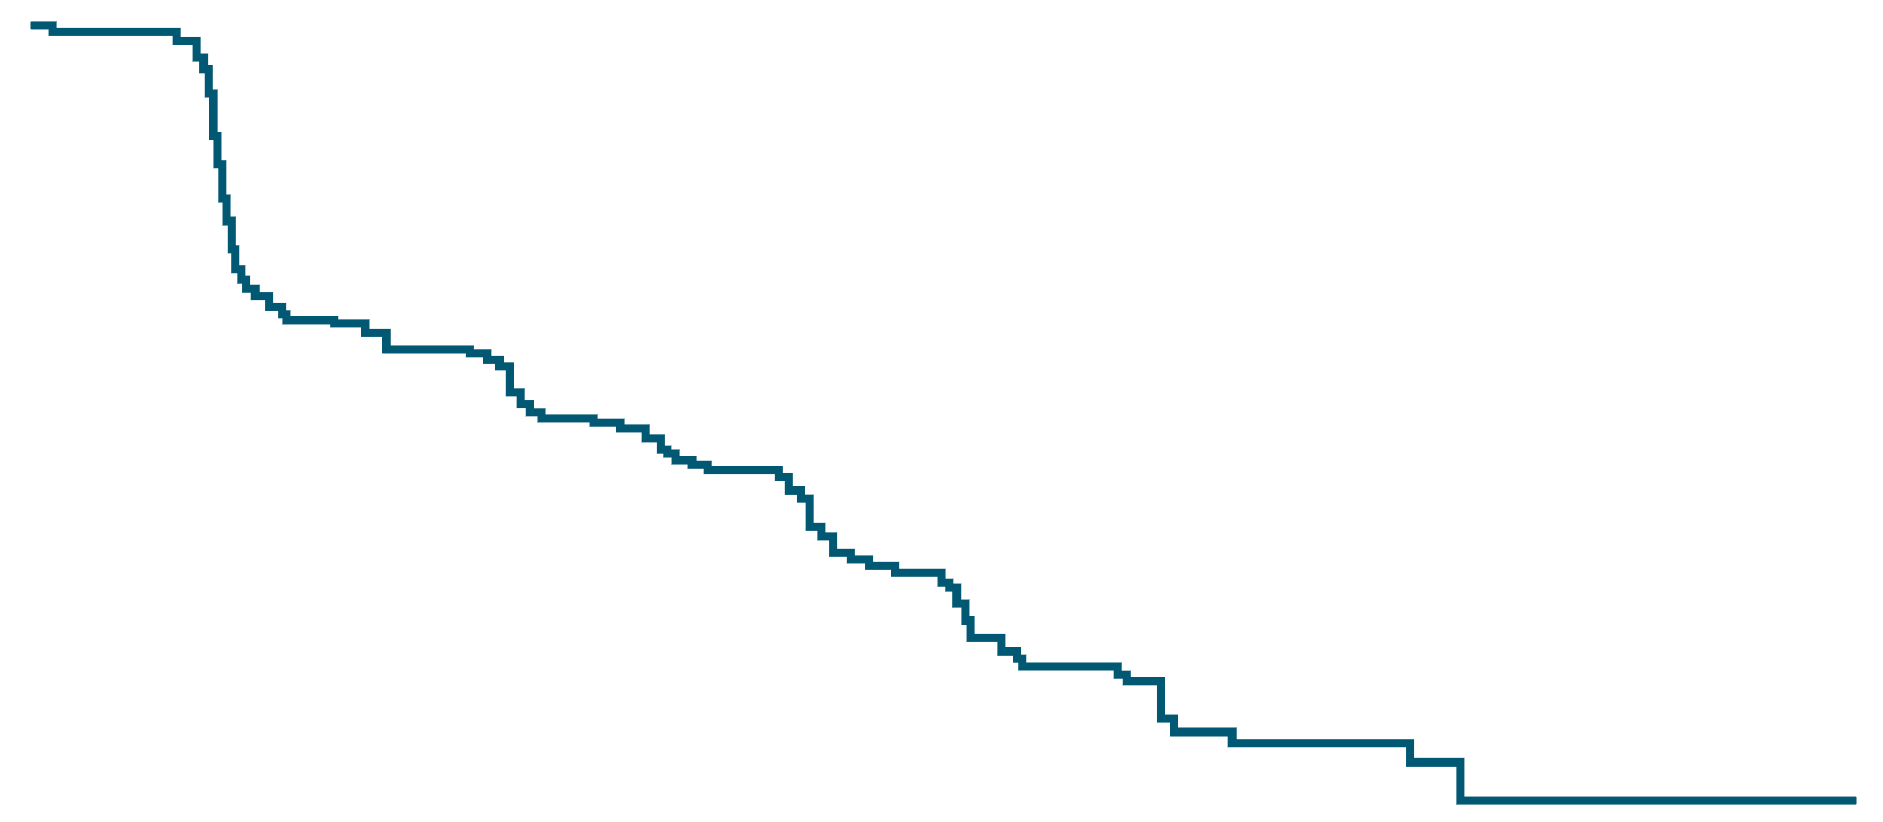
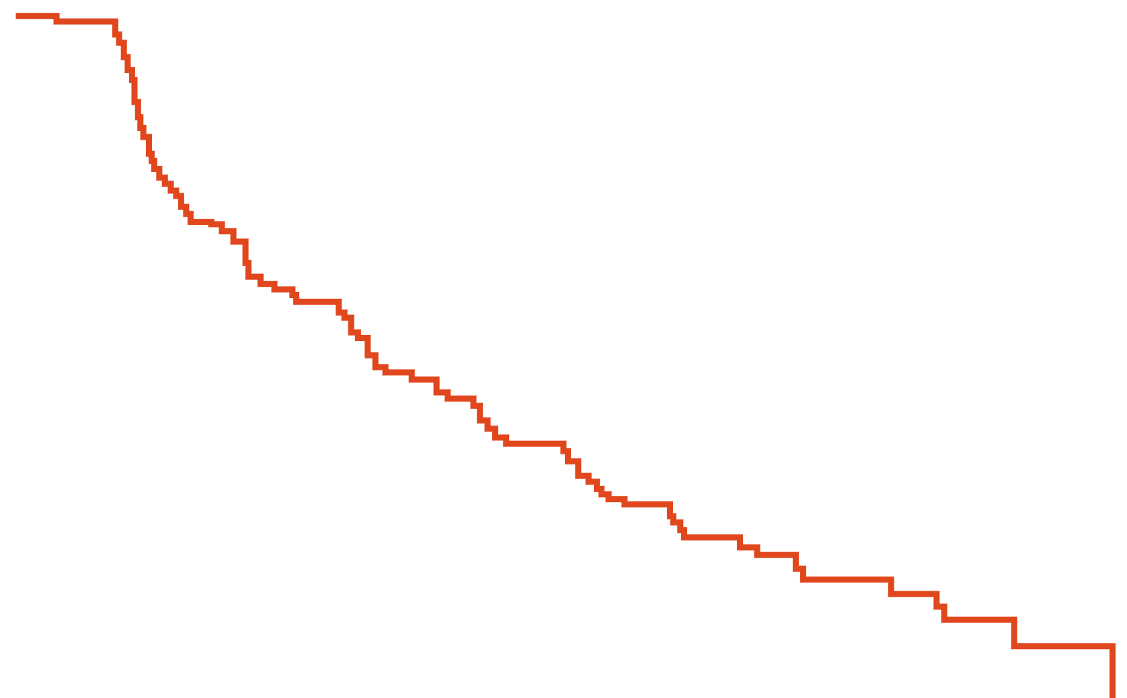
SPLASH: Primary Analysis of rPFS (Primary Endpoint)
100
+
+
+
+
Censored
¹⁷⁷Lu-PNT2002
Enza/Abi
+
+
+
+
+
+
+
+
+
+
+
+
80
+
Outcome* | ¹⁷⁷Lu-PNT2002 (n = 276) | Alternate ARPI (n = 136)
Events, n (%) | 162 (58.7) | 96 (70.6)
Median rPFS, mo (95% CI) | 9.5 (7.4-10.0) | 6.0 (4.7-7.9)
Median follow-up, mo (95% CI) | 11.1 (10.1-11.6) | 12.9 (10.2-15.9)
+
+
+
+
+
+
+
+
+
+
+
+
+
+
+
60
+
+
+
+
+
+
+
+
+
Event-Free Probability (%)
+
+
+
+
+
+
+
+
+
+
40
+
+
+
+
+
+
+
+
+
+
+
+
+
+
+
+
+
+
+
+
+
+
+
+
+
+
+
+
+
+
+
+
+
+
20
+
+
+
HR: 0.71 (95% CI: 0.55-0.92;
P = .0088)
+
+
+
+
+
+
+
¹⁷⁷Lu-PNT2002 reduced the risk of radiographic progression or death by 29% vs ARPI
OS data are still immature
+
+
+
+
0
0
1
2
3
4
5
6
7
8
9
10
11
12
13
14
15
16
17
18
19
20
21
22
23
Mo From Randomization
Patients at Risk, n
¹⁷⁷Lu-PNT2002
276
136
266
115
172
72
146
57
119
42
72
27
34
18
22
9
14
5
4
1
1
0
1
0
1
0
0
0
Enza/Abi
*Data cutoff: November 1, 2023.
Sartor. ESMO 2024. Abstr LBA65.

Slide 40
ECLIPSE: ¹⁷⁷Lu-PSMA-I&T vs SoC in mCRPC
International, open-label, randomized phase III study
Primary endpoint: rPFS
Key secondary endpoints: OS, PFS, PSA response, QoL, safety
Exploratory endpoints: ORR, DCR, DoR, time to PSA progression, PK
¹⁷⁷Lu-PSMA-I&T 7.4 GBq (200 mCi)
(± 10%) IV Q6W up to 6 cycles
Patients with progressive mCRPC; previously treated with ARPI in hormone-sensitive or castration-resistant setting; PSMA-PET scan positive by central reader
(N = 439)
2:1
Crossover permitted at radiographic PD
*ARPI switch to abiraterone† or enzalutamide
*Based on investigator’s judgment or first-line therapy received. †With prednisone.
NCT05204927.

Slide 41
Other Targeted Radionuclide Agents Under Investigation in mCRPC
Study | Phase | Status | Estimated N | Patient Population | Treatment Arm(s)
AcTFirst (NCT06855277) | III | Active, recruiting | 605 | Taxane-naive mCRPC adenocarcinoma (excluding neuroendocrine histology) and previous ARPI | ²²⁵Ac-PSMA-617 ± ARPI vs SoC (ARPI or taxane CT)
AlphaBreak (NCT06402331) | II/III | Active, recruiting | 100 | PSMA-positive mCRPC who have had previous treatment with¹⁷⁷Lu-PSMA-617 or another ¹⁷⁷Lu-PSMA radioligand | ²²⁵Ac-PSMA-I&T
20-08022500 (NCT04946370) | I/II | Active, recruiting | 76 | mCRPC adenocarcinoma with previous ARPI | Pembrolizumab + ARPI ± ²²⁵Ac-J591
PAnTHA (NCT06217822) | I | Active, recruiting | 235 | mCRPC adenocarcinoma without small-cell or neuroendocrine features, and previously treated with a novel hormonal therapy and taxane | ²²⁵Ac-PSMA-Trillium at various dose levels
clinicaltrials.gov.​
*As of September 2025.

Slide 42
Applying PSMA-Targeted Radioligand
Therapy in the Care of mCRPC

Slide 43
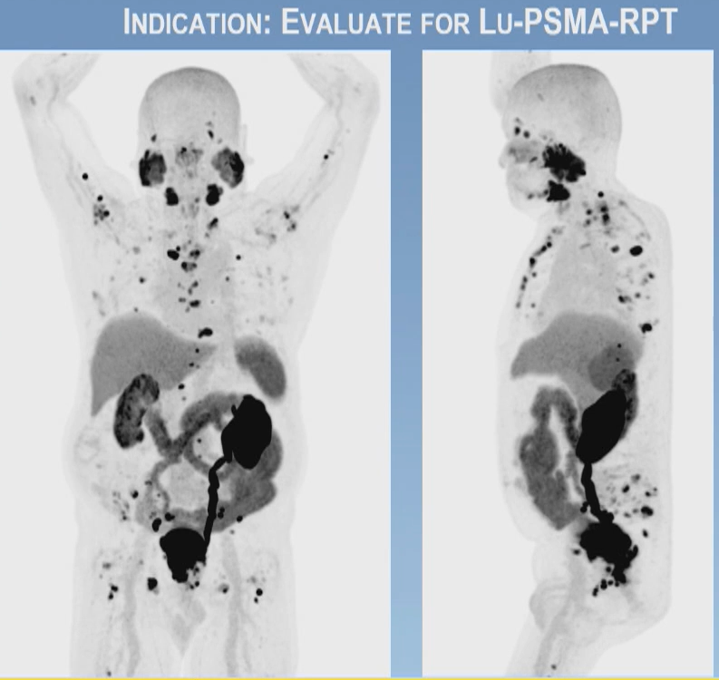
Selecting Appropriate Patients For Radioligand Therapy
Select patients with several lesions with PSMA-positive ≥ liver
Exclude if there are significant numbers of PSMA-negative lesions
Numerous PSMA+ bone metastases
Is the patient symptomatic from local (bone only) disease
Image courtesy of Dr Phillip Kuo, MD, PhD, FACR; City of Hope, Duarte California.
Lu177 PI.

Slide 44
Factors Contributing to Radioligand Therapy Selection
  Selection of a radioligand agent as therapy for mCRPC should consider:
Cancer
Volume of disease, pace of disease progression, symptoms vs not
Treatment
  Availability, ability of team to manage safely and successfully
Patient
Marrow and renal function, urinary function, and socioeconomic considerations
HCP
Comfort with management and confidence in outcomes, ability to remain engaged with multidisciplinary treatment team

Slide 45
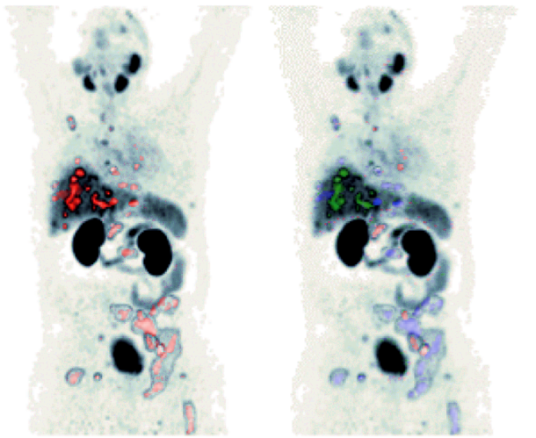
Interpreting Response on PSMA-PET and Utility of SPECT
Segmentation of Anatomic Regions and Distribution of Quantitative 68Ga-PSMA-11 PET Parameters
Whole body
(all lesions, red)
Segmented anatomical regions
(liver, green; bone, blue; LN, red)
100
o
¹⁷⁷Lu-PSMA-617+SoC
Censoring times
<6.0 (n/n = 66/95)
≥6.0 - <7.8 (n/n = 65/96)
≥7.8 - <10.2 (n/n = 70/95)
≥10.2 (n/n = 50/96)
o
+ o
o
+
+
+
80
o
+
o
+
+
o
+
o
+
+
o
+
+
o
+
+
+
o
o
60
+
o
+
+
o
o
+
Proportion of Patients Without rPFS Event (%)
+
o
o
+
+
o
o
o
+
+
o
+
+
+
o
+
+
+
+
+
+
+
+
+
40
+
o
+
+
Kaplan−Meier medians
<6.0:5.8 mo
≥6.0 - <7.8: 7.8 mo
≥7.8 - <10.2: 9.8 mo
≥10.2: 14.1 mo
o
+
+
+
+
+
+
o
+
+
+
o
o
20
o
o
o
o
o
o
o
o
+
o
o
+
+
+
o
+
+
o
0
+
0
1
2
3
4
5
6
7
8
9
10
11
12
13
14
15
16
17
18
19
20
21
22
23
Time From Randomization (Mo)
Baseline ⁶⁸Ga PSMA-11 PET/CT SUV_{mean} was strongly correlated with improved rPFS outcomes following ¹⁷⁷Lu-PSMA-617+SoC vs control arm
  A 1-unit in whole-body tumor SUV_{mean} increase correlated with a 10% to 12% decreased risk of radiographic progression or death
Kuo. Radiology. 2024;312:e233460.

Slide 46
Go Online for More CCO
Education on Radioligand Therapies!
Interactive Decision Support Tool with experts' recommendations for selecting therapy in patients with metastatic castration-resistant prostate cancer (mCRPC)
CME-certified text module with key expert’s insight on the latest data radioligand therapies use for mCRPC
clinicaloptions.com/oncology

