Slide 1
Overcoming Vaccine Hesitancy: Evidence-Based Communication Tools for Clinicians
Provided by Clinical Care Options, LLC dba Decera Clinical Education
This educational activity is supported by an independent medical education grants from GSK, Merck & Co., Inc., Rahway, NJ, USA, & Sanofi.

Slide 2
About These Slides
Please feel free to use and share some or all of these slides in your noncommercial presentations to colleagues or patients
When using our slides, please retain the source attribution:
Slide credit: deceraclinical.com/education
These slides may not be published, posted online, or used in commercial presentations without permission. Please contact permissions@deceraclinical.com for details
Notes:
Disclaimer: The materials published on the Decera Clinical Education website reflect the views of the authors of the Decera Clinical Education material, not those of Decera Clinical Education, the CME providers, or the companies providing educational grants. The materials may discuss uses and dosages for therapeutic products that have not been approved by the FDA. A qualified healthcare professional should be consulted before using any therapeutic product discussed. Readers should verify all information and data before treating patients or using any therapies described in these materials.

Slide 3
Faculty
Rupali Limaye, PhD, MPH, MA
Associate Professor
Department of Global and Community Health
College of Public Health, George Mason University
Fairfax, Virginia
Richard Zimmerman, MD, MPH, MA
Vice Chair of Research
Professor of Family Medicine and Clinical Epidemiology
Center for Vaccine Research
University of Pittsburgh
Pittsburgh, Pennsylvania

Slide 4
Disclosures
Rupali Limaye, PhD, MPH, MA, has no relevant financial relationships to disclose.
Richard Zimmerman, MD, MPH, MA: consultant/advisor/speaker: Merck, Sanofi Pasteur; researcher: Merck, Sanofi Pasteur.

Slide 5
Learning Objectives
Inform people about vaccine safety to alleviate common concerns about vaccines and their components
Tailor messaging strategies to each person when recommending vaccines
Notes:
BSI, bloodstream infection.

Slide 6
The Vaccine Hesitancy Continuum
Vaccine Hesitancy
Accept Some, Delay Some, Refuse Some
Active Demand
Actively Seeking
Passive Acceptance
Accept All, May Be Unsure
Refuse All Vaccines
unicef.org/documents/vaccine-messaging-guide.

Slide 7
Individual and Group Root Causes of Vaccine Hesitancy
Past experiences with vaccines (personal and those of others)
Past experiences with and trust in the health system
Beliefs and attitudes regarding health and prevention
Perception of risks and benefits
Perception of necessity and societal norms
Knowledge and awareness
Habits
Convenience
MacDonald. Vaccine. 2015;33:4180. Schmid. PLoS One. 2017;12:e0170550. Cataldi. Curr Opin Infect Dis. 2021;34:519.

Slide 8
Vaccination-Specific Root Causes of Vaccine Hesitancy
Novelty of vaccine, formulation, or recommendations
Mode of vaccine administration
Vaccination program design (eg, routine program vs mass vaccination campaign)
Vaccination schedule
Costs
Knowledge, attitude, and strength of HCP recommendation
MacDonald. Vaccine. 2015;33:4180. Schmid. PLoS One. 2017;12:e0170550. Cataldi. Curr Opin Infect Dis. 2021;34:519.
Notes:
HCP, healthcare professional.

Slide 9
Contextual Root Causes of Vaccine Hesitancy
Communication and media environment
Influence of leaders and lobbies
Influence of religious, culture, gender, or socioeconomic factors
Influence of politics and policies
Geographic barriers
Perception of the pharmaceutical industry
MacDonald. Vaccine. 2015;33:4180. Schmid. PLoS One. 2017;12:e0170550. Cataldi. Curr Opin Infect Dis. 2021;34:519.

Slide 10
Steps You Can Take With Every Vaccine-Hesitant Person
1
2
3
4
5
Change social norms by sharing that you and others receive vaccines
Ask about concerns and listen with empathy and understanding
Respond using motivational interviewing techniques
Use analogies, visual storytelling, and reframing to make messaging memorable and concrete
Give a personal and presumptive vaccine recommendation

Slide 11

Change social norms by sharing that you and others receive vaccines
1

Slide 12

Ask about concerns and listen with empathy and understanding
Empathetic Mindset
Curiosity and open-mindedness
“Success” is understanding
Commitment to the relationship regardless of vaccine decision
2
Techniques
Meet people where they are
Mirror
Paraphrase

Slide 13
Respond using motivational interviewing techniques
3
Ask open-ended questions
Reflect and respond
Affirm strengths and validate concerns
Ask – provide – verify
Summarize interaction and determine action

Slide 14
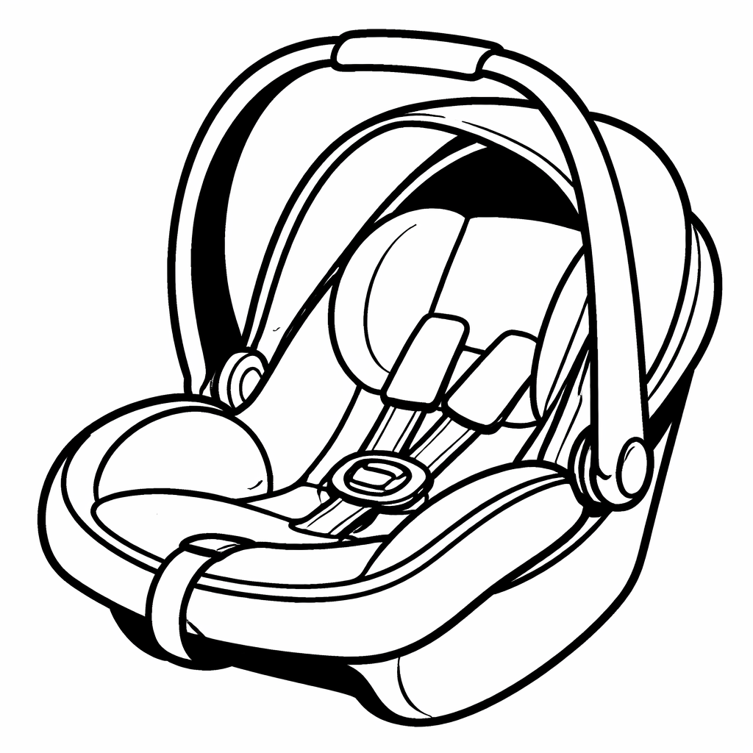
Use analogies, visual storytelling, and reframing to make messaging memorable and concrete
4

Slide 15

Give a personal and presumptive vaccine recommendation
5

Slide 16
Making Clear Recommendations: SHARE Framework
S
SHARE tailored reasons why the vaccine is right for the patient given his or her age, health status, lifestyle, occupation, or other risk factors
H
HIGHLIGHT positive experiences with vaccines (personal or in your practice), as appropriate, to reinforce the benefits and strengthen confidence in vaccination
A
ADDRESS patient questions and any concerns about the vaccine, including adverse events, safety, and vaccine effectiveness in plain and understandable language
R
REMIND patients that vaccines protect them and their loved ones from serious illnesses and complications
E
EXPLAIN the potential costs of getting infectious diseases, including serious health effects, time lost (such as missing work or family obligations), and financial costs
cdc.gov/vaccines-adults/hcp/imz-standards/.

Slide 17
Shared Decision-making Using Another SHARE Model
5-step process that explores and compares the benefits, harms, and risks of the patient’s options:
    Seek participation from your patients
    Help your patients explore and compare their options
    Assess your patients’ values and preferences
    Reach an agreed-upon decision with your patients
    Evaluate your patients’ decision
ahrq.gov/sdm/share-approach/index.html.

Slide 18
Facilitating Discussions With Patients Using the AIMS Model
An actionable, process-based, behavior-change program to move from “talking at” to “talking with” with patients:
Announce vaccination is necessary and needed; assume your patients are ready for it
Inquire about your patients’ concerns or hesitation if such are presented
Mirror your patients’ responses by repeating what they say and confirming what they mean
Secure trust at the conclusion of the conversation with your patients
Parrish-Sprowl. Front Public Health. 2023;11:1120326.

Slide 19
Resources to Consult for Vaccine Recommendations and Info
AAP childhood immunization scheduled that was endorsed by AAFP, IDSA, and others¹
    2026 immunization schedule released
AAFP immunization schedules that are considered standard for some places, eg, official standard for PA²
ACOG immunization schedule for pregnant women³
ACP adult immunization schedule⁴
IDSA guidelines for immunocompromised persons⁵
Vaccine Integrity Project⁶
1. publications.aap.org/redbook/resources/15585/AAP-Immunization-Schedule. 2. aafp.org/family-physician/patient-care/prevention-wellness/immunizations-vaccines.html. 3. acog.org/womens-health/infographics/vaccines-during-pregnancy. 4. acponline.org/clinical-information/clinical-resources-products/adult-immunization .
5. idsociety.org/Seasonal-RTI-Vaccinations-in-Immunocompromised-Patients/. 6. vaxintegrity.cidrap.umn.edu/.
Notes:
AAFP, American Academy of Family Physicians; AAP, American Academy of Pediatrics; ACOG, American College of Obstetricians and Gynecologists; ACP, American College of Physicians; IDSA, Infectious Diseases Society of America.

Slide 20

Addressing Common Safety Concerns About Vaccine Components

Slide 21

Addressing Concerns About a Link Between MMR Vaccine and Autism
Notes:
MMR, measles, mumps, rubella.

Slide 22
Vaccine Safety Systems in the US
Vaccine Adverse Event Reporting System (VAERS)
Clinical Immunization Safety Assessment Project (CISA)
The Vaccine Safety Datalink (VSD)
Post-licensure Rapid Immunization Safety Monitoring System (PRISM)
V-safe
cdc.gov/vaccine-safety-systems/vaers/index.html. cdc.gov/vaccine-safety-systems/v-safe/index.html. cdc.gov/vaccine-safety-systems/hcp/cisa/index.html . cdc.gov/vaccine-safety-systems/vsd/index.html. Baker. Vaccine. 2013;31(Suppl 10):K98.

Slide 23
Go Online for More Coverage of Vaccines!
Adaptive interactive case experiences
Downloadable slidesets of all the key data
ClinicalThought commentaries featuring expert faculty perspectives
deceraclinical.com/education

