Slide 1
CCO Think Tank on Emerging HER2-Targeted ADCs: Gastrointestinal Malignancies
Provided by Clinical Care Options, LLC
Supported by educational grants from AstraZeneca and Daiichi Sankyo, Inc.
Notes:
ADC, antibody–drug conjugate.

Slide 2

About These Slides
Please feel free to use and share some or all of these slides in your noncommercial presentations to colleagues or patients
When using our slides, please retain the source attribution:
These slides may not be published, posted online, or used in commercial presentations without permission. Please contact permissions@clinicaloptions.com for details
Slide credit: clinicaloptions.com
Notes:
Disclaimer: The materials published on the Clinical Care Options website reflect the views of the authors of the CCO material, not those of Clinical Care Options, LLC, the CME providers, or the companies providing educational grants. The materials may discuss uses and dosages for therapeutic products that have not been approved by the United States Food and Drug Administration. A qualified healthcare professional should be consulted before using any therapeutic product discussed. Readers should verify all information and data before treating patients or using any therapies described in these materials.

Slide 3
Faculty and Disclosures
Zev A. Wainberg, MD
Professor of Medicine and Surgery
Department of Hematology
Division of Oncology
University of California School of Medicine
Los Angeles, California
Zev A. Wainberg, MD: consultant/advisor/speaker: Amgen, Arcus, AstraZeneca, Bayer, Bristol-Myers Squibb, Daiichi Sankyo, Ipsen, Merck, Novartis, Seagen; data safety monitoring board: Mirati, Pfizer.

Slide 4
Tumor Agnostic Prevalence of HER2 Alterations (Mutations and Amplifications) in GI Cancers
Mutation
Amplification
Multiple alterations
15%
Alteration Frequency
15%
5%
Mutation data
CAN data
+
+
+
+
+
+
+
+
+
+
+
+
+
+
+
+
+
+
+
+
+
+
+
+
+
+
+
+
+
+
+
+
+
+
+
+
+
+
+
+
+
+
+
+
+
+
+
+
+
+
+
+
+
+
+
+
+
+
+
+
+
+
+
+
+
+
+
+
Glioma
Melanoma
Leukemia
CNS Cancer
Bladder Cancer
Breast Cancer
Anal Cancer
Vaginal Cancer
Sellar Tumor
Histiocytosis
Thymic Tumor
Cervical Cancer
Colorectal Cancer
Ovarian Cancer
Small Bowel Cancer
Ampullary Cancer
Pancreatic Cancer
Endometrial Cancer
Appendiceal Cancer
Soft Tissue Sarcoma
Salivary Gland Cancer
Hepatobiliary Cancer
Nerve Sheath Tumor
Renal Cell Carcinoma
Esophagogastric Cancer
Small-Cell Lung Cancer
Head and Neck Cancer
Mature B-Cell Neoplasms
Non-small Cell Lung Cancer
Peripheral Nervous System
Cancer of Unknown Primary
Skin Cancer, Non-Melanoma
Gastrointestinal Neuroendocrine
Mature T and NK Neoplasms
Raghav. Clin Cancer Res. 2023;29:3251
Notes:
CNS, central nervous system; GI, gastrointestinal.

Slide 5
Guideline Recommendations for HER2 Testing
Guidelines recommend HER2 testing for advanced/metastatic GI cancers
HER2 testing can be considered in CRC, and BTC as per guidelines
HER2 Testing Recommendation | Gastric or Esophageal/GEJ | Colon | Pancreatic | Biliary Tract
When | All patients at diagnosis if metastatic disease is documented or suspected | All patients unless known RAS/RAF mutation positive | When therapy targeting uncommon mutations is considered | All patients
How | IHC and ISH first (NGS may be considered) | IHC, ISH, or NGS | NGS | IHC, FISH, or NGS
NCCN. Clinical practice guidelines in oncology: gastric cancer. v.3.2023. nccn.org.
NCCN. Clinical practice guidelines in oncology: esophageal and esophagogastric junction cancers. v.4.2023. nccn.org.
NCCN. Clinical practice guidelines in oncology: colon cancer. v.1.2024. nccn.org.
NCCN. Clinical practice guidelines in oncology: pancreatic adenocarcinoma. v.1.2024. nccn.org.
NCCN. Clinical practice guidelines in oncology: biliary tract cancers. v.3.2023. nccn.org.
Notes:
BTC, biliary tract cancer; CRC, colorectal cancer; FISH, fluorescence in situ hybridization; GEJ, gastroesophageal junction; GI, gastrointestinal; IHC, immunohistochemistry; NGS, next-generation sequencing.

Slide 6
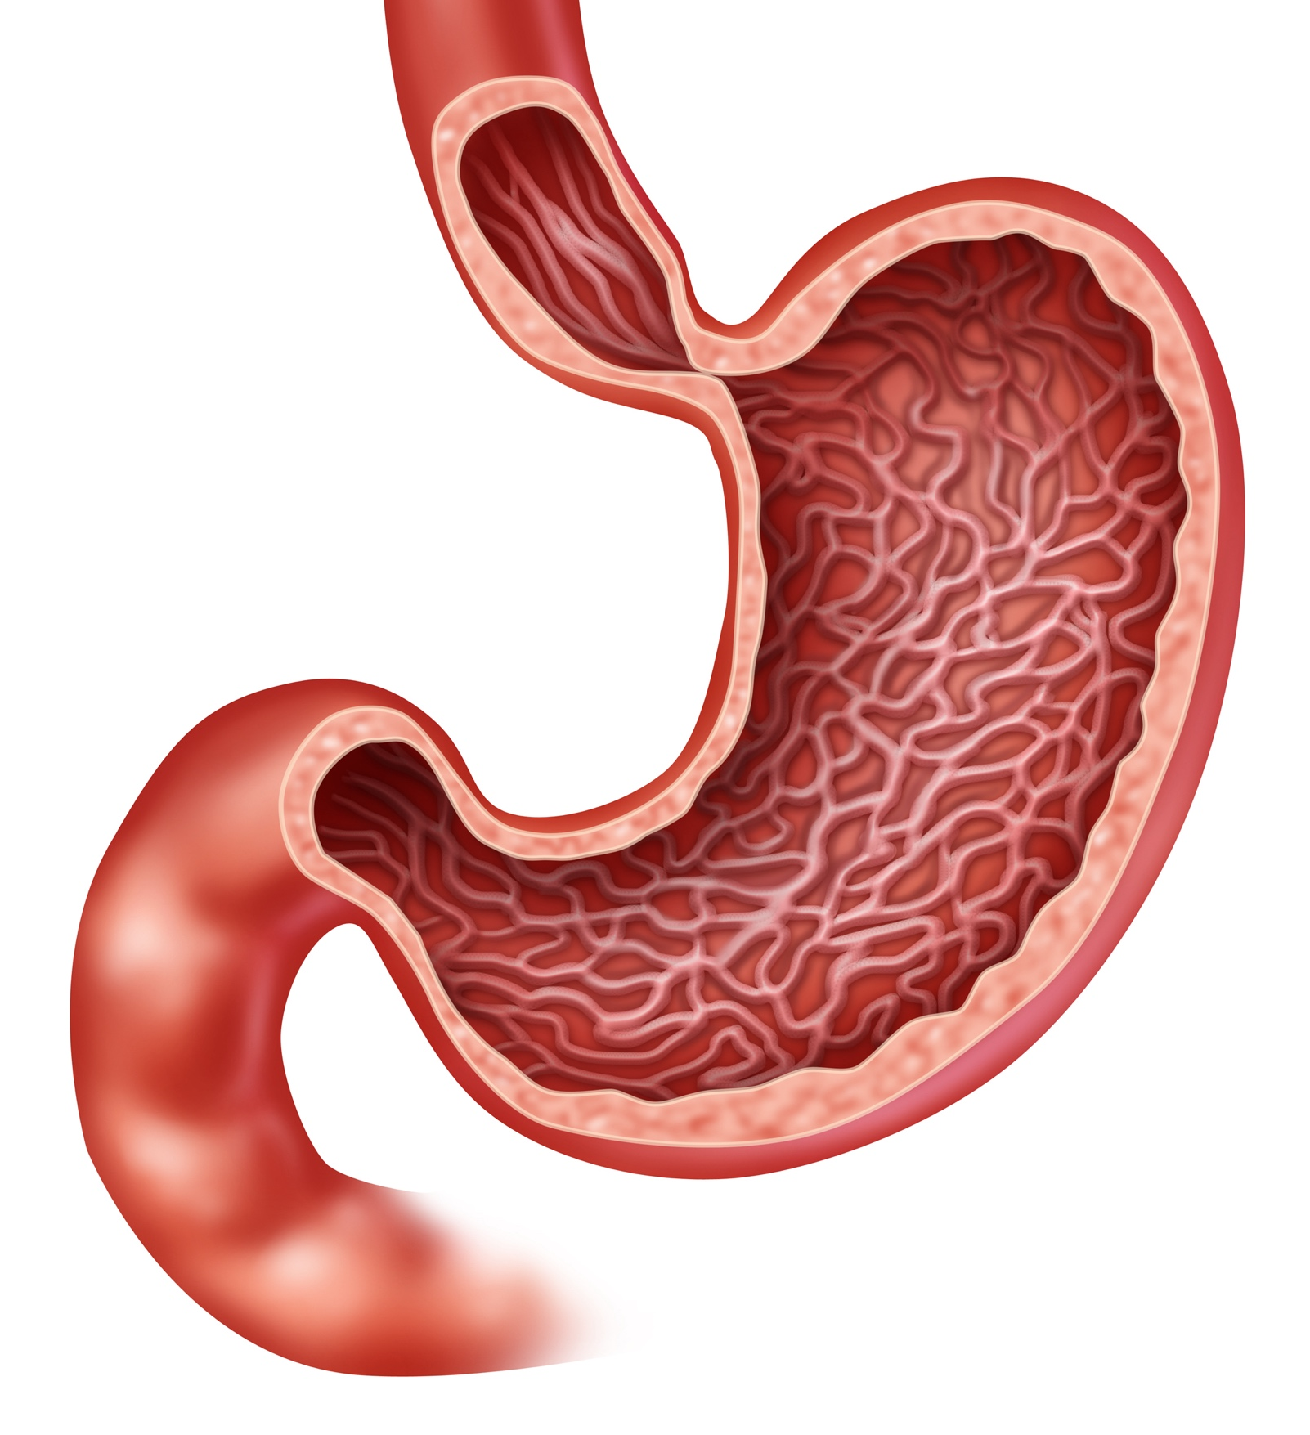
Molecular Subtypes of Gastric Cancer
CIN
Intestinal histology
TP53 mutation
RTK-RAS activation
MSI
Hypermutation
Gastric-CIMP
MLH1 silencing
Mitotic pathways
Cardia
EBV
PIK3CA mutation
PD-L1/2 overexpression
EBV-CIMP
CDKN2A silencing
Immune cell signaling
Fundus
GEJ
Body
Pylorus
Antrum
GS
Diffuse histology
CDH1, RHOA mutations
CLDN18-ARHGAP fusion
Cell adhesion
Cancer Genome Atlas Research Network. Nature. 2014;513:202.
Notes:
CIN, chromosomal instability; EBV, Epstein-Barr virus; EBV-CIMP, Epstein-Barr virus CpG island methylator phenotype; GEJ, gastroesophageal junction; MSI, microsatellite instability.

Slide 7
Molecular Subtypes of Gastric Cancer
HER2 expression
16%-34%
CIN
Intestinal histology
TP53 mutation
RTK-RAS activation
MSI
Hypermutation
Gastric-CIMP
MLH1 silencing
Mitotic pathways
Cardia
GEJ:
HER2 expression
25%-34%
EBV
PIK3CA mutation
PD-L1/2 overexpression
EBV-CIMP
CDKN2A silencing
Immune cell signaling
Fundus
GEJ
All gastric cancer:
HER2 expression 17.9%
Body
Pylorus
Antrum
GS
Diffuse histology
CDH1, RHOA mutations
CLDN18-ARHGAP fusion
Cell adhesion
HER2 expression
6%-7%
Cancer Genome Atlas Research Network. Nature. 2014;513:202. Bang. Lancet 2010;376:687.
Gravalos. Ann Oncol. 2008;19:1523. Yano. ASCO 2004. Abstr 4053. Gravalos. ASCO GI 2007. Abstr 89.
Lordick. ECCO 2007. Abrahao-Machado. World J Gastroenterol. 2016;22:4619.
Notes:
CIN, chromosomal instability; EBV, Epstein-Barr virus; EBV-CIMP, Epstein-Barr virus CpG island methylator phenotype; GEJ, gastroesophageal junction; MSI, microsatellite instability.

Slide 8
Incorporating Recommended
HER2 Testing Into GI Cancer Management
Notes:
GI, gastrointestinal.

Slide 9
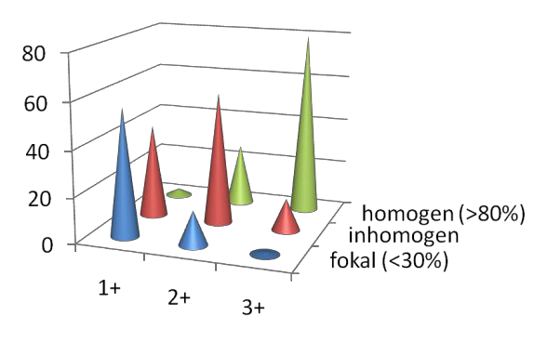
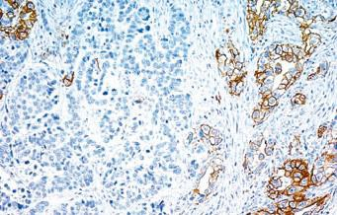
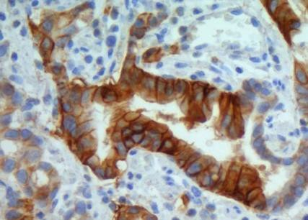
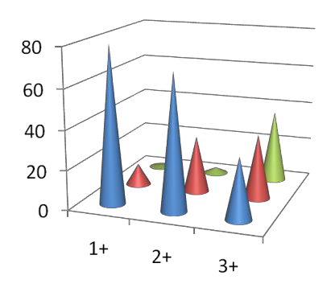
Intratumoral Heterogeneity and
Incomplete Membrane Staining of HER2
Breast Cancer (HERA; N = 1969)
Tumor
heterogeneity is
more common in
GC vs BC
Incomplete membrane staining with IHC is more common in GC vs BC
Homogeneous (>80%)
Nonhomogeneous
Focal (<30%)
Gastric Cancer (ToGA; N = 1453)
3+: moderate to strong complete or basolateral 3+ / positive membrane staining in >10% of tumor cells
Overexpression of HER2, EGFR, MET, FGFR
by IHC in 9% to 25%
Coexpression in 19%
Hofmann. Histopathology. 2008;52:797. Modified slide courtesy of K. Shitara.
Notes:
BC, breast cancer; GC, gastric cancers; IHC, immunohistochemistry.

Slide 10
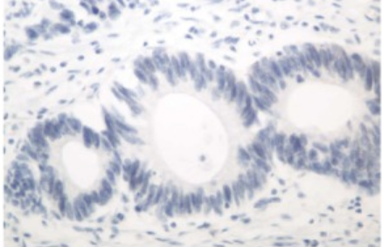
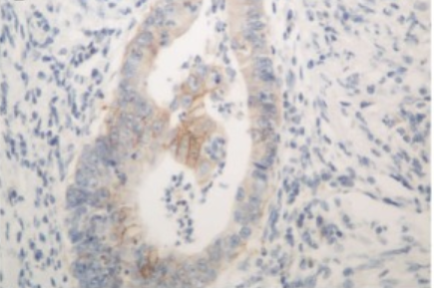
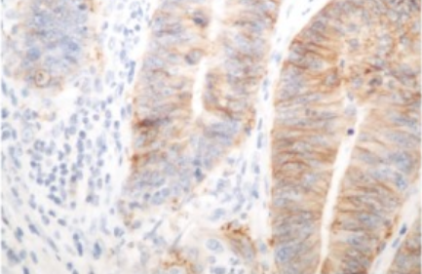
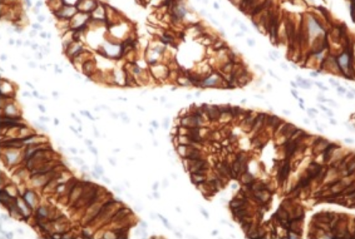
HER2 Immunohistochemistry Scoring: ToGA Study
 | Score | Surgical Specimen Staining Pattern | Biopsy Specimen Staining Pattern | HER2 Overexpression Assessment
 | 0 | No reactivity or membranous reactivity in <10% of tumor cells | No reactivity or no membranous reactivity in any tumor cell | Negative
 | 1+ | Faint or barely perceptible membranous reactivity in ≥10% of tumor cells; cells are reactive only in part of their membrane | Tumor cell cluster with faint or barely perceptible membranous reactivity irrespective of % of tumor cells stained | Negative
 | 2+ | Weak to moderate complete basolateral or lateral membranous reactivity in ≥10% of tumor cells | Tumor cell cluster with weak to moderate complete basolateral or lateral membranous reactivity irrespective of % of tumor cells stained | Equivocal
 | 3+ | Strong complete basolateral or lateral membranous reactivity in ≥10% of tumor cells | Tumor cell cluster with strong complete basolateral or lateral membranous reactivity irrespective of % of tumor cells stained | Positive
Bang. Lancet 2010;376:687. Images from Abrahao-Machado. World J Gastroenterol. 2016;22:4619.

Slide 11
Types of HER2 Testing: NCCN Recommendations
 | IHC or FISH | Individual or Panel Genomic Sequencing (NGS)
Directly tests for: | HER2 protein overexpression and amplification¹ | HER2 amplification¹
Read as: | IHC: 3+ staining in >50% of cells is read as positive, whereas 2+ is equivocal and reflexive FISH testing is recommended¹ FISH: HER2:CEP17 ratio ≥2 in >50% of cells is read as positive¹ | Genetic sequencing¹
Potential disadvantages: | May not identify mutated HER2, such as short variants that are functionally active but do not bind staining antibody² May not be optimized for mCRC³ | May not identify promoter region or other driver mutations that cause overexpression without increasing copy number² More expensive than IHC³
1. NCCN. Clinical practice guidelines in oncology: colon cancer. v.1.2024. nccn.org.
2. Ross. Cancer. 2018;124:1358. 3. Siena. Ann Oncol. 2018;29:1108.
Notes:
FISH, fluorescent in situ hybridization; IHC, immunohistochemistry; mCRC, metastatic colorectal cancer; NGS, next-generation sequencing.

Slide 12
Important Considerations for
HER2 Testing in GI Cancers
Notes:
GI, gastrointestinal.

Slide 13
Loss of HER2 on Disease Progression After Trastuzumab: ctDNA Profiling
Serial plasma samples from patients with HER2+ mGC that progressed on treatment with trastuzumab + chemotherapy (N = 17)
Potential Trastuzumab Resistance Clones at PD
HER2 Copy Number at Baseline and PD
Baseline
PD
Unknown
12%
50
New HER2amp
6%
40
30
HER2 SCNA
20
Non-HER2amp
23%
10
HER2amp
59%
0
PR1
PR2
PR3
AR1
AR2
AR3
AR4
AR5
AR6
AR7
AR8
AR9
AR10
AR11
AR12
AR14
AR13
Wang. Gut. 2019;68:1152.
Notes:
ctDNA, circulating tumor DNA; mGC, metastatic gastric cancer; PD, progressive disease; SCNA, somatic copy number alteration.

Slide 14
Loss of HER2 on Disease Progression After Trastuzumab:
2L Trial Outcomes
Patients with HER2+ mGC refractory following prior 1L treatment with trastuzumab +
platinum-based chemotherapy who received 2L trastuzumab + paclitaxel in the T-ACT study
HER2+ Rates Pre and Post
1L Trastuzumab (N = 16)
PFS on 2L Paclitaxel ± Trastuzumab
0
PTX
PTX + trastuzumab
PTX + Trastuzumab
(n = 44)
100
 | PTX (n = 45)
Median, mo (95% Cl) | 3.19 (2.86-3.48) | 3.68 (2.76-4.53)
Stratified HR (95% Cl) | 0.906 (0.674-1.219)
P value (stratified log-rank test) | .334
80
60
50
Probability (%)
40
20
100%
31%
0
0
Pre 1L Trastuzumab
Post 1L Trastuzumab
0
2
4
6
8
10
12
14
16
18
20
22
Mo
Makiyama. ASCO 2018. Abstr 4011.
Notes:
1L, first-line; 2L, second-line; ctDNA, circulating tumor DNA; mGC, metastatic gastric cancer; PD, progressive disease; PTX, paclitaxel.

Slide 15
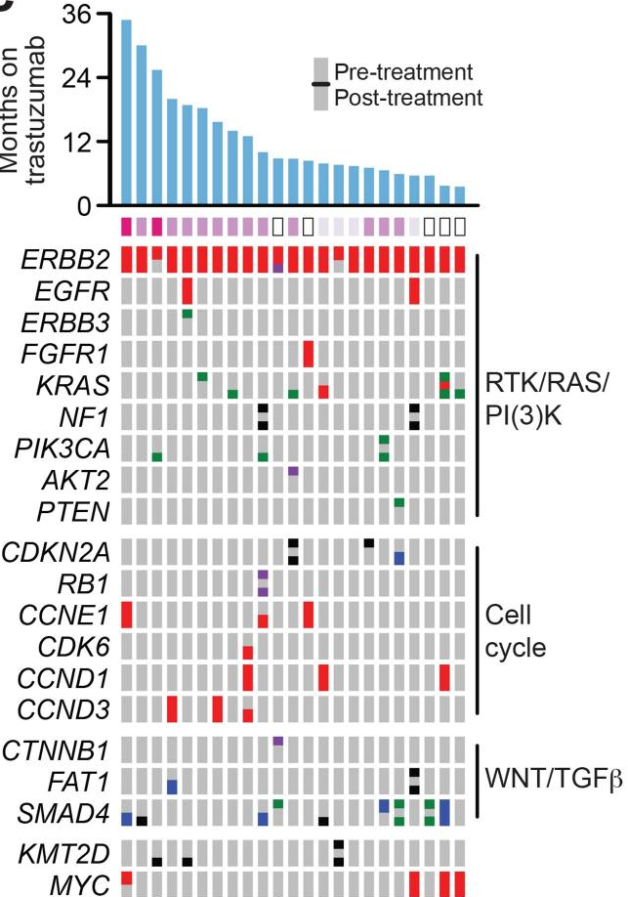
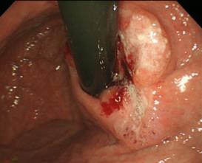
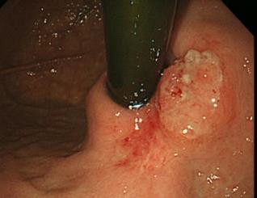
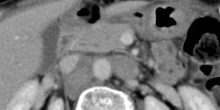
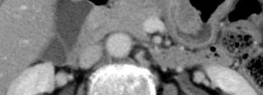
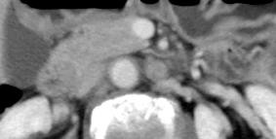
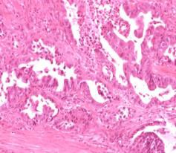
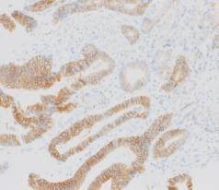
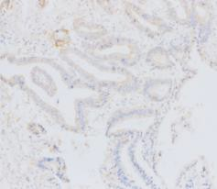

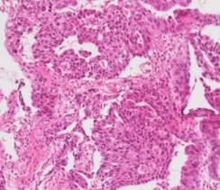
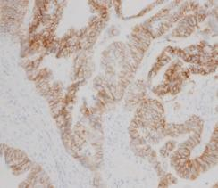
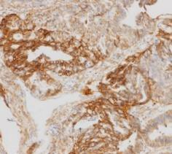
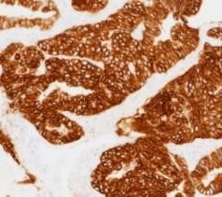
Several Emerging Gene Alterations After Trastuzumab
Comutations that induce RAS or PI3K pathway activation may be mechanisms of both intrinsic and acquired resistance to trastuzumab
Cases in NCCHE
Trastuzumab + CT
HER2 IHC 3+
Trastuzumab + CT
cMET/SEP 6
PR
With MET-TKI
Janjigian. Cancer Discov. 2018;8:49. Case images courtesy of K. Shitara.
Notes:
CT, chemotherapy; PR, partial response; TKI, tyrosine kinase inhibitor.

Slide 16
Summary: HER2 Testing in GI Cancers
HER2 testing by IHC/FISH can be complicated by staining factors; NGS is an alternative
HER2 overexpression patterns differ among molecular subtypes of gastric cancer and differ from those seen in breast cancer
HER2-targeted therapy may lead to reduction in HER2 expression and emergence of other genetic alterations
  Rebiopsy is important after disease progression on trastuzumab
  Evidenced by clinical trial data and included in ongoing protocols
Notes:
FISH, fluorescence in situ hybridization; GI, gastrointestinal; IHC, immunohistochemistry; NGS, next-generation sequencing.

Slide 17
Current Management of
HER2-Altered GI Cancers
Notes:
GI, gastrointestinal.

Slide 18
ToGA: Chemotherapy ± Trastuzumab as
First-line Therapy in HER2-Positive mGC
Randomized phase III study of patients with HER2-positive gastric or GEJ cancer
Total of 594 patients randomly assigned to chemotherapy (fluoropyrimidine + platinum) with or without trastuzumab
Significant improvement in OS in HER2-positive mGC with addition of trastuzumab to chemotherapy
Median OS, Mo
HR
(95% CI)
Events
P Value
Trastuzumab + chemotherapy
Chemotherapy alone
167
182
13.8
11.1
0.74
(0.60-0.91)
.0046
1.0
0.8
0.6
Survival Probability
0.4
0.2
11.1
13.8
0
0
2
4
6
8
10
12
14
16
18
20
22
24
26
28
32
34
36
Mo
18
Bang. Lancet. 2010;376:687.
Notes:
GEJ, gastroesophageal junction; mGC, metastatic gastric cancer; OS, overall survival.

Slide 19
ToGA: HER2 Subgroup Analysis
Overall survival benefit of trastuzumab appeared to vary by HER2 subgroup
Median OS,
Mo
HR (95% CI)
N
HR (95% CI)
Trastuzumab regulatory approvals:
US: IHC 3+ and/or FISH+ tumors (2010)
Europe: IHC 2+/FISH+ or IHC 3+ (2022)
All
Preplanned exploratory analysis
IHC 0/FISH positive
IHC 1+/FISH positive
IHC 2+/FISH positive
IHC 3+/FISH positive
IHC 3+/FISH negative
Post-hoc exploratory analysis
IHC 0 or 1+/FISH positive
IHC 2+/FISH positive or IHC 3+
584
61
70
159
256
15
131
446
13.8 vs 11.1
10.6 vs 7.2
8.7 vs 10.2
12.3 vs 10.8
17.9 vs 12.3
17.5 vs 17.7
10.0 vs 8.7
16.0 vs 11.8
0.74 (0.60-0.91)
0.92 (0.48-1.76)
1.24 (0.70-2.20)
0.75 (0.51-1.11)
0.58 (0.41-0.81)
0.83 (0.20-3.38)
1.07 (0.70-1.62)
0.65 (0.51-0.83)
0.2
0.4
0.6
1
2
3
4
5
Favors trastuzumab plus chemotherapy
Favors chemotherapy alone
Bang. Lancet. 2010;376:687.
Notes:
FISH, fluorescence in situ hybridization; IHC, immunohistochemistry; OS, overall survival.

Slide 20
KEYNOTE-811: First-line Trastuzumab and Chemotherapy ± Pembrolizumab in HER2+ Gastric/GEJ
Randomized, double-blind, placebo-controlled phase III study
Primary endpoints: OS, PFS per RECIST v1.1 by BICR
Secondary endpoints: ORR and DoR per RECIST v1.1 by BICR, safety
Stratified by geographic region, PD-L1 CPS, chemotherapy choice
Baseline Characteristics (Efficacy Population)
Patients with HER2+ advanced gastric or
GEJ adenocarcinoma;
no prior therapy in advanced setting;
ECOG PS 0/1
(N = 694)
Pembrolizumab 200 mg IV Q3W +
Trastuzumab 6 mg/kg IV Q3W +
FP or CAPOX*
Up to 35 cycles or until PD, unacceptable toxicity, or study withdrawal
 | Pembro Arm | Placebo Arm
PD-L1 CPS ≥1, % | 88 | 85
HER2 status, % IHC 2+, ISH+ IHC 3+ | 18 82 | 21 79
Placebo IV Q3W +
Trastuzumab 6 mg/kg IV Q3W +
FP or CAPOX*
*Trastuzumab 8 mg/kg loading dose.
FP: 5-fluorouracil 800 mg/m² IV Days 1-5
Q3W + cisplatin 80 mg/m² IV Q3W.
CAPOX: capecitabine 1000 mg/m² BID Days 1-14 Q3W + oxaliplatin 130 mg/m² IV Q3W.
Janjigian. ASCO 2021. Abstr 4013. Janjigian. Nature. 2021;600:727. Janjigian. Lancet. 2023;402:2197
Notes:
BICR, blinded independent central review; CPS, combined positive score; DoR, duration of response; ECOG, Eastern Cooperative Oncology Group; GEJ, gastroesophageal junction; IHC, immunohistochemistry; ISH, in situ hybridization; ORR, overall response rate; OS, overall survival; PD, progressive disease; Pembro, pembrolizumab; PFS, progression-free survival; PS, performance status; RECIST, Response Evaluation Criteria in Solid Tumors.

Slide 21

KEYNOTE-811: Pembrolizumab/Trastuzumab/CT
Antitumor Response at Interim Analysis 3
Response Parameters | Pembrolizumab (n = 350) | Placebo (n = 348)
Objective response, % (95% CI) | 73 (68-77) | 60 (55-65)
Best response, n (%) CR PR SD | 58 (17) 196 (56) 67 (19) | 39 (11) 170 (49) 95 (27)
DCR, % (95% CI) | 92 (88-94) | 87 (83-91)
Median DoR, mo (range) | 11.3 (1.1-49.7) | 9.5 (1.4-48.7)
100
+Pembrolizumab
(n = 323)
80
60
40
20
0
-20
-40
-60
-80
-100
Best Percentage Change From Baseline in the Size of Target Lesions
100
+Placebo
(n = 321)
80
60
40
20
0
-20
-40
-60
-80
-100
Janjigian. Lancet. 2023;402:2197. Pembrolizumab PI.
Slide credit: clinicaloptions.com
Notes:
1L, first-line; CR, complete response; CT, chemotherapy; DCR, disease control rate; DoR, duration of response; GEJ, gastroesophageal junction; ORR, overall response rate; PD, progressive disease; Pembro, pembrolizumab; PR, partial response; SD, stable disease.

Slide 22
KEYNOTE-811: PFS and OS (3rd Interim Analysis)
PFS in All Patients
Median PFS
10.0 mo
8.1 mo
OS in All Patients
Median OS
20.0 mo
16.8 mo
100
Pembrolizumab group (n = 350)
Placebo group (n = 348)
HR: 0.73 (95% Cl: 0.61-0.87)
100
Pembrolizumab group (n = 350)
Placebo group (n = 348)
HR: 0.84 (95% Cl: 0.70-1.01)
80
80
60
60
PFS (%)
40
OS (%)
Median FU: 38.4 in the pembro arm vs 38.6 with placebo
40
20
20
0
0
0
3
6
9
12
15
18
21
24
27
30
33
36
39
42
45
48
51
0
6
12
18
24
30
36
42
48
54
OS in PD-L1 CPS ≥1
Median OS
20.0 mo
15.7 mo
100
PFS in PD-L1 CPS ≥1
100
Median PFS
10.9 mo
7.3 mo
Pembrolizumab group (n = 298)
Placebo group (n = 296)
HR: 0.81 (95% Cl: 0.67-0.98)
80
Pembrolizumab group (n = 298)
Placebo group (n = 296)
HR: 0.71 (94% Cl: 0.59-0.86)
80
60
60
PFS (%)
OS (%)
40
40
20
20
0
0
0
3
6
9
12
15
18
21
24
27
30
33
36
39
42
45
48
51
0
6
12
18
24
30
36
42
48
54
Mo Since Randomization
FDA approved pembrolizumab + trastuzumab/chemotherapy as first-line therapy for HER2-positive GEJ/gastric cancer in May 2021
Janjigian. Lancet. 2023;402:2197
Notes:
CPS, combined positive score; FU, follow-up; GEJ, gastroesophageal junction; OS, overall survival; Pembro, pembrolizumab; PFS, progression-free survival.

Slide 23
Subsequent Negative Phase III Studies in Advanced GC
First-line Studies
JACOB: capecitabine/cisplatin/trastuzumab ± pertuzumab (N = 780)¹ Median OS: 17.5 vs 14.2 mo (HR: 0.84; P = .057) HELOISE: capecitabine/cisplatin + 2 dose levels of trastuzumab (N = 400)² Median OS: 12.5 vs 10.6 mo (HR: 1.24; P = .2401) TRIO-013/LOGiC: capecitabine/oxaliplatin ± lapatinib (N = 545)³ No difference in OS (12.2 vs 10.5 mo; HR: 0.91)
Second-line Studies
TyTAN: paclitaxel ± lapatinib (N = 261)⁴ Median OS: 11.0 vs 8.9 (P = .1044) GATSBY: paclitaxel or docetaxel vs T-DM1 (N = 415)⁵ Median OS: 7.9 vs 8.6 mo (HR: 1·15; P = .86) T-ACT: paclitaxel ± trastuzumab (N = 91)⁶ Median OS: 10 in both arms (HR: 1.2; P = .20)
1. Tabernero. Lancet Oncol. 2018;19:1372. 2. Shah. JCO. 2017;35:2558. 3. Randolph Hecht. JCO. 2016;34:443.
4. Satoh. JCO. 2014;32:2039. 5. Thuss-Patience. Lancet Oncol. 2017;18:640. 6. Makiyama. JCO. 2020;38:1919.
Notes:
GC, gastric cancer; OS, overall survival; T-DM1, ado-trastuzumab emtansine.

Slide 24
Recent Data for Anti-HER2
Therapies in Gastric Cancers

Slide 25
Studies of Anti-HER2 Therapies in GC/GEJ
Parameter* | DESTINY-Gastric01¹ | DESTINY-Gastric02² | ASPEN-01³ | ZWI-ZW25-201^{4,5} | HERIZON-GEA-01⁶
N | 188 | 79 | 18 | 36 | 714
Treatment/patient population | T-DXd vs physician’s choice (irinotecan or paclitaxel) after 2 previous tx | T-DXd Following failure to 1L trastuzumab tx | Evorpacept + TRP and paclitaxel as 2L+ in HER2+ GC | Zanidatamab + physician’s choice CT* in patients with no prior anti-HER2/systemic tx | Zanidatamab + CT ± tislelizumab in patients with no prior HER2, ICI, or systemic tx
ORR, % | 51 vs 14 (HR: 0.59; P <.0001) | 33 (CR: 5) | 72 | 75 | --
Median PFS, mo | 5.6 vs 3.5 (HR: 0.47) | 5.6 | 17.1 | 12.5 | --
Median OS, mo | 12.5 vs 8.9 (HR: 0.60) | 12.1 | 17.1 | NE (95% CI: 23.6-NE) | --
Common grade ≥3 AEs (%) | Neutropenia (51% vs 24%), anemia (38% vs 23%); WBC count decrease (21% vs 11%), ILD (2.4% vs 0%) | Anemia (14%), nausea (8%), neutropenia (8%), WBC count decrease (6%), ILD (1%) | Neutrophil count decrease (44%), hypertension (33%), anemia (22%), and AST elevation (6%) | Diarrhea (42%), hypokalemia (17%), vomiting (8%), neutropenia (8%), WBC count decrease (6%), and nausea (6%), | --
*Either CAPOX, FP, or mFOLFOX6-1 or mFOLFOX6-2.
1. Yamaguchi. ASCO GI 2022. Abstr 242. 2. Van Cutsen. 2023;24:744. 3. Lee. SITC 2021. Abstr 498. 4. Ku. ESMO. 2021. Abstr 1380.
5. Elimova. ASCO GI 2023. Abstr 347. 6. Taberno. Future Oncol. 2022;18:3255.
Notes:
1L, first line; 2L, second line; AE, adverse event; AST aspartate aminotransferase; CAPOX, capecitabine/oxaliplatin; CR, complete response; CT, chemotherapy; FP, fluorouracil/cisplatin; GC, gastric cancer; ICI, immune checkpoint inhibitor; ILD, interstitial lung disease; mFOLFOX5, modified fluorouracil/leucovorin/oxaliplatin; ORR, overall response rate; OS, overall survival; PFS, progression-free survival; T-DXd, trastuzumab deruxtecan; TRP, trastuzumab/ramucirumab/paclitaxel; tx, treatment; WBC, white blood cell.

Slide 26
DESTINY-Gastric01: Response by Prior ICI in mGC
Under current treatment guidelines,
more patients will receive ICI as
first-line therapy in mGC
Exploratory analysis by prior
treatment with anti-PD-1 ICI
T-DXd more effective than chemotherapy regardless of prior ICI
Safety outcomes similar in patients
with or without prior ICI, including
rates of ILD
Outcome | T-DXd |  | Chemotherapy*
Prior ICI | Yes n = 44 | No n = 81 | Yes n = 17 | No n = 45
Confirmed ORR, % | 56.8 | 34.7 | 18.5 | 10.0
Median OS, mo 95% CI | 16.6 12.1-21.2 | 10.3 8.1-13.0 | 8.6 3.6-10.7 | 8.4 6.9-13.6
Any grade ILD, % | 9.1 | 9.9 | -- | --
*Physician’s choice of irinotecan or paclitaxel.
Notes:
ICI, immune checkpoint inhibitor; ILD, interstitial lung disease; mGC, metastatic gastric cancer; ORR, objective response rate; OS, overall survival; T-DXd, trastuzumab deruxtecan.

Slide 27
DESTINY-Gastric01 Biomarker Analysis
T-DXd in HER2+ Advanced Gastric/GEJ Cancer After ≥2 Prior Regimens
Only 30% of new tumor samples obtained after/during trastuzumab therapy
ORR slightly higher in patients with HER2+ tumor after/during first trastuzumab
  ORR: 57% vs 48%
  OS confounded by small sample size (same)
High level of ERBB2 (mRNA or plasma) predicts high ORR
Tissue mRNA >9.7: ORR 81% vs 23% (small sample size)
Plasma ERBB2 detected in 64% of patients (Guardant360)
  ORR with ERBB2+ ctDNA: 76% vs 40%
  OS nearly doubled if ctDNA ERBB2 >6 copy: 21 vs 12 mo
  median OS
Co-occurring EGFR/MET amplifications associated with
worse outcome
FDA urges biopsy of all patients after trastuzumab progression
  ~20% of patients with esophagogastric cancer have loss of HER2
This analysis indicates that ctDNA can be used if biopsy is not feasible
Shitara. ESMO World GI 2021. Abstr O14.
Notes:
ctDNA, circulating tumor DNA; GEJ, gastroesophageal junction; ORR, overall response rate; OS, overall survival; T-DXd, trastuzumab deruxtecan.

Slide 28
DESTINY-Gastric02: T-DXd in HER2+
Advanced GC/GEJ in Western Patients
OS
T-DXd 6.4 mg/kg
(N = 79)
100
Upper limit
Lower limit
Censored cases
80
60
Multicenter, open-label, randomized phase II study
OS (%)
40
Patients with previously treated HER2-expressing advanced gastric or GEJ cancer; pathologically documented, unresectable or metastatic gastric or GEJ cancer;
Centrally confirmed HER2-positive disease after progression on 1L trastuzumab-containing regimen
(n = 79)
Median OS:
12.1 mo
(95% CI: 9.4-15.4)
20
0
15
21
8
9
10
11
12
16
22
23
13
14
17
18
Trastuzumab deruxtecan 6.4 mg/kg Q3W
0
1
2
3
4
5
6
7
19
20
Mo
50
13
11
3
1
0
47
41
37
26
79
78
19
14
10
9
7
5
74
73
66
62
59
53
PFS
T-DXd 6.4 mg/kg
(N = 79)
100
Upper limit
Lower limit
Censored cases
80
Primary Endpoint: ORR by ICR
Secondary Endpoints: OS, DoR, PFS, safety, patient-reported outcomes
60
PFS (%)
40
Median PFS:
5.6 mo
(95% CI: 4.2-8.3)
20
0
15
21
8
9
10
11
12
16
22
13
14
17
18
0
1
2
3
4
5
6
7
19
20
Mo
79
77
60
49
44
35
27
25
22
19
11
9
5
5
4
3
3
3
3
3
1
1
0
Van Cutsem. Lancet Oncology. 2023;24:744.
Notes:
1L, first line; DoR, duration of response; GC, gastric cancer; GEJ, gastroesophageal junction; ICR, independent committee review; ORR, overall response rate; OS, overall survival; PFS, progression-free survival; T-DXd, trastuzumab deruxtecan

Slide 29
Summary: Treatment of HER2+ Advanced/Metastatic Gastric/GEJ Cancer
The ToGA study established trastuzumab + chemotherapy as first-line SoC in
HER2-positive mGC
  Addition of pembrolizumab was approved by the FDA based on response data from KEYNOTE-811; survival data are pending
T-DXd can provide benefit in second-line or later setting, regardless of prior ICI exposure
  Monitoring and patient education are essential to mitigate risk of ILD with
  T-DXd
  Studies of T-DXd in combination with other agents, including ICI, are ongoing
The phase III HERIZON-GEA-01 study of the biparatopic HER2 zanidatamab in
first-line HER2-positive mGC is currently enrolling
Notes:
ICI, immune checkpoint inhibitor; GEJ, gastroesophageal junction; mGC, metastatic gastric cancer; SoC, standard of care; T-DXd, trastuzumab deruxtecan.

Slide 30
Current Data for Anti-HER2
Therapies in mCRC
Notes:
mCRC, metastatic colorectal cancer.

Slide 31
CRC: A Molecularly Diverse Entity
RAS exon 2-4 Mutation
(45%-55%)
BRAF V600 Mutation
(8%)
dMMR (MSI-High)
(4%-5%)
Fusions (incl. NTRK)
(<1%)
HER2 Overexpressed/Amplified
(2%-4%)
KRAS 12C Mutation
(3%)
RAS Wild-Type
(40%-45%)
Raghav. Clin Cancer Res. 2022;CCR-22-0283.
Notes:
CRC, colorectal cancer.

Slide 32
HER2: Overexpressed/Amplified in 2% to 4% of CRC
Study | N | Site | HER2 Testing | Stage | RAS/BRAF Status | Prevalence, %
Heppner 2014 | 1645 | Primary | IHC/CISH | All | Unselected | 1.6
Richman 2015 | 1914 | NS | IHC/FISH | II-III | Unselected | 1.3
 |  |  |  |  | KRAS/BRAF WT (811) | 2.1
 |  |  |  |  | KRAS/BRAF MUT (421) | 0.2
 | 1342 | NS | IHC/FISH | IV | Unselected | 2.2
 |  |  |  |  | KRAS/BRAF WT (466) | 5.2
 |  |  |  |  | KRAS/BRAF MUT (525) | 1.0
Valtorta 2015 | 914 | Mixed | IHC/FISH | IV | KRAS exon 2 WT | 5.3
Raghav 2019 | 98 | Metastatic | IHC/DISH | IV | WT | 13.3
Ross 2018 | 8887 | Mixed | NGS | IV | Unselected | 2.8
 |  |  |  |  | WT (3158) | 6.5
 |  |  |  |  | MUT (5731) | 0.9
Heppner. Br J Cancer. 2014;11:1977. Richman. J Pathol. 2015;238:562. Valtorta. Mod. Pathol. 2015;28:1481. Raghav. J Clin Oncol Precis Oncol. 2019;3:1. Ross. Cancer. 2018;124:1358.
Notes:
CRC, colorectal cancer; FISH, fluorescence in situ hybridization; IHC, immunohistochemistry; NGS, next-generation sequencing.

Slide 33
NCCN Guidelines for mCRC
Biomarker-Defined Patient Subset | Incidence | Typical Regimens | Expected ORR
KRAS/NRAS/BRAF WT and left-sided | -- | Cetuximab Panitumumab Irinotecan + (cetuximab or panitumumab) | --
dMMR/MSI-H | 4%-5% | Pembrolizumab Nivolumab ± ipilimumab Dostarlimab | 45%-55%
HER2 amplified and RAS/BRAF WT | 2%-3% | Trastuzumab + (pertuzumab or lapatinib or tucatinib) Trastuzumab deruxtecan | 30%-50%
BRAF V600E | 7%-8% | Encorafenib + (cetuximab or panitumumab) | 20%
NTRK gene fusion | <0.5% | Larotrectinib Entrectinib | 57%-80%
RET gene fusion | <0.5% | Selpercatinib | 64%
NCCN. Clinical practice guidelines in oncology: colon cancer. v.2.2023. nccn.org. Morris. JCO. 2023;41:678.
Ohishi. Int J Molecular Sci. 2023;24:1702. Oaknin. J Immunother Cancer. 2022;10:e003777. Xie. Signal Transduct Target Ther. 2020;5:22. Hong. Lancet Oncol. 2020;21:531. Doebele. Lancet Oncol. 2020;21:271. Drilon. NEJM. 2020;383:813.
Notes:
mCRC, metastatic colorectal cancer; ORR, overall response rate.

Slide 34
HER2+ mCRC: A Distinct Subset
More likely left-sided or distal CRC (OR: 0.50)
More frequent lung metastases (OR: 2.04)
High incidence of brain metastases (~20%: 4x more frequent than usually reported in mCRC)
HER2 amplification is enriched in RAS/BRAF wild-type tumors (6%-12% vs 1%-2% in RAS mutant)
Prognostic role is still unclear
  Stage III CRC: HER2 alterations associated with shorter RFS (HR: 1.55) and OS (HR: 1.57)
  Other retrospective analyses: with all stages do not show significant association with survival
Djaballah. ASCO Edu Book. 2022;42:219.
Notes:
CRC, colorectal cancer; mCRC, metastatic colorectal cancer; OR, odds ratio; OS, overall survival; RFS, recurrence-free survival.

Slide 35
HER2 in CRC: A Negative Predictor for Anti-EGFR
Relationship Between HER2 Amplification and PFS With (Top)
and Without (Bottom) Anti-EGFR Therapy
HER1/EGFR
HER2/NEU
Cetuximab
Panitumumab
Trastuzumab
100
mPFS,
Mo
2.8
8.1
HR
(95% CI)
7.05
(3.4-14.9)
100
mPFS,
Mo
2.8
9.3
HR
(95% CI)
10.66
(4.5-25.2)
P
<.001
P
<.001
80
HER2amp
HER2NA
80
HER2amp
HER2NA
60
HER2amp
HER2NA
60
HER2amp
HER2NA
Patients (%)
40
40
Erlotinib
Gefitinib
RAS
20
20
PI3K
RAF
0
0
0
6
12
18
24
0
6
12
18
24
PTEN
100
mPFS,
Mo
9.7
11.1
HR
(95% CI)
1.01
(0.4-2.4)
100
mPFS,
Mo
9.6
11.3
HR
(95% CI)
1.21
(0.5-3.1)
P
<.97
--
P
<.66
AKT
MEK
80
HER2amp
HER2NA
80
HER2amp
HER2NA
HER2amp
HER2NA
60
HER2amp
HER2NA
60
mTOR
MAPK
Patients (%)
40
40
20
20
Target gene activation
0
0
0
6
12
18
24
0
6
12
18
24
Mo
Mo
Raghav. J Clin Oncol Precis Oncol. 2019;3:1.
Notes:
CRC, colorectal cancer; mPFS, median progression-free survival; NA, nonamplified; PFS, progression-free survival.

Slide 36
Trials Evaluating Anti-HER2 Tx in mCRC
Parameter* | HERACLES-A¹ | MyPathway² | TRIUMPH³ | MOUNTAINEER⁴ | SWOG S1613⁵
N | 27 | 57 | 30 | 84 | 54
Treatment/ patient population | Lapatinib + trastuzumab as 3L+ tx for HER2+ KRAS wild-type mCRC | Pertuzumab + trastuzumab as 3L+ tx for HER2+ KRAS wild-type mCRC | Pertuzumab + trastuzumab in patients with refractory HER2amp* and KRAS wild-type mCRC | Tucatinib + trastuzumab as 3L+ tx in HER2+ KRAS wild-type mCRC | Trastuzumab + pertuzumab vs CETIRI as 2L+ tx in HER2+ KRAS wild-type mCRC
ORR, % | 30 | 32 | 28-30 | 38.1 | 31 vs 24
Median PFS, mo | 4.8 | 2.9 | 3.1-4.0 | NE | 4.4 vs 3.7
Median OS, mo | 10.6 | 11.5 | 8.8-10.1 | NE | NR vs 24.7
Common grade ≥3 AEs (%) | Fatigue (15%) and bilirubin increase (4%) | Hypokalemia (5%), abdominal pain (5%) | N/A | Hypertension (7%), urinary tract infection (5%), large intestinal obstruction (3%), and small intestinal obstruction (2%) | Rash (0% vs 19%), Diarrhea (4% vs 12%), Fatigue (0% vs 8%),
*IHC3+/ISH+ in tissue or by ctDNA. †Planned.
1. Sartore-Bianchi. Lancet Oncol. 2016;17:738. 2. Meric-Bernstam. Lancet Oncol. 2019;20:518. 3. Nakamura. Nat Med. 2021;27:1899. 4. Strickler. Lancet Oncol. 2023;24:496. 5. Raghav. ASCO GI 2023. Abstr 140.
Notes:
2L, second line; 3L, third line; AE, adverse event; CETIRI, cetuximab irinotecan; mCRC, metastatic colorectal cancer; N/A, not available; NE, not estimable; NR, not reached; ORR, overall response rate; OS, overall survival; PFS, progression-free survival; tx, treatment.

Slide 37
HER2 ADCs in Management of HER2+ mCRC
Parameter* | HERACLES-B^{1,2} | DESTINY-CRC01 | DESTINY-CRC02⁴ | MOUNTAINEER-03⁵
N | 36 | 78 | 120 | 400
Treatment/ patient population | Ado-trastuzumab Emtansine in refractory HER2-positive mCRC | T-DXd as 3L+ tx* in patients with unresectable/metastatic HER2+ RAS/BRAF wild-type CRC | T-DXd as 2L+ tx in patients with HER2+ (IHC 3+ or IHC 2+/ISH+) RAS/BRAF wild-type recurrent or metastatic CRC | Tucatinib with trastuzumab, and mFOLFOX vs SoC as 1L tx of HER2+ RAS wild-type mCRC
ORR, % | 5.6 | 45.3 | 37.8 (in 5.4 mg/kg cohort) | --
Median PFS, mo | 4.1 (6-mo PFS: 23.6%) | 6.9 (95% CI: 4.1-8.7) | 5.8 (4.6-7.0) | --
Median OS, mo | N/A | 15.5 (95% CI: 8.8-20.8) | -- | --
Common grade ≥3 AEs (%) | N/A | Neutrophil count decrease (22%), anemia (14%), platelet count decrease (9%), and nausea (5.8) | ILD (8.4% in 5.4 mg/kg; 12.8% with 6.4 mg/kg) | --
*Previous anti-HER2 tx permitted.
1. Sartore-Bianchi. ESMO Open. 2020;5:e000911. 2. Jhaveri. Ann Oncol. 2019;30:1821. 3.Yoshino. Nat Commun. 2023;14:3332. 4. Raghav. ASCO 2023. Abstr 3501. 5. NCT05253651. 6. Bekaii-Saab. ASCo 2023. Abstr TPS261.
Notes:
1L, first line; 2L, second line; 3L, third line; AE adverse event; CRC, colorectal cancer; ILD, interstitial lung disease; mCRC, metastatic colorectal cancer; N/A, not available; PFS, progression-free survival; SoC, standard of care; T-DXd, trastuzumab deruxtecan.

Slide 38
Summary
HER2 overexpression/amplification seen in 2%-3% of CRC and enriched in RAS/BRAF WT tumors
HER2 amplification appears to confer resistance to anti-EGFR therapies in mCRC
Dual HER2 inhibition appears to be effective in this population (tucatinib + trastuzumab now approved)
HER2 ADCs show promising activity and are area of active investigation
HER2 testing should be performed early in CRC and patients referred early for clinical trials
Novel strategies and biomarkers for response/resistance are needed
Notes:
ADC, antibody–drug conjugate; CRC, colorectal cancer; mCRC, metastatic colorectal cancer; WT, wild type.

Slide 39
Recent Data for Anti-HER2
Therapies in Biliary Tract Cancers

Slide 40
ADC Therapies in Management of HER2+ BTC
Parameter | MyPathway¹ | HERB^{2,3} | DESTINY-PanTumor02⁴
N | 39 | 32* | 41
Treatment/patient population | Pertuzumab + trastuzumab | T-DXd for unresectable/recurrent HER2-expressing BTC | T-DXd in patients with HER2+ BTC
ORR, % | 23 | 30 | 22
Median PFS, mo | 4.0 | 5.1† | N/A
Median OS, mo | 10.9 | 7.1† | N/A
Common grade ≥3 AEs (%) | Alanine aminotransferase increase (13%), aspartate aminotransferase increase (13%), blood alkaline phosphatase increase (10%), and abdominal pain (8%) | Anemia (53.1%), neutrophil count decrease (31.3%), WBC count decrease (31.3%), and lymphocyte count decrease (21.9%) | Neutropenia (19.1%), anemia (8.6%), fatigue (6.0%), and diarrhea (3.7%)
*N = 32, safety analysis set. n = 30, full analysis set; n = 2 determined to be ineligible. †n = 22
1. Javle. Lancet Oncol 2021; 22:1290; 2. Ohba. ASCO 2022. Abstr 4006. 2. Ohba. Future Oncol. 2022;18:2351. 3. Makker. ASCO 2023; Asbtr LBA3000.
Notes:
ADC, antibody–drug conjugate; AE, adverse event; BTC, biliary tract cancer; ORR, overall response rate; OS, overall survival; PFS, progression-free survival; T-DXd, trastuzumab deruxtecan; WBC, white blood cell.

Slide 41
Non-ADC Therapies in Management of HER2+ BTC
Parameter | SGNTUC-019¹ | HERIZON-BTC-01² | KCSG-HB19-14³
N | 30 | 80 | 34
Treatment/patient population | Tucatinib + trastuzumab for previously treated HER2-overexpressing or amplified tumors | Zanidatamab in patients with locally advanced or metastatic HER2-amplified BTC | Trastuzumab plus FOLFOX in patients with gemcitabine/cisplatin refractory HER2-positive BTC
ORR, % | 46.6 | 41.3* | 29.4
Median PFS, mo | 5.5 | ⁻⁻ | 5.1
Median OS, mo | 15.5 | ⁻⁻ | 10.7
Common grade ≥3 AEs (%) | Grade ≥3 TEAEs 60%; cholangitis, decreased appetite, and nausea (all 10%) | Diarrhea (7.5%), decreased LVEF (3.8%), noninfectious pulmonary toxic effects (1.3%) | Neutrophil count decreased (56%), neutrophil count decrease (14.7%), white blood cell decrease (11.8%), peripheral sensory neuropathy (11.8), and diarrhea (5.9%)
*By ICR.
1. Nakamura. J Clin Oncol. 2023;00:1. Pant. ASCO 2023. Abstr 4008. Lee. ASCO 2022. Abstr 4096.
Notes:
ADC, antibody–drug conjugate; AE, adverse event; BTC, biliary tract cancer; ICR, independent central review; LVEF, left ventricular ejection fraction; ORR, overall response rate; OS, overall survival; PFS, progression-free survival; TEAEs, treatment emergent adverse events.

Slide 42
Managing the Safety Profile of Anti-HER2 ADCs
Notes:
ADC, antibody–drug conjugate.

Slide 43
Management of ILD Associated With T-DXd
T-DXd has boxed warnings for ILD and embryofetal toxicity
Monitor
Confirm
Manage
Suspected ILD
Assessments should include:
High-resolution CT
Pulmonologist consult; if indicated, ID consult
Blood culture and CBC; other blood tests
as needed
Consider bronchoscopy and BAL if indicated and feasible
PFTs and pulse oximetry
Arterial blood gases, if indicated
As soon as ILD suspected, collect 1 blood sample for PK assessment, if feasible
Rule out other causes of ILD (eg, progression, infection, other drugs, radiotherapy)
All ILD events should be followed until resolution and after drug discontinuation
Grade 1: Hold until resolved to grade 0, consider corticosteroids (0.5 mg/kg/day prednisolone), then:
  If resolved ≤28 days from onset:
  Maintain dose
  If resolved >28 days after onset:
  Reduce dose by 1 level
  If grade 1 ILD occurs beyond cycle Day 22 and has not resolved within 49 days from last infusion: Discontinue drug
Grades 2-4: Permanently discontinue treatment and promptly initiate systemic corticosteroid treatment, eg, ≥1 mg/kg/day prednisolone or equivalent for ≥14 days, followed by taper for ≥4 wk
Interrupt drug
Rule out ILD if the patient exhibits:
Radiographic changes suggesting ILD
Acute onset of new/worsening pulmonary
or related symptoms
(eg, cough, dyspnea, fever)
Trastuzumab deruxtecan PI. Modi. NEJM. 2020;382:610.
Notes:
BAL, bronchoalveolar lavage; CBC, complete blood count; CT, chemotherapy; ID, infectious disease; ILD, interstitial lung disease; PFT, pulmonary function test; PK, pharmacokinetics; T-DXd, trastuzumab deruxtecan.

Slide 44
Risk Factors for ILD With T-DXd: Pooled Analysis
Patients, n
(N = 1150)
HR
(95% CI)
Potential Risk Factor
HR (95% CI)
Age group
<65 yr
≥65 yr
Country
Japan
Non-Japan
Lung comorbidities
Yes
No
Baseline real function
Normal
Mild decrease
Moderate/severe decrease
Time since disease diagnosis
0 to ≤4 yr
>4 yr
Dose
5.4 mg/kg q3w
6.4 mg/kg q3w
>6.4 mg/kg q3w
Baseline SpO₂
≥95%
<95%
754
396
506
644
81
1069
470
458
196
624
403
315
808
27
1080
57
1.56 (1.02-2.38)
Ref
2.08 (1.45-2.98)
Ref
1.75 (1.03-2.98)
Ref
Ref
1.24 (0.83-1.84)
2.73 (1.65-4.52)
Ref
1.82 (1.20-2.75)
Ref
1.30 (0.85-1.99)
2.92 (1.32-6.42)
Ref
2.14 (1.11-4.13)
0.05
0.1
0.25
0.5
1
2
4
8
16
32
64
Notes:
ILD, interstitial lung disease; NSCLC, non-small-cell lung cancer; T-DXd, trastuzumab deruxtecan.

Slide 45
Go Online for More CCO
Coverage of Anti-HER2 ADCs in Solid Tumors!
ClinicalThought commentary including experts’ takeaways on the use of anti-HER2 ADCs for genitourinary, gastrointestinal, and gynecologic cancers
On-demand CME-certified text modules for genitourinary and gynecologic cancers (coming soon!)
clinicaloptions.com/oncology

