Slide 1
SAP-port System Building: Empowering Patients With Seizure Action Plans
Danielle Becker, MD, MS, FAES
Division Director of Epilepsy
Associate Professor of Neurology
The Ohio State University Wexner Medical Center
Columbus, Ohio
Sarah Weatherspoon, MD
Associate Chief of Child Neurology
Associate Professor, Department of Pediatrics
Tuberous Sclerosis Center of Excellence, Neurology Co-Director
Le Bonheur Children's Hospital
University of Tennessee Health Science Center
Memphis, Tennessee
Provided by Clinical Care Options, LLC dba Decera Clinical Education
Supported by a grant from Neurelis.

Slide 2
About These Slides
Please feel free to use and share some or all of these slides in your noncommercial presentations to colleagues or patients
When using our slides, please retain the source attribution:
These slides may not be published, posted online, or used in commercial presentations without permission. Please contact permissions@deceraclinical.com for details
Slide credit: deceraclinical.com/education
formerly clinicaloptions.com
Notes:
Disclaimer: The materials published on the Decera Clinical Education website reflect the views of the authors of the Decera Clinical Education material, not those of Decera Clinical Education, the CME providers, or the companies providing educational grants. The materials may discuss uses and dosages for therapeutic products that have not been approved by the FDA. A qualified healthcare professional should be consulted before using any therapeutic product discussed. Readers should verify all information and data before treating patients or using any therapies described in these materials.

Slide 3
Faculty
Danielle Becker, MD, MS, FAES
Division Director of Epilepsy
Associate Professor of Neurology
The Ohio State University Wexner Medical Center
Columbus, Ohio
Sarah Weatherspoon, MD
Associate Chief of Child Neurology
Associate Professor, Department of Pediatrics
Tuberous Sclerosis Center of Excellence, Neurology Co-Director
Le Bonheur Children's Hospital
University of Tennessee Health Science Center
Memphis, Tennessee

Slide 4
Disclosures
The faculty reported the following relevant financial relationships or relationships to products or devices they have with ineligible companies related to the content of this educational activity:
Danielle Becker, MD, MS, FAES: consultant/advisor/speaker: Jazz, Neurelis, SK Life Science
Sarah Weatherspoon, MD: consultant/advisor/speaker: Neurelis, UCB

Slide 5
Learning Objectives
Assess the clinical indications, mechanisms of action, and routes of administration for rescue therapies used in the treatment of breakthrough seizures
Explain the importance of seizure action plans based on epilepsy type and individual patient characteristics
Describe the key elements of a seizure action plan to support effective communication with patients and caregivers

Slide 6
What Is a Seizure Emergency?
A seizure is an emergency when it lasts longer than the baseline pattern of time or when seizures occur back-to-back and there is no recovery between them
A cluster of seizures or acute repetitive seizures (≥2 in 24 hr) with or without returning to baseline in between episodes
A prolonged generalized convulsion (≥5 min)
A seizure causing injury or illnesses
A seizure that is different from a patient’s baseline or usual seizure pattern
Increase in frequency, intensity, severity, or duration
epilepsy.com/complications-risks/emergencies. Jafarpour. Seizure. 2019;68:9. Pellock. Child Neurol. 2007;22:9S. 4. Samanta. Neurol Sci. 2021;42:4017.

Slide 7
Consequences of Seizures
Injuries/hospitalizations
Increased morbidity and mortality; increased risk of premature death
Risk of status epilepticus
Reduction in quality of life
Live in fear that a seizure could come at any time
Emotional burden associated with having seizures for patient/caregiver
Sperling. CNS Spectr. 2004;9:98. Heuser. Modern Treatment of Status Epilepticus in Adults. 2022:5.

Slide 8
Patients Live With the Burden of Not Knowing When Seizure Clusters Will Occur
An internet-based survey of adult patients experiencing or managing seizure clusters found:
75% of patients
However, 80%
agreed they live in fear that they will have a seizure at any time
do not take rescue medication
25%
20%
75%
80%
*N = 259 patients.
Penovich. Neurologist. 2017;22:207.

Slide 9
What Is a Seizure Action Plan?
A written plan or tailored guidelines on how to respond when a seizure occurs
Contains essential information one may need to know in order to help someone who has a seizure
Includes summaries on patients’ treatment plan, history, medications, nonmedical interventions, and treatment of seizure emergencies
Can promote comprehensive communication of care across care partners
Herman. Epilepsy Behav. 2023;140:109002.

Slide 10
The Current State of the Conversation
Only schools and group homes require SAPs
Only 20% of patients use a rescue medication
Patients and caregivers rely more heavily on EMS and the ED for emergency treatment which leads to delay in care and negative outcomes
Prior to 2019/2020, the only FDA-approved rescue medication was rectal diazepam
Many prescribe non–FDA-approved rescue medication with variable absorption
Patients utilize multiple benzodiazepine treatments, sometimes at the same time
Mixed messaging about how and when to take a rescue medication
The empowerment provided by a rescue plan/medication is rarely addressed
Penovich. Neurologist. 2017;22:207. Penovich. CNS Drugs. 2024;38:125. Terman. Epilepsy Curr. 2025:15357597251362657.
Notes:
ED, emergency department; EMS, emergency medial services; SAP, seizure action plan.

Slide 11
Despite Benefits, Seizure Action Plans and Rescue Medications Are Underutilized
Seizure action plans and rescue medications appear to be underused,
and
EDs MAY BE OVERUSED
In a 2014 survey, >500 patients and caregivers reported a typical response to a seizure cluster
80% DO NOT take rescue medication
31% of patients and 40% of caregivers used the ED for seizure clusters
The same survey reported that
61% of physicians said they recommend the ED to their patients for seizure clusters
Penovich. Neurologist. 2017;22:207. Chen. Epilepsy Res. 2017;133:98. Sander. Eur J Neurol. 2005;12:S3.
Notes:
ED, emergency department.

Slide 12

Epilepsy Costs and Outcomes
25
20
15
Adults with uncontrolled epilepsy spent:
10
5
0
4.4x more on ED visits
2.2x more on in-office visits
Compared to those with controlled epilepsy
Cramer. 2014. Epilepsy and Behavior, 31:356.
Notes:
ED, emergency department.

Slide 13
Use of Seizure Action Plans and Rescue Medication Are Associated With Reduced Healthcare Utilization
Having no rescue medication, or an inappropriate dose,
is associated with increased ED utilization
A retrospective database study of 120 pediatric patients with epilepsy showed that patients given no, or an inappropriate dose of, rescue medication are...
11x more likely
…to have multiple ED visits and/or unplanned hospitalizations than those given correct dosing
Patel. Epilepsy Behav. 2014;31:172.
Notes:
ED, emergency department.

Slide 14
Proper Use of Rescue Medication Reduces ED Visits
A survey study reported:
…after families received training for at-home use of rectally administered diazepam for children with a history of severe seizures
A prospective study found:
…for 12 hr after diazepam rectal gel administration:
Only 4% required ER treatment after 1st dose
Only 3% after 2nd dose
Seizure-free
Dreifuss. N Engl J Med. 1998;338:1869. Kriel RL. Pediatr Neurol. 1991;7:13. Mitchell. Epilepsia. 1999;40:1610.
Notes:
ED, emergency department.

Slide 15
Use of Rescue Medication for Seizure Clusters Is Associated With Improved Outcomes and Lower Costs
Rescue Medication use Among
Underutilizers and Utilizers
Rescue medication utilizers’ healthcare costs were
12-Mo Healthcare Costs Among
Underutilizers and Utilizers
100
80
Underutilizers
Utilizers
57%
60
45%
~40%
LESS
Patients (%)
41%
40
25%
26%
20
15%
0
Progress to Status Epilepticus
P <.01
Visit an ED
P = .012
Require Hospitalization
P <.01
vs underutilizers
Utilizers: Consistently used rescue medications for every seizure cluster over 1-yr period
Underutilizers: Not prescribed or failed to use rescue medication for at least 1 seizure cluster over 1-yr period
Vazquez. Value Health. 2015;18:A289.

Slide 16
Where Do Seizure Action Plans Fit in?
Multiple definitions of seizure clusters without clear consensus
Recent studies have reduced the time interval and number of seizures needed to define a seizure cluster
Aims to promote earlier recognition of seizure clusters and the prompt use of rescue medications
An acute seizure action plan can provide patient-specific guidance
May help with identification and clarification regarding what to do when a seizure cluster occurs
Bauman K. Front Neurol. 2021;12:636045. Penovich. Epilepsy Behav. 2021;123:108264. Penovich. Epilepsia. 2022;63 Suppl 1:S3.

Slide 17
Who Is the IDEAL Candidate for an SAP?
Ideal: Anyone with a diagnosis of epilepsy
Reality: School-age children and those with epilepsy syndromes (Lennox-Gastaut, Dravet)
History of cluster seizures/acute repetitive seizures
History of prolonged seizures
History of status epilepticus
History of frequent unprovoked generalized tonic-clonic seizures
seizureactionplans.org/wp-content/uploads/2023/01/SAPAW_2023_Toolkit_February-2023-1.pdf.
Notes:
SAP, seizure action plan.

Slide 18
Who Benefits From a Seizure Action Plan?
Anyone with a history of seizures, but especially…
New onset epilepsy or >1 seizure in the last 12 mo
Patients who are seizure-free but have risk factors for breakthrough seizures
Patients who need help identifying their seizure pattern
Patients who live far from medical facilities
Patients who are at high risk for status epilepticus or seizure clusters
seizureactionplans.org/wp-content/uploads/2023/01/SAPAW_2023_Toolkit_February-2023-1.pdf

Slide 19
What Should a Seizure Action Plan Look Like?
Brief and easy instructions with simple wording/images to reduce confusion during a time of a seizure
The plan should include individually customized content about what to look for in the case of a seizure cluster and when and how to treat it once recognized
Easily used by school personnel, babysitters, roommates, and coworkers as well as traditional caregivers, family, and friends
In a recent study of action plan use in an adult epilepsy center, 83% of patients who reported they did not have the knowledge to recognize seizure emergencies before using the action plan reported an improvement after using the plan
Penovich. Epilepsy Behav. 2021;123:108264. Long. Neurol Clin Prac. 2024;14:e200275.

Slide 20
Who Is the Ideal Candidate for Rescue Medication?
History of cluster seizures/acute repetitive seizures
History of prolonged seizures
History of status epilepticus
History of convulsive status epilepticus
BUT… What about patients who are seizure free for more than a yr but live in fear of when that next seizure may come?
Blond. Expert Rev Neurother. 2022;22:567.

Slide 21
Communication With the Patient/Caregiver
Formulate strategies for counseling patients, family members, caregivers
Flexible, individualized seizure cluster definitions (rather than 1 all-encompassing definition) allow for customized variations in descriptions of the number of seizures and duration that define a seizure cluster for that patient, which may enhance a caregiver’s ability to recognize a seizure cluster quickly
A study comparing traditional definitions with a computerized algorithm using individualized patient-specific definitions (taking into account baseline seizure frequency and natural variation), found that traditional definitions were more likely to miss or misidentify seizure clusters
Customized definitions may be more sensitive for identifying seizure clusters
Chiang. Epilepsy Research. 2020;163:106330.

Slide 22
Planning Gives Empowerment
Format, literacy level, interpretation of visuals
Seizure information
Seizure type, usual duration, emergency
When and when not to give rescue medication and when to call 911
Individualizing therapy = reduction in seizure burden
Reduction in seizure worry and reinforcing timely care
Increase in social functioning and decrease in hospitalizations
Penovich. Epilepsy Behav. 2021;123:108264.

Slide 23
Practical Aspects
Where?
Where to keep plan and rescue medication
Who?
Who should have it
How often?
How often, when should it be updated
Shinnar. J Child Neurol. 2007;22(5 Suppl):14S.

Slide 24
Thought Question:
When Is the Ideal Time to Use a Rescue Medication?
Immediately after a seizure starts
After 2 min
After 3-5 min
After 5 min
Shinnar. J Child Neurol. 2007;22(5 Suppl):14S.

Slide 25

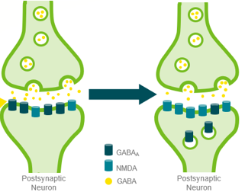
Importance of SAPs and Early Treatment:
Why Are We Waiting?
Increased seizure duration and delays in rescue therapy
have been repeatedly linked to negative outcomes
Seizures lasting longer than 5 min are unlikely to stop on their own
The longer a seizure lasts, the more resistant to treatment it becomes
During seizures, GABA receptors are internalized and NMDA receptors accumulate in the postsynaptic membrane, resulting in loss of inhibition and increased excitation
Villamar. Neurol Clin Pract. 2018;8:486. Gaínza-Lein. JAMA Neurol. 2018;75:410. Kapoor. J Control Release. 2016;237:147. Madzar. J Neurol. 2016;263:485. Gaínza-Lein. Seizure. 2017;52:188. Gainza-Lein. Seizure. 2019;68: 22. Becker. Neurol Ther. 2023;12:1439. CC BY NC 4.0.
Notes:
SAP, seizure action plan.

Slide 26
Practice Gaps?
Current gaps exist in discussing SAPs and use of rescue medications:
How adults vs pediatric patients are managed acutely for their seizures
Different approaches may be better suited for different age groups and populations with different demands
eg, schools and summer camps vs work environment and group homes
Lack of knowledge about when and how to develop and implement an SAP and use seizure rescue medications
Differences in training programs on how to manage seizure emergencies
Different practices between general neurologists and epilepsy centers
Limited knowledge of how to promote awareness of seizure clusters
Sandra Dewar. J Nurse Practitioners. 2023;6:104638.
Notes:
SAP, seizure action plan.

Slide 27


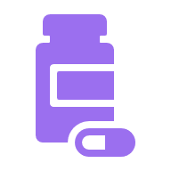
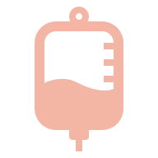
Previous Lack of Acceptable Treatment Options
ORAL TABLETS
& WAFERS
IV MEDICATIONS
(DELIVERED IN EMERGENCY SERVICES SETTINGS)
RECTAL GEL
Associated with social objections
There are cautions against placing anything in the mouth of an actively seizing patient
Not always accessible
Can result in treatment delays
Kapoor. J Control Release. 2016;237:147. Haut. Curr Opin Neurol. 2015;28. cdc.gov/epilepsy/about/first-aid.htm. Gaínza-Lein. Seizure. 2019;68:22. Haut. Epilepsy Behav. 2016;63:109.

Slide 28
Where Are We Now?
There are 3 FDA-approved medications for seizure rescue:
Rectal diazepam: approved for ages 2 yr or older
Nasal diazepam: approved for ages 2 yr or older
Nasal midazolam: approved for ages 12 yr or older
On the horizon: alprazolam (inhaled)
What is the role of the patient’s preference?
What is the role for consideration of the ease of use?
What is the role for pharmacokinetics?
Diazepam PI. Nasal midazolam PI.

Slide 29



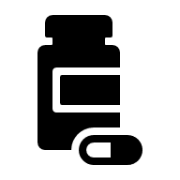
Differential Characteristics of Pharmacologic Options
ROUTE OF ADMINISTRATION | AVAILABLE BZDs | TIME TO ONSET (MIN) | COMMENTS
Intranasal (IN) | Diazepam Midazolam |  | FDA-approved formulations available Administration bypasses first-pass metabolism Administration may cause nasal discomfort
Rectal | Diazepam |  | FDA-approved formulations available Administration can present social and privacy concerns
Buccal/Sublingual | Clobazam Clonazepam Lorazepam Midazolam |  | Affected by drug half-life Risk of incomplete absorption First-pass metabolism and other gastrointestinal factors can affect absorption and bioavailability Administration may be challenging in seizing patients
Oral | Clonazepam Diazepam Lorazepam |  | No FDA-approved formulations for acute repetitive seizures First-pass metabolism and other gastrointestinal factors can affect absorption and bioavailability Administration may present some challenges and risks in a seizing patient
2-10 min
2-10 min
5-30 min
5-60 min
Kienitz. CNS Drugs. 2022;36:951. Almohaish. J Clin Med. 2021;10:1754. Blond. Expert Rev Neurother. 2022;22:567. Becker. Neurol Ther. 2023;12:1439. Gidal. Epilepsia. 2022;63:S34. Diazepam PI.

Slide 30
Benefits of Nasal Over Rectal Administration?
Variable absorption and bioavailability with rectal administration
Nasal administration is more convenient in public settings whereas rectal administration has poor social acceptability
Nasal administration more comfortable and simpler to administer in the midst of a seizure
FDA deemed diazepam nasal spray “clinically superior” in 2019 over the rectal formulation due to improved ease of administration
Krauss GL. Neurotherapeutics. 2023;20:758. Gidal. Epilepsia. 2022;63:S34. fda.gov/industry/designating-orphan-product-drugs-and-biological-products/clinical-superiority-findings.

Slide 31
What to Convey in an SAP
This is a medical emergency
Have a treatment plan
You can do it
Stay calm
All people with epilepsy should have an individualized emergency plan in place
seizureactionplans.org/wp-content/uploads/2023/01/SAPAW_2023_Toolkit_February-2023-1.pdf.

Slide 32
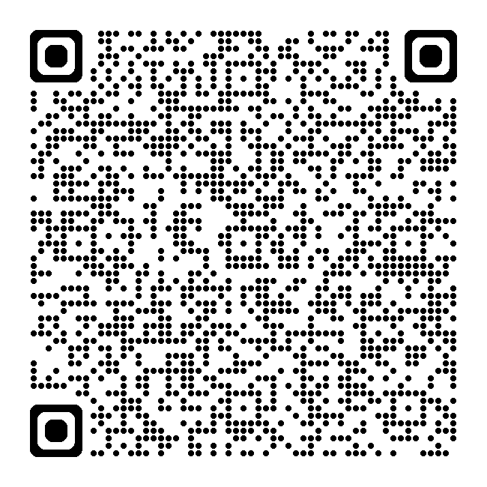
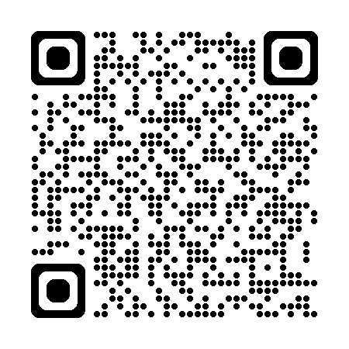
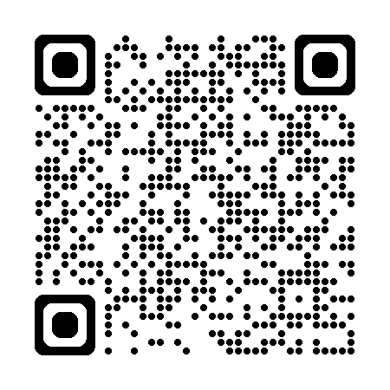
Rescue Medications Should be Part of Every SAP
Anyone can initiate a seizure action plan!
Epilepsy Foundation
SAP Coalition
Epilepsy Alliance
Notes:
SAP, seizure action plan.

Slide 33
Who Should Know About the SAP for Children With Epilepsy?
If you are a caregiver of a child with seizures, give one to a school nurse so appropriate people will know what to do in the case of a seizure. Ensure your child knows you are doing this and is willing to participate in the process.
1
If your child goes to camp or other programs where they will be spending a lot of time, give a copy to the appropriate personnel (nurse, counselor).
2
Make sure your child is aware that you are giving out their SAP to others and is apart of the process.
3
Review the plan with your healthcare team and family regularly—at least every 12 mo, or if seizures occur, or if your treatment changes.
4
1
2
3
4
epilepsy.com/preparedness-safety/action-plans.
Notes:
SAP, seizure action plan.

Slide 34
Why it Is important to Have a Response or Seizure Action Plan
Patients and family play a central role in seizure management
The success in managing epilepsy depends on being ready to take on whatever comes; this includes understanding epilepsy, being able to maintain seizure control, responding to seizures, and managing patient safety
SAPs help patients organize their seizure information and have it readily available whenever needed
A prepared plan can help patients know what to do or tell others what to do to prevent or act in seizure emergencies
A patient can also utilize and transform seizure action plans for different situations in their life
By helping patients be prepared, seizures or the fear of seizures will not prevent patients from living and enjoying their lives to the fullest extent
epilepsy.com/preparedness-safety/action-plans.
Notes:
SAP, seizure action plan.

Slide 35
Take-home Message
Make an SAP and after everyone has knowledge of the seizure action plan, make copies!
Keep an SAP with you everywhere—in your purse, wallet, or backpack
Put 1 in a central location in your home
Give 1 to those you see most frequently
(if you/your loved one feels comfortable with this)
epilepsy.com/preparedness-safety/action-plans.
Notes:
SAP, seizure action plan.

Slide 36
Go Online for More Coverage of Epilepsy!
deceraclinical.com/education
Podcast targeting the critical gaps in epilepsy treatment with rescue therapies used in the treatment of breakthrough seizures.
Text Module with expert perspective on the clinical use of rescue therapies for breakthrough seizures, the importance of individualized SAP, and strategies for effectively counseling patients and caregivers on the appropriate use of these treatments.
Clinical Thought addressing the unmet medical need for novel therapeutic approaches and insights on frequently aske questions for healthcare professional learners.

