Slide 1
Molecular Testing for Key Biomarkers in
Advanced Endometrial Cancer
Provided by Clinical Care Options, LLC
Hye Sook Chon, MD
Associate Professor
Clinical Trial Medical Director
Department of Gynecologic Oncology
H. Lee Moffitt Cancer Center & Research Institute
Tampa, Florida
Supported by an educational grant from GSK.

Slide 2

About These Slides
Please feel free to use and share some or all of these slides in your noncommercial presentations to colleagues or patients
When using our slides, please retain the source attribution:
These slides may not be published, posted online, or used in commercial presentations without permission. Please contact permissions@clinicaloptions.com for details
Slide credit: clinicaloptions.com
Notes:
Disclaimer: The materials published on the Clinical Care Options website reflect the views of the authors of the CCO material, not those of Clinical Care Options, LLC, the CME providers, or the companies providing educational grants. The materials may discuss uses and dosages for therapeutic products that have not been approved by the United States Food and Drug Administration. A qualified healthcare professional should be consulted before using any therapeutic product discussed. Readers should verify all information and data before treating patients or using any therapies described in these materials.

Slide 3
Faculty Disclosures
Hye Sook Chon, MD, has no relevant financial relationships to disclose.
Notes:
This slide lists the disclosure information of the faculty and staff involved in the development of these slides.

Slide 4
Endometrial Cancer: Overview
Endometrial cancer (uterine or corpus cancer): most common gynecologic malignancy in US and developed nations¹
  Incidence: 66,200 women
  13,030 women die from this disease
Average age at diagnosis is 63 yr²
Incidence increasing by 1% per yr for
women aged ≥50 yr since mid-2000s¹
Most individuals diagnosed with endometrial cancer have early-stage disease¹
Non-Hispanic Black women have 2-fold higher likelihood of dying from endometrial cancer vs non-Hispanic White women¹
FIGO Stage³ | 5-Yr OS, %
I | 86.3
II | 74.6
III | 48.7
IV | 28.2
1. Siegel. CA Cancer J Clin. 2023;73:17. 2. cancer.org/cancer/types/endometrial-cancer/about/key-statistics.html.
3. Kasius. Cancers. 2021;13:5848.
Notes:
FIGO, International Federation of Gynecology and Obstetrics; OS, overall survival.

Slide 5
Clinical Implications of Key Biomarkers
Biomarker | FDA-Approved EC Biomarker | Predictive of Response to Tx |  | Prognostic | Exploratory
dMMR | ✓ | ✓ |  | ✓
MSI | ✓* | ✓ | IO | ✓
TMB high | ✓* | ✓
p53 |  | ✓ | Selinexor (WT) | ✓ | ✓
HER2 |  | ✓ | Trastuzumab, T-DXd | ✓
ER/PgR |  | ✓ | Hormone tx | +/- | ✓
NTRK fusion | ✓* | ✓ | Larotrectinib, entrectinib
L1CAM |  |  |  | ✓ | ✓
CTNNB1 |  |  |  | ✓ | ✓
POLE |  |  |  | ✓ | ✓
PD-L1 |  |  |  | +/- | ✓
ARID1A |  |  |  |  | ✓
PI3K/AKT/mTOR |  |  |  |  | ✓
*Tumor agnostic.
Walsh. Gynecol Oncol. 2023;168:48. Pembrolizumab PI.
NCCN. Clinical practice guidelines in oncology: uterine neoplasms. v.1.2024. nccn.org.
Notes:
dMMR, mismatch repair deficient; EC, endometrial cancer; ER/PgR, estrogen receptor/progesterone receptor; IO, immuno-oncogenic therapy; MSI, microsatellite instability; TMB, tumor mutational burden; tx, therapy; WT, wild-type.

Slide 6
TCGA Molecular Classification and Outcomes
Molecular Subtyping: Prognostic and Predictive Value
Patients Divided Into TCGA Subgroups^{1,2}
100 hypothetical patients with newly diagnosed EC
Outcomes by TCGA Subgroup in High-Risk EC³
100
100
POLE sequencing
75
95
OS Probability (%)
POLE hotspot or exonuclease domain mutation
2-marker IHC
(PMS2 and MSH6)
50
POLE (~5%)
25
POLEmut
dMMR
NSMP
p53abn
PMS2 or MSH6 loss
70
TP53 sequencing or p53 IHC
Log-rank P <.001
MSI (~25%)
0
Patients at
Risk, n
POLEmut
dMMR
NSMP
p53abn
0
1
2
3
4
5
TP53
wild-type
TP53
mutant
Yr Since Random Assignment
51
137
129
93
51
136
125
87
50
128
122
71
49
115
118
61
48
108
110
52
37
85
85
37
Copy number low/ NSMP (~40%)
Copy number high (~30%)
Prognostic value of molecular classification of high-risk endometrial cancer for benefit from chemotherapy
83% and 17% of endometrial cancer can be classified as endometrioid and nonendometrioid, respectively
410 patients with successful molecular testing
  12% POLEmut: POLE ultramutated
  33% dMMR: mismatch repair deficient
  32% NSMP: no specific molecular profile
  23% p53abn: p53 abnormal
1. MacKay. Oncotarget. 2017;8:84579. 2. Cancer Genome Atlas Research Network. Nature. 2013;497:67.
3. León-Castillo. JCO. 2020;38:3388.
Notes:
dMMR, mismatch repair deficient; EC, endometrial cancer; IHC, immunohistochemistry; MSI, microsatellite instability; NSMP, no specific molecular profile; OS, overall survival; TCGA, The Cancer Genome Atlas.

Slide 7
Molecular Subtyping of EC: PORTEC-3 Trial
Prognostic and Predictive Value of Treatment
POLEmut
p53abn
dMMR
Copy Number Low/ NSMP
100
100
 | 5-Yr RFS, %
CRT | 58.6
RT | 36.2
100
100
75
75
75
75
60
 | 5-Yr RFS, %
CRT | 100
RT | 96.6
HR: 0.02 (95% CI: <0.01 to >10⁵; P = .637)
60
60
 | 5-Yr RFS, %
CRT | 68.0
RT | 75.5
HR: 1.29 (95% CI: 0.68-2.45; P = .429)
60
 | 5-Yr RFS, %
CRT | 79.7
RT | 67.7
HR: 0.68 (95% CI: 0.36-1.30; P = .246
RFS (%)
RFS (%)
RFS (%)
RFS (%)
25
25
25
25
HR: 0.52 (95% CI: 0.30-0.91; P = .021)
0
0
0
0
0
1
2
3
4
5
0
1
2
3
4
5
0
1
2
3
4
5
0
1
2
3
4
5
Yr Since Random Assignment
No adj therapy needed?
No adj therapy needed?
No adj therapy needed?
POLEmut: does not relapse regardless of therapy
p53abn: worst prognosis but significant benefit from adjuvant CT
MSI and copy number low/NSMP: intermediate prognosis, little benefit from adjuvant CT
León-Castillo. JCO. 2020;38:3388.
Notes:
CRT, chemoradiotherapy; CT, chemotherapy; dMMR, mismatch repair deficient; EC, endometrial cancer; MSI, microsatellite instability; NSMP, no specific molecular profile; RFS, relapse-free survival; RT, radiotherapy.

Slide 8
Molecular Profile and Potential Drugs by
TCGA Classification
Potential therapeutic impact on endometrial cancer
Parameter | POLE | MSI | Copy Number Low | Copy Number High
MSI/MLH methylation | Mixed MSI high, low, stable | MSI high | MSI stable | MSI stable
Molecular profile¹ | POLE (100%) PTEN (94%) PIK3CA (71%) FBXW7 (82%) ARID1A (76%)³ KRAS (53%)³ PD-1/PD-L1 overexpression⁶ | PTEN (88%)² RPL22 (37%)⁴ KRAS (35%)² PIK3CA (54%)² ARID1A (37%)² PD-1/PD-L1 overexpression⁵ | PTEN (77%)² CTNNB1 (52%) PIK3CA (53%)² ARID1A (52%)² FGFR2 (12%)⁵ | TP53 (90%) PPP2R1A (22%) FBXW7 (22%) PIK3CA (47%)² PTEN (11%) FGFR (3%)⁶ HER2 (25%)²
Potential drugs² | PI3K/PTEN/AKT/mTOR pathway Anti–PD-1/PD-L1 Hormones | Anti-PD-1/PD-L1 PI3K/PTEN/AKT/ mTOR pathway Hormones | Hormones PI3K/PTEN/AKT/ mTOR pathway FGFR-I | HER2- I PI3K- I PARP-I Wee-1 I FGFR-I
1. Cancer Genome Atlas Research Network. Nature. 2013;497:67. 2. Li. Ann Transl Med. 2022;10:870.
3. Mitamura. Jpn J Clin Oncol. 2019;49:108. 4. McAlpine. J Pathol. 2018;244:538.
5. Pasanen. Am J Surg Pathol. 2020;44:174. 6. Stelloo. Clin Cancer Res. 2016;22:4215.
Notes:
MSI, microsatellite instability; TCGA, The Cancer Genome Atlas.

Slide 9
NCCN Guidelines on Molecular Testing in
Endometrial Cancer
All patients should be tested for MMR proteins
HER2 testing recommended for all patients with serous or carcinosarcoma disease
  Consider for any p53-abnormal carcinomas
ER/PgR testing recommended for stage III/IV and recurrent disease
Strongly encourage:
  Assessing for POLE hotspot mutations in exonuclease domain
  IHC staining for MMR proteins or MSI testing
  IHC testing for p53
  Comprehensive molecular profiling at initial assessment
Consider:
  NTRK gene fusion testing for metastatic/recurrent EC
  TMB testing
Can perform molecular testing on initial biopsy, D&C material, or final hysterectomy specimen
NCCN. Clinical practice guidelines in oncology: uterine neoplasms. v.1.2024. nccn.org.
Notes:
D&C, dilation and curettage; ER/PgR, estrogen receptor/progesterone receptor; IHC, immunohistochemistry; MSI, microsatellite instability; NCCN, National Comprehensive Cancer Network; TMB, tumor mutational burden.

Slide 10
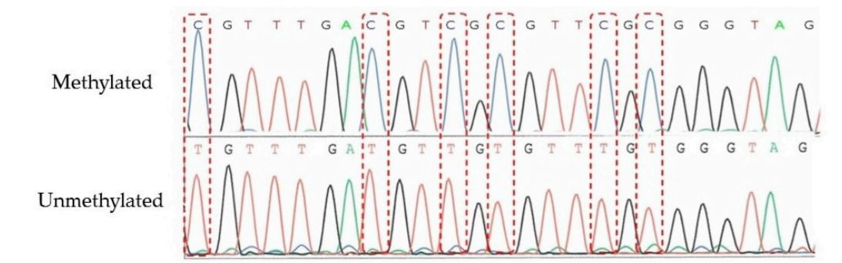
SGO and NCCN Recommend Universal Testing for
MMR Proteins in Patients With Endometrial Cancer
dMMR testing by IHC for MLH1, MSH2, MSH6, and PMS2 protein loss
If MLH1 protein loss found: reflex testing for MLH1 promoter methylation status
If findings are equivocal: MSI testing recommended (eg, NGS, multiplex PCR)
DNA Sequencing of MLH1 Promoter Region
Methylated
Unmethylated
Walsh. Gynecol Oncol. 2023;168:48. NCCN. Clinical practice guidelines in oncology: uterine neoplasms. v.1.2024. nccn.org.
Takeda. Genes (Basel). 2016;7:86. https://creativecommons.org/licenses/by/4.0/.
Notes:
dMMR, mismatch repair deficiency; IHC, immunohistochemistry; NCCN, National Comprehensive Cancer Network; NGS, next-generation sequencing; PCR, polymerase chain reaction; SGO, Society of Gynecologic Oncology.

Slide 11
When to Pursue Germline Testing for Lynch Syndrome
Lynch syndrome: hereditable syndrome conferring increased
cancer risk¹
  Caused by germline variants in MMR genes MLH1, MSH2, MSH6, or PMS2
Observed in ~3% of patients with endometrial cancer; more common among those with dMMR (~10%)¹
Early diagnosis of Lynch syndrome enables cancer surveillance and cascade testing in relatives²⁻⁴
Screening for Lynch Syndrome in Endometrial Cancer^{3,4}
Endometrial cancer
IHC for MLH1, MSH2, MSH6, and PMS2 and/or MSI testing
MLH1 protein absent ± PMS2 loss
MSH2, MSH6, or PMS2 protein absent
MSI-H without MMR IHC loss*
MLH1 promoter methylation
No protein loss or MSS
Normal
Hypermethylated
Not Lynch syndrome
Not Lynch syndrome
Genetic counseling and germline testing for Lynch syndrome–associated mutations
*If only microsatellite testing was done, perform either methylation testing or direct germline analysis.
1. Post. J Natl Cancer Inst. 2021;113:1212. 2. NCCN. Clinical practice guidelines in oncology: uterine neoplasms. v.1.2024. nccn.org.
3. Walsh. Gynecol Oncol. 2023;168:48. 4. Crosbie. Genet Med. 2019;21:2390. https://creativecommons.org/licenses/by/4.0/.
Notes:
dMMR, mismatch repair deficiency; IHC, immunohistochemistry.

Slide 12
Tumor Mutational Burden Testing
Currently assessed only by large NGS panels
  NGS panels also assess other relevant targets
  Slow and costly but provide much more information
Good communication with laboratory and molecular professional
is critical
TMB varies significantly across MSI-H tumors
  Loss of expression of MSH2/MSH6 associated with higher mean TMB than loss of MLH1/PMS2
Allgauer. Transl Lung Cancer Res. 2018;7:703. Jardim. Cancer Cell. 2021;39:154. Salem. Int J Cancer. 2020;147:2948.
Notes:
MSI-H, microsatellite instability‒high; NGS, next-generation sequencing; TMB, tumor mutational burden.

Slide 13
HER2/neu Testing in Serous Endometrial Cancer
HER2 overexpression and/or gene amplification seen in 25%-30% of serous EC cases^{1,2}
  HER2+ status in serous EC associated with response to trastuzumab
  Carboplatin, paclitaxel, and trastuzumab recommended for stage III/IV or recurrent HER2+ EC³
  Trastuzumab deruxtecan now recommended for 2L+ treatment of EC that is HER2+ (IHC 3+/2+)³
Testing for HER2^{1,2}
Can be associated with significant intratumor heterogeneity
  2 degrees of difference in staining intensity observed in >50% of cells
Parameter/Cutoff^{1,2} | Endometrial Serous Carcinoma
HER2 IHC 3+ (protein level) | >30%, strong complete or basolateral/lateral
HER2 FISH (gene amplification) | HER2/CEP17 ratio ≥2.0
1. Buza. Arch Pathol Lab Med. 2020;145:687. 2. Fader. Clin Cancer Res. 2020;26:3928.
3. NCCN. Clinical practice guidelines in oncology: uterine neoplasms. v.1.2024. nccn.org.
Notes:
2L, second-line; EC, endometrial cancer; FISH, fluorescence in situ hybridization; IHC, immunohistochemistry.

Slide 14
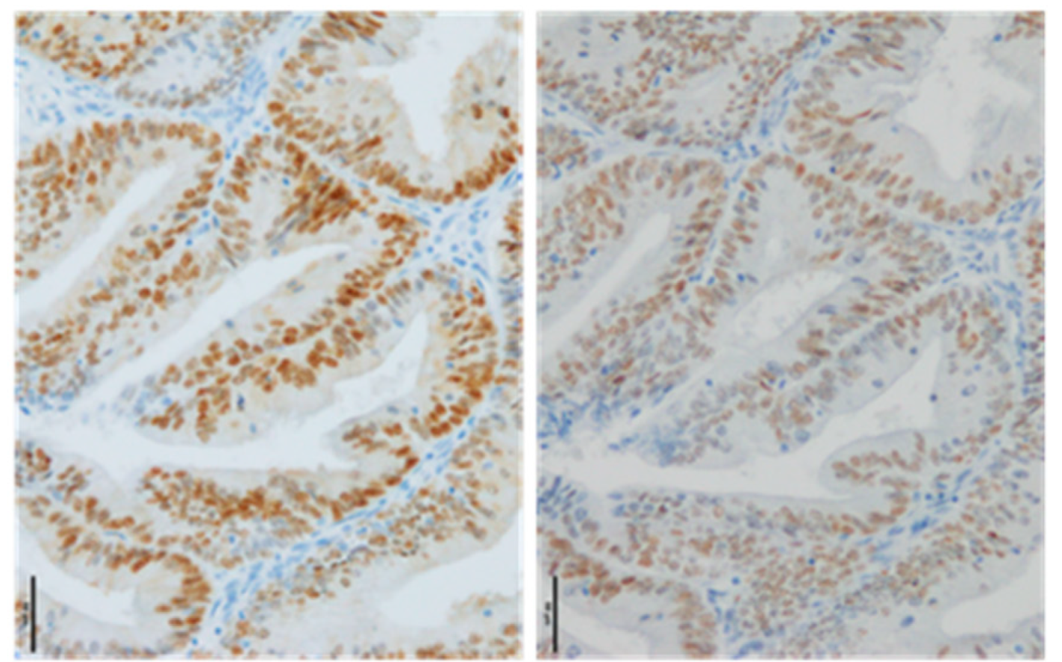
ER/PgR Testing
No consensus guidelines exist for reporting results of ER/PgR IHC testing in endometrial cancer¹
CAP recommends using same reporting approach as for ER/PgR IHC testing in breast cancer²
  Proportion of cells with positive staining
  Staining intensity—degree of nuclear positivity
Results are positive when nuclear immunoreactivity present in ≥1% of tumor cells²
IHC for Nuclear Staining of ER and PgR in Endometrial Cancer³
ERα
PgR
Scale bar = 50 µm.
1. Walsh. Gynecol Oncol. 2023;168:48. 2. Longacre. Arch Pathol Lab Med. 2017;141:1508.
3. Miki. Cancers. 2020;12:2595. https://creativecommons.org/licenses/by/4.0/.
Notes:
CAP, College of American Pathologists; ER/PgR, estrogen receptor/progesterone receptor; IHC, immunohistochemistry.

Slide 15
NTRK Gene Fusion Testing
NTRK gene fusions very rare in endometrial cancers (0.19%)¹
Patients with NTRK fusion–positive advanced cancers benefit from TRK inhibitors
  ORR of 61.2% and median OS of 33.8 mo in clinical trials of entrectinib²
NCCN recommends considering NTRK gene fusion testing in setting of recurrent/metastatic disease³
RNA-based NGS is current gold standard for detection of NTRK fusions⁴⁻⁶
  DNA NGS testing suboptimal because must sequence large and difficult introns
 | IHC | FISH | NGS
Advantages | Rapid results Low cost as single test | Rapid results | Potential for multiplexed testing Less depletion of tissue Fusion partner and position are defined
Disadvantages | Depletion of tissue Fusion partner and position unknown Poor sensitivity and specificity | Depletion of tissue Fusion partner and position unknown Poor sensitivity for adjacent intrachromosomal rearrangements | Longer wait time for results Cost
1. Westphalen. NPJ Precis Oncol. 2021;5:69. 2. Demetri. Clin Cancer Res. 2022;28:1302. 3. NCCN. Clinical practice guidelines in oncology: uterine neoplasms. v.1.2024. nccn.org. 4. Hyman. ASCO 2017. Abstr LBA2501. 5. Farago. J Thorac Oncol. 2015;10:1670.
6. Hechtman. Am J Surg Pathol. 2017;41:1547.
Notes:
FISH, fluorescence in situ hybridization; IHC, immunohistochemistry; NCCN, National Comprehensive Cancer Network; NGS, next-generation sequencing; ORR, objective response rate; OS, overall survival.

Slide 16
Key Takeaways
Test all patients with endometrial cancer for MMR proteins by IHC
  Important implications for deciding whether to use immunotherapy-based regimens
Test patients with serous, carcinosarcoma, or any p53-abnormal disease for
HER2 expression by IHC
  Determines eligibility for anti-HER2–based therapy
Test patients with advanced/recurrent disease for ER/PgR expression by IHC
  May predict response to hormone therapy
Ideally, perform comprehensive molecular profiling (eg, NGS) at initial assessment
  NGS can help identify other actionable biomarkers that are established
  (eg, NTRK fusion) or under investigation in clinical trials
Notes:
ER/PgR, estrogen receptor/progesterone receptor; IHC, immunohistochemistry; NGS, next-generation sequencing.

Slide 17
Go Online for More CCO
Coverage of Endometrial Cancer!
CME/ABIM MOC‒certified “micro” text modules and downloadable slidesets on key clinical considerations
in advanced endometrial cancer, from molecular testing to irAE care
“Call to Action” ClinicalThought commentary with expert perspectives and survey data on key gaps in
endometrial cancer care
Podcast featuring a patient advocate and HCP discussing how to work together for equitable care
Updates to Interactive Decision Support Tool providing expert recommendations tailored to specific scenarios
for patients with advanced endometrial cancer
clinicaloptions.com/EndometrialThinkTank

