Slide 1
Text Module 1: Recent Updates in MASH Pathogenesis
Supported by an educational grant from Novo Nordisk.
Notes:
MASH, nonalcoholic steatohepatitis.
Clinical Pathways: Multidisciplinary Approach to Managing Metabolic Dysfunction-associated Steatohepatitis

Slide 2

About These Slides
Please feel free to use and share some or all of these slides in your noncommercial presentations to colleagues or patients
When using our slides, please retain the source attribution:
These slides may not be published, posted online, or used in commercial presentations without permission. Please contact permissions@clinicaloptions.com for details
Slide credit: clinicaloptions.com
Notes:
Disclaimer: The materials published on the Clinical Care Options Web site reflect the views of the authors of the CCO material, not those of Clinical Care Options, LLC, the CME providers, or the companies providing educational grants. The materials may discuss uses and dosages for therapeutic products that have not been approved by the United States Food and Drug Administration. A qualified healthcare professional should be consulted before using any therapeutic product discussed. Readers should verify all information and data before treating patients or using any therapies described in these materials.

Slide 3
Faculty
Mazen Noureddin, MD, MHSc
Lynda K. and David M. Underwood Center for Digestive Disorders
Department of Medicine
Sherrie & Alan Conover Center for Liver Disease & Transplantation
Houston Methodist Research Institute
Houston Methodist Hospital
Houston, Texas
Notes:
This slide lists the faculty who were involved in the production of these slides.

Slide 4
Disclosures
The faculty reported the following relevant financial relationships or relationships to products or devices they have with ineligible companies related to the content of this educational activity:
Mazen Noureddin, MD, MHSc: consultant/advisor/speaker: 89BIO, Altimmune, BI, Cytodyn, GSK, Madrigal, Merck, Novo Nordisk, Perspectum, Siemens, Takeda, Terns; researcher: Allergan, Akero, Bristol-Myers Squibb, Gilead, Galectin, Genfit, GlaxoSmithKline, Conatus, Corcept, Enanta, Madrigal, Novartis, Novo Nordisk, Shire, Takeda, Terns, Viking, Zydus; individual publicly traded stocks and stock options: CIMA, ChronWell, Cytodyn, Rivus Pharma.
Notes:
This slide lists the disclosure information of the faculty and staff involved in the development of these slides.

Slide 5
Adipose Tissue as a Metabolic Organ
Metabolic flux
Insulin action/resistance
Regulation of appetite Energy expenditure Metabolism
Inflammation
Insulin resistance
Metabolites
FFAs, BCAA, others
Peptides, hormones, growth factors
Leptin, adiponectin, BMPs, FGF21, GDFs, Nrg4
Inflammatory
mediators
TNF, IL-6, MCP-1, resistin, adipsin, RBP4
Binding proteins and precursors
Angiotensinogen, PAI-1, FABP4, apelin, asprosin
Novel signaling lipids
FAHFAs, di-HOMEs
Circulating
exosomal miRNAs
miR-99b, miR-155, others
Vascular integrity
Blood flow and clotting
Insulin sensitivity
Insulin secretion
Thermogenesis
Gene expression in liver, macrophages, and other tissues
Kahn. JCI 2019;129:3990. Reproduced in accordance with https://creativecommons.org/licenses/by/4.0/.
Notes:
BCAA, branched-chain amino acid; FFA, free fatty acid; GDF, growth differentiation factor; Nrg4, neuregulin 4.

Slide 6
Adipose Tissue as a Metabolic Organ
Metabolic flux
Insulin action/resistance
Regulation of appetite Energy expenditure Metabolism
Inflammation
Insulin resistance
Metabolites
FFAs, BCAA, others
Peptides, hormones, growth factors
Leptin, adiponectin, BMPs, FGF21, GDFs, Nrg4
Inflammatory
mediators
TNF, IL-6, MCP-1, resistin, adipsin, RBP4
Binding proteins and precursors
Angiotensinogen, PAI-1, FABP4, apelin, asprosin
Novel signaling lipids
FAHFAs, di-HOMEs
Circulating
exosomal miRNAs
miR-99b, miR-155, others
Vascular integrity
Blood flow and clotting
Insulin sensitivity
Insulin secretion
Thermogenesis
Gene expression in liver, macrophages, and other tissues
Kahn. JCI 2019;129:3990. Reproduced in accordance with https://creativecommons.org/licenses/by/4.0/.
Notes:
BCAA, branched-chain amino acid; FFA, free fatty acid; GDF, growth differentiation factor; Nrg4, neuregulin 4.

Slide 7
Adipose Tissue as a Metabolic Organ
Metabolic flux
Insulin action/resistance
Regulation of appetite Energy expenditure Metabolism
Inflammation
Insulin resistance
Metabolites
FFAs, BCAA, others
Peptides, hormones, growth factors
Leptin, adiponectin, BMPs, FGF21, GDFs, Nrg4
Inflammatory
mediators
TNF, IL-6, MCP-1, resistin, adipsin, RBP4
Binding proteins and precursors
Angiotensinogen, PAI-1, FABP4, apelin, asprosin
Novel signaling lipids
FAHFAs, di-HOMEs
Circulating
exosomal miRNAs
miR-99b, miR-155, others
Vascular integrity
Blood flow and clotting
Insulin sensitivity
Insulin secretion
Thermogenesis
Gene expression in liver, macrophages, and other tissues
Kahn. JCI 2019;129:3990. Reproduced in accordance with https://creativecommons.org/licenses/by/4.0/.
Notes:
BCAA, branched-chain amino acid; FFA, free fatty acid; GDF, growth differentiation factor; Nrg4, neuregulin 4.

Slide 8

Adipose Tissue as a Metabolic Organ: Adiponectin
Tissue-Specific Adiponectin Signaling¹
Regulation of Neuronal Plasticity by Adiponectin Signaling²
Adiponectin
Ins
G
Ins
Endothelial cells
↑Differentiation
↑Migration
↑eNOS activity
↓Oxidative stress
↓Adhesion molecules
↓Apoptosis
G
Insulin
Glutamate
Ins
AdipoR1/2
G
NMDAr
Insulin Receptor
Skeletal muscle
↑Fatty acid oxidation
↑Insulin-induced
glucose utilization
↓Triglycerides
Cardiomyocyte
↓Hypertrophy
↓Inflammation
↓Apoptosis
P
APPL1
PI3K
AMPK
P
APPL1
P
IRS
Akt
Akt
Liver
↓Gluconeogenesis
↓Lipogenesis
↓Triglycerides
↓Ceramides
Adiponectin
Bone
↑Osteoblastogenesis
↓Osteoclastogenesis
Mitochondrion
TSC1/2
Energetic homeostasis during synaptic activity
PPARα
Pancreatic β-cells
↑Glucose-induced
insulin secretion
↑β-cell survival
↓Apoptosis
VSMCs
↑Migration
↑Proliferation
↑Apoptosis
mTORC1
Nucleus
Protein synthesis
(late LTP maintenance)
Cellular growth
(spinogenesis)
CREB
1. Roy. Cell Biosci. 2021;11:77. 2. Reprinted from Formolo. Brain Plasticity. 2022;8:79 with permission from IOS Press. https://content.iospress.com/articles/brain-plasticity/bpl220138.
Notes:
eNOS, endothelial nitric oxide synthase.

Slide 9
Adipose Tissue as a Metabolic Organ
Plasma adiponectin levels with pioglitazone treatment in patients with MASH (n = 47) vs controls (n = 20)
Plasma Adiponectin Concentration
vs Hepatic Insulin Sensitivity
Baseline Adiponectin Levels
5
16
14
4
12
Hepatic Insulin
(µmol/min kg mmol/L)⁻¹
10
3
Adiponectin Concentration (µg/mL)
*†
8
*†
6
2
All controls
4
Patients with MASH
2
1
Pioglitazone
Placebo
0
r = 0.52; P <.0001
Controls
NGT
Controls
MASH
MASH
T2D
0
IGT
4
8
12
16
*P <.001 vs NGT. †P <.01 vs IGT.
Adiponectin (µg/mL)
Gastaldelli. Aliment Pharmacol Ther. 2010;32:769.
Notes:
IGT, impaired glucose tolerance; MASH, nonalcoholic steatohepatitis; NGT, normal glucose tolerance; T2D, type 2 diabetes.

Slide 10
Stressed Adipose Tissue
Normal adipose development
Normal nutrition
Normal microbiome
Adipocyte growth factors
Normal adipose development
Different adipocyte populations and other adipocyte precursors
Preadipocyte subtypes
Mature adipocyte subtypes
Lipodystrophic adipocytes
Resident macrophages (M2)
Proinflammatory macrophages (M1)
Distinct types of macrophages
Stromovascular cells
Insulin receptors
Kahn. J Clin Invest. 2019;129:3990. Reproduced in accordance with https://creativecommons.org/licenses/by/4.0/.

Slide 11
Stressed Adipose Tissue
Normal adipose development
Healthy adipose expansion
Normal nutrition
Normal microbiome
Adipocyte growth factors
Increased number of small adipocytes
Low inflammation
Normal adipose development
Adipose expansion
Different adipocyte populations and other adipocyte precursors
Preadipocyte proliferation
Adipocyte hyperplasia
Preadipocyte subtypes
Mature adipocyte subtypes
Lipodystrophic adipocytes
Resident macrophages (M2)
Proinflammatory macrophages (M1)
Distinct types of macrophages
Stromovascular cells
Insulin receptors
Kahn. J Clin Invest. 2019;129:3990. Reproduced in accordance with https://creativecommons.org/licenses/by/4.0/.

Slide 12
Stressed Adipose Tissue
Normal adipose development
Healthy adipose expansion
Metabolically unhealthy obesity
Normal nutrition
Normal microbiome
Adipocyte growth factors
Increased number of small adipocytes
Low inflammation
Insulin resistance
Ectopic fat deposits
Metabolic syndrome
↑MCP-1
Normal adipose development
Adipose expansion
Adipose remodeling
Different adipocyte populations and other adipocyte precursors
Preadipocyte proliferation
Adipocyte hyperplasia
More adipocyte hyperplasia and hypertrophy
Changing adipose hormones Inflammation
Preadipocyte subtypes
Mature adipocyte subtypes
Lipodystrophic adipocytes
Resident macrophages (M2)
Proinflammatory macrophages (M1)
Distinct types of macrophages
Stromovascular cells
Insulin receptors
FFA
↑di-HOMEs
↓FAHFAs
∆ Exosomal miRNAs
↑Leptin
↓Adiponectin
∆ Other adipose hormones
↑TNF-α,
IL-1β, etc
Kahn. J Clin Invest. 2019;129:3990. Reproduced in accordance with https://creativecommons.org/licenses/by/4.0/.
Notes:
FAHFA, fatty acid esters of hydroxy fatty acid; FFA, free fatty acid.

Slide 13
Stressed Adipose Tissue
Normal adipose development
Healthy adipose expansion
Metabolically unhealthy obesity
Normal nutrition
Normal microbiome
Adipocyte growth factors
Increased number of small adipocytes
Low inflammation
Insulin resistance
Ectopic fat deposits
Metabolic syndrome
↑MCP-1
Normal adipose development
Adipose expansion
Adipose remodeling
Different adipocyte populations and other adipocyte precursors
Preadipocyte proliferation
Adipocyte hyperplasia
More adipocyte hyperplasia and hypertrophy
Changing adipose hormones Inflammation
Lipodystrophy
FFA
Insulin resistance
Ectopic fat deposits
Metabolic syndrome
↑di-HOMEs
↓FAHFAs
∆ Exosomal miRNAs
↑Leptin
↓Adiponectin
∆ Other adipose hormones
↑TNF-α,
IL-1β, etc
Genetic
Acquired/HIV
Genetic
Acquired/HIV
↑Leptin
↓Adiponectin
Kahn. J Clin Invest. 2019;129:3990. Reproduced in accordance with https://creativecommons.org/licenses/by/4.0/.
Notes:
FAHFA, fatty acid esters of hydroxy fatty acid; FFA, free fatty acid.

Slide 14
Genetic Factors in MASLD/MASH
Predisposing
  PNPLA3 I148M
  TM6SF2 E167K
  MBOAT7
  GCKR
Protective
  HSD17B13
  MARC1
  CIDEB (loss of function mutations)
Pennisi. Hepatol Commun. 2022;6:1032.
Notes:
MASLD, metabolic dysfunction–associated steatotic liver disease; MASH, metabolic dysfunction–associated steatohepatitis.

Slide 15
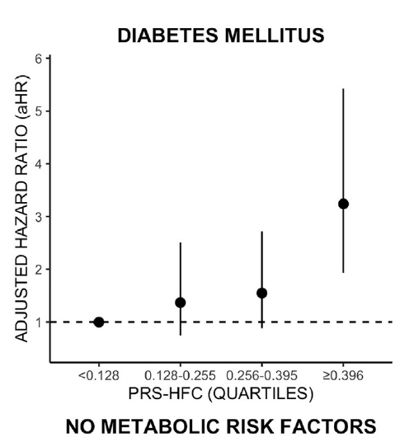
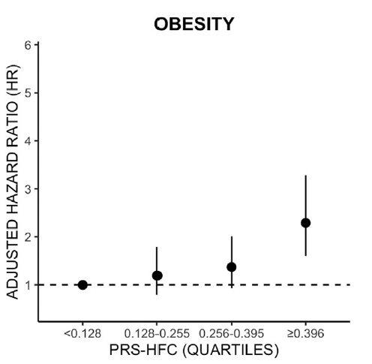
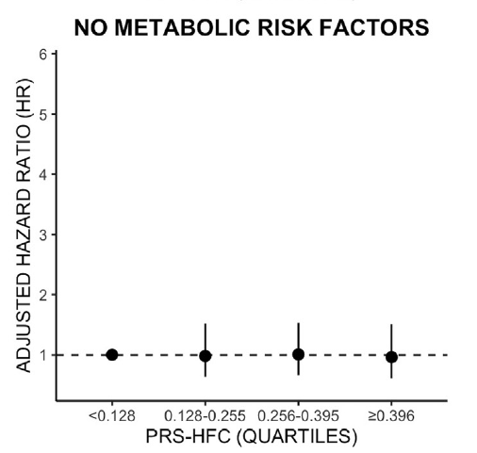
Genetics vs Role of Metabolic Comorbidities
UK BioBank subjects (n = 266,687 with median follow-up of 9 yr)
Risk of liver-related events based on polygenic risk score‒hepatic fat content (PRS-HFC*)
*Weighted scored based on PNPLA3, TM6SF2, GCKR, and MBOAT7.
De Vincentis. Clin Gastroenterol Hepatol. 2022;20:658.
Notes:
MASH, nonalcoholic steatohepatitis; PRS-HFC, polygenic risk score‒hepatic fat content.

Slide 16
MASH Pathogenesis: Role of Metabolic Comorbidities
Fat supply exceeds adipose storage capacity
Dietary/
environmental contributors
Genetic contributors
MASLD
Neuschwander-Tetri. Hepatology. 2010;52:774.
Notes:
MASLD, metabolic dysfunction–associated steatotic liver disease; MASH, metabolic dysfunction–associated steatohepatitis

Slide 17
MASH Pathogenesis: Role of Metabolic Comorbidities
Fat supply exceeds adipose storage capacity
Type 2 diabetes
Hypertension
??
MASLD
Macrovascular disease
Hyperuricemia
Hyperglycemia
Dyslipidemia
Neuschwander-Tetri. Hepatology. 2010;52:774. Cohen. Science. 2011;332:1519. Chakravarthy. Endocrinol Diabetes Metab. 2020;3:e00112. Yen. J Clin Med. 2022;11:1445.
Insulin resistance
Notes:
MASLD, metabolic dysfunction–associated steatotic liver disease; MASH, metabolic dysfunction–associated steatohepatitis.

Slide 18
MASH Pathogenesis: Role of Metabolic Comorbidities
Fat supply exceeds adipose storage capacity
Type 2 diabetes
Hypertension
Controversial, but:
Data show correlations, not causation
Variants of ApoB, PNPLA3 associated with NAFLD but not IR^{1,2}
X
MASLD
Macrovascular disease
Hyperuricemia
Hyperglycemia
Dyslipidemia
Insulin resistance
1. Neuschwander-Tetri. Hepatology. 2010;52:774.
2. Cohen. Science. 2011;332:1519.
Notes:
ApoB, apolipoprotein B; IR, insulin resistance; MASLD, metabolic dysfunction–associated steatotic liver disease; MASH, metabolic dysfunction–associated steatohepatitis.

Slide 19
MASH Pathogenesis: Role of Metabolic Comorbidities
Fat supply exceeds adipose storage capacity
Type 2 diabetes
Hypertension
MASLD
Macrovascular disease
Hyperuricemia
Hyperglycemia
Dyslipidemia
Insulin resistance
1. Neuschwander-Tetri. Hepatology. 2010;52:774.
2. Cohen. Science. 2011;332:1519.
Notes:
MASLD, metabolic dysfunction–associated steatotic liver disease; MASH, metabolic dysfunction–associated steatohepatitis.

Slide 20
MASH Pathogenesis: Role of Metabolic Comorbidities
Fat supply exceeds adipose storage capacity
Rx
Rx
Type 2 diabetes
Hypertension
Insulin resistance
Increased circulating FFA
Macrovascular disease
Hyperuricemia
Rx
Rx
Neuschwander-Tetri. Hepatology. 2010;52:774.
Cohen. Science. 2011;332:1519. Chakravarthy. Endocrinol Diabetes Metab. 2020;3:e00112.
Yen. J Clin Med. 2022;11:1445.
Hyperglycemia
Dyslipidemia
Rx
MASLD
Rx
Notes:
FFA, free fatty acid; MASLD, metabolic dysfunction–associated steatotic liver disease; MASH, metabolic dysfunction–associated steatohepatitis; Rx, prescription.

Slide 21
MASH Pathogenesis: Role of Metabolic Comorbidities
Fat supply exceeds adipose storage capacity
Ideal metabolic Rx?
Type 2 diabetes
Hypertension
Insulin resistance
Increased circulating FFA
Macrovascular disease
Hyperuricemia
Hyperglycemia
Dyslipidemia
Neuschwander-Tetri. Hepatology. 2010;52:774. Cohen. Science. 2011;332:1519. Chakravarthy. Endocrinol Diabetes Metab. 2020;3:e00112. Yen. J Clin Med. 2022;11:1445.
MASLD
Notes:
FFA, free fatty acid; metabolic dysfunction–associated steatotic liver disease; MASH, metabolic dysfunction–associated steatohepatitis; Rx, prescription.

Slide 22


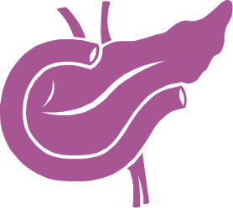
The Pathogenic Relationship
Between Diabetes and MASH
Adipose Tissue Insulin Resistance
↑Lipolysis
FFA
↑Secretion of proinflammatory cytokines
↓Anti-inflammatory adipokine secretion
Impaired
Activation
MCP-1, TNF-α
TGFβ, IL-6, leptin
Lipotoxicity
↓Adiponectin, IL-1
Insulin resistance in liver and muscle
Activation of proinflammatory pathways
Impaired insulin secretion
Gastaldelli. JHEP Rep. 2019;1:312.
Notes:
FFA, free fatty acid; MASH, metabolic dysfunction–associated steatohepatitis.

Slide 23



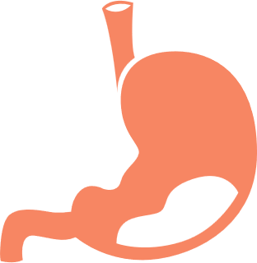
Role of GLP-1 in MASH Pathogenesis
Brain
↑Neuroprotection
↑Memory
↓Appetite
Heart
↑Myocardial contractility
↑Heart rate
↑Myocardial injury secondary to ischemia
Liver
↑Glucose production
Stomach
↓Gastric emptying
↓Gastric acid secretion
Pancreas
↑Insulin secretion
↓Glucagon secretion
↑Insulin biosynthesis
↑New β-cell formation
↓β-cell apoptosis
↑ Insulin Sensitivity
Muscle
↑Glucose uptake
↑Glucose storage
Armstrong. Clinical Liver Disease. 2017;10:32.
Notes:
GLP-1, glucagon-like peptide-1; MASH, nonalcoholic steatohepatitis.

Slide 24
MASH Pathogenesis: Summary
Epidemiologic data have been interpreted to
suggest complex bidirectional relationships
Mechanistic data indicate common underlying causes
  Adipose tissue overwhelmed for fat storage
  Insulin resistance
  Genetic contributions that predispose to MASLD/MASH that are additive to insulin resistance/adipose dysfunction
Therapies that address underlying metabolic disease may be effective
  Treatments focused on inflammation/death pathways have not worked
?
Type 2 diabetes
MASH
Metabolic disease/IR
Type 2 diabetes
MASH
Tomah. Clin Diabetes Endocrinol. 2020;6:9. Neuschwander-Tetri. Hepatology. 2010;52:774. Cohen. Science. 2011;332:1519. Chakravarthy. Endocrinol Diabetes Metab. 2020;3:e00112. Ferguson. Nat Rev Endocrinol. 2021;17:484.
Notes:
IR, insulin resistance; metabolic dysfunction–associated steatotic liver disease; MASH, metabolic dysfunction–associated steatohepatitis

Slide 25
Go Online for More CCO Coverage of A Metabolic Approach to MASH Management!
Downloadable slidesets
ClinicalThought commentaries
https://clinicaloptions.com/CE-CME/gastroenterology

