Slide 1
Diagnostic Precision in Essential Thrombocythemia and Polycythemia Vera
Provided by Clinical Care Options, LLC dba Decera Clinical Education.
Supported by an educational grant from Merck Sharp & Dohme LLC.

Slide 2
About These Slides
Please feel free to use and share some or all of these slides in your noncommercial presentations to colleagues or patients
When using our slides, please retain the source attribution:
Slide credit: deceraclinical.com/education
These slides may not be published, posted online, or used in commercial presentations without permission. Please contact permissions@deceraclinical.com for details
Notes:
Disclaimer: The materials published on the Decera Clinical Education website reflect the views of the authors of the Decera Clinical Education material, not those of Decera Clinical Education, the CME providers, or the companies providing educational grants. The materials may discuss uses and dosages for therapeutic products that have not been approved by the FDA. A qualified healthcare professional should be consulted before using any therapeutic product discussed. Readers should verify all information and data before treating patients or using any therapies described in these materials.

Slide 3
WHO and ICC 2022 Criteria for Diagnosing ET and PV
 | ET | PV
Major criteria | PLT ≥450 x 10⁹/L BM biopsy with predominant proliferation of megakaryocytes JAK2, CALR, or MPL mutation Not meeting WHO criteria for other MPN subtype | Hb >16.5 g/dL in men, Hb >16.0 g/dL in women OR Hct >49% in men, Hct >48% in women OR increased red cell mass (ICC only) BM biopsy showing trilineage proliferation (panmyelosis) JAK2 mutation
Minor criteria | Presence of a clonal marker or absence of evidence for reactive THR | Subnormal serum EPO level
Diagnosis | All 4 major criteria or the first 3 major criteria and 1 of the minor criteria | All 3 major criteria or the first 2 major criteria and the minor criterion
Khoury. Leukemia. 2022;36:1703. Arber. Blood. 2022;140:1200. Thiele. Am J Hematol. 2023;98:166.

Slide 4

WHO and ICC 2022 Criteria for Diagnosing ET and PV:
Major Criteria for PV
 | ET | PV
Major criteria | PLT ≥450 x 10⁹/L BM biopsy with predominant proliferation of megakaryocytes JAK2, CALR, or MPL mutation Not meeting WHO criteria for other MPN subtype | Hb >16.5 g/dL in men, Hb >16.0 g/dL in women OR Hct >49% in men, Hct >48% in women OR increased red cell mass (ICC only) BM biopsy showing trilineage proliferation (panmyelosis) JAK2 mutation
Minor criteria | Presence of a clonal marker or absence of evidence for reactive THR | Subnormal serum EPO level
Diagnosis | All 4 major criteria or the first 3 major criteria and 1 of the minor criteria | All 3 major criteria or the first 2 major criteria and the minor criterion
Hb and Hct criteria lowered in most recent criteria to capture “masked” PV
Khoury. Leukemia. 2022;36:1703. Arber. Blood. 2022;140:1200. Thiele. Am J Hematol. 2023;98:166.

Slide 5
WHO and ICC 2022 Criteria for Diagnosing ET and PV: Erythropoietin Levels
 | ET | PV
Major criteria | PLT ≥450 x 10⁹/L BM biopsy with predominant proliferation of megakaryocytes JAK2, CALR, or MPL mutation Not meeting WHO criteria for other MPN subtype | Hb >16.5 g/dL in men, Hb >16.0 g/dL in women OR Hct >49% in men, Hct >48% in women OR increased red cell mass (ICC only) BM biopsy showing trilineage proliferation (panmyelosis) JAK2 mutation
Minor criteria | Presence of a clonal marker or absence of evidence for reactive THR | Subnormal serum EPO level
Diagnosis | All 4 major criteria or the first 3 major criteria and 1 of the minor criteria | All 3 major criteria or the first 2 major criteria and the minor criterion
Up to 20%-30% of PV patients will have normal epo level; does not rule out diagnosis
Khoury. Leukemia. 2022;36:1703. Arber. Blood. 2022;140:1200. Thiele. Am J Hematol. 2023;98:166.

Slide 6
WHO and ICC 2022 Criteria for Diagnosing ET and PV: Bone Marrow Biopsy in PV
 | ET | PV
Major criteria | PLT ≥450 x 10⁹/L BM biopsy with predominant proliferation of megakaryocytes JAK2, CALR, or MPL mutation Not meeting WHO criteria for other MPN subtype | Hb >16.5 g/dL in men, Hb >16.0 g/dL in women OR Hct >49% in men, Hct >48% in women OR increased red cell mass (ICC only) BM biopsy showing trilineage proliferation (panmyelosis) JAK2 mutation
Minor criteria | Presence of a clonal marker or absence of evidence for reactive THR | Subnormal serum EPO level
Diagnosis | All 4 major criteria or the first 3 major criteria and 1 of the minor criteria | All 3 major criteria or the first 2 major criteria and the minor criterion
BM biopsy not required for PV diagnosis if Hb >18.5 g/dL in men or >16.5 g/dL in women, Hct >55.5% in men or >49.5% in women if JAK2 mutation is present
Khoury. Leukemia. 2022;36:1703. Arber. Blood. 2022;140:1200. Thiele. Am J Hematol. 2023;98:166.

Slide 7
WHO and ICC 2022 Criteria for Diagnosing ET and PV: Bone Marrow Biopsy in ET
 | ET | PV
Major criteria | PLT ≥450 x 10⁹/L BM biopsy with predominant proliferation of megakaryocytes JAK2, CALR, or MPL mutation Not meeting WHO criteria for other MPN subtype | Hb >16.5 g/dL in men, Hb >16.0 g/dL in women OR Hct >49% in men, Hct >48% in women OR increased red cell mass (ICC only) BM biopsy showing trilineage proliferation (panmyelosis) JAK2 mutation
Minor criteria | Presence of a clonal marker or absence of evidence for reactive THR | Subnormal serum EPO level
Diagnosis | All 4 major criteria or the first 3 major criteria and 1 of the minor criteria | All 3 major criteria or the first 2 major criteria and the minor criterion
BM biopsy is required for ET diagnosis but often does not change management
Khoury. Leukemia. 2022;36:1703. Arber. Blood. 2022;140:1200. Thiele. Am J Hematol. 2023;98:166.

Slide 8
Overlapping Features With Essential Thrombocythemia, Prefibrotic Myelofibrosis, and Polycythemia Vera
Key Distinguishing Factors | Essential Thrombocythemia | Polycythemia Vera
Hematologic requirement | Platelet count ≥450 x 10⁹/L | Men: hemoglobin >16.5 g/dL or hematocrit >49% Women: hemoglobin >16 g/dL or hematocrit >48%
Marrow cellularity | Normocellular | Hypercellular
Megakaryocyte morphology | Enlarged mature megakaryocytes | Pleomorphic mature megakaryocytes
Marrow morphology | Isolated megakaryocyte hyperplasia | Panmyelosis (trilineage hematopoiesis)
Khoury. Leukemia. 2022;36:1703.
Key Distinguishing Factors | Prefibrotic Myelofibrosis | Polycythemia Vera
Megakaryocyte morphology | Megakaryocyte atypia | Pleomorphic mature megakaryocytes
Erythroid morphology | Often decreased erythropoiesis | Erythroid hyperplasia (as part of panmyelosis)
Hematologic parameters | Anemia more often present | Increased hemoglobin/hematocrit
Khoury. Leukemia. 2022;36:1703. Arber. Blood. 2022;140:1200. Gianelli. Virchows Arch. 2022;482:53. Thiele. Am J Hematol. 2023;98:166.

Slide 9
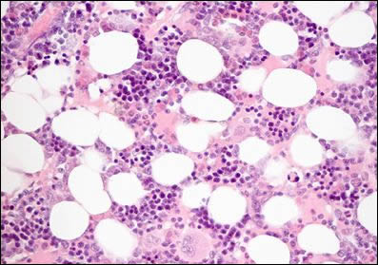
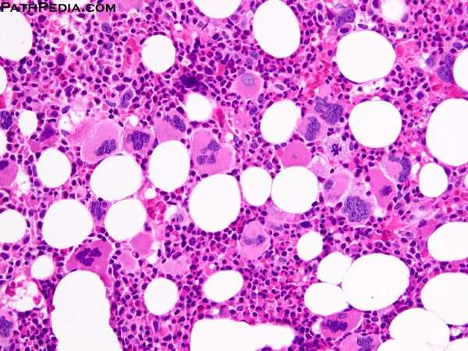
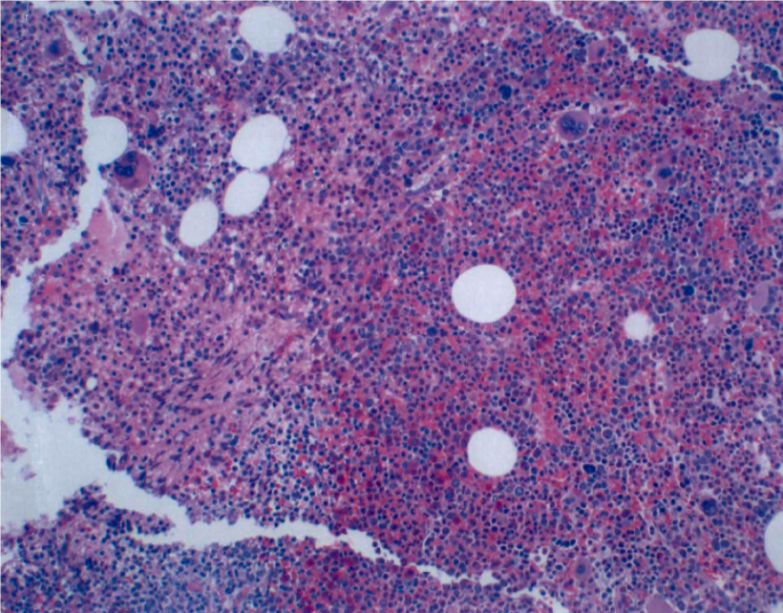
BM Biopsy: Normal vs ET or PV
Normal bone marrow
ET bone marrow
PV bone marrow
Courtesy of R. T. Silver, Weill Cornell Medicine.

Slide 10
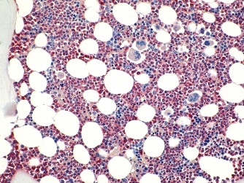
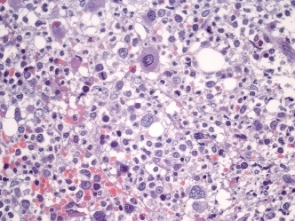
The Current Genetic Landscape Concerning Phenotypic Driver Mutations in MPN
Reactive Conditions?
CALR (20%-25%)
Exclude reactive conditions:
Inflammation
Iron deficiency
Splenectomy
MPL (3%-5%)
ET
Triple Negative
10%-15%
JAK2 (60%)
??
Clonal/Unknown
CALR (20%-30%)
MPL (5%-8%)
PMF
JAK2 (60%)
Triple Negative
5%-10%
Exclude MDS/MPN
or MDS
??
Clonal/ unknown
PV
JAK2 Exon 12 (≈ 5%)
Rare JAK2 negative PV
JAK2V617F (>95%)
Vannucchi. CA Cancer J Clin. 2009;59:171. Harrison. Blood 2016;127:276. Zoi. JCO. 2017;35;947. Thiele. Am J Hematol. 2023;98:166.

Slide 11
Not So Mutually Exclusive?
Rare cases of patients with double (1%-2%) or even triple (<1%) positive MPN
Possible impact on disease phenotype and prognosis
Raises the question of how we sequence molecular testing
Sequential?
Reflex?
Simultaneous?
Include other pathogenic nondriver mutations?
He. Am J Hematol 2025; 100:2431. NCCN Guidelines. Myeloproliferative neoplasms. V2.2025.

Slide 12
Pathogenic Nondriver Mutations in ET and PV
Somatic Mutations Among Patients With MPN (N = 197)
Most common nondriver mutations in ET and PV
  TET2
  ASXL1
  DNMT3A
  EZH2
  IDH1
  SH2B3
  SF3B1
ET
PV
PMF
3%
(2)
3%
(3)
3%
(1)
Number of mutations
5
4
3
2
1
0
13%
(9)
7%
(7)
10%
(9)
12%
(4)
15%
(5)
22%
(15)
Epigenetic regulation
24%
(23)
18%
(6)
62%
(43)
55%
(52)
53%
(18)
n = 69
patients
n = 94
patients
n = 34
patients
JAK signaling regulation
mRNA splicing
Lundberg. Blood. 2014;123:2220. Paz. Blood. 2022;141:1909. Tefferi. Br J Haematol. 2020;189:291.

Slide 13
Final Thoughts on Diagnosing ET and PV
Bone marrow biopsy
  Timing of bone marrow biopsy
    Can bone marrow biopsy be omitted, particularly in frailer or older patients?
  Subjectivity of morphology
    Essential thrombocythemia vs prefibrotic myelofibrosis
    Disease can also evolve, making precise classification difficult
Genetic testing
  How to sequence, particularly considering barriers and costs?
  How to integrate nondriver pathogenic mutations?

Slide 14
Go Online for More Coverage of MPNs!
Additional CME-certified text modules on PV and ET
ClinicalThought commentaries
CME-certified podcast on shared decision-making for PV and ET
deceraclinical.com/education

