Slide 1
Strategies for Pharmacists to Overcome Current Challenges and Integrate Novel Maintenance Therapies for the Management of COPD
Provided by ProCE, LLC
This program is supported in part by an independent medical educational grant from Mylan Specialty L.P., a Viatris Company and Theravance Biopharma Inc.

Slide 2

About These Slides
Please feel free to use and share some or all of these slides in your noncommercial presentations to colleagues or patients
When using our slides, please retain the source attribution:
These slides may not be published, posted online, or used in commercial presentations without permission. Please contact info@ProCE.com for details
Slide credit: ProCE.com
Notes:
Disclaimer: The materials published on the Clinical Care Options website reflect the views of the authors of the CCO material, not those of Clinical Care Options, LLC, the CME providers, or the companies providing educational grants. The materials may discuss uses and dosages for therapeutic products that have not been approved by the United States Food and Drug Administration. A qualified healthcare professional should be consulted before using any therapeutic product discussed. Readers should verify all information and data before treating patients or using any therapies described in these materials.

Slide 3
Faculty
J. Andrew Woods, PharmD, BCPS
Chair, Translational Sciences and Inpatient Practice
Professor of Pharmacy
Wingate University School of Pharmacy
Wingate, North Carolina
Notes:
This slide lists the faculty who were involved in the production of these slides.

Slide 4
Disclosures
The faculty reported the following relevant financial relationships or relationships to products or devices they have with ineligible companies related to the content of this educational activity:
J. Andrew Woods, PharmD, BCPS: consultant/advisor/speaker: Boehringer Ingelheim.
Notes:
This slide lists the disclosure information of the faculty and staff involved in the development of these slides.

Slide 5
Learning Objectives
Assess the most recent GOLD guideline updates and their impact on selection of maintenance therapy in COPD
Formulate individualized treatment plans for COPD maintenance therapy based on efficacy and safety evidence, current guidelines, and patient-related and disease-related factors, including choice of inhalation device
Identify strategies to address barriers to optimal outcomes, including disease progression, adherence, access to care, and disparities

Slide 6
Updates in COPD
Notes:
COPD, chronic obstructive pulmonary disease

Slide 7





Some Things Haven’t Changed: COPD in the US
Approximately 16 million people diagnosed
Rank regarding mortality?
Rank as a cause of disability?
Rank in NIH funding?
Who is diagnosed with COPD?
nhlbi.nih.gov/health/copd. Mokdad. JAMA. 2018;319:1444. Murray. JAMA. 2013;310:591.
Notes:
COPD, chronic obstructive pulmonary disease.

Slide 8
COPD: Prevalence and Burden
Prevalence of COPD Among Adults ≥45 Yr (2019)
Mortality With COPD as Underlying or Contributing Cause Among Adults ≥45 Yr (2019)
WA
Age-Adjusted Prevalence (%)
5.2-7.9
8.0-9.0
9.1-11.6
11.7-16.8
Data unavailable
WA
Age-Adjusted Rate (cases per 100,000)
92.7-183.2
183.3-227.7
227.8-260.2
260.3-415.8
Data unavailable
MT
ND
ME
MT
ND
ME
OR
ID
MN
VT
OR
ID
MN
VT
WY
SD
WI
MI
NY
MA
WY
SD
WI
MI
NY
MA
NV
UT
NE
IA
IN
OH
PA
NJ
NV
UT
NE
IA
IN
OH
PA
NJ
CO
IL
WV
MD
CO
IL
WV
MD
CA
KS
MO
KY
VA
RI
CA
KS
MO
KY
VA
RI
AZ
NM
OK
AR
TN
NC
DE
AZ
NM
OK
AR
TN
NC
DE
SC
DC
SC
DC
TX
LA
MS
AL
GA
TX
LA
MS
AL
GA
AK
FL
AK
FL
HI
HI
Age-Adjusted Prevalence of COPD Among US Adults Aged ≥18 Yr (2011-2020)
7.0
Estimated to contribute to 3 million deaths globally each year
COPD was fifth-leading cause of death behind
heart disease, cancer, COVID-19, and stroke
6.0
Age-Adjusted Prevalence (%)
Overall
Men
Women
5.0
Age-Adjusted Prevalence
4.0
3.0
2.0
1.0
0
2011
2012
2013
2014
2015
2016
2017
2018
2019
2020
Yr
cdc.gov/copd/data-and-statistics/national-trends.html. goldcopd.org/2023-gold-report-2. goldcopd.org/2024-gold-report. nccd.cdc.gov/cdi/rdPage.aspx?rdReport=DPH_CDI.ExploreByTopic&islTopic=COPD&islYear=9999&go=GO.
Notes:
COPD, chronic obstructive pulmonary disease.

Slide 9
GOLD Report Updates: Making Progress
GOLD 2023
  Challenges (some) accepted dogma of COPD
  Calls attention to concept of GETomics
  Acknowledges etiotypes as understanding of endotypes and recognition of phenotype advances
  Expands COPD diagnostic considerations
  Simplifies initial management strategies
GOLD 2024
  Continued to refine terminology and taxonomy
  Treatment impact on mortality discussed
  Adherence considerations discussed
  Importance of inhaler/device selection emphasized
  Role of CT imaging
  Updates added on assessment and management of exacerbations
goldcopd.org/2024-gold-report. Stolz. Lancet. 2022;400:921. Agusti. Respir Med. 2023;207:107041.
Notes:
COPD, chronic obstructive pulmonary disease.

Slide 10
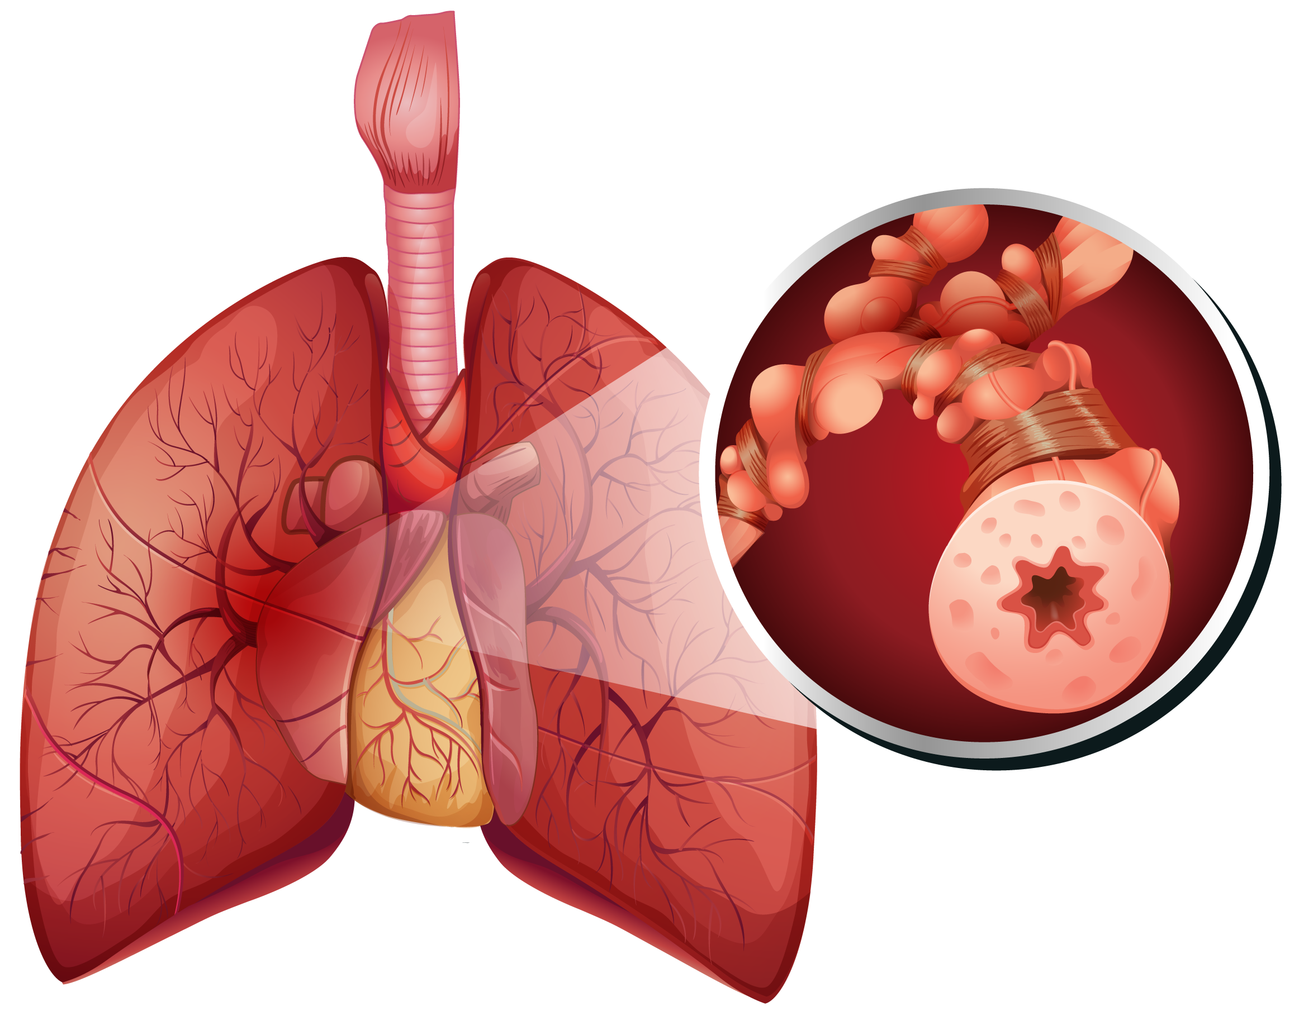
GOLD: Redefining COPD
“COPD is a heterogeneous lung condition characterized by chronic respiratory symptoms… due to abnormalities of the airways… and/or alveoli…
that cause persistent, often progressive, airflow obstruction”
goldcopd.org/2023-gold-report-2. goldcopd.org/2024-gold-report.
Notes:
COPD, chronic obstructive pulmonary disease.

Slide 11
It’s All Fun and Games Until It Overlaps
Chronic bronchitis
Emphysema
COPD
Airflow obstruction
Asthma
National Center for Chronic Disease Prevention and Health Promotion (US) Office on Smoking and Health, 2014
Notes:
COPD, chronic obstructive pulmonary disease.

Slide 12



Reframing COPD: Pathogenesis
COPD is not just a self-inflicted disease caused by smoking
COPD results from the dynamic interplay of genetics (G) and environmental exposures (E) over time (T)
G
E
T
  omics
goldcopd.org/2024-gold-report. Agusti. Lancet Respir Med. 2022;10:512. Cho. Lancet Respir Med. 2022;10:485.
Notes:
COPD, chronic obstructive pulmonary disease.

Slide 13
Reframing COPD: Pathogenesis
Genetics
Genetic heritability of COPD is moderate
Environment
Smoking
Timing
Peak lung function can be attenuated by processes that occur during lung development
Genetic–environmental exposure interactions may accelerate decline of lung function
α-1 antitrypsin deficiency and telomerase reverse transcriptase mutation are well-established monogenetic variants with causative role in COPD
Gene-environment interactions incompletely understood
Non-smoking
– Biomass exposure
– Occupational exposure
– Air pollution
goldcopd.org/2024-gold-report. Agusti. Lancet Respir Med. 2022;10:512. Cho. Lancet Respir Med. 2022;10:485.
Yang. Lancet Respir Med. 2022;10:497. Marchetti. Am J Respir Crit Care Med. 2014;190:756. Agusti. Lancet Respir Med. 2019;7:358.
Notes:
COPD, chronic obstructive pulmonary disease.

Slide 14


Reframing COPD: Level-Setting Terminology
Early COPD
Mild COPD
Young COPD
Pre COPD
PRISm
Reserved for explanation of “biological” first steps in experimental setting
Describes severity of airflow obstruction measured via spirometry
(FEV₁ ≥80% predicted)
Patient aged
20-50 yr, never achieved peak lung function, shorter plateau of and/or earlier-than-predicted decline in lung function
Respiratory symptoms and/or detectable structural and/or functional abnormality WITHOUT airflow obstruction on forced spirometry
Preserved ratio-impaired spirometry; FEV₁/FVC ≥0.7 but FEV₁ <80%
goldcopd.org/2024-gold-report.
Notes:
COPD, chronic obstructive pulmonary disease; PRISm, preserved ratio-impaired spirometry.

Slide 15
Proposed Taxonomy: Etiotypes for COPD
Classification | Description
Genetically determined COPD (COPD-G) | α-1–antitrypsin deficiency, other genetic variants in combination
COPD due to abnormal lung development (COPD-D) | Premature birth/low birth weight
Environmental COPD Cigarette smoking COPD (COPD-C) Biomass and pollution exposure COPD (COPD-P) | Exposure to tobacco smoke (including in utero) or via passive smoke, vaping/electronic cigarette use, cannabis Household pollution, occupational hazards, ambient air pollution, wildfire smoke
COPD due to infections (COPD-I) | Childhood infections, TB/HIV–associated COPD
COPD and asthma (COPD-A) | Particularly in those with childhood asthma
COPD of unknown cause (COPD-U)
goldcopd.org/2024-gold-report.
Notes:
COPD, chronic obstructive pulmonary disease; TB, tuberculosis.

Slide 16
Proposed Taxonomy: Etiotypes for COPD
Classification | Description
Genetically determined COPD (COPD-G) | α-1–antitrypsin deficiency, other genetic variants in combination
COPD due to abnormal lung development (COPD-D) | Premature birth/low birth weight
Environmental COPD Cigarette smoking COPD (COPD-C) Biomass and pollution exposure COPD (COPD-P) | Exposure to tobacco smoke (including in utero) or via passive smoke, vaping/electronic cigarette use, cannabis Household pollution, occupational hazards, ambient air pollution, wildfire smoke
COPD due to infections (COPD-I) | Childhood infections, TB/HIV–associated COPD
COPD and asthma (COPD-A) | Particularly in those with childhood asthma
COPD of unknown cause (COPD-U)
goldcopd.org/2024-gold-report.
Notes:
COPD, chronic obstructive pulmonary disease; TB, tuberculosis.

Slide 17
COPD-P vs COPD-C
More common in younger age groups
Nonsmoking COPD
More common in females
Symptoms are milder
Slower decline in respiratory function
Trend toward greater eosinophilic-driven inflammation
goldcopd.org/2024-gold-report. goldcopd.org/2024-gold-report. Salvi. Respir Res. 2020;21:50.
Notes:
COPD, chronic obstructive pulmonary disease; COPD-C, cigarette smoking chronic obstructive pulmonary disease; COPD-P, biomass and pollution exposure chronic obstructive pulmonary disease.

Slide 18
A Move to Expand Diagnostic Criteria
Accepted diagnostic criteria
for COPD do not capture complexity/heterogeneity of disease
  Focus on single disease entity
  Fail to identify COPD in early stages
COPD should be considered in any patient with dyspnea, chronic cough, and/or sputum production who has risk factors
  Symptoms should be significant
  Active case finding vs screening
Forced spirometry remains mandatory
CT takes step forward
goldcopd.org/2024-gold-report.
Notes:
COPD, chronic obstructive pulmonary disease.

Slide 19
Use of CT in Diagnosing COPD
CT is routinely available and accessible
Evaluating thoracic CT for emphysema, air trapping, and/or airway remodeling could substantially increase detection of COPD
Advancements in CT have enhanced understanding of disease phenotypes and have led to development of novel disease metrics
CT also can provide information related to COPD comorbidities
Haruna. BMC Pulm Med. 2010;10:10. Martinez-Garcia. Clin Infect Dis. 2021;72:403. Smith. JAMA. 2020;323:2268.
Bhatt. Am J Respir Crit Care Med. 2016;194:178. Ezponda. Respirology. 2022;27:286. goldcopd.org/2024-gold-report.
Notes:
COPD, chronic obstructive pulmonary disease.

Slide 20
The Future of COPD Diagnosis?
Exposure
 | No COPD
 | Possible COPD
 | Probable COPD
 | Definite COPD
CT Imaging
Symptoms
Pre-COPD
Spirometry
COPD
Lowe. Chronic Obstr Pulm Dis. 2019;6:384. Thomashow. Am J Physiol Lung Cell Mol Physiol. 2021;321:L983.
Notes:
COPD, chronic obstructive pulmonary disease.

Slide 21
Initial Management of COPD

Slide 22

Evaluating Symptoms: mMRC Questionnaire
Please Tick in the Box That Applies to You (One Box Only)
mMRC Grade | Description
0 | I only get breathless with strenuous exercise
1 | I get short of breath when hurrying on the level or walking up a slight hill
2 | I walk slower than people of the same age on the level because of breathlessness, or I have to stop for breath when walking at my own pace on the level
3 | I stop for breath after walking about 100 meters or after a few minutes on the level
4 | I am too breathless to leave the house or I am breathless when dressing or undressing
(One Box Only)
goldcopd.org/2024-gold-report. Launois. BMC Pulm Med 2012;12:61. Adapted from Stenton. Occup Med (Lond). 2008;58:226.
Notes:
mMRC, modified Medical Research Council.

Slide 23
Evaluating Symptoms: mMRC Questionnaire
Please Tick in the Box That Applies to You (One Box Only)
mMRC Grade | Description
0 | I only get breathless with strenuous exercise
1 | I get short of breath when hurrying on the level or walking up a slight hill
2 | I walk slower than people of the same age on the level because of breathlessness, or I have to stop for breath when walking at my own pace on the level
3 | I stop for breath after walking about 100 meters or after a few minutes on the level
4 | I am too breathless to leave the house or I am breathless when dressing or undressing
(One Box Only)
Can begin with just this question
goldcopd.org/2024-gold-report. Launois. BMC Pulm Med 2012;12:61. Adapted from Stenton. Occup Med (Lond). 2008;58:226.
Notes:
mMRC, modified Medical Research Council.

Slide 24
Evaluating Symptoms: CAT
One of several validated questionnaires
Patient can fill out on their own
  Administer in waiting or exam room
  Add to EHR
8 items rating symptoms 0-5;
total 0-40
CAT scores <10 uncommon in
patients with COPD
CAT scores ≥10 very uncommon
in healthy individuals
COPD Assessment Test (CAT) Rate 0-5 for each item
 | Score |  | Score
I never cough |  | I cough all the time
I have no phlegm (mucus) in my chest at all |  | My chest is completely full of phlegm (mucus)
My chest does not feel tight at all |  | My chest feels very tight
When I walk up a hill or 1 flight of stairs I am not breathless |  | When I walk up a hill or 1 flight of stairs I am very breathless
I am not limited doing any activities at home |  | I am very limited doing activities at home
I am confident leaving my home despite my condition |  | I am not at all confident leaving my home because of my condition
I sleep soundly |  | I do not sleep soundly because of my condition
I have lots of energy |  | I have no energy at all
Total Score:
goldcopd.org/2024-gold-report. Jones. BMC Pulm Med. 2011;11:42. catestonline.org.
Notes:
CAT, COPD Assessment Test; COPD, chronic obstructive pulmonary disease; EHR, electronic health record.

Slide 25
GOLD 2024: Choosing Initial Therapy
Spirometrically confirmed diagnosis
Assessment of airflow obstruction
Assessment of airflow obstruction
Exacerbation History
(per yr)
GRADE | FEV₁ (% predicted)
GOLD 1 | ≥80
GOLD 2 | 50-79
GOLD 3 | 30-49
GOLD 4 | <30
≥2 moderate exacerbations or
≥1 leading to hospitalization
Group E
LABA/LAMA*
Consider LABA/LAMA + ICS* if
blood eosinophils ≥300 cells/µL
Post bronchodilator FEV₁/FVC <0.7
0 or 1 moderate exacerbation
(not leading to hospitalization)
Bronchodilator
LABA/LAMA*
Group A
Group B
*Use of a single inhaler device may be more convenient and effective than multiple individual devices
mMRC 0-1, CAT <10
mMRC ≥2, CAT ≥10
Symptoms
goldcopd.org/2024-gold-report.
Notes:
CAT, COPD Assessment Test; ICS, inhaled corticosteroid; LABA, long-acting β-agonist; LAMA, long-acting muscarinic antagonist; mMRC, modified Medical Research Council.

Slide 26





Evaluating Patient Readiness to Quit Smoking
ASK
ADVISE
ASSESS
ASSIST
ARRANGE
Identify tobacco users at every visit by asking about and documenting tobacco use
Urge tobacco users to quit in clear, strong, and personalized manner
Determine willingness to quit within proposed timeframe and discuss patient rationale and barriers
Aid patient in quitting by helping to develop plan and providing resources; offer pharmacotherapy when appropriate; provide education
Schedule follow-up
Offer pharmacotherapy
goldcopd.org/2024-gold-report. Leone. Am J Respir Crit Care Med. 2020;202:e5.

Slide 27
Immunizations in Stable COPD
Vaccine | 2024 Recommendations for Patients With COPD
COVID-19 | ≥1 updated dose
Influenza | Annually
Pneumococcal | 1 dose of 20-valent pneumococcal conjugate (PCV20) OR 1 dose of 15-valent pneumococcal conjugate (PCV15) followed by 23-valent pneumococcal polysaccharide (PPSV23)
RSV | Those >60 yr of age and/or with concomitant chronic heart or lung disease
Tdap (dTaP/dTPa) | If not received in adolescence, every 10 yr for all adults
Zoster | Those over 50 yr of age
goldcopd.org/2024-gold-report. cdc.gov/vaccines/adults/rec-vac/index.html. cdc.gov/vaccines/hcp/vis/vis-statements/rsv.html.
Notes:
COPD, chronic obstructive pulmonary disease; DTaP, diphtheria, tetanus, and pertussis; dTPa, diphtheria, tetanus, and pertussis; RSV, respiratory syncytial virus; Tdap, tetanus, diphtheria, and pertussis.

Slide 28
COPD Management Best Practices
COPD MEDICATION SELECTION
Base on symptom burden + exacerbation history
(GOLD group), not airflow limitation
No COPD med changes warranted in COVID-19 era
DEVICE SELECTION
Provide education on device types, use (teach, reteach)
Check for conditions that could impede use of certain handheld devices
Consider nebulizer in patients with cognitive or physical limitations (or who may prefer it)
goldcopd.org/2024-gold-report.
Notes:
COPD, chronic obstructive pulmonary disease.

Slide 29
Selecting the Most Appropriate Therapy
Compared with monotherapy, LABA/LAMA combination therapy:
  Increases FEV₁
  Improves patient-reported outcomes
  Reduces exacerbations
LAMA
LABA
ICS
GOLD 2024
(ABE/dyspnea)
Eosinophils/
exacerbations
Farne. Cochrane Database Syst Rev. 2015;10:CD008989. Maltais. Respir Res. 2019;20:238.
Vogelmeier. Ther Adv Respir Dis. 2020;14:1753466620968500. Wedzicha. Lancet Respir Med. 2013;1:4.
Notes:
ICS, inhaled corticosteroids; LABA, long-acting β-agonist; LAMA, long-acting muscarinic antagonist.

Slide 30
FDA-Approved Long-Acting Bronchodilator Therapies
Class | Agent | Brand | Delivery
LABA | Arformoterol | Brovana | Nebulizer
 | Formoterol | Perforomist | Nebulizer
 | Olodaterol | Striverdi Respimat | DPI
 | Salmeterol | Serevent Diskus | DPI
LAMA | Aclidinium | Tudorza Pressair | DPI
 | Glycopyrrolate | Lonhala Magnair | Nebulizer
 | Revefenacin | Yupelri | Nebulizer (once daily)
 | Tiotropium | Spiriva Respimat | SMI
 |  | Spiriva HandiHaler | DPI
 | Umeclidinium | Incruse Ellipta | DPI
Aclidinium PI. Arformoterol tartrate PI. Formoterol fumarate dihydrate PI. Formoterol fumarate PI.
Glycopyrrolate PI. Olodaterol PI. Revefenacin PI. Salmeterol PI. Tiotropium bromide PI. Umeclidinium PI.
Notes:
DPI, dry powder inhaler; LABA, long-acting β-agonist; LAMA, long-acting muscarinic antagonist; MDI, metered-dose inhaler; SMI, soft mist inhaler.

Slide 31
FDA-Approved Fixed-Dose Combination Therapies
Class | Agents | Brands | Delivery
LABA/LAMA | Formoterol + aclidinium | Duaklir Pressair | DPI
 | Formoterol + glycopyrrolate | Bevespi Aerosphere | MDI
 | Olodaterol + tiotropium | Stiolto Respimat | SMI
 | Vilanterol + umeclidinium | Anoro Ellipta | DPI
LABA/ICS | Formoterol + budesonide | Symbicort, Breyna | MDI, DPI
 | Formoterol + mometasone | Dulera | MDI
 | Salmeterol + fluticasone | Advair Diskus | DPI
 | Vilanterol + fluticasone | Breo Ellipta | DPI
LABA/LAMA/ICS | Budesonide + glycopyrrolate + formoterol | Breztri Aerosphere | MDI
LABA/LAMA/ICS | Fluticasone furoate + umeclidinium + vilanterol | Trelegy Ellipta | DPI
Aclidinium bromide/formoterol fumarate PI. Budesonide/formoterol fumarate dihydrate PI. Budesonide/formoterol/glycopyrrolate PI. Fluticasone propionate/salmeterol PI. Fluticasone furoate/vilanterol trifenatate PI. Fluticasone furoate/umeclidinium bromide/vilanterol trifenatate PI. Glycopyrrolate/formoterol fumarate PI. Mometasone furoate/formoterol fumarate dihydrate PI. Tiotropium bromide/olodaterol PI. Umeclidinium bromide/vilanterol trifenatate PI.
Notes:
DPI, dry powder inhaler; ICS, inhaled corticosteroid; LABA, long-acting β-agonist; LAMA, long-acting muscarinic antagonist; MDI, metered-dose inhaler; SMI, soft mist inhaler.

Slide 32
Considerations in Managing Pre-COPD/PRISm
Most important loss of lung function occurs in patients <50 yr of age and those who have not yet developed severe airflow obstruction
First exacerbation is most detrimental to loss of lung function
Risk of mortality reduced with bronchodilators in earlier stages of COPD
RETHINC highlights need to explore novel treatment strategies
Morice. Respir Med. 2010;104:1659. Decramer. Lancet. 2009;374:1171. Dransfield. Am J Respir Crit Care Med. 2017;195:324. Jenkins. Respir Res. 2009;10:59. Han. NEJM. 2022;387:1173.
Notes:
COPD, chronic obstructive pulmonary disease; PRISm, preserved ratio-impaired spirometry.

Slide 33
Follow-Up Management of COPD

Slide 34
Monitoring and Follow-up of COPD
Pharmacologic and nonpharmacologic therapy should be adjusted as necessary and further reviews undertaken, eg:
  Risk factors (eg, smoking)
  Physical activity
  Need for pulmonary rehabilitation
  Self-management skills
  Need for O₂
  Vaccinations
  Comorbidities
  Spirometry (at least annually)
Review symptoms, dyspnea, exacerbations
Assess inhaler technique, adherence, nonpharmacologic approaches
Adjust
regimen
(step up or down, switch device)
goldcopd.org/2024-gold-report. cdc.gov/vaccines/hcp/vis/vis-statements/rsv.html.
Notes:
COPD, chronic obstructive pulmonary disease.

Slide 35
Treatment of Patients With Persistent Dyspnea
LABA or LAMA
LABA/LAMA*
Consider switching device or molecule
Implement or escalate nonpharmacologic treatment(s)
Investigate and treat other causes
*Single inhaler may be more convenient and effective.
goldcopd.org/2024-gold-report.
Notes:
LABA, long-acting β-agonist; LAMA, long-acting muscarinic antagonist.

Slide 36
Treatment of Patients With Consistent Exacerbations
LABA or LAMA
BEC <300
BEC ≥300
LABA/LAMA*
†
BEC <100
BEC ≥100
LABA/LAMA + ICS*
Roflumilast
FEV₁ <50% and chronic bronchitis
Azithromycin
Preferentially in former smokers
Dupilumab?
*Single inhaler may be more convenient and effective. †Consider ICS withdrawal if PNA or other AEs.
goldcopd.org/2024-gold-report.
Notes:
AE, adverse event; BEC, blood eosinophil count; ECOPD, exacerbations of chronic obstructive pulmonary disease; ICS, inhaled corticosteroid; LABA, long-acting β-agonist; LAMA, long-acting muscarinic antagonist; PNA, pneumonia.

Slide 37
Inhaled Corticosteroids: Withdrawal vs Continuation
Strong recommendation
for ICS continuation
Withdrawal of ICS vs Continuation by Eosinophils
3
Eosinophil count ≥300 cells µL⁻¹
Inflammation
2
Conditional recommendation for ICS withdrawal
Limited evidence available;
discuss risks and benefits with patient
Eosinophil count <300 cells µL⁻¹
Exacerbations (RR, 95% CI)
1
<2 per yr and no hospitalization
≥2 per yr
or 1 hospitalization
1.02
1.22
1.27
1.63
1.82
0
Exacerbations
<2%
≥2%
≥3%
≥4%
≥5%
Baseline Blood Eosinophils (%)
Chalmers. Eur Respir J 2020;55:2000351. Watz. Lancet Respir Med. 2016;4:390.
Notes:
ICS, inhaled corticosteroid; RR, rate ratio.

Slide 38
Considerations of Pneumonia Risk
Further investigations reveal:
  No increased risk of PNA with
  BEC >150 on ICS vs non-ICS
  (HR: 1.00; 95% CI: 0.88-1.14)
  Higher rates of hospitalization for
  PNA in patients receiving ICS with
  BEC <150
  PNA higher on ICS with BEC <2% vs ≥2% (HR: 1.31; 95% CI: 1.06-1.62)
  FEV₁, BEC <100 independently increase PNA risk, not ICS
Lee. PLOS Medicine. 2019;16:e1002958. Ashdown. ERJ Open Res. 2022;8:00606-2021.
Pavord. Lancet Respir Med. 2016;4:731. Martinez-Garcia. Am J Resp Crit Care Med. 2020;201:1078.
Notes:
BEC, blood eosinophil count; ICS, inhaled corticosteroid; OR, odds ratio; PNA, pneumonia.

Slide 39

Should You Include an ICS?
?
YESS
MAYBE
NO
History of severe exacerbations (hospitalized)*
≥2 moderate exacerbations/yr*
Blood eosinophils
≥300 cells/μL
Comorbid asthma
1 moderate exacerbation/yr*
Blood eosinophils
100-299 cells/μL
Recurrent pneumonia
Blood eosinophils
<100 cells/μL
History of mycobacterial infection
*Despite long-acting bronchodilator therapy.
goldcopd.org/2024-gold-report. LeMaster. Chest. 2023;163:515.
Notes:
ICS, inhaled corticosteroid.

Slide 40
Dupilumab: Investigational Agent
IL-4/IL-13 inhibitor: blocks many aspects of type 2 inflammation
  Currently approved for atopic dermatitis, asthma, chronic rhinosinusitis with
  nasal polyposis, prurigo nodularis, and eosinophilic esophagitis
BOREAS phase III study
  Patients with COPD with type 2 inflammation who were active or former smokers receiving maximum standard-of-care inhaled therapy
  939 patients with chronic bronchitis, 2 moderate or 1 severe ECOPD, BEC ≥300 cells/µL, and receiving LABA/LAMA/ICS
  Annualized moderate to severe exacerbation rate was 0.78 (DUP) and 1.10 (PBO)
  (rate ratio: 0.70; 95% CI: 0.58-0.86; P <.001)
Bhatt. NEJM. 2023;389:205.
Notes:
BEC, blood eosinophil count; COPD, chronic obstructive pulmonary disease; DUP, dupilumab; ECOPD, exacerbations of chronic obstructive pulmonary disease; ICS, inhaled corticosteroid; LABA, long-acting β-agonist; LAMA, long-acting muscarinic antagonist; PBO, placebo.

Slide 41
Other Agents on the Horizon
Late-Phase Studies
Other Developments
Ensifentrine
Itepekimab
Tezepelumab
Tozorakimab
Dual PDE3/PDE4 inhibitor
ENHANCE-1 and ENHANCE-2
Anti–IL-33
AERIFY-1 and AERIFY-2
Anti-TSLP
Anti–IL-33
OBERON, PROSPERO, TITANIA, and MIRANDA
COURSE and UPSTREAM-COPD
Mepolizumab and benralizumab, anti–IL-5 biologics, mentioned in guidelines:
  Inconsistent results in phase III studies, trending toward lack of benefit for most patients with COPD
  Potential benefit in those with eosinophilic COPD and frequent need for oral corticosteroids
Genetic therapies targeting α-1 antitrypsin deficiency are in early stages
Pavord. NEJM. 2017;377:1613. Criner. NEJM. 2019;381:1023. goldcopd.org/2024-gold-report.
Martinez. Am J Respir Crit Care Med. 2021;203:553. nhlbi.nih.gov/research/copd. NCT04535986. NCT04542057.
NCT04701983. NCT04751487. NCT05742802. NCT05166889. NCT05158387. NCT06040086. NCT05507242. NCT04039113.
Notes:
COPD, chronic obstructive pulmonary disease.

Slide 42
Strategies to Optimize COPD Outcomes

Slide 43
Optimizing Care in COPD: The Pharmacist’s Role
With COPD, it is more than ideal pharmacotherapy
Pharmacists are uniquely positioned to consider and improve aspects of COPD care that are consistently overlooked
Device selection
Access
Adherence
Healthcare disparities
Transitions of care
Leeds Inhaler Device Guide, 1e. Usmani. Respir Res. 2018;19:25.
Hsiao. Int J Chron Obstruct Pulmon Dis. 2022;17:2067. Mahler. Ann Am Thorac Soc. 2023;20:1389.
Notes:
COPD, chronic obstructive pulmonary disease.

Slide 44
Device Selection: A Plethora of Options
At least 22 different inhaler devices are available to deliver 33 different inhaled therapies
No delivery system has been shown to be superior to another
Patient-to-inhaler mismatch has potential consequences on
health status and exacerbation risk
Device selection should provider guided and patient driven
Leeds Inhaler Device Guide (1st Ed). Usmani. Respir Res. 2018;19:25.
Hsiao. Int J Chron Obstruct Pulmon Dis. 2022;17:2067. Mahler. Ann Am Thorac Soc. 2023;20:1389.
Notes:
COPD, chronic obstructive pulmonary disease.

Slide 45


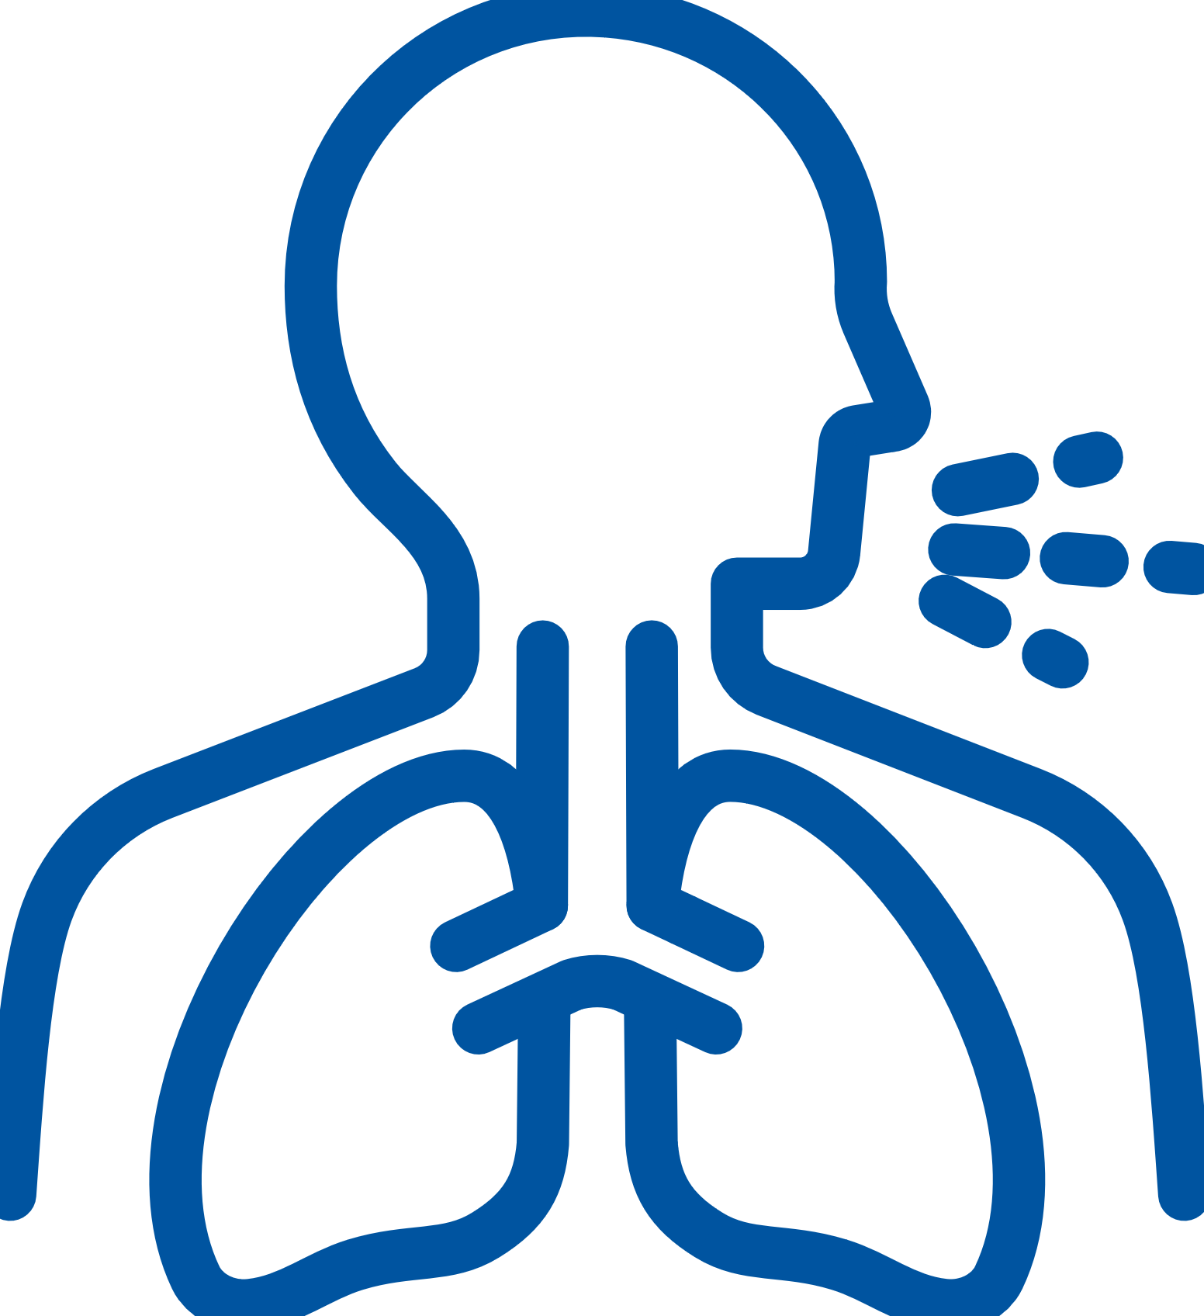


Process of Device Selection
What class of medication(s) is indicated?
What formulations/devices are available?
Can the patient handle the device?
Can the patient perform the correct inhalation maneuver?
If considering a DPI, is peak inspiratory flow sufficient?
Mahler. Ann Am Thorac Soc. 2023;20:1389.
Notes:
DPI, dry powder inhaler.

Slide 46
Key Principles of Device Choice
Patient preferences and prior experiences
Consolidate device types for each patient
Avoid switching devices unnecessarily
Patient cognition, dexterity, and strength
Assess patient’s ability to use device properly: teach-back method
Device size and portability
Access: agent availability, cost, and coverage
Smart inhalers for patients with adherence/persistence issues
Shared decision-making is essential when choosing inhalation device
HCPs should be familiar with all devices they prescribe
goldcopd.org/2024-gold-report.
Notes:
HCP, healthcare professional.

Slide 47
Patient-Specific Considerations With Device Selection
Unnecessary complexity of mixed-device regimens leads to worse outcomes
Single-device regimens enhance adherence and reduce exacerbations
  Continuity of delivery system
  Cognitive ability
  Manual dexterity/coordination
Poor inhaler technique and errors using devices are more common with advancing age, likely reflective of decreasing cognition and dexterity
  Peak inspiratory flow
Recommend assessment when DPI is indicated
Bosnic-Anticevich. Int J Chron Obstruct Pulmon Dis. 2017;12:59.
Halpin. Int J Chron Obstruct Pulmon Dis. 2022;17:2417. Maricoto. Drugs Aging. 2020;37:605.
Notes:
DPI, dry powder inhaler.

Slide 48
Peak Inspiratory Flow Rate Considerations
Objective quantitative measure of maximal airflow generated during inspiration
Sufficient PIFr necessary to disaggregate, aerosolize, and disperse powder formulation within DPIs into respirable particles
Optimal PIFr for low- to medium-resistance DPIs considered to be
≥60 L/min
Suboptimal PIFr linked to poor COPD-related outcomes
Laube. Eur Respir J. 2011;37:1308. Ghosh. J Aerosol Med Pulm Drug Deliv. 2017;30:381. Haidl. Respir Med. 2016;118:65. Loh. Ann Am Thorac Soc. 2017;14:1305. Mahler. Int J Chron Obstruct Pulmon Dis. 2022;17:559.
Notes:
COPD, chronic obstructive pulmonary disease; DPI, dry powder inhaler; PIFr, peak inspiratory flow rate.

Slide 49



Considerations for Each Device Type
Metered-dose inhaler
Requires coordination between activation and inhalation
Ability to perform a slow and deep inhalation is key
Soft mist inhaler
Requires similar coordination and performance as MDI
to a lesser extent
Dry powder inhaler
Requires forceful and deep inhalation
When correct performance is in doubt, add a spacer/valved holding chamber
(for MDI) or choose a different device
goldcopd.org/2024-gold-report.
Notes:
MDI, metered-dose inhaler.

Slide 50




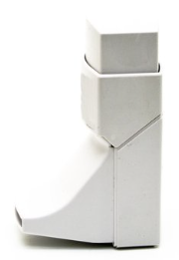
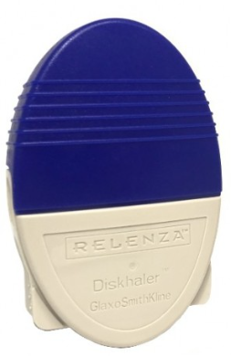

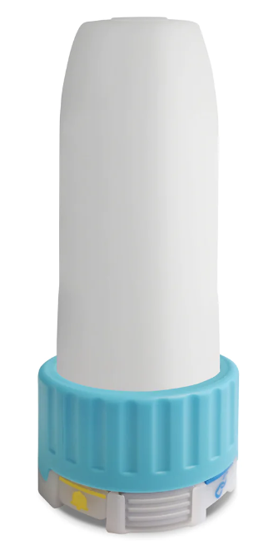

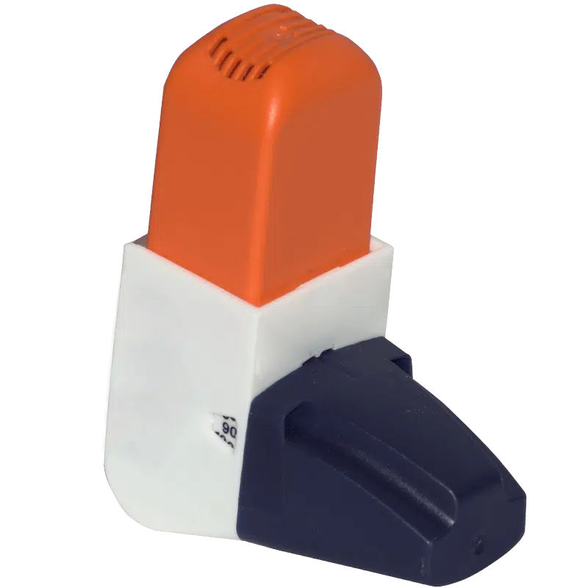
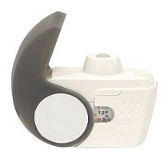

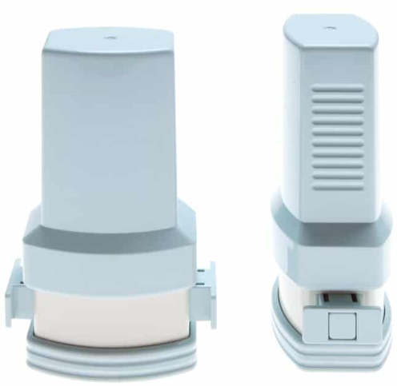
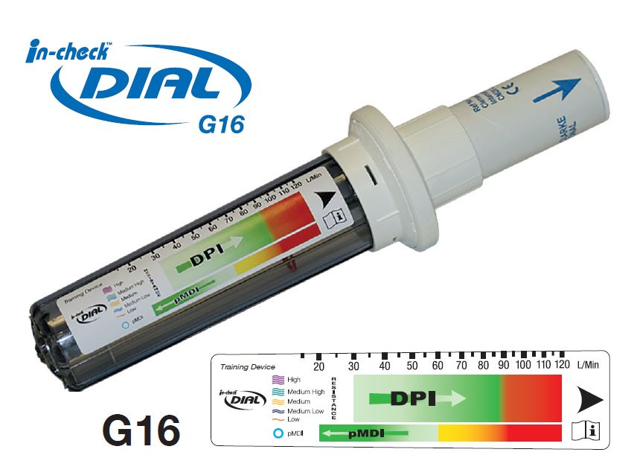

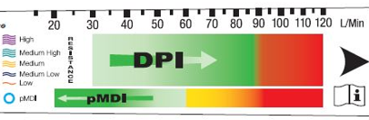
In-Check DIAL
International
HandiHaler
Easyhaler
NEXThaler
Twisthaler
Turbuhaler
Turbuhaler, Flexhaler
Clickhaler
RespiClick, SpiroMax
Novolizer, Genuair, Pressair
Ellipta
Diskhaler
Diskus
Breezhaler, Aerolizer
High
Med high
Medium
Med low
Low
pMDI
Genuair
Turbuhaler S (Symbicort)
Spiromax
Ellipta
Clickhaler
Diskhaler
Accuhaler
Turbuhaler (Pulmicort)
Twisthaler
Breezhaler
NEXThaler
Easyhaler
pMDI
HandiHaler
alliancetechmedical.com/check-dial-training-device.
Notes:
DPI, dry powder inhaler; pMDI, pressurized metered-dose inhaler.

Slide 51
Device Selection and Adherence
Device technique
  ~80% of patients make at least 1 mistake in using an inhalation device
  no matter the device delivery system
Dry Powder Inhalers
Slow Mist Inhalers
Metered-Dose Inhalers
Device preparation
Inhalation maneuver
No breath hold
No full exhale before inhale
No full exhale before inhale
No breath hold
Inhalation maneuver
Device preparation
No full exhale before inhale
Inhalation maneuver
No breath hold
Sanchis. Chest. 2016;150:394. Cho-Reyes. Chron Obstr Pulm Dis. 2019;6:267.
Sulaiman. Am J Respir Crit Care Med. 2017;195:1333. Mahler. Ann Am Thorac Soc. 2023;20:1389.

Slide 52
Device Technique Education
Pharmacists are best in class and accessible
In-check device to teach and then reinforce device-specific inhalation maneuver
“Teach-back” method most effective
Web-based education is available and effective, but retention of education wanes over time
Jia. J Clin Pharm Ther. 2020;45:904. Dantic. Health Educ J. 2014;73:41. asthmaandlung.org.uk/living-with/inhaler-videos.
Klijn. NPJ Prim Care Respir Med. 2017;27:24.

Slide 53
Comprehensive Assessment of Access and Adherence
Adherence to inhaled therapy is generally low
Adherence is more than patient’s engagement in the care process
  Access
  Device technique
Access
  Inhaled therapies are costly
  Pricing reform is needed
  Pharmacists should be aware of and equipped to circumvent cost as
  barrier to care
    Patient assistance programs may be best option at present
Bhattarai. Respir Care. 2020;65:1738. Swiatoniowska. Adv Exp Med Biol. 2020;1271:37.

Slide 54
Optimizing Outcomes Via Improved Adherence
Inadequate inhaler technique results in decreased efficacy and possibly equates to/results in unrecognized nonadherence
Enhanced inhaler technique likely results in improved COPD-related outcomes
  Increased FEV₁
  Reduction of symptoms
  Fewer annual exacerbations
  Reduced healthcare costs
Maricoto. J Bras Pneumol. 2016;42:440. Goris. J Aerosol Med Pulm Drug Deliv. 2013;26:336.
Cushen. Am J Respir Crit Care Med. 2018;197:1630. Leving. Int J Cron Obstruct Pulmon Dis. 2022;17:2401.
Notes:
COPD, chronic obstructive pulmonary disease.

Slide 55
Barriers to COPD Care Optimization
Transitions of Care | Finances | Tools/Resources
Poor communication | Inadequate reimbursement for time-intensive efforts | Lack of adherence to existing evidence/guidelines
Ineffective discharge counseling | Affordability of treatments and healthcare visits | Infective use of EHR
Lack of effective follow-up | Lack of incentive alignment across health systems | Access barriers for oxygen and pulmonary rehabilitation
Limited efforts to engage patients/family | Indirect costs related to care | Use of ED as treatment center
Patient not placed at center of care | Policies limiting access to educators, respiratory therapists, and other HCPs outside of hospital | Insufficient HCP/patient education
Fragmented health systems | Insufficient time for HCP/patient engagements | Lack of dissemination of existing tools
Press. Ann Am Thorac Soc. 2019;16:161. Willard. Chronic Obstr Pulm Dis. 2016;3:778.
Notes:
COPD, chronic obstructive pulmonary disease; ED, emergency department; EHR, electronic health record; HCP, healthcare professional.

Slide 56

Healthcare Disparities in COPD
Most studies describe disparities; there is lack of data to evaluate impact of interventions to address disparities
Healthcare disparities cannot be reduced on individual level, and interventions need to be multifactorial
Interventions should be tailored to:
  Region, to account for:
    Region-specific concerns and resources
    Assessment of clinical suspicion and diagnosis
  Patient, to address actual challenges present for each patient
General socioeconomic, cultural, and environmental conditions
Living and working conditions
Work environment
Unemployment
Social and community networks
Individual lifestyle factors
Water and sanitation
Education
Healthcare services
Agriculture and food production
Age, sex, and constitutional factors
Housing
Harper. Chest. 2023;164:179. Figure adapted from: Dahlgren. Policies and strategies to promote social equity in health. iffs.se/media/1326/20080109110739filmZ8UVQv2wQFShMRF6cuT.pdf.
Notes:
COPD, chronic obstructive pulmonary disease.

Slide 57
Strategies to Address Healthcare Disparities
Patient Level
Education
Environmental mitigation
HCP Level
Educational interventions to address implicit biases
System Level
Clinical trial enrollment should be adjusted for more diversity/inclusion
EHR interventions to provide reminders and standardization
– Telehealth can address access and transportation challenges
– In-person education allows for more tailored education
– Reduction of allergens and pollutants
Policy to address inequity of resources among different groups with varying socioeconomic and political power
– Change in environment
Diversity and inclusion
– Residency/fellowship programs
– Practice sites
– Leadership
Training on use of policies, procedures, and resources
– School admissions
Harper. Chest. 2023;164:179. Capers. J Health Care Poor Underserved. 2018;29:9. Talamantes. NEJM. 2019;380:803.
Notes:
EHR, electronic health record; HCP, healthcare professional.

Slide 58
Navigating Financial Access Barriers
Commercially or Privately Insured
Medicare Part D
Formulary review
  Before prescribing
  To recommend/choose alternative agent
  Collaborating to follow step-therapy
Prior authorization, peer to peer, and appeals
Copay assistance cards
Formulary review
  Before prescribing
  To recommend/choose alternative agent
Assist in applying for Extra Help
Plan for coverage gap
  Find and assist with preparing medication assistance application
Plan for open enrollment
  Important for patients to review and select
  best plan each year during open enrollment (October 15 - December 7)
Uninsured
Find free clinics in your area
  National Association of Free & Charitable Clinics: nafcclinics.org
Find links and information for active copay and medication assistance programs at needymeds.org
needymeds.org. ssa.gov/medicare/part-d-extra-help. medicare.gov. nafcclinics.org.

Slide 59
Best Practices in Improving COPD Care
Comprehensive affordable discharge bundles, 24-hr calls, 7- to 10-day f/u, referral to PR, home visit, smoking cessation, device instruction
Multidisciplinary COPD clinic
Empower pharmacists and respiratory therapists
Patient and family engagement in all decisions, not just education
Screen for, assess, and address comorbidities
Adapted from: Press. Ann Am Thorac Soc. 2019;16:161.
Notes:
COPD, chronic obstructive pulmonary disease; f/u, follow-up; PR, pulmonary rehab.

Slide 60
Improving Transitions of Care
Pre Admission
Patient and family meeting with case management or care coordinator in ED
Admission and Stay
Medication, device, and oxygen reconciliation
Discharge
Medication, device, and oxygen reconciliation
-
-
Post Acute
-
Medication, device, and oxygen reconciliation
Multidisciplinary care team (to include respiratory therapy, pharmacy, and behavioral health) rounds daily with case management team lead
Psychosocial assessment
Multidisciplinary care team with case management team lead
Confirm postacute follow-up appointments
Referrals to pulmonary rehab, palliative care, hospice as appropriate
Coordination between acute and postacute HCP
Ongoing telephonic or home care follow-up with patient and family (within 48 hr)
and PCP visit within 7 days (for high-risk patients, 72 hr)
Diagnosis confirmation via spirometry
Innovative home monitoring (eg, paramedicine, telehealth)
Scheduling of postacute follow-up appointments
At Each Stage
Risk assessment
Patient and family education
Shared decision-making
Find a COPD Transitions of Care Checklist at copdcare.org
Willard. Chronic Obstr Pulm Dis. 2016;3:778. copdcare.org/transition-of-care-checklist.php.
Notes:
COPD, chronic obstructive pulmonary disease; ED, emergency department; PCP, primary care provider.

Slide 61
Multidisciplinary Care Approach: 360° Accountability
Pharmacists’ roles across settings?
  Inpatient
  Ambulatory care
  Community
  Specialty/managed care
Partnering with others for resources
  HCPs
  Manufacturers
360° Accountability
Community Partners
Patient
Primary and Behavioral Health Providers
Family
Administrators
Willard. Chronic Obstr Pulm Dis. 2016;3:778.
Notes:
HCP, healthcare professional.

Slide 62
Create a COPD Action Plan
Instructions: Work with your doctor to complete this section on special medications for use on your Yellow and Red days.
My Green Days
A Normal Day for Me
My breathing is normal
My cough and mucus are normal
My sleeping is normal
My eating and appetite are normal
My activity level is normal
Take Action
I will take all medications as prescribed
I will keep routine doctor appointments
I will use oxygen as prescribed
I will exercise and eat regularly
I will avoid all inhaled irritants and bad air days
I will update my COPD Action Plan every 6 mo
My Yellow Days
A Bad Day for Me
I have a low-grade fever that doesn’t go away
I have increased use of rescue medications without relief
I have a change in color, thickness, odor, or amount of mucus
I am more tired than normal or have trouble sleeping
I have new or more ankle swelling
I am more breathless than normal
I feel like I am catching a cold
Take Action
I will limit my activity and use pursed-lips breathing
I will take regular medications as prescribed
I will report these changes to my doctor today
I will start special medications prearranged with
my doctor, which include:
My
Red Days
A Bad Day When I Need Help Right Away
I have disorientation, confusion, or slurring of speech
I have severe shortness of breath or chest pain
I have a blue color around my lips or fingers
I am coughing up blood
Take Action
I will call 911 right away
I will start these special medications:
Notes:
COPD, chronic obstructive pulmonary disease.

Slide 63
Go Online for More ProCE
Coverage of COPD!
CE-certified text module on integrating novel therapies for the maintenance of COPD
ClinicalThought commentary on GOLD Report updates
proce.com

