Slide 1
Optimizing the Use of BTK Inhibitors in B-Cell Malignancies: Addressing BTK Inhibitor Toxicities
Christopher R. Flowers, MD, MS
Department Chair, Department of Lymphoma/Myeloma
Division of Cancer Medicine
University of Texas MD Anderson Cancer Center
Houston, Texas
Supported by educational grants from AstraZeneca and Beigene, Ltd.

Slide 2

About These Slides
Please feel free to use, update, and share some or all of these slides in your noncommercial presentations to colleagues or patients
When using our slides, please retain the source attribution:
These slides may not be published, posted online, or used in commercial presentations without permission. Please contact permissions@clinicaloptions.com for details
Slide credit: clinicaloptions.com
Notes:
Disclaimer: The materials published on the Clinical Care Options Web site reflect the views of the authors of the CCO material, not those of Clinical Care Options, LLC, the CME providers, or the companies providing educational grants. The materials may discuss uses and dosages for therapeutic products that have not been approved by the United States Food and Drug Administration. A qualified healthcare professional should be consulted before using any therapeutic product discussed. Readers should verify all information and data before treating patients or using any therapies described in these materials.

Slide 3
Faculty Disclosures
Christopher R. Flowers, MD, MS, has disclosed that he has received consulting fees from AbbVie, Bayer, BeiGene, Celgene, Denovo Biopharma, Genentech/ Roche, Genmab, Gilead Sciences, Janssen, Karyopharm, Pharmacyclics, Seattle Genetics, and Spectrum and funds for research support from 4D, AbbVie, Acerta, Adaptimmune, Allogene, Amgen, Bayer, Burroughs Wellcome Fund, Cancer Prevention and Research Institute of Texas: CPRIT Scholar in Cancer Research, Celgene, Cellectis, Eastern Cooperative Oncology Group, EMD, Genentech/Roche, Gilead Sciences, Guardant, Iovance, Janssen, Kite, Morphosys, National Cancer Institute, Nektar, Novartis, Pfizer, Pharmacyclics, Sanofi, Takeda Pharmaceuticals, TG Therapeutics, V Foundation, Xencor, and Ziopharm.
Notes:
This slide lists the disclosure information of the faculty and staff involved in the development of these slides.

Slide 4
Outline
Overview and rationale for the role of BTK inhibitors in hematologic malignancies
The current clinical landscape for BTK inhibitors: MCL, CLL, WM, and MZL
Practical strategies to identify and manage treatment-related adverse events from BTK inhibitor therapy
Notes:
CLL, chronic lymphocytic leukemia; MCL, mantle cell lymphoma; MZL, marginal zone lymphoma; WM, Waldenström macroglobulinemia.

Slide 5
Overview and Rationale: The Role of
BTK Inhibitors in B-Cell Malignancies

Slide 6

B-Cell Malignancies: Cell Types and Associated Diseases
Cell Types¹
Lymphoid progenitor
Associated Diseases
Acute lymphoblastic leukemia²
Blood and Marrow
Pre B-cell
Naive B-cell
Mantle cell lymphoma,
marginal zone lymphoma, CLL³⁻⁵
Secondary Lymphoid Tissues
Activated B-cell
DLBCL⁶
Follicular lymphoma, DLBCL,
Hodgkin’s lymphoma^{6,7}
Germinal-center B-cell
Memory B-cell
Burkitt lymphoma, CLL⁸
Lymphoplasmacytoid
Waldenström macroglobulinemia⁹
Bone Marrow
Multiple myeloma,
amyloidosis¹⁰
Plasma cells
1. Melchers. J Clin Invest. 2015;125:2203. 2. Purizaca. Clin Dev Immunol. 2013;2013:349067. 3. Pileri. Haematologica. 2009;94:1488. 4. Bahler. Am J Pathol. 2002;161:81. 5. Darwiche. Front Immunol. 2018;9:683. 6. Sagaert. Leukemia. 2007;21:1378. 7. Jaffe. Haematologica. 2013;98:1163. 8. Gemenetzi. Front Oncol. 2020;10:67. 9. MedlinePlus. Waldenström macroglobulinemia. Updated August 18, 2020. 10. NCI. Plasma cell neoplasms (including multiple myeloma) treatment (PDQ®)–health professional version. Updated May 14, 2021.
Slide credit: clinicaloptions.com
Notes:
CLL, chronic lymphocytic leukemia; DLBCL, diffuse large B-cell lymphoma.

Slide 7
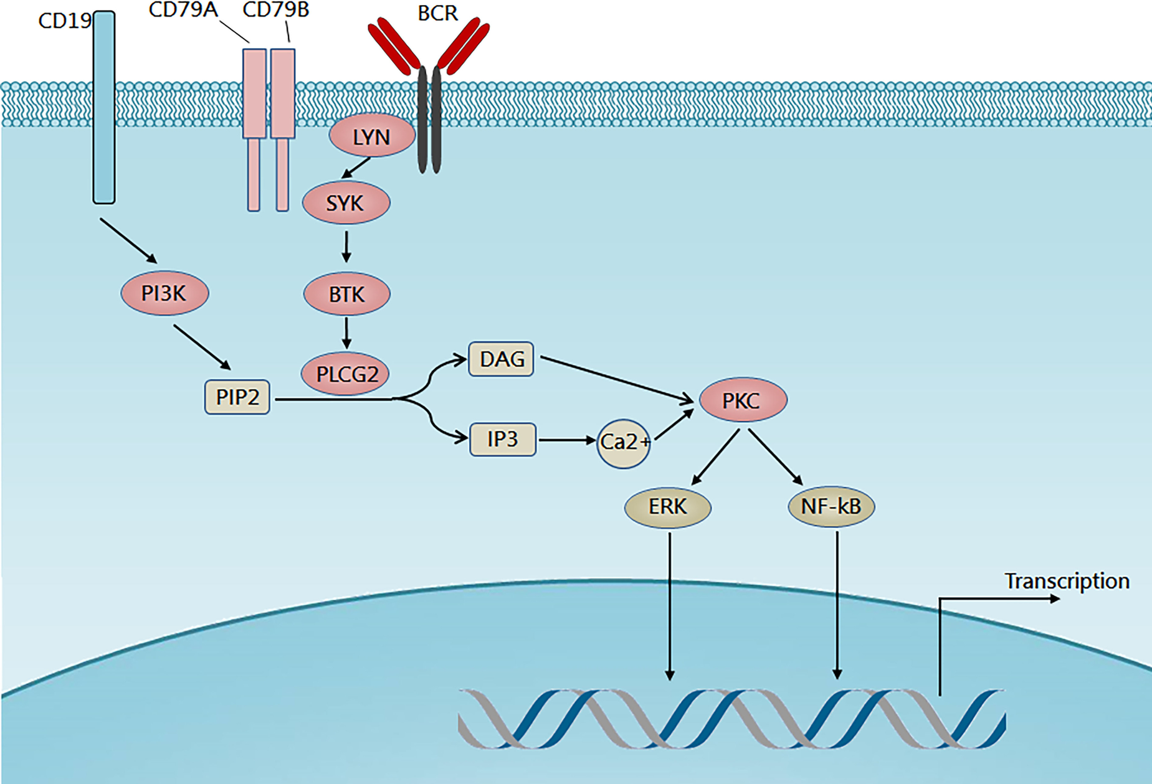
BTK Signaling Pathway
Survival of resting mature
B-cells depend on BCR signaling¹
Some B-cell malignancies depend on tonic BCR signaling for tumor expansion and proliferation²
BTK inhibitors block BCR signaling, induce apoptosis, and inhibit adhesion of malignant B-cells to
microenvironment cells³
1. Kraus. Cell. 2004;117:787. 2. Buchner. Curr Opin Hematol. 2014;21:341. 3. Seda. Eur J Haematol. 2015;94:193.
Figure used under terms and conditions of the Creative Commons Attribution 4.0 International license (CC BY 4.0) from Gu. J Hematol Oncol. 2021;14:40.
Slide credit: clinicaloptions.com

Slide 8
Indications for Available BTK Inhibitors
Ibrutinib
Adults with MCL treated with ≥1 prior tx
Adults with CLL/SLL with or without 17p deletion
Adults with Waldenström macroglobulinemia
Adults with MZL requiring systemic tx and treated with ≥1 prior anti–CD20-based tx
Adults with chronic GVHD after failure of ≥1 lines of systemic tx
Acalabrutinib
Adults with MCL treated with ≥1 prior tx
Adults with CLL/SLL
Zanubrutinib
Adults with MCL treated with ≥1 prior tx
Adults with Waldenström macroglobulinemia
Adults with R/R MZL treated with ≥1 prior anti–CD20-based tx
Ibrutinib PI. Acalabrutinib PI. Zanubrutinib PI.
Slide credit: clinicaloptions.com
Notes:
CLL, chronic lymphocytic leukemia; GVHD, graft-vs-host disease; MCL, mantle cell lymphoma; MZL, marginal zone lymphoma; SLL, small lymphocytic lymphoma; tx, treatment.

Slide 9
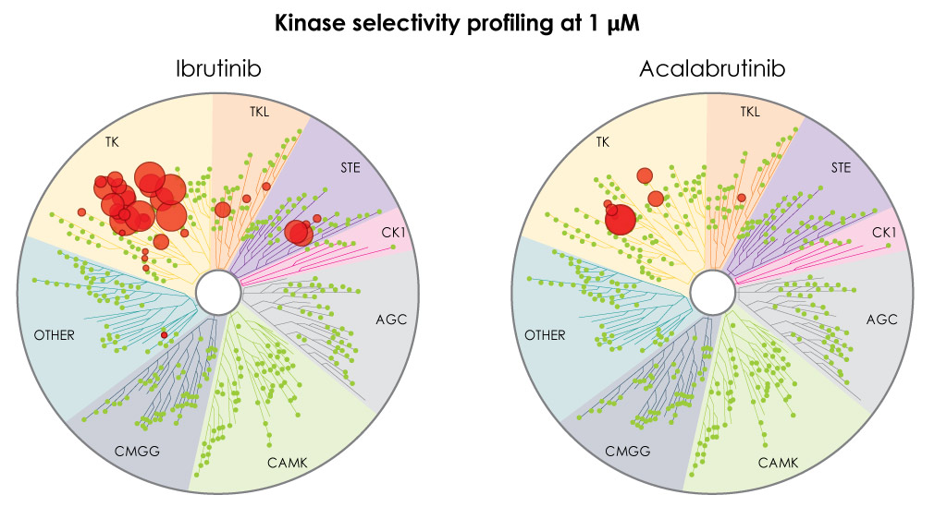
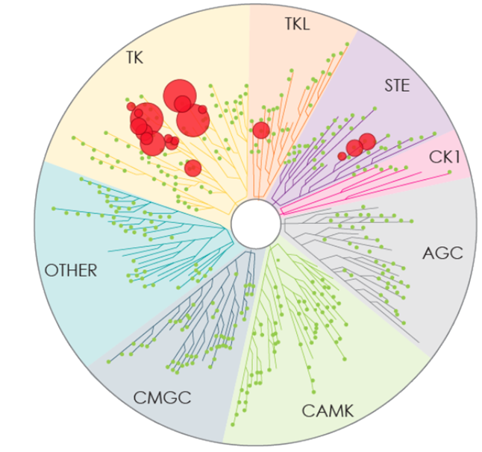

Kinase Selectivity of BTK Inhibitors
Kinase Selectivity Profiling at 1 μmol/L (in vitro)
 | IC₅₀/EC₅₀ (nM)
Kinase | Ibrutinib | Acalabrutinib | Zanubrutinib
BTK | 1.5 | 5.1 | 0.5
TEC | 10 | 126 | 44
ITK | 4.9 | >1000 | 50
BMX | 0.8 | 46 | 1.4
EGFR | 5.3 | >1000 | 21
ERBB4 | 3.4 | 16 | 6.9
JAK3 | 32 | >1000 | 1377
BLK | 0.1 | >1000 | 2.5
Larger red circles represent stronger inhibition
Ibrutinib
Acalabrutinib
Zanubrutinib
Kaptein. ASH 2018. Abstr 1871.
Slide credit: clinicaloptions.com

Slide 10
Alternative Targets of Ibrutinib: Potential AEs
EGFR
  Rash
  Cardiac toxicity
  Diarrhea
ERBB4
  Cardiac toxicity
BMX
  Cardiac toxicity
ITK
  Antibody-dependent cellular cytotoxicity (antibody therapy efficacy)
TEC
  Platelet effects
JAK3
  Immune effects
Berglӧf. Scand J Immunol. 2015;82:208.
Slide credit: clinicaloptions.com
Notes:
AE, adverse event.

Slide 11
Potential Mechanisms of Off-Target Inhibition
Atrial
Fibrillation
Inhibition of
phosphoinositol
3-kinase
Inhibition of platelet
aggregation via
glycoprotein VI
Bleeding
BTKi
Adverse
Events
Inhibition of
interleukin-2–inducible
T-cell kinase, inhibition of
macrophage function
Infection
Unknown, but
possible inhibition of
an alternative target
of ibrutinib
Arthralgia
Stephens. Blood. 2019;133:1298.
Slide credit: clinicaloptions.com

Slide 12
Identification and Management of AEs
Associated With BTK Inhibitor Therapy
Notes:
AE, adverse event.

Slide 13
Adverse Events of Available BTK Inhibitors: Cytopenias, Infection, Bruising and Hemorrhage, Lymphocytosis
Ibrutinib
Cytopenias (Grade 3/4)
Neutropenia 13% to 29% Thrombocytopenia 5% to 17% Anemia 0% to 13%
Infection (Grade 3-5)
14% to 29% of patients
Bruising and Hemorrhage
Bleeding consistent with “hemostatic failure” with bruising and subcutaneous bleeding with minor trauma in up to 50% Grade ≥3 hemorrhage: up to 6%
Lymphocytosis
Up to 77% of patients
Acalabrutinib
Cytopenias (Grade 3/4)
Neutropenia 10% to 23% Thrombocytopenia 5% to 8% Anemia 5% to 11%
Infection (Grade 3-5)
11% to 18% of patients
Bruising and Hemorrhage
Overall, bleeding events including bruising and petechiae of any grade occurred in approximately 30% of patients Grade ≥3 hemorrhage: up to 3%
Lymphocytosis
26% of patients
Zanubrutinib
Cytopenias (Grade 3/4)
Neutropenia 26% Thrombocytopenia 11% Anemia 8%
Infection (Grade 3-5)
27% of patients
Bruising and Hemorrhage
Any-grade hemorrhage: 35% Grade ≥3 hemorrhage: 3.4%
Lymphocytosis
41% of patients
Ibrutinib PI. Acalabrutinib PI. Zanubrutinib PI.
Slide credit: clinicaloptions.com

Slide 14
Adverse Events of Available BTK Inhibitors:
GI, Musculoskeletal, and Other Common AEs
Ibrutinib
Gastrointestinal
Diarrhea 34% to 63% (up to 5% grade ≥3) Nausea 21% to 31% (2% grade ≥3)
Musculoskeletal
Includes pain, arthralgias, myalgias 21% to 37% of patients (up to 6% grade ≥3)
Other Common AEs
Rash 22% to 27% (up to 3% grade ≥3) Fatigue 21% to 41% (up to 5% grade ≥3) Headache 13% to 19% (up to 2% grade ≥3)
Acalabrutinib
Gastrointestinal
Diarrhea 18% to 35% (up to 1.3% grade ≥3) Nausea 22% (0% grade ≥3)
Musculoskeletal
Includes pain, arthralgias, myalgias 16% to 23% of patients (1.1% grade ≥3)
Other Common AEs
Rash 25% (<1% grade 3) Fatigue 15% to 23% (up to 1.9% grade ≥3) Headache 22% to 39% (up to 1.1% grade ≥3)
Zanubrutinib
Gastrointestinal
Diarrhea 22% to 23% (0.8% to 3% grade 3) Nausea 13% to 18% (0% grade ≥3)
Musculoskeletal
Includes pain, arthralgias, myalgias 14% to 45% of patients (1.1% to 9% grade ≥3)
Other Common AEs
Rash 21% to 36% (0% grade ≥3) Fatigue 21% to 31% (1% to 2.3% grade ≥3) Headache 4.2% to 18% (1% grade ≥3)
Ibrutinib PI. Acalabrutinib PI. Zanubrutinib PI.
Slide credit: clinicaloptions.com
Notes:
AE, adverse event; GI, gastrointestinal; NR, not reported.

Slide 15
Adverse Events of Available BTK Inhibitors:
Hypertension, Atrial Fibrillation, and Cardiac Arrhythmias
Ibrutinib
Hypertension up to 19% Incidence of atrial fibrillation: MCL: 11% CLL: 5% (8% all cardiac dysfunction) WM: 2% (7% all cardiac dysfunction)
Acalabrutinib
Hypertension up to 5% Incidence of atrial fibrillation: MCL: 0% (8% other cardiac dysfunction) CLL: 3% WM: 5%
Zanubrutinib
Hypertension 12% to 14% Atrial fibrillation and atrial flutter have occurred in 2.8% (grade ≥3: 0.8%)
Ibrutinib PI. Acalabrutinib PI. Zanubrutinib PI.
Slide credit: clinicaloptions.com
Notes:
CLL, chronic lymphocytic leukemia; MCL, mantle cell lymphoma; WM, Waldenström macroglobulinemia.

Slide 16
BTK Inhibitor AE Management:
Bleeding and Infections
Hemorrhage/Bleeding
  Increased risk of bleeding on concomitant anticoagulant or antiplatelet therapy
  Manage low-grade bleeding with supportive care
  Manage significant bleeding by holding BTK inhibitor, consider platelet transfusion
  Consider risks and benefits of withholding for 3-7 days before and after surgery
  Requires initial and ongoing patient education
Infections
  Cases of progressive multifocal leukoencephalopathy, P jirovecii pneumonia, herpes simplex virus, hepatitis B reactivation have occurred
  Immunocompromise or long-term corticosteroid use increases risk;
  consider prophylaxis
  Monitor and evaluate patients for fever and infections; treat appropriately
  No standard guidelines/ recommendations for antimicrobial prophylaxis
Ibrutinib PI. Acalabrutinib PI. Zanubrutinib PI. Moore. J Adv Pract Oncol. 2021;12:439. Stephens. Blood. 2019;133:1298. Rogers. J Adv Pract Oncol. 2017;8:97. National Comprehensive Cancer Network. Clinical practice guidelines in oncology: chronic lymphocytic leukemia/small lymphocytic lymphoma. v.4.2021. nccn.org. Accessed August 4, 2021.
Slide credit: clinicaloptions.com
Notes:
AE, adverse event.

Slide 17
BTK Inhibitor AE Management: Lymphocytosis, Headache, Rash, and Second Primary Malignancies
Lymphocytosis
  Presents in initial few weeks of therapy, typically resolves within 2 mo
Headache
  Typically low grade, observed early in therapy, and resolves over 1-2 mo
  Generally well managed with analgesics (eg, acetaminophen, caffeine supplements)
  More frequent with acalabrutinib
  Avoid NSAIDs due to increased risk of bleeding
Rash
  May be asymptomatic petechial, or palpable, eruptive pruritic rash with pustules
  Eruptive rash management: topical antihistamines, corticosteroids
  Severe cases may require oral antihistamines or corticosteroids, plus dose interruption or reduction
Second primary malignancies
  Most common: skin cancer
  Advise protection from sun exposure, and encourage regular cancer screening
Ibrutinib PI. Acalabrutinib PI. Zanubrutinib PI. Moore. J Adv Pract Oncol. 2021;12:439. Stephens. Blood. 2019;133:1298. Rogers. J Adv Pract Oncol. 2017;8:97. National Comprehensive Cancer Network. Clinical practice guidelines in oncology: chronic lymphocytic leukemia/small lymphocytic lymphoma. v.4.2021. nccn.org. Accessed August 4, 2021.
Slide credit: clinicaloptions.com
Notes:
AE, adverse event; NSAIDs, nonsteroidal anti-inflammatory drugs.

Slide 18

Risk Factors for Developing Atrial Fibrillation
Hypertension
Heart failure
Diabetes mellitus
Age
Obesity
Excess alcohol consumption
Valvular heart disease, murmur
COPD
Hyperthyroidism
Obstructive sleep apnea
Chronic kidney disease
Acute infections
Careful history and assessment—numerous risk score calculators
Optimize modifiable factors
Reassess on regular basis
Educate patient and caregivers
Stuhlinger. Wien Klin Wochenschr. 2019;132:97. Wiczer. Blood Adv. 2017;1:1739.
www.framinghamheartstudy.org/fhs-risk-functions/atrial-fibrillation-10-year-risk/
Slide credit: clinicaloptions.com
Notes:
COPD, chronic obstructive pulmonary disease.

Slide 19
BTK Inhibitor AE Management: Cardiovascular
Atrial fibrillation/flutter
  Regularly monitor for cardiac arrythmias; ECG if symptoms develop (eg, palpitations, lightheadedness, syncope, chest pain) or new-onset dyspnea
  Cardiology comanagement recommended
  Not an absolute indication to discontinue BTK inhibitors
  Use anticoagulation with caution
  Manage cardiac arrythmias as appropriate
  For persistent atrial fibrillation, consider dose modification
Hypertension
  Document baseline blood pressure
  Monitor for new/
  uncontrolled hypertension
  Initiate hypertensives as needed
  New or worsening hypertension increases risk of major cardiovascular events
Ibrutinib PI. Acalabrutinib PI. Zanubrutinib PI. Rogers. J Adv Pract Oncol. 2017;8:97. Dickerson. Blood. 2019;134:1919.
National Comprehensive Cancer Network. Clinical practice guidelines in oncology: chronic lymphocytic leukemia/small lymphocytic lymphoma. v.4.2021. nccn.org. Accessed August 4, 2021.
Slide credit: clinicaloptions.com

Slide 20
BTK Inhibitor AE Management: Musculoskeletal
Arthralgias/Myalgias
  Usually occur early in treatment course
  Consider acetaminophen or short course of prednisone
  Anti-inflammatory agents (eg, ibuprofen) should be avoided to minimize bleeding
  Transition to selective BTK inhibitor can diminish or resolve arthralgias and myalgias
Other Musculoskeletal AEs
  Musculoskeletal pain
  Muscle spasms
  Treat like arthralgias and myalgias
Ibrutinib PI. Acalabrutinib PI. Zanubrutinib PI. Rogers. J Adv Pract Oncol. 2017;8:97. National Comprehensive Cancer Network. Clinical practice guidelines in oncology: chronic lymphocytic leukemia/small lymphocytic lymphoma. v.4.2021. nccn.org.
Slide credit: clinicaloptions.com
Notes:
AE, adverse event.

Slide 21
Dosing Guidance for Ibrutinib
Dose Modifications
420 mg once daily for CLL/SLL and WM
560 mg once daily for MCL and MZL
If dose is missed, take it as soon as possible on the same day
  Next dose should be taken at regular time on the next day
  Do not take 2 doses in 1 day to make up for a missed dose
Drug–drug interactions with CYP3A inhibitors/inducers
Any grade ≥3 nonheme AEs, grade 3 neutropenia + fever or infection, grade 4 heme AEs
First Occurrence:
Stop ibrutinib until resolves to grade 1 or better
Resume ibrutinib at starting dose
Second Occurrence:
Stop ibrutinib until resolves to grade 1 or better
Resume ibrutinib, reduce dose by 140 mg
Third Occurrence:
Stop ibrutinib until resolves to grade 1 or better
Resume ibrutinib, reduce dose by additional 140 mg
Fourth Occurrence:
Stop ibrutinib permanently
Ibrutinib PI.
Slide credit: clinicaloptions.com
Notes:
AE, adverse event; CLL, chronic lymphocytic leukemia; MCL, mantle cell lymphoma; MZL, marginal zone lymphoma; SLL, small lymphocytic lymphoma; WM, Waldenström macroglobulinemia.

Slide 22
Dosing Guidance for Acalabrutinib
100 mg twice daily (every 12 hr)
Can be taken with or without food
If dose is missed by more than 3 hr, skip that dose and take the next one at the regularly scheduled time
  Do not take extra dose to make up for a missed dose
Drug–drug interactions with CYP3A inhibitors/inducers AND gastric acid reducing agents/proton pump inhibitors
Dose Modifications
Any grade ≥3 nonheme AEs, grade 3 thrombocytopenia + bleeding, grade 4 thrombocytopenia, grade 4 neutropenia >7 days
First or Second Occurrence:
Stop acalabrutinib until resolves to grade 1 or better
Resume acalabrutinib at 100 mg twice daily
Third Occurrence:
Stop acalabrutinib until resolves to grade 1 or better
Resume acalabrutinib at 100 mg once daily
Fourth Occurrence:
Stop acalabrutinib permanently
Acalabrutinib PI.
Slide credit: clinicaloptions.com
Notes:
AE, adverse event.

Slide 23
Dosing Guidance for Zanubrutinib
Dose Modifications
160 mg twice daily or
320 mg once daily
Can be taken with or without food
If dose is missed, take it as soon as possible on the same day
  Next dose should be taken at regular time on the next day
Drug–drug interactions with CYP3A inhibitors/inducers
Any grade ≥3 nonheme AEs, grade 3 febrile neutropenia, grade 3 thrombocytopenia with significant bleeding, grade 4 neutropenia or thrombocytopenia lasting ≥10 days
First Occurrence:
Stop zanubrutinib until resolves to grade 1 or better
Resume zanubrutinib at starting dose
Second Occurrence:
Stop zanubrutinib until resolves to grade 1 or better
Resume zanubrutinib at 80 mg twice daily or 160 mg once daily
Third Occurrence:
Stop zanubrutinib until resolves to grade 1 or better
Resume zanubrutinib at 80 mg once daily
Fourth Occurrence:
Stop zanubrutinib permanently
Zanubrutinib PI.
Slide credit: clinicaloptions.com
Notes:
AE, adverse event.

Slide 24
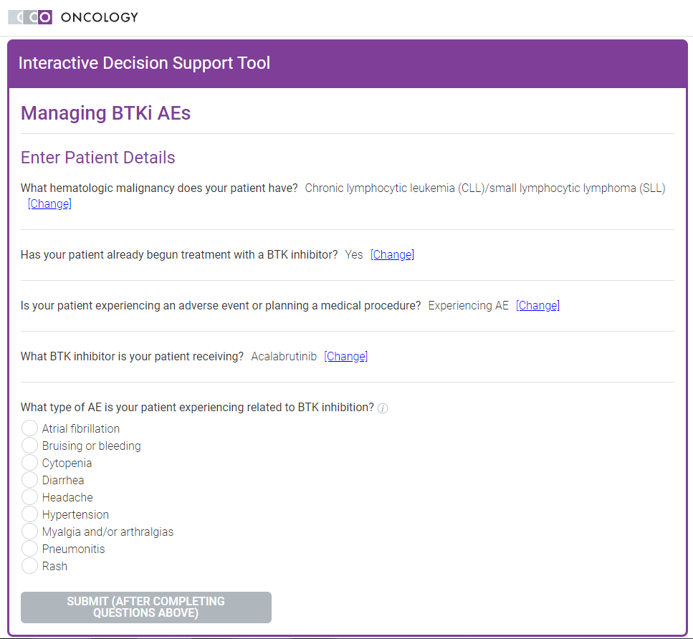
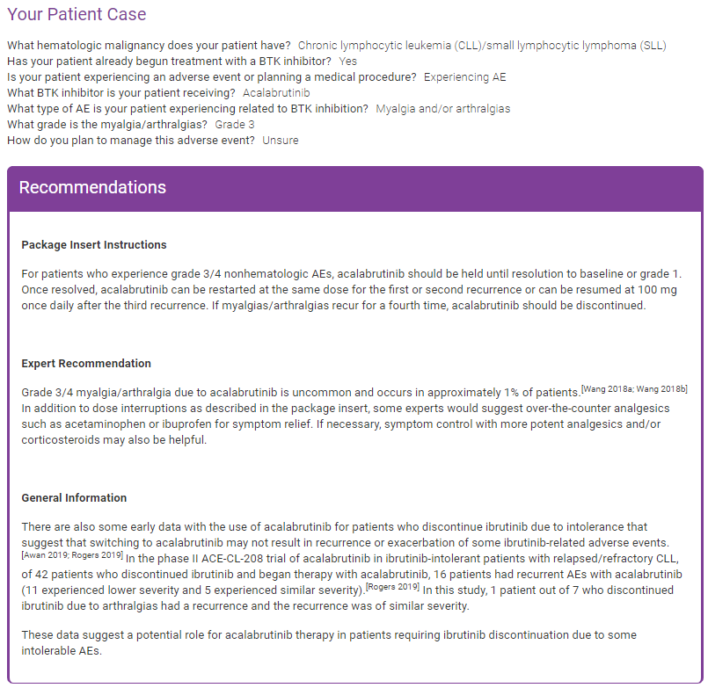

An Interactive Algorithm Tool: Assessment and Management of BTK Inhibitor Adverse Events
To see management recommendations, enter specific type of AE and severity by answering a series of multiple-choice questions
Available at: clinicaloptions.com/BTKiTool
Slide credit: clinicaloptions.com
Notes:
AE, adverse event

Slide 25
Recommendations to Reduce Drug–Food Interactions With BTK Inhibitors
BTK Inhibitor | How Supplied | Recommended Dosage and Administration
Acalabrutinib | 100-mg capsules | 100 mg orally twice daily Can be taken with or without food Advise patients to swallow capsules whole with water
Ibrutinib | Capsules: 70 mg, 140 mg Tablets: 140 mg, 280 mg, 420 mg | Advise patients to swallow capsules whole with water Do not cut, crush, or chew the tablets The administration of ibrutinib with a high-fat and high-calorie meal increased ibrutinib C_{max} by 2- to 4-fold and AUC by approximately 2-fold, compared with administration of ibrutinib after overnight fasting
Zanubrutinib | 80-mg capsules | 160 mg twice daily or 320 mg once daily Can be taken with or without food Advise patients to swallow capsules whole with water
Ibrutinib PI. Acalabrutinib PI. Zanubrutinib PI.
Slide credit: clinicaloptions.com
Acalabrutinib PI. Ibrutinib PI. Zanubrutinib PI.
Notes:
AUC, area under the curve; C_{max}, maximum serum concentration.

Slide 26
Drug–Drug Interactions: CYP450
The CYP450 enzymes are essential for the detoxification of foreign chemicals and the metabolism of drugs
  Most drugs are (largely) metabolized by CYP3A4
Substrate: a biologic enzyme for which a medication has an affinity
Inducer: raises the plasma concentration of another medication that is metabolized by an enzyme
  St John’s wort is a strong inducer of CYP3A
Inhibitor: lowers the plasma concentration of another medication that is metabolized by an enzyme
  Grapefruit juice is a widely known strong inhibitor of hepatic CYP3A
  In general, 1 single grapefruit or 200 mL or more of grapefruit juice can cause relevant escalation of drug concentrations
  Seville oranges have a similar effect; often used in marmalades
Characterization of
Inhibitors and Inducers
Inhibitor/ Inducer | Change in AUC | Clearance of Medication, %
Strong | >5-fold | >80
Moderate | 2- to 5-fold | 50-80
Weak | 1.25- to 2-fold | 20-50
Abbreviation: AUC, area under the curve.
Segal. J Oncol Pract. 2014;10:e255. Veerman. Lancet Oncol. 2020;21:e265.
Slide credit: clinicaloptions.com
Notes:
AUC, area under the curve.

Slide 27
BTK Inhibitor Drug–Drug Interactions
Dosing Recommendation by Inhibitors/Inducers | Ibrutinib | Acalabrutinib | Zanubrutinib
Strong CYP3A inhibitor | Avoid concomitant use Dose modification is recommended If strong inhibitor intended for short-term use (eg, up to 7 days as anti-infectives), hold ibrutinib | Avoid concomitant use Dose modification is recommended If strong inhibitor intended for short-term use (eg, up to 7 days as anti-infectives), hold acalabrutinib | 80 mg once daily Interrupt dose as recommended for adverse reactions
Moderate CYP3A inhibitor | 280 mg once daily | 100 mg once daily | 80 mg twice daily Modify dose as recommended for adverse reactions
Strong CYP3A inducer | Avoid concomitant use | Avoid concomitant use If inducers can not be avoided, increase acalabrutinib dose to 200 mg every 12 hr | Avoid concomitant use
Gastric acid–reducing agents | N/A | Avoid coadministration with proton pump inhibitors Take acalabrutinib 2 hr before an H2 receptor antagonist Separate dosing by at least 2 hr before and after antacids | N/A
Ibrutinib PI.
Slide credit: clinicaloptions.com
Ibrutinib PI. Acalabrutinib PI. Zanubrutinib PI.
Notes:
N/A, not applicable.

Slide 28

RESONATE: Prevalence of Most Grade ≥3 AEs of Clinical Interest With Ibrutinib Decreased Over Time
Prevalence of Grade ≥3 AEs of Clinical Interest Over Time in Ibrutinib Arm (ITT Population)
At a median follow-up of up to
6 yr, extended ibrutinib tx was efficacious in R/R CLL/SLL
  Comparable efficacy in those with high-risk genetic features
Tolerable safety profile with low rate of discontinuation due to AEs
  No new long-term safety signals
Data support long-term benefit, tolerability of continuous ibrutinib for R/R CLL/SLL
Neutropenia
>0-1 yr (n = 195)
>1-2 yr (n = 160)
>2-3 yr (n = 137)
>3-4 yr (n = 103)
>4-5 yr (n = 79)
>5 yr (n = 57)
Anemia
Thrombocytopenia
Pneumonia
Diarrhea
Hypertension
Atrial Fibrillation
Fatigue
Arthralgia
Congestive Heart Failure (Combined Terms)
Peripheral Neuropathy (Combined Terms)
Major Hemorrhage (Combined Terms)
Infections (Combined Terms)
0
10
20
30
40
50
60
70
80
90
100
Patients (%)
Slide credit: clinicaloptions.com
Munir. Am J Hematol. 2019;94:1353.
Notes:
AE, adverse event; CLL, chronic lymphocytic leukemia; ITT, intention-to-treat; R/R, relapsed/refractory; SLL, small lymphocytic lymphoma.

Slide 29
Ibrutinib Intolerance in the “Real World”
Multicenter, retrospective analysis of patients with CLL treated in clinics and clinical trials (N = 616)
Discontinuation rate: 42% after median f/u of 17 mo
Toxicity: 50%
Disease progression: 10-20%
PFS From Start of Ibrutinib (Entire Cohort)
Reasons for Discontinuation (%)
Frontline | Relapsed
Arthralgias (42) | Atrial fibrillation (12.3)
Atrial fibrillation (25) | Infection (11)
Rash (16) | Pneumonitis (10)
 | Bleeding (9)
 | Diarrhea (7)
1.00
0.75
0.50
Median PFS: 36 mo
0.25
n = 592, 168 PFS events, 8649 total mo at risk
0
0
20
Mo
40
60
Mato. Haematologica. 2018;103:874.
Slide credit: clinicaloptions.com
Notes:
CLL, chronic lymphocytic leukemia; f/u, follow up; PFS, progression-free survival.

Slide 30
Risk of Atrial Fibrillation on Ibrutinib
Risk Category Score | Patients, n (%) (N = 588) | Patients With AF, n (%) | HR (95% CI) | Estimated 5-Yr AF Rate, %
 |  |  |  | Median F/u: 15.4 Mo | Median F/u: 7.3 Yr
0-1 | 282 (48.0) | 10 (3.5) | Ref | 0.40 (0.1-2.8) | 1.8 (0.8-2.8)
2-3 | 209 (35.5) | 16 (7.7) | 2.294 (1.016-5.183) | 2.8 (1.2-6.5) | 4.1 (2.5-5.6)
4 | 71 (12.1) | 6 (8.5) | 2.997 (1.089-8.250) | 7.6 (2.9-19.2) | 8.0 (4.8-11.0)
≥ 5 | 26 (4.4) | 4 (15.4) | 3.289 (0.868-12.467) | 17.9 (6.8-42.1) | 17.2 (10.3-23.5)
0.5
0.4
0.3
0.2
0.1
0
Shanafelt Risk Score Category
History of AF
Factor | Points
Age, yr 65-74 ≥75 | 2 3
Male | 1
Valvular disease | 1
HTN | 1
P <.01
Framingham Health Study AF risk score
Cumulative Incidence
of AF
No history of AF
0 1 2 3 4 5
Patients at Risk, n
History of AF 34 10 5 1 1 0
No history of AF 548 333 238 122 50 15
Yr From Start of Ibrutinib
Brown. Haematologica. 2017;102:1796.
Wiczer. Blood Adv. 2017;1:1739.
Slide credit: clinicaloptions.com
Notes:
AF, atrial fibrillation; AF, atrial fibrillation; HTN, hypertension.

Slide 31
Hypertension and MACE on Ibrutinib
Cumulative Incidence of
New Hypertension
Cumulative Incidence of
Hypertension During Ibrutinib
Cumulative Incidence of
MACE Over Time
100
100
15
New or worsened HTN
No or stable HTN
75
75
Cumulative Incidence of New HTN (%)
Cumulative Incidence of Worsened HTN (%)
10
50
50
MACE (%)
25
5
25
0
0
0
0 6 12 18 24 30 36
0 6 12 18 24 30 36
0 6 12 18 24
Mo From Ibrutinib Start
Mo From Ibrutinib Start
Mo From Ibrutinib Start
Patients at Risk, n
New/worse HTN
400 360 317 281 242
No/stable HTN
122 59 46 41 32
Time to 50% cumulative incidence: 4.2 mo
Median follow-up: 31.0 mo
Time to 50% cumulative incidence: 1.1 mo
Median follow-up: 29.3 mo
Dickerson. Blood. 2019;134:1919.
Slide credit: clinicaloptions.com
Notes:
HTN, hypertension; MACE, major adverse cardiovascular event.

Slide 32
Ibrutinib: Risk of Bleeding on Clinical Trials
Bleeding Characteristic, % per 1000 Patient-Mo | Ibrutinib | Comparator
Any bleeding | 53.4 | 24.0
Grade 3 (in CLL) | 2.2 | 2.1
Major hemorrhage (MH): NO anticoag/antiplatelet YES anticoag/antiplatelet | 3 3.5 | 2.2 5.3
50
Ibrutinib
40
30
Cumulative Incidence of First MH (%)
20
Use of AC/AP (50% of patients) increased risk of major bleeding in both ibrutinib and comparator arms
Patients with MCL had higher bleeding risks (HR: 1.8)
10
0
0
10
20
30
40
50
60
70
80
90
100
110
120
130
140
150
Wk
Clinical Management
Impact of platelet aggregation is reversible within 1 wk of discontinuation Recommend holding BTK inhibitor prior to and after invasive procedures for 3 (minor) to 7 days (major) Anticoagulants and antiplatelet agents (aspirin, clopidogrel, prasugrel, ticagrelor) may increase bleeding risk
Brown. Br J Haematol. 2019;184:558.
Slide credit: clinicaloptions.com
Notes:
AC/AP, anticoagulants/antiplatelet agents; CLL, chronic lymphocytic leukemia; MCL, mantle cell lymphoma; MH, major hemorrhage.

Slide 33

Phase III E1912 Trial of First-line Ibrutinib + R in Younger Patients With CLL: Grade 3-5 TRAEs
Grade 3-5 Treatment-Related AE Throughout Observation, % | Ibrutinib + R (n = 352) | FCR (n = 158) | P Value
Any grade ≥3 AE | 58.5 | 72.1 | .004
Neutropenia | 22.7 | 43.7 | <.001
Anemia | 2.6 | 12.0 | <.001
Thrombocytopenia | 2.9 | 13.9 | <.001
Any infection Infection Neutropenic fever | 7.1 5.4 2.3 | 19.0 8.2 15.8 | <.001 .24 <.001
Atrial fibrillation | 2.9 | 0.0 | .04
Bleeding | 1.1 | 0.0 | .32
Hypertension | 7.4 | 1.9 | .01
Diarrhea | 2.6 | 0.6 | .19
With ibrutinib + R vs FCR, significantly higher rates of AF, HTN (both P <.05); significantly lower rates of grade ≥3 AEs, myelosuppression, any infection, neutropenic fever (all P ≤.004)
Shanafelt. NEJM. 2019;381:432.
Slide credit: clinicaloptions.com
Notes:
AE, adverse event; AF, atrial fibrillation; CLL, chronic lymphocytic leukemia; FCR, fludarabine/cyclophosphamide/rituximab; HTN, hypertension; R, rituximab; TRAE, treatment-related adverse event.

Slide 34
Phase III Alliance A041202 Trial of First-line Ibrutinib ± R vs BR in Older Patients With CLL: Safety
Grade 3-5 AEs During Treatment or Follow-up,* n (%) | Ibrutinib (n = 180) | Ibrutinib + R (n = 181) | BR (n = 176) | P Value
Any hematologic Anemia Neutropenia Thrombocytopenia | 74 (41) 21 (12) 27 (15) 12 (7) | 70 (38) 11 (6) 39 (22) 9 (5) | 107 (61) 22 (13) 71 (40) 26 (15) | <.001 .09 <.001 .008
Any nonhematologic Bleeding Infections Febrile neutropenia Atrial fibrillation Hypertension | 133 (74) 3 (2) 37 (21) 3 (2) 17 (9) 53 (29) | 134 (74) 5 (3) 37 (20) 1 (1) 10 (6) 61 (34) | 111 (63) 0 26 (15) 13 (7) 5 (3) 25 (14) | .04 .46 .62 <.001 .05 <.001
Death Unexplained/unwitnessed During active treatment + 30 days During active treatment + 30 days, up to 6 cycles | 7 (4) 13 (7) 3 (2) | 4 (2) 13 (7) 6 (3) | 2 (1) 2 (1) 2 (1) | .24 -- --
*Excludes crossover.
Woyach. ASH 2018. Abstr 6. Woyach. NEJM. 2018;379:2517.
Slide credit: clinicaloptions.com
Notes:
AE, adverse event; BR, bendamustine/rituximab; CLL, chronic lymphocytic leukemia; R, rituximab.

Slide 35
ACE-CL-001: Select AEs Over Time With Acalabrutinib in CLL
50
45
44
≤1 yr (n = 99)
1-2 yr (n = 96)
2-3 yr (n = 93)
3-4 yr (n = 87)
40
35
33
30
25
24
Patients (%)
23
22
20
19
20
17
16
16
15
12
10
10
8
7
6
6
6
6
5
5
3
4
3
3
2
1
1
2
0
Diarrhea
Headache
URTI
Contusion
Arthralgia
Petechiae
Ecchymosis
HTN
In general, AEs more common in first yr of acalabrutinib treatment
Byrd. Blood. 2021;[Epub]. Byrd. ASH 2018. Abstr 692.
Slide credit: clinicaloptions.com
Notes:
AE, adverse event; CLL, chronic lymphocytic leukemia; HTN, hypertension; URTI, upper respiratory tract infection.

Slide 36
ACE-CL-001: Results in Ibrutinib-Intolerant Cohort
N = 33 heavily pretreated patients with CLL treated with acalabrutinib
  23 remained on acalabrutinib at median of
  19 mo on treatment
  No acalabrutinib dose reductions
61 ibrutinib-related AEs associated with intolerance at study entry
  No recurrence: 72%
  Recurrence at lower grade than with acalabrutinib: 13%
ORR: 76%
Median PFS: not reached
  1-yr PFS rate: 83.4%
Recurrence of Ibrutinib-Related AEs During Acalabrutinib Tx (n = 61 Ibrutinib-Related AEs)
Higher grade 3%
Recurred
28%
Same
grade
11%
Lower grade
13%
Did not recur
72%
Awan. Blood Adv. 2019;3:1553.
Slide credit: clinicaloptions.com
Notes:
AE, adverse event; CLL, chronic lymphocytic leukemia; ORR, overall response rate; PFS, progression-free survival; Tx, treatment.

Slide 37
ELEVATE-RR: Most Common AEs With Acalabrutinib vs Ibrutinib in Previously Treated CLL
Most Common AEs,* n (%) | Acalabrutinib (n = 266) |  | Ibrutinib (n = 263)
 | Any Grade | Grade ≥3 | Any Grade | Grade ≥3
Diarrhea | 92 (34.6) | 3 (1.1) | 121 (46.0) | 13 (4.9)
Headache | 92 (34.6) | 4 (1.5) | 53 (20.2) | 0
Cough | 77 (28.9) | 2 (0.8) | 56 (21.3) | 1 (0.4)
URTI | 71 (26.7) | 5 (1.9) | 65 (24.7) | 1 (0.4)
Pyrexia | 62 (23.3) | 8 (3.0) | 50 (19.0) | 2 (0.8)
Anemia | 58 (21.8) | 31 (11.7) | 49 (18.6) | 34 (12.9)
Neutropenia | 56 (21.1) | 52 (19.5) | 65 (24.7) | 60 (22.8)
Fatigue | 54 (20.3) | 9 (3.4) | 44 (16.7) | 0
Arthralgia | 42 (15.8) | 0 | 60 (22.8) | 2 (0.8)
Hypertension | 23 (8.6) | 11 (4.1) | 60 (22.8) | 23 (8.7)
Nausea | 41 (17.7) | 0 | 49 (18.6) | 1 (0.4)
Pneumonia | 47 (17.7) | 28 (10.5) | 43 (16.3) | 23 (8.7)
Thrombocytopenia | 40 (15.0) | 26 (9.8) | 35 (13.3) | 18 (6.8)
Dyspnea | 37 (13.9) | 6 (2.3) | 23 (8.7) | 1 (0.4)
Bronchitis | 34 (12.8) | 3 (1.1) | 23 (8.7) | 2 (0.8)
Most Common AEs,* n (%) | Acalabrutinib (n = 266) |  | Ibrutinib (n = 263)
 | Any Grade | Grade ≥3 | Any Grade | Grade ≥3
Constipation | 31 (11.7) | 0 | 37 (14.1) | 2 (0.8)
Contusion | 31 (11.7) | 0 | 48 (18.3) | 1 (0.4)
Nasopharyngitis | 29 (10.9) | 0 | 27 (10.3) | 0
Dizziness | 28 (10.5) | 0 | 26 (9.9) | 0
Vomiting | 28 (10.5) | 1 (0.4) | 36 (13.7) | 3 (1.1)
Peripheral edema | 26 (9.8) | 0 | 38 (14.4) | 1 (0.4)
Rash | 26 (9.8) | 2 (0.8) | 33 (12.5) | 0
Myalgia | 25 (9.4) | 2 (0.8) | 27 (10.3) | 1 (0.4)
Atrial fibrillation | 24 (9.0) | 12 (4.5) | 41 (15.6) | 9 (3.4)
UTI | 22 (8.3) | 3 (1.1) | 36 (13.7) | 6 (2.3)
Back pain | 20 (7.5) | 0 | 34 (12.9) | 2 (0.8)
Epistaxis | 19 (7.1) | 1 (0.4) | 28 (10.6) | 1 (0.4)
Muscle spasms | 16 (6.0) | 0 | 35 (13.3) | 2 (0.8)
Dyspepsia | 10 (3.8) | 0 | 32 (12.2) | 0
Bolded numbers significantly higher vs the comparator (P <.05).
*Of any grade in ≥10% of grade ≥3 in ≥5% of patients in either arm.
Deaths due to AEs occurred in 28 (10.5%) patients with acalabrutinib vs 33 (12.5%) with ibrutinib: infections and infestations, 4.5% vs 5.7%; cardiac disorders, 0.4% vs 0.8%; renal failure, 0.4% vs 0.4%; 0.4% vs 0% each for pyrexia, cerebrovascular accident, dyspnea; 0% vs 0.4% each for sudden cardiac death, respiratory failure, GI disorders, cachexia, TLS, lung adenocarcinoma, circulatory collapse
Byrd. JCO. 2021;[Epub].
Slide credit: clinicaloptions.com
Notes:
AEs, adverse events; GI, gastrointestinal; TLS, tumor lysis syndrome; URTI, upper respiratory tract infection; UTI, urinary tract infection.

Slide 38
ELEVATE-RR: Select AEs of Clinical Interest
AE, n (%) | Acalabrutinib (n = 266) |  | Ibrutinib (n = 263)
 | Any Grade | Grade ≥3 | Any Grade | Grade ≥3
Cardiac events Atrial fibrillation/flutter Ventricular arrhythmia | 64 (24.1) 25 (9.4) 0 | 23 (8.6) 13 (4.9) 0 | 79 (30.0) 42 (16.0) 1 (0.4) | 25 (9.5) 10 (3.8) 0
Bleeding events Major bleeding events | 101 (38.0) 12 (4.5) | 10 (3.8) 10 (3.8) | 135 (51.3) 14 (5.3) | 12 (4.6) 12 (4.6)
Hypertension | 25 (9.4) | 11 (4.1) | 61 (23.2) | 24 (9.1)
Infections | 208 (78.2) | 82 (30.8) | 214 (81.4) | 79 (30.0)
ILD/pneumonitis | 7 (2.6) | 1 (0.4) | 17 (6.5) | 2 (0.8)
SPMs, excluding NMSC | 24 (9.0) | 16 (6.0) | 20 (7.6) | 14 (5.3)
Bolded numbers significantly higher vs the comparator (P <.05).
Most common grade ≥3 infections: pneumonia (acalabrutinib vs ibrutinib, 10.5% vs 8.7%), sepsis (1.5% vs 2.7%), and urinary tract infections (1.1% vs 2.3%)
Byrd. JCO. 2021;[Epub].
Slide credit: clinicaloptions.com
Notes:
AE, adverse event; ILD, interstitial lung disease; NMSC, nonmelanoma skin cancer; SPMs, second primary malignancies.

Slide 39
ALPINE: AEs of Clinical Interest With Zanubrutinib vs Ibrutinib in Relapsed/Refractory CLL
Select AEs of Any Grade, % | Zanubrutinib (n = 207) | Ibrutinib (n = 208)
Atrial fibrillation or flutter | 2.5 | 10.1
Cardiac disorders | 13.7 | 25.1
Hemorrhage | 35.8 | 36.2
Major hemorrhage | 2.9 | 3.9
Hypertension | 16.7 | 16.4
Infections | 59.8 | 63.3
Neutropenia | 28.4 | 21.7
Secondary primary malignancies | 8.3 | 6.3
Skin cancers | 3.4 | 4.8
Thrombocytopenia | 9.3 | 12.6
Hillmen. EHA 2021. Abstr 1900.
Slide credit: clinicaloptions.com
Notes:
AE, adverse event; CLL, chronic lymphocytic leukemia; R/R, relapsed/refractory.

Slide 40
ASPEN: AEs of Interest With Zanubrutinib vs Ibrutinib in Waldenström Macroglobulinemia
AE of Interest, Events/100 Person-Mo | Zanubrutinib (n = 101) |  | Ibrutinib (n = 98)
 | All Grade | Grade ≥3 | All Grade | Grade ≥3
Infections Opportunistic infections | 8.3 0.1 | 1.2 0 | 7.9 0.1 | 1.1 0.1
Bleeding Major hemorrhage | 7.0* 0.6 | 0.5 0.5 | 4.4 0.3 | 0.3 0.3
Hypertension | 1.2 | 0.8 | 0.7 | 0.3
Atrial fibrillation/flutter | 1.0* | 0.2* | 0.1 | 0
Neutropenia | 0.9* | 0.5* | 2.1 | 1.3
Thrombocytopenia | 0.8 | 0.2 | 0.6 | 0.3
Second primary malignancies Skin cancers | 0.7 0.6 | 0.1 0 | 0.7 0.5 | 0.1 0
Anemia | 0.6 | 0.3 | 0.7 | 0.3
Tumor lysis syndrome | 0 | 0 | 0 | 0
*2-sided P ≤.05 vs ibrutinib without multiplicity adjustment.
Tam. Blood. 2020;136:2038.
Slide credit: clinicaloptions.com

Slide 41
BGB-3111-206 Trial: Safety of Zanubrutinib in R/R MCL
Any-Grade TEAEs in ≥5% of Patients or
Grade ≥3 TEAEs in ≥2 Patients¹
Safety Outcomes² | Patients (N = 86)
Grade ≥3 AEs, % | 41.9
AEs leading to tx discontinuation, n (%) | 8 (9.3)
AEs leading to death, n (%) | 6 (7.0)*
Grade ≥3 AEs of special interest, n (%) Infections Hypertension Major hemorrhage Atrial fibrillation/flutter | 12 (14.0) 3 (3.5) 1 (1.2) 0
Neutrophil count decreased
Rash
Upper respiratory tract infection
Platelet count decreased
White blood cell decreased
Anemia
Hypokalemia
Diarrhea
Alanine aminotransferase increased
Hypertension
Weight increased
Neutropenia
Hyperuricemia
Lung infection
Cough
Toothache
Constipation
Hyperglycemia
Urinary tract infection
Blood creatinine increased
Pneumonia
Peripheral swelling
Gr ≥3: 0%
Gr ≥3: 2.3%
Grade 1/2
Grade ≥3
*n = 1 each for left occipital lobe hemorrhage, pneumonia, traffic accident; unknown causes, n = 3.
0
10
20
30
40
50
Patients (%)
1. Song. ASH 2018. Abstr 148. 2. Song. Clin Cancer Res. 2020;26:4216.
Slide credit: clinicaloptions.com
Notes:
AE, adverse event; MCL, mantle-cell lymphoma; R/R, relapsed/refractory; TEAE, treatment-emergent adverse event.

Slide 42

Conclusions
BTK inhibitors have shown potent efficacy for treatment of CLL, MCL, MZL, and WM
  Ibrutinib (first-generation BTK inhibitor) indicated in CLL, MCL, MZL, and WM
  Acalabrutinib (second-generation BTK inhibitor) indicated in MCL and CLL
  Zanubrutinib (third-generation BTK inhibitor) indicated in MCL and WM
BTK inhibitors are generally well tolerated but can be associated with treatment-related AEs such as diarrhea, bleeding, rash, and atrial fibrillation
Open-ended treatment requires ongoing diligent management of AEs to ensure best outcomes
Selecting optimal BTK inhibitor therapy for patients with CLL, MCL, MZL, and WM should be based on efficacy, safety profiles as well as patient preferences and comorbidities
Slide credit: clinicaloptions.com
Notes:
AE, adverse event; CLL, chronic lymphocytic leukemia; MCL, mantle cell lymphoma; MZL, marginal zone lymphoma; WM, Waldenström macroglobulinemia.

Slide 43
Go Online for More CCO
Coverage of BTK Inhibitor Therapy!
CME/CE/CPE-certified text module on identification and management of adverse events
ClinicalThought™ with expert faculty commentary on the nurse’s role in counseling patients
Downloadable resource for patients and caregivers on monitoring for adverse events when receiving BTK inhibitor therapy
Interactive Decision Support Tool featuring recommendations from
5 experts on managing adverse events customized to individual
patient scenarios
clinicaloptions.com/oncology
clinicaloptions.com/BTKitool

