Slide 1
Updated Results From Phase I/II MajesTEC-1 Study: Teclistamab, a BCMA x CD3 Bispecific Antibody, in Relapsed/Refractory Multiple Myeloma
CCO Independent Conference Coverage Highlights*
of the 2021 ASH Annual Meeting, December 11-14, 2021
Atlanta, Georgia
*CCO is an independent medical education company that provides state-of-the-art medical information to healthcare professionals through conference coverage and other educational programs.
This program is supported by educational grants from AbbVie; AstraZeneca; Daiichi Sankyo, Inc.; GlaxoSmithKline; Incyte Corporation; Jazz Pharmaceuticals; Merck Sharp & Dohme Corp.; and Novartis Pharmaceuticals Corporation.
Notes:
BCMA, B-cell maturation agent; MM, multiple myeloma; R/R, relapsed refractory.

Slide 2

About These Slides
Please feel free to use, update, and share some or all of these slides in your noncommercial presentations to colleagues or patients
When using our slides, please retain the source attribution:
These slides may not be published, posted online, or used in commercial presentations without permission. Please contact permissions@clinicaloptions.com for details
Slide credit: clinicaloptions.com
Notes:
Disclaimer: The materials published on the Clinical Care Options Web site reflect the views of the authors of the CCO material, not those of Clinical Care Options, LLC, the CME providers, or the companies providing educational grants. The materials may discuss uses and dosages for therapeutic products that have not been approved by the United States Food and Drug Administration. A qualified healthcare professional should be consulted before using any therapeutic product discussed. Readers should verify all information and data before treating patients or using any therapies described in these materials.

Slide 3
MajesTEC-1: Background
Triple class–exposed patients with R/R MM still in need of novel therapies despite newly approved agents^{1,2}
Teclistamab (JNJ-64007957): off-the-shelf, investigational BCMA x CD3 bispecific antibody^{3,4}
  Engineered to enhance the immune response against tumor cells by binding to CD3 on T-cells and BCMA on plasma cells, promoting T-cell–mediated killing of BCMA-positive myeloma cells
Phase I/II MajesTEC-1: first-in-human, dose-escalation/dose-expansion trial of teclistamab SC in patients with R/R MM^{3,4}
  Initial phase I results identified RP2D as 1.5 mg/kg QW with step-up doses of 0.06 and
  0.3 mg/kg³
Current analysis reports updated phase I/II MajesTEC-1 data for teclistamab SC in patients with R/R MM at 1.5-mg/kg dose⁴
1. Mateos. ASCO 2021. Abstr 8041. 2. Costa. ASCO 2021. Abstr 8030. 3. Usmani. Lancet. 2021;398:665. 4. Moreau. ASH 2021. Abstr 896.
Slide credit: clinicaloptions.com
Notes:
BCMA, B-cell maturation agent; MM, multiple myeloma; RP2D, recommended phase II dose; R/R, relapsed refractory; SC, subcutaneous.

Slide 4
MajesTEC-1: Study Design
First-in-human, open-label, dose-escalation/dose-expansion phase I/II trial
  Median follow-up: 7.8 mo (range: 0.5+ to 18); data cutoff: September 7, 2021
Patients with R/R MM who received ≥3 prior lines of therapy and were triple-class exposed (ie, received IMiD, PI, and anti-CD38 mAb);
no prior BCMA therapy
(N = 165)
Week 1
Cycles 1+
Continue until PD, intolerance, withdrawal, physician decision, or death
F/u 2 yr after LPI
Teclistamab
step-up doses of
0.06 and 0.3 mg/kg SC
Teclistamab
1.5 mg/kg SC
once weekly
Primary endpoint: ORR
Key secondary endpoints: DoR, ≥VGPR, ≥CR, sCR, TTR, MRD status, PFS, OS, safety, PK, immunogenicity, PROs
Moreau. ASH 2021. Abstr 896. NCT03145181. NCT04557098.
Slide credit: clinicaloptions.com
Notes:
CR, complete response; DoR, duration of response; F/u, follow-up; IMiD, immunomodulatory agent; LPI, last patient in; mAb, monoclonal antibody; MM, multiple myeloma; MRD, measurable residual disease; ORR, objective response rate; OS, overall survival; PD, progressive disease; PFS, progression-free survival; PI, proteasome inhibitor; PK, pharmacokinetics; PRO, patient-reported outcome; R/R, relapsed refractory; sCR, stringent complete response; TTR, time to response; VGPR, very good partial response.

Slide 5
MajesTEC-1: Treatment Disposition
All Patients
N = 165
Median treatment duration for patients in primary safety analysis: 5.9 mo (range: 0.2-18.0)
  46.7% received ≥6 mo of treatment
  16.4% received ≥9 mo of treatment
No dose reductions
Phase 1: 1.5 mg/kg
n = 40
Phase 2: 1.5 mg/kg cohort
n = 125
Discontinued, n = 20
Progressive disease, n = 16
Physician decision, n = 3
Patient withdrawal, n = 1
Discontinued, n = 50
Progressive disease, n = 29
Death, n = 9
Physician decision, n = 7
Patient withdrawal, n = 4
AE, n = 1
Ongoing, n = 20
Ongoing, n = 75
Patients, n | Phase I Cohort | Phase II Cohort | Total Patients
Primary efficacy analysis* | 40 | 110 | 150
Primary safety analysis† | 40 | 125 | 165
*Includes all patients who received ≥1 dose before March 18, 2021.
†Includes all patients enrolled before data cutoff of September 7, 2021.
Moreau. ASH 2021. Abstr 896.
Slide credit: clinicaloptions.com
Notes:
AE, adverse event;

Slide 6
MajesTEC-1: Baseline Characteristics
Characteristic | All Patients (N = 165)
Median age, yr (range) Age ≥75 yr, n (%) | 64.0 (33-84) 24 (14.5)
Male, n (%) | 96 (58.2)
Race, n (%) White Black Other | 134 (81.2) 21 (12.7) 10 (6.1)
BM plasma cells ≥60%, n (%)* | 18 (11.3)
Extramedullary plasmacytomas ≥ 1, n (%)† | 28 (17.0)
High-risk cytogenetics, n (%)‡ | 38 (25.9)
ISS stage at BL, n (%)§ I II III | 85 (52.5) 57 (35.2) 20 (12.3)
Characteristic | All Patients (N = 165)
eGFR < 60 mL/min/1.73 m², n (%) | 44 (26.7)
Median time since dx, yr (range) | 6.0 (0.8-22.7)
Median prior lines of therapy, n (range) | 5 (2-14)
Prior SCT, n (%) | 135 (81.8)
Exposure status, n (%) Triple class exposed‖ Penta drug exposed¶ Selinexor | 165 (100) 116 (70.3) 6 (3.6)
Refractory status, n (%) Triple class refractory‖ Penta drug refractory¶ Refractory to last line of therapy | 128 (77.6) 50 (30.3) 148 (89.7)
*n = 160; includes bone marrow biopsy and aspirate. †Included soft-tissue plasmacytomas not associated with bone. ‡n = 147; del(17p), t(4:14), and/or t(14;16). §n = 162. ‖≥1 PI, ≥1 IMiD, ≥1 anti-CD38 mAb.
¶≥2 PI, ≥2 IMiD, ≥1 anti-CD38 mAb.
Moreau. ASH 2021. Abstr 896.
Slide credit: clinicaloptions.com
Notes:
BL, baseline; BM, bone marrow; dx, diagnosis; eGFR, estimated glomerular filtration rate; IMiD, immunomodulatory drug; ISS, International Staging System; mAb, monoclonal antibody; PI, proteasome inhibitor; SCT, stem cell transplant.

Slide 7
MajesTEC-1: Efficacy Outcomes
ORR
Event | All Patients (N = 165)
MRD negativity, n (%, 95% CI) At 10⁻⁵ At 10⁻⁶ | (n = 150) 37 (24.7; 18.0-32.4) 25 (16.7; 11.1-23.6)
MRD negativity with ≥CR, % | 41.9
Median TTR, mo (range) | 1.2 (0.2-5.5)
Median DoR, mo | Not yet reached
EFS rates, % (95% CI) 6-Mos 9-Mos | 92.5 (80.6-97.2) 85.9 (70.0-93.7)
PFS rates, % (95% CI) 6-Mos 9-Mos | 64.4 (56.0–71.7) 58.5 (48.8–67.0)
Median OS | Not yet reached
93 of 150 pts
62.0% (95% CI: 53.7-69.8)
sCR:
21.3%
≥CR:
28.7%
Patients (%)
≥VGPR:
58.0%
  Efficacy Analysis Subset
Median follow-up: 7.8 mos (range: 0.5+ to 18)
Moreau. ASH 2021. Abstr 896. Reproduced with permission.
Slide credit: clinicaloptions.com
Notes:
CR, complete response; DoR, duration of response; MRD, measurable residual disease; ORR, objective response rate; OS, overall survival; PFS, progression-free survival; PR, partial response; sCR, stringent complete response; TTR, time to response; VGPR, very good partial response.

Slide 8
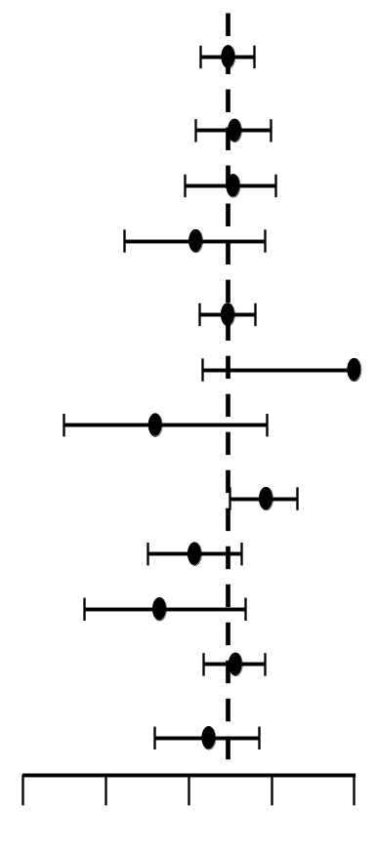
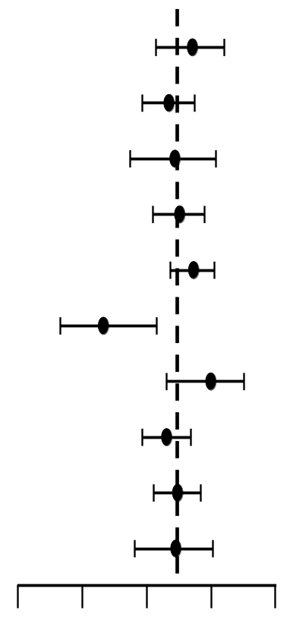
MajesTEC-1: ORR Across Subgroups
Subgroup
Patients, n
ORR (95% CI)
Subgroup
Patients, n
ORR (95% CI)
Overall
150
Baseline ECOG performance status
Age
0
53
<65 yr
75
≥1
97
65-75 yr
52
Cytogenetic risk
≥75 yr
23
High risk
36
Race
Standard risk
97
White
134
Extramedullary plasmacytomas
Black
6
0
123
Other
10
≥1
27
Baseline ISS
Prior Lines of therapy
I
79
≤3
36
II
52
Ill
17
>3
114
Baseline renal function
Refractory status
>60 mL/min/1.73m²
109
Triple class
116
≤60 mL/min/1.73m²
41
Penta drug
44
0
25
50
75
100
0
25
50
75
100
Percent
Percent
Moreau. ASH 2021. Abstr 896. Reproduced with permission.
Slide credit: clinicaloptions.com
Notes:
ECOG, Eastern Cooperative Oncology Group; ISS, International Staging System; ORR, objective response rate.

Slide 9
MajesTEC-1: Response Durability
Responses durable, deepened over time
At data cutoff, 82 of 93 responders (88.2%) alive, without subsequent treatment or PD
  11 (11.8%) responders have progressed or died
  1 responder is still responding off treatment
19 patients changed to less-frequent dosing
Response:
sCR
CR
VGPR
PR
PD
End of treatment status:
D/c-PD
D/c-AE
D/c-Other
Still being followed
Death
Schedule change:
Biweekly
Monthly
0
2
4
6
8
10
12
14
16
18
20
Moreau. ASH 2021. Abstr 896. Reproduced with permission.
Slide credit: clinicaloptions.com
Mo
Notes:
AE, adverse event; CR, complete response; D/c, discontinued; PD, progressive disease; PR, partial response; sCR, stringent complete response; VGPR, very good partial response.

Slide 10
MajesTEC-1: Safety
AEs in ≥20% of Patients, n (%) | All Patients (N =165)
AEs in ≥20% of Patients, n (%) | Any Grade | Grade 3/4
Hematologic Neutropenia Anemia Thrombocytopenia Lymphopenia | 108 (65.5) 82 (49.7) 63 (38.2) 56 (33.9) | 94 (57.0) 57 (34.5) 35 (21.2) 53 (32.1)
Nonhematologic CRS Injection site erythema Fatigue Nausea Headache Diarrhea | 118 (71.5) 42 (25.5) 41 (24.8) 40 (24.2) 36 (21.8) 34 (20.6) | 1 (0.6) 0 3 (1.8) 1 (0.6) 1 (0.6) 4 (2.4)
No patients required teclistamab dose reduction; only
1 patient discontinued due to AE (adenoviral pneumonia)
Serious AEs: 88 (53.3%)
  Teclistamab-related per investigator: 33 (20.0%)
Injection-site reactions (all grade 1/2): 58 (35.2%)
Infections: any grade, 104 (63.0%); grade 3/4: 35.2%
  Opportunistic infections: 9 (5.5%)
Hypogammaglobulinemia: 119 (72.1%)
  41 patients received IVIG at any time during the study
  (at physician discretion)
9 deaths due to AEs; none related to teclistamab
  7 COVID-19, 1 pneumonia, 1 hemoperitoneum
Moreau. ASH 2021. Abstr 896.
Slide credit: clinicaloptions.com
Notes:
AEs, adverse events; CRS, cytokine-release syndrome; IVIG, intravenous immunoglobulin.

Slide 11
MajesTEC-1: CRS
CRS Parameter | All Patients (n = 165)
CRS, n (%) | 118 (71.5)
≥2 CRS events, n (%) | 54 (32.7)
Median time to onset, days (range) | 2 (1-6)
Median duration, days (range) | 2 (1-9)
Supportive measures, n (%)* Tocilizumab Low-flow oxygen by nasal cannula† Steroids Single vasopressor | 109 (66.1) 60 (36.4) 21 (12.7) 13 (7.9) 1 (0.6)
All CRS events grade 1 (49.7%) or
grade 2 (21.2%), except for 1 transient grade 3 CRS event (0.6%) that fully resolved
97% of events confined to step-up and cycle 1
All CRS events resolved without the need for treatment discontinuation
2.4% of patients received >1 dose of tocilizumab for a single CRS event
*Patients could receive >1 supportive measure. †≤6 L/min.
Moreau. ASH 2021. Abstr 896.
Slide credit: clinicaloptions.com
Notes:
AEs, adverse events; CRS, cytokine-release syndrome; IVIG, intravenous immunoglobulin.

Slide 12
MajesTEC-1: Neurotoxicity
Neurotoxicity Parameter | All Patients (n = 165)
Neurotoxicity, n (%) Grade ≥3 | 21 (12.7) 0
Specific event, n (%) Headache ICANS Encephalopathy Tremor | 14 (8.5) 5 (3.0) 2 (1.2) 2 (1.2)
Median time to onset, days (range) | 2.5 (1-7)
Median duration, days (range) | 3 (1-37)
Supportive measures, n (%) Tocilizumab Dexamethasone Levetiracetam | 12 (7.3) 3 (1.8) 3 (1.8) 1 (0.6)
No treatment discontinuations or dose reductions due to neurotoxicity
5 patients had ICANS events at RP2D, all grade 1/2
Most (7/9) ICANS events occurred concurrently with CRS
  All resolved
Moreau. ASH 2021. Abstr 896.
Slide credit: clinicaloptions.com
Notes:
CRS, cytokine-release syndrome; ICANS, immune effector cell–associated neurotoxicity syndrome; RP2D, recommended phase II dose.

Slide 13
MajesTEC-1: Conclusions
In the phase I/II MajesTEC-1 trial, teclistamab achieved deep and durable responses in patients with triple-class–exposed R/R MM
  ORR: 62%
Teclistamab was well tolerated with manageable safety profile
  No patients required dose reduction
  Most common AEs: CRS (mostly low grade) and hematologic events
  ICANS events rare and low grade, all resolved without discontinuation
Investigator's concluded that teclistamab is a promising new, off-the-shelf, T-cell redirecting,
BCMA-targeting therapy for patients with R/R MM
  Ongoing studies are evaluating teclistamab in earlier-line settings and in combination with other agents (NCT04722146, NCT04586426, NCT04108195)
  Phase III MajesTEC-3 underway in patients with R/R MM and prior BCMA exposure (NCT05083169)
Moreau. ASH 2021. Abstr 896.
Slide credit: clinicaloptions.com
Notes:
AEs, adverse events; BCMA, B-cell maturation agent; CRS, cytokine-release syndrome; ICANS, immune effector cell–associated neurotoxicity syndrome; MM, multiple myeloma; ORR, objective response rate; R/R, relapsed/refractory.

Slide 14
Go Online for More CCO
Coverage of ASH 2021!
Short slideset summaries and additional CME-certified analyses with expert faculty commentary on key studies in:
Acute and chronic leukemias
Lymphomas and chronic lymphocytic leukemia
Myelodysplastic syndromes and myeloproliferative neoplasms
Myeloma
Nonmalignant hematology
clinicaloptions.com/oncology

