Slide 1
Expert Guidance and Clinical Resources to Improve the Care of Patients With Mantle Cell Lymphoma
Provided by Clinical Care Options, LLC dba Decera Clinical Education.
Supported by an educational grant from AstraZeneca.

Slide 2
About These Slides
Please feel free to use and share some or all of these slides in your noncommercial presentations to colleagues or patients
When using our slides, please retain the source attribution:
Slide credit: deceraclinical.com/education
These slides may not be published, posted online, or used in commercial presentations without permission. Please contact permissions@deceraclinical.com for details
Notes:
Disclaimer: The materials published on the Clinical Care Options website reflect the views of the authors of the CCO material, not those of Clinical Care Options, LLC, the CME providers, or the companies providing educational grants. The materials may discuss uses and dosages for therapeutic products that have not been approved by the United States Food and Drug Administration. A qualified healthcare professional should be consulted before using any therapeutic product discussed. Readers should verify all information and data before treating patients or using any therapies described in these materials.

Slide 3
Faculty
Tycel J. Phillips, MD
Associate Professor of Medicine
Department of Hematology and Bone Marrow Transplantation
City of Hope National Medical Center
Duarte, California
Tycel J. Phillips, MD: advisory board: AbbVie, ADCT, BeiGene, Celgene/Bristol Myers Squibb, Genentech, Genmab, Lilly, Merck, Pharmacyclics, Seattle Genetics/Pfizer, Xencor; researcher: AbbVie, ADC, Bristol Myers Squibb, Genentech, Sobi; consultant: AbbVie, AstraZeneca, Bristol Myers Squibb, Caribou, Genentech, Gilead/Kite, Incyte, Ipsen, Janssen, Johnson & Johnson, Pfizer, Xencor.

Slide 4
Learning Objectives
Select optimal treatments for patients with treatment-naive MCL, considering expert recommendations along with available efficacy and safety evidence
Identify patients with MCL most likely to benefit from chemotherapy-free treatment options
Plan therapeutic strategies for patients with relapsed/refractory MCL based on the clinical evidence and expert guidance on current and emerging treatment options
Evaluate emerging evidence for novel treatment options or combinations for patients with MCL
Manage toxicities associated with BTK inhibitor–based therapy to support adherence, appropriate dosing, and treatment continuation for optimal patient outcomes

Slide 5
Overview of Current Standards of Care in Mantle Cell Lymphoma

Slide 6
MCL: Background
Disease characteristics: t(11;14) leading to cyclin D1 dysregulation
Median age at diagnosis: 60-70 yr
More common in men: 70%-80%
Typically advanced stage with extranodal sites (eg, GI tract, spleen, bone marrow)
Heterogeneous presentation: ranging from indolent to very aggressive
MCL: often initially responsive to therapy but shows continuous relapse pattern in many cases
Burkitt (2.5%)
Other subtypes (9%)
Mantle cell (6%)
Follicular (25%)
T and NK cell (12%)
Small
lymphocytic (7%)
Diffuse large
B-cell lymphoma (30%)
MALT lymphoma (7.5%)
Nodal marginal zone (<2%)
Lymphoplasmacytic (<2%)
Armitage. NEJM. 2022;386:2495. Jain. Am J Hematol. 2019;94:710. Teras. CA Cancer J Clin. 2016;66:443. Smith. Br J Cancer. 2011;105:1684. Sant. Blood. 2010;116:3724. Lichtman. Williams Hematology. 7th ed. New York, NY: McGraw Hill. 2006;1408.

Slide 7








MCL: Pathogenesis
Progression
(TP53 and other oncogenic abnormalities)
Higher proportion of aggressive morphology (blastoid/pleomorphic)
Classical MCL
Blastoid/Pleomorphic MCL
Unmutated/minimally mutated IG SOX11+ B-cell
Lymph node, extranodal
In situ MC neoplasia
t(11;14)
CCND1-R
Germinal center
Mantle
zone
Pre–B-cell
Naive
B-cell
Hypermutated IG SOX11- B cell
PB, BM, spleen
Cyclin D1 neg
Leukemic nonnodal
MCL
Figure adapted from Dreyling. Ann Oncol. 2017;28(suppl 4):IV62.

Slide 8
MCL: Risk Factors
Risk factors are heterogeneous within a patient and between patients
MCL is biologically heterogeneous, and risk stratification incorporates multiple biologic factors
    Low Risk
      Low Ki-67 (≤10%)
      SOX-11 negative
      IGHV hypermutated
      Stable karyotype
    High Risk
      Blastic/blastoid/pleomorphic
      High Ki-67 (>30%)*
      Complex karyotype
      TP53 deletion or mutations
*Some suggest 50% is more predictive.
Indolent
Classic
Blastic
Armitage. NEJM. 2022;386:2495. Wang. Expert Rev Hematol. 2014;7:233. Hoster. Blood. 2008;111:558.

Slide 9
MIPI-c Calculator: Integrating Biologic and Clinical Risk Predictors
Integration of MIPI and Ki-67 >30% generates 4 distinct risk groups
    Age (yr)
    ECOG PS
    WBC count (g/L)
    LDH
Ki-67 >30% largely explains outcomes of blastoid and different growth patterns
European MCL Younger/MCL Elderly
Low, median not reached
Low-Int, median not reached
High-Int, median = 4.3
High, median = 1.5
1.0
0.8
0.6
Probability
0.4
0.2
P <.001
0
0
1
2
3
4
5
6
7
8
9
10
www.european-mcl.net/home/scores-mipi-mipi-c-19.html
Yr Since Registration
Hoster. JCO. 2016;34:1386. Scheubeck. Leukemia. 2023;37:1887.

Slide 10
NCCN Guidelines: Newly Diagnosed MCL
Stage I or Stage II Nonbulky or Classical TP53 Wildtype: Stage II Bulky Noncontiguous; Stage III, IV
Less Aggressive Induction Therapy
Acalabrutinib (continuous) + BR BR VR-CAP R-CHOP Lenalidomide (continuous) + R Other recommended regimen: Acalabrutinib (continuous) + R
Classical TP53 Wildtype: Stage II Bulky Noncontiguous; Stage III, IV
Aggressive Induction Therapy
LYMA: RDHA + platinum x 4 cycles followed by R-CHOP for non-PET CR NORDIC: dose-intensified induction immunotherapy with R + cyclophosphamide, vincristine, doxorubicin, prednisone (maxi-CHOP) alternating with R + high-dose cytarabine BR followed by R + high-dose cytarabine TRIANGLE (fixed duration): alternating R-CHOP + covalent BTK inhibitor/RDHA (rituximab, dexamethasone, cytarabine) + platinum Other recommended regimen: HyperCVAD + R RBAC500
Classical TP53 Mutated: Stage II Bulky Noncontiguous; Stage III, IV
Suitable for All Patients
Zanubrutinib/obinutuzumab/venetoclax
Aggressive Induction Therapy
TRIANGLE (fixed duration): alternating R-CHOP + covalent BTK inhibitor/RDHA (rituximab, dexamethasone, cytarabine) + platinum
Consider prophylaxis for tumor lysis syndrome
NCCN. Clinical practice guidelines in oncology: B-cell lymphomas. v.3.2026. nccn.org.

Slide 11
NCCN Guidelines: R/R MCL
Second-line Therapy and Beyond: Preferred Regimens
Covalent BTK inhibitor (continuous) Acalabrutinib Zanubrutinib Lenalidomide + R Other recommended regimen: Ibrutinib (continuous) ± R
Second-line Therapy and Beyond: Under Certain Circumstances
Bendamustine + R (if bendamustine not previously given) Bortezomib ± R DHA + platinum + R R-DHAP (if not previously given) GemOx + R Ibrutinib (continuous) + venetoclax RBAC500 (if bendamustine not previously given) Venetoclax (continuous) ± R
Second-line Therapy and Beyond (Continued)
PD after prior covalent BTK inhibitor: Non-covalent BTK inhibitor (continuous) Pirtobrutinib CAR T-cell therapy Brexucabtagene autoleucel Lisocabtagene maraleucel Bispecific antibody therapy Glofitamab-gxbm Mosunetuzumab-axgb + polatuzumab vedotin-piiq
Consider prophylaxis for tumor lysis syndrome
NCCN. Clinical practice guidelines in oncology: B-cell lymphomas. v.3.2026. nccn.org.

Slide 12
NCCN Guidelines: MCL Workup
Essential
Physical exam: attention to node-bearing areas, including Waldeyer’s ring, and to size of liver and spleen
Performance status
B symptoms
CBC with differential
Comprehensive metabolic panel
LDH
PET/CT scan (preferred) or CAP CT with contrast of diagnostic quality if systemic therapy is planned
Hepatitis B testing
Echocardiogram or MUGA scan if anthracycline-based regimen is indicated
Pregnancy testing in patients of childbearing age (if chemotherapy or RT planned)
Useful Under Certain Circumstances
Endoscopy/colonoscopy (essential for confirmation of stage I-II)
Bone marrow biopsy ± aspirate
Neck CT with contrast
Uric acid
β₂-microglobulin
Hepatitis C testing
Lumbar puncture (for blastic variant or central nervous system symptoms)
Discuss fertility preservation
NCCN. Clinical practice guidelines in oncology: B-cell lymphomas. v.3.2026. nccn.org.

Slide 13
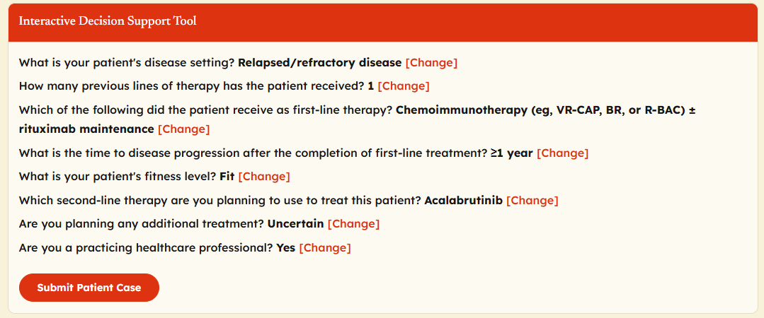
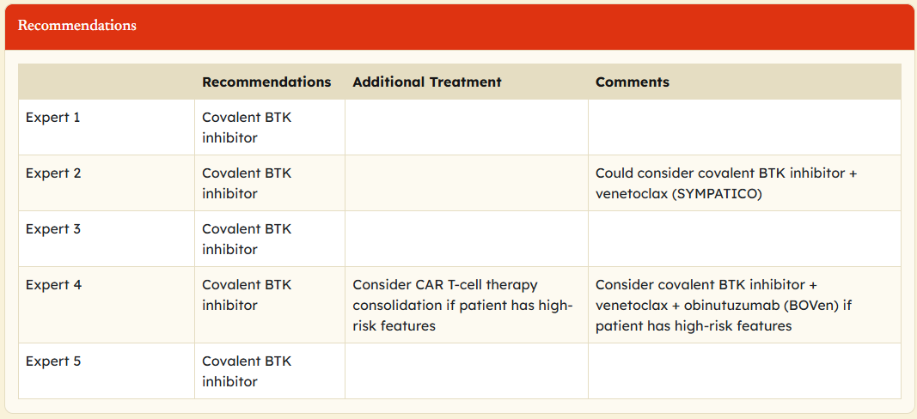
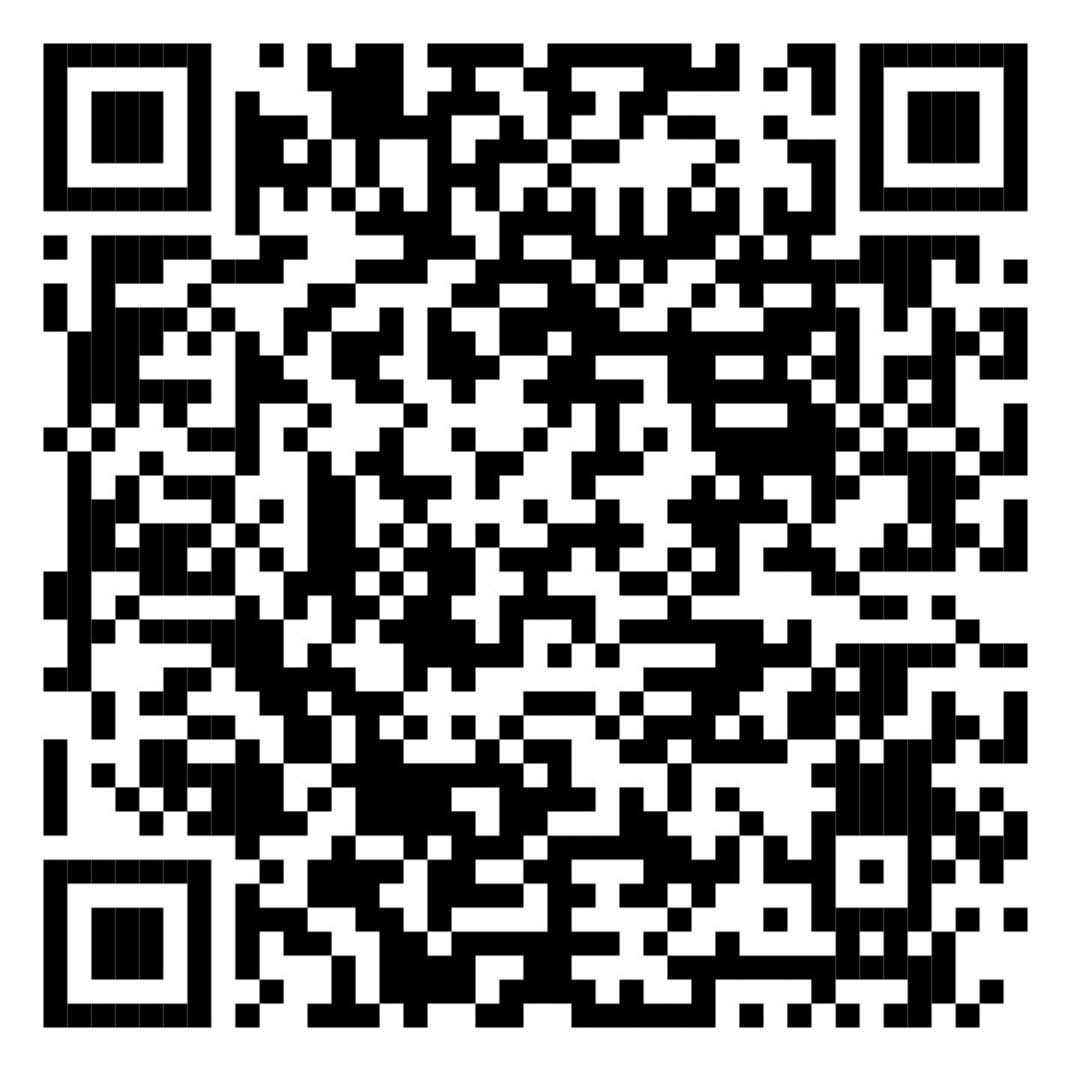
Interactive Treatment Decision Tool for MCL:
A US Perspective
HCP enters patient history and characteristics
Recommendations from 5 experts
Tool available at:
deceraclinical.com/education/activities/oncology/mcl-us-idst-1/141349/content
Released: February 25, 2026

Slide 14
Clinical Evidence Informing
Frontline Treatment Decisions in MCL

Slide 15
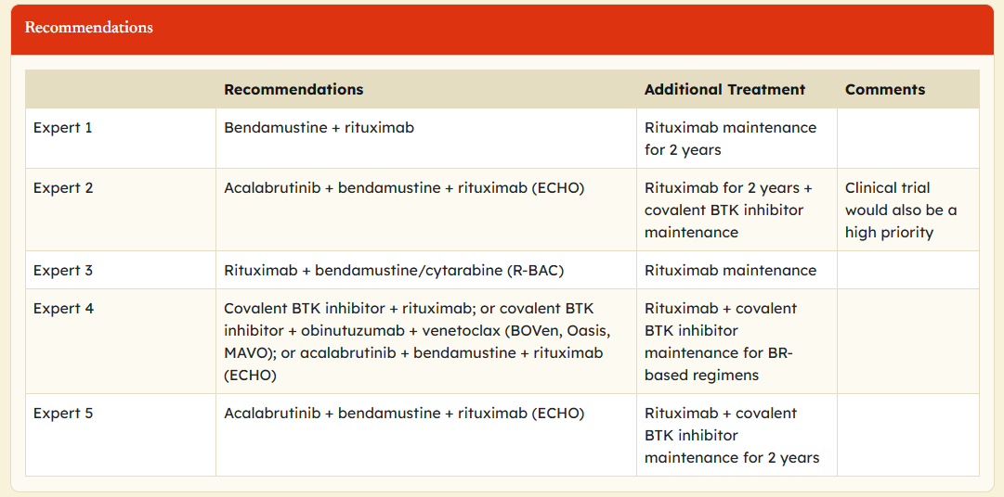
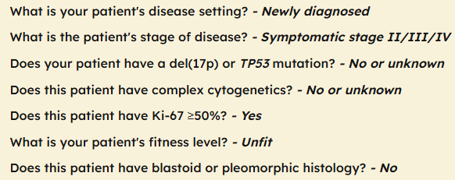
Case 1: 75-Yr-Old Woman With Newly Diagnosed MCL
75-yr-old woman presents with 3 mo of enlarging lymph nodes, fatigue, and weight loss and is diagnosed with stage III MCL
    No TP53 mutation, no complex cytogenetics, and classic morphology
    High Ki-67 55%
History of mild chronic kidney disease, osteoarthritis, and hypertension

Slide 16
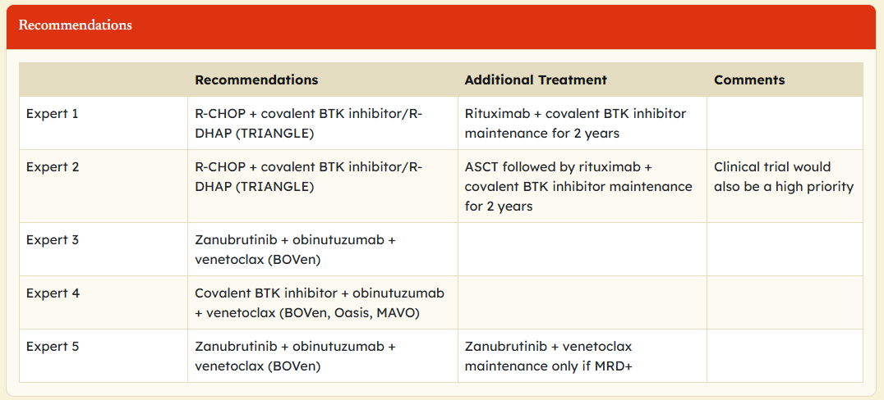
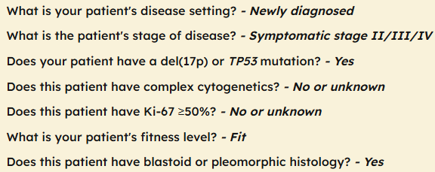
CASE 2: 62-Yr-Old Man With Newly Diagnosed MCL
62-yr-old man who presents with localized axillary lymphadenopathy but is otherwise in good health
Biopsy confirms stage II MCL with no complex abnormalities and Ki-67
Molecular testing identifies TP53 mutation and blastoid morphology

Slide 17
STiL and BRIGHT Phase III Trials: PFS With BR
Superior to R-CHOP in Untreated MCL Cohorts
STiL: Progression-Free Survival¹
BRIGHT: Progression-Free Survival²
1.0
1.0
BR
R-CHOP
BR
R-CHOP/R-CVP
0.8
0.8
HR: 0.49
(95% CI: 0.28-0.79;
P = .0044)
0.6
0.6
PFS (Probability)
PFS (Probability)
0.4
0.4
0.2
0.2
5-yr rate: 39.7% vs 14.2%
HR: 0.40 (95% CI: 0.21-0.75; P = .0035)
0
0
0
12
24
36
48
60
72
84
96
0
2
4
6
8
10
12
18
24
30
36
42
48
54
60
66
72
Mo
Mo
BR median PFS: 35.4 mo
(IQR: 28.8-54.9)
R-CHOP median PFS: 22.1 mo
(IQR: 15.1-33.8)
1. Rummel. Lancet. 2013;381:1203. 2. Flinn. JCO. 2019;37:984.

Slide 18
MCL: First-line Treatment Pattern by Yr
Cytarabine-containing regimens were used in 30.5%
of patients aged <65 yr
BR was most used first-line treatment: 61% of older patients
Trend of BR use increased over time across both age groups vs decrease in R-CHOP use over time; use of cytarabine-containing regimens did not change over time
Patients Aged <65 Yr (n = 1265)
Patients Aged ≥65 Yr (n = 2329)
100
100
Others*
Others*
75
75
BR
50
Patients† (%)
50
Patients† (%)
R-CHOP
BR
25
25
Cytarabine containing‡
R-CHOP
0
0
Cytarabine containing‡
2011
2015
2019
2020
2011
2015
2019
2013
2020
2012
2014
2017
2016
2018
2013
2012
2014
2017
2016
2018
Yr
Yr
*Among 3614 treated patients, includes: 9.5% targeted agents (eg, bortezomib, lenalidomide, BTK inhibitor, BCL2 inhibitor);
7.8% immunotherapy; 4.7% clinical trial agent; 2.4% chemotherapy only; additional 1.8% other types of chemoimmunotherapy.
†No. of patients treated between 2011 and 2020 (different from n = 1274 but includes patients treated in 2021).
‡Cytarabine-containing regimens, including all regimens with record of cytarabine within 1L treatment (such as hyperCVAD, NORDIC, and alternating R-CHOP/R-DHAP)
Martin. JCO. 2023;41:541.

Slide 19
Real-world Analysis of Maintenance Rituximab Benefit
“Real-world” analysis of 1461 patients
Large benefit for MR
    TTNT
    OS
    After both R-CHOP
    and BR
Real-world TTNT
OS
100
100
75
75
50
50
Real-world TTNT (%)
OS (%)
BR only
BR + MR
R-CHOP only
R-CHOP + MR
BR only
BR + MR
R-CHOP only
R-CHOP + MR
25
25
0
0
0
12
24
36
48
60
0
12
24
36
48
60
Mo
Mo
Patients at Risk, n
BR only
BR + MR
R-CHOP only
R-CHOP + MR
Patients at Risk, n
BR only
BR + MR
R-CHOP only
R-CHOP + MR
679
427
195
160
431
403
113
149
258
310
60
105
161
205
42
82
97
147
24
57
66
92
19
42
679
427
195
160
458
409
144
155
317
330
120
129
225
235
99
108
156
179
75
85
106
113
61
71
 | BR Only (n = 679) | BR + MR (n = 427) | R-CHOP Only (n = 195) | R-CHOP + MR (n = 160)
Median rwTTNT, mo | 37.7 | 65.3 | 18.8 | 47.8
3-yr rwTTNT, % | 51 | 74 | 30 | 63
HR (95% CI) | 1.96 (1.61-2.38) |  | 2.17 (1.66-2.83)
Log-rank P | <.001 |  | <.001
 | BR Only (n = 679) | BR + MR (n = 427) | R-CHOP Only (n = 195) | R-CHOP + MR (n = 160)
Median OS, mo | 78.1 | 89.5 | 81.9 | 99.0
3-yr OS, % | 74 | 84 | 70 | 86
HR (95% CI) | 1.51 (1.19-1.92) |  | 1.53 (1.06-2.20)
Log-rank P | <.001 |  | .023
Martin. JCO. 2023;41:541.

Slide 20
LyMa: Rituximab Maintenance After ASCT in MCL
Randomized, open-label phase III trial
Primary endpoint: EFS
Secondary endpoints: PFS, OS, ORR
Rituximab 375 mg/m² IV Q2M
(n = 120)
Adults <65 yr with previously untreated MCL; eligible for ASCT; stage II-IV disease; ECOG PS 0-2
(N = 240)
Rituximab + DHAP x 4 cycles
Follow-up every 2 mo for 3 yr
ASCT
Observation
(n = 120)
Sarkozy. JCO. 2024;42:769. Le Gouill. NEJM. 2017;377:1250.

Slide 21
LyMa: EFS, PFS, OS Results
Rituximab
Observation
Early POD
No early POD
EFS (ITT)
OS
1.0
1.0
0.8
0.8
0.6
0.6
7-yr EFS: 85% vs 12% (median: 0.7 yr)
HR: 15 (95% CI: 9.3-22.9)
P <.001
Probability
Probability
0.4
0.4
7-yr EFS: 76.2% vs 46%
HR: 0.39 (95% CI: 0.52-0.60)
P <.0001
0.2
0.2
0
0
0
1
2
3
4
5
6
7
8
9
10
0
1
2
3
4
5
6
7
8
9
Yr From Randomization
Yr From POD
Observ.
Rituximab
120
120
107
111
92
110
82
102
74
94
62
91
47
74
29
44
16
26
6
11
0
0
Early POD
No early POD
47
236
19
232
12
221
7
210
7
196
5
141
4
73
3
24
0
3
0
0
Result | Rituximab (n = 120) | Observation (n = 120)
mEFS, mo (95% CI) | NA (NA-NA) | 5.8 (4.4-NA)
HR (95% CI) | 0.39 (0.25-0.60); P <.0001
7-yr EFS rate, % | 76.2 | 46
mPFS, mo (95% CI) | NR (NR-NR) | 6.1 (4.8-NR)
HR (95% CI) | 0.36 (0.23-0.56); P <.0001
7-yr PFS rate, % | 78.5 | 47.4
Median OS NR in both arms (rituximab vs observation HR: 0.63; P = .0879)
22 (18.3%) and 33 (27.5%) OS events in rituximab and observation arms respectively
Sarkozy. JCO. 2024;42:769.

Slide 22
LyMa-101: Potential Benefit of Obinutuzumab Maintenance
Single-arm phase II LyMa-101 trial of obinutuzumab maintenance after ASCT (n = 85) compared to LyMa rituximab maintenance after ASCT*
    Obinutuzumab + DHAP → ASCT → obinutuzumab maintenance Q2M x 3 Yr
5-yr PFS and OS higher for obinutuzumab than rituximab (PFS: P = .0299; OS: P = .0398)
*Propensity score matched population, n = 82 from each study
PFS
LyMa 101
LyMa
OS
1.0
1.0
0.8
0.8
0.6
0.6
Probability
Probability
0.4
0.4
 | LyMa (Rituximab) | LyMa-101 (Obinutuzumab)
mPFS, mo (95% CI) | NR (92.2-NR) | NR (69.4-NR)
 | LyMa (Rituximab) | LyMa-101 (Obinutuzumab)
mPFS, mo (95% CI) | NR (92.6-NR) | NR (69.4-NR)
0.2
0.2
0
0
0
12
24
36
48
60
72
84
96
108
120
0
12
24
36
48
60
72
84
96
108
120
Mo
Mo
LyMa
LyMa-101
82
82
68
77
62
75
57
72
52
71
51
38
49
0
37
20
9
1
LyMa
LyMa-101
82
82
71
79
66
76
64
74
56
73
55
41
53
0
41
22
10
1
Sarkozy. Blood. 2024;144:262

Slide 23
BTK in B-Cell Malignancies
BCR pathway plays role in growth, proliferation, and survival of normal
and malignant B-cells
BTK is essential enzyme in BCR signaling pathway
Inhibition of BTK leads to downstream mitigation of cell growth, proliferation, adhesion, migration, and survival of malignant B-cells
BCR
SYK inhibitors
PI3K inhibitors
BTK inhibitors
BTK
PLCγ
SFK
CD19
CD79a
CD79b
SFK
SFK
SYK
P
P
SYK
PI3K
P
P
P
PKCβ
IKKγ
NFAT activation
IKKβ
IKKα
MAPK activation
AKT/mTOR activation
BTK inhibitors approved in multiple lymphoma settings:
CLL, FL, MCL, and MZL, and Waldenström macroglobulinemia
NF-κB activation
Young. Nat Rev Drug Discov. 2013;12:229.

Slide 24
TRIANGLE: Addition of Ibrutinib to Chemo-IO With or Without ASCT in Patients With MCL
Randomized, open-label, 3-arm phase III trial
Primary endpoint: FFS
Secondary endpoints: response rates, PFS, OS, safety
ASCT Arm:
R-CHOP x 3/
R-DHAP x 3
(n = 288)
ASCT*
Observation
Patients with previously untreated stage II-IV MCL; aged ≤65 yr; suitable for high-dose cytarabine and ASCT; ECOG PS 0-2
(N = 870)
Ibrutinib Arm:
R-CHOP + Ibrutinib x 3/
R-DHAP x 3
(n = 290)
2-Yr Ibrutinib
Maintenance*
Observation
ASCT + Ibrutinib Arm:
R-CHOP + Ibrutinib x 3/
R-DHAP x 3
(n = 292)
ASCT
2-Yr Ibrutinib
Maintenance*
Observation
*R maintenance was added following national guidelines in all 3 arms
(ASCT arm: 58%; ibrutinib arm: 54%; ibrutinib + ASCT arm: 57%).
Dreyling. ASH 2024. Abstr 240. Dreyling. Lancet. 2024;403:2293.

Slide 25
TRIANGLE: 4-Yr FFS and 4-Yr OS
FFS (Arm A vs Arm I)
FFS (Arm A vs Arm A + I)
OS (Arm A vs Arm A + I vs Arm I)
+
+
+
+
+
+
1.0
1.0
+
1.0
+
+
90%
+
+
+
+
88%
+
+
+
+
82%
+
+
+
+
+
+
+
+
+
+
81%
+
+
+
+
+
+
+
+
+
+
+
+
+
+
+
+
+
+
+
+
+
+
+
+
+
+
+
+
+
+
+
+
+
+
+
+
+
+
+
+
+
+
+
+
+
+
+
+
+
+
+
+
+
+
+
+
+
+
+
+
+
+
+
+
+
+
+
+
+
+
+
+
+
+
+
+
+
+
+
+
+
+
+
+
+
+
+
+
+
+
+
+
+
+
+
+
+
+
+
+
+
+
+
+
+
+
+
+
+
+
+
+
+
+
+
+
+
+
+
+
+
+
+
+
+
+
+
+
+
+
+
+
+
+
+
+
+
+
+
+
+
+
+
+
+
+
+
+
+
+
+
+
+
+
+
+
+
+
+
+
+
+
+
+
+
+
+
+
+
+
+
+
+
+
+
+
+
+
+
+
+
+
+
+
+
0.8
0.8
0.8
+
+
+
+
+
+
+
+
+
+
+
+
+
+
+
+
+
+
+
+
+
+
+
+
+
+
+
+
+
+
+
+
+
+
+
+
+
+
+
+
+
+
+
+
+
+
+
+
+
+
+
+
+
+
+
+
+
+
+
+
+
+
+
+
+
+
+
+
+
+
+
+
+
+
+
+
+
+
+
+
+
+
+
+
+
+
+
+
+
81%
+
+
+
+
+
+
+
+
+
+
+
+
+
+
+
+
+
+
+
+
+
+
+
+
+
+
+
+
+
+
+
+
+
+
+
+
+
+
+
+
+
+
+
+
+
+
+
+
+
+
+
+
+
+
+
+
+
+
+
+
+
+
+
+
+
+
+
+
+
+
+
+
+
+
+
+
+
+
+
+
+
+
+
+
+
+
+
+
+
+
+
+
+
+
+
+
+
+
+
+
+
+
+
+
+
+
+
+
+
+
+
+
+
+
+
+
+
+
+
+
+
+
+
+
+
+
0.6
70%
0.6
70%
+
+
0.6
Probability
0.4
0.4
0.4
Median follow-up = 55 mo
A (n = 288): median not reached
A + I (n = 292): median not reached
I (n = 290): median not reached
Median follow-up = 55 mo
A (n = 288): median not reached
I (n = 290): median not reached
Median follow-up = 55 mo
A (n = 288): median not reached
A + I (n = 292): median not reached
0.2
0.2
0.2
0
0
0
0
6
12
18
24
30
36
42
48
54
60
66
72
78
84
90
96
0
6
12
18
24
30
36
42
48
54
60
66
72
78
84
90
96
0
6
12
18
24
30
36
42
48
54
60
66
72
78
84
90
96
Mo From Randomization
Mo From Randomization
Mo From Randomization
4-yr FFS:
Arm A vs I (HR: 1.29; 1-sided P = .9890)
Superiority of A vs I rejected
Superiority of I (2-sided, retrospective): P = .0208
4-yr FFS:
Arm A vs A + I (HR: 0.64; 1-sided P = .0026)
A + I superior to A – confirmed
Arm A + I vs I (HR: 0.83; 1-sided P = .21)
4-yr OS:
Arm A vs I (HR: 0.565; P = .0019)
Arm A vs A + I (HR: 0.587; P = .0036)
Arm A + I vs I: ongoing
Treatment:
Arm A (R-CHOP/R-DHAP): alternating 3 cycles of R-CHOP in cycle 1, 3, 5 and 3 cycles of R-DHAP in cycle 2, 4, 6 (21-day cycles)
Arm A + I (R-CHOP + ibrutinib/R-DHAP): alternating 3 cycles of R-CHOP + ibrutinib on Days 1-19 in cycle 1, 3, 5 and 3 cycles of R-DHAP in cycle 2, 4, 6 (21-day cycles)
Arm I (R-CHOP + ibrutinib/R-DHAP): alternating 3 cycles of R-CHOP + ibrutinib on Days 1-19 in cycle 1, 3, 5 and 3 cycles of R-DHAP in cycle 2, 4, 6 (21-day cycles)
ASCT: planned for responding patients on arm A and arm A + I; rituximab maintenance could be received according to national guidelines in all responding patients regardless of treatment arm
Dreyling. ASH 2024. Abstr 240.

Slide 26
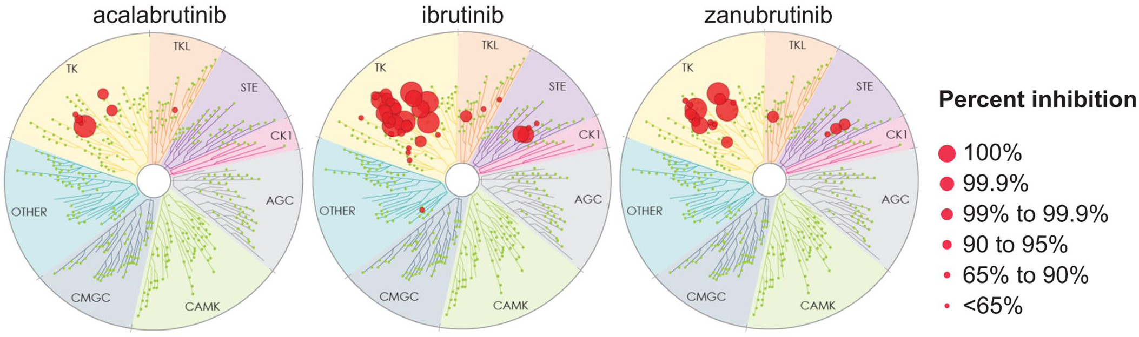
BTK Inhibitor Comparisons
Ibrutinib⁴
Acalabrutinib and zanubrutinib better tolerated than
ibrutinib in CLL and WM
    Phase III ELEVATE-RR trial¹
    Phase III ALPINE trial²
    Phase III ASPEN trial³
Zanubrutinib more active than ibrutinib in CLL
    Phase III ALPINE trial²
    Tolerance??
Zanubrutinib and acalabrutinib have never been directly compared in a randomized clinical trial
Acalabrutinib⁴
Zanubrutinib⁴
1. Seymour. Blood. 2023;142:687. 2. Brown. ASH 2023. Abstr 202. 3. Dimopoulos. JCO. 2023;41:5099.
4. Muñoz. Ther Adv Hematol. 2022;13. CC BY-NC 4.0. No changes made.

Slide 27
Monitoring and Managing BTKi-Related AEs in Practice
AE | Management Strategy
Atrial fibrillation | Monitor for during treatment Administer direct oral anticoagulants Stop BTKi if atrial fibrillation is not controlled with medication
Bleeding events | Monitor for bleeding signs Administer direct oral anticoagulants if needed Hold BTKi for 3-7 days before and after surgery (depending on surgery type and bleeding risk)
Diarrhea | Administer antidiarrheal agent (eg, loperamide) as needed
Headache | Before treatment begins: Advise patients that headaches should lessen quickly, are easily managed, and are not a long-term result of treatment After treatment starts: Recommend the use of caffeine or acetaminophen; avoid NSAIDs
Wang. JCO. 2023;41:3988. O’Brien. Front Oncol. 2021;11:Art 720704.

Slide 28
Monitoring and Managing BTKi-Related AEs in Practice
AE | Management Strategy
Hypertension | Monitor for treatment-emergent hypertension Administer antihypertensive drug Reduce dose of antihypertensive drug once BTKi is stopped
Infection | Consider prophylaxis for people at higher risk of opportunistic infection Monitor for signs and symptoms of infection Treat as needed
Musculoskeletal pain | Intervention may not be required for grade 1 myalgias/arthralgias Dose reduction/interruption should be used as appropriate
Neutropenia | Dose hold recommended for 1st to 3rd occurrences of grade 3/4 BTKi discontinuation recommended for 4th occurrence of grade 3/4
Thrombocytopenia | Dose hold recommended for 1st to 3rd occurrences of grade 3/4 BTKi discontinuation recommended for 4th occurrence of grade 3/4 (unless related to CLL infiltration of bone marrow)
Wang. JCO. 2023;41:3988. O’Brien. Front Oncol. 2021;11:Art 720704.

Slide 29
Adverse Events of Available Covalent BTK Inhibitors
Ibrutinib
Acalabrutinib
Zanubrutinib
Cytopenias (grade 3/4)
Cytopenias (grade 3/4)
Cytopenias (grade 3/4)
Neutropenia: 13% to 29%
Thrombocytopenia: 5% to 17%
Anemia: 0% to 13%
Neutropenia: 10% to 23%
Thrombocytopenia: 5% to 8%
Anemia: 5% to 11%
Neutropenia: 15% to 27%
Thrombocytopenia: 5% to 10%
Anemia: 8%
Infection (grade 3-5)
Infection (grade 3-5)
Infection (grade 3-5)
14% to 29%
11% to 18%
23%
Bruising and hemorrhage
Bruising and hemorrhage
Bruising and hemorrhage
Bleeding consistent with
“hemostatic failure” with bruising and SC bleeding with minor trauma in up to 50%
Grade ≥3 hemorrhage: up to 6%
Overall, bleeding events including bruising and petechiae of any grade occurred in ~30% of patients
Grade ≥3 hemorrhage: up to 3%
Bleeding events including bruising and petechiae of any grade occurred in 50% of patients
Grade ≥3 hemorrhage: 2%
Ibrutinib PI. Acalabrutinib PI. Zanubrutinib PI.

Slide 30
ECHO (ACE-LY-308): Acalabrutinib + BR vs Placebo + BR in Older Patients With Untreated MCL
International, randomized, double-blind phase III trial
Primary endpoint:
PFS per IRC
Stratified by sMIPI score (low vs intermediate vs high), region (N America vs W Europe vs other)
6 x 28-day cycles
Acalabrutinib 100 mg PO BID +
Bendamustine 90 mg/m² IV on Days 1, 2 +
Rituximab 375 mg/m² IV on Day 1
(n = 299)
Acalabrutinib until PD or toxicity; if ≥ PR, maintenance rituximab every 2 cycles x 2 yr
Patients aged
≥65 yr with previously untreated MCL; ECOG PS ≤2
(N = 598)
Crossover permitted after PD
Placebo PO BID +
Bendamustine 90 mg/m² IV on Days 1, 2 +
Rituximab 375 mg/m² IV on Day 1
(n = 299)
Placebo until PD or toxicity;
if ≥ PR, maintenance rituximab every 2 cycles x 2 yr
Key secondary endpoints:
ORR per IRC, OS, safety
Wang. JCO. 2025;43:2276. Wang. ASH 2025. Abstr 885. NCT02972840.

Slide 31
ECHO (ACE-LY-308): PFS, OS Results
Primary Analysis
Updated Analysis
 | Acala + BR (n = 299) | Pbo + BR (n = 299)
Median follow-up, mo | 49.8
Median PFS, mo (95% CI) | 66.4 (55.1-NE) | 49.6 (36.0-64.1)
Stratified HR: | 0.73 (95% CI: 0.57-0.94; log-rank P = .0160)
Acala + BR (n = 299) | Pbo + BR (n = 299)
60.8
72.5 (60.7-NE) | 47.8 (36.1-60.8)
0.68 (95% CI: 0.53-0.87; log-rank P = .0022)
100
+
+
+
+
+
+
+
+
+
+
+
+
+
+
+
+
+
+
+
+
+
+
+
+
+
80
+
+
+
+
+
+
+
+
+
+
+
+
+
+
+
+
+
+
+
+
+
+
+
+
+
+
+
+
+
+
+
+
60
+
+
+
+
+
+
+
+
+
+
+
+
+
+
+
+
+
+
+
+
+
+
+
+
+
+
+
+
+
+
+
+
+
+
PFS (%)
+
+
+
+
+
+
+
+
+
+
+
+
+
+
+
+
+
+
+
+
+
+
+
+
+
+
40
+
+
+
+
+
+
+
+
+
+
+
+
+
+
+
+
+
+
+
+
20
Acala + BR
Pbo + BR
0
Patients
at Risk, n
Acala + BR
Pbo + BR
0
6
12
18
24
30
36
42
48
54
60
66
72
78
84
90
Mo
299
299
258
244
232
205
205
182
184
160
165
145
147
128
131
116
123
103
115
89
95
74
70
56
39
27
18
11
4
3
0
0
Of the 100 patients with PD on pbo + BR, 79% subsequently received a BTK inhibitor
OS (including crossover) HR: 0.87 (95% CI: 0.67-1.13)
Wang. ASH 2025. Abstr 885.

Slide 32
EA4181: BR + Cytarabine ± Acalabrutinib vs BR + Acalabrutinib in Previously Untreated Older MCL
Multicenter, randomized, open-label phase II trial
Primary outcome: composite of CR rate (PET/CT) and PB MRD negativity rate
Secondary outcomes: PFS, ORR, OS, mobilization failure rate, safety
Stratified by MIPI score
(high vs intermediate vs low)
BR x 3 cycles → R + Cytarabine x 3 cycles
+ Acalabrutinib
(n = 129)
Adults with previously untreated MCL;
aged 18-70 yr; adequate organ and marrow function; ECOG PS 0-2
(N = 359)
BR + Acalabrutinib x 6 cycles
(n = 102)
Until PD or unacceptable toxicity
BR x 3 cycles → R + Cytarabine x 3 cycles
(n = 128)
Wagner-Johnston. ASH 2024. Abstr 236. NCT04115631.

Slide 33
EA4181: MRD, ORR, CR Results
Median follow-up 27.9 mo
No significant difference in PFS or OS
    12 mo PFS: 90% (BR/CR), 91% (BR/CR-A) and 92% (BR-A)
BR/CR-A was not superior
    More toxic
BR-A had lowest toxicity
    Likely the best option for efficacy and to avoid toxicity of high-dose cytarabine
Primary Analysis, % (N = 260) | BR/CR (n = 85) | BR/CR-A (n = 98) | BR-A (n = 77)
Completed protocol therapy | 94 | 91 | 90
PET/CT CR/PB uMRD | 82 | 82 | 78
P value vs BR/CR |  | .55 | .76
ORR | 94 | 99 | 94
CR | 91 | 90 | 91
Sensitivity Analysis, % (N = 281) | BR/CR (n = 94) | BR/CR-A (n = 106) | BR-A (n = 81)
PET/CT CR/PB uMRD | 74 | 76 | 74
P value vs BR/CR |  | .44 | .52
ORR | 88 | 97 | 92
CR | 85 | 89 | 89
Wagner-Johnston. ASH 2024. Abstr 236.

Slide 34
MAVO Phase I/II Trial of Acalabrutinib + Venetoclax + Obinutuzumab in MCL: Response
Phase I/II multicenter trial in patients (N = 56) with*:
    Relapsed/refractory (R/R) MCL (cohort A)
    Treatment-naive (TN) MCL:
      TP53 aberrant or induction ineligible (cohort B)
      TP53 wild type, induction eligible
      (cohort C)
Targeted, chemotherapy-free regimen
MRD-guided discontinuation strategy
Result | R/R MCL (n = 20) | TN MCL (n = 24) | TN MCL (n = 12)
Median follow-up, mo (range) | 24 (7.3-39.4) | 20 (0-26) | 9 (2.0-14.2)
ORR, % | 86 | 88 | 100
CR, % | 75 | 83 | 100
2-yr PFS, % (95% CI) | 75 (58-97) | 78 (63-97) | --
2-yr OS, % (95% CI) | 86 (69-100) | 96 (88-100) | --
12-mo PFS/OS | -- | -- | 100
MRD-negative CR, % | -- | 79 (15/19 evaluable) | 100 (8/8 evaluable
*Acalabrutinib continuous from C1; obinutuzumab initiated C2 (split dosing C2, then C3-7) with maintenance every 2 cycles; venetoclax ramp-up from C3 to 400 mg daily. MRD-guided discontinuation of A+V permitted after ≥10 cycles in TN cohorts.
Kim. ASH 2025. Abstr 664.

Slide 35
TrAVeRse: Phase II Study of Acalabrutinib + Venetoclax and Rituximab in Treatment-Naive MCL
PFS (N = 108)
ORR and CR
At Any Time
(Intent-to-Treat)
At Cycle 14
(Response evaluable at C14)
100
97.1%
95.2%
100
100
95%
(103/
108)
100%
(94/94)
94%
(88/94)
80
80
86%
(93/
108)
80
60
60
60
Patients (%)
Patients (%)
PFS (%)
40
40
40
20
20
20
0
0
Overall
ORR
CR by Lugano
ORR
CR by Lugano
0
Grade ≥3 Treatment-Emergent AEs During AVR Induction, n (%)* | N = 108
Neutropenia | 31 (28.7)
Neutrophil count decreased | 9 (8.3)
Pneumonia | 8 (7.4)
Thrombocytopenia | 6 (5.6)
Febrile neutropenia | 5 (4.6)
0
6
12
18
24
Mo From First Dose of AVR
Patients at Risk, n
Overall
108
102
90
3
0
Median follow-up: 14.9 mo
*1 grade 5 AE: NSCLC (considered unrelated to study treatment).
Hawkes. ASH 2025.Abstr 884.

Slide 36







Zanubrutinib in R/R MCL: Long-term Efficacy and Safety
PFS
OS
Censored
Censored
Single-arm, open-label phase II study
+
+
+
100
100
+
+
+
+
+
+
+
+
+
Measure of Efficacy | Total Population (n = 86)
ORR (CR + PR), % (95% CI) | 83.7 (74.2-90.8)
Best response, n (%) CR PR SD PD d/c before first assessment | 67 (77.9) 5 (5.8) 1 (1.2) 8 (9.3) 5 (5.8)
Median time to response, mo (range) | 2.7 (2.5-3.0)
Median time to CR, mo (range) | 2.8 (2.5-16.7)
Median DoR, mo (range) | NE (2.3-36.2)
80
+
80
+
+
+
+
+
+
+
+
+
+
+
+
+
+
+
+
+
+
+
+
+
+
+
+
60
60
Patients (%)
+
+
Patients (%)
+
+
+
+
+
+
40
40
20
Median f/u: 33.3 mo (95% CI: 33.1-34.3)
36-mo PFS rate: 47.6% (95% CI: 36.2-58.1)
20
Median f/u: 36.8 mo (95% CI: 35.4-37.2)
36-mo OS rate: 74.8% (95% CI: 63.7-83.0)
0
0
3
6
9
12
15
18
21
24
27
30
33
36
39
0
0
3
6
9
12
15
18
21
24
27
30
33
36
39
42
Mo
Mo
Patients at Risk, n
Patients at Risk, n
86
73
67
64
60
58
51
48
45
43
38
36
9
0
86
79
76
71
65
64
61
59
58
56
56
54
38
7
0
PFS by Best Response
OS by Best Response
CR
PR
SD/PD
Censored
100
+
100
+
+
+
+
+
+
+
+
+
+
+
+
+
+
+
+
+
+
+
+
+
+
+
+
+
+
80
+
80
+
+
+
+
+
+
+
+
+
+
+
60
+
60
+
Patients (%)
Patients (%)
+
+
40
40
CR
PR
SD/PD
Censored
20
+
20
+
+
+
0
0
3
6
9
12
15
18
21
24
27
30
33
36
39
0
0
3
6
9
12
15
18
21
24
27
30
33
36
39
42
Mo
Mo
Patients at Risk, n
Patients at Risk, n
CR
PR
PD
67
5
9
67
5
1
63
3
1
60
3
1
57
3
0
55
3
0
50
1
0
47
1
0
44
1
0
42
1
0
37
1
0
35
1
0
9
0
0
0
0
0
CR
PR
PD
67
5
9
675
7
66
5
3
64
4
3
59
3
3
59
3
2
57
3
1
55
3
1
54
3
1
53
2
1
53
2
1
51
2
1
35
2
0
7
0
0
0
0
0
Song. Blood. 2022;139:3148.

Slide 37
BOVen: Zanubrutinib + Obinutuzumab + Venetoclax for Untreated TP53m MCL
Multicenter, single-arm, open-label, multicohort phase II trial
Primary endpoint of TP53m cohort: 2-yr PFS rate
Other endpoints: response, MRD, safety
TP53 Mutation MCL Cohort
Adults with previously untreated stage II-IV MCL; no prior systemic therapy; TP53 mutation irrespective of variant allele frequency; ECOG PS 0-2
(N = 25)
Zanubrutinib 160 mg PO BID +
Obinutuzumab 1000 mg IV on Days 1, 8, 15 of C1 and Day 1 of C2-8 +
Venetoclax 20-400 mg over 5-Wk ramp-up starting C3, then 400 mg
PO QD†
After 24 cycles in selected patients:
CR and uMRD:
stop tx
< CR and/or dMRD: continue tx
Additional Eligibility Criteria for Transplant-Ineligible Patients
Diagnosis of untreated stage II-IV MCL
Age ≥65 yr OR age <65 yr if:
  Ineligible for HDT/ASCT due to comorbidity or organ dysfunction and with ≥1 of the following:
    Comorbid dx; ECOG 2; EF ≥35% and <45%; impaired pulmonary function test precluding HDT/ASCT
Kumar. Blood 2025;145:497.

Slide 38
BOVen in MCL: Efficacy in Patients With TP53mut
Best Response, n (%) | Evaluable Patients (n = 25)
ORR CR | 24 (96) 22 (88)
Median follow-up: 28.2 mo (range: 7.2-44.6)
    2-yr PFS: 72% (95% CI: 56-92)
    2-yr disease-specific survival: 91% (95% CI: 79-100)
    2-yr OS: 76% (95% CI: 61-95)
MRD, n/N (%) | Patients
Cycle 3 uMRD5* uMRD6† | 17/22 (77) 7/22 (32)
Cycle 13 uMRD5* uMRD6† | 18/19 (95) 16/19 (84)
End of Tx uMRD5* uMRD6† | 17/17 (100) 12/15 (71)
Sensitivity levels of *1 x 10⁻⁵ or †1 x 10⁻⁶.
Kumar. Blood 2025;145:497.

Slide 39
BOVen in MCL: Efficacy According to Age
−
<65 yr of age
≥65 yr of age
−
PFS
OS
1.00
1.00
0.75
0.75
0.50
0.50
% of Subjects Free of PD or Death
% of Subjects Free of PD or Death
0.25
0.25
P = .14
P = .044
0
0
0
6
12
18
24
30
36
42
48
0
6
12
18
24
30
36
42
48
Mo From Treatment Start
Mo From Treatment Start
Kumar. Blood 2025;145:497.

Slide 40
MANGROVE: BR vs Zanubrutinib + Rituximab for Untreated MCL
Multicenter, randomized, open-label phase III trial
Primary endpoint: PFS by IRC
Secondary endpoints: PFS by INV, ORR, DoR, OS, PROs, safety
28-day cycles
Patients aged ≥75 yr or ≥65 yr and <70 yr with comorbidities precluding ASCT; histologically confirmed MCL; no prior systemic therapy; ECOG PS ≤2
(planned N = 500)
Zanubrutinib 160 mg PO BID +
Rituximab 375 mg/m² IV D1 of cycles 1-6
Zanubrutinib monotherapy until PD
Response assessed every 3 mo for 2 yr, then every 6 mo until PD
Bendamustine 90 mg/m² IV D1, D2 +
Rituximab 375 mg/m² IV D1 of cycles 1-6
Observation
Dreyling. Future Oncol. 2021;17:255.

Slide 41
Clinical Evidence Informing
Treatment Decisions in R/R MCL

Slide 42
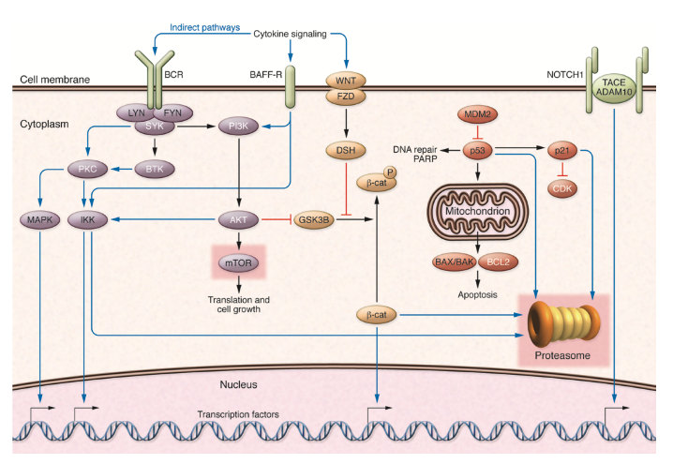
How Do We Approach R/R MCL?
Better understanding of biology of MCL has led to shift away from chemotherapy
    BTK: covalent inhibitors ibrutinib,* acalabrutinib, zanubrutinib
    BTK: noncovalent inhibitors pirtobrutinib, nemtabrutinib*
    IMiDs: lenalidomide
    BCL2: venetoclax*, sonrotoclax
    CAR T-cell therapy: brexu-cel, liso-cel
    Bispecific mAb: mosunetuzumab/polatuzumab,* glofitamab*
*Not approved by FDA for R/R MCL.
NCCN. Clinical practice guidelines in oncology: B-cell lymphomas. v.3.2026. nccn.org.
Jares. J Clin Invest. 2012;122:3416. Figure reproduced by Creative Commons Attribution License (CC BY).

Slide 43
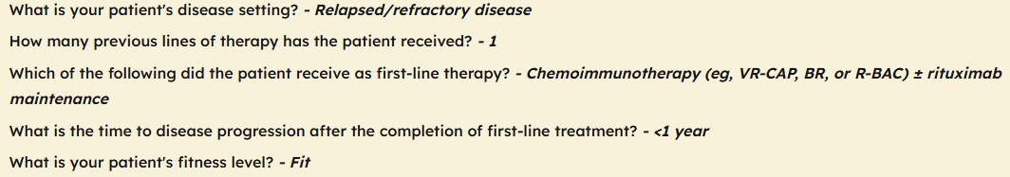
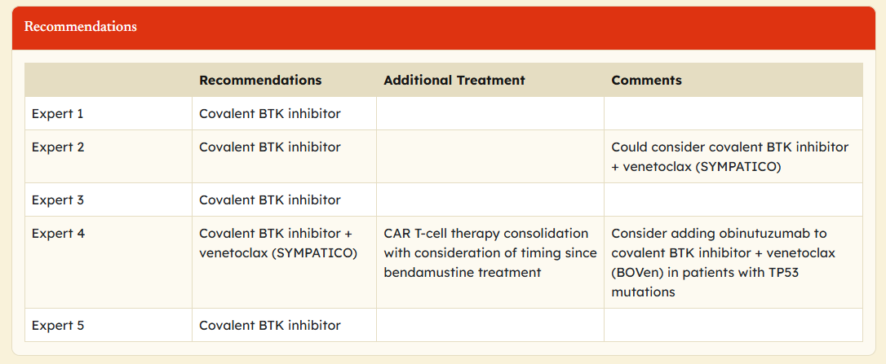
CASE 3: 60-Yr-Old Woman With R/R MCL
60-yr-old woman presented with fever and rash to local ED
    Workup revealed splenomegaly, and elevated WBC; flow consistent with MCL
Patient started BR therapy
    Completed 6 cycles and achieved complete metabolic response
    Started on R maintenance every other mo (planned for 2 yr)
Remained in remission for just under 1 yr when she was
noted on imaging to have recurrent disease after self-palpating a new node

Slide 44
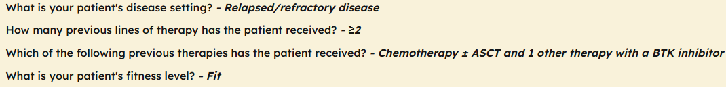
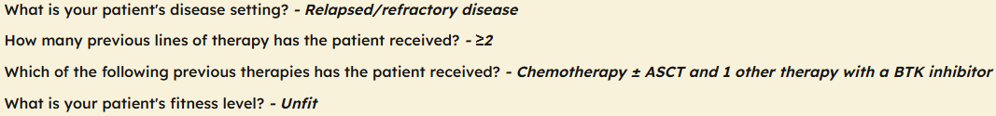
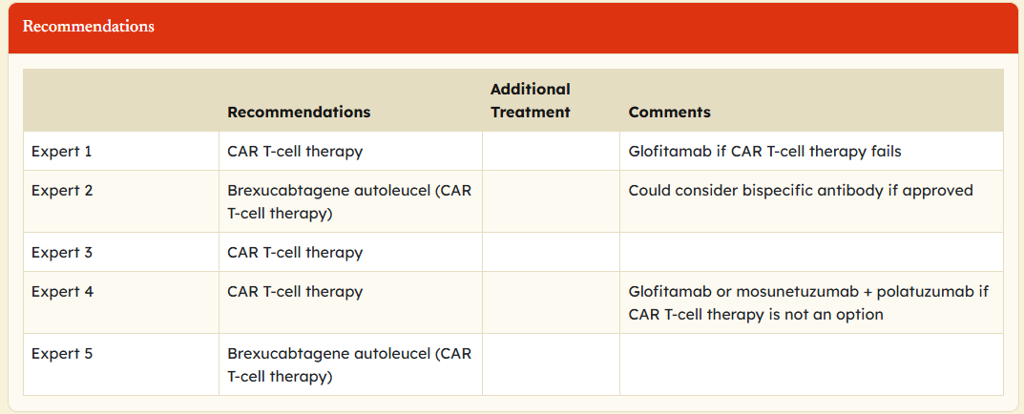
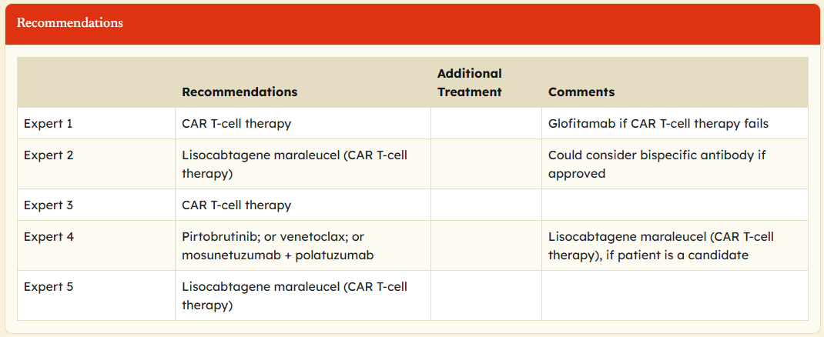
Case 4: R/R MCL After Chemotherapy and BTK Inhibitor
Fit Patient
Unfit Patient

Slide 45

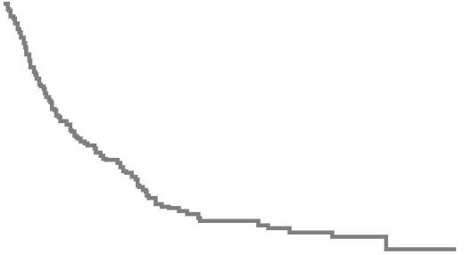
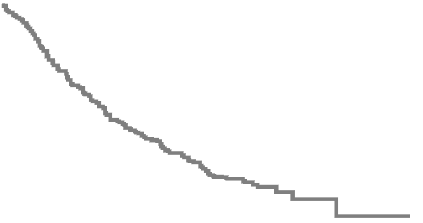

Younger Patients With MCL Who Experience Late Relapse
(LATE-POD)
A multicenter, historical, mixed-design study with retrospective data collection
PFS2 by Second-line Tx
OS by Second-line Tx
1.0
1.0
BTKi
CIT
0.8
0.8
0.6
0.6
Probability
Probability
0.4
0.4
0.2
0.2
P = .0003
P = .04
0
0
0
20
40
60
80
100
120
140
0
20
40
60
80
100
120
140
160
Patients
at Risk, n
Mo
Patients
at Risk, n
Mo
CIT
BTKi
271
114
122
52
52
21
23
3
6
0
0
0
CIT
BTKi
271
114
184
60
114
28
56
4
18
0
3
0
Malinverni. Blood. 2024;144:1001.

Slide 46
Long-term OS Outcomes With 2L vs Later-line Zanubrutinib in R/R MCL: Pooled Analysis of 2 Clinical Trials
Clinical trials (N = 112):
    Phase I BGB-3111-AU-003 trial
    (n = 33)
    Phase II BGB-3111-206 trial
    (n = 79)
Median follow-up: 35.2 mo
Conclusion: long-term follow-up studies further demonstrated that zanubrutinib as second-line therapy was associated with significantly prolonged OS compared with its use in the later-line treatment of patients with R/R MCL
OS in the ≥2L Group After Weighting
Strata
Second line
Later line
1.00
0.75
Survival Probability
0.50
0.25
HR: 0.459 (95% CI: 0.215-0.980;
P = .044)
0
0
6
12
18
24
30
36
42
48
54
60
Mo to Death
Effective Sample Size
Strata
Second line
Later line
30
61
28
54
23
46
22
43
21
39
19
35
15
27
6
5
3
2
1
1
0
0
Song. Blood. 2022;140:6501.

Slide 47
SYMPATICO: Ibrutinib With or Without Venetoclax in Patients With R/R MCL
Randomized, multinational, double-blind, placebo-controlled phase III study
Primary endpoint: investigator-assessed PFS (Lugano criteria)
Key secondary endpoints: investigator-assessed CR rate, TTNT, OS, ORR (investigator-assessed) tested in hierarchical order
Stratified by ECOG PS, prior lines of therapy, risk of TLS
Ibrutinib 560 mg PO QD +
Venetoclax 5-wk ramp-up
to 400 mg PO QD for 24 mo
(n = 134)
Ibrutinib 560 mg PO
QD until unacceptable toxicity or PD
Adults with R/R MCL and cyclin D1 overexpression or t(11;14); received 1-5 prior tx regimens; no prior BTK or BCL inhibitors; ECOG PS 0-2
(N = 267)
Ibrutinib 560 mg PO QD +
Placebo PO QD for 24 mo
(n = 133)
Ibrutinib 560 mg PO
QD until unacceptable toxicity or PD
Wang. JCO. 2025;26:200. Wang. ASH 2023. Abstr LBA-2.

Slide 48
SYMPATICO: PFS, ORR, CR, Safety Results
Investigator-Assessed PFS
ORR/CR rate: ibr + ven, 82%/54%; ibr + pbo, 74%/32%
Median OS: ibr + ven, 44.9 mo; ibr + pbo, 38.6 mo
Grade ≥3 AEs: ibr + ven, 84%; ibr + pbo, 76%
AEs leading to d/c: ibr + ven, 31%; ibr + pbo, 36%
 | Ibr + Ven (n = 134) | Ibr + Pbo (n = 133)
PFS events, n (%) | 73 (54) | 94 (71)
Median PFS, mo | 31.9 | 22.1
HR (95% CI) | 0.65 (0.47-0.88)
Log-rank P value | .0052
100
80
60
PFS (%)
40
20
Ibr + ven
Ibr + pbo
0
0
6
12
18
24
30
36
42
48
54
60
66
Mo Since Randomization
*Ibrutinib 560 mg QD + venetoclax 5-wk ramp-up to 400 mg QD; at 2 yr, discontinue venetoclax/placebo and continue ibrutinib until PD or unacceptable toxicity.
Wang. JCO. 2025;26:200. Wang. ASH 2023. Abstr LBA-2.

Slide 49
Role of BTK Inhibitors for R/R MCL
Agent | Study Population, N | Response Rate, % | Median DoR, Mo
Bortezomib¹ | 155 | 33 | 9.2
Lenalidomide² | 134 | 28 | 16.6
Lenalidomide + rituximab³ | 52 | 57 | 18.9
Ibrutinib*⁴ | 111 | 68 | 17.5
Acalabrutinib⁵ | 124 | 81 | 28.6
Zanubrutinib⁶ | 86 | 84 | ~36.0
Pirtobrutinib^{†7} | 90 | 58 | 21.6
Venetoclax*⁸ | 28 | 75 | 15.7
Ibrutinib + venetoclax*⁹ | 134 | 82 | 42.0
*Not FDA approved in MCL. †Approved after prior therapy failure.
1. Goy. Ann Oncol. 2009;20:520. 2. Goy. JCO. 2013;31:3688. 3. Wang. Lancet Oncol. 2012;13:716. 4. Wang. NEJM. 2013;369:507.
5. Wang. 2020;136:38. 6. Song. Blood. 2022;139:3148. 7. Wang. JCO. 2023;41:3988. 8. Davids. Clin Cancer Res. 2021;27:4690.
9. Wang. JCO. 2025;26:200.

Slide 50
Historically: Extremely Poor Outcomes in MCL
Following Progression on Covalent BTK Inhibitors
Covalent BTK inhibitor resistance in MCL and other lymphomas is incompletely understood¹⁻¹⁰
BTK C481 mutations are uncommon; bypass alterations and epigenetic changes implicated in some patients⁷
Overall Survival Following Covalent BTK Inhibitor Therapy^{3,4,11}
OS After Ibrutinib Cessation
OS After Progression on Ibrutinib
100
OS After Progression on BTKi
1.00
80
1.0
No response
Response
0.8
0.75
60
0.50
OS (%)
0.6
OS (Proportion)
40
OS (Probability)
0.4
0.25
0.2
20
0
0
0
0
10
20
30
40
0
6
12
18
24
0
4
8
12
16
20
24
Mo
Mo
Mo
N = 114 (global)⁴
Median OS: 2.9 mo
N = 31 (US)³
Median OS: 8.4 mo
N = 108 (Japan)¹¹
Median OS: 5.46 mo
1. Hershkovitz-Rokah. Br J Haemtol. 2018;181:306. 2. Wang. NEJM. 2013;369:507. 3. Cheah. Ann Oncol. 2015;26:1175. 4. Martin. Blood. 2016;127:1559. 5. Dreyling. Lancet. 2016;387:770. 6. Epperla. Hematol Oncol. 2017;35:528. 7. Ondrisova. Front Oncol. 2020;10. 8. O’Brien.
Clin Lymphoma Myeloma Leuk. 2018;18:648. 9. Byrd. Blood. 2017;130(suppl 1):4326. 10. Tam. Blood. 2020;136:2038. 11. Rai. Clin Lymphoma Myeloma Leuk. 2021;21(suppl 1):S407.

Slide 51

ZUMA-2: CAR T-Cell Therapy
Brexucabtagene Autoleucel in R/R MCL
Multicenter phase II trial of brexucabtagene autoleucel for patients with relapsed/refractory MCL; 1-5 prior therapies; ≥1 measurable lesion (N = 74)
OS by Best Response in Cohort 1
Median OS, Mo (95% CI)
46.6 (24.9-NE)
60.2 (42.8-NE)
16.3 (3.8-46.6)
8.5 (2.3-NE)
All treated patients (N = 68)
Patients with CR (n = 46)
Patients with PR (n = 16)
Patients with NR (n = 6)
100
80
60
+
+
+
+
OS Probability (%)
+
+
+
+
+
+
+
+
+
+
+
+
40
+
+
+
+
+
+
+
+
+
+
+
+
+
+
+
+
+
+
+
+
+
20
+
+
0
+ Censored
0
4
8
12
16
20
24
28
32
36
40
44
48
52
56
60
64
68
72
76
80
84
88
Patients at Risk, n
Patients with CR
Patients with PR
Patients with NR
Mo
46
16
6
46
12
4
44
9
3
43
9
3
40
8
2
39
7
1
37
6
0
35
6
0
35
6
0
34
6
0
32
5
0
30
5
0
27
4
0
23
3
0
22
2
0
19
1
0
14
0
0
8
0
0
8
0
0
7
0
0
7
0
0
2
0
0
1
0
0
FDA granted approval to brexucabtagene autoleucel for R/R MCL
Muñoz. J Hematol Oncol. 2026 Apr 27.

Slide 52
TRANSCEND NHL 001: CAR T-Cell Therapy
Lisocabtagene Maraleucel in R/R MCL
MCL cohort of the open-label phase I trial of lisocabtagene maraleucel for patients with R/R MCL after ≥2 prior therapies including a BTK inhibitor, alkylating agent, and CD20-targeted therapy (N = 88)
Patient Population | Median OS, Mo
Primary analysis set (n = 74) | 18.2
Efficacy set (n = 83) | 18.2
Achieved CR (n = 60) | 36.3
Overall Survival After a Median
Follow-up of 24.0 mo
100
80
Median OS: 18.2 mo (95% CI: 12.9- 36.3)
Patient Population | Median PFS, Mo
Primary analysis set (n = 74) | 12.3
Efficacy set (n = 83) | 15.3
Achieved CR (n = 60) | 17.8
60
OS (%)
40
Patient Population | ORR, %
Primary analysis set (n = 74) | 86.5
Efficacy set (n = 83) | 83.1
20
0
0
3
6
9
12
15
18
21
24
27
30
33
36
39
42
45
48
51
54
57
60
63
Patient Population | CR Rate, %
Primary analysis set (n = 74) | 74.3
Efficacy set (n = 83) | 72.3
Mo Since Liso-Cel Infusion
Patients at Risk, n
83
72
65
57
46
42
37
31
16
8
8
8
5
4
4
4
4
3
2
1
1
0
Wang. JCO. 2024;42:1146.

Slide 53
Adverse Events of CAR T-Cell Therapy for R/R MCL
Brexucabtagene Autoleucel (Brexu-cel)
Cytokine release syndrome (grade 3-5)
Any grade: 91% Grade ≥3: 18%
Cytopenias (grade 3/4)
Neutropenia: 95% Leukopenia: 95% Lymphopenia: 86% Thrombocytopenia: 63% Anemia: 55%
ICANS
Any grade: 61% Grade ≥3: 32%
Infection with pathogen unspecified (grade 3-5)
24%
Lisocabtagene Maraleucel (Liso-cel)
Cytokine release syndrome (grade 3-5)
Any grade: 61% Grade ≥3: 1%
Cytopenias (grade 3/4)
Neutropenia: 85% Leukopenia: 83% Lymphopenia: 89% Thrombocytopenia: 39% Anemia: 33%
ICANS
Any grade: 31% Grade ≥3: 9%
Infection with pathogen unspecified (grade 3-5)
6%
Brexucabtagene Autoleucel PI. Wang. JCO. 2023;41:2594. Lisocabtagene Maraleucel PI. Wang. JCO. 2024;42:1146.

Slide 54
Covalent vs Noncovalent BTK Inhibitors
Noncovalent non–C481-dependent binding
BCR
Pirtobrutinib
Vecabrutinib
Fenebrutinib
Nemtabrutinib
CXCL12
IgH
Covalent inhibitors bind to residue C481 and block
ATP-binding site
CXCR4
P
BTK
PLCγ
CD79A
CD79B
P
Gβ
Gγ
Gα
Lyn
P
Lyn
P
P
PI3K
P
SYK
SYK
PKCβ
P
Ibrutinib
Acalabrutinib
Zanubrutinib
IKKγ
IKKα
IKKβ
MAPK
activation
Covalent C481-dependent binding
AKT/mTOR activation
NF-κB activation
Adapted from Lewis. J Pers Med. 2021;11:764.

Slide 55
BRUIN (MCL Population): Pirtobrutinib OS and Responses in R/R MCL
Open-label phase I/II trial of pirtobrutinib (N = 166)
Median PFS: 5.6 mo
Median DoR (cBTKi pretreated): 21.6 mo
OS in cBTKi Pretreated and Naive
Patients With R/R MCL
100
+
+
+
+
+
80
76.2%
+
+
+
+
+
+
+
+
+
+
+
+
60
+
+
+
+
+
+
OS Probability (%)
+
+
+
+
+
+
+
+
+
+
+
43.2%
+
+
+
+
+
+
+
+
+
+
40
+
+
+
+
Prior cBTKi
23.9
17.3-51.5
37.8
76/152
cBTKi Naive Not reached
33.5-NE
45.3
3/14
+
+
Efficacy-Evaluable Patients With MCL | cBTKi Pretreated (n = 152) | cBTKi Naive (n = 14)
ORR, % (95% CI) | 49.3 (41.1 -57.6) | 85.7 (57.2-98.2)
CR | 24 (15.8) | 5 (35.7)
PR | 51 (33.6) | 7 (50)
mOS, mo
95% CI
mFU, mo
Events/total
+
+
+
+
+
+
20
0
0
2
4
6
8
10
12
14
16
18
20
22
24
26
28
30
32
34
36
38
40
42
44
46
48
50
52
54
56
58
60
62
64
66
68
70
Mo
152
14
135
13
123
12
109
12
100
12
Prior cBTKi
cBTKi naive
90
12
84
12
79
12
76
12
70
12
67
12
63
12
58
12
56
12
49
12
44
12
40
11
37
9
33
9
31
9
25
9
25
9
17
5
13
5
12
5
12
3
11
3
11
3
6
3
5
3
3
2
2
1
1
1
1
1
1
0
0
0
Wang. ASH 2025. Abstr 7068.

Slide 56
BRUIN: Safety of Pirtobrutinib in Patients Previously Intolerant to a Covalent BTK Inhibitor
Recurring TEAEs as Those Leading to Prior BTKi Discontinuation:
MCL, CLL, and Other B-Cell NHL*¹
Cardiac disorders (n = 40)
Atrial fibrillation (n = 30)
Infections (n = 13)
Neutropenia (n = 12)
Rash (n = 11)
Arthralgias/myalgias (n = 10)
Bleeding/hemorrhage (n = 9)
Gastrointestinal disorders (n = 8)
Diarrhea (n = 6)
Fatigue (n = 6)
Pain (n = 6)
0 patients discontinued prior BTKi due to TEAEs and had to discontinue pirtobrutinib for same TEAEs¹
49% of patients discontinued pirtobrutinib (26.8% due to PD)¹
93% of patients received
≥1 dose of pirtobrutinib at
≥ RP2D of 200 mg/day²
75%
18%
8%
93%
7%
23%
31%
46%
25%
8%
67%
55%
45%
50%
50%
67%
33%
38%
50%
13%
83%
17%
No recurrence
Low grade
Grade ≥3
50%
50%
83%
17%
0
5
10
15
20
25
30
35
40
45
Patients (n)
1. Shah. Haematologica. 2025;110:92. 2. Shah. ASH 2022. Abstr 1797.

Slide 57
BRUIN-MCL-321: Pirtobrutinib vs Investigator’s Choice BTKi in R/R MCL
International, open-label, randomized phase III trial
Primary endpoint: PFS
Secondary endpoints: EFS, ORR, DoR, OS, TTF, time to worsening of MCL-related symptoms, tolerability
Stratified by sMIPI risk group, comparator BTK inhibitor, number of prior LOT
Pirtobrutinib 200 mg PO QD
Patients with MCL; previously treated with ≥1 systemic tx; no prior BTKi; ECOG PS 0-2
(planned N = 500)
Investigator’s Choice BTKi*
(ibrutinib, acalabrutinib, zanubrutinib)
*Ibrutinib: 560 mg PO QD.
Acalabrutinib: 100 mg PO BID.
Zanubrutinib 160 mg PO BID or 320 mg PO QD.
Wang. ASCO 2023. Abstr TPS7587. Eyre. Future Oncol. 2022;18:3961. NCT04662255.

Slide 58
BGB-11417-201: Sonrotoclax Monotherapy in R/R MCL
Single-arm, open-label, multicenter, dose-escalation/dose-expansion phase I/II study
    Patients with R/R MCL (exposure to anti-CD20–based therapy and ≥1 BTK inhibitor) (n = 125)
Key endpoints: DLTs, response, PFS, OS, safety and tolerability
Efficacy | Evaluable Patients (n = 103)
 | By IRC | By INV
ORR by IRC, n (%) CR | 55 (53.4) 15 (14.6) | 50 (48.5) 18 (17.5)
Median TTR, mo | 1.9 | 1.9
Median DoR, mo | 15.8 | 15.8
Median follow-up, mo | 7.4 | 9.3
Median PFS, mo | 6.5 | 6.3
Median OS, mo | NR | NR
TEAE, % | Evaluable Patients (n = 115)
Grade ≥3 Neutropenia | 19.1
Serious Pneumonia | 36.5 7.0
Led to tx discontinuation | 13.9
Led to death | 13.0
Clinical TLS* | 1.7
Laboratory TLS* | 5.2
*Recovered without sequelae.
On May 13, 2026, the FDA granted accelerated approval to sonrotoclax
for adults with R/R MCL after ≥2 lines of systemic therapy, including a BTKi
Wang. ASH 2025. Abstr 663. NCT05471843. Sonrotoclax PI.

Slide 59
Bispecifics in Late-Stage Development in MCL
Mosunetuzumab
CD20 x CD3
Glofitamab
(CD20)₂ x CD3
CD20
CD20
CD3
CD20
CD3
Tapia-Galisteo. J Hematol Oncol. 2023;16:83. Figure used under terms and conditions of the Creative Commons Attribution 4.0 International license (CC BY 4.0: https://creativecommons.org/licenses/by/4.0/).

Slide 60
NP30179: Phase I/II Trial of Fixed-Duration
Glofitamab in R/R MCL Cohort
International, open-label, dose-escalation/-expansion phase I/II trial
Primary endpoint: CR by Investigator
Secondary endpoints: ORR, DoCR DoR, PFS, OS, safety
Cycle 1
Cycles 2-12 (~8.5 mo)
Obinutuzumab 1000 or 2000 mg IV on Day 1 +
Glofitamab 2.5 mg IV on Day 8 followed by 10 mg IV on Day 15
Glofitamab 30 mg* IV on Day 1 of 21-day cycles
CRS mitigation:
Cycle 1 obinutuzumab pretreatment
Cycle 1 step-up dosing
Monitoring after first dose of 2.5 mg
Adults with R/R B-cell NHL; ≥1 prior systemic tx; ECOG PS 0/1
(MCL ITT: N = 61)
*In cohort treated with obinutuzumab 1000 mg, n = 2 received 16 mg as target glofitamab dose in dose-escalation phase.
Phillips. JCO. 2025;43:318. NCT03075696.

Slide 61
NP30179: Glofitamab Responses, DoR, PFS, OS
DoCR
Median follow-up: 17.2 mo
100
ORR 74.2%
ORR 96.6%
Patients with a CR (n = 47)
ORR 85.0%
80
PR 3.2%
Censored
60
DoCR (%)
40
20
0
Prior BTKi
(n = 31)
BTKi Naive
(n = 29)
All Patients
(N = 60)
0
3
6
9
12
15
18
21
24
27
30
33
36
39
Patients
at Risk, n
Mo
DoCR | Prior BTKi (n = 22) | All patients (n = 47)
Median DoCR, mo (95% CI) | 12.6 (5.4-NE) | 15.4 (12.7-NE)
15-mo DoCR rate, % (95% CI) | 33.5 (10.6-56.4) | 50.3 (32.0-68.6)
Ongoing CR, n (%) | 10 (45.5) | 28 (59.6)
DoR | (n = 23) | (n = 51)
Median DoR, mo (95% CI) | 12.6 (7.4-NE) | 16.2 (12.6-NE)
15-mo DoR rate, % (95% CI) | 38.0 (15.5-60.6) | 59.7 (44.1-75.3)
Ongoing response, n (%) | 10 (43.5) | 28 (54.9)
47
41
33
25
19
12
9
7
6
3
2
2
1
NE
PFS and OS | Prior BTKi (n = 32) | All patients (N = 61)
Median follow-up, mo | 26.1 (13.5-31.2) | 19.6 (11.9-26.1)
Median PFS, mo (95% CI) | 8.6 (3.4-15.6) | 16.8 (8.9-21.6)
15-mo PFS rate, % (95% CI) | 33.0 (14.8-51.1) | 54.0 (40.1-67.8)
Median follow-up, mo | 24.7 (13.6-28.8) | 21.8 (14.0-14.9)
Median OS, mo (95% CI) | 21.2 (9.0-NE) | 29.9 (17.0-NE)
15-mo OS rate, % (95% CI) | 55.0 (36.5-73.6) | 71.4 (59.3-83.5)
Phillips. JCO. 2025;43:318. Phillips. EHA 2024. Abstr S231.

Slide 62
NP30179: Glofitamab Safety
Safety Outcome, n (%) | All (n = 60)
Any-grade AE | 60 (100)
Glofitamab related | 55 (91.7)
Serious AE | 47 (78.3)
Glofitamab related | 36 (60.0)
Grade 3/4 AE | 39 (65.0)
Glofitamab related | 35 (58.3)
Grade 5 AE | 9 (15.0)
Glofitamab related | 0
Any-grade CRS Grade 1 Grade 2 Grade 3 Grade 4 | 42 (70.0) 22 (36.7) 13 (21.7) 5 (8.3) 2 (3.3)
Serious AE of CRS | 23 (38.3)
Other AESI, n (%) | All (n = 60)
Infections Grade 3/4 Grade 5 | 44 (73.3) 13 (21.7) 8 (13.3)
Glofitamab-related ICANS Grade 3/4 Grade 5 | 3 (5.0) 2 (3.3) 1 (1.7)
COVID-19/COVID-19 pneumonia Grade 3/4 Grade 5 | 19 (31.7) 5 (8.3) 5 (8.3)
Majority of CRS events were grade 1/2 and occurred in cycle 1
All ICANS resolved and were considered nonserious
No new or unexpected safety signals
Phillips. JCO. 2025;43:318. Phillips. EHA 2024. Abstr S231.

Slide 63
GO2971: Phase Ib/II Trial of Mosunetuzumab With Polatuzumab Vedotin in R/R MCL
Open-label phase Ib/II study
Primary endpoint: ORR by IRC
Secondary endpoints: ORR by investigator, CR, DoR, PFS, OS, safety
Cycle 1
Step-up Dosing
Cycles 2-6
Fixed Dosing
Cycles 7-17
Fixed Dosing
Adults with R/R MCL;
≥2 prior systemic therapies including
anti-CD20 therapy, BTK inhibitor, or anthracycline or bendamustine; no prior anti-CD20 bispecific antibody or polatuzumab vedotin; ECOG PS 0-2
(N = 20)
Mosunetuzumab*
5 mg SC Day 1, 45 mg SC Days 8, 15
Polatuzumab vedotin
1.8 mg/kg IV Day 1
Mosunetuzumab
45 mg SC Q3W
Polatuzumab vedotin
1.8 mg/kg IV Q3W
Mosunetuzumab
45 mg SC Q3W
*12-wk cycles. All patients received corticosteroids before each C1 dose. After C1, corticosteroid pretreatment was optional if patient did not experience CRS in previous cycle.
Budde. Blood. 2026:blood.2025032422.

Slide 64
GO2971: Mosunetuzumab + Polatuzumab Vedotin ORR, DoR, PFS, OS Results
ORR 88%
Subgroup | n (%) | ORR, %
Overall | 42 (100) | 88
Age ≥70 yr | 18 (43) | 83
Received prior CAR T-cell therapy | 11 (26) | 91
Ki-67 ≥50% | 28 (67) | 93
Pleomorphic/blastoid MCL | 16 (38) | 94
TP53 mutated/deleted | 13 (31) | 100
PR 9%
Response Rate (%)
All Patients
N = 42
Median follow-up: 15.9 mo
Median DoR: NR mo (95% CI: 11.4-NE)
    12-mo DoR rate: 66.0% (95% CI: 45.0-86.9)
Median PFS: 18.6 mo (95% CI: 13.9-NE)
    12-mo PFS rate: 74.8% (95% CI: 60.2-89.4)
Median OS: 20.7 (95% CI: 17.0-NE)
    12-mo OS rate: 83.1% (95% CI: 71.7-94.5)
Budde. Blood. 2026:blood.2025032422.

Slide 65
GO2971: Mosunetuzumab + Polatuzumab Vedotin Safety
Safety Outcome, n (%) | All patients (N = 42)
AE | 42 (100)
Tx related | 39 (93)
Grade 3/4 AE | 29 (69)
Tx related | 25 (60)
Serious AE | 26 (62)
Tx related | 17 (41)
Grade 5 (fatal) AE | 5 (12)*
Tx related | 1 (2)†
AE leading to treatment d/c | 10 (24)‡
Tx related | 5 (12)
*n = 3 COVID-19 pneumonia, n = 1 pneumonia, and n = 1 West Nile virus encephalitis.
†COVID-19 pneumonia.
‡n = 2 grade 5 COVID-19 pneumonia (not tx related), n = 1 grade 3 uveitis (tx related), n = 1 grade 3 pneumonitis (tx related, polatuzumab vedotin d/c) and n = 1 C. difficile (mosunetuzumab related, mosunetuzumab d/c).
Cytokine release syndrome observed in 42.9% of patients; all cases grade 1/2 severity
Budde. Blood. 2026:blood.2025032422.

Slide 66
Go Online for More CCO Coverage of Mantle Cell Lymphoma!
Interactive Decision Support Tools to help choose treatments for patients with MCL
ClinicalThought commentary with expert faculty thoughts on MCL treatment
deceraclinical.com/education/oncology

