Slide 1
Improving Outcomes in Patients With High-Risk Breast Cancer: Expert Guidance and Team Training for HR-Positive/HER2-Negative Disease
Provided by Clinical Care Options, LLC
Supported by an educational grant from Lilly.

Slide 2

About These Slides
Please feel free to use and share some or all of these slides in your noncommercial presentations to colleagues or patients
When using our slides, please retain the source attribution:
These slides may not be published, posted online, or used in commercial presentations without permission. Please contact permissions@clinicaloptions.com for details
Slide credit: clinicaloptions.com
Notes:
Disclaimer: The materials published on the Clinical Care Options website reflect the views of the authors of the CCO material, not those of Clinical Care Options, LLC, the CME providers, or the companies providing educational grants. The materials may discuss uses and dosages for therapeutic products that have not been approved by the United States Food and Drug Administration. A qualified healthcare professional should be consulted before using any therapeutic product discussed. Readers should verify all information and data before treating patients or using any therapies described in these materials.

Slide 3
Program Co-Chairs
Carey K. Anders, MD, FASCO
Professor of Medicine
Division of Medical Oncology
Division Chief of Medical Oncology, Interim
Medical Director of the Duke Center for Brain and Spine Metastasis
Translating Duke Health Scholar
Duke Cancer Institute
Duke University Health System
Durham, North Carolina
Laura M. Spring, MD
Breast Medical Oncologist
Massachusetts General Hospital
Cancer Center
Harvard Medical School
Boston, Massachusetts

Slide 4
Faculty Disclosures
Carey K. Anders, MD, FASCO: consultant/advisor/speaker: AstraZeneca, Athenex, Eisai, Elucida, Genentech, Immunomedics, Ipsen, Novartis, Roche, Seattle Genetics; researcher: AstraZeneca, Caris, Elucida, G1-Therapeutics, Lilly, Merck, Nektar, Novartis, Pfizer, PUMA, Seattle Genetics, Tesaro, ZION.
Laura M. Spring, MD: consultant/advisor/speaker: AstraZeneca, Daiichi Sankyo, G1 Therapeutics, Novartis, Puma; researcher (paid to institution): Genentech, Gilead, Lilly, Merck, Phillips.
Notes:
This slide lists the disclosure information of the faculty involved in the development of these slides.

Slide 5
Individualizing Adjuvant Therapy for
HR-Positive/HER2-Negative High-Risk EBC
Notes:
EBC, early breast cancer

Slide 6
Defining High-Risk HR+/HER2- EBC
Tumor size, nodal (ALN+) status, and high-grade impact recurrence risk and improve prognostic accuracy of gene expression signatures
Higher proliferation (eg, Ki-67) and lower ER levels increase risk of recurrence
  Failure of preoperative ET to suppress Ki-67 predicts poor outcome with adjuvant ET
Luminal B, HER2 enriched, and basal like are high-risk HR+/HER2- EBCs
Endocrine therapy resistance is a key feature of high-risk HR+/HER2- EBC that recurs within 5 yr of diagnosis
Fan. Future Med Chem. 2015;7:1511. Garutti. Cancers. 2022;14:1898.
Notes:
ALN, axial lymph node; EBC, early breast cancer; ER, estrogen receptor; ET, endocrine therapy; HR, hormone receptor.

Slide 7
Summary of CDK4/6 Inhibitor Trials in EBC
Parameter* | monarchE¹⁻³ | PALLAS^{4,5} | PENELOPE-B⁶ | NATALEE⁷
N | 5637 | 5761 | 1250 | 5101
CDK inhibitor | Abemaciclib | Palbociclib | Palbociclib | Ribociclib
Eligibility | Cohort 1: ≥N2 or ≥N1 and G3 or T3 Cohort 2: N1 and Ki-67 ≥20% | Anatomic stage II or III (59% N2 or N1 and G3 or T3) | CPS-EG 3 or 2 with ypN+ | Stage II-III
CDKi duration, mo | 24 | 24 | 12 | 36
Follow-up, mo | 42 | 31 | 42.8
4-yr iDFS, % (abs diff) | 85.8 vs 79.4 (6.4) | 84.2 vs 84.5 (-.3) | 73.0 vs 72.4 (0.6) | NR
DRFS, % (abs diff) | 88.4 vs 82.5 (5.9) | 87.8 vs 86.2 (1.6) | 76.3 vs 71.2 (5.1) | NR
Discontinuation rate, % | 26 | 45 | 18 | NR
Discontinuation due to AE, % | 19 | 27 | 3 | NR
*Cross-trial comparisons have significant limitations due to differences in study design and populations.
1. Johnston. JCO. 2020;38:3987. 2. Harbeck. Ann Oncol. 2021;32:1571. 3. Johnston. Lancet Oncol. 2023;24:77. 4. Mayer. Lancet Oncol. 2021;22:212. 5. Gnant. J Clin Oncol. 2022;40:282. 6. Loibl. JCO. 2021;39:1518. 7. Slamon. ASCO 2019. Abstr TPS597.
Notes:
abs diff, absolute difference; AE, adverse event; CDKi, CDK inhibitor; CPS-EG, clinical-pathologic stage—estrogen/grade; DRFS, distant recurrence-free survival; EBC, early breast cancer iDFS, invasive disease–free survival; NR, not reported.

Slide 8
monarchE: Adjuvant Abemaciclib + ET in
High-Risk, Node-Positive, HR+/HER2- EBC
International, randomized, open-label phase III trial
Primary endpoint: iDFS
  Planned for after ~390 iDFS events (~85% power; assumed iDFS hazard ratio: 0.73; cumulative 2-sided α = 0.05)
  Median follow-up for current analysis: 4.5 yr (54 mo)
Key secondary endpoints: iDFS in Ki-67 high (≥20%) population, distant RFS, OS, safety, PRO, PK
Stratified by prior CT,
menopausal status, region
ITT Population (Cohorts 1 + 2)
Women or men with high-risk, node-positive, HR+/HER2- EBC; prior (neo)adjuvant CT permitted; pre- or postmenopausal;
no distant metastasis;
≤16 mo from surgery to randomization; ≤12 wk of ET
after last non-ET
(N = 5637)
Cohort 1
≥4 positive ALN or 1-3 positive ALN + histologic grade 3 and/or tumor ≥5 cm
Abemaciclib 150 mg BID up to 2 yr +
ET per standard of care of physician’s choice for 5-10 yr as clinically indicated
(n = 2808)
Cohort 2
1-3 positive ALN, Ki-67 ≥20% per central testing, not
grade 3, tumor size <5 cm
ET per standard of care of physician’s choice for 5-10 yr as clinically indicated
(n = 2829)
Johnston. JCO. 2020;38:3987. Johnston. Lancet Oncol. 2023;24:77. Harbeck. ESMO 2023. Abstr LBA17.
Notes:
ALN, axillary lymph nodes; CT, chemotherapy; EBC, early breast cancer; ET, endocrine therapy; HR, hormone receptor; iDFS, invasive disease–free survival; ITT, intention-to-treat; OS, overall survival; PK, pharmacokinetics; PRO, patient-reported outcomes; RFS, relapse-free survival.

Slide 9
monarchE: 5-Yr iDFS in ITT Population (Interim Analysis 3)
100
Abemaciclib + ET
92.7(∆ = 2.8)
89.2 (∆ = 4.8)
86.0 (∆ = 6.0)
89.9
83.6 (∆ = 7.6)
80
84.4
80.0
76.0
ET alone
Absolute difference in
5-yr rates: 7.6%
60
iDFS (%)
Number of IDFS events
40
Abemaciclib + ET
407
ET Alone
585
20
HR: 0.680 (95% CI: 0.599-0.772;
nominal P <.001)
2-yr abemaciclib treatment period
0
0
6
12
18
24
30
36
42
48
54
60
66
72
Patients at Risk, n
Abemaciclib + ET
ET alone
Mo
2808
2829
2621
2653
2549
2573
2479
2474
2408
2374
2347
2281
2284
2195
2220
2125
2095
1974
1175
1124
490
473
74
67
0
0
5-yr iDFS favored abemaciclib in all evaluated subgroups, including by number of positive LNs, histologic grade, primary tumor size, previous chemotherapy, and menopausal status
Johnston. SABCS 2022. Abstr GS1-09. Johnston. Lancet Oncol. 2023;24:77. Harbeck. ESMO 2023. Abstr LBA17.
Notes:
ET, endocrine therapy; iDFS, invasive disease–free survival; ITT, intention-to-treat; LN, lymph node.

Slide 10
monarchE: Sustained DRFS Benefit in ITT
100
94.0 (∆ = 2.5)
Abemaciclib + ET
90.9 (∆ = 4.1)
88.4 (∆ = 5.3)
Absolute difference in
5-yr DRFS rates: 6.7%
91.5
86.0 (∆ = 6.7)
80
86.7
83.1
ET alone
79.2
DRFS Events
Abemaciclib + ET n = 2808 | ET Alone n = 2829
345 | 501
HR: 0.675 (95% CI: 0.588-0.774) Nominal P <.001
60
DRFS (%)
40
20
2-year abemaciclib treatment period
0
0
6
12
18
24
30
36
42
48
54
60
66
72
Although OS data remain immature, fewer deaths were observed in the abemaciclib arm
  HR of OS: 0.903; P = 0.284
Mo
Patients at Risk, n
Abemaciclib + ET
ET alone
2808
2829
2630
2660
2567
2590
2500
2499
2434
2410
2375
2327
2313
2243
2258
2176
2141
2032
1202
1161
500
488
75
72
0
0
Patients experienced sustained reduction in the risk of developing DRFS event at 5 yrs; 32%
Johnston. Lancet Oncol. 2023;24:77. Harbeck. ESMO 2023. Abstr LBA17.
Notes:
ET, endocrine therapy; DRFS, distant recurrence–free survival; HR, hazard ratio; ITT, intention-to-treat; LN, lymph node.

Slide 11
monarchE: Efficacy Outcomes by Ki-67 Status (Cohort 1)
Outcome | Ki-67 High |  | Ki-67 Low
 | Abema + ET (n = 1017) | ET (n = 986) | Abema + ET (n = 946) | ET (n = 968)
iDFS events, n | 176 | 251 | 116 | 171
HR (95% CI); nominal P value | 0.643 (0.530-0.781); .001 |  | 0.62 (0.522-0.839); .001
5-yr iDFS rate, % (95% CI) | 81.0 (78-83.4) | 72.0 (68.7-75.0) | 86.3 (83.6-88.6) | 80.2 (77.2-82.9)
DRFS events, n | 152 | 221 | 96 | 143
HR (95% CI); nominal P value | 0.634 (0.515-0.781); .001 |  | 0.664 (0.512-0.861); .002
5-yr DRFS rate, % (95% CI) | 83.4 (80.7-85.8) | 75.2 (72.1-78.0) | 88.6 (86.1-90.7) | 83.5 (80.7-86.0)
OS (immature) events, n | 92 | 121 | 56 | 62
HR (95% CI); nominal P value | 0.717 (0.546-0.941); .016 |  | 0.911 (0.633-1.309); .613
Similar treatment effects were observed regardless of Ki-67 index status
Johnston. SABCS 2022. Abstr GS1-09. Johnston. Lancet Oncol. 2023;24:77. Harbeck. ESMO 2023. Abstr LBA17.
Notes:
DRFS, distant relapse-free survival; ET, endocrine therapy; iDFS, invasive disease–free survival; OS, overall survival.

Slide 12
monarchE: Safety Summary
AEs in ≥20 of Patients | Abema + ET (n = 2791) |  | ET Alone (n = 2800)
Grade | Any | Gr ≥3 | Any | Gr ≥3
Diarrhea | 83.5 | 7.8 | 8.7 | 0.2
Neutropenia | 45.9 | 19.7 | 5.6 | 0.9
Fatigue | 40.9 | 2.9 | 18.0 | 0.1
Leukopenia | 37.7 | 11.4 | 6.7 | 0.4
Abdominal Pain | 35.7 | 1.4 | 9.9 | 0.3
Nausea | 29.6 | 0.5 | 9.1 | 0.1
Arthralgia | 26.5 | 0.3 | 37.8 | 1.0
Anemia | 24.4 | 2.0 | 3.8 | 0.4
AEs of Interest, Any Grade, % | Abema + ET (n = 2791) | ET Alone (n = 2800)
VTE PE | 2.5 1.0 | 0.7 0.1
VTE by first ET
Tamoxifen | 4.3 | 0.7
AI | 1.8 | 0.6
ILD | 3.3 | 1.3
AI preferred over tamoxifen due to VTE risk
n = 15 deaths in the abemaciclib arm, n = 2 related to abemaciclib (1 each diarrhea, pneumonitis)
n = 11 deaths in the ET alone arm
TEAE, grade ≥3 TEAE, and SAE, in 1 or more patients all remained consistent between second and third interim analysis
Rugo. Ann Oncol. 2022;33:616. Johnston. Lancet Oncol. 2023;24:77. Harbeck. ESMO 2023. Abstr LBA17.
Notes:
Abema, abemaciclib; AE, adverse event; AI, aromatase inhibitor; ET, endocrine therapy; Gr, grade; ILD, interstitial lung disease; PE, pulmonary embolism; VTE, venous thromboembolic event.

Slide 13
Approvals and Recommendations:
Adjuvant Abemaciclib + ET
Node-positive, HR+/HER2- EBC at high risk of recurrence¹
HR+/HER2- EBC at high risk of recurrence: ≥4 axillary LNs or 1-3 axillary LNs with ≥1 of following: tumor ≥5 cm, grade 3 disease, and/or Ki-67 ≥20%²
HR+/HER2- EBC at high risk of recurrence: ≥4 axillary LNs or 1-3 axillary LNs with ≥1 of following: tumor ≥5 cm or grade 3 disease³
Updated
2023
FDA
ASCO
NCCN
1. Abemaciclib PI. 2. Giordano. JCO. 2022;40:307. 3. NCCN. Clinical practice guidelines in oncology: breast cancer. v.4.2023. nccn.org.

Slide 14
Phase III of Adjuvant Ribociclib + ET Vs ET in HR+/HER2- EBC (NATALEE)
International, randomized, open-label trial (data cutoff: July 21, 2023; median FU: 33.3 mo)
Stratified by stage (II vs III), menopausal status (men and premenopausal vs postmenopausal women),
prior (neo)adjuvant CT (yes vs no), geography (N America/W Europe/Oceania vs rest of world)
Pre/postmenopausal women and men with HR+/HER2- EBC; stage IIA (either N0 with grade 2 and Ki-67 ≥20%, Oncotype DX
RS ≥26, or high risk via genomic risk profiling, N0 with grade 3, or N1, stage IIB (N0 or N1), or stage III disease; prior ET up to 12 mo permitted; prior (neo)adjuvant CT permitted
(N = 5101)
Ribociclib 400 mg PO QD for 3 wk on/1 wk off for 3 yr + NSAI* for ≥5 yr
(n = 2549)
*Letrozole or anastrozole. Men and premenopausal women also received goserelin 3.6 mg/28 days.
NSAI* for ≥5 yr
(n = 2552)
Primary endpoint: iDFS (STEEP criteria)
  ~85% power assuming hazard ratio of 0.76 (1-sided α = 0.025), with 2 interim efficacy analyses planned
  (at ~350 and ~425 events) plus final analysis (~500 events)
Key secondary endpoints: recurrence-free survival, DDFS, OS, PROs, PK, safety
NCT03701334. Hortobagyi. SABCS 2023. Abstr GS03-03.
Notes:
CT, chemotherapy; DDFS, distant disease‒free survival; EBC, early breast cancer; ET, endocrine therapy; HR, hormone receptor; iDFS, invasive disease‒free survival; NSAI, nonsteroidal aromatase inhibitor; OS, overall survival; PK, pharmacokinetics; PRO, patient-reported outcome; RS, recurrence score; STEEP, Standardized Definitions for Efficacy End Points.

Slide 15
NATALEE: iDFS (Final Analysis)
100
93.5%
90.7%
Protocol-specified final iDFS analysis after approximately 500 iDFS events
Median follow-up: 33.3 mo (5.6 mo more than at second interim efficacy analysis)
Absolute iDFS benefit of 3.1% at 3 yr with ribociclib + NSAI vs NSAI alone
25.1% reduction in risk of invasive disease with ribociclib + NSAI vs NSAI alone
92.0%
80
87.6%
∆1.5%
Rib + NSAI
NSAI Alone
∆3.1%
60
iDFS (%)
Median f/u: 33.3 mo
40
 | Rib + NSAI (n = 2549) | NSAI Alone (n = 2552)
3-yr iDFS rate, % | 90.7 | 87.6
HR (95% CI) | 0.749 (0.628-0.892; P = .0006)
20
0
0
6
12
18
24
30
36
42
48
54
Patients at Risk, n
Rib + NSAI
NSAI
Mo
2549
2552
2350
2241
2273
2169
2204
2080
2100
1975
1694
1597
1111
1067
368
354
21
26
0
0
Hortobagyi. SABCS 2023. Abstr GS03-03.
Notes:
iDFS, invasive disease-free survival; NSAI, nonsteroidal aromatase inhibitor.

Slide 16
NATALEE: DDFS (Final Analysis)
100
Absolute DDFS benefit with ribociclib + NSAI (at 3-yrs): 2.5%
Risk of distant disease recurrence was reduced by 25.1% with ribociclib + NSAI vs NSA
80
Rib + NSAI
NSAI Alone
60
iDFS (%)
40
 | Rib + NSAI (n = 2549) | NSAI Alone (n = 2552)
3-yr DDFS rate, % | 92.9 | 90.2
HR (95% CI) | 0.749 (0.623-0.900; P = .0010)
20
0
0
6
12
18
24
30
36
42
48
54
Patients at Risk, n
Rib + NSAI
NSAI
Mo
2549
2552
2352
2245
2280
2171
2212
2091
2113
1990
1704
1609
1119
1080
369
356
21
26
0
0
Hortobagyi. SABCS 2023. Abstr GS03-03.
Notes:
DDFS, Distant disease-free survival; NSAI, nonsteroidal aromatase inhibitor.

Slide 17
NATALEE: iDFS in Key Patient Subgroups
iDFS benefit consistent across key prespecified subgroups, including patients with stage II, stage III, N0 and node-positive disease
iDFS by Anatomical Stage | Ribociclib + NSAI (n = 1011) | NSAI Alone (n = 1034)
Stage II Events, n (%) 3-yr iDFS, % | 55 (5.44) 94.2 | 80 (7.74) 92.6
 | HR: 0.700 (95% CI: 0.496-0.986)
 | Ribociclib + NSAI (n = 1528) | NSAI Alone (n = 1512)
Stage III Events, n (%) 3-yr iDFS, % | 170 (11.1) 88.1 | 203 (13.4) 83.8
 | HR: 0.755 (95% CI: 0.616-0.926)
iDFS by Nodal Status | Ribociclib + NSAI (n = 285) | NSAI Alone (n = 328)
N0 Events, n (%) 3-yr iDFS, % | 20 (7.0) 93.2 | 31 (9.5) 90.6
 | HR: 0.723 (95% CI: 0.412-1.268)
 | Ribociclib + NSAI (n = 2261) | NSAI Alone (n = 2219)
N1-3 Events, n (%) 3-yr iDFS, % | 206 (9.1) 90.3 | 251 (11.3) 87.1
 | HR: 0.759 (95% CI: 0.631-0.912)
Hortobagyi. SABCS 2023. Abstr GS03-03.
Notes:
iDFS, invasive disease-free survival; NSAI, nonsteroidal aromatase inhibitor.

Slide 18
NATALEE: Safety
AE, % | Ribociclib + NSAI (n = 2525) |  | NSAI Alone (n = 2442)
AE of Special Interest | Any Grade | Grade ≥3 | Any Grade | Grade ≥3
Neutropenia Febrile neutropenia | 62.5 0.3 | 44.3 0.3 | 4.6 0 | 0.9 0
Liver-related AEs | 26.4 | 8.6 | 11.2 | 1.7
QT interval prolongation ECG QT prolonged | 5.3 4.3 | 1.0 0.3 | 1.4 0.7 | 0.6 0
ILD/pneumonitis | 1.5 | 0 | 0.9 | 0.1
Other Clinically Relevant AEs
Arthralgia | 37.3 | 1.0 | 43.3 | 1.3
Nausea | 23.3 | 0.2 | 7.8 | 0
Headache | 22.8 | 0.4 | 17.0 | 0.2
Fatigue | 22.3 | 0.8 | 13.2 | 0.2
Diarrhea | 14.5 | 0.6 | 5.5 | 0.1
VTE | 1.5 | 0.6 | 0.8 | 0.4
Liver-related AEs were most frequent reason for discontinuing ribociclib
No AEs of special interest or clinically relevant AEs increased by >1% in updated analysis
  0.8% increase in discontinuations
Hortobagyi. SABCS 2023. Abstr GS03-03.
Notes:
AE, adverse event; ECG, electrocardiogram; ILD, interstitial lung disease; VTE, venous thromboembolism.

Slide 19
Adjuvant Olaparib vs Pbo in BRCAmut, HER2-neg
High-Risk EBC (OlympiA): iDFS (Primary Endpoint) and OS
iDFS
OS
98.0
95.0
92.8
89.8
100
93.4
89.7
86.1
82.7
100
80
80
96.9
92.8
89.1
86.4
88.4
81.4
77.3
75.4
60
60
iDFS (%)
 | 4-Yr iDFS, % | Stratified HR for iDFS (95% CI)
— Olaparib | 82.7 | 0.63 (0.50-0.78);
— Placebo | 75.4
iDFS (%)
 | 4-Yr OS, % | Stratified HR for OS (99% CI)
— Olaparib | 89.8 | 0.68 (0.47-0.97); P = .009
— Placebo | 86.4
40
40
20
20
0
0
0
6
12
18
24
30
36
42
48
54
0
6
12
18
24
30
36
42
48
54
Mo From Randomization
Mo From Randomization
Geyer. Ann Oncol. 2022; 33:1250.
Notes:
iDFS, invasive disease–free survival; OS, overall survival.

Slide 20
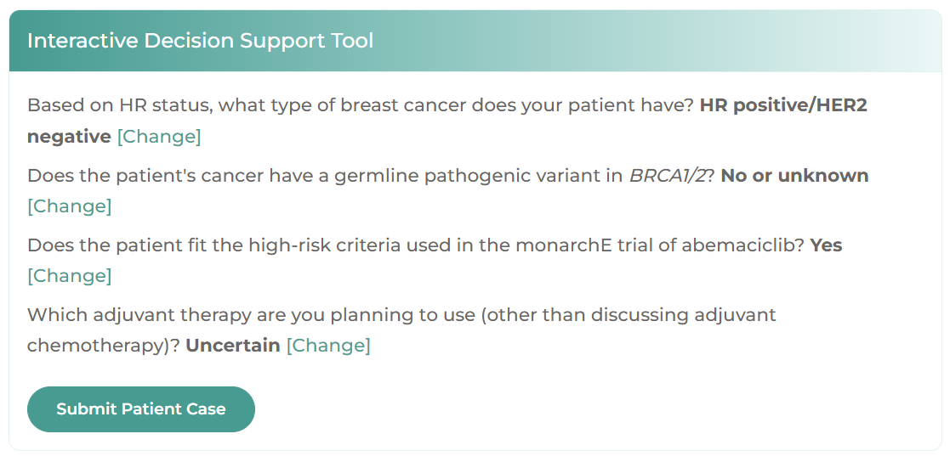
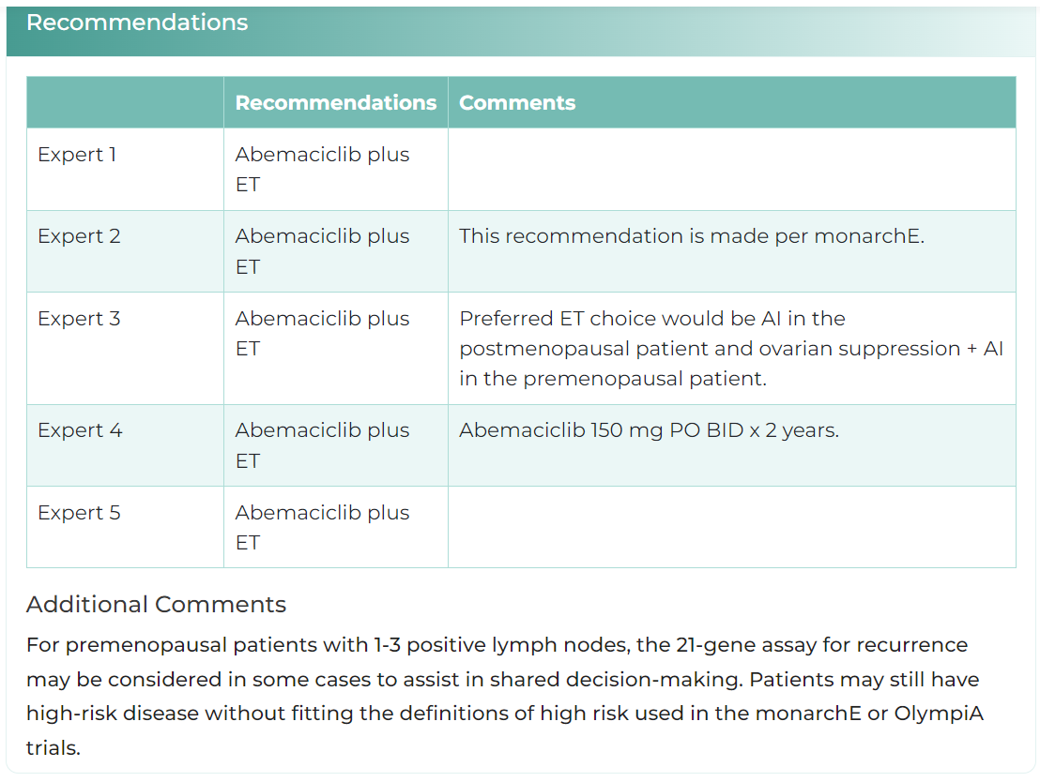

Interactive Decision Support Tool for HER2- EBC
HCP enters patient characteristics
Recommendations from 5 experts
Tool available at:
clinicaloptions.com/HR_TNBC_EBC_Tool
or as an app in your app store
Released: October 06, 2023
Notes:
EBC, early breast cancer; HCP, healthcare professional.

Slide 21
Other Considerations for Adjuvant Therapy in
HR+/HER2- EBC

Slide 22
Additional Considerations of Adjuvant Therapy in
Special Patients With High-Risk EBC
Adjuvant chemotherapy use may be followed by ET if genomic assay and/or recurrence score is high
Optimal targeted agent in the setting of germline BRCA1/2 mutation
  Head-to-head comparison of CDK4/6i and PARP not available at this time
  Most practitioners would favor olaparib in this setting
NCCN. Clinical practice guidelines in oncology: breast cancer. v.4.2023. nccn.org.
Dowsett. J Natl Cancer Inst. 2011;103.1656. Geyer. Ann Oncol. 2022; 33:1250.

Slide 23
Individualizing Therapy for
HR-Positive/HER2-Negative High-Risk MBC

Slide 24
Considerations for First-line Treatment in HR+/HER2- MBC
Localized recurrence
Consider treatment for locoregional recurrence and supportive care measures
Bone disease: consider bone anti-resorptive agents (eg, denosumab or zoledronic acid)
If visceral crises: consider chemotherapy
If no visceral crisis:
  If premenopausal: ovarian suppr/abl + AI + CDK4/6i
  If postmenopausal: AI + CDK4/6i
If CNS disease: local CNS-directed therapy followed by endocrine tx + CDK4/6i (abemaciclib preferred)
If ET refractory: consider systemic chemotherapy, or PARP if gBRCA mutation
Stage IV (M1): Metastatic
Systemic/unresectable disease Systemic tx
Supportive care
Considerations
NCCN. Clinical practice guidelines in oncology: breast cancer. v.4.2023. nccn.org.
Notes:
AI, aromatase inhibitor; CDK4/6i, CDK4/6 inhibitor; CNS, central nervous system; ET, endocrine therapy; MBC, metastatic breast cancer; suppr/abl, suppression/ablation; tx, treatment.
SPEAKER notes:
Aggressive disease in MBC includes w/the following: symptomatic visceral metastases, rapid disease progression or impending visceral compromise, or markedly symptomatic nonvisceral disease.

Slide 25
Expert’s Risk Assessment Algorithm to
Guide Systemic Therapy Selection in MBC
Consideration of Systemic Chemotherapy
Yes
Significant
Visceral Crisis*
?
Stage IV (M1): Metastatic
Metastatic or Locoregional LN HR+ Recurrence
No
ET + CDK4/6i
No
gBRCAmut
?
ET + CDK4/6i
PARPi
Yes
Comorbidity or Frail
Single-Agent ET
*Defined as a patient with significant organ compromise; lymphangitic carcinomatosis, T-bilirubin high, liver enzyme elevation, in need of supplemental oxygen.
NCCN. Clinical practice guidelines in oncology: breast cancer. v.4.2023. nccn.org.
Notes:
CDK4/6i, CDK4/6 inhibitor; ET, endocrine therapy; HR, hormone receptor; LN, lymph node; MBC, metastatic breast cancer; PARPi, PARP inhibitor.

Slide 26
Data Supporting Current Management of MBC
Notes:
MBC, metastatic breast cancer.

Slide 27
Recommended CDK4/6 Inhibitors in 1L HR+ HER2- MBC
Parameter* | PALOMA-2^{1,2} | MONALESSA-2^{3,4} | MONALEESA-7^{5,6} | RIGHT Choice⁷ | MONARCH 3⁸
N | 666 | 668 | 672 | 222 | 493
Treatment arm | Letrozole ± palbociclib | Letrozole ± ribociclib | Tamoxifen, anastrozole, or letrozole ± ribociclib | Ribociclib + anastrozole + goserelin or letrozole vs Inv choice of CT | Anastrozole or letrozole ± abemaciclib
Patient population | Postmenopausal adv BC; no previous systemic tx† | Postmenopausal adv BC with recurrent or MBC; no previous systemic tx† | Pre/perimenopausal advanced BC; no previous ET for adv BC | Adv or metastatic BC; with aggressive disease§ no previous systemic tx | Locally advanced or MBC; postmenopausal; no previous systemic tx
Median PFS, mo (HR; P value) | 27.6 vs 14.5 (0.56; .0001)¹ | 25.3 vs 16.0 (0.57; .0001)³ | 23.8 vs 13.0 (0.55; .0001)⁵ | 24.0 vs 12.3 (0.65; .00065) | 29.0 vs 14.8 (0.518; .0001)
Median OS, mo (HR; P value) | 53.9 vs 51.2 (0.96; .3378)² | 63.9 vs 51.4 (0.76; .008)⁴ | NE vs 40.9 (0.71; .0097)⁶ | -- | 67.1 vs 54.5 (0.754; .0301)
Grade ≥3 AEs (%) | Neutropenia (69.1), WBC decrease (26.0), anemia (7.0) | Neutropenia (52.0), hypertension (15.6), WBC decrease (13.8) | Neutropenia (64.0), WBC decrease (16.1), hepatobiliary (11.0) | Neutropenia (58.0), WBC decrease (23.2), and anemia (5.4) | Neutropenia (27), diarrhea (9.8), and anemia (8.9)
*Cross-trial comparisons have significant limitations due to differences in study design and populations.†No previous therapy has been received for the advanced, recurrent, or metastatic setting.‡Investigators’ choice of combination chemotherapy could consist of docetaxel + capecitabine, paclitaxel + gemcitabine, or capecitabine + vinorelbine. §Defined as asymptomatic visceral metastases rapid progression or impending visceral compromise, highly symptomatic disease.
Rugo. Breast Cancer Res Treat. 2019;174:719. 2. Finn. ASCO 2022. Abstr LBA1003. 3. Hortobagyi. Ann Oncol. 2018;29;1541. 4. Hortobagyi. NEJM. 2022;386;942.
5. Tripathy. Lancet Oncol. 2018;19;904. 6. Im. NEJM. 2019;381;307. 7. Lu. SABCS 2022. Abstr GS1-10. 8. Goetz. ESMO 2022. Abstr LBA15.
Notes:
Adv, advanced; BC, breast cancer; DFI, disease-free interval; FU, follow-up; inv, investigator; CT, chemotherapy; ITT, intention-to-treat population; pbo, placebo; tx, therapy
Pre/perimenopausal women with HR+/HER2- advanced breast cancer (>10% ER+); no prior systemic therapy; aggressive disease*; ECOG PS ≤2;
total bilirubin ≤1.5 ULN
(N = 222)

Slide 28
RIGHT Choice: Ribociclib + ET vs Combination CT in Aggressive HR+/HER2- ABC
Randomized, open-label, multinational phase II study
Primary endpoint: PFS (locally assessed per RECIST 1.1)
Secondary endpoints: TTF, 3-mo TFR, ORR, CBR, TTR, OS, safety, QoL
Stratification by presence of liver metastases and DFI < or ≥2 yr
Ribociclib
600 mg QD PO, 3 wk on/1 wk off
+ ET (letrozole or anastrozole + goserelin)
Pre/perimenopausal women with HR+/HER2- advanced breast cancer (>10% ER+); no prior systemic therapy; aggressive disease*; ECOG PS ≤2;
total bilirubin ≤1.5 ULN
(N = 222)
Until PD or death
Investigators’ Choice of Combination CT
Docetaxel + capecitabine
Paclitaxel + gemcitabine
Capecitabine + vinorelbine
*Aggressive disease includes symptomatic visceral metastases, rapid disease progression or impending visceral compromise, or markedly symptomatic nonvisceral disease.
Lu. SABCS 2022. Abstr GS1-10.
Notes:
CBR, clinical benefit rate; CT, chemotherapy; DFI, disease-free interval; ECOG, Eastern Cooperative Oncology Group; ER, estrogen receptor; ET, endocrine therapy; HR, hormone receptor; ORR, overall response rate; OS, overall survival; PD, progressive disease; PFS, progression-free survival; PS, performance status; QoL, quality of life; RECIST, Response Evaluation Criteria in Solid Tumors; TFR, treatment failure rate; TTF, time to treatment failure; TTR, time to treatment resistance; ULN, upper limit of normal.

Slide 29
RIGHT Choice: PFS and Time to Treatment Failure
PFS (Primary Endpoint)
Time to Treatment Failure
 | Ribociclib + ET | Combination CT
Events/n | 52/112 | 58/110*
Median PFS, mo | 24.0 | 12.3
HR (95% CI) | 0.54 (0.36-0.79; P = .0007)
100
100
Combination CT
80
80
Ribociclib + ET
60
60
PFS (%)
Patients with Treatment Failure (%)
40
40
Ribociclib + ET
 | Ribociclib + ET | Combination CT
Events/n | 61/112 | 84/110*
Median TTF, mo | 18.6 | 8.5
HR (95% CI) | 0.45 (0.32-0.63)
20
20
Combination CT
0
0
0
2
4
6
8
10
12
14
16
18
20
22
24
26
28
30
32
34
36
0
3
6
9
12
15
18
21
24
27
30
33
36
Patients at Risk, n
Ribociclib + ET
Combination CT
Mo
Mo
112
103
99
88
78
70
63
56
50
45
36
30
24
18
7
2
2
1
0
112
99
88
72
63
56
45
36
24
8
2
1
0
110
90
84
75
56
46
37
26
22
20
14
9
6
6
3
1
1
0
0
110
86
75
47
37
26
20
12
6
3
1
0
0
Benefit with ribociclib was seen in most subgroups analyzed
*10 patients in CT arm did not receive treatment.
Lu. SABCS 2022. Abstr GS1-10.
Notes:
CT, chemotherapy; ET, endocrine therapy; PFS, progression-free survival; TTF, time to treatment failure.

Slide 30
RIGHT Choice: Responses and Tolerability
Response
TEAEs and Dose Reductions
100
AE Parameter, n (%) | Ribociclib + ET (n = 112) |  | Combo CT (n = 100)§
 | All Grade | Grade 3/4 | All Grade | Grade 3/4
Total AEs | 112 (100) | 84 (75.0) | 100 (100) | 71 (71.0)
Treatment-related serious AEs | 2 (1.8) | 1 (0.9) | 8 (8.0) | 7 (7.0)
TRAEs leading to discontinuation¶ | 8 (7.1) | 7 (6.3) | 23 (23.0) | 7 (7.0)
Ribociclib + ET (n = 112)
Combination CT (n = 110)
80
60
Patients (%)
40
80.4
72.7
65.2
60.0
20
0
ORR*
CBR†
§10 patients in CT arm excluded from safety set due to failure to receive any treatment. ¶Includes discontinuation of any treatment component.
*Confirmation imaging was not required per study protocol.
†CR or PR without confirmation or SD or non-CR/non-PD ≥24 wk.
Dose Modifications
Time to Response
Dose Reductions |  | Ribociclib + ET (n = 112) | Combo CT (n = 100)*
Number of dose reductions, n (%) | 0 1 2 ≥3 | 81 (72.3) 27 (24.1) 4 (3.6) 0 | 54 (54.0) 12 (12.0) 14 (14.0) 20.0 (20.0)
 | Ribociclib + ET | Combination CT
Events/n | 73/112 | 66/110‡
Median TTR, mo | 4.9 | 3.2
HR (95% CI) | 0.78 (0.56-1.09)
‡10 patients in CT arm did not receive treatment.
Lu. SABCS 2022. Abstr GS1-10.
Notes:
AE, adverse event; CBR, clinical benefit rate; CR, complete response; CT, chemotherapy; ET, endocrine therapy; ORR, overall response rate; PD, progressive disease; PR, partial response; SD, stable disease; TRAE, treatment-related adverse event.

Slide 31
SOLAR-1: PFS and OS With Addition of Alpelisib to Fulvestrant in PIK3CA-Mutant, HR+, ABC
Randomized double-blind, placebo controlled, phase III study of alpelisib plus fulvestrant in men and postmenopausal women with HR+/HER2-negative advanced breast cancer with disease progression on or after AI therapy
PFS (Primary Endpoint)
100
OS (Key Secondary Endpoint)
Alpelisib + FUL (n = 169)
Placebo + FUL (n = 172)
Alpelisib + FUL (n = 169)
Placebo + FUL (n = 172)
100
80
80
60
60
Event-Free Probability (%)
Event-Free Probability (%)
40
40
20
20
0
13
0
15
16
17
18
19
20
21
22
23
1
2
3
4
5
6
7
8
9
24
28
10
11
12
14
25
26
27
29
30
Patients at Risk, n
Alpelisib + FUL
Placebo + FUL
0
31
26
30
32
34
36
38
40
42
44
46
2
4
6
8
48
10
12
14
16
18
20
22
24
28
50
52
Mo
0
54
54
41
43
29
39
29
32
21
30
20
Mo
27
19
158
167
17
14
16
13
14
9
5
3
5
3
1
0
145
120
141
111
123
89
113
88
169
172
97
80
95
77
85
67
82
66
75
58
71
54
82
48
50
37
4
2
3
2
3
2
1
0
1
0
0
0
162
164
94
80
91
74
85
73
68
60
56
49
47
42
35
29
26
20
19
13
9
7
159
155
156
150
145
149
141
143
138
133
133
126
126
119
122
115
112
111
111
104
169
172
108
98
103
92
102
86
4
6
1
3
0
0
Median PFS: 11.0 vs 5.7 mo
Hazard ratio: 0.65 (0.50-0.85)
P = .00065
Median OS: 39.3 vs 31.4 mo
Hazard ratio: 0.86 (0.64-1.15)
P = .15
Notes:
BC, breast cancer; FUL, fulvestrant; HR, hormone receptor; OS, overall survival; PFS, progression-free survival;

Slide 32
BYLieve: Alpelisib + Fulvestrant in PIK3CAm HR+/HER2- ABC After CDK4/6 Inhibitor + AI (Cohort A)
Primary endpoint met in cohort A
in patients who received prior
CDK4/6i + AI
  50.4% alive without PD at
  6 mo per investigator assessment
  Lower bound of 95% CI >30%
Median PFS in mFAS*: 7.3 mo
Reduction in tumor size (70.1%) comparable to cohort B patients who received alpelisib + letrozole after PD on prior CDK4/6i + fulvestrant (66.3%)
Investigator-Assessed Outcome, n (%) | mFAS* (n = 121) | mFAS* With Measurable Disease (n = 100)
Best overall response CR PR Neither CR nor PR SD PD Unknown | 0 21 (17) 16 (13) 55 (45) 14 (12) 15 (12) | 0 21 (21) 0 55 (55) 11 (11) 13 (13)
ORR | 21 (17) | 21 (21)
Clinical benefit rate† | 55 (45) | 42 (42)
*Patients with centrally confirmed PIK3CA mutation.
†Clinical benefit rate = CR + PR + SD + non-CR/non-PD ≥24 wk.
Rugo. SABCS 2020. Abstr PD2-07 Rugo. Lancet Oncol. 2021;22:489.
Notes:
AI, aromatase inhibitor; CBR, clinical benefit rate; CDK4/6i, CKD4/6 inhibitor; CR, complete response; FULV, fulvestrant; mFAS, modified full analysis set; ORR, overall response rate; PD, progressive disease; PR, partial response; SD, stable disease.

Slide 33
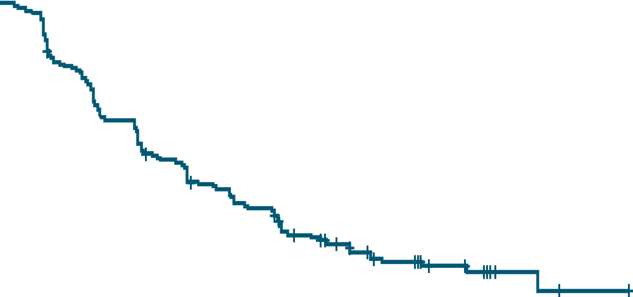
Capivasertib + FULV vs Pbo + FULV in AI-Resistant, HR+/HER2- ABC (CAPItello): Investigator-Assessed PFS
NOW FDA
Approved
PFS in Overall Population
PFS in AKT-Pathway Altered Population
100
100
 | Capivasertib + FULV (n = 355) | Placebo + FULV (n = 353)
PFS events | 258 | 293
Median PFS, mo (95% CI) | 7.2 (5.5-7.4) | 3.6 (2.8-3.7)
 | Adjusted HR: 0.60 (95% CI: 0.51-0.71; 2-sided P <.001)
 | Capivasertib + FULV (n = 155) | Placebo + FULV (n = 134)
PFS events | 121 | 115
Median PFS, mo (95% CI) | 7.3 (5.5-9.0) | 3.1 (2.0-3.7)
 | Adjusted HR: 0.50 (95% CI: 0.38-0.65; 2-sided P <.001)
80
80
60
60
PFS (%)
PFS (%)
40
40
20
20
+ Censored
+ Censored
0
0
0
Patients at Risk, n
Capivasertib + FULV
Placebo + FULV
1
2
3
4
5
6
7
8
9
10
11
12
13
14
15
16
17
18
19
20
21
22
23
24
25
26
0
1
2
3
4
5
6
7
8
9
10
11
12
13
14
15
16
17
18
19
20
21
22
23
24
25
26
Mo From Randomization
Mo From Randomization
355 | 330 | 266 | 252 | 207 | 199 | 172 | 166 | 138 | 133 | 115 | 98 | 78 | 64 | 55 | 44 | 43 | 25 | 25 | 21 | 8 | 8 | 5 | 2 | 2 | 1 | 0
353 | 329 | 207 | 182 | 142 | 136 | 106 | 100 | 86 | 81 | 66 | 59 | 51 | 41 | 33 | 24 | 23 | 12 | 11 | 10 | 4 | 4 | 3 | 1 | 1 | 0 | 0
155 | 150 | 127 | 212 | 99 | 97 | 80 | 76 | 65 | 62 | 54 | 49 | 38 | 31 | 26 | 22 | 21 | 12 | 12 | 9 | 3 | 3 | 2 | 1 | 1 | 0 | 0
134 | 124 | 77 | 64 | 48 | 47 | 37 | 35 | 28 | 27 | 24 | 20 | 17 | 14 | 11 | 6 | 6 | 2 | 2 | 2 | 1 | 1 | 1 | 0 | 0 | 0 | 0
Study met dual primary endpoints, showing significantly prolonged PFS with capivasertib + FULV vs placebo + FULV in overall and AKT pathway–altered populations
PFS benefit consistent across subgroups, including those with prior CDK4/6i and those with liver metastases
OS data at 28% maturity in overall population; HR: 0.74 in overall population; HR: 0.69 in AKT-altered population
Turner. SABCS 2022. Abstr GS3-04. Turner. NEJM. 2023;388:2058.
Notes:
FULV, fulvestrant; PFS, progression-free survival.

Slide 34
EMERALD: Elacestrant vs Investigator’s Choice SoC ET in ER+/HER2- MBC
Randomized, open-label, active-controlled phase III trial
Stratified by mESR1 status (Y vs N), prior fulvestrant (Y vs N), presence of visceral metastases (Y vs N)
Elacestrant 345 mg PO QD
(n = 239)
Men and postmenopausal women with ER+/HER2- MBC; relapse/PD after 1-2 lines of ET (1 line with CDK4/6 inhibitor);
≤1 line of CT for advanced disease; ECOG PS 0/1
(N = 478)
Until progression, unacceptable toxicity, or withdrawal
SoC
(investigator’s choice of fulvestrant,
anastrozole, letrozole, exemestane)
(n = 239)
Coprimary endpoints: PFS in all patients, PFS in patients with ESR1 mutation, both by BICR
Key secondary endpoint: OS
Current analysis examined impact of prior CDK4/6i duration on PFS
Bidard. JCO. 2022;40:3246. Bardia. SABCS 2022. Abstr GS3-01. Elacestrant PI.
Notes:
BICR, blinded independent central review; CDK4/6i, CDK4/6 inhibitor; CT, chemotherapy; ECOG, Eastern Cooperative Oncology Group; ER, estrogen receptor; ET, endocrine therapy; MBC, metastatic breast cancer; OS, overall survival; PFS, progression-free survival; PS, performance status; SoC, standard of care.

Slide 35
EMERALD: PFS in All Patients and in Patients With ESR1 Mutation
PFS Outcomes in All Patients | Elacestrant (n = 239) | SoC (n = 238)
Median PFS, mo 6-mo PFS, % (95% CI) 12-mo PFS, % (95% CI) | 2.8 34.3 (27.2 – 41.5) 22.3 (15.2 – 29.4) | 1.9 20.4 (14.1 – 26.7) 9.4 (4.0 – 14.8)
HR (95% CI) P value | 0.70 (0.55 - 0.88) .002
PFS Outcomes in ESR1 Mutated | Elacestrant (n = 115) | SoC (n = 113)
Median PFS, mo 6-mo PFS, % (95% CI) 12-mo PFS, % (95% CI) | 3.8 40.8 (30.1 – 51.4) 26.8 (16.2 – 37.4) | 1.9 19.1 (10.5 – 27.8) 8.2 (1.3 – 15.1)
HR (95% CI) P value | 0.55 (0.39 - 0.77) .0005
47.8% of patients had ESR1 mutation and 43.4% had 2 previous ET
Bidard. JCO. 2022;40:3246.
Median follow-up: 15.1 mo
Notes:
ET, endocrine therapy.

Slide 36
EMERALD: PFS by Duration (≥6, ≥12, and ≥18 Mo) of
Prior CDK4/6i in All Patients and in ESR1 Mutated
PFS Outcomes in All Patients | CDK4/6i ≥6 Mo (87.5%) |  | CDK4/6i ≥12 Mo (66.7%) |  | CDK4/6i ≥18 Mo (46.7%)
 | Elacestrant (n = 202) | SoC (n = 205) | Elacestrant (n = 150) | SoC (n = 160) | Elacestrant (n = 98) | SoC (n = 119)
Median PFS, mo (95% CI) | 2.79 (1.94-3.78) | 1.91 (1.87-2.14) | 3.78 (2.33-6.51) | 1.91 (1.87-3.58) | 5.45 (2.33-8.61) | 3.29 (1.87-3.71)
HR (95% CI) | 0.688 (0.535-0.884) |  | 0.613 (0.453-0.828) |  | 0.703 (0.482-1.019)
PFS Outcomes in ESR1 Mutated | CDK4/6i ≥6 Mo (92.3%) |  | CDK4/6i ≥12 Mo (71.6%) |  | CDK4/6i ≥18 Mo (50.0%)
 | Elacestrant (n = 103) | SoC (n = 102) | Elacestrant (n = 78) | SoC (n = 81) | Elacestrant (n = 55) | SoC (n = 56)
Median PFS, mo (95% CI) | 4.14 (2.20-7.79) | 1.87 (1.87-3.29) | 8.61 (4.14-10.84) | 1.91 (1.87-3.68) | 8.61 (5.45-16.89) | 2.10 (1.87-3.75)
HR (95% CI) | 0.517 (0.361-0.738) |  | 0.410 (0.262-0.634) |  | 0.466 (0.270-0.791)
Bardia. SABCS 2022. Abstr GS3-01. Bidard. JCO. 2022; 40:3246.
Notes:
CDK4/6i, CDK4/6 inhibitor; PFS, progression-free survival; SoC, standard of care.

Slide 37
EMERALD: PFS by Duration (<6, 6-12, and 12-18 Mo) of Prior CDK4/6i in All Patients and in ESR1 Mutated
PFS Outcomes in All Patients | CDK4/6i <6 Mo |  | CDK4/6i 6-12 Mo |  | CDK4/6i 12-18 Mo
 | Elacestrant (n = 29) | SoC (n = 29) | Elacestrant (n = 52) | SoC (n = 46) | Elacestrant (n = 52) | SoC (n = 40)
Median PFS, mo (95% CI) | 3.55 (1.87-9.43) | 1.87 (1.74-2.20) | 1.91 (1.84-1.94) | 1.87 (1.81-2.14) | 3.52 (1.87-7.29) | 1.84 (1.84-1.87)
HR (95% CI) | 0.709 (0.347-1.405) |  | 1.070 (0.638-1.814) |  | 0.367 (0.204-0.654)
PFS Outcomes in ESR1 Mutated | CDK4/6i <6 Mo |  | CDK4/6i 6-12 Mo |  | CDK4/6i 12-18 Mo
 | Elacestrant (n = 9) | SoC (n = 8) | Elacestrant (n = 25) | SoC (n = 21) | Elacestrant (n = 23) | SoC (n = 25)
Median PFS, mo (95% CI) | 1.87 (1.64-NR) | 1.87 (1.68-5.55) | 1.91 (1.87-2.79) | 1.84 (1.68-3.45) | 5.49 (1.94-NR) | 1.84 (1.84-1.94)
HR (95% CI) | 1.565 (0.424-5.769) |  | 1.122 (0.547-2.347) |  | 0.302 (0.126-0.677)
Bardia. SABCS 2022. Abstr GS3-01. Bidard. JCO. 2022; 40:3246.
Notes:
CDK4/6i, CDK4/6 inhibitor; NA, not applicable; PFS, progression-free survival; SoC, standard of care.

Slide 38
EMERALD: Safety Summary
Safety Outcome, n (%) | Elacestrant (n = 237) | SoC (n = 230)
Grade 3 nausea, n (%) | 6 (2.5) | 2 (0.9)
Dose reduction due to nausea, n (%) | 3 (1.3) | NA
Discontinuation due to nausea, n (%) | 3 (1.3) | 0 (0)
Antiemetic use, % | 8 | 10.3 (AI) 1.3 (fulvestrant)
3.4% of patients receiving elacestrant and 0.9% of patients receiving SoC discontinued treatment due to TRAE
Most AEs grade 1/2; no grade 4 or 5 TRAEs
No hematologic safety signals
No cases of sinus bradycardia
Bardia. SABCS 2022. Abstr GS3-01. Bidard. JCO. 2022; 40:3246.
Notes:
AE, adverse event; AI, aromatase inhibitor; NA, not applicable; SoC, standard of care; TRAE, treatment-related adverse event.

Slide 39
Phase II Trial of Camizestrant vs FV in Postmenopausal ER+/HER2- Adv BC SERENA-2: PFS and Responses
Investigational
PFS by Investigator Assessment
C 75
(n = 74)
C 150
(n = 73)
F
(n = 73)
BICR-assessed PFS was generally consistent with investigator-assessed PFS
  Higher degree of discordance noted
  between investigator-
  and BICR-assessed PFS in camizestrant 150-mg arm
ORR:
  Camizestrant 75 mg, n/N (%): 11/70 (15.7)
  Camizestrant 150 mg, n/N (%): 13/65 (20.8)
  Fulvestrant, n/N (%): 8/68 (11.8)
CBR24:
  Camizestrant 75 mg, n/N (%): 35/74 (47.3)
  Camizestrant 150 mg, n/N (%): 36/73 (49.3)
  Fulvestrant, n/N (%): 28/73 (38.4)
1.0
Median duration
of follow-up, mo
Event, n (%)
Median PFS, mo
(90% CI)
Adjusted HR
(90% CI)*
P value
17.4
58 (79.5)
3.7
(2.0-6.0)
--
--
16.6
50 (67.6)
7.2
(3.7-10.9)
0.58
(0.41-0.81)
0.0124
16.6
51 (69.9)
7.7
(5.5-12.9)
0.67
(0.48-0.92)
0.0161
0.8
0.6
Probability of PFS
0.4
0.2
Camizestrant 75 mg
Camizestrant 150 mg
Fulvestrant 500 mg
0
0
3
6
9
12
15
18
21
24
27
Mo
C 75
C 150
F
74
73
73
50
50
37
33
37
28
27
32
22
21
25
14
14
12
8
7
6
5
2
2
0
1
0
0
*HR adjusted for prior CDK4/6i and for lung/liver metastases.
Oliveira. SABCS 2022. Abstr GS3-02.
Notes:
BICR, blinded independent central review; CBR24, clinical benefit rate at Week 24; C, camizestrant. F, fulvestrant; PFS, progression-free survival.

Slide 40
Phase Ia/b EMBER Study of Imlunestrant + CDK4/6i ±
AI in Patients With ER+/HER2- ABC: Efficacy
Investigational
PFS: Imlunestrant + Abemaciclib
Outcome | Imlunestrant + Abemaciclib (n = 42) | Imlunestrant + Abemaciclib + AI (n = 43) | Total (N = 85)
ORR, n/N (%)* | 9/28 (32) | 20/34 (59) | 29/62 (47)
Median TTR, mo (range) | 3.7 (1.6-10.9) | 3.7 (1.7-7.1) | 3.7 (1.6-10.9)
CBR, n/N (%) | 30/42 (71) | 34/43 (79) | 64/85 (75)
12-mo PFS, % | 80 | 80 | 80
100
80%
80%
75
PFS (%)
50
N Events
42 7
25
0
0
3
6
9
12
15
18
21
Mo
Patients at Risk, n
42
37
26
17
7
4
2
0
PFS: Imlunestrant + Abemaciclib + AI
100
83%
80%
75
*ORR = CR + PR in patients with measurable disease at baseline.
AI addition approximately doubled ORR
  Difference may be due to imbalance in baseline characteristics
1-yr PFS, clinical benefit, and response rate similar to that in MONARCH 2 trial
PFS (%)
50
N Events
43 9
25
0
0
3
6
9
12
15
18
21
Mo
Patients at Risk, n
43
37
30
21
9
4
0
0
Jhaveri. SABCS 2022. Abstr PD13-12.
Notes:
AI, aromatase inhibitor; CBR, clinical benefit rate; CR, complete response; ORR, overall response rate; PFS, progression-free survival; PR, partial response; TTR, time to response.

Slide 41
TROPiCS-02: Sacituzumab Govitecan vs CT for
Previously Treated HR+/HER2- ABC: Updated PFS/OS
PFS (by BICR)
6 mo
45.6% vs 29.4%
12 mo
21.7% vs 8.4%
18 mo
14.4% vs 4.7%
100
80
BICR Analysis
Median PFS, mo (95% CI)
Stratified hazard ratio (95% CI)
Nominal P value
SG (n = 272)
5.5 (4.2-6.9)
TPC (n = 271)
4.0 (3.0-4.4)
60
PFS Probability (%)
0.65 (0.53-0.81)
.0001
40
20
SG
TPC
0
0
3
6
9
12
15
18
21
24
27
30
33
36
OS
Mo
12 mo
60.9% vs 47.1%
18 mo
39.2% vs 31.7%
24 mo
25.7% vs 21.1%
100
Median OS, mo (95% CI)
Stratified hazard ratio (95% CI)
Nominal P value
SG (n = 272)
14.5 (13.0-16.0)
TPC (n = 271)
11.2 (10.2-12.6)
80
60
0.79 (0.65-0.95)
.0133
OS Probability (%)
40
20
SG
TPC
0
0
3
6
9
12
15
18
21
24
27
30
33
36
39
Tolaney. ASCO 2023. Abstr 1003.
Mo
Notes:
BICR, blinded independent central review; OS, overall survival; SG, sacituzumab govitecan; TPC, treatment of physician’s choice.

Slide 42
T-DXd vs Chemotherapy for Previously Treated
HER2-Low ABC (DESTINY-Breast04): PFS and OS
PFS in HR+ Disease (Primary endpoint)
OS in HR+ Disease
 | T-DXd (n = 331) | CT (n = 163)
mOS, mo (95% CI) | 23.9 (20.8-24.8) | 17.5 (15.2-22.4)
HR (95% CI) | 0.64 (0.48-0.86; P = .003)
 | T-DXd (n = 331) | CT (n = 163)
mPFS, mo (95% CI) | 10.1 (9.5-11.5) | 5.4 (4.4-7.1)
HR (95% CI) | 0.51 (0.40-0.64; P <.001)
100
100
80
80
60
60
PFS (%)
OS (%)
40
40
20
20
Δ 4.7 mo
Δ 6.4 mo
0
0
0
1
2
3
4
5
6
7
8
9
10
11
12
13
14
15
16
17
18
19
20
21
22
23
24
25
26
27
28
29
0
1
2
3
4
5
6
7
8
9
10
11
12
13
14
15
16
17
19
20
21
22
23
24
25
26
27
28
29
30
31
32
33
18
34
Patients at Risk, n
Mo
Patients at Risk, n
Mo
T-DXd
331
324
290
265
262
248
218
198
182
165
142
128
107
89
78
73
64
48
37
31
28
17
14
12
7
4
4
1
1
0
T-DXd
331
325
323
319
314
309
303
293
285
280
268
260
250
228
199
190
168
144
95
81
70
51
40
26
14
9
8
6
6
2
1
1
1
0
CT
163
146
105
116
85
84
69
57
48
43
32
30
27
24
20
14
12
8
4
3
2
1
1
1
1
1
1
0
163
151
145
143
139
135
130
124
115
109
104
CT
98
96
89
80
71
56
45
37
29
25
23
16
14
7
5
3
1
0
Modi. ASCO 2022. LBA3. Modi. NEJM. 2022;387:9.
Notes:
CT, chemotherapy; HR, hormone receptor; mOS median overall survival; OS, overall survival; T-DXd, trastuzumab deruxtecan.

Slide 43
Planning and Sequencing Treatment in HR+/HER2- MBC
1L¹ | 2L¹ | 3L¹ | 4/5L¹ | 4L¹ | ≥5L¹
AI + CDK4/6i | ET + CDK4/6i |  | Taxane or cape |  | Eribulin
Fulv + CDK4/6i | ET + Everolimus |  | TMB-H or MSI-H/dMMR: Dostarlimab/Pembrolizumab
 | PIK3CAm: Fulv + Alpelisib² PIK3CA, AKT1, or PTEN alterations: Fulv + capivasertib³* |  | HER2 low: T-DXd¹⁰ | HER2 low: T-DXd⁹
 | BRCAm: Olaparib⁴ or Talazoparib⁵ |  | Sacituzumab govitecan¹¹ |  | Sacituzumab govitecan¹⁰
 | ESR1m: Elacestrant⁶
Investigational
 | ESR1m: Camizestrant⁷ Imlunestrant⁸
 | HER2m: Neratinib + Fulv/Trastuzumab^{1,9} |  |  | HER3-DXd¹²
 |  |  |  | Dato-DXd¹³
*FDA approval: Nov 16, 2023.
1. NCCN. Breast cancer guidelines. v.4.2023. 2. Alpelisib PI. 3. Turner. NEJM. 2023;388:2058. 4. Olaparib PI. 5. Talazoparib PI.
6. Elacestrant PI. 7. Oliveira. SABCS 2022. Abstr GS3-02. 8. Jhaveri. SABCS 2022. Abstr PD13-12. 9. Jhaveri. ASCO 2022. Abstr 1028. 10. Trastuzumab deruxtecan PI. 11. Sacituzumab govitecan PI. 12. Hamilton. ASCO 2023. Abstr 1004. 13. Meric-Bernstam. SABCS 2022. Abstr PD13-08.
Notes:
1L, first line; 2L, second line; 3L, third line, 4, fourth line; 5L, fifth line; AI, aromatase inhibitor; cape, capecitabine; CDK4/6i, CDK4/6 inhibitor; Dato-DXd, datopotamab deruxtecan; dMMR, mismatch repair deficient; ET, endocrine therapy; Fulv, fulvestrant; HER3-DXd, patritumab deruxtecan; MSI-H, microsatellite instability-high; Pembro, pembrolizumab; T-DXd, trastuzumab deruxtecan.

Slide 44
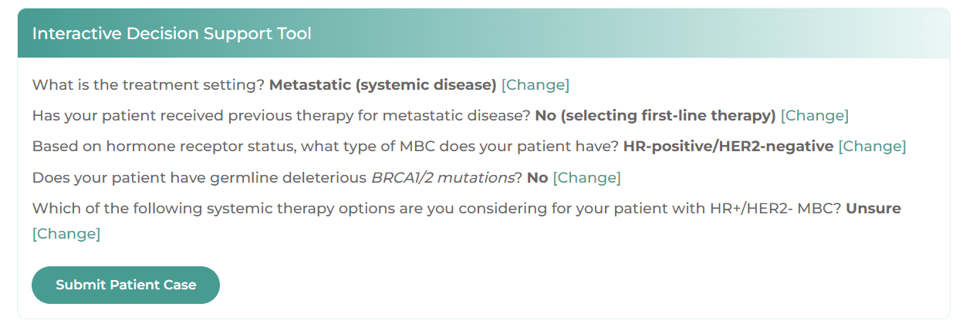
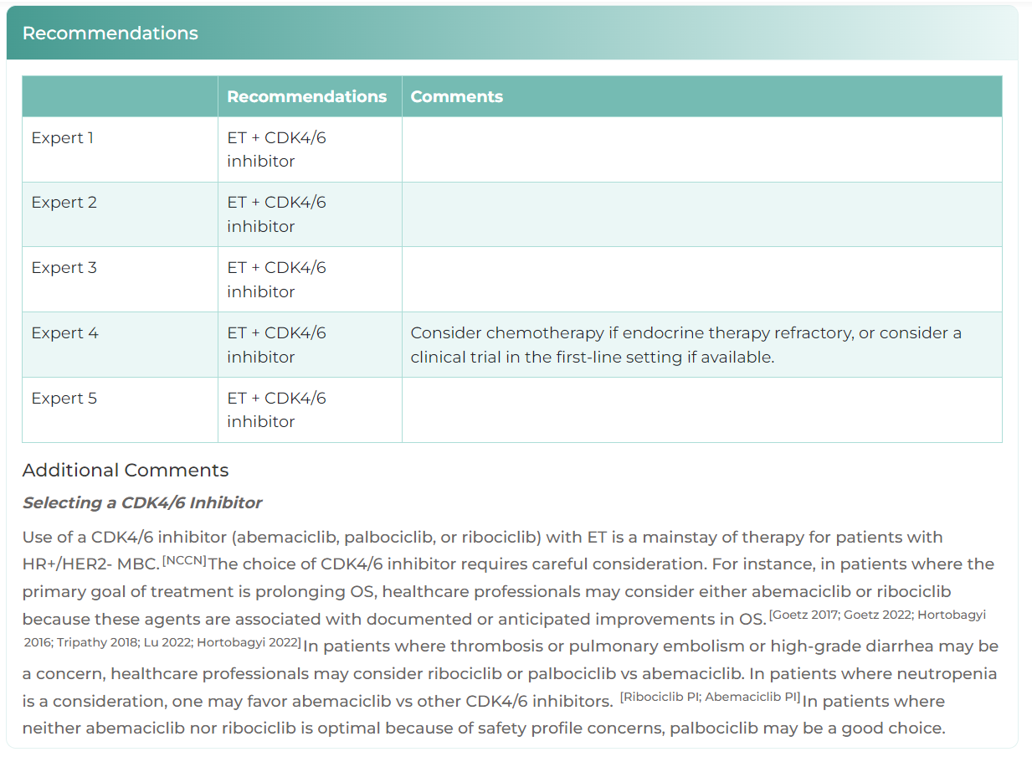

Interactive Decision Support Tool for MBC
HCP enters patient characteristics
Recommendations from 5 experts
Tool available at:
clinicaloptions.com/MBCtool
or as an app in your app store
Released: November 21, 2023

Slide 45
Proactive Management of AEs and Strategies for Promoting Adherence and Persistence to Oral Therapies in Breast Cancer

Slide 46
Key AEs With CDK4/6 Inhibitors:
Monitoring and Prevention to Maximize Adherence
Diarrhea
Abemaciclib
Palbociclib
Ribociclib
Hepatobiliary Toxicity
Abemaciclib
Ribociclib
Neutropenia
Abemaciclib
Palbociclib
Ribociclib
VTE
Abemaciclib
ILD/
Pneumonitis
Abemaciclib
Palbociclib
Ribociclib
Antidiarrheal therapy
Increase oral hydration
Notify healthcare professional
Dietary modification
LFTs before starting treatment, Q2W x
2 mo, then:
Abemaciclib, QM x 2 mo, then as indicated
Ribociclib, at start of cycle x 4 cycles
CBC before starting treatment, then:
Abemaciclib, Q2W x 2 mo,
QM x 2 mo, then as indicated
Palbociclib, D1 and D15 of C1-2, then as indicated
Ribociclib, Q2W x 2 cycles, start of next 4 cycles, then as indicated
Monitor for signs and symptoms of thrombosis or pulmonary embolism
Monitor for pulmonary symptoms indicative of ILD or pneumonitis
(eg, hypoxia, cough, dyspnea)
Abemaciclib PI. Palbociclib PI. Ribociclib PI.
Notes:
AE, adverse event; CBC, complete blood count; ILD, interstitial lung disease; LFT, liver function test; VTE, venous thromboembolism.

Slide 47
Management of Abemaciclib-Induced Diarrhea
At first sign of loose stools
Initiate antidiarrheals (eg, loperamide) and increase oral fluid intake
Grade 1
<4 stools/day over baseline
Grade 2
4-6 stools/day over baseline
Grade 3
≥7 stools/day over baseline
Grade 4
Life-threatening consequences/urgent intervention indicated
Does not resolve to grade ≤1 within 24 hr
Persistent or recurs at same dose despite max supportive care
Continue abemaciclib; no dose modification
Hold dose until resolves to grade ≤1
Hold dose until resolves to
grade ≤1
Dietary modification: Low fiber, low fat, smaller frequent meals
Reduce dose
No dose modification
Reduce dose
1 dose reduction = 50 mg/dose reduction in abemaciclib at a time
Discontinue abemaciclib if unable
to tolerate 50 mg BID
Abemaciclib PI. Rugo. Ann Oncol. 2022;33:616. Sammons. Exp Rev Anticancer Ther. 2022;22:805.

Slide 48
Monitoring and Management for Abemaciclib-Induced Hematologic Toxicity
CBC prior to the beginning of therapy
Every 2 wk for the first 2 mo
Monthly for subsequent 2 mo
Grade 1/2
Grade 3
Recurrent grade 3/4
Continue abemaciclib; no dose modification
Hold dose until resolves to grade ≤2
Hold dose until resolves to grade ≤2
No dose reduction required
Reduce dose
1 dose reduction = 50 mg/dose reduction in abemaciclib at a time
Discontinue abemaciclib if unable to tolerate 50 mg BID
Abemaciclib PI. Rugo. Ann Oncol. 2022;33:616. Sammons. Exp Rev Anticancer Ther. 2022;22:805.
Notes:
CBC, complete blood count.

Slide 49
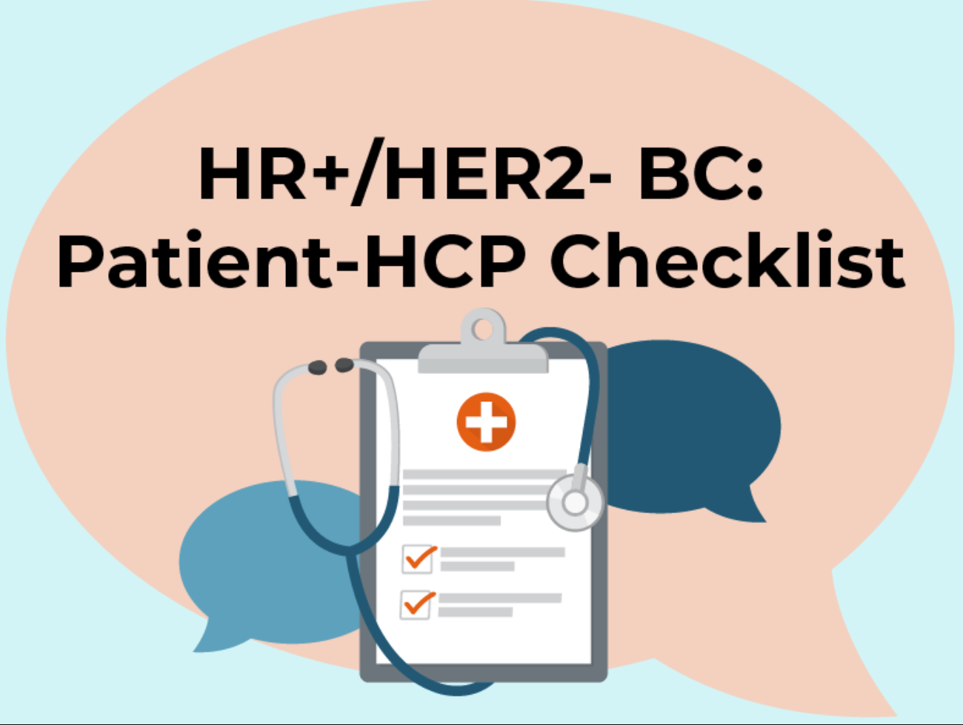
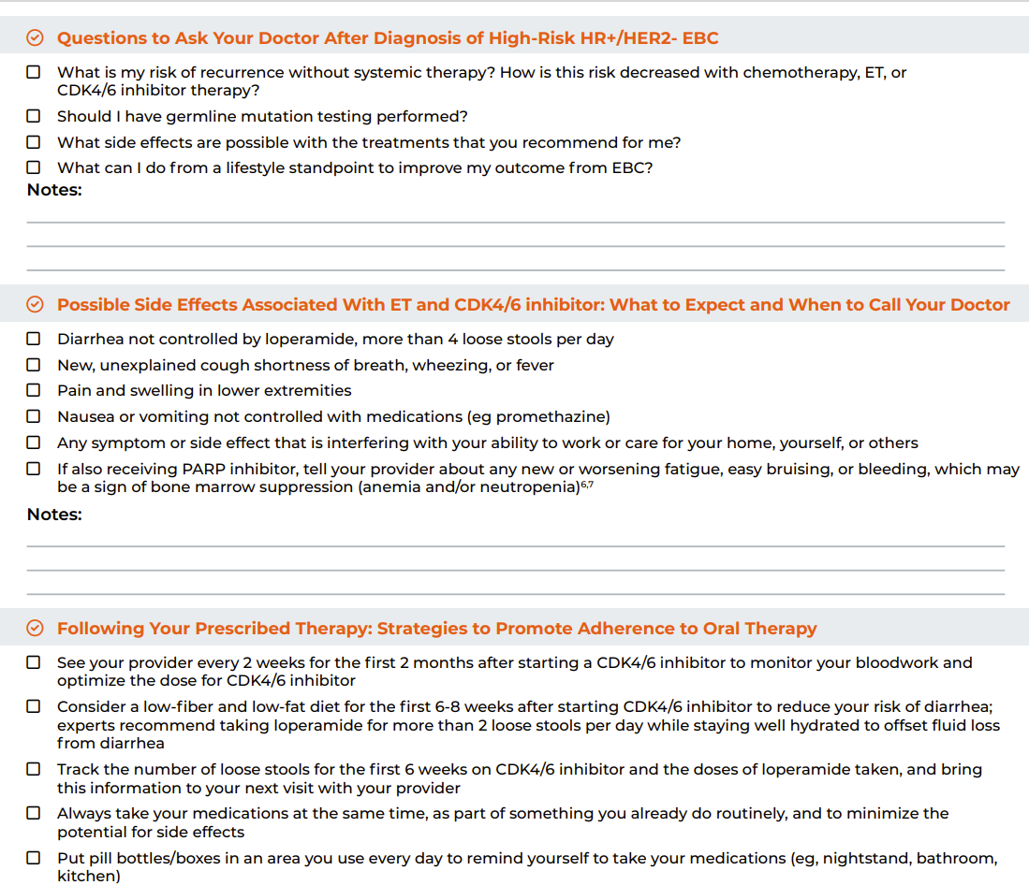

Patient Communication Checklist
Printable, downable resource
Suggests questions for patients to pose to their care team
Space for note-taking
Summary of AEs associated with ET and CDK4/6 inhibitors
Strategies to promote adherence to oral therapy
Available at:
clinicaloptions.com/pt-hcp-checklist

Slide 50
Go Online for More CCO
Coverage of Breast Cancer!
Slides from today’s meeting already available for download from the CCO website!
Clinical commentaries on high-risk breast cancer
Point of care resources with key information for improving patient and provider communication regarding molecular/genetics testing and available patient resources
Interactive decision support tool with expert recommendation on selecting appropriate therapy for patients with metastatic breast cancer
clinicaloptions.com
clinicaloptions.com/MBCtool
clinicaloptions.com/HR_TNBC_EBC_Tool
clinicaloptions.com/pt-hcp-checklist

Slide 51
Supplemental Slides

Slide 52
Risk Assessment Criteria to Guide
Adjuvant Therapy Selection in EBC
1-3 positive ALN
Tumor ≥5 cm (consideration for RT)
Positive margins (consideration for re-excision and/or RT to chest wall ± comprehensive RNI
Postmenopausal, 21-gene panel for CT eligibility (recurrence score <26, ≥26):
  Adj ET
  Adj CT -> ET
Premenopausal and tumor >5 cm, and 21-gene panel for CT eligibility (recurrence score: ≤15, 16-25, ≥26)
  Adj ET ± ovarian suppr/abl,
  Adj ET ± ovarian suppr/abl or Adj CT -> ET,
  Adj CT -> ET
Symptomatic disease
Surgical staging
(M0)
cT1-T3, cN0-3, M0: Considering systemic therapy
Summary
List of variables
NCCN. Clinical practice guidelines in oncology: breast cancer. v.4.2023. nccn.org.
Notes:
ALN, axillary lymph node; RNI, regional nodal irradiation; suppr/abl, suppression/ablation.

Slide 53
Expert’s Risk Assessment Algorithm to Inform
Systemic Adjuvant Therapy Selection in EBC
Comorbidity or Frail?
Yes
Single-agent ET
High risk after CT?
Consideration of neo/adjuvant Chemotherapy
Yes
Abemaciclib + ET
Surgical staging
(M0)
cT1-T3,cN0-3,M0: Considering systemic therapy
High Risk of Recurrence*
No
AI, NSAI, or ET
Relevant biomarkers?
ET + PARP inhibitor (if meets OlympiA criteria)
gBRCAmut
*May also consider adjuvant zoledronic acid in selected cases.
†Not yet FDA approved.
Yes
NCCN. Clinical practice guidelines in oncology: breast cancer. v.4.2023. nccn.org. He. J Hematol Oncol. 2013;5:80.
Notes:
ALN, axillary lymph node; EBC, early breast cancer; MBC, metastatic breast cancer; RNI, regional nodal irradiation.

Slide 54
monarchE: Adjuvant Abemaciclib + ET in
High-Risk, Node-Positive, HR+/HER2- EBC
International, randomized, open-label phase III trial
Stratified by prior CT,
menopausal status, region
ITT Population (Cohorts 1 + 2)
Patients with high-risk, node-positive, HR+/HER2- EBC; prior (neo)adjuvant CT permitted;
pre- or postmenopausal;
no distant metastasis;
≤16 mo from surgery to randomization; ≤12 wk of ET
after last non-ET
(N = 5637)
Cohort 1 (91% of patients)
≥4 positive ALNs or 1-3 positive ALNs plus histologic grade 3 and/or tumor ≥5 cm
Abemaciclib 150 mg BID up to 2 yr +
ET per standard of care of physician’s choice for 5-10 yr as clinically indicated
(n = 2808)
Cohort 2 (9% of patients)
1-3 positive ALNs, Ki-67 ≥20% per central testing, grade 1/2, tumor size <5 cm
ET per standard of care of physician’s choice for 5-10 yr as clinically indicated
(n = 2829)
Primary endpoint: iDFS
Key secondary endpoints: iDFS in Ki-67 high (≥20%) population; DRFS; OS; safety; PROs
Current analyses: molecular profiling of primary tumor and relationship with clinical outcomes;
pilot study of technical feasibility of ctDNA monitoring and association with recurrence
Johnston. JCO. 2020;38:3987. Loi. SABCS 2023. Abstr PS06-01. Turner. SABCS 2023. Abstr GS03-06.
Notes:
ALN, axillary lymph node; CT, chemotherapy; DRFS, distant relapse–free survival; EBC, early breast cancer; ET, endocrine therapy; HR, hormone receptor; iDFS, invasive disease–free survival; ITT, intention-to-treat; OS, overall survival; PRO, patient-reported outcome.

Slide 55
monarchE Molecular Profiling
Design: case-cohort design to evaluate treatment effect (HR) of abemaciclib
Patient subset: n = 1400 biomarker population consisting of:
  Stratified, random sample of patients from ITT population and
  All patients with iDFS events (cases) at primary analysis cutoff (July 8, 2020)
Biomarker analysis: whole-exome sequencing (WES) and exome-capture RNA sequencing (RNAseq) performed on baseline primary tumor samples
  WES identified mutations/indels, CNVs, structural variants
  RNAseq assessed gene expression, fusions, and RNA subtypes
Statistical analysis: examined association between iDFS and molecular subtypes, risk predictors, and biomarker mutations/CNVs using K–M analyses with Cox proportional hazards
Tumors With Adequate Results, n | Total | Abema + ET | ET Alone
WES | 1173 | 580 | 593
RNAseq | 1190 | 605 | 585
Turner. SABCS 2023. Abstr GS03-06.
Notes:
CNV, copy number variation; ET, endocrine therapy; HR, hormone receptor; iDFS, invasive disease–free survival; ITT, intention-to-treat; RNAseq, exome-capture RNA sequencing; WES, whole exome sequencing.

Slide 56
monarchE Molecular Profiling: Baseline Characteristics in ITT Population and Biomarker Subset
Characteristic, n (%) |  | ITT (N = 5637) |  | Biomarker WES (n = 1173) |  | Biomarker RNA (n = 1190)
 |  | Abemaciclib + ET | ET | Abemaciclib + ET | ET | Abemaciclib + ET | ET
Age ≥65 yr |  | 437 (16) | 413 (15) | 104 (18) | 75 (13) | 92 (15) | 82 (14)
Race | Asian White | 675 (24) 1947 (69) | 669 (24) 1978 (70) | 125 (22) 414 (71) | 125 (21) 430 (73) | 65 (11) 490 (81) | 59 (10) 480 (82)
Menopausal status | Pre Post | 1227 (44) 1576 (56) | 1224 (43) 1605 (57) | 237 (41) 343 (59) | 259 (44) 334 (56) | 247 (41) 357 (59) | 230 (39) 355 (61)
Prior tx | ET only CT only CT + ET | 84 (3) 953 (34) 1690 (60) | 106 (4) 946 (33) 1709 (60) | 28 (5) 184 (32) 351 (61) | 22 (4) 202 (34) 353 (60) | 26 (4) 211 (35) 353 (58) | 27 (5) 211 (36) 331 (57)
Tumor stage | IA IIA IIB IIIA IIIB IIIC | 14 (1) 336 (12) 404 (14) 1041 (37) 111 (4) 962 (34) | 12 (0) 364 (13) 398 (14) 1037 (37) 99 (4) 974 (34) | 1 (0) 58 (10) 80 (14) 228 (39) 22 (4) 191 (33) | 2 (0) 58 (10) 93 (16) 218 (37) 16 (3) 216 (36) | 1 (0) 66 (11) 84 (14) 229 (38) 20 (3) 205 (34) | 2 (0) 66 (11) 92 (16) 207 (35) 13 (2) 215 (37)
Characteristics similar between ITT population and biomarker subset
Turner. SABCS 2023. Abstr GS03-06.
Notes:
CT, chemotherapy; ET, endocrine therapy; ITT, intention-to-treat; WES, whole exome sequencing.

Slide 57
monarchE Molecular Profiling: iDFS in ITT Population and Biomarker Subset
Outcome | iDFS
Parameter, % | ITT (N = 5637) | Biomarker WES (n = 1173)* | Biomarker RNA (n = 1190)*
Events, n* Abemaciclib + ET ET alone | 407 585 | 123 169 | 138 182
HR (95% CI) | 0.68 (0.60-0.77; nominal P <.0001) | 0.72 (0.57-0.91; nominal P = .0052) | 0.70 (0.56-0.88; nominal P = .0017)
4-yr iDFS rate, % (95% CI) Abemaciclib + ET ET alone | 86.0 (84.7-87.3) 80.0 (78.5-81.6) | 79.9 (76.6-83.3) 71.9 (68.3-75.6) | 77.4 (74.1-80.9) 69.8 (66.1-73.7)
*Case-cohort design enriched iDFS events in biomarker subset compared with ITT population.
Consistent benefit with addition of abemaciclib to ET observed in biomarker subset
Turner. SABCS 2023. Abstr GS03-06.
Notes:
ET, endocrine therapy; iDFS, invasive disease–free survival; ITT, intention-to-treat; WES, whole exome sequencing.

Slide 58
monarchE Molecular Profiling: iDFS Across Intrinsic Molecular Subtypes
Outcome | Abemaciclib + ET |  |  | ET Alone |  |  | HR (95% CI)†
 | Prevalence, % | Events, n/N (%)* | 4-Yr iDFS, % (95% CI) | Prevalence, % | Events, n/N (%)* | 4-Yr iDFS, % (95% CI)
ITT | — | 407/2808 (14) | 86.0 (84.7-87.3) | — | 585/2829 (21) | 80.0 (78.5-81.6) | 0.68 (0.60-0.77)
Biomarker subset Luminal A Luminal B HER2 enriched Basal | 38 44 11 3 | 138/605 (23) 28/230 (12) 65/265 (25) 32/69 (46) 9/21 (43) | 77.4 (74.1-80.9) 87.5 (83.2-92) 76.3 (71.2-81.7) 52.6 (41.8-66.2) 57.1 (39.5-82.8) | 39 45 10 3 | 182/585 (31) 45/228 (20) 88/262 (34) 34/59 (58) 8/15 (53) | 69.8 (66.1-73.7) 81.4 (76.3-86.8) 66.6 (61.1-72.7) 42.5 (31.4-57.5) 46.7 (27.2-80.2) | 0.70 (0.56-0.88) 0.59 (0.37-0.95) 0.70 (0.51-0.97) 0.74 (0.46-1.2) 0.75 (0.29-1.9)
*Case-cohort design enriched for iDFS events in biomarker subset compared with ITT population. †P = .621 for interaction across all subtypes.
Abemaciclib associated with comparable iDFS benefit across molecular subtypes
  Normal-like subtype (in 3%-4%) excluded from analysis due to low WES purity
Molecular subtype assignments and RNA expression of ER/PgR/HER2 comparable between monarchE biomarker subset and TCGA cohort
  In both treatment arms, ~80% of tumors assigned to Luminal A/B subtypes
Turner. SABCS 2023. Abstr GS03-06.
Notes:
ER, estrogen receptor; ET, endocrine therapy; HER2, human epidermal growth factor receptor 2; iDFS, invasive disease–free survival; PgR, progesterone receptor; ITT, intention-to-treat; WES, whole exome sequencing.

Slide 59
monarchE Molecular Profiling: iDFS Across Inferred Oncotype Risk Scores
Outcome¹ | Abemaciclib + ET |  |  | ET Alone |  |  | HR (95% CI)†
 | Prevalence, % | Events, n/N (%)* | 4-Yr iDFS, % (95% CI) | Prevalence, % | Events, n/N (%)* | 4-Yr iDFS, % (95% CI)
ITT | — | 407/2808 (14) | 86.0 (84.7-87.3) | -- | 585/2829 (21) | 80.0 (78.5-81.6) | 0.68 (0.60-0.77)
Biomarker subset |  | 138/605 (23) | 77.4 (74.1-80.9) |  | 182/585 (31) | 69.8 (66.1-73.7) | 0.70 (0.56-0.88)
Inferred Oncotype-RNA score ≤25 | 29 | 18/173 (10) | 90.2 (85.8-94.9) | 28 | 28/165 (17) | 84.2 (78.7-90.1) | 0.59 (0.33-1.10)
Inferred Oncotype-RNA score >25 | 71 | 120/432 (28) | 72.3 (68.1-76.8) | 72 | 154/420 (37) | 64.1 (59.6-69) | 0.73 (0.57-0.92)
*Case-cohort design enriched for iDFS events in biomarker subset vs ITT population; presented iDFS rates indicative of relative prognosis but do not inform actual risk of recurrence within each subtype. †P = .532 for interaction across high and low inferred Oncotype scores.
Used RNAseq data to infer 21-gene Oncotype expression signature score¹
  Inferring Oncotype from RNAseq provides results comparable to standard RT-PCR assay²
iDFS benefit with abemaciclib observed in high-risk and low-risk subgroups, where risk defined by inferred Oncotype risk score¹
1. Turner. SABCS 2023. Abstr GS03-06. 2. Buus. NPJ Breast Cancer. 2021;7:15.
Notes:
ET, endocrine therapy; iDFS, invasive disease–free survival; ITT, intention-to-treat.

Slide 60
monarchE Molecular Profiling: iDFS Across Most Common Oncogenic Alterations* (Prevalence ≥9%)
Alteration | Prevalence, % | Events/n (%) |  | HR (95% CI) | Interaction P Value
 |  | Abema + ET | ET Alone
All patients |  | 123/580 (22) | 169/593 (28) | 0.72 (0.57-0.91)
PIK3CA mut | 38 | 55/217 (26) | 73/229 (32) | 0.75 (0.53-1.1) | .758
PIK3CA wt |  | 68/363 (18) | 96/364 (26) | 0.70 (0.51-0.95)
TP53 mut/homdel | 32 | 55/189 (30) | 82/184 (44) | 0.60 (0.42-0.84) | .184
TP53 wt |  | 68/391 (18) | 87/409 (22) | 0.81 (0.59-1.1)
CCND1 amp | 20 | 36/113 (32) | 42/129 (32) | 0.94 (0.6-1.5) | .177
CCND1 wt |  | 87/467 (18) | 127/464 (28) | 0.66 (0.5-0.87)
ZNF703 amp | 16 | 28/96 (30) | 37/100 (36) | 0.77 (0.47-1.3) | .776
ZNF703 wt |  | 95/484 (20) | 132/493 (26) | 0.71 (0.54-0.92)
MYC amp | 16 | 34/92 (36) | 25/84 (30) | 1.30 (0.77-2.2) | .014
MYC wt |  | 89/488 (18) | 144/509 (28) | 0.62 (0.47-0.8)
FGFR1 amp | 16 | 26/88 (30) | 35/98 (36) | 0.80 (0.48-1.3) | .641
FGFR1 wt |  | 97/492 (20) | 134/495 (28) | 0.70 (0.54-0.91)
GATA3 mut | 14 | 13/73 (18) | 17/88 (20) | 0.86 (0.42-1.8) | .513
GATA3 wt |  | 110/507 (22) | 152/505 (30) | 0.69 (0.54-0.89)
Prevalence of oncogenic alterations* in monarchE similar to TCGA population
iDFS benefit with abemaciclib consistent across most common alterations
MYC amp associated with decreased benefit from abemaciclib
  Exploratory analysis limited by small sample size
*Variants known to be activating or to impart loss of function.
Turner. SABCS 2023. Abstr GS03-06.
Notes:
Amp, amplification; homdel, homozygous deletion; ET, endocrine therapy; iDFS, invasive disease–free survival; mut, mutation; wt, wild-type.

Slide 61
Technical Feasibility of ctDNA Detection in monarchE:
Pilot Study Design and Patient Subset Characteristics
Design: pilot study evaluating technical feasibility of ctDNA detection and dynamics in subset of patients from monarchE¹
Patient subset: preselected N = 178 patients with range of tumor mutation burden based on existing data from WES of primary tumors¹
  Limited to those with available samples, prior adjuvant CT,* and who initiated ET before randomization
  Excluded those who experienced iDFS events within 2-yr treatment period
Sample collection and analysis:¹
  Tumor tissue collected at screening, plasma collected at Mo 0 and Mo 24
  ctDNA detected with Signatera™ ctDNA assay individualized to each patient using up to 16 genetic variants from baseline WES data
  Clinical data cutoff: July 1, 2022
Characteristic¹ | Patient Subset (N = 178)
Treatment arm, n Abemaciclib + ET ET alone | 84 94
Prior CT, % | 95
On adjuvant ET at time of randomization, % | 60
*In ITT population of monarchE, 58% had received adjuvant CT.²
1. Loi. SABCS 2023. Abstr PS06-01. 2. Johnston. JCO. 2020;38:3987.
Notes:
CT, chemotherapy; ET, endocrine therapy; iDFS, invasive disease–free survival; WES, whole exome sequencing.

Slide 62
Technical Feasibility of ctDNA Detection in monarchE: Association Between ctDNA Positivity and Recurrence
Parameter, n (%) | Patients | ctDNA+ at BL | ctDNA+ at Mo 24 | iDFS Event
Pilot subset | 178 | 10 (5.6) | 42 (23.6) | 70 (39.3)
With recurrence | 70 (39.3) | 7 (10.0) | 42 (60.0) | 70 (100)
Without recurrence | 108 (60.7) | 3 (2.8) | NA | NA
ctDNA+ at BL | 10 (5.6) | 10 (100) | 7 (70.0) | 7 (70.0)
Remained ctDNA+ | 7 (3.9) | 7 (100) | 7 (100) | 7 (100)
Cleared at 24 mo | 3 (1.7) | 3 (100) | NA | NA
Became ctDNA+ at 24 mo | 35 (19.7) | NA | 35 (100) | 35 (100)
Persistent ctDNA- at 0 and 24 mo | 133 (74.7) | NA | NA | 28 (21.1)
 |  | Recurrence, n
 |  | Yes | No
At Mo 0 | ctDNA+ | 7 | 3 | PPV = 70%
 | ctDNA- | 63 | 105 | NPV = 63%
 |  | Recurrence, n
 |  | Yes | No
At Mo 24 | ctDNA+ | 42 | 0 | PPV = 100%
 | ctDNA- | 28 | 108 | NPV = 79%
Median duration from ctDNA detection → recurrence (range):
  Among those ctDNA+ at BL: from BL, 27 mo (25-43); from Mo 24, 3 mo (1-19)
  Among those who became ctDNA+ at 24 mo: from Mo 24, 5 mo (0-25)
Loi. SABCS 2023. Abstr PS06-01.
Notes:
BL, baseline; NA, not applicable; iDFS, invasive disease–free survival; NPV, negative predictive value; PPV, positive predictive value.

Slide 63
Abemaciclib + Nonsteroidal AI as 1L for HR+/HER2- Advanced Breast Cancer (MONARCH 3)
Randomized, multicenter phase III study
Stratification by metastatic site (visceral, bone only, or other) and prior ET (AI, no ET, or other)
Patients with HR+/HER2- ABC
with metastatic or locoregionally recurrent disease with no prior systemic therapy; postmenopausal; >12 mo
disease-free interval since (neo)adjuvant ET, if applicable: ECOG PS ≤1
(N = 493)
Abemaciclib 150 mg PO BID
+ Anastrozole* 1 mg PO QD
or Letrozole* 2.5 mg PO QD
(n = 328)
Until PD
Placebo PO BID
+ Anastrozole* 1 mg PO QD
or Letrozole* 2.5 mg PO QD
(n = 165)
*Physician’s choice: 79.1% letrozole, 19.9% anastrozole.
Primary endpoint: investigator-assessed PFS
Secondary endpoints: OS, response rates, safety
Goetz. ESMO 2022. Abstr LBA15.
Notes:
ABC, advanced breast cancer; AI, aromatase inhibitor; ECOG, Eastern Oncology Cooperative Group; ET, endocrine therapy; HR, hormone receptor; OS, overall survival; PD, progressive disease; PFS, progression-free survival; PS, performance status.

Slide 64
MONARCH 3: Updated PFS and OS
PFS in ITT analysis Abema + NSAI vs NSAI: 29.0 vs 14.8 mo (hazard ratio: 0.518; P <.0001†)
5-yr PFS rate Abema + NSAI vs NSAI: 26.7% vs 9.6%
OS in Overall Population
Subgroup With Visceral Disease
Result* | Abemaciclib + NSAI (n = 328) | Placebo + NSAI (n = 165)
Median OS, mo | 67.1 | 54.5
Hazard ratio (95% CI) P value | 0.754 (0.584-0.974) .0301†
Events, n | 158 | 97
Received subsequent CDK4/6 therapy, % | 31.5 | 10.1
Result* | Abemaciclib + NSAI (n = 173) | Placebo + NSAI (n = 90) | Placebo + NSAI (n = 90)
Median OS, mo | 65.1 | 48.8 | 48.8
Hazard ratio (95% CI) P value | 0.708 (0.508-0.985) .0392†
Events, n | 91 |  | 58
*Preplanned OS interim 2 analysis data cutoff: July 2, 2021.
†P value for statistical significance not reached.
Goetz. ESMO 2022. Abstr LBA15.
Notes:
ITT, intention-to-treat; NSAI, nonsteroidal aromatase inhibitor; OS, overall survival; PFS, progression-free survival.

Slide 65
MONARCH 3: Safety Summary
Adverse Event, n (%) | Abemaciclib + NSAI (n = 327) |  | Placebo + NSAI (n = 161)
 | Any Grade | Grade ≥3 | Any Grade | Grade ≥3
Patients with ≥1 TEAE | 323 (98.8) | 224 (68.5) | 152 (94.4) | 46 (28.6)
Diarrhea | 272 (83.2) | 32 (9.8) | 54 (33.5) | 2 (1.2)
Neutropenia | 153 (46.8) | 89 (27.2) | 3 (1.9) | 2 (1.2)
Fatigue | 145 (44.3) | 7 (2.1) | 57 (35.4) | 0
Nausea | 137 (41.9) | 4 (1.2) | 35 (21.7) | 2 (1.2)
Anemia | 113 (34.6) | 29 (8.9) | 16 (9.9) | 2 (1.2)
Abdominal pain | 108 (33.0) | 6 (1.8) | 26 (16.1) | 2 (1.2)
Vomiting | 104 (31.8) | 5 (1.5) | 24 (14.9) | 4 (2.5)
Goetz. ESMO 2022. Abstr LBA15.
Notes:
NSAI, nonsteroidal aromatase inhibitor; TEAE, treatment-emergent adverse event.

Slide 66
postMONARCH: Abemaciclib + Fulvestrant vs Placebo + Fulvestrant in HR+/HER2- MBC After CDK4/6i and ET
Global, multicenter, randomized, double-blind, placebo-controlled phase III study
Primary endpoint: PFS by investigator
Key secondary endpoints: OS, PFS by BICR, ORR, safety, PRO, CBR, DCR, DoR, pharmacokinetics
Stratified by geography, presence of visceral metastasis, and duration of prior CDK4 & 6 inhibitor-based therapy
Abemaciclib 150 mg BID up to 2 yr +
Fulvestrant 500 mg IV on D1,15 of cycle 1, then Q4W
Statistical consideration:
Powered at 80% with cumulative Type I error of 0.025 to detect the superiority of experimental arm vs control for PFS by investigator.
Women or men with HR+/HER2- locally advanced or MBC; evidence of recurrence or disease progression either while receiving treatment with CDK4/6i and AI as initial therapy for advanced disease or on/after therapy with CDK4/6i + ET as adjuvant therapy for early-stage breast cancer; ECOG PS ≤1
(N = 350)
Placebo PO BID
(4 days on, 3 days off) +
Fulvestrant 500 mg IV on D1,15 of cycle 1, then Q4W
NCT05169567. Kalinsky. ASCO 2022. Abstr TPS1117.
Notes:
AI, aromatase inhibitor; BICR, blind independent central review; CBR, clinical benefit ratel CDK4/6i, CDK4/6 inhibitor; DCR, disease control rate; DoR, duration of response; ECOG, Eastern Cooperative Oncology Group ET, endocrine therapy; HR, hormone receptor; MBC, metastatic breast cancer; OS, overall survival; PFS, progression–free survival; PRO, patient-reported outcome; PS, performance status.

