Slide 1

Mechanism Matters:
The Future of Targeted Treatments in Myasthenia Gravis
Gil Wolfe, MD, FAAN
SUNY Distinguished Professor
Neuromuscular Division
Department of Neurology
University at Buffalo Jacobs School of Medicine and Biomedical Sciences
State University of New York
Buffalo, New York
Provided by Clinical Care Options, LLC dba Decera Clinical Education.
This activity is supported by an independent medical education grant from Regeneron Pharmaceuticals, Inc.

Slide 2
About These Slides
Please feel free to use and share some or all of these slides in your noncommercial presentations to colleagues or patients
When using our slides, please retain the source attribution:
Slide credit: deceraclinical.com/education
These slides may not be published, posted online, or used in commercial presentations without permission. Please contact permissions@deceraclinical.com for details
Notes:
Disclaimer: The materials published on the Decera Clinical Education website reflect the views of the authors of the Decera Clinical Education material, not those of Decera Clinical Education, the CME providers, or the companies providing educational grants. The materials may discuss uses and dosages for therapeutic products that have not been approved by the FDA. A qualified healthcare professional should be consulted before using any therapeutic product discussed. Readers should verify all information and data before treating patients or using any therapies described in these materials.

Slide 3
Faculty
Gil Wolfe, MD, FAAN
SUNY Distinguished Professor
Neuromuscular Division
Department of Neurology
University at Buffalo Jacobs School of Medicine and Biomedical Sciences
State University of New York
Buffalo, New York

Slide 4
Disclosures
The faculty reported the following relevant financial relationships or relationships to products or devices they have with ineligible companies related to the content of this educational activity:
Gil Wolfe, MD, FAAN: consultant/advisor/speaker: Alexion, Amgen, Johnson & Johnson, UCB; researcher: ArgenX, Cartesian, Novartis, Vor Bio

Slide 5
Learning Objectives
Summarize emerging clinical trial data related to novel and emerging C5 inhibitors and FcRn inhibitors in the care of people with gMG
Differentiate novel and emerging C5 inhibitors and FcRn inhibitors based on their clinical characteristics, such as efficacy, safety profiles, and schedules/routes of administration
Notes:
C5, complement component 5; FcRn, neonatal Fc receptor; gMG, generalized myasthenia gravis.

Slide 6


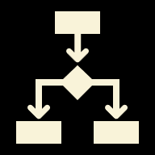

gMG Treatment Landscape: Where Targeted Agents Fit
Treatment goals: improve function, reduce exacerbations, and minimize toxicity
Traditional therapies remain foundational; targeted agents add mechanism-specific options
Selection now depends on antibody status, disease phenotype, safety logistics, route/cadence, and patient preference
Key question: Which mechanism best fits this patient and treatment goal?
Narayanaswami. Neurology. 2021;96:114. Eculizumab PI. Ravulizumab-cwvz PI. Zilucoplan PI. Efgartigimod alfa-fcab PI. Rozanolixizumab-noli PI. Nipocalimab-aahu PI.
Notes:
gMG, generalized myasthenia gravis.

Slide 7
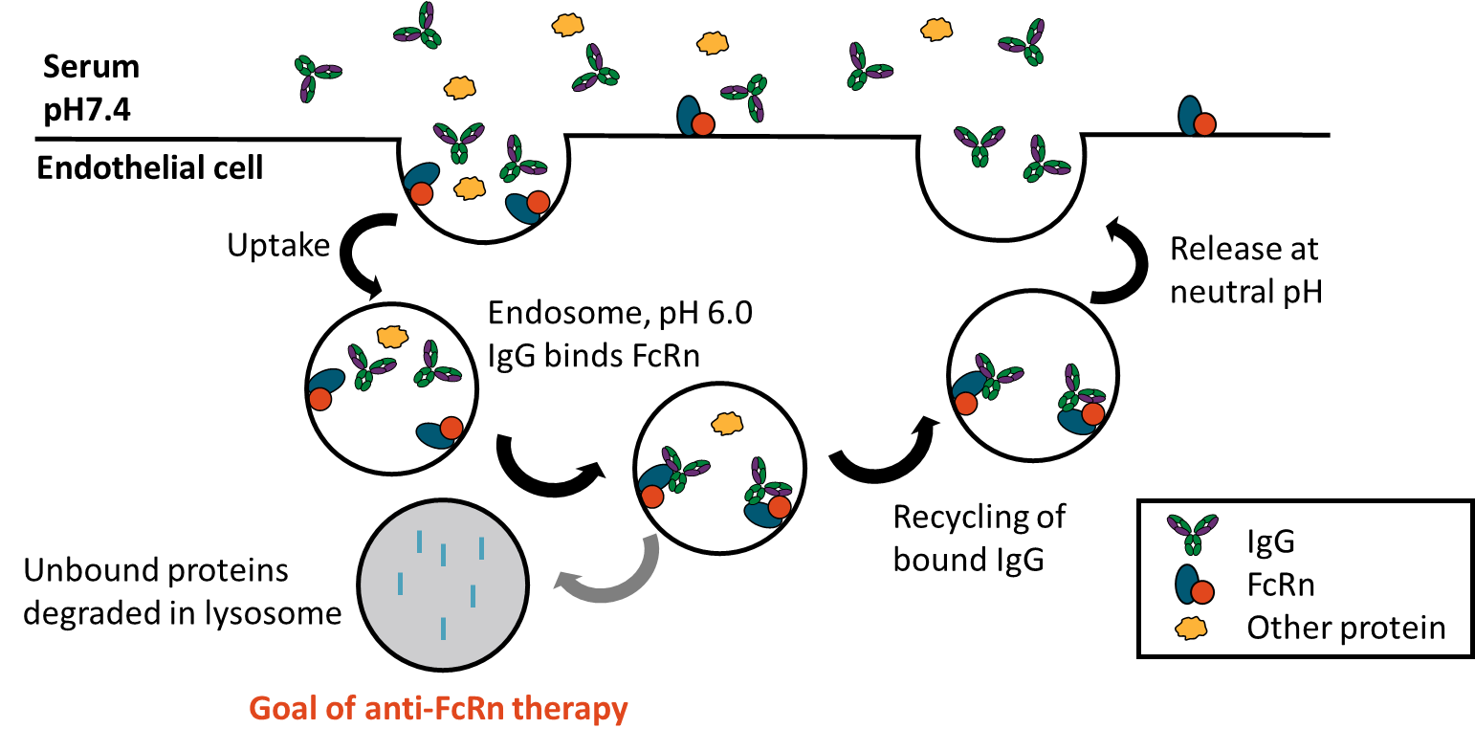
Pathobiology Refresher: Complement vs IgG Recycling
C5 inhibition: blocks terminal complement/MAC injury in AChR Ab+ gMG
FcRn inhibition: increases IgG degradation and lowers pathogenic IgG
Clinical implication: different mechanisms → different selection/safety questions
Autoreactive T-cell
NERVE terminal
Agrin
Thymus
VGCC
B-cell
Acetylcholine
Complement activation
Acetylcholine-esterase
Muscle
MAC
MuSK
AChR
Rapsyn
LRP4
Cell signaling
Fold destruction
Block of Ach binding to AChR
AChR internalization
Reduced muscle contraction
Howard. Ann N Y Acad Sci. 2018;1412:113. Roopenian. Nat Rev Immunol. 2007;7:715.
Notes:
ACh, acetylcholine; AChR, acetylcholine receptor; AChR Ab+, acetylcholine receptor antibody-positive; C5, complement component 5; FcRn, neonatal Fc receptor; gMG, generalized myasthenia gravis; IgG, immunoglobulin G; LRP4, low-density lipoprotein receptor-related protein 4; MAC, membrane attack complex; MuSK, muscle-specific kinase; VGCC, voltage-gated calcium channel.

Slide 8
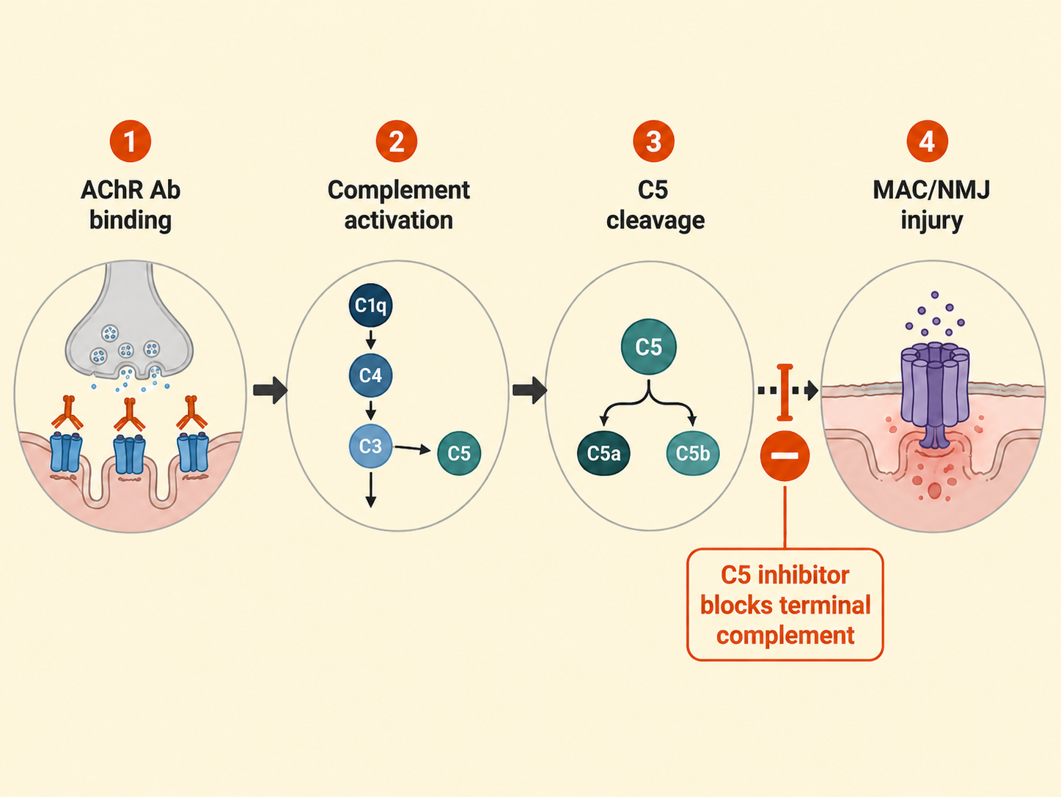
C5 Inhibition in AChR+ gMG: Mechanism → Selection
Best biologic fit: AChR Ab+ gMG with complement-mediated NMJ injury
Differentiate by logistics: IV vs SC, dosing cadence, self-administration, treatment burden
Safety is central: meningococcal vaccination/REMS planning and infection counseling
Emerging C5 strategies may change cadence and delivery, but current data do not support cross-trial superiority claims.
Howard. Ann N Y Acad Sci. 2018;1412. San. Front Neurol. 2023;14:1277596.
Notes:
AChR+, acetylcholine receptor antibody-positive; C5, complement component 5; gMG, generalized myasthenia gravis; IV, intravenous; NMJ, neuromuscular junction; REMS, Risk Evaluation and Mitigation Strategy; SC, subcutaneous.

Slide 9
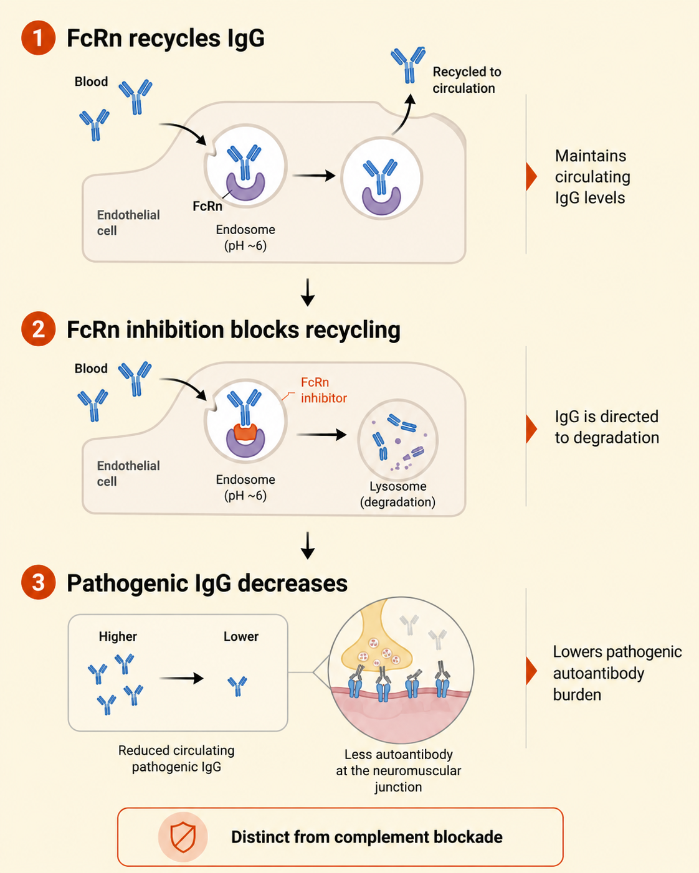
FcRn Inhibition in gMG: Lowering Pathogenic IgG
Mechanistic rationale
    FcRn recycles IgG and helps maintain circulating IgG levels
    Blocking FcRn reduces IgG recycling, lowering pathogenic autoantibody burden
How this differs from complement blockade
    FcRn inhibition lowers circulating IgG; complement inhibitors directly block terminal complement activation
Clinical selection hinges on:
    Antibody status and labeled population
    Route, schedule, and cyclic vs continuous treatment regimen
    Infection risk, IgG reduction/monitoring, and patient preference
Takeaway:
    FcRn inhibitors expand individualized gMG care, but agent selection should be based on mechanism, label, cadence, and monitoring—not class identity alone
Roopenian. Nat Rev Immunol. 2007;7:715. Howard. Ann N Y Acad Sci. 2018;1412:113. Huntemann. J Neurol Neurosurg Psychiatry. 2025;96:310.
Notes:
FcRn, neonatal Fc receptor; gMG, generalized myasthenia gravis; IgG, immunoglobulin G.

Slide 10

Cross-Trial Comparisons: Compare Context, Not Rankings
Population
Antibody requirements
Baseline severity
Prior treatment exposure
Background therapy
Endpoint & Timing
MG-ADL change at Wk 12 or Wk 26
Day 43 endpoints
Averaged Wk 22-24 endpoints
Cycle-based responder definitions
Practical Fit
Labeled population
Route and dosing cadence
Safety requirements
Patient-centered treatment fit
Evidence should guide individualized selection—not declare a class winner
Cross-trial comparisons are limited by differences in populations, endpoints, timing, and trial design
Huntemann. J Neurol Neurosurg Psychiatry. 2025;96:310. Jacob. Adv Ther. 2026;43:2125. Filippakopoulou. J Neurol. 2026;273:244.
Notes:
MG-ADL, Myasthenia Gravis Activities of Daily Living.

Slide 11
C5 Inhibitors in gMG: Evidence Snapshot
Agent | Status | Route/Cadence | Key Evidence | Practical Differentiator
Eculizumab | Approved | IV maintenance q2wk | REGAIN + extension data | Established proof of concept for terminal complement blockade
Ravulizumab | Approved | IV, longer maintenance interval | CHAMPION-MG | Less frequent IV maintenance than eculizumab
Zilucoplan | Approved | Daily self-administered SC injection | RAISE; MG-ADL benefit at Wk 12 | Non-IV, self-administered C5 option
Cemdisiran ± pozelimab | Investigational | SC siRNA approach ± anti-C5 antibody | NIMBLE; primary MG-ADL endpoint met at Wk 24 | Emerging C5-suppression strategy with longer-interval potential
Gefurulimab | Investigational | Once-weekly self-administered SC injection | PREVAIL; primary and secondary endpoints met | Weekly self-administered dual-binding C5 nanobody
Differentiate C5 inhibitors by regulatory status, route, dosing cadence, safety logistics, and trial context—not by unsupported cross-trial ranking
Not all complement strategies have translated clinically: oral alternative-pathway inhibition with vemircopan did not meet the prespecified efficacy threshold in a phase II AChR Ab+ gMG trial
Di Martino. J Clin Med. 2025;14:8205. Vu. Lancet. 2026;407:1712. Gwathmey. AAN Annual Meeting; 2026. Abstract S14.006.
Notes:
AAN, American Academy of Neurology; AChR Ab+, acetylcholine receptor antibody-positive; C5, complement component 5; gMG, generalized myasthenia gravis; IV, intravenous; MG-ADL, Myasthenia Gravis Activities of Daily Living; SC, subcutaneous; siRNA, small interfering RNA.

Slide 12
Emerging C5 Agent Focus: Cemdisiran ± Pozelimab
Cemdisiran is an investigational siRNA that reduces hepatic C5 production and is dosed SC every 12 wk
In phase III NIMBLE, cemdisiran met the Wk 24 primary MG-ADL endpoint: LS mean change –4.5 vs –2.2 with placebo; placebo-adjusted difference –2.3, P <.001
QMG also improved: placebo-adjusted difference –2.8 at
Wk 24, P = .002
NIMBLE also evaluated lower-dose cemdisiran plus pozelimab every 4 wk; both regimens improved MG-ADL vs placebo
Cemdisiran remains investigational; a US regulatory application has been submitted
Interpret cautiously: placebo-controlled, not head-to-head vs approved C5 or FcRn inhibitors
Vu. Lancet. Lancet. 2026;407:1712.
Notes:
C5, complement component 5; FcRn, neonatal Fc receptor; LS, least squares; MG-ADL, Myasthenia Gravis Activities of Daily Living; QMG, Quantitative Myasthenia Gravis; SC, subcutaneous; siRNA, small interfering RNA.

Slide 13
Emerging C5 Agent Focus: Gefurulimab
Investigational dual-binding C5 nanobody optimized for once-weekly self-administered SC dosing
PREVAIL enrolled 260 adults with AChR Ab+ gMG across 20 countries
Primary endpoint met at Wk 26: MG-ADL treatment difference –1.6 vs placebo; P <.0001.
Clinically meaningful MG-ADL improvement was observed as early as Wk 1 and sustained through Wk 26; QMG improved by Wk 4 and was sustained through Wk 26
Safety: TEAEs were similar vs placebo; most were mild/moderate
Interpretation: placebo-controlled phase III data; no head-to-head efficacy comparison with approved C5 inhibitors
Gwathmey. AAN 2026. Abstract S14-006. Jindal. Mol Immunol. 2024;165:29.
Notes:
AAN, American Academy of Neurology; AChR Ab+, acetylcholine receptor antibody-positive; C5, complement component 5; gMG, generalized myasthenia gravis; MG-ADL, Myasthenia Gravis Activities of Daily Living; QMG, Quantitative Myasthenia Gravis; SC, subcutaneous; TEAE, treatment-emergent adverse event.

Slide 14
Evidence Snapshot: FcRn Inhibitors in gMG
Agent | Label / Status | Route and Treatment Model | Key Evidence Anchor
Efgartigimod | Approved for adult gMG; evidence includes AChR Ab+ and AChR Ab– populations | IV cyclic dosing; SC efgartigimod/ hyaluronidase also available | ADAPT: MG-ADL responder framework during treatment cycle 1 in AChR Ab+ gMG ADAPT SERON: Significant MG-ADL improvement at Day 29 in AChR Ab– gMG, including MuSK+, LRP4+, and triple-seronegative subtypes
Rozanolixizumab | Approved for adult AChR Ab+ or MuSK Ab+ gMG | Weekly SC infusion in 6-wk treatment cycles | MycarinG: Significant MG-ADL improvement at Day 43 Long-term pooled MycarinG/OLE data support repeated symptom-driven cycles, with clinically meaningful improvements reported across up to 13 cycles
Nipocalimab | Approved for AChR Ab+ or MuSK Ab+ gMG in adults and pediatric patients ≥12 yr | IV dosing model | Vivacity-MG3: average MG-ADL change across Wk 22-24; OLE data show sustained MG-ADL/QMG improvements and total IgG reduction through up to 120 wk EPIC: Head-to-head vs efgartigimod is enrolling, with no comparative results yet
Batoclimab | Investigational FcRn monoclonal antibody | SC dosing studied in phase III | Phase III data showed higher sustained MG-ADL improvement vs placebo in antibody-positive gMG
FcRn inhibitors expand individualized gMG treatment options, but agents differ by labeled population, route, cycle structure, endpoint timing, and monitoring considerations.
Howard. Lancet Neurol. 2021;20:526. Bril. Lancet Neurol. 2023;22:383. Antozzi. Lancet Neurol. 2025;24:105.
Yan. JAMA Neurol. 2024;81:336. Efgartigimod alfa-fcab PI. Nipocalimab-aahu PI.
Notes:
AChR Ab+, acetylcholine receptor antibody-positive; AChR Ab–, acetylcholine receptor antibody-negative; FcRn, neonatal Fc receptor; gMG, generalized myasthenia gravis; IgG, immunoglobulin G; IV, intravenous; LRP4+, low-density lipoprotein receptor-related protein 4 antibody-positive; MG-ADL, Myasthenia Gravis Activities of Daily Living; MuSK Ab+, muscle-specific kinase antibody-positive; OLE, open-label extension; QMG, Quantitative Myasthenia Gravis; SC, subcutaneous.

Slide 15
Emerging FcRn Agent Focus: Batoclimab
Batoclimab is an investigational anti-FcRn monoclonal antibody administered by SC injection
In a China phase III trial, sustained MG-ADL improvement occurred in 58.2% with batoclimab vs 31.3% with placebo; OR 3.45; P = .001
In a separate phase III AChR Ab+ MG study, sponsor-reported topline data showed Wk 12 MG-ADL improvements of 5.6 points with 680 mg QW and 4.7 points with 340 mg QW vs 3.6 points with placebo
Safety caveat: monitor FcRn-class issues, including infection risk and IgG reduction, along with study specific laboratory changes
Key update: Immunovant states it does not currently intend to seek regulatory approval for batoclimab in MG, focusing instead on IMVT-1402
Yan. JAMA Neurol. 2024;81:336. Benatar. BMJ Neurol Open. 2024;6:e000536.
Notes:
AChR Ab+, acetylcholine receptor antibody-positive; FcRn, neonatal Fc receptor; IgG, immunoglobulin G; MG, myasthenia gravis; MG-ADL, Myasthenia Gravis Activities of Daily Living; SC, subcutaneous.

Slide 16
Comparing Safety: Infection, IgG Reduction, Vaccination, Monitoring
C5 inhibitors: meningococcal risk workflow
Complete or update MenACWY and MenB vaccination per ACIP, ideally at least 2 wk before the first dose
Confirm product-specific REMS and prophylaxis logistics before treatment initiation
Counsel patients that vaccination reduces but does not eliminate the risk of meningococcal infection
Instruct patients to seek urgent evaluation for fever, headache, neck stiffness, rash, myalgias, sepsis symptoms, or other signs of serious infection
FcRn inhibitors: IgG-lowering workflow
IgG reduction may increase infection risk; review active infection, recurrent infection history, and baseline infection risk before treatment
Plan immunization timing before treatment or treatment cycles when feasible
Account for treatment-cycle timing when assessing infection risk and vaccination planning
Do not assume a uniform FcRn safety profile; monitoring details vary by agent and label
Before therapy initiation, document vaccination status, infection-risk counseling, treatment timing, and monitoring responsibilities.
Vu. Lancet. 2026;407:1712. Eculizumab PI. Ravulizumab-cwvz PI. Zilucoplan PI. Efgartigimod alfa-fcab PI. Efgartigimod alfa and hyaluronidase-qvfc PI. Rozanolixizumab-noli PI. Nipocalimab-aahu PI.
Notes:
ACIP, Advisory Committee on Immunization Practices; C5, complement component 5; FcRn, neonatal Fc receptor; IgG, immunoglobulin G; MenACWY, meningococcal serogroups A, C, W, and Y vaccine; MenB, meningococcal serogroup B vaccine; REMS, Risk Evaluation and Mitigation Strategy.

Slide 17
Administration Burden Is a Treatment-Selection Variable
Clinic-Based IV | SC/Self-Administered | Cyclic/Interval Planning
Eculizumab: IV q2wk after induction | Zilucoplan: daily SC | Efgartigimod: cyclic IV or SC
Ravulizumab: longer-interval IV maintenance | Gefurulimab: weekly SC, investigational | Rozanolixizumab: weekly SC infusion x 6 wk, repeated symptom-driven cycles supported by pooled long-term data
Nipocalimab: IV q2wk after loading | Cemdisiran: q12wk SC, investigational | Retreatment timing/ monitoring varies
Fit depends on more than efficacy: patient preference, dexterity, needle comfort, caregiver support, travel burden, clinic capacity, vaccination/REMS workflows, and adherence feasibility
Gwathmey. AAN 2026 Abstract S14-006. Eculizumab PI. Ravulizumab-cwvz PI. Zilucoplan PI. Efgartigimod alfa-fcab PI. Efgartigimod alfa and hyaluronidase-qvfc PI. Rozanolixizumab-noli PI. Nipocalimab-aahu PI.
Notes:
AAN, American Academy of Neurology; IV, intravenous; REMS, Risk Evaluation and Mitigation Strategy; SC, subcutaneous.

Slide 18
Applying the Evidence: Match Mechanism to Patient Fit
Start with biology
AChR Ab+ → consider complement biology/C5 fit
AChR Ab– gMG, including MuSK+, LRP4+, and triple-seronegative subtypes → FcRn inhibition now includes efgartigimod as a labeled option
Interpret subtype-level evidence by study design and sample size
Then pressure-test the choice
Disease activity and rescue/steroid reliance
Route, cadence, self-administration, clinic burden
Vaccination, infection risk, IgG monitoring, comorbidities
San. Front Neurol. 2023;14:1277596. Bhandari. Front Neurol. 2023;14:1229112. Efgartigimod alfa-fcab PI. Rozanolixizumab-noli PI. Nipocalimab-aahu PI.
Notes:
AChR Ab+, acetylcholine receptor antibody-positive; AChR Ab–, acetylcholine receptor antibody-negative; FcRn, neonatal Fc receptor; gMG, generalized myasthenia gravis; IgG, immunoglobulin G; LRP4+, low-density lipoprotein receptor-related protein 4 antibody-positive; MuSK+, muscle-specific kinase antibody-positive.

Slide 19
Assess Response Before Switching Therapy
Document Baseline
MG-ADL, QMG, MMT or other structured disease measure
Antibody status, current therapies, exacerbation history
Patient goals and treatment priorities
Assess Early Response
Match expectations to mechanism of action
Consider regimen, dosing model, and trial time horizon
Use structured measures rather than impression alone
Evaluate Inadequate Response
Review diagnosis and current disease activity
Confirm adherence and adequate treatment exposure
Check concomitant medications and competing causes of weakness/fatigue
Plan Therapy Transition
Individualize by mechanism, label, and patient context
Do not assume interchangeable efficacy across agents or classes
Address vaccination status, safety logistics, washout/timing, and payer access
Before switching therapy, confirm adequate exposure and reassess disease activity;
transitions should be mechanism driven and patient specific
Narayanaswami. Neurology. 2021;96:114. San. Front Neurol. 2023;14:1277596. Bhandari. Front Neurol. 2023;14:1229112. Howard. Lancet Neurol. 2021;20:526. Bril. Lancet Neurol. 2023;22:383. Antozzi. Lancet Neurol. 2025;24:105. Howard. Lancet Neurol. 2023;22:395. Meisel. NEJM Evid. 2022;1:EVIDoa2100066. Gwathmey. AAN 2026 Abstract S14-006.
Notes:
AAN, American Academy of Neurology; MG-ADL, Myasthenia Gravis Activities of Daily Living; QMG, Quantitative Myasthenia Gravis

Slide 20
Clinical Bottom Line: Match Mechanism to Patient Context
Start with mechanism
C5 inhibition and FcRn blockade target different points in antibody-mediated gMG
Select by patient fit
Antibody status, safety requirements, route/ cadence, treatment burden, and patient preference should drive therapy choice
Interpret evidence in context
Do not rank agents across trials without accounting for population, endpoint, timing, and design differences
Howard. Ann N Y Acad Sci. 2018;1412:113. San. Front Neurol. 2023;14:1277596. Bhandari. Front Neurol. 2023;14:1229112. Huntemann. J Neurol Neurosurg Psychiatry. 2025;96:310.
Notes:
C5, complement component 5; FcRn, neonatal Fc receptor; gMG, generalized myasthenia gravis

Slide 21
Go Online for More Coverage of Myasthenia Gravis!
Clinical Thought focused on mechanism-based care, emerging therapeutic strategies, and practical clinical considerations for individualized management of generalized myasthenia gravis.
deceraclinical.com/education

