Slide 1
Targeted Therapy Advances in HR+/HER2- Breast Cancer: Best Practices for Oncology Pharmacists
Provided by ProCE, LLC.
Supported by an educational grant from AstraZeneca.

Slide 2
About These Slides
Please feel free to use and share some or all of these slides in your noncommercial presentations to colleagues or patients
When using our slides, please retain the source attribution:
Slide credit: deceraclinical.com/education
These slides may not be published, posted online, or used in commercial presentations without permission. Please contact permissions@deceraclinical.com for details
Notes:
Disclaimer: The materials published on the Decera Clinical Education website reflect the views of the authors of the Decera Clinical Education material, not those of Decera Clinical Education, the CME providers, or the companies providing educational grants. The materials may discuss uses and dosages for therapeutic products that have not been approved by the FDA. A qualified healthcare professional should be consulted before using any therapeutic product discussed. Readers should verify all information and data before treating patients or using any therapies described in these materials.

Slide 3
Faculty
Jordan Hill, PharmD, BCOP
Clinical Pharmacy Specialist, Breast Oncology
West Virginia University Cancer Institute
Morgantown, West Virginia
Danielle Roman, PharmD, BCOP
Manager, Oncology Clinical Pharmacy Services
Oncology Clinical Pharmacy Specialist
Allegheny Health Network
Pittsburgh, Pennsylvania

Slide 4
Disclosures
The faculty reported the following relevant financial relationships or relationships to products or devices they have with ineligible companies related to the content of this educational activity:
Jordan Hill, PharmD, BCOP, has no relevant financial relationships to disclose.
Danielle Roman, PharmD, BCOP: consultant/advisor/speaker: Daiichi Sankyo, Genentech, Pfizer, Regeneron.

Slide 5
Treatment Algorithm for Adjuvant Targeted Therapy in
HR+/HER2- EBC
Received adjuvant chemotherapy with ≥4 LNs
OR
RD s/p neoadjuvant treatment + CPS and EG score ≥3?
gBRCAmut
ET + olaparib x 1 yr
Pearl: Risk factors can be based on clinical or pathologic features
gBRCAwt or otherwise not a candidate for olaparib
No positive LNs
1-3 positive LNs
≥4 positive LNs
No additional high-risk features and/or
baseline QTc >450 ms
T >5 cm OR
>2 cm AND:
grade 3 or
grade 2 + high genomic risk
Not grade 3, T ≤5 cm
and/or
bowel comorbidity
Grade 3 or T ≥5 cm
OR
ET + abemaciclib
OR
ribociclib
ET + abemaciclib
OR
ribociclib
ET alone
ET + ribociclib
ET + ribociclib
Abemaciclib PI. Ribociclib PI. NCCN. Clinical practice guidelines in oncology: breast cancer. v.2.2026. nccn.org.

Slide 6
What Is “High Risk” in HR+/HER2- EBC?
Risk of First Recurrence After Primary Treatment¹
Recurrence risk increases with²⁻⁵:
ET resistance
Larger tumor size
Node positivity
Higher grade
Higher proliferation rate
(ie, Ki-67 index)
Lower ER and/or PgR levels
Luminal B, HER2-enriched, and
basal-like molecular subtypes
0.25
Stage
I
II
III
0.20
0.15
Estimated Annual Hazard Rate
0.10
0.05
0
0
2
4
6
8
10
Yr After Primary Diagnosis of Breast Cancer
1. Cheng. Cancer Epidemiol Biomarkers Prev. 2012;21:800. 2. Fan. Future Med Chem. 2015;7:1511.
3. Garutti. Cancers. 2022;14:1898. 4. Pan. NEJM. 2017;377:1836. 5. Pan. SABCS 2019. Abstr GS2-04.

Slide 7
Adjuvant EBC Trials With CDK4/6 Inhibitors
 | PENELOPE-B^{1,2} | PALLAS³⁻⁵ | monarchE⁶⁻⁸ | NATALEE⁹⁻¹¹
CDK4/6 inhibitor | Palbociclib | Palbociclib | Abemaciclib | Ribociclib
Sample size/sites | 1250/267 | 5760/406 | 4580/612 | 5101/384
Design | Phase III randomized, placebo controlled | Phase III randomized, open-label | Phase III randomized, open-label | Phase III randomized, open-label
Patient population | Very high–risk with residual disease after neoadjuvant chemo (CPS-EG score ≥3 or 2 and N+) | Stage II-III (stage IIA capped at 1000 patients) | High-risk N+ plus 1 other risk factor (size, grade, Ki67) | Stage II-III
Duration of CDK4/6i therapy | 1 yr (13 cycles) | 2 yr (26 cycles) | 2 yr (26 cycles) | 3 yr (39 cycles)
Primary endpoint | iDFS | iDFS | iDFS | iDFS
Median duration of f/u | 43 mo | 59.8 mo | 76 mo | 55 mo
1. Loibl. JCO. 2021;39:1518. 2. NCT01864746. 3. DeMichele. ASCO Plenary Series October 2022. Abstr 390216.
4. NCT02513394. 5. Mayer. Ann Oncol. 2026;37:271. 6. Rastogi. JCO. 2024;42:987. 7. NCT03155997.
8. Johnston. Ann Oncol. 2026;37:155. 9. Hortobagyi. Ann Oncol. 2025;36:149. 10. NCT03701334.
11. Crown. Ann Oncol. 2025;11:105858.

Slide 8
monarchE: Sustained iDFS Benefit at 7 Yr
Absolute difference in 7-yr rates: 6.5%
100
Abemaciclib + ET
83.1 (∆ = 6.6)
80.0 (∆ = 5.9)
80
77.4 (∆ = 6.5)
ET alone
76.5
74.1
60
70.9
iDFS (%)
 | Abemaciclib + ET (n = 2808) | ET Alone (n = 2829)
iDFS events, n | 547 | 722
HR (95% CI) | 0.734 (0.657-0.820)
Nominal P value | <.0001
40
20
2-yr abemaciclib treatment period
0
0
12
24
36
48
60
72
84
96
Patients at Risk, n
Abemaciclib + ET
ET alone
Mo
2808
2829
2549
2573
2408
2374
2284
2195
2173
2057
2056
1923
1763
1621
369
363
0
0
7-yr iDFS favored abemaciclib in all evaluated subgroups, including by number of positive LNs, histologic grade, primary tumor size, previous chemotherapy, and menopausal status
Rastogi. JCO. 2024;42:987. Johnston. Ann Oncol. 2026;37;155.

Slide 9
monarchE: OS in ITT (Key Secondary Endpoint)
100
91.2
89.2
86.8
80
90.2
Absolute difference in
OS: 1.8%
87.9
85.0
60
 | Abemaciclib + ET (n = 2808) | ET (n = 2829)
OS events, n | 301 | 360
Hazard ratio (95% CI) P value | 0.842 (0.722-0.981) .0273
OS (%)
40
20
0
0
12
24
36
48
60
72
84
96
Mo
Patients at Risk, n
Abemaciclib + ET
ET
2808
2829
2614
2664
2518
2546
2407
2443
2342
2338
2236
2215
1967
1908
425
433
0
0
Met critical boundary for statistical significance
Median follow-up for current analysis: 6.3 yr (76.2 mo)
Johnston. ESMO 2025. Abstr LBA13. Johnston. Ann Oncol. 2026;37:155.

Slide 10
NATALEE: iDFS
100
90.8 (∆ = 2.7)
85.5 (∆ = 4.5)
80
88.0
81.0
Median follow-up of 55.4 mo
60
 | RIB + NSAI (n = 2549) | NSAI Alone (n = 2552)
5-yr iDFS events, n | 317 | 407
Hazard ratio (95% CI) | 0.716 (0.618-0.829)
P value | <.0001
Invasive Disease–Free Survival (%)
40
20
3-yr RIB treatment period
Follow-up of current analysis
0
0
6
12
18
24
30
36
42
48
54
60
66
72
78
Mo
Continued trend toward improved OS with ribo + NSAI as data continue to mature
Crown. Ann Oncol. 2025;11:105858.

Slide 11
Biomarker Testing for Breast Cancer: BRCA
BRCA mutations are the most common genetic variants in breast cancer and are associated with aggressive clinical and biological features
    HR+/HER2- EBC: ~10%¹
    TNBC EBC: 10% to 24%²⁻⁵
    Prevalence differs by ethnicity, race, and age^{4,6}
Recommendations for testing:
    TNBC (at any age)
    Meet criteria for personal or family history
    Male sex
    When considering olaparib as adjuvant therapy
1. O’Shaughnessy. Breast Cancer Res. 2020;22:114. 2. Hartman. Cancer 2012;118:2787. 3. Wong-Brown. Breast Cancer Res Treat. 2015;150:71. 4. Sharma. Breast Cancer Res Treat. 2014;145:707. 5. Pogoda.
J Oncol. 2020;2020:8545643. 6. Greenup. Ann Surg Onc. 2013;10:3254.

Slide 12
OlympiA: Adjuvant Olaparib vs Placebo for BRCA1/2m High-Risk, HER2- EBC
International, double-blind, randomized phase III trial
Primary endpoint: iDFS
Key secondary endpoints: distant DFS, OS, safety
Stratified by HR status (HR+ vs TNBC), prior CT (neoadjuvant vs adjuvant), prior platinum-based CT (yes vs no)
TNBC Subgroup
Prior neoadjuvant tx: no pCR
Prior adjuvant tx: ≥ pN1 or ≥ pT2
(n = 1509*)
Olaparib
300 mg BID for 1 yr
(n = 921)
Men and women with gBRCA1/2-mutated, HER2-,
high-risk primary BC; completed definitive local tx and ≥6 cycles of (neo)adjuvant CT containing anthracyclines and/or taxanes; ECOG PS 0/1
(N = 1836)
HR+/HER2- BC Subgroup
Prior neoadjuvant tx: no pCR and CPS + EG score ≥3†
Prior adjuvant tx: ≥4 LN+
(n = 325)
Placebo
BID for 1 yr
(n = 915)
*Excluded n = 2 (both in olaparib arm) due to unconfirmed HER2- status.
†Staging system for BC-specific survival after neoadjuvant tx incorporating pretreatment clinical stage, ER status, nuclear grade, pathologic stage (range: 0-6).
Geyer. Ann Oncol. 2022;33:1250. NCT02032823.

Slide 13
OlympiA: iDFS in ITT (Third Interim Analysis)
100
93.4
89.7
86.2
83.1
81.5
79.6
80
88.4
81.4
77.4
74.8
72.8
70.3
60
Invasive Disease–Free Survival (%)
40
 | Events, n | 6-Yr iDFS, %
Olaparib | 178 | 79.6
Placebo | 258 | 70.3
Stratified HR for invasive disease/death: 0.65 (95% CI: 0.53-0.78)
20
0
0
6
12
18
24
30
36
42
48
54
60
66
72
78
84
Mo Since Randomization
Patients at Risk, n
Olaparib
Placebo
921
915
778
766
712
683
670
628
632
588
570
512
361
327
194
181
Garber. SABCS 2024. Abstr GS1-09.

Slide 14
OlympiA: OS in ITT (Third Interim Analysis)
100
98.0
95.0
92.8
90.4
89.4
87.5
80
96.9
92.8
89.2
87.2
85.5
83.2
60
Overall Survival (%)
40
 | Events, n | 6-Yr iDFS, %
Olaparib | 178 | 79.6
Placebo | 258 | 70.3
Stratified HR for invasive disease/death: 0.65 (95% CI: 0.53-0.78)
20
0
0
6
12
18
24
30
36
42
48
54
60
66
72
78
84
Mo Since Randomization
Patients at Risk, n
Olaparib
Placebo
921
915
846
843
795
788
765
739
728
698
660
616
420
390
224
221
Garber. SABCS 2024. Abstr GS1-09.

Slide 15
Treatment Algorithm for HR+/HER2- MBC
1L
AI or fulvestrant + CDK4/6 inhibitor
Fulvestrant + palbociclib + inavolisib (if PIK3CAm)
PI3K and ESR1 wild type
ESR1 mut
PI3K pathway altered
2L
AI or fulvestrant + everolimus
Imlunestrant + abemaciclib
Elacestrant, imlunestrant, or vepdegestrant
(post CDK4/6i progression)
Fulvestrant + capivasertib
Fulvestrant + alpelisib
(if PIK3CAm)
AI or fulvestrant or tamoxifen ±
targeted therapy
(if not previously received)
Elacestrant, imlunestrant or vepdegestrant
(if ESR1m)
Olaparib or talazoparib
(if BRCAm)
T-DXd
(if HER2 low [IHC 1+/2+] or HER2 ultralow)
Chemotherapy
(eg, capecitabine, paclitaxel)
3L
Chemotherapy
(eg, capecitabine, paclitaxel, eribulin)
Olaparib or talazoparib
(if BRCAm)
T-DXd
(if HER2 low [IHC 1+/2+] or HER2 ultralow)
Sacituzumab govitecan or
datopotamab deruxtecan
(after ≥1 prior CHT)
Biomarker positive*
(TMB-H, MSI-H/dMMR, NTRK, RET)
4L+
*TMB-H: pembrolizumab; MSI-H/dMMR: pembrolizumab, dostarlimab; NTRK fusion: larotrectinib, entrectinib; RET fusion: selpercatinib.
NCCN. Clinical practice guidelines in oncology: breast cancer. v.2.2026. nccn.org.

Slide 16
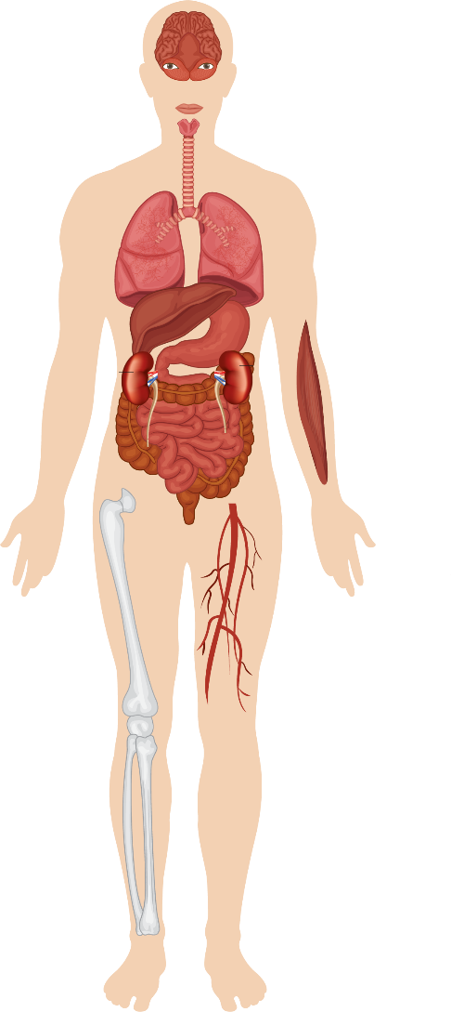



Role of Biomarker Testing in ER+/HER2- MBC
The importance of biomarker testing in ER+/HER2- MBC continues to increase and evolve
    ctDNA testing revealed more ESR1
    mutations than contemporaneous biopsy
    Different metastases may develop different resistance mutations
Contemporaneous Paired Samples
Metastatic
breast cancer
Sensitivity
Specificity
100
91.2
100
100
100
57.9
88.9
96.7
100
Blood test
dPCR vs Tissue Sequencing
Binary Status Agreement
75
Concordant negative
Concordant positive
Discordant: tissue positive,
dPCR negative
Discordant: tissue negative,
dPCR positive
50
%
DNA
isolation
25
DNA analysis
0
T
A
C
G
C
T
G
A
AKT1
(n = 39)
HER2
(n = 39)
ESR1
(n = 39)
PIK3CA
(n = 39)
A
T
G
C
G
A
C
T
Adapted from: Pessoa. Crit Rev Oncol Hematol. 2020.
Turner. Lancet Oncol. 2020;21:1296. Pessoa. Crit Rev Oncol Hematol. 2020;155:103109.
Burstein. JCO. 2023;41:3423.

Slide 17
Utility of Tumor Genomic Profiling in MBC
When and how should tumor genomic profiling be performed?
    Check genomics using metastatic tissue or ctDNA
      Use biopsies from diagnosis of metastatic disease
      Recheck using ctDNA at disease progression
      Look for acquired alterations, like those in ESR1, HER2 (ERBB2), PTEN
    If needed, perform genomic tests on primary tissue for nonacquired alterations (eg, PIK3CA)
    To determine combination partner with endocrine therapy based on the presence or absence of specific genomic alterations
Xi. JCO Oncol Pract. 2024;20:1460.Bharde. J Liq Biopsy. 2024;7:100284. Yoo. Sci Rep. 2024;14:20252.
Rizzolo. Appl Clin Genet. 2011;4:145.

Slide 18
Biomarkers Associated With FDA-Approved Therapies
BC Subtype | Biomarker | Detection | Approved Agent | NCCN Category
HR+/HER2- | PIK3CA-activating mutation | NGS, PCR | Inavolisib + palbociclib + fulvestrant | 1
HR+/HER2- | PIK3CA-activating mutation | NGS, PCR | Alpelisib + fulvestrant | 1
HR+/HER2- | PIK3CA/AKT1-activating mutations or PTEN-inactivating mutations and genomic changes | NGS, PCR | Capivasertib + fulvestrant | 1
HR+/HER2- | ESR1 mutation | NGS, PCR | Elacestrant, imlunestrant, vepdegestrant | 1 2A
BC Subtype | Biomarker | Detection | Approved Agent | NCCN Category
Any | gBRCA1/2 mutation | Germline seq | Olaparib, talazoparib | 1
Any | gPALB2 mutation | Germline seq | Olaparib | 2A
Any | NTRK1/2/3 fusion | FISH, NGS, PCR | Larotrectinib, entrectinib, repotrectinib | 1 2A
Any | MSI-H/dMMR | IHC, NGS, PCR | Pembrolizumab, dostarlimab | 1
Any | TMB (≥10 mut/Mb) | NGS | Pembrolizumab | 2A
Any | RET fusion | NGS | Selpercatinib | 2A
NCCN. Clinical practice guidelines in oncology: breast cancer. v2.2026. nccn.org.

Slide 19
INAVO120: First-line Therapy for Early Relapse and PIK3CA-Mutated HR+/HER2- Advanced/Metastatic BC
International, double-blind, placebo-controlled, randomized phase III trial
Primary endpoint: investigator-assessed PFS
Key secondary endpoints: OS, investigator-assessed ORR, BOR, CBR, and DoR; PROs
Stratified by visceral disease, endocrine resistance, region
Pre/postmenopausal women and men with PIK3CA-mutated HR+/HER2- advanced/metastatic BC; progression during or within 12 mo after completing adjuvant ET, fasting glucose <126 mg/dL, A1C <6.0%,
and measureable disease
according to RECIST v1.1
(N = 325)
Inavolisib 9 mg PO QD +
Palbociclib 125 mg PO QD D1-D21 + Fulvestrant 500 mg C1D1/15 and Q4W
(n = 161)
Placebo PO QD +
Palbociclib 125 mg PO QD D1-D21 + Fulvestrant 500 mg C1D1/15 and Q4W
(n = 164)
Jhaveri. NEJM. 2025;393:151.

Slide 20
INAVO120: PFS and OS
Median follow-up of 21.3 mo (inavolisib arm) and 21.5 mo (placebo arm)
 | No. of Deaths (%) | Median OS, Mo (95% CI)
Inavolisib (n = 161) | 72 (44.7) | 34.0 (28.4-44.8)
Placebo (n = 164) | 82 (50.0) | 27.0 (22.8-38.7)
 | No. of Patients With Event (%) | Median PFS, Mo (95% CI)
Inavolisib (n = 161) | 103 (64.0) | 17.2 (11.6-22.2)
Placebo (n = 164) | 141 (86.0) | 7.3 (5.9-9.2)
100
+
100
+
+
+
96.8
+
+
+
+
+
+
+
87.0
+
+
+
83.4
+
+
+
90.1
+
+
+
74.3
+
+
+
Stratified HR for death: 0.67 (95% CI: 0.48-0.94; P = .02)
75
75
+
+
+
Stratified HR for disease progression or death: 0.43 (95% CI: 0.32-0.59)
+
+
+
+
65.8
+
+
76.7
+
+
+
+
58.0
+
+
+
+
+
+
+
+
+
+
+
+
+
+
+
56.5
+
67.2
+
+
+
+
+
+
+
+
+
+
+
+
49.7
+
+
+
+
+
+
+
+
57.9
Inavolisib
Placebo
+
PFS (%)
+
+
OS (%)
56.3
+
+
50
+
+
41.8
50
+
+
+
+
+
+
+
+
+
+
+
+
+
+
+
+
+
+
+
+
+
+
46.3
+
+
+
+
+
+
+
+
+
+
+
+
+
+
+
+
+
+
+
+
+
+
+
+
+
+
+
+
+
+
+
+
+
+
+
+
+
+
+
31.3
+
+
+
+
+
+
+
25
+
+
+
25
+
+
+
+
+
+
+
+
+
+
+
+
+
+
+
+
+
+
+
20.5
+
+
+
16.7
+
+
+
+
+
+
+
+
+
+
0
0
0
3
6
9
12
15
18
21
24
27
30
33
36
39
42
45
48
0
51
3
6
9
12
15
18
21
24
27
30
33
36
39
42
45
48
Patients at
Risk, n
Inavolisib
Placebo
51
Patients at
Risk, n
Inavolisib
Placebo
Mo
Mo
161
164
146
125
129
95
112
74
89
50
73
34
65
30
57
24
46
21
32
14
25
11
19
10
15
8
11
4
10
2
7
1
3
1
1
1
161
164
155
155
149
142
142
127
131
119
114
104
99
90
88
77
78
63
67
48
54
42
43
36
34
32
22
18
19
10
13
4
7
2
1
1
Jhaveri. NEJM. 2025;393:151.

Slide 21
CAPItello-291: Capivasertib + Fulvestrant in AI-Resistant,
HR+/HER2- ABC
International, double-blind, randomized phase III trial
Coprimary endpoints: investigator-assessed PFS in overall population and in PIK3CA/AKT1/PTEN-altered population (≥1 qualifying PIK3CA, AKT1, or PTEN alteration)
Key secondary endpoints: OS and ORR in overall population and in PIK3CA/AKT1/PTEN-altered population
Stratified by liver metastases (yes vs no), prior CDK4/6i (yes vs no), region
Pre-/postmenopausal women and men with HR+/HER2- ABC; recurrence or progression on or <12 mo from end of adjuvant AI, or PD on prior AI for ABC;
≤2 lines of ET and ≤ 1 line of CT for ABC;
no prior SERD, mTORi, PI3Ki, or AKTi; A1C <8.0% and diabetes not requiring insulin permitted; prior CDK4/6i permitted
(N = 708)
Capivasertib 400 mg PO BID
(4 days on, 3 days off) +
Fulvestrant 500 mg C1D1/15, then Q4W
(n = 355)
Placebo PO BID (4 days on, 3 days off) +
Fulvestrant 500 mg C1D1/15, then Q4W
(n = 353)
Turner. NEJM. 2023;22:2058.

Slide 22
CAPItello-291: PFS in Overall Population and Patients With AKT-Pathway Alteration
Overall population
PIK3CA/AKT1/PTEN-altered population
 | Capivasertib+ FULV (n = 355) | Placebo + FULV (n = 353)
Events | 176 | 207
Median PFS, mo (95% CI) | 14.7 (13.6-16.4) | 12.5 (11.3-13.4)
Adjusted HR: 0.70 (95% CI: 0.57-0.86)
 | Capivasertib+ FULV (n = 155) | Placebo + FULV (n = 134)
Events | 79 | 87
Median PFS, mo (95% CI) | 15.5 (13.2-17.6) | 10.8 (8.1-12.7)
Adjusted HR: 0.52 (95% CI: 0.38-0.71)
+
100
+
+
100
+
+
+
+
+
+
+
+
+
+
+
+
+
+
+
+
+
+
+
+
+
+
+
+
90
+
+
90
+
+
80
+
+
80
+
+
+
+
+
+
+
+
+
+
+
+
70
+
+
+
+
70
+
+
+
+
+
+
+
+
+
+
+
+
+
+
+
+
+
+
+
+
+
+
+
+
+
+
+
+
60
+
+
60
+
+
+
+
+
+
+
+
+
+
+
+
+
+
+
+
PFS (%)
+
+
+
PFS (%)
+
+
50
+
50
+
+
+
+
+
+
+
+
+
+
+
+
+
+
+
+
+
+
+
+
+
+
+
+
+
+
+
+
+
+
40
+
+
40
+
+
+
+
+
+
+
+
+
+
+
+
+
+
+
+
+
+
+
+
+
+
+
+
+
+
+
+
+
+
+
30
+
30
+
+
+
+
+
+
+
+
+
+
+
+
+
+
+
+
20
+
20
+
+
+
+
+
+
+
+
+
+
+
+
+
+
+
+
+
+
+
+
10
+
+
10
+
0
0
0
2
4
6
8
10
12
14
16
18
20
22
24
26
0
2
4
6
8
10
12
14
16
18
20
22
24
26
Patients at
Risk, n
Capivasertib
Placebo
Mo From Randomization
Patients at
Risk, n
Capivasertib
Placebo
Mo From Randomization
355
353
334
321
315
294
283
252
248
216
218
185
164
137
108
88
78
63
48
33
20
14
11
9
2
2
0
0
155
134
151
124
140
113
129
89
118
72
105
63
76
45
53
29
38
22
22
11
8
7
5
4
1
0
0
0
Study met dual primary endpoints, showing significantly prolonged PFS with capivasertib + FULV vs placebo + FULV in overall and AKT pathway–altered populations
Exploratory analysis observed improved PFS in nonaltered subpopulation (hazard ratio: 0.70; 95% CI: 0.56-0.88)
OS immature
Turner. SABCS 2022. Abstr GS3-04. Turner. NEJM. 2023;388:2058.

Slide 23
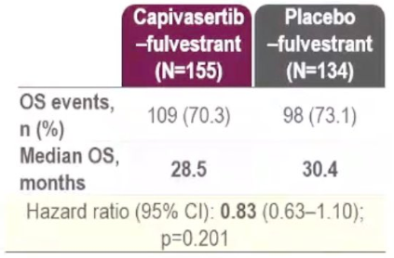
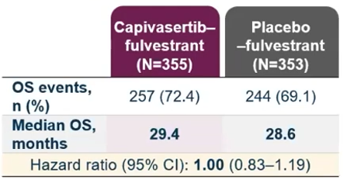
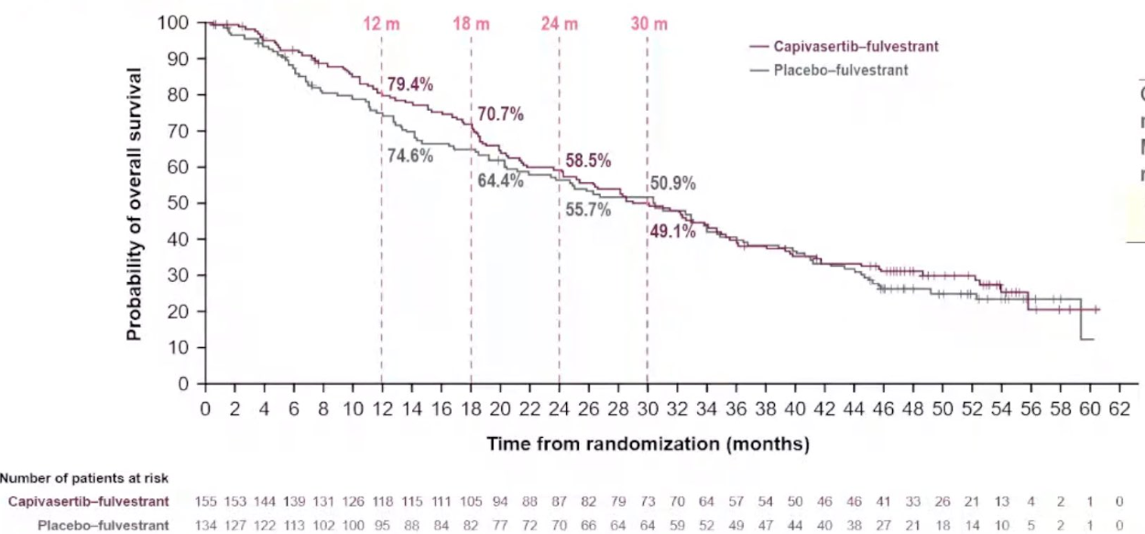
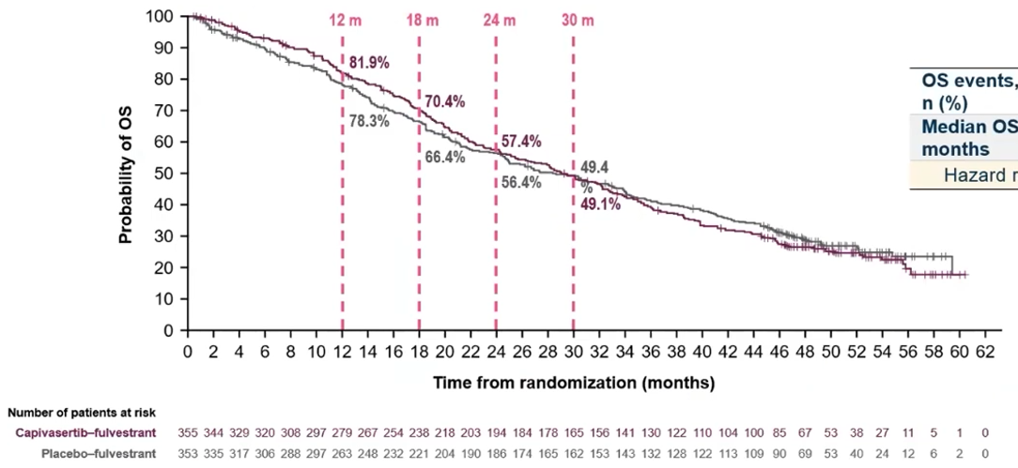
CAPItello-291: OS
PIK3CA/AKT1/PTEN-altered population
Overall population
OS analysis underpowered; trend favoring capivasertib + FULV but no statistical significance reached
OS not formally tested in overall population as statistical difference not seen in altered population
Rugo. ESMO Breast 2026. Abstr 417O.

Slide 24
Select PI3K Pathway Trials in ER+/HER2- MBC
Trial | N | Treatment Arms | Setting
VIKTORIA-1¹ (NCT05501886) | 392 | Gedatolisib + palbociclib + fulvestrant Gedatolisib + fulvestrant Fulvestrant | PD during/after prior CDK4/6i + AI, PIK3CA WT
CAPItello-292² (NCT04862663) | 895* | Capivasertib + CDK4/6i + fulvestrant CDK4/6i + fulvestrant | No prior ET in advanced setting (phase Ib), recurrence or progression on/after ET (phase III), any AKT status
VIKTORIA-2² (NCT06757634) | 674* | Gedatolisib + CDK4/6i + fulvestrant CDK4/6i + fulvestrant | PD during or within 12 mo of adjuvant ET and no prior systemic therapy for ABC, any PIK3CA status
FINER (NCT04650581) | 250 | Ipatasertib + fulvestrant Fulvestrant | PD on prior CDK4/6i + AI; any AKT status
*Estimated N.
1. Hurvitz. JCO. 2026;44:1108. 2. ClinicalTrials.gov.

Slide 25
Novel Endocrine Therapies May Address Endocrine Resistance in MBC
SERDs: Mechanism of Action
SERM
SERD
SERD
Estrogen
Tamoxifen
Lasofoxifene
Bazedoxifene
Camizestrant
Elacestrant
Fulvestrant
Giredestrant Imlunestrant
Competitive
binding to ERα
PROTAC
CERAN
Estrogen receptor α (ERα)
ERα
degradation
Vepdegestrant AC699
Palazestrant
Key advantages
Oral formulation
Higher potency
Activity in ESR1-mutant MBC
Activity in post-ET and CDK4/6i treated patients
SERCA
Estrogen response
element (ERE)
H3B-6545
Nucleus
5’
3’ 5’
3’
Transcription
ERα
antagonism
Estrogen
response gene
Adapted from Hernando. Int J Mol Sci. 2021;22:7812. Bardia. NEJM. 2018;379:1946.

Slide 26
ESR1 Mutations in Advanced Breast Cancer
ESR1 gene
ESR1m: major acquired mutation in ER+ MBC¹⁻⁴
    Acquired through prior AI therapy
    Function in a ligand-independent manner
    Rare in primary tumors (<1%) but highly enriched in MBC
Y537S (n = 1029)
Y537N (n = 508)
Y537C (n = 193)
1000
E380Q (n = 417)
D538G (1475)
Characterized as missense mutation
Characterized as variant of uncertain significance
L536H (n = 132)
L536P (n = 107)
L536R (n = 60)
100
10
1
Ligand Binding Domain
310
547
Trial | Treatment | ER+ MBC Patient Population | ESR1 Mut, n/N (%)
MONALEESA-2⁵ | Letrozole ± ribociclib | First line | 18/427 (4)
BOLERO-2⁶ | Exemestane ± everolimus | After PD on ET | 156/541 (28.8)
FERGI⁷ | Fulvestrant ± pictilisib | After PD on ET | 57/153 (37.3)
PALOMA-3^{8,9} | Fulvestrant ± palbociclib | After PD on ET | 91/360 (25.3)
SOFeA⁹ | Fulvestrant ± anastrozole | After PD on ET | 63/161 (39.1)
1. Yates. Endocrinology. 2024;165:bqae111. 2. Toy. Nat Genet. 2013;45:1439. 3. Jeselsohn. Nat Rev Clin Oncol. 2015;12:573. 4. Ross. Mod Pathol. 2019;32:81. 5. Hortobagyi. Ann Oncol. 2018;29:1541. 6. Chandarlapaty. JAMA Oncol. 2016;2:1310. 7. Spoerke. Nat Commun. 2016;7:11579. 8. Cristofanilli. Lancet Oncol. 2016;17:425.
9. Fribbens. JCO. 2016;34:2961.

Slide 27
EMERALD: Elacestrant vs Investigator’s Choice SoC ET in ER+/HER2- MBC
International, open-label, active-controlled, randomized phase III study
Coprimary endpoints: PFS in full population and patients with ESR1 mutations per BICR
Key secondary endpoints: OS in full population and patients with ESR1 mutations
Stratified by mESR1 status, prior fulvestrant,
presence of visceral metastases
Elacestrant 400 mg QD
(n = 239)
Men and postmenopausal women with ER+/HER2- MBC; relapse/PD after 1-2 lines of ET (1 line with CDK4/6 inhibitor);
≤1 line of CT for advanced disease; ECOG PS 0/1
(N = 478)
Until progression, unacceptable toxicity, or withdrawal
SoC
(investigator’s choice of fulvestrant,
anastrozole, letrozole, or exemestane)
(n = 239)
Bardia. Clin Cancer Res. 2024;30:4299. NCT03778931. Bidard. JCO. 2022;40:3246.

Slide 28
EMERALD: PFS With Elacestrant vs SoC in ITT and
Population With ESR1mut+ Disease
Elacestrant
SoC
All Patients
With ESR1mut+ Disease
 | Elacestrant (n = 239) | SoC (n = 238)
Events, n (%) | 144 (60.3) | 156 (65.5)
HR (95% Cl) | 0.70 (0.55-0.88)
P value | .0018
6-mo PFS, % (95% Cl) | 34.3 (27.2-41.5) | 20.4 (14.1-26.7)
12-mo PFS, % (95% Cl) | 22.3 (15.2-29.4) | 9.4 (4.0-14.8)
 | Elacestrant (n = 115) | SoC (n = 113)
Events, n (%) | 62 (53.9) | 78 (69.0)
HR (95% Cl) | 0.55 (0.39-0.77)
P value | .0005
6-mo PFS, % (95% Cl) | 40.8 (30.1-51.4) | 19.1 (10.5-27.8)
12-mo PFS, % (95% Cl) | 26.8 (16.2-37.4) | 8.2 (1.3-15.1)
100
100
80
80
60
60
PFS (%)
PFS (%)
40
40
20
20
0
0
0
1
2
3
4
5
6
7
8
9
10
11
12
13
14
15
16
17
18
19
20
21
22
23
24
25
1
2
3
4
5
6
7
8
9
10
11
12
13
14
15
16
17
18
19
20
0
21
22
23
24
25
Mo
Mo
Patients at Risk, n
Patients at Risk, n
Elacestrant
SoC
239 223 106 89 60 57 42 40 34 33 27 24 19 13 11 8 7 6 6 2 2 2 2 1 0
238 206 84 68 39 38 25 25 16 15 7 4 3 3 2 2 1 0
Elacestrant
SoC
115 105 54 46 35 33 26 26 21 20 16 14 11 9 7 5 5 4 4 1 1 1 1 1 0
113 99 39 34 19 18 12 12 9 9 4 1 1 1 0
Bidard. JCO. 2022;40:3246.

Slide 29
EMERALD: PFS by Duration of CDK4/6i in ESR1m Population
Prior ET+ CDK4/6i ≥6 Mo
Prior ET + CDK4/6i ≥12 Mo
Prior CDK4/6i ≥18 Mo
100
+
+
+
+
+
+
100
+
+
+
+
100
+
Elacestrant
SoC
+
Elacestrant
SoC
+
Elacestrant
SoC
+
+
+
+
+
+
+
+
+
+
+
+
+
+
80
+
80
+
80
+
+
+
+
+
+
+
+
+
+
+
+
60
+
60
+
+
60
+
+
+
+
+
+
+
+
+
PFS (%)
PFS (%)
PFS (%)
+
+
40
+
40
+
40
+
+
+
+
+
+
+
+
+
+
+
+
+
+
+
+
+
+
+
+
+
+
+
+
+
+
+
20
+
+
+
20
+
+
+
20
+
+
+
+
+
+
+
+
+
0
+
0
0
0
5
10
15
20
25
30
0
5
10
15
20
25
30
0
5
10
15
20
25
30
Mo
Mo
Mo
Parameter | Elacestrant (n = 103) | SoC (n = 102)
mPFS, mo (95% CI) | 4.14 (2.20-7.79) | 1.87 (1.87-3.29)
HR (95% CI) | 0.517 (0.361-0.738)
Parameter | Elacestrant (n = 78) | SoC (n = 81)
mPFS, mo (95% CI) | 8.61 (4.14-10.84) | 1.91 (1.87-3.68)
HR (95% CI) | 0.41 (0.262-0.634)
Parameter | Elacestrant (n = 55) | SoC (n = 56)
mPFS, mo (95% CI) | 8.61 (5.45-16.89) | 2.10 (1.87-3.75)
HR (95% CI) | 0.466 (0.270-0.791)
Bardia. Clin Cancer Res. 2024;30:4299.

Slide 30
EMBER-3: Imlunestrant ± Abemaciclib vs SoC for
ER+/HER2- ABC
International, open-label, randomized phase III study (data cutoff: June 24, 2024)
Coprimary endpoints: PFS by INV with imlunestrant vs SoC in ITT population and ESR1-mutant population; PFS by INV with imlunestrant vs imlunestrant + abemaciclib
Key secondary endpoints: OS and PFS by BICR, ORR, safety
Stratified by duration of prior CDK4/6i (yes vs no), presence of visceral metastases (yes vs no), geographic region (East Asia vs North America/Western Europe vs others)
Imlunestrant 400 mg QD
(n = 331)
Men and pre-/postmenopausal women* with ER+/HER2- locally advanced or MBC; prior therapy (recurrence ≤12 mo of adjuvant AI ± CDK4/6i or PD on/after AI ± CDK4/6i as 1L therapy for ABC); ECOG PS 0/1
(N = 874)
Imlunestrant 400 mg QD + Abemaciclib 150 mg BID
(n = 213)
SoC (Fulvestrant or Exemestane)
(n = 330)
*GnRH agonist required in men and premenopausal women.
NCT04975308. Jhaveri. NEJM. 2025;392:1189.

Slide 31
EMBER-3: PFS and OS With Imlunestrant Alone vs SoC
Primary Endpoint: Imlunestrant vs SoC ET
Investigator-Assessed PFS in Patients With ESR1m*
Primary Endpoint: Imlunestrant vs SoC ET
Investigator-Assessed PFS, All Patients†
100
100
75
75
44%
45%
PFS (%)
PFS (%)
50
50
30%
26%
43%
25
32%
25
22%
0
7%
0
0
2
4
6
8
10
12
14
16
18
20
22
36
0
3
6
9
12
15
18
21
24
27
30
33
36
39
42
Mo
Mo
Patients at Risk, n
Patients at Risk, n
136
118
92
70
66
33
50
18
30
6
25
5
16
1
8
0
7
0
4
0
2
0
1
0
0
0
331
330
211
213
136
122
124
89
87
60
73
56
57
41
45
31
35
25
28
22
19
15
15
9
6
5
5
1
0
0
*Median follow-up: 28.5 mo.
†Median follow-up: 28.5 mo.
Final OS analysis (median follow-up: 28.5 mo), imlunestrant vs SoC:
Patients with ESR1m: 34.5 vs 23.1 mo (HR: 0.60; 95% CI: 0.43-0.86; P = .0043)
All patients: 34.4 vs 28.9 mo, respectively (HR: 0.77; 95% CI: 0.61-0.98)
‡Prespecified Critical HR <0.74
Jhaveri. Ann Oncol. 2026;37:112.

Slide 32
EMBER-3: PFS With Imlunestrant ± Abemaciclib
 | No. of Patients | No. of Events | Median PFS, Mo (95% Cl)
Imlunestrant + abemaciclib | 213 | 144 | 10.9 (7.5-12.5)
SOC | 213 | 173 | 3.9 (3.7-5.5)
100
+
+
+
+
+
66%
+
+
+
+
+
75
+
+
+
43%
HR: 0.48 (95% CI: 0.38-0.61;
nominal P <.0001)
+
+
+
+
PFS (%)
+
50
+
+
+
38%
+
+
+
+
+
+
+
25
+
+
+
+
+
+
+
+
+
+
+
20%
+
+
+
+
+
+
+
+
+
+
+
+
0
0
3
6
9
12
15
18
21
24
27
30
33
36
39
Mo
Patients at Risk, n
Imlunestrant+ abemaciclib
213
213
159
127
122
67
101
49
76
34
70
30
59
21
54
16
36
13
20
10
14
8
10
3
2
1
0
0
SoC
Jhaveri. Ann Oncol. 2026;37:112.

Slide 33
Select Trials of Novel Endocrine Therapies in ER+/HER2- MBC
Trial | N | Treatment Arms | Setting
SERENA-4 (NCT04711252) | 1370 | Camizestrant + palbociclib Anastrozole + palbociclib | First line
persevERA Breast Cancer (NCT04546009) | 992 | Giredestrant + palbociclib Letrozole + palbociclib | First line
pionERA Breast Cancer (NCT06065748) | 1050* | Giredestrant + CDK4/6i Fulvestrant + CDK4/6i | First-line ET resistant after adjuvant ET; ESR1m status known
SERENA-6 (NCT04964934) | 315 | Camizestrant + CDK4/6i AI + CDK4/6i | ESR1m without progression
evERA Breast Cancer (NCT05306340) | 373 | Giredestrant + everolimus ET + everolimus | Prior CDK4/6i + ET; ESR1m status known
VERITAC-2 (NCT05654623) | 624 | Vepdegestrant Fulvestrant | ≤1 ET in addition to CDK4/6i with ET
*Estimated N.
ClinicalTrials.gov. Bidard. NEJM. 2025;393:569. Campone. NEJM. 2025;393:556.

Slide 34
Go Online for More Coverage of HR+/HER2- Breast Cancer!
Certified downloadable slides of all the key data
ClinicalThought commentary featuring expert-authored responses to
questions about frequent clinical challenges
Podcast summarizing key clinical take-home points
deceraclinical.com/education

