Slide 1
Implementing the New Clinical Obesity Diagnosis Into Practice
Provided by Clinical Care Options, LLC. in partnership with Practicing Clinicians Exchange.
Supported by an educational grant from Novo Nordisk.

Slide 2

About These Slides
Please feel free to use and share some or all of these slides in your noncommercial presentations to colleagues or patients
When using our slides, please retain the source attribution:
These slides may not be published, posted online, or used in commercial presentations without permission. Please contact permissions@clinicaloptions.com for details
Slide credit: clinicaleducationalliance.com
Notes:
Disclaimer: The materials published on the Clinical Care Options Web site reflect the views of the authors of the CCO material, not those of Clinical Care Options, LLC, the CME providers, or the companies providing educational grants. The materials may discuss uses and dosages for therapeutic products that have not been approved by the United States Food and Drug Administration. A qualified healthcare professional should be consulted before using any therapeutic product discussed. Readers should verify all information and data before treating patients or using any therapies described in these materials.

Slide 3
Faculty
Lucia M. Novak, MSN, ANP-BC, BC-ADM
President, Diabesity LLC
North Bethesda, Maryland
Co-Executive Director, Capital Health and Metabolic Center
Capital Diabetes and Endocrine Associates
Camp Springs and Silver Spring, Maryland
Notes:
This slide lists the faculty who were involved in the production of these slides.

Slide 4
Disclosures
The faculty reported the following relevant financial relationships or relationships to products or devices they have with ineligible companies related to the content of this educational activity:
Lucia M. Novak, MSN, ANP-BC, BC-ADM: consultant/advisor/speaker: Abbott Diabetes Care, Ascencia, Nestle, Novo Nordisk, Sanofi.
Notes:
This slide lists the disclosure information of the faculty and staff involved in the development of these slides.

Slide 5
Learning Objectives
Assess patients for obesity and related conditions based on the latest recommendations

Slide 6
What Is Obesity?
OMA defines obesity as “a chronic, progressive, relapsing, and treatable multifactorial, neurobehavioral disease, wherein an increase in body fat promotes adipose tissue dysfunction and abnormal fat mass physical forces, resulting in adverse metabolic, biomechanical, and psychosocial health consequences”
Ways to quantitatively define and categorize obesity:
  BMI (used by the CDC and WHO) takes one’s weight in kg and divides that by their height squared in meters
  Abdominal circumference measures one’s central adiposity, which correlates with metabolic disease risk
  Body fat percentage—the most accurate way to assess adiposity—is obtained via DEXA scan, air/water displacement, 2-/4-point bioimpedance, skin calipers, MRI, or CT
Obesitymedicine.org.
Notes:
BMI, body mass index; CDC, Centers for Disease Control and Prevention; OMA, Obesity Medicine Association.; WHO, World Health Organization.

Slide 7
Diagnosing Preclinical and Clinical Obesity
Considerations | Preclinical Obesity (Physical Phenotype) | Clinical Obesity (Chronic, Systemic Illness)
Pathophysiologic continuum
Discreet diagnostic criteria | Confirmed obesity with the function of other tissues/organs preserved | Confirmed obesity with the function of tissues/organs/the individual altered due to excess adiposity
Measures to confirm excess adiposity | Direct body fat measurement ≥1 anthropometric criteria + BMI ≥2 anthropometric criteria regardless of BMI BMI alone is sufficient for screening, not diagnosis; assess all people with excess adiposity for clinical obesity (history, physical, tests)
Clinical manifestations | Minor or absent with organ function substantially preserved | Signs and symptoms, complications, and/or limitations of daily activities
Alterations of cells/tissues
Alterations of organ structure
Alterations of organ function
End-organ damage
Rubino. Lancet Diabetes Endocrinol. 2025;13:221.
Notes:
BMI, body mass index

Slide 8
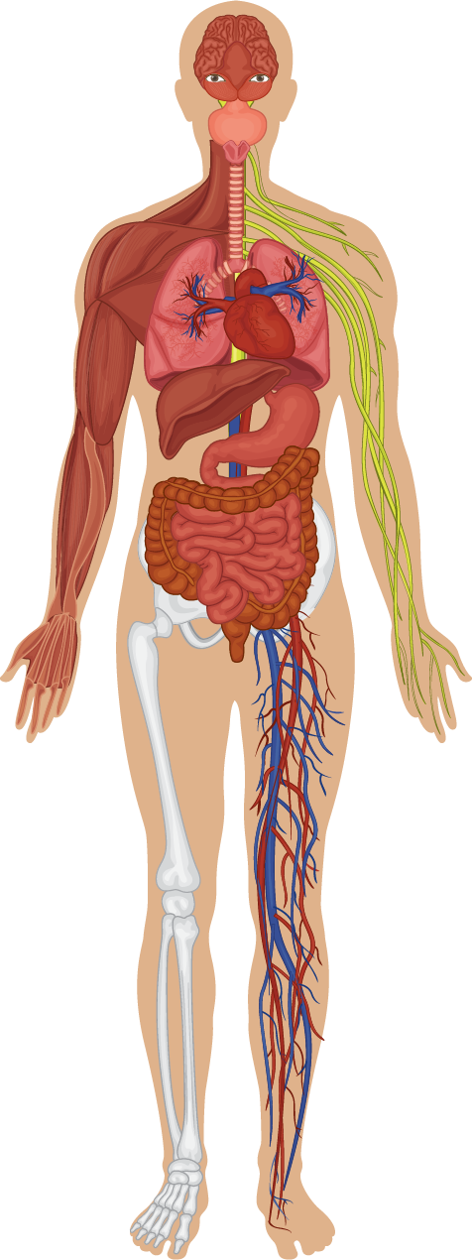
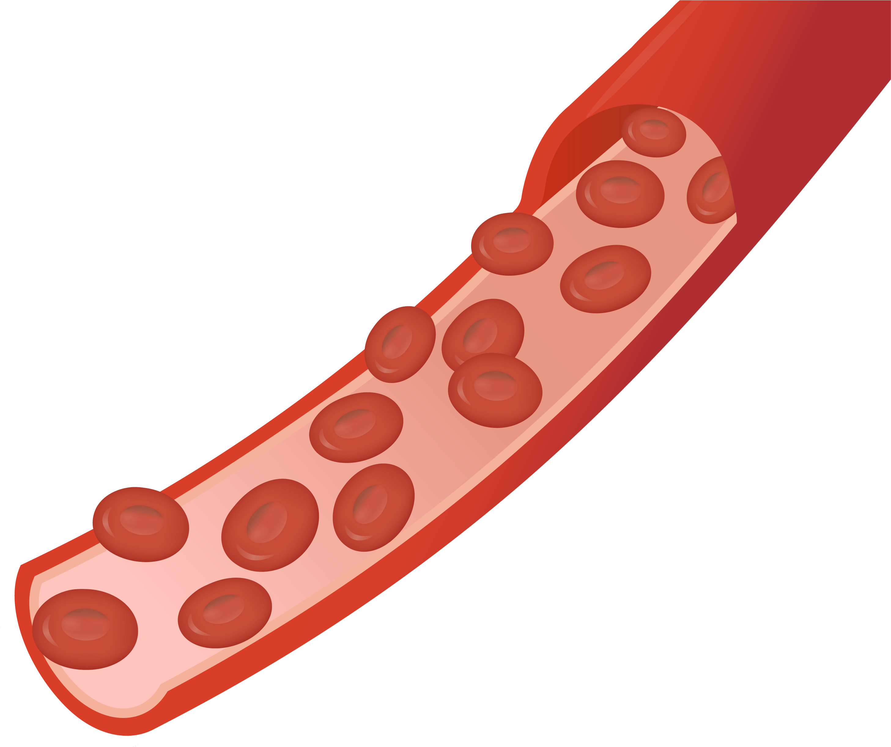

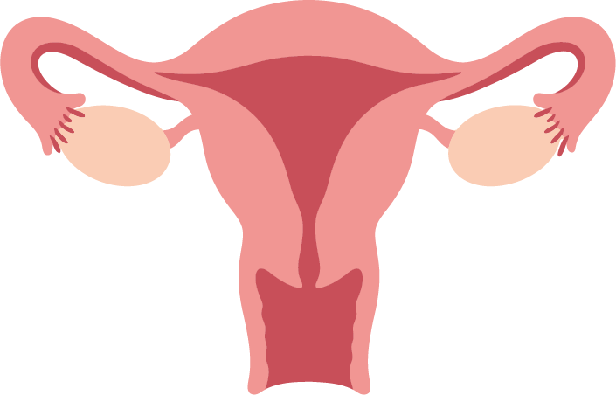
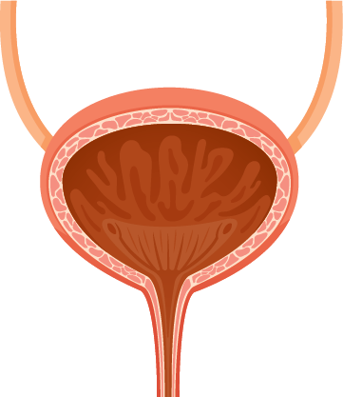
Diagnostic Criteria for Clinical Obesity in Adults*: Reduced Function Due to Excess Adiposity
Central nervous system
Vision loss, recurrent headaches, or both due to raised intracranial pressure
Upper airways
Apnea or hypopnea during sleep due to increased upper airway resistance
Respiratory system
Hypoventilation, breathlessness, wheezing, or a combination of these due to reduced lung and/or diaphragmatic compliance
Cardiovascular system
HFrEF due to reduced left ventricular systolic function
Chronic fatigue and lower limb edema due to impaired diastolic function (HFpEF)
Chronic or recurrent AFib
PAH
Recurrent DVT or pulmonary embolism
Raised arterial blood pressure
Metabolism
Cluster of hyperglycemia, high TG, and low HDL
Liver
MASLD with fibrosis
Urinary system
Chronic or recurrent urinary incontinence
Kidney
Microalbuminuria with reduced eGFR
Reproductive
Anovulation, oligomenorrhea and PCOS, male hypogonadism
Musculoskeletal system
Chronic, severe knee/hip pain associated with joint stiffness and reduced range of motion
Limitations of daily activities
Substantial, age-adjusted limitations of daily living
Lymphatic system
Lower limb lymphoedema that causes chronic pain and/or reduced range of motion
*Separate similar criteria for children and adolescents are also included in the statement.
Rubino. Lancet Diabetes Endocrinol. 2025;13:221.
Notes:
AFib, atrial fibrillation; CNS, central nervous system; DVT, deep-vein thrombosis; HDL, high-density lipoprotein cholesterol; HFpEF, heart failure with preserved ejection fraction; HFrEF, heart failure with reduced ejection fraction; MASLD, metabolic dysfunction-associated steatotic liver disease; PAH, pulmonary artery hypertension; PCOS, polycystic ovary syndrome; TG, triglycerides.

Slide 9
Goals of Obesity Treatment
Adipose tissue expansion
Genetic, nutritional, environmental, psychological, other/unknown causes
Preclinical obesity
Risk to health
Clinical obesity
Systemic, chronic illness
Approach/goal:
Approach/goal:
Approach/goal:
Prevention
Monitoring ± prophylactic intervention
Therapeutic intervention/ treatment
Improve manifestations
Prevent end-organ damage
Rubino. Lancet Diabetes Endocrinol. 2025;13:221.

Slide 10








Diagnosing Clinical Obesity
Body Size Measurements*
3 measurements to confirm excess body fat:
1
Excess body fat?
The first step in diagnosing obesity is confirming excess body fat via 1 of the 3 criteria below:
No
2
No obesity
Yes
3
Obesity
After confirming excess body fat, further assessment is required to establish obesity as an illness
Waist circumference:
≥102 cm for men
≥88 cm for women
≥1 measurement of BMI and
body size
4
Past medical history, physical examination, and
blood testing
Are sign/symptoms of organ dysfunction present?
Does the patient have limitations on their daily activities?
Waist to hip ratio:
>0.90 for men
> 0.85 cm for women
≥2 measurements of body size with or without BMI
No signs/symptoms or limitations
Signs/symptoms present
Daily activities are limited
Waist to height ratio:
>0.50 for men and women
Organ dysfunction related to obesity?
Direct measurement of body fat (ie, DEXA scan)
5
No
Yes
HCPs can pragmatically assume excess body fat if BMI is >40 kg/m²
Preclinical obesity
Clinical obesity
*Measurements for White Caucasian people only. Criteria for other races/ethnic groups may be different.
thelancet.com/pb-assets/Lancet/infographics/clinical-obesity/image.pdf.
Notes:
BMI, body mass index; HCP, healthcare professional.

Slide 11
Comprehensive History and Physical Exam
History: body weight trajectory, nutritional habits, physical activity history, prescriptions, mental health, sleep, social determinants of health
  Nutrition: detailed food recall, triggers, binge/night eating, readiness for change
Physical exam: Height, weight, waist/neck circumference, and blood pressure with cardiopulmonary/neuromusculoskeletal focus
Preventive care: screening for cancer, osteoporosis, immunizations, and substance use
Routine labs: CBC, CMP, A1C, lipids, TSH, vitamin D
Individualized testing: OGTT, insulin resistance, cortisol, reproductive hormones, CRP, apoB
Imaging and diagnostics: sleep study, cardiac test, liver imaging, DEXA scan for body composition
Identify secondary causes: genetic syndromes, hypothalamic disorders, endocrine conditions, behavioral disorders
Burridge. Obes Pillars. 2022;1:100007.
Notes:
A1C, glycated hemoglobin; CBC, complete blood count; CMP, comprehensive metabolic profile; CRP, C-reactive protein; OGTT, oral glucose tolerance test; TSH, thyroid-stimulating hormone.

Slide 12
The 5 C’s for Choosing an Obesity Management Medication
C
1
ontraindications
and cautions
Assess patients’ past medical history and the risk/benefit profile of each agent
C
omorbidities
2
Use an agent that can treat obesity and address other comorbidities when appropriate
C
ues
3
Consider patients’ self-described appetite control symptoms, AEs, and administration preference
C
ombinations
4
Consider prescribing lifestyle interventions, other antiobesity agents, and/or surgery in combination
5
C
ost and coverage
Consider costs and patients’ health
insurance coverage
Adapted from Horn. Postgrad Med. 2022;134:359.
Notes:
AE, adverse event.

Slide 13
Integrating Obesity Care Into Clinical Practice
Apply updated CPT and ICD-10 codes for obesity visits; align visit level with time and medical decision-making
Include documentation that details lifestyle counseling, comorbidity assessment, and any social determinants of health
Updated billing codes:
  New ICD-10 codes for obesity class 1-3 (E66.811–E66.813)
  CPT add-on code G2211 for complex care
  Remote patient monitoring codes 99453-99458 for e-scales, blood pressure monitors, and more
  Counseling codes (G0447, 97802-97804) for behavioral/nutrition interventions
Counseling: bill separately for preventive counseling or behavioral interventions when appropriate
Team-based care: include dietitians, behavioral health, and multidisciplinary documentation for coverage
cms.gov/medicare/physician-fee-schedule/search.
obesitymedicine.org/blog/new-icd-10-codes-for-obesity-treatment-advancements-in-accurate-diagnosis-and-care/.

Slide 14
Documentation and Billing for Obesity Management
Common documentation requirements:
  BMI calculation
  Obesity classification
  Comorbidity assessment
  Treatment plan
  Progress monitoring
Assessment documentation
  5A’s: Ask, Assess, Advise, Agree, Assist
  Readiness assessment
  Lifestyle factors
  Psychosocial screening
Reimbursement considerations:
  Medicare coverage for intensive counseling if BMI ≥30 kg/m²
  Commercial plan coverage varies
  Documentation: Medical necessity and treatment plan
  Frequency limits: 20 sessions max per yr (Medicare)
cms.gov/medicare-coverage-database/view/ncd.aspx?NCDId=353.

Slide 15
A Patient-Centered Approach to Obesity Management
Personalized
care plans
Tailor interventions to patients’ needs, preferences, and cultural backgrounds
Incorporate patients’ goals, motivations, and readiness to change
Collaborative
goal setting
Engage patients in setting realistic and achievable goals
Continuous
support and
follow-up
Follow-up regularly to monitor progress and adjust care plans as needed
Encourage participation in support groups and/or community resources
Education and empowerment
Provide information about nutrition, physical activity, and behavior change
Empower patients with tools and resources for self-management
Fastenau. Clin Obes. 2019;9:e12309.

Slide 16
Go Online for More CCO/PCE
Coverage of Obesity!
ClinicalThought expert commentary with patient perspective
Text Modules
Additional CME/CE-certified slideset on obesity with expert faculty commentary on all the key studies
clinicaloptions.com
practicingclinicians.com

