Slide 1
CADENZA: Patient-Reported and Quality-of-Life Outcomes From Phase III Study of Sutimlimab vs Placebo in Patients With Cold Agglutinin Disease
CCO Independent Conference Highlights*
of the 2022 ASH Annual Meeting; December 10-13, 2022;
New Orleans, Louisiana
*CCO is an independent medical education company that provides state-of-the-art medical information to healthcare professionals through conference coverage and other educational programs.
Supported by educational grants from AbbVie, Amgen, AstraZeneca, Epizyme, GSK, Incyte Corporation,
Jazz Pharmaceuticals, Karyopharm Therapeutics Inc., Novartis Pharmaceuticals Corporation, Sanofi, and Seagen.

Slide 2

About These Slides
Please feel free to use and share some or all of these slides in your noncommercial presentations to colleagues or patients
When using our slides, please retain the source attribution:
These slides may not be published, posted online, or used in commercial presentations without permission. Please contact permissions@clinicaloptions.com for details
Slide credit: clinicaloptions.com
Notes:
Disclaimer: The materials published on the Clinical Care Options website reflect the views of the authors of the CCO material, not those of Clinical Care Options, LLC, the CME providers, or the companies providing educational grants. The materials may discuss uses and dosages for therapeutic products that have not been approved by the United States Food and Drug Administration. A qualified healthcare professional should be consulted before using any therapeutic product discussed. Readers should verify all information and data before treating patients or using any therapies described in these materials.

Slide 3
CADENZA: Background
CAD is a rare chronic autoimmune hemolytic anemia dependent on activation of classical complement pathway¹
CAD causes chronic hemolysis, anemia, fatigue, hemoglobinuria, and negative effects on QoL²
CADENZA is a randomized, double-blind, placebo-controlled phase III trial of sutimlimab, a selective classical complement pathway inhibitor, in patients with CAD with no recent history of transfusion³
  In 26-wk pivotal phase (part A), sutimlimab rapidly halted hemolysis, increased
  Hb levels, and improved fatigue³
  Current analysis evaluated long-term PROs for patients who received sutimlimab, including those who received placebo in part A and switched to sutimlimab in
  open-label extension⁴
1. Berentsen. Semin Hematol. 2018;55:141. 2. Mullins. Blood. Adv. 2017;1:839. 3. Roeth. Blood. 2022;140:980. 4. Roeth. ASH 2022. Abstr 31.
Notes:
CAD, cold agglutinin disease; Hb, hemoglobin; PRO, patient-reported outcome; QoL, quality of life.

Slide 4
CADENZA: Study Design
Randomized, placebo-controlled phase phase III study^{1,2}
Primary endpoint: Hb increase ≥1.5 g/dL at treatment assessment timepoint
(mean of Wk 23, 25, 26), transfusion avoidance, and study-prohibited CAD therapy¹
PRO endpoints included: FACIT-Fatigue, PGIC, PGIS, SF-12, EQ VAS²
6-Wk
Screening Period
Part A:
26-Wk Double-Blind Treatment Period
Part B:
Safety Extension Period (Open Label)
Adult patients with CAD with baseline Hb ≤10 g/dL, elevated bilirubin, and ≥1 CAD symptom within 3 mo of screening, with no blood transfusions within
6 mo of enrollment
(N = 42)
Sutimlimab* IV on
Days 0, 7, then Q2W
(n = 22)
Sutimlimab* IV Q2W
until 1 yr† after completion of part A
(open to all patients completing part A)
Screening/Observation
9-wk follow-up
Placebo IV on
Days 0, 7, then Q2W
(n = 20)
*Weight-based dosing: <75 kg, 6.5 g; ≥75 kg, 7.5 g.
†Minimum time of 1 yr to maximum time of approximately 2 yr.
1. Roeth. Blood. 2022;140:980. 2. Roeth. ASH 2022. Abstr 31.
Notes:
CAD, cold agglutinin disease; EQ VAS, EuroQol Visual Analog Scale; FACIT-Fatigue, Functional Assessment of Chronic Illness Therapy-Fatigue; Hb, hemoglobin; PGIC, Patient Global Impression of Change; PGIS, Patient Global Impression of [Fatigue] Severity; PRO, patient-reported outcome; SF-12, 12-item Short Form Health Survey.

Slide 5
CADENZA PRO Analysis: Measures and
Baseline Characteristics
PROs assessed
Baseline characteristics
Of 42 patients in part A, 39 (92.9%) completed part A and entered part B
  Of these, 32 (82.1%) completed part B
Median duration of sutimlimab in part B: 99 wk (range: 22–177)
Scale | Description
FACIT-Fatigue | Assesses fatigue over prior 7 days; ranges from 0 (worst fatigue) to 52 (no fatigue); change of ≥5 points within group is clinically important in CAD
PGIS | Global index rates severity of specific condition (eg, fatigue) over prior 7 days; ranges from 1 (no fatigue) to 5 (very severe fatigue)
PGIC | Self-reported 7-point scale assesses perspective on overall health status vs baseline
SF-12 | Assesses physical, mental health over prior 4 wk; ranges from 0 (worst health) to 100 (best health); change of ≥3.9 (physical) and ≥2.8 (mental) points within group is clinically important in CAD
EQ VAS | Standardized measure of health status during current day; visual analog scale ranges from 0 (worst health) to 100 (best health)
Characteristic | All Patients (N = 39)
Mean age, yr (range) | 67 (46-88)
Female, n (%) | 31 (79.5)
Mean FACIT-Fatigue, points (SD) | 33.0 (11.2)
Mean SF-12 PCS, points (SD) | 41.2 (7.4)
Mean SF-12 MCS, points (SD) | 47.4 (9.9)
Mean EQ VAS, points (SD) | 64.5 (18.4)
Roeth. ASH 2022. Abstr 31.
Notes:
EQ VAS, EuroQol Visual Analog Scale; FACIT-Fatigue, Functional Assessment of Chronic Illness Therapy-Fatigue; PGIC, Patient Global Impression of Change; PGIS, Patient Global Impression of [Fatigue] Severity; PRO, patient-reported outcome; SD, standard deviation; SF-12, 12-item Short Form Health Survey.

Slide 6
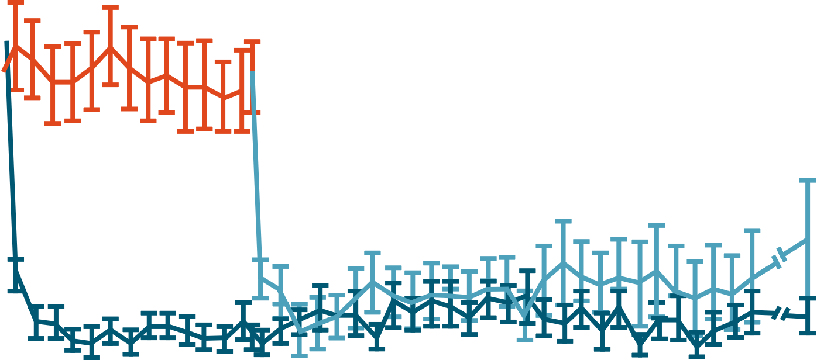
CADENZA PRO Analysis: Hematologic Response
PBO (Part A)
SUT (Part B)
Placebo arm
SUT (Part A and B)
Sutimlimab arm
Hemoglobin Response
Bilirubin Response
Part A
Part B
Part A
Part B
14
40
12
30
Mean (SE) hemoglobin (g/dL)
Mean (SE) bilirubin (g/μmolL)
20
LILN
10
8
10
BL
20
19
5
19
19
11
19
17
17
19
18
23
20
18
26
19
19
33
19
18
39
18
17
45
20
18
51
19
16
57
17
16
63
17
17
69
17
16
75
16
15
79
15
13
LV
20
19
BL
18
17
5
15
17
11
17
16
17
16
17
23
18
17
LV
19
17
26
18
17
33
16
15
39
15
15
45
18
18
51
16
14
57
15
13
63
15
15
69
15
14
75
14
12
79
14
12
Visit (week)
Visit (week)
PBO/SUT(n)
SUT(n)
PBO/SUT(n)
SUT(n)
Sutimlimab rapidly improved hemoglobin levels, including in patients previously treated with placebo and switched to sutimlimab in part B​
Sutimlimab rapidly normalized bilirubin levels, including in patients previously treated with placebo and switched to sutimlimab in part B​
Roeth. ASH 2022. Abstr 31. Reproduced with permission.
Notes:
FACIT-Fatigue, Functional Assessment of Chronic Illness Therapy-Fatigue; PBO, placebo; PRO, patient-reported outcome; SE, standard error; SUT, sutimlimab.

Slide 7

CADENZA PRO Analysis: Changes in FACIT-Fatigue Score
FACIT-Fatigue Score: Mean Change From Baseline
Placebo arm
Part A
Part B
PBO (Part A)
SUT (Part B)
16
Sutimlimab arm
14
SUT (Part A and B)
12
10
Mean improvement in
FACIT-Fatigue score for patients switching from placebo (part A) to sutimlimab (part B): 8.0 points (SE: 2.8)
  Exceeds clinically important change threshold of 5 points
Mean change for all patients at last on-treatment visit:
8.8 points (SE: 2.1)
8
FACIT-Fatigue Subscore Scaling Mean (SE)
Change from BL
6
4
CIC
2
0
-2
-4
BL
5
11
17
23
26
33
39
45
51
57
63
69
75
79
83
87
LV
Analysis Visit (Wk)
SUT
19
19
19
18
19
19
18
15
16
13
13
19
PBO/SUT
20
18
19
19
20
19
18
16
16
14
15
20
Roeth. ASH 2022. Abstr 31. Reproduced with permission.
Notes:
BL, baseline; FACIT-Fatigue, Functional Assessment of Chronic Illness Therapy-Fatigue; PBO, placebo; PRO, patient-reported outcome; SE, standard error; SUT, sutimlimab.

Slide 8

CADENZA PRO Analysis: Patient Fatigue (PGIS) and Overall QoL (PGIC)
Global Impression of Fatigue Severity
in Part B – All Patients
Global Impression of Change from
Baseline in Part B – All Patients
100
Response
None
Mild
Moderate
Severe
Very severe
100
Response
Improved
Unchanged
Worsened
75
75
Patients (%)
Patients (%)
50
50
25
25
0
0
Visit (Week) BL
n = 30
…
…
39
34
51
31
63
33
75
28
87
28
Visit (Week) BL
n = 30
39
33
51
31
63
33
75
28
87
28
Percentage of patients reporting no or mild fatigue improved from 46.7% at baseline to 78.5% at Wk 87
71.4% of patients reported improvements in global impression of QoL from baseline to Wk 87
Roeth. ASH 2022. Abstr 31. Reproduced with permission.
Notes:
BL, baseline; PGIC, Patient Global Impression of Change; PGIS, Patient Global Impression of [Fatigue] Severity; PRO, patient-reported outcome; QoL, quality of life.

Slide 9
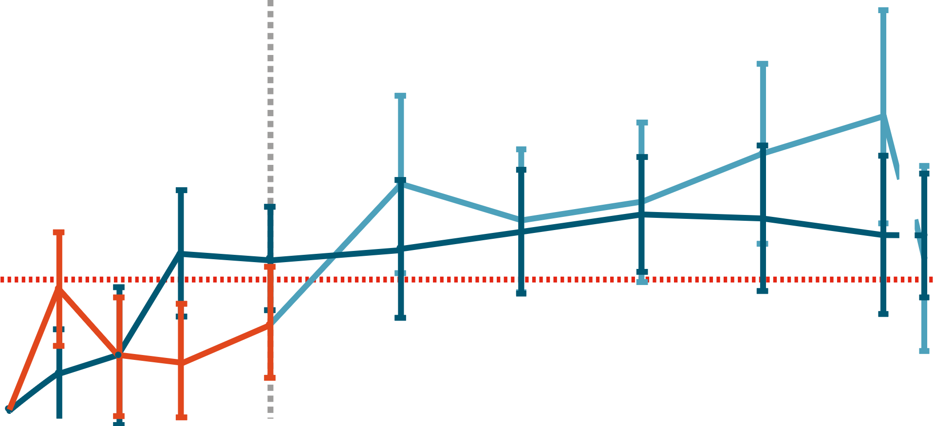
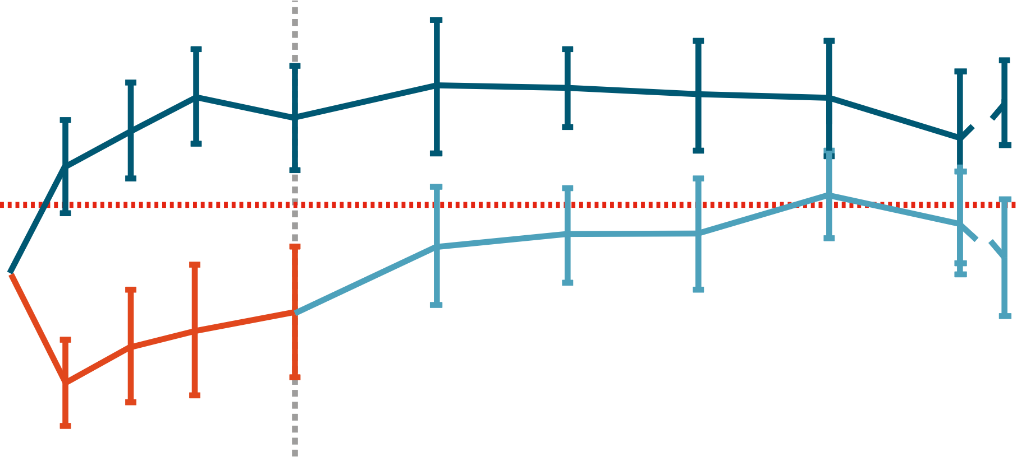
CADENZA PRO Analysis: SF-12 PCS and MCS
Sutimlimab arm
SUT (Part A and B)
Placebo arm
PBO (Part A)
SUT (Part B)
SF-12 PCS Score: Mean Change from Baseline
SF-12 MCS Score: Mean Change from Baseline
Part A
Part B
12
Part A
Part B
12
10
8
8
4
Physical Component Score Mean (SE) Change from Baseline
Mental Component Score Mean (SE) Change from Baseline
CIC
6
0
4
CIC
2
-4
0
-8
23
33
57
69
79
LV
18
20
23
33
57
69
79
LV
18
20
BL
18
20
5
18
18
11
18
19
17
17
19
26
18
18
39
18
18
45
51
14
16
63
16
16
75
12
15
83
87
12
15
BL
18
20
5
18
18
11
18
19
17
17
19
26
18
18
39
18
18
45
51
14
16
63
16
16
75
12
15
83
87
12
15
Analysis Visit (Wk)
Analysis Visit (Wk)
SUT(n)
PBO/SUT(n)
SUT(n)
PBO/SUT(n)
Rapid improvement in SF-12 PCS observed upon switching from placebo to sutimlimab
Mean change for all patients (N = 38) at last on-treatment visit: 4.9 points (SE: 1.7), exceeding threshold for clinically important change
Mean change in MCS in patients switching from placebo to sutimlimab exceeded clinically important change of 2.8 at Wk 75
Mean change for all patients (N = 38) at last on-treatment visit: 4.0 points (SE: 1.8)
Roeth. ASH 2022. Abstr 31. Reproduced with permission.
Notes:
BL, baseline; MCS, Mental Component Score; PBO, placebo; PCS, Physical Component Score; PRO, patient-reported outcome; SE, standard error; SF-12, SF-12, 12-item Short Form Health Survey; SUT, sutimlimab.

Slide 10
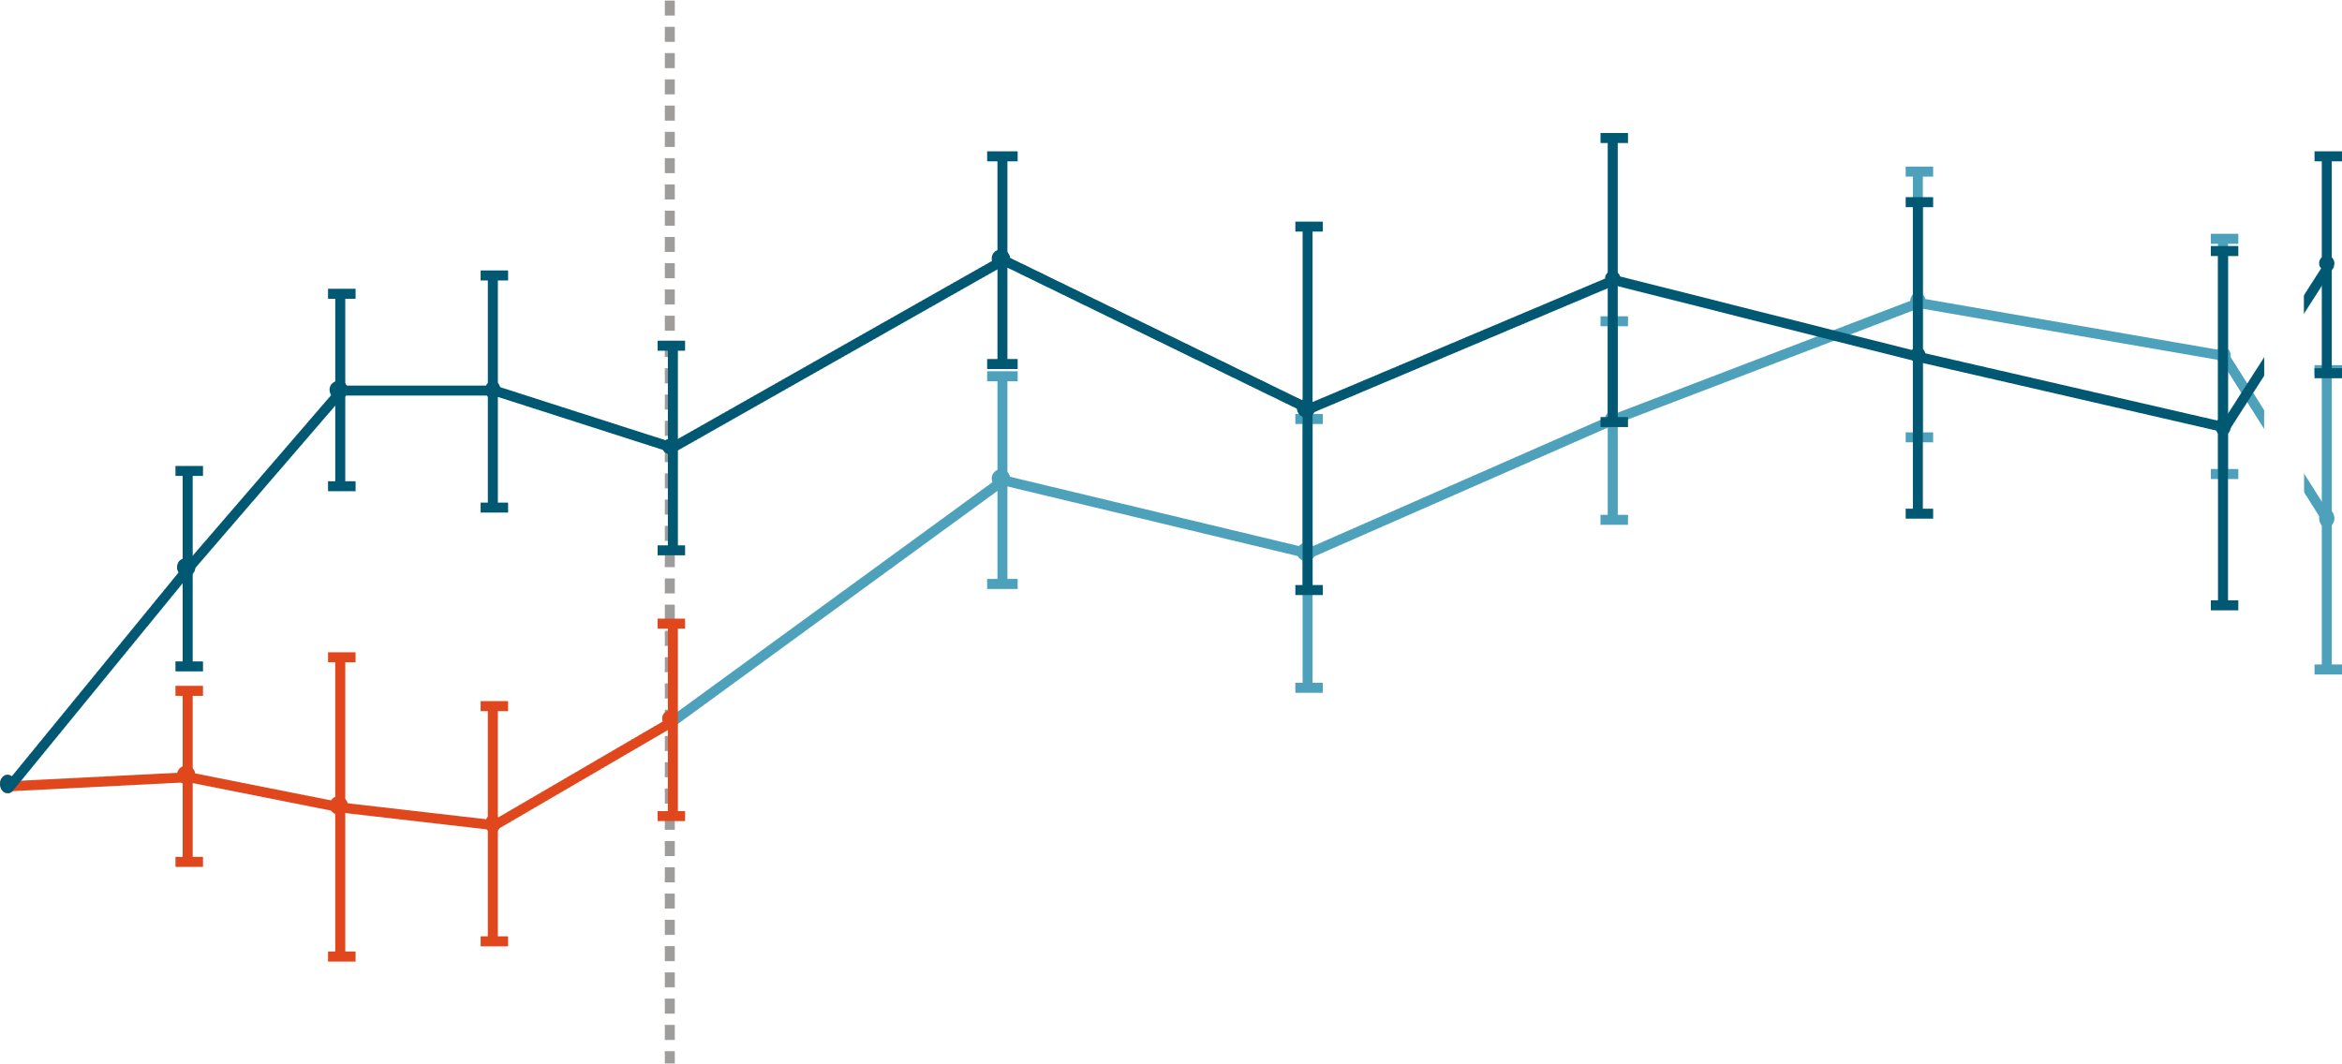
CADENZA PRO Analysis: EQ VAS
EQ VAS Score: Mean Change from Baseline
30
Part A
Part B
Placebo arm
PBO (Part A)
SUT (Part B)
25
Sutimlimab arm
20
SUT (Part A and B)
15
Rapid improvement in EQ VAS observed upon switching from placebo to sutimlimab
Mean change for all patients (N = 39) at last on-treatment visit: 15.3 points (SE: 3.7)
10
EQ5D VAS Score Mean (SE)
Change from Baseline
5
0
-5
-10
BL
5
11
17
23
26
33
39
45
51
57
63
69
75
79
83
87
LV
Analysis Visit (Wk)
SUT
19
18
17
15
15
13
13
19
PBO/SUT
20
18
18
16
16
14
15
20
Roeth. ASH 2022. Abstr 31. Reproduced with permission.
Notes:
BL, baseline; EQ VAS, EuroQol Visual Analog Scale; PBO, placebo; PRO, patient-reported outcome; SE, standard error; SUT, sutimlimab.

Slide 11
CADENZA PRO Analysis: Investigators’ Conclusions
In phase III CADENZA trial, sutimlimab was associated with sustained improvements in fatigue and overall QoL that were maintained for >1 yr
  Patients receiving placebo in part A had rapid improvements in PROs upon switching to sutimlimab in part B
  Most patients reported improved QoL vs baseline throughout part B
  Most patients reported no or mild fatigue at Wk 87
Investigators concluded that sutimlimab is associated with meaningful
long-term benefits related to fatigue and patient-reported QoL, in addition to improvements in hematologic parameters, in patients with CAD without recent transfusion history
Roeth. ASH 2022. Abstr 31.
Notes:
CAD, cold agglutinin disease; PRO, patient-reported outcome; QoL, quality of life.

Slide 12
Go Online for More CCO
Coverage of ASH 2022!
Short slideset summaries and additional CME-certified analyses with expert faculty commentary on key studies in:
Acute and chronic leukemias
Lymphomas and chronic lymphocytic leukemia
Myelodysplastic syndromes and myeloproliferative neoplasms
Myeloma
Nonmalignant hematology
clinicaloptions.com/oncology

