Slide 1

Clinical Compass BriefCASE 1: Engaging Patients in Conversations About New Advances in Obesity Care
Provided by Clinical Care Options, LLC dba Decera Clinical Education, in partnership with Smart Patients and the Obesity Medicine Association.
This activity is supported by an educational grant from Lilly

Slide 2
About These Slides
Please feel free to use and share some or all of these slides in your noncommercial presentations to colleagues or patients
When using our slides, please retain the source attribution:
Slide credit: deceraclinical.com/education
These slides may not be published, posted online, or used in commercial presentations without permission. Please contact permissions@deceraclinical.com for details
Notes:
Disclaimer: The materials published on the Decera Clinical Education website reflect the views of the authors of the Decera Clinical Education material, not those of Decera Clinical Education, the CME providers, or the companies providing educational grants. The materials may discuss uses and dosages for therapeutic products that have not been approved by the FDA. A qualified healthcare professional should be consulted before using any therapeutic product discussed. Readers should verify all information and data before treating patients or using any therapies described in these materials.

Slide 3
Faculty
Amy Butts, PA-C, DFAAPA, BC-ADM, CDCES
Endocrine Physician Associate
WVU Medicine Wheeling Hospital
Immediate Past President of American Society of Endocrine Physician Associates
Wellsburg, West Virginia

Slide 4
Disclosures
The faculty reported the following relevant financial relationships or relationships to products or devices they have with ineligible companies related to the content of this educational activity:
Amy Butts, PA-C, DFAAPA, BC-ADM, CDCES: consultant/speaker: Abbott, Corcept, Madrigal, Novo Nordisk, Xeris.

Slide 5
Learning Objective
Integrate strategies that promote sustained weight loss and reduce risk of related comorbidities to improve outcomes and quality of life
Notes:
FCS, familial chylomicronemia syndrome.

Slide 6

The Tug-of-war of Weight Management
WEIGHT LOSS
WEIGHT GAIN
↓ calories
↑ activity
↓ metabolism
↑ hunger hormone
↓ fullness hormones
Decreased calories
People may see results when they limit calories
(eg, reduce the size
of meals)
Increased activity
Physical activity increases, which can modestly increase energy expenditure (calories burned)
Decreased metabolism
Metabolism slows down and gets more efficient, requiring fewer calories to do its job
Increased hunger hormone
The body increases a hunger hormone (ghrelin) that triggers the need to eat more calories
Decreased satiety hormones
Reduction in the hormones that tell the brain it is time to stop eating
Sumithran. NEJM. 2011;365:1597.

Slide 7
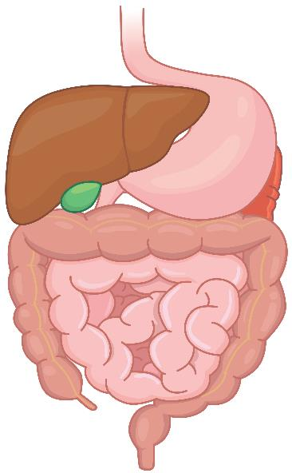
FDA-Approved Obesity Management Medications
⬆ DA/NE
Phentermine/
topiramate
Bupropion/ naltrexone
⬆ DA/NE
GABA-R and CAI
MOP-R
Liraglutide
Orforglipron
Semaglutide
GLP-1 RA
⬆ DA/NE
Phentermine
GLP-1 RA and
dual GIP/GLP-1 RA
GIP/GLP-1 RA
↓ GASTRIC EMPTYING
Tirzepatide
↓↑ LIPOLYSIS
Off-label Medications
Metformin
Other GLP-1 RAs
SGLT2 inhibitors
Topiramate
Bupropion
↓ GASTRIC EMPTYING
Gastric device
↓ Stomach volume
Pipeline Medications
Other GIP/GLP-1 RAs
Oral GLP-1 RAs
GLP-1/GCGR agonist
GIP/GLP-1/GCGR agonist
GLP-1 RA/amylin analogue
PYY analogue
GDF-15 analogue
LIPASE INHIBITION
Orlistat
Angelidi. Endocr Rev. 2022;43:507. Giruzzi. Clin Diabetes. 2020;38:313. Tak. Curr Obes Rep. 2021;10:14.
Tschöp. Diabetologia. 2023;66:1796. Tirzepatide PI. Orforglipron PI. prnewswire.com/news-releases/epitomee-medical-announces-fda-clearance-of-its-capsule-weight-management-device-302249169.html.
Notes:
CAI, carbonic anhydrase inhibitor; DA, dopamine; GCGR, glucagon receptor; GDF-15, growth differentiating factor 15; GIP, glucose-dependent insulinotropic polypeptide; GABA-R, gamma-aminobutyric acid receptor; GLP-1, glucagon-like peptide-1; MOP-R, mu opioid receptor; NE, norepinephrine; PYY, peptide YY; RA, receptor agonist; SGLT2, sodium-glucose cotransporter 2.

Slide 8
The 5 C’s for Choosing an Obesity Management Medication
C
1
ontraindications
and cautions
Assess patients’ past medical history and the risk/benefit profile of each agent
omorbidities
2
C
Use an agent that can treat obesity and address other comorbidities when appropriate
Comorbidity-driven therapy beats selection based on weight only
ues
3
C
Consider patients’ self-described appetite control symptoms, AEs, and administration preference
4
ombinations
C
Consider prescribing lifestyle interventions, other anti-obesity agents, and/or surgery in combination
5
ost and coverage
C
Consider costs and patients’ health insurance coverage
Adapted from Horn. Postgrad Med. 2022;134:359.
Notes:
AE, adverse event.

Slide 9
Roadmap for Patient-Centered Conversations in Obesity Care
Goal: base conversations on the current evidence—same as the prescription
Use respectful, patient-centered language to discuss the latest advances and align treatment with their health goals, preferences, and long-term follow-up
    Open the conversation by asking permission and framing obesity as a chronic disease
    Reframe outcomes from weight loss only to overall health gains
    Address patients’ concerns about cost, safety, stigma, and duration
Kane. PLoS One. 2025;20:e0314269. Nadolsky. Endocr Pract. 2025;31:351.

Slide 10
Stepwise Approach to Building Trust in Obesity Care
Step 1
Step 2
Step 3
Step 4
Step 5
Ask permission
Open the conversation without blaming or shaming patients
Validate patients’ experience
Acknowledge prior weight loss efforts and stigma
Explain the latest advances
Frame therapy as biology and support
Align with patients’ health goals
Connect options to health, life, and function
Plan follow-up
Course-correct together over time
Kane. PLoS One. 2025;20:e0314269. Nadolsky. Endocr Pract. 2025;31:351.
American Diabetes Association Professional Practice Committee for Diabetes. Diabetes Care. 2026;49:S166.

Slide 11
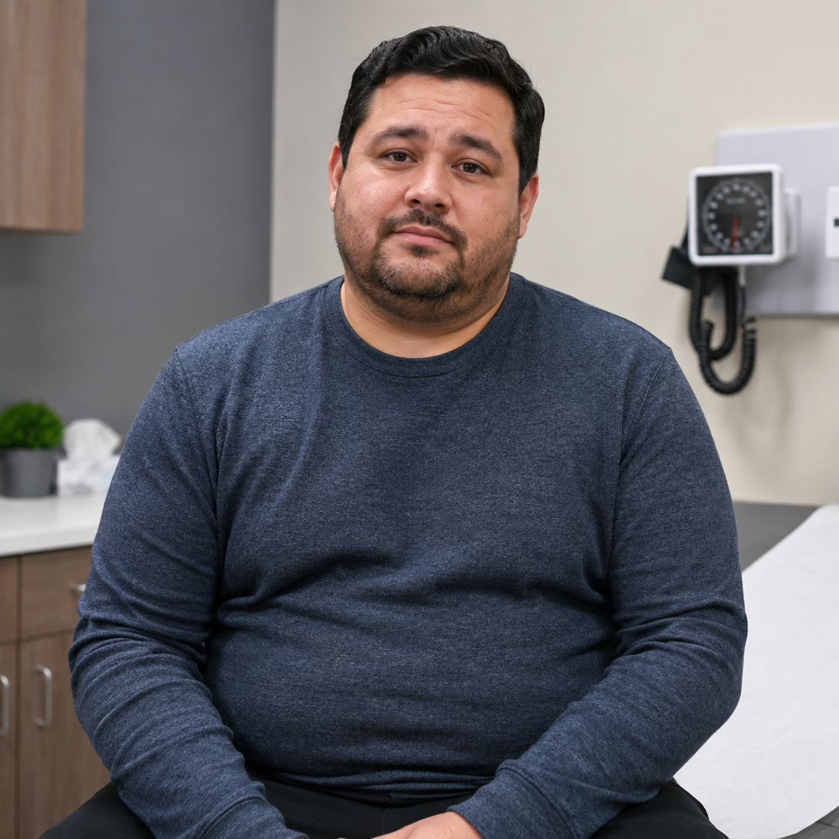
Patient Case: Obesity Care After a Dismissive Experience
Think about this
patient’s story
Do you see patients
like this frequently in
your practice?
How would you open
the conversation?
What opportunities
are there to rebuild trust and invite partnership?
Snapshot
46-yr-old man with obesity (BMI: 33 kg/m²), hypertension, and poor sleep; family history of diabetes
He hates being told to eat less and move more because he already has done that
He says, “I keep hearing there are weight-loss pills now. I do not want injections, but I also do not want to be blamed if another treatment does not work.”
He wants a respectful partnership with his doctor

Slide 12
Patient Case: Obesity Care After a Dismissive Experience
Think about this
patient’s story
Do you see patients
like this frequently in
your practice?
How would you open
the conversation?
What opportunities
are there to rebuild trust and invite partnership?
Teaching Point:
The clinical task is not to simply describe new obesity treatments. It is to rebuild trust, identify health goals, and invite partnership with patients.

Slide 13
Moving the Conversation From Scale Only to Whole Health Goals
Energy
Less fatigue
More stamina
Sleep
Improved OSA, symptoms, and restfulness
Function
Walking and stairs
Risk
Joint pain
Cardiovascular disease: blood pressure and lipids
Liver enzymes
Conversation goal: “What would feeling better or doing better look like for you?”
Nadolsky. Endocr Pract. 2025;31:351.
Notes:
OSA, obstructive sleep apnea.

Slide 14
Handling Concerns: Follow Curiosity Before Correction
Cost:
“Let us check your coverage before we choose a plan.”
Maintenance:
“Obesity often requires ongoing treatment like hypertension.”
Safety:
“Let us review the benefits, risks, and symptoms that warrant warning.”
Stigma:
“This is not a character flaw;
it is a treatable disease.”
Administration:
“Let us compare what fits your health goals, routine, safety, and access needs.”
Nadolsky. Endocr Pract. 2025;31:351.

Slide 15
Follow-up Is Part of Your Prescription
Patients hear of your commitment when their plan includes ongoing support
    Try saying, “How does it sound if we schedule regular follow-up visits to see what is working vs what is hard for you and whether the plan needs adjusted?”
Track more than weight loss
    Labs, blood pressure, sleep, function, mood, quality of life, tolerability, adherence, access, and whether the administration route fits patients’ lifestyle
Use multidisciplinary, team-based support
Maintain a course-correction mindset
(ie, dose adjustments, alternate therapies, added support, and/or revised goals are expected—not failures)
    Dietitian/nutrition, behavioral health, physical therapy/exercise support, and others on the care team
Kane. PLoS One. 2025;20:e0314269. Nadolsky. Endocr Pract. 2025;31:351.

Slide 16
Patient Case: Building a Sustainable Obesity Care Plan
Ask permission to
discuss weight, health,
and treatment preferences
Does the patient know
that “oral” is only 1 factor, not the whole decision?
What matters most to patient: oral route, health, goals, safety, or access
What support will help
the patient start and maintain treatment?
Teaching Point:
Obesity is a chronic, treatable medical condition.
Although oral options expand shared decision-making, the best plan considers patients’ health goals, safety needs, access, daily routine, and long-term care.

Slide 17
Key Takeaways: 5 Steps for Respectful, Sustained Obesity Care
Step 1
Step 2
Step 3
Step 4
Step 5
Ask permission before discussing weight or treatment
Validate patients’ prior weight loss efforts and experiences with stigma
Connect new therapies to health gains and patient-defined goals
Discuss long-term use, safety, cost, and uncertainty honestly
Use follow-up and team-based support to sustain patient engagement
Kane. PLoS One. 2025;20:e0314269. Nadolsky. Endocr Pract. 2025;31:351.
American Diabetes Association Professional Practice Committee for Diabetes. Diabetes Care. 2026;49:S166.

Slide 18
Go Online for More Coverage of Obesity!
Downloadable slides of all the key data discussed today
On-demand webcast to revisit today’s expert-led discussion and learnings
ClinicalThought commentaries with new perspectives in patient care
deceraclinical.com/education

