Slide 1
Shingles Solutions: Optimizing Shingles Vaccination in Clinical Practice
Provided by Clinical Care Options, LLC dba Decera Clinical Education
This educational activity is supported by an independent medical education grant from GSK.

Slide 2
About These Slides
Please feel free to use and share some or all of these slides in your noncommercial presentations to colleagues or patients
When using our slides, please retain the source attribution:
These slides may not be published, posted online, or used in commercial presentations without permission. Please contact permissions@deceraclinical.com for details
Slide credit: deceraclinical.com/education
Notes:
Disclaimer: The materials published on the Decera Clinical Education website reflect the views of the authors of the Decera Clinical Education material, not those of Decera Clinical Education, the CME providers, or the companies providing educational grants. The materials may discuss uses and dosages for therapeutic products that have not been approved by the FDA. A qualified healthcare professional should be consulted before using any therapeutic product discussed. Readers should verify all information and data before treating patients or using any therapies described in these materials.

Slide 3
Epidemiology of Shingles
~1 in 3 US individuals will develop shingles in their lifetime¹
    Approximately 1 million cases of herpes zoster occur annually in the United States²
Incidence of shingles increases with immunocompromise¹ and as age increases³
    More common at age ≥50 yr
    Incidence at 60 yr of age is 6-8 cases per 1000 vs 8-12 cases per 1000 at 80 yr of age
    Peak incidence at ages 60-69 yr
  1. cdc.gov/shingles/surveillance.html. 2. cdc.gov/shingles/hcp/clinical-overview.html.
  3. Koshy. Indian J Dermatol Venereol Leprol. 2018;84:251.

Slide 4
Potential Complications of Shingles
Secondary bacterial infections (eg, cellulitis, septicemia)
Acute retinal necrosis leading to blindness
Aseptic meningitis/encephalitis with adverse functional sequelae
Cranial and peripheral nerve palsies
Spinal cord involvement (eg, acute urinary retention, urinary or bowel dysfunction)
Postherpetic neuralgia
Koshy. Indian J Dermatol Venereol Leprol. 2018;84:251.

Slide 5

The Disease Burden of Shingles
Functional burden¹
Sleep quality, social activities
Pain, depression
Weight loss, chronic fatigue
Reduced ability to perform activities of daily living
Pill burden
Anticholinergic burden (constipation, risk of delirium)
Polypharmacy
  Psychological distress, delirium, falls, mortality (especially in older patients)
Social burden
Hospitalizations: up to 4% of patients²
ED/outpatient visits
Complications
Prescriptions³
Shingles is preventable and prevention yields significant downstream benefits!
1. Koshy. Indian J Dermatol Venereol Leprol. 2018;84:251. 2. cdc.gov/shingles/hcp/clinical-overview.html. 3. Dommasch. JAMA Dermatol. 2017;153:874.
Notes:
ED, emergency department.

Slide 6
CDC Guidelines for RZV: Older Adults
FDA approved and ACIP recommended in 2017 for people aged ≥50
2 doses of recombinant zoster vaccine (RZV) regardless of previous history of shingles or receipt of zoster vaccine live (ZVL)
In the US, ACIP considers those born before 1980 to have natural VZV immunity via childhood exposure
CDC and ACIP recommend shingles vaccination regardless of whether patients recall having had a naturally occurring varicella infection (ie, chickenpox)
Anderson. MMWR Morb Mortal Wkly Rep. 2022;71:80. cdc.gov/vaccines/vpd/shingles/index.html. Zoster vaccine recombinant PI.
Notes:
ACIP, Advisory Committee on Immunization Practices.

Slide 7
CDC Guidelines for RZV: People With Immunocompromise
FDA approved for people aged ≥18 with immunocompromise in 2021 and
ACIP recommended for people aged ≥19 with immunocompromise in 2021
    Immunosuppressive conditions: DM, RA, IBD, COPD, HIV
    Immunosuppressive medications: daily steroids; hydroxychloroquine; methotrexate, azathioprine, or 6-MP; cancer chemotherapeutic agents; anti-rejection medications; biologic agents (eg, TNF-α inhibitors)
Recommend vaccination to adult patients anticipating, undergoing, or recovering from immunocompromising illnesses or procedures, eg, chemotherapy or solid organ transplant
  Highest effectiveness if administered prior to starting immunosuppressing medication
Anderson. MMWR Morb Mortal Wkly Rep. 2022;71:80. dc.gov/vaccines/vpd/shingles/index.html. cdc.gov/vaccines/vpd/shingles/hcp/immunocompromised-adults.html. Zoster vaccine recombinant PI.
Notes:
6-MP, 6-mercaptopurine; ACIP, Advisory Committee on Immunization Practices; COPD, chronic obstructive pulmonary disease; DM, diabetes mellitus; IBD, irritable bowel disease; RA, rheumatoid arthritis; RZV, recombinant zoster vaccine; TNF, tumor necrosis factor.

Slide 8
Uptake of Shingles Vaccine in US Adults
Coverage With ≥1 Dose of Any Zoster Vaccine
NHIS 2021 Survey evaluated self-reported immunization rates for 5 vaccine-preventable diseases in US adults ≥19 yr of age (N = 29,142)¹
Zoster vaccination coverage with ≥1 dose of any type of vaccination was:
      32.6% among adults ≥50 yr of age
      41.1% among adults ≥60 yr of age
White adults ≥50 and ≥60 yr of age had higher vaccine coverage compared with Black, Hispanic, and other races/ethnicities
Coverage With 2 Doses of Recombinant Zoster Vaccine
Claims data evaluated for adults (N = 726,352) ≥50 yr of age who received ≥1 RZV dose between 4/2017 and 3/2021²
      Receipt of dose 2 within 2-6 mo: 71.8%
Low receipt of on-time dose 2 and/or completion rates associated with
    Younger age (50-64 yr)
    Black race or Hispanic ethnicity
    Lower income and educational attainment
    Commercial insurance
1. cdc.gov/adultvaxview/publications-resources/vaccination-coverage-adults-2021.html?CDC_AAref_Val=https://cdc.gov/vaccines/imz-managers/coverage/adultvaxview/pubs-resources/vaccination-coverage-adults-2021.html. 2. LaMori. Vaccine. 2022;40:2266.
Notes:
NHIS, National Health Interview Survey; RZV, recombinant zoster vaccine.

Slide 9
3 Major Areas of Emphasis for Shingles Vaccination
Coordinating between primary and specialty care
Ensuring series completion
Addressing disparities in access to, patient acceptance of, and administration of vaccine

Slide 10
Care Coordination Is a Foundation for RZV Uptake
Primary care
Specialty care
Notes:
RZV, recombinant zoster vaccine.

Slide 11
Strategies to Boost RZV Uptake
Increase vaccine-related discussions
    Vaccination is the responsibility of primary care HCPs, specialists, APPs, nurses, and pharmacists
Improve methods to identify high-risk patients
    Screen patients based on their age and risk factors, including immune compromise status and treatments that may indicate need for vaccination
  Discuss vaccination with all eligible patients
    Important even when patients are under a specialist’s care
Scalia. J Intern Med. 2022;291:408. cdc.gov/acip/vaccine-recommendations/shared-clinical-decision-making.html.
Notes:
APP, advanced practice providers; HCP, healthcare professional; NP, nurse practitioner; RZV, recombinant zoster vaccine.

Slide 12




Care Coordination Considerations to Support RZV Uptake
Is the vaccine available in the primary care clinic/office? If not, is there an established, organized, and workable process for patient referral?
Is there coordination
of vaccine recommendation across specialties? Is there communication between specialty and primary care HCPs?
Are all HCPs aware of the current vaccine recommendation? Can clinic staff answer patients’ questions and support vaccination?
Does the clinic/office use decision support, patient communication, AI, or other tools to enable/support vaccination?
Notes:
AI, artificial intelligence; RZV, recombinant zoster vaccine.

Slide 13
NVAC Adult Vaccination Standards of Care for All HCPs Include:
Preparation
Use systems to incorporate vaccine assessment into routine clinical care
Assess vaccination status in
every patient care and counseling encounter
Action
Strongly recommend needed vaccines
    Educate patients on vaccine guidelines
If necessary, refer to an HCP who can immunize
Document receipt of vaccination in health record and participate in your state’s immunization registry
NVAC. Public Health Rep. 2014;129:115.
Notes:
HCP, healthcare professional; NVAC, National Vaccine Advisory Committee.

Slide 14
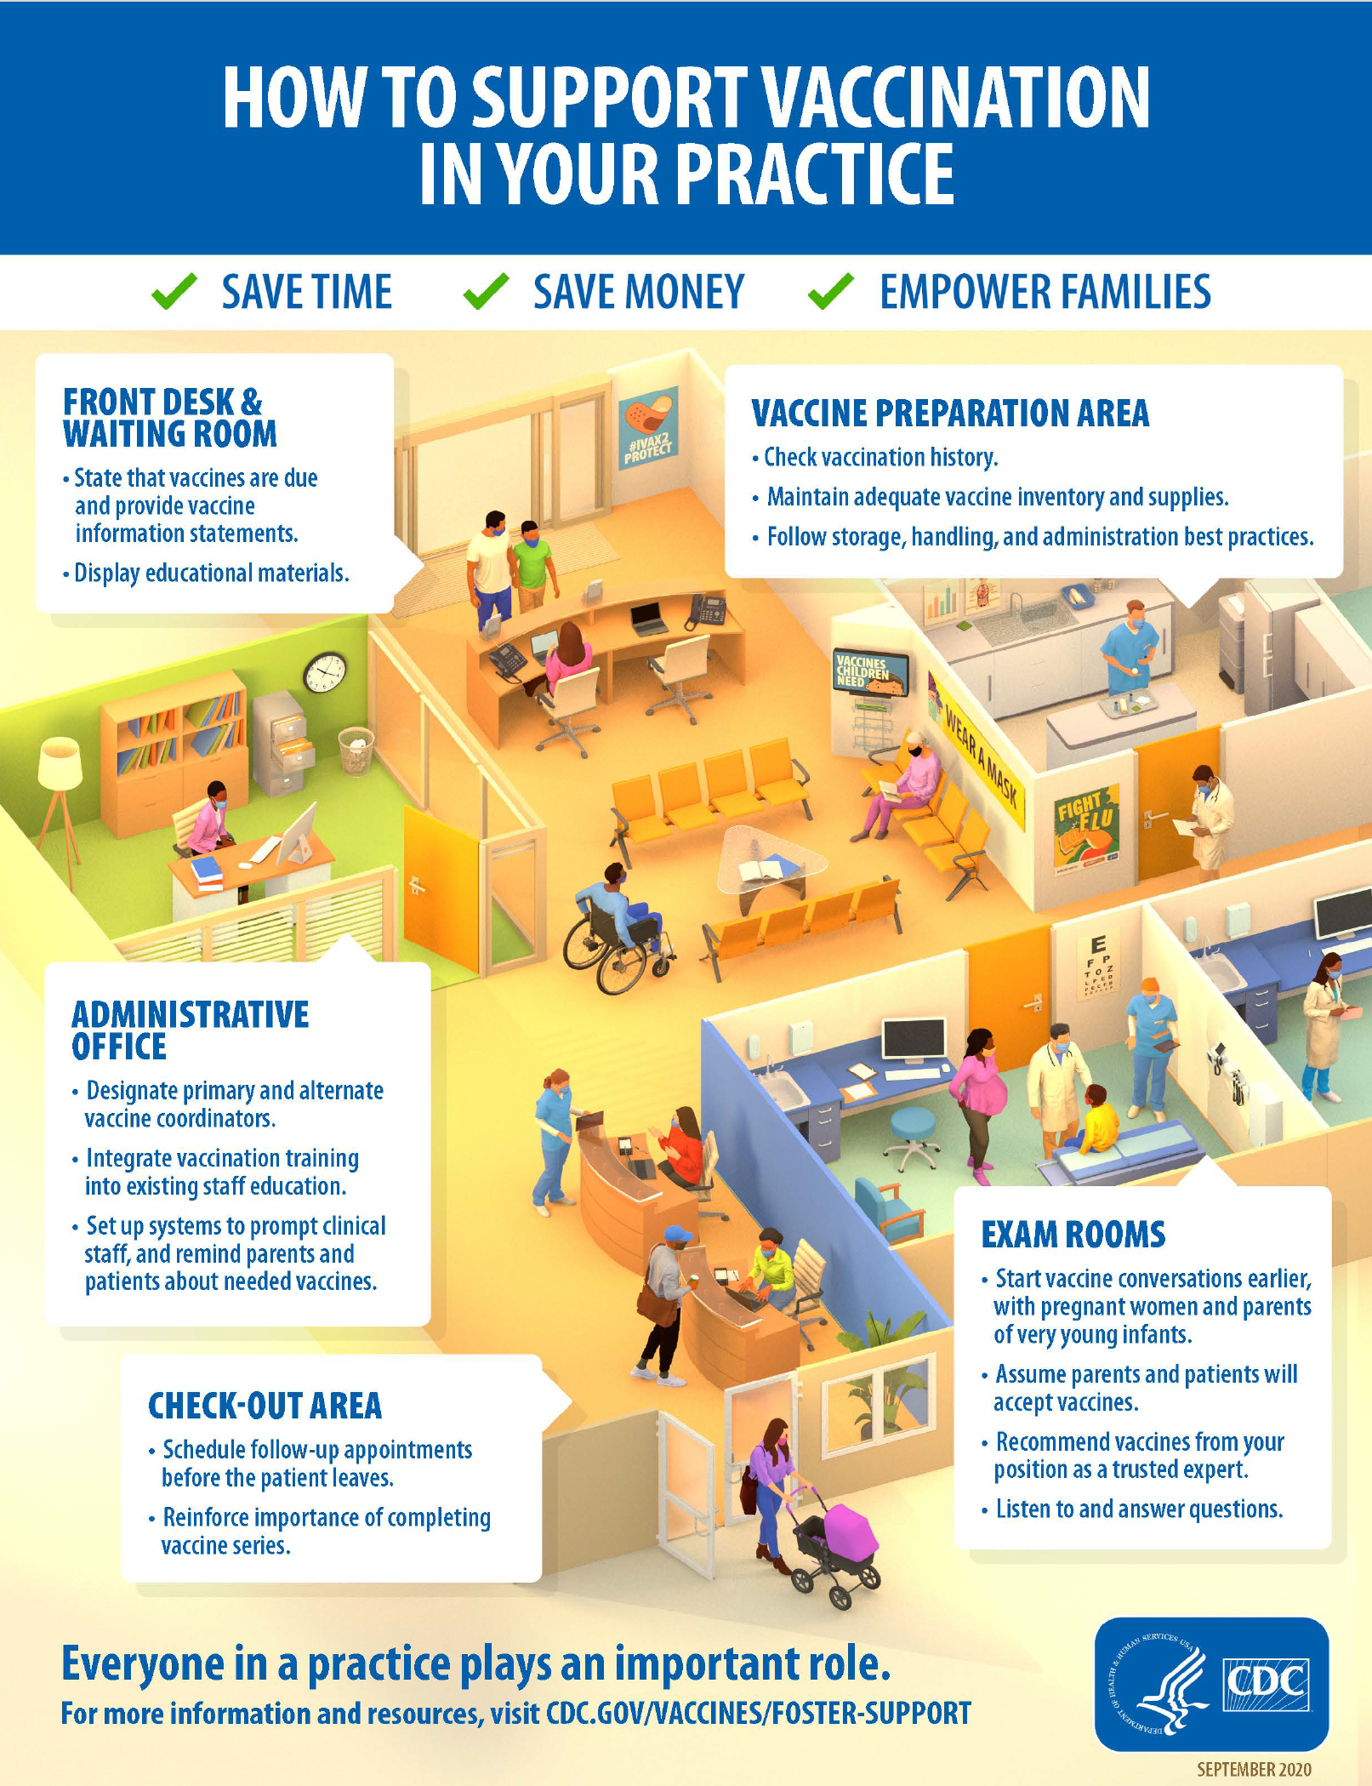
How the Healthcare Team Can Support Vaccination
Ensure patients are aware of your vaccination policy
Ensure vaccine resources are easy to find
Review all patients’ vaccination status and prepare them for vaccine receival
Recommend needed vaccines effectively
Answer patients’ questions and address their concerns
Implement policies and procedures that assist staff in supporting vaccination
Schedule next vaccinations before patients leave your office/clinic
Remind patients about upcoming vaccination and/or missed appointments
cdc.gov/vaccines/hcp/conversations/your-practice.html.

Slide 15
Pharmacists’ Role: Proactive Approaches to RZV Uptake
Provide
Education
Offer disease and vaccine information
Encourage and Provide Vaccination
Provide strong RZV vaccine recommendations
Determine whether coadministration with other vaccines is possible
Identify Ideal Candidates
Run reports at your practice for all patients ≥50 yr of age and those with immunocompromise
Offer incentives for being up to date with vaccination
Evaluate medication list for immune suppressing medications or others that may indicate need for vaccination (eg, hydroxychloroquine)
cdc.gov/vaccines/hcp/current-vis/shingles.html.
thecommunityguide.org/findings/vaccination-programs-health-care-system-based-interventions-implemented-combination.html.
Notes:
RZV, recombinant zoster vaccine.

Slide 16
Pharmacists’ Role Across Care Settings
Ambulatory Care
Vaccinate in-house or send to pharmacy that can
Transitions of Care
Referrals for medication management post discharge
Outpatient (primary care, cardiology, pulmonology, endocrinology) or community based
Community-based pharmacies often partner with clinics in their community
Partner with local health systems
Recommend vaccines to prevent rehospitalization due to respiratory illness
Vaccine indication when new diagnosis is made
pharmacytimes.com/view/pharmacists-are-vital-to-transitions-of-care.
ashp.org/-/media/assets/pharmacy-practice/resource-centers/ambulatory-care/ambulatory-care-career-tool.ashx.

Slide 17
Need for Second Dose: Real-world Efficacy of RZV Vaccination After 1 and 2 Doses
Study Design and Methods
Prospective cohort study of adults ≥50 yr of age who received care at 1 of 4 VSD sites
Study conducted between January 1, 2018, and December 31, 2022
RZV vaccination available to all age-eligible members
Primary outcome: incidence of herpes zoster infection
Results and Conclusions
2.0 million persons = 7.6 million person-yr of follow-up
RZV vaccine efficacy:
2 doses of RZV were highly effective and waned very little during 4 yr of follow-up; 1 dose waned ~20%
Efficacy, % | Yr 1 | Yr 2 | Yr 3+
1 dose | 70 | 45 | 48
2 doses | 79 | 75 | 73
Zerbo. Ann Intern Med. 2024;177:189.
Notes:
RZV, recombinant zoster vaccine; VSD, Vaccine Safety Datalink.

Slide 18
Questions to Ask About Series Completion
Can HCPs address patients’ questions about the data behind the timing of second dose? And about the impact of series completion?
Can HCPs and office/clinic staff educate patients about postvaccination immune response and reactogenicity?
  Is there a process to address patients’ concerns postvaccination?
Are HCPs measuring the effectiveness of their series completion interventions?
  Do they have an iterative improvement process to increase performance?
Notes:
HCP, healthcare professional.

Slide 19
Patient Counseling on RZV Safety and Adverse Events
Most common AE is a local injection-site reaction (eg, sore, red arm)
1 in 6 people may experience symptoms that prevent them from doing their daily activities
    Reaction to dose 1 does not predict reaction to dose 2
    No reaction to dose 1 does predict no reaction to dose 2
Adults ≥65 yr may be at risk for Guillain-Barré syndrome during the 42 days post vaccination (new warning)
Patient Counseling
Schedule vaccine appointments where they will not interrupt planned activities
Plan to avoid strenuous activities for a few days after vaccination
Encourage patients to get the second dose even if they experience an AE (eg, fatigue, myalgia) with the first dose
  Take OTC pain medications after vaccination if needed for pain or fever
  If injection-site reactions or reactogenicity occur with the first dose, do not extend the dosing interval for the second dose
cdc.gov/vaccines/vpd/shingles/index.html. cdc.gov/vaccines/vpd/shingles/hcp/shingrix/faqs.html.
Zoster vaccine recombinant PI. cdc.gov/vaccines/vpd/shingles/hcp/shingrix/about-vaccine.html. fda.gov/vaccines-blood-biologics/safety-availability-biologics/fda-requires-warning-about-guillain-barre-syndrome-gbs-be-included-prescribing-information-Shingrix. Zoster vaccine recombinant PI.
Notes:
AE, adverse event; OTC, over-the-counter; RZV, recombinant zoster vaccine.

Slide 20
Patient Counseling on RZV Benefits: Talking Points
Highly effective in preventing HZ reactivation
Associated with a reduced incidence of dementia
Associated with a reduction in major adverse cardiovascular events
Dehghani. IDWeek 2025. Abstr 218.
Notes:
HZ, herpes zoster; RZV, recombinant zoster vaccine.

Slide 21
HZ Incidence and HZ-related Hospitalization Risk in
Black Vs White Adults
Retrospective cohort study of EHR and claims data in US from 2015-2023
Assessed HZ incidence and HZ-related complications/hospitalizations by race and ethnicity
    Included adults with Medicare Advantage + Part D or commercial insurance and who were unvaccinated for HZ
    N = 1.64M White, 203K Black, 158K Hispanic, and 67K Asian adults
Black adults had lower HZ incidence but higher odds of PHN and HZ-related hospitalization vs their White counterparts
    Black adults with HZ face increased risk of severe outcomes—highlighting the need for targeted strategies to address this disparity in vaccination
Stempniewicz. IDWeek 2024. Abstr P-2343.
Notes:
EHR, electronic health record; HZ, herpes zoster; PHN, postherpetic neuralgia.

Slide 22
Disparities in RZV Uptake Persist Across Many Groups
Decreased RZV coverage:
Black race or Hispanic ethnicity
Lower education level or socioeconomic status
Larger household
Lack of healthcare insurance
Increased time since last medical visit
Poorer overall health status
Unmarried
Younger age
Increased RZV coverage:
Prior receipt of other vaccination (ie, influenza)
Cancer
Immunocompromised
Singer. Popul Health Manag. 2025;28:288.

Slide 23
Vaccine Equity: Role of Social Determinants of Health
Social Determinants
of Health
Impact on Vaccine Equity
Education
Language barriers and low health literacy of respiratory diseases and their prevention
Socioeconomic status
Public transportation and influence on
workplace with increased exposure to viruses
Racism + other systems of oppression
(eg, homophobia, ableism, ageism)
Environment
Housing can be multigenerational and overpopulated—ease in infection transmission
Access to health services
Healthcare professional shortages decrease opportunities to receive vaccinations
Sangster. Vaccines (Basel). 2021;9:1378. Mamelund. PLoS One. 2021;16:e0244346.
Adapted from boston.gov/government/cabinets/boston-public-health-commission/racial-justice-and-health-equity#framework.

Slide 24
Addressing Disparities in Vaccine Access and Uptake
Does the office/clinic operate in way that effectively addresses the needs of the populations it serves?
Are HCPs addressing patients’ specific questions, concerns, or hesitancy?
Is the office/clinic soliciting patients’ feedback to inform strategic and intentional opportunities to listen and respond?
Are there any outreach activities that are focused on vaccinating underserved populations?
Notes:
HCP, healthcare professional.

Slide 25
Addressing Biases Relevant to Vaccine Hesitancy
Optimism Bias | Confirmation Bias | Omission Bias | Social Norms
“I rarely get sick, and it is always mild if I do. So I do not need the vaccine.” | “I read that vaccines do not work.” | “I am afraid of the side effects of the vaccine, so I have not gotten it.” | “None of my family or friends are vaccinated.”
Visual Storytelling | Reframe Vaccination as Avoiding Loss
Principle: the more patients can picture something, the more important it will be to them | Principle: people value avoiding a loss much more than they value winning a gain
Application: paint a vivid picture of shingles using photos and videos of: - Shingles with its different manifestations - The vaccine (also explaining how it works) - Outcomes (ensure the benefits are easy to understand) | Application: describe the loss that may occur without vaccination: - Illness - Long-term complications - Possible hospitalization - Potential for lost work or activities of daily living
Graves. EMJ Microbiol Infect Dis. 2023;4:2.

Slide 26
Motivational Interviewing Strategies
Ask open-ended questions
Reflect and respond
Affirm strengths and validate concerns
Ask – provide – verify
Summarize interaction and determine action
Gagneur. Can Commun Dis Rep. 2020;46:93.

Slide 27
Getting Patients on Board With Vaccination
AIMS
(Announce, Inquire, Mirror, Secure)
An actionable, process-based, behavior-change program to facilitate discussions with patients. This moves us from “talking at” to “talking with” with patients in conversations
Announce vaccination is necessary and needed; assume your patients are ready for it
Inquire about your patients’ concerns or hesitation if such are presented
Mirror your patients’ responses by repeating what they say and confirming what they mean
Secure trust at the conclusion of the conversation with your patients
SHARE
(Seek, Help, Assess, Reach, Evaluate)
5-step process for shared decision-making that explores and compares the benefits, harms, and risks of the patient’s options
Seek participation from your patients
Help your patients explore and compare their options
Assess your patients’ values and preferences
Reach an agreed-upon decision with your patients
Evaluate your patients’ decision
Parrish-Sprowl. Front Public Health. 2023;11:1120326.
ahrq.gov/sdm/share-approach/index.html.

Slide 28
NVAC: Strategies Shown to Improve Vaccination Rates
HCP recommendation is one of the most important predictors of vaccination among adults
Patient and HCP recall/reminder systems
HCP assessment and feedback
Standing orders or protocols
Electronic heath record systems with incentives
Reducing patient out-of-pocket costs
Worksite interventions/offering on-site vaccinations
Pairing healthcare system‒based interventions with culturally competent, community-based interventions
NVAC. Public Health Rep. 2014;129:115.
Notes:
HCP, healthcare professional; NVAC, National Vaccine Advisory Committee.

Slide 29
A Model of Care: Addressing Equitable Vaccination Access in the Black Community
3 tiers to promote equitable vaccination access include:
Tier 1
Engage faith/community leaders
Tier 2
Educate individuals using HCPs from their specific community
Tier 3
Develop low-barrier clinics to increase access within the community
Abdul-Mutakabbir. Lancet Glob Health. 2021;9:e749.
Notes:
HCP, healthcare professional.

Slide 30
Tier 1: Engage Faith/Community Leaders
The US is a highly religious nation and faith leaders occupy large roles in the Black community
Leveraged existing relationship with 2 religious organizations and gained access to their congregation:
  Inland Empire Concerned African American Churches (IECAAC)
  Congregations Organized for Prophetic Engagement (COPE)
Faith/community leaders organized platforms to:
  Disseminate information
  Manage major processes necessary for vaccine clinics
Abdul-Mutakabbir. Lancet Glob Health. 2021;9:e749.

Slide 31
Tier 2: Provide Vaccine Education Through Black HCPs
Education sessions were offered alongside community vaccination clinics, intentionally focusing on:
  Translating the pathophysiology of the disease
  Mechanism of vaccines
  Race/ethnicity-specific clinical trial information
Previous published research, an increase in postsession awareness and acceptance of the vaccines was reported
Abdul-Mutakabbir. Lancet Glob Health. 2021;9:e749.
Notes:
HCP, healthcare professional.

Slide 32




Tier 3: Address Barriers to Vaccination in the Black Community
Lack of Digital Readiness
Limited Transport Options
Distance to Healthcare Facilities
Discrimination and Stigmatization
Abdul-Mutakabbir. Lancet Glob Health. 2021;9:e749.

Slide 33
Takeaway Points
Successful shingles vaccine uptake requires broad collaboration and care coordination between primary care, specialties, and pharmacy
Patients’ concerns regarding vaccine safety and need for a second dose require coordinated and intentional approaches to communication
    Education about adverse events, tolerability, and why the second dose is essential is important
Benefits of RZV extend beyond shingles
    Associated with a reduction in dementia and major cardiovascular adverse events
Disparities exist in RZV uptake
  These should be addressed by removing barriers to access
Notes:
RZV, recombinant zoster vaccine.

Slide 34
Go Online for More Coverage of Shingles!
ClinicalThought commentaries featuring expert faculty perspectives
Podcasts of expert-led discourse
A Clinical Focus Module exploring all the key data
deceraclinical.com/education

