Slide 1
TROP-2 as a Therapeutic Target in
Advanced NSCLC
Provided by Clinical Care Options, LLC
Supported by educational grants from AstraZeneca and Daiichi Sankyo, Inc.
Notes:
NSCLC, non-small-cell lung cancer.

Slide 2

About These Slides
Please feel free to use and share some or all of these slides in your noncommercial presentations to colleagues or patients
When using our slides, please retain the source attribution:
These slides may not be published, posted online, or used in commercial presentations without permission. Please contact permissions@clinicaloptions.com for details
Slide credit: clinicaloptions.com
Notes:
Disclaimer: The materials published on the Clinical Care Options website reflect the views of the authors of the CCO material, not those of Clinical Care Options, LLC, the CME providers, or the companies providing educational grants. The materials may discuss uses and dosages for therapeutic products that have not been approved by the United States Food and Drug Administration. A qualified healthcare professional should be consulted before using any therapeutic product discussed. Readers should verify all information and data before treating patients or using any therapies described in these materials.

Slide 3
Presenting Faculty
Narjust Florez, MD
Associate Director of The Cancer Care Equity Program
Thoracic Medical Oncologist
Dana-Farber Cancer Institute
Assistant Professor of Medicine
Harvard Medical School
Associate Editor, JAMA Oncology
Boston, Massachusetts
Narjust Florez, MD: consultant/advisor/speaker: AstraZeneca, Bristol Myers Squibb, DSI, Janssen, Merck, Mirati, Novocure, Pfizer, Regeneron.
Notes:
This slide lists the faculty who were involved in the production of these slides.

Slide 4
Molecular and PD-L1 Testing at Initial Diagnosis to
Guide Treatment in NSCLC
Initial Diagnosis of NSCLC
Early Stage
Advanced
Neoadjuvant:
EGFR/ALK testing*
and
PD-L1 IHC
Adjuvant:
Molecular testing (EGFR/ALK) and PD-L1 IHC
Broad NGS testing and PD-L1 IHC
(at diagnosis)
Test for PD-L1 expression required for all advanced NSCLC
Broad molecular testing for all cases of advanced NSCLC should include ALK, BRAF EGFR, HER2, KRAS, METex14, NTRK, PD-LI, RET, and ROS1 mutation
Biomarker results should be obtained before starting checkpoint inhibitor therapy
Pennell. ASCO Educ Book. 2019;39:351. Godoy. Biomark Res. 2023;11:7. NCCN. NSCLC. V3.2024.
Notes:
IHC, immunohistochemistry; NSCLC, non-small-cell lung cancer; NSQ, nonsquamous; SQ, squamous.

Slide 5
Heterogeneity in NSCLC
Protein Expression⁵
PD-L1 Expression Level⁴
Comprehensive
Molecular Characterization^{2,3}
NSCLC
as One Disease
Histology-Based
Subtyping¹
~18% with
TPS ≥50%
TROP-2
c-Met
EGFR
~28-54%*
Unknown
~12%
Other
25%
Adeno-
carcinoma
40%
NSCLC
Large cell
10%
~56% with
TPS <1%
Squamous
25%
~26% with
TPS 1%-49%
HER3
CEACAM5
KRAS
~25%
Traditional View
HER2
Future View?
Present View
*Varies widely by population.
1. https://www.cancer.gov/types/lung/hp/non-small-cell-lung-treatment-pdq#_359. 2. Jordan. Cancer Discov. 2017;7:596.
3. Pi. Thorac Cancer. 2018;9:814. 4. Gelatti. Clin Lung Cancer. 2020;21:e511. 5. Marks. Lung Cancer. 2022;163:59.
Notes:
NSCLC, non-small-cell lung cancer; TPS, tumor proportion score.

Slide 6
Targeted Therapy in Advanced NSCLC With Actionable Driver Mutations (2024)
Advanced NSCLC
(Molecular Biomarker Positive)
EGFR
ALK
ROS1
BRAF V600E
NTRK
RET
METex14
skipping
KRAS G12C
HER2
Classical
(del19 or
L858R)
Uncommon
Alectinib, brigatinib, or lorlatinib (preferred);
ceritinib or crizotinib
Crizotinib, repotrectinib,
or entrectinib (preferred);
or ceritinib
Dabrafenib/
trametinib or
encorafenib/
binimetinib
Entrectinib
or
larotrectinib
Selpercatinib
or
pralsetinib
Capmatinib
or
tepotinib
ex20ins
S768I, L861Q, G719X
First line
Osimertinib* (preferred), erlotinib†, afatinib, gefitinib, or dacomitinib
Osimertinib* or afatinib (preferred), erlotinib, gefitinib, or dacomitinib
Amivantamab + CT
Progression
Alectinib,
brigatinib, ceritinib, or lorlatinib dependent on previous therapy
Sotorasib or adagrasib
Amivantamab
Trastuzumab deruxtecan
Second line+
Follow treatment options for adenocarcinoma or squamous cell carcinoma without actionable biomarker (ie, chemotherapy ± immunotherapy)
*Also approved as second-line therapy for EGFR T790M–positive disease after an earlier-generation EGFR TKI. †Erlotinib can be prescribed alone or in combination with ramucirumab or bevacizumab.
Adagrasib PI. Afatinib PI. Alectinib PI. Amivantamab PI. Brigatinib PI. Capmatinib PI. Ceritinib PI. Crizotinib PI. Dabrafenib PI. Dacomitinib PI. Encorafenib PI. Entrectinib PI. Erlotinib PI. Gefitinib PI. Lorlatinib PI. Larotrectinib PI. Osimertinib PI. Pralsetinib PI. Repotrectinib PI. Selpercatinib PI. Sotorasib PI. Tepotinib PI. Trastuzumab deruxtecan PI. NCCN. Clinical practice guidelines in oncology: NSCLC. v.3.2024.
Notes:
CT, chemotherapy; NSCLC, non-small-cell lung cancer; TKI, tyrosine kinase inhibitor.

Slide 7
TROP-2 as a Therapeutic Target
TROP-2: Cell Signaling
Transmembrane glycoprotein overexpressed in many solid tumors, including NSCLC
  Also underexpressed in NSCLC
Epithelial cell adhesion molecule that regulates cell growth, regeneration, and proliferation
TROP-2
p27
Ca²⁺
Ki-67
Cyclin E
MAPK
Cyclin D
ERK1
ERK2
P
P
Cell cycle progression
FOXO3a
P
AP-1
MDM2
Ubiquitination
Invasion metastasis via MMPs, Pdpn, Ezrin, CD44, etc
Angiogenesis via VEGF, etc
Proteasomal degradation
Apoptosis via BCL-2, FasL, etc
EMT
via Pdpn, etc
Proliferation via cyclins, CDKs
FOXO3a
β-catenin
Cell survival
β-catenin
Cell growth
Jiang. Oncol Lett. 2013;6:375. Shvartsur. Genes Cancer. 2015;6:84. CC BY 4.0 DEED. Changes made.
Notes:
NSCLC, non-small-cell lung cancer.

Slide 8
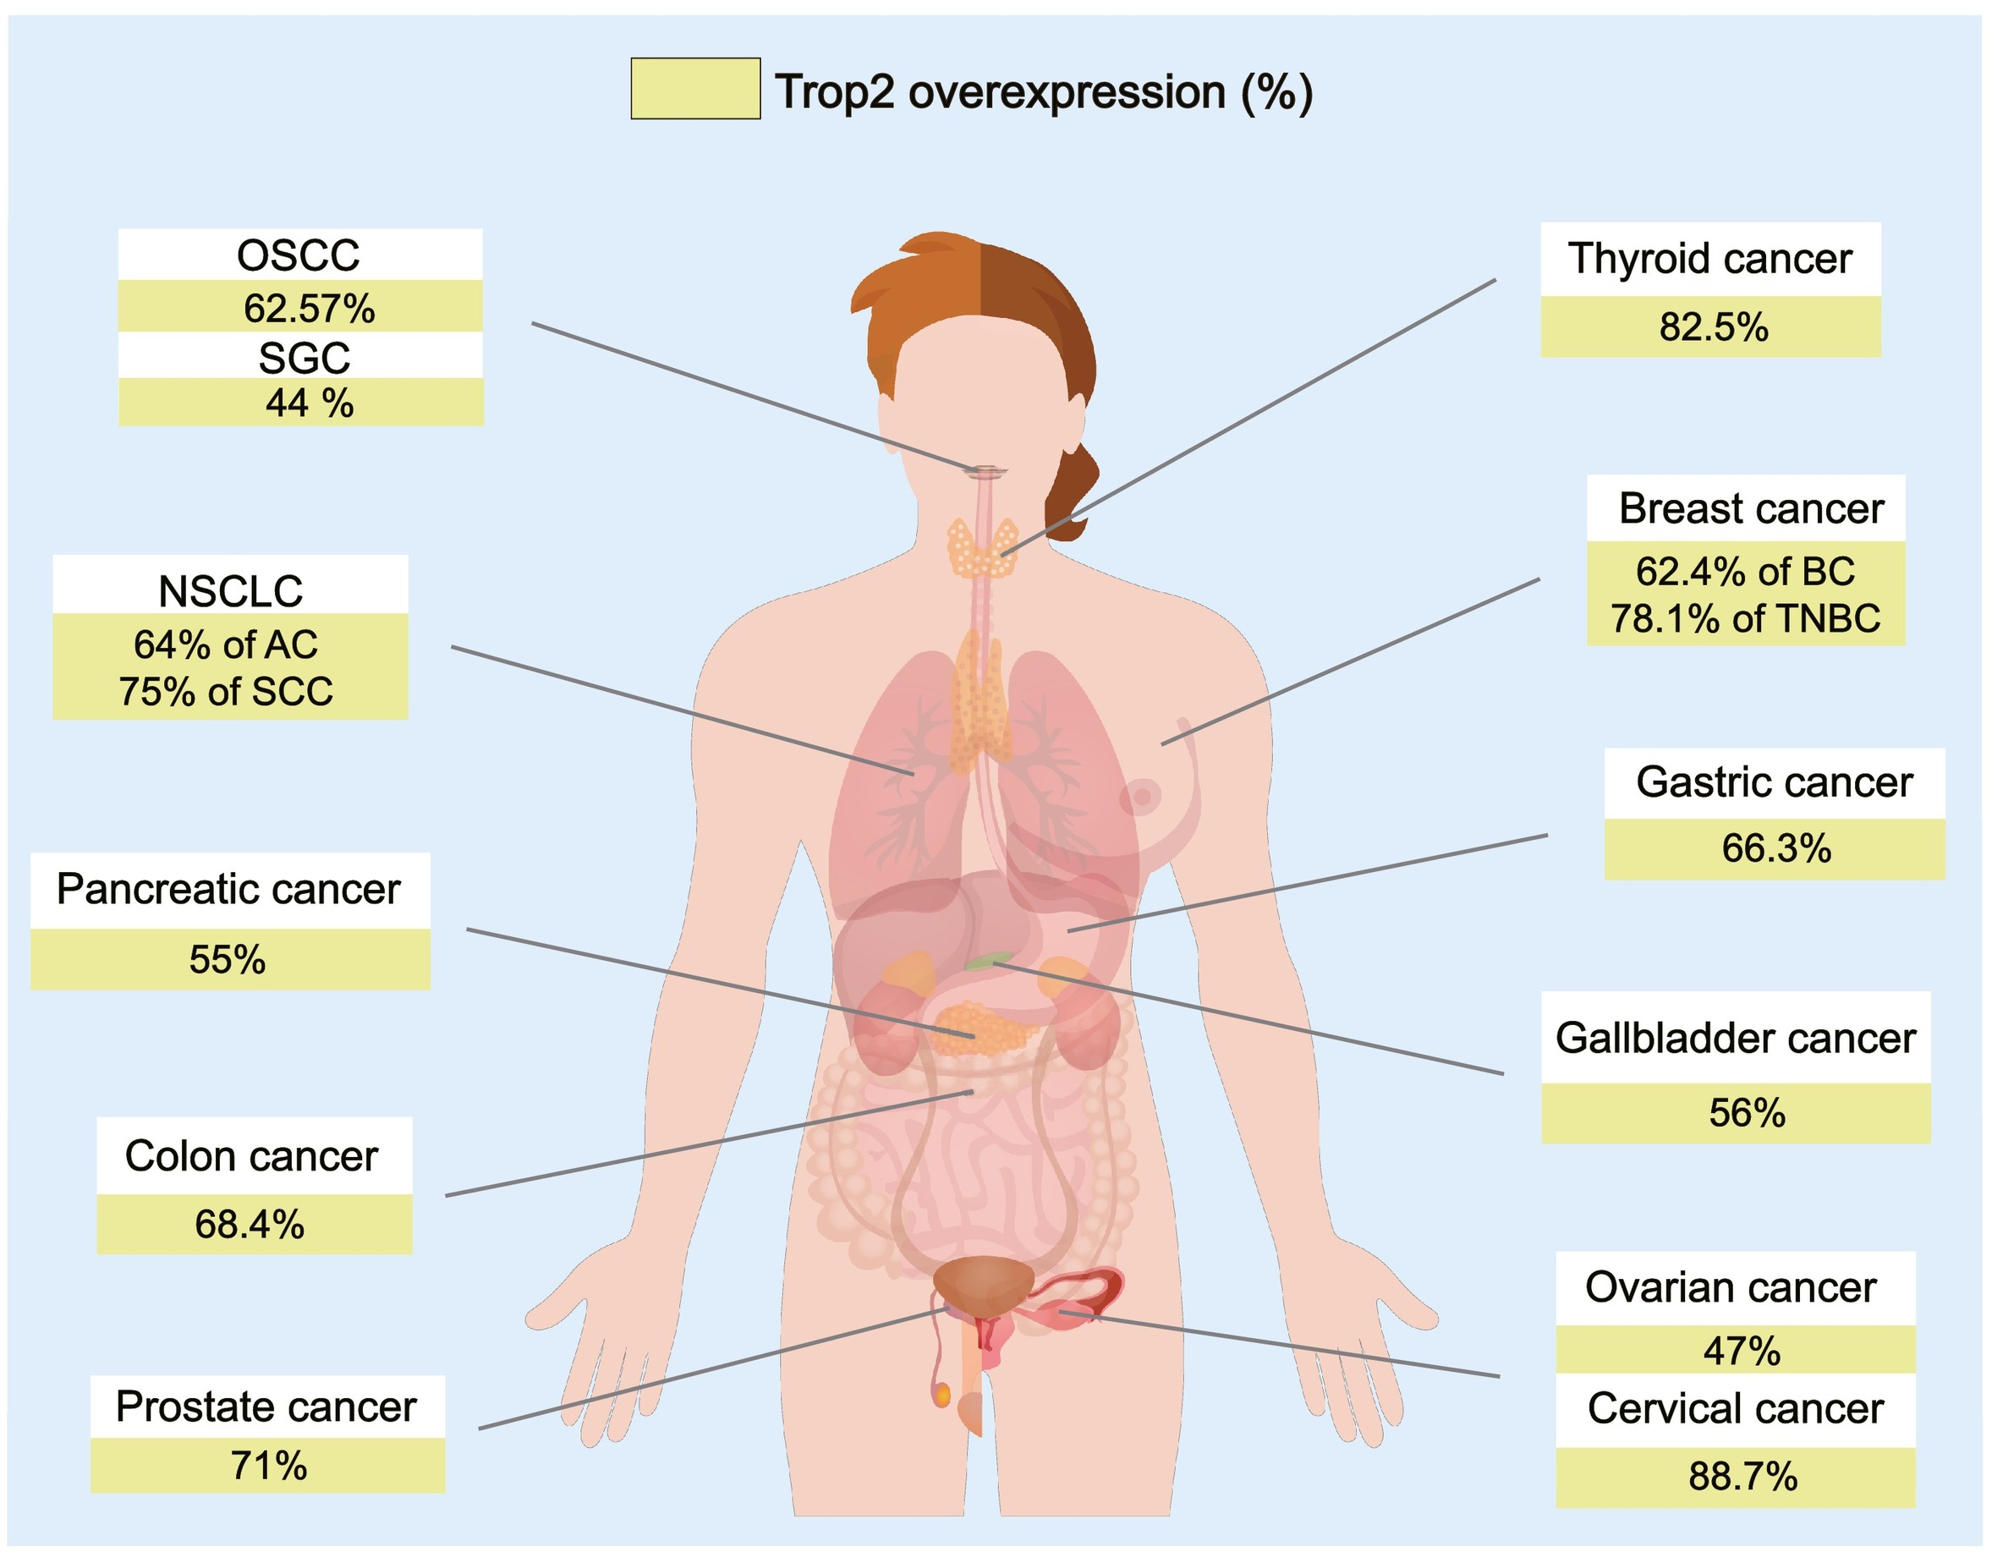
TROP-2 Overexpression in NSCLC and Other Cancers
Liu. Pharmacol Ther. 2022;239:108296. CC BY-NC-ND 4.0 DEED. No changes made.
Notes:
AC, atypical carcinoid; BC, breast cancer; NSCLC, non-small-cell lung cancer; OSCC, oral squamous cell carcinoma; SCC, squamous cell carcinoma; SGC, salivary gland carcinoma; TNBC, triple-negative breast cancer.

Slide 9
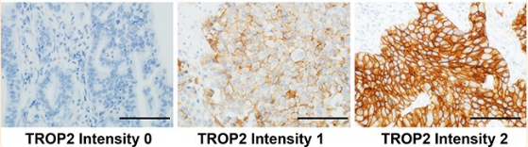
Association of Tumor TROP-2 Expression With
Prognosis Varies Among Lung Cancer Subtypes
Adenocarcinoma
Adenocarcinoma
TROP-2 IHC
1.0
1.0
0.8
No/low TROP-2 (n = 98)
0.8
No/low TROP-2 (n = 98)
0.6
0.6
OS Probability
LCSS Probability
0.4
High TROP-2 (n = 172)
0.4
0.2
0.2
High TROP-2 (n = 172)
Log-rank P = .025
Log-rank P = .023
0
0
0
50
100
150
200
250
0
50
100
150
200
250
Scale bar = 200 µm.
Mo
Mo
High TROP-2 expression associated with increased lung cancer‒specific mortality for adenocarcinoma and
not SCC
  HR adenocarcinoma: 1.60
  (95% CI: 1.07-2.44; P = .022)
  HR SCC: 0.79 (95% CI: 0.35-1.94;
  P = .79)
SCC
SCC
1.0
High TROP-2 (n = 150)
1.0
No/low TROP-2 (n = 51)
0.8
0.8
No/low TROP-2 (n = 51)
0.6
0.6
LCSS Probability
OS Probability
High TROP-2 (n = 150)
0.4
0.4
0.2
0.2
Log-rank P = .58
Log-rank P = .36
0
0
0
20
40
60
80
100
120
0
20
40
60
80
100
120
Mo
Mo
Inamura. Oncotarget. 2017;8:28725. Figure 1: CC BY 4.0 DEED. No changes made.
Notes:
IHC, immunohistochemistry; LCSS, lung cancer-specific survival; SCC, squamous cell carcinoma.

Slide 10
TROP-2 Overexpression Associated With Shorter OS, DFS
TROP-2 Expression Correlates With Shorter OS
TROP-2 Expression Correlates With Shorter DFS
Study ID
Zhao W (2015)
Guan GF (2015)
Chen MB (2014)
Liu T (2013)
Chen RJ (2013)
Pak MG (2012)
Wu H (2012)
Ning SL (2012)
Bignotti E (2012)
Bignotti E (2010)
Kobayashi H (2010)
Fang YJ (2009)
Fong D (2008)
Fong D (2008)
Ohmachi T (2006)
Overall (I-squared = 0%, P = .677)
HR (95% CI)
1.82 (1.21-2.73)
4.56 (1.04-19.92)
1.46 (0.71-2.22)
1.89 (1.10-3.26)
2.74 (0.34-22.28)
1.60 (0.15-17.26)
2.44 (1.19-5.01)
3.26 (1.47-7.21)
1.83 (0.65-5.18)
2.35 (1.03-5.34)
2.88 (1.02-8.12)
1.14 (0.55-1.38)
1.80 (1.10-3.10)
2.26 (1.34-3.84)
2.38 (1.29-4.74)
1.90 (1.60-2.25)
Study ID
Guan GF (2015)
Liu T (2013)
Pak MG (2012)
Bignotti E (2012)
Bignotti E (2010)
Muhlmann G (2008)
Overall
(I-squared = 30%, P = .210)
Study ID
4.81 (1.10-21.07)
1.95 (1.14-3.36)
1.58 (0.31-8.18)
2.82 (1.05-7.58)
0.99 (0.31-3.14)
6.30 (2.20-18.50)
2.34 (1.60-3.42)
.0475
1
21.1
.0449
1
22.3
Zeng. Sci. Rep. 2016;6:33658. CC BY 4.0 DEED. Changes made.
Notes:
DFS, disease-free survival; OS, overall survival.

Slide 11
Go Online for More CCO
Coverage of NSCLC!
Downloadable slidesets on targeting TROP-2 in advanced NSCLC (coming soon!)
CME-certified modules with expert faculty commentary on data with TROP-2–targeting
ADCs in advanced NSCLC (coming soon!)
clinicaloptions.com

