Slide 1
Multidisciplinary Approaches for
Evaluating Risk Factors and Preventive
Measures for Transgender Individuals
Madeline Deutsch, MD, MPH
Associate Professor of Clinical Family & Community Medicine
Medical Director, UCSF Gender Affirming Health Program
University of California, San Francisco
San Francisco, California
Supported by an educational grant from Merck Sharp & Dohme Corp.

Slide 2

About These Slides
Please feel free to use, update, and share some or all of these slides in your noncommercial presentations to colleagues or patients
When using our slides, please retain the source attribution:
These slides may not be published, posted online, or used in commercial presentations without permission. Please contact permissions@clinicaloptions.com for details
Slide credit: clinicaloptions.com
Notes:
Disclaimer: The materials published on the Clinical Care Options Web site reflect the views of the authors of the CCO material, not those of Clinical Care Options, LLC, the CME providers, or the companies providing educational grants. The materials may discuss uses and dosages for therapeutic products that have not been approved by the United States Food and Drug Administration. A qualified healthcare professional should be consulted before using any therapeutic product discussed. Readers should verify all information and data before treating patients or using any therapies described in these materials.

Slide 3
Faculty Disclosures
Madeline B. Deutsch, MD, MPH, has no relevant financial relationships to disclose.

Slide 4
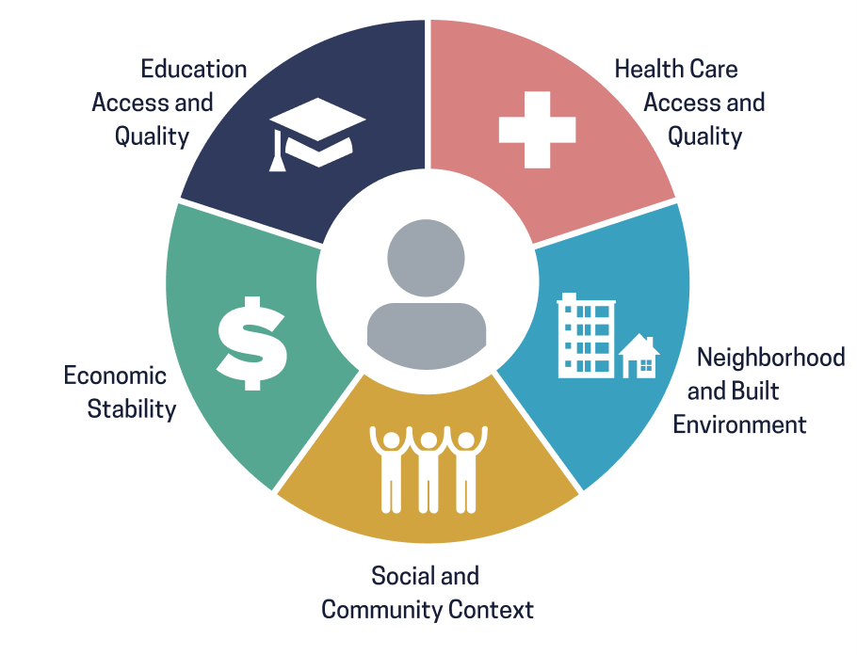

Social Determinants Impacting Transgender People
Discrimination
Stigma, shame, denial of
gender identity
Emotional and physical trauma
Unstable housing
Lack of employment protections/options
  Poverty
Lack of general legal protections
High rates of incarceration
  Survival sex work
Poteat. Lancet. 2015;385:274. James. Report of the 2015 U S Transgender Survey. 2016. Healthy People 2030, US Department of Health and Human Services, Office of Disease Prevention and Health Promotion. Retrieved August 10, 2022, from health.gov/healthypeople/objectives-and-data/social-determinants-health.
Slide credit: clinicaloptions.com

Slide 5


Creating a Culturally Appropriate
Clinical Setting for Transgender People
Waiting room atmosphere
Staff attitudes
Nondiscrimination/visitation policy
Referrals and community resources
Understanding how LGBTQ people have sex
  Sex means more than
  penile–vaginal intercourse
aamc.org/what-we-do/equity-diversity-inclusion/lgbt-health-resources/culturally-sensitive-care
Slide credit: clinicaloptions.com
Notes:
LGBTQ, lesbian, gay, bisexual, transgender, queer/questioning.

Slide 6

Creating a Culturally Appropriate Setting:
Names and Pronouns
Names and pronouns
  Proper collection and use in clinic
SOGI data
  Informs research and QI efforts
  Informs clinical care
  Should be collected via nonverbal self-report or in discussion with provider
cdc.gov/hiv/clinicians/transforming-health/health-care-providers/collecting-sexual-orientation.html
Image provided courtesy of unsplash.com/@sharonmccutcheon.
Slide credit: clinicaloptions.com
Notes:
QI, quality improvement; SOGI, Sexual Orientation/Gender Identity.

Slide 7
Creating a Culturally Appropriate Setting:
Organ Inventory
Organ inventory
  Informs preventive and general healthcare
  Collect self-reported information
  Synchronize with preventive health reminders, surgical history
Recommended Organs for Inventory
Penis
Testes
Prostate
Breasts
Vagina
Cervix
Uterus
Ovaries
Deutsch. J Am Med Inform Assoc. 2013;20:700.
Slide credit: clinicaloptions.com

Slide 8
Creating a Culturally Appropriate Setting:
The Care Team and Relationships
Each person has a role in the experience of patients
  It is essential that all staff—including reception staff, nurses, medical assistants, and physicians—use appropriate names and pronouns
  Avoid honorifics (sir, ma’am, Mr, Mrs, etc)
It often takes >1 visit to develop a rapport conducive for sensitive discussions
  Consider whether systems are in place to facilitate or impede the
  patient–provider relationship
  For example, are gowns necessary if that makes the patient uncomfortable and impedes the patient–provider relationship?
Slide credit: clinicaloptions.com

Slide 9
Cultural Competency vs Cultural Humility
Cultural Competency
Cultural
Humility
  Knowledge
  Attitudes
  Compassion
  Empathy
  Make no assumptions
  Assume you know nothing
Lekas. Health Serv Insights. 2020;13:117863292097058.
Slide credit: clinicaloptions.com

Slide 10
Cardiovascular/Metabolic Disorders and
Hormone Therapy: Philosophy
Psychosocial benefits of hormones may include positive lifestyle changes that can reduce obesity and glucose and lipid disorders
  These benefits likely outweigh any potential increased metabolic risks
Role of minority stress in the development of chronic health conditions
Role of lifestyle factors of higher prevalence in transgender (and other minority) groups: tobacco, drug use, sedentary lifestyle
Chan Metabol Open. 2022;13:100173; Martinez. Curr Probl Cardiol. 2020;45:100396.
Slide credit: clinicaloptions.com

Slide 11
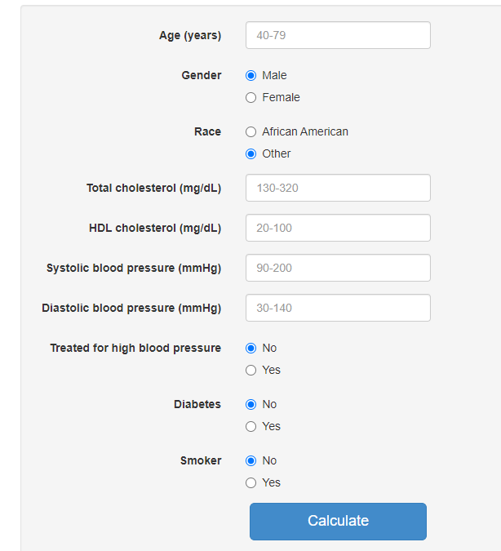
Cardiovascular Risk Calculator
cvriskcalculator.com
Slide credit: clinicaloptions.com
Notes:
HDL, high-density lipoprotein.

Slide 12
Cross-Sex Hormones and Acute Cardiovascular
Events in Transgender Persons: A Cohort Study
1
Initial EMR search to identify cohort candidates
2
Validation of transgender status
3
Determination of sex recorded at birth
10 male and 10 female cisgender enrollees were matched to each member of the final validated transgender cohort and stratified by race/ethnicity, year of birth, study site, and calendar year of membership
Getahun. Ann Intern Med. 2018;169:205.
Slide credit: clinicaloptions.com

Slide 13
Cross-Sex Hormones and Acute CV Events: Transfeminine Cohort
Overall cohort, N = 2842
Event of Interest | Transfeminine Cohort |  | Adjusted HR (95% CI)
 | ACVEs, n | Incidence Rate (95% CI) | vs Reference Cis Men | vs Reference Cis Women
VTE | 61 | 5.5 (4.3-7.0) | 1.9 (1.4-2.7) | 2.0 (1.4-2.8)
Ischemic stroke | 54 | 4.8 (3.7-6.3) | 1.2 (0.9-1.7) | 1.9 (1.3-2.6)
Myocardial infarction | 33 | 2.9 (2.1-4.1) | 0.9 (0.6-1.5) | 1.8 (1.1-2.9)
Getahun. Ann Intern Med. 2018;169:205.
Slide credit: clinicaloptions.com
Notes:
ACVE, acute cardiovascular event; Cis, cisgender; CV, cardiovascular; VTE, venous thromboembolism.

Slide 14
Cross-Sex Hormones and Acute CV Events: Transfeminine Cohort Considerations
Overall cohort, N = 2842
Event of Interest | Transfeminine Cohort |  | Adjusted HR (95% CI)
 | ACVEs, n | Incidence Rate (95% CI) | vs Reference Cis Men | NNH, n | vs Reference Cis Women | NNH, n
VTE | 61 | 5.5 (4.3-7.0) | 1.9 (1.4-2.7) | 111.1 | 2.0 (1.4-2.8) | 90.9
Ischemic stroke | 54 | 4.8 (3.7-6.3) | 1.2 (0.9-1.7) |  | 1.9 (1.3-2.6) | 111.1
Myocardial infarction | 33 | 2.9 (2.1-4.1) | 0.9 (0.6-1.5) |  | 1.8 (1.1-2.9) | 166.7
Getahun. Ann Intern Med. 2018;169:205.
Slide credit: clinicaloptions.com
Notes:
ACVE, acute cardiovascular event; Cis, cisgender; CV, cardiovascular; NNH, number needed to harm; VTE, venous thromboembolism.

Slide 15
Cross-Sex Hormones and Acute CV Events: Transmasculine Cohort
Overall cohort, N = 2118
Event of Interest | Transmasculine Cohort |  | Adjusted HR (95% CI)
 | ACVEs, n | Incidence Rate (95% CI) | vs Reference Cis Men | vs Reference Cis Women
VTE | 23 | 3.1 (2.0-4.6) | 1.6 (0.9-2.9) | 1.1 (0.6-2.1)
Ischemic stroke | 16 | 2.1 (1.3-3.5) | 1.1 (0.6-2.0) | 1.3 (0.7-2.5)
Myocardial infarction | 9 | 1.2 (0.6-2.3) | 0.7 (0.3-1.8) | 1.3 (0.5-3.9)
Getahun. Ann Intern Med. 2018;169:205.
Slide credit: clinicaloptions.com
Notes:
ACVE, acute cardiovascular event; Cis, cisgender; CV, cardiovascular; VTE, venous thromboembolism.

Slide 16
Multivariable Associations Between Transgender Women and Myocardial Infarction, BRFSS Analysis
Characteristics | OR (95% CI) | P Value
Transgender status
Reference group | Cisgender men
Transgender women | 1.32 (0.92-1.90) | .13
Transgender men | 2.53 (1.14-5.63) | .02
Cisgender women | 0.52 (0.48-0.55) | <.01
Reference group | Cisgender women
Transgender women | 2.56 (1.78-3.68) | <.01
Transgender men | 4.90 (2.21-10.90) | <.01
Cisgender women | 1.94 (1.81-2.07) | <.01
Alzahrani. Cardiovasc Qual Outcomes. 2019;12:e005597.
Slide credit: clinicaloptions.com
Notes:
BRFSS, Behavioral Risk Factor Surveillance System; OR, odds ratio.

Slide 17
Cardiovascular Risk Take-home Summary
Available data have some limitations
  Retrospective
  Do not control for differences in dose or route
  Some rely on self-report of outcomes
Where differences are seen in comparison to birth sex, actual
effect size is small
  Can be incorporated into informed consent discussions
  In reality, unlikely to impact decision-making for most
Slide credit: clinicaloptions.com

Slide 18
Cancer Screening in Transgender People
If an organ is present, appropriate cancer screening should be applied
Gender dysphoria decreases a patient’s chance of undergoing screening for birth sex organs
  Provider factors (such as lack of education and comfort)
  Patient factors (such aggravation of gender dysphoria with physical examination of sex organs)
Sex Organ–Specific Cancer Screening Recommendations
Transgender Men | Transgender Women
Breast | Testicular
Uterine | Prostate
Cervical | Penile
Ovarian | Breast
Vulva
Sterling. Transl Androl Urol. 2020;9:2771.
Slide credit: clinicaloptions.com

Slide 19
Cervical Cancer Screening in Transgender Men
49% current for screening vs 69% in general US population of cisgender women
57.1% preferred self-sampling
Understanding Transgender Men’s Experiences With and Preferences for Cervical Cancer Screening: A Rapid Assessment Survey
Seay J, Ranck A, Weiss R, Salgado C, Fein L, Kobetz E
Seay. LGBT Health. 2017;4:304.
Slide credit: clinicaloptions.com

Slide 20
Self- vs Provider-Collected Samples for High-Risk
HPV Testing in Female-to-Male Transgender Patients
Concordance of self-collected vaginal HPV DNA hybridization assay to provider-collected cervical HPV DNA specimen
Self-Collected Vaginal DNA | Provider-Collected Cervical DNA (n = 131)
Self Collected Vaginal DNA | Positive, n (%) | Negative, n (%) | Total, n (%)
Positive | 15 (11.5) | 2 (1.5) | 17 (13.0)
Negative | 6 (4.6) | 108 (82.4) | 114 (87.0)
Total | 21 (16.0) | 110 (84.0) | 131 (100)
Primary Outcome Variable | % | 95% CI
Sensitivity | 71.43 | 0.48-0.89
Specificity | 98.18 | 0.94-1.00
Positive predictive value | 88.24 | 0.64-0.99
Negative predictive value | 94.74 | 0.89-0.98
Kappa | 75.40 | 0.58-0.92
Reisner. PLoS One. 2018;13:e0190172.
Slide credit: clinicaloptions.com
Notes:
HPV, human papillomavirus.

Slide 21
Recent Penile Sexual Contact and High-Risk
Cervical HPV Infection in Transgender Men
Sexual Behavior | Bivariate |  |  | Adjusted Model
 | OR | 95% CI | P Value | OR | 95% CI | P Value
Yes, receptive penile–vaginal sex | 5.06 | 1.69-15.12 | .01 | 5.23 | 1.61-17.02 | <.01
Yes, penile sex, but not receptive vaginal | 1.48 | 0.15-14.28 | .74 | 1.42 | 0.13-15.04 | .77
No penile sex | Reference | -- | -- | Reference | -- | --
Deutsch. Sex Transm Dis. 2020;4:48.
Slide credit: clinicaloptions.com
Notes:
HPV, human papillomavirus; OR, odds ratio.

Slide 22
Breast Cancer Screening in Transgender People: Overview
There is a deficit of prospective, longitudinal outcomes data for
breast cancer screening in transgender people
Data on how to approach screening people with prior mastectomy is lacking
Available data suggest lower rates of breast cancer among all transgender populations compared with cisgender women but higher compared with cisgender men
Consider potential harms of screening
de Blok. BMJ. 2019;365:l1652.
Slide credit: clinicaloptions.com

Slide 23
Breast Cancer in Transgender People
Population | Variables | Observed Cases | Expected Cases | Standardized Incidence Ratio (95% CI) | Expected Cases | Standardized Incidence Ratio (95% CI)
 |  |  | Reference: Incidence Ratio Cis Men |  | Reference: Incidence Ratio Cis Women
Transgender Women (n = 2260) | Invasive | 15 | 0.32 | 46.7 (27.2-75.4) | 59.95 | 0.3 (0.2-0.4)
 | Aged <30 yr | 0 | 0.00 | -- | 0.14 | --
 | Aged 30-50 yr | 9 | 0.01 | 659.4 (321.6-1210.0) | 9.16 | 1.0 (0.5-1.8)
 | Aged >50 yr | 6 | 0.31 | 19.5 (7.0-40.6) | 50.65 | 0.1 (0.1-0.3)
 | Noninvasive | 3 | 0.03 | 96.1 (24.5-261.6) | 12.10 | 0.3 (0.1-0.7)
 | Aged <30 yr | 0 | 0.00 | -- | 0.01 | --
 | Aged 30-50 yr | 1 | 0.00 | 5288.0 (264.6-26,080.0) | 1.25 | 0.8 (0.00-4.0)
 | Aged >50 yr | 2 | 0.03 | 64.5 (10.8-213.0) | 10.83 | 0.2 (0.0-0.6)
Transgender Men (n = 1229) | Invasive | 4 | 0.07 | 58.9 (18.7-142.2) | 18.54 | 0.2 (0.1-0.5)
 | Aged <30 yr | 0 | 0.00 | -- | 0.14 | --
 | Aged 30-50 yr | 2 | 0.01 | 282.3 (47.3-932.5) | 4.78 | 0.4 (0.1-1.4)
 | Aged >50 yr | 2 | 0.06 | 32.9 (5.5-108.8) | 13.62 | 0.2 (0.0-0.5)
 | Noninvasive | 0 | 0.01 | -- | 3.55 | --
de Blok. BMJ. 2019;365:l1652.
Slide credit: clinicaloptions.com
Notes:
Cis, cisgender.

Slide 24
Uterine Cancer Considerations in Transgender Men
Amenorrhea prior to initiation of testosterone requires evaluation,
as with cisgender females
Amenorrhea while receiving testosterone is generally safe
  Unexplained return of menses requires evaluation
Causes to explain return of menses on testosterone
  Missed doses
  Change in BMI
  New medications or medical conditions
Sterling. Trans Androl Urol. 2020;9:2771.
Slide credit: clinicaloptions.com
Notes:
BMI, body mass index.

Slide 25
Uterine and Ovarian Changes
During Testosterone Administration
Patient Number | Age, Yr | Endometrium | Myometrium | Ovary
1 | 26 | Secretive | Fibrosis | Corpus luteum
2 | 37 | Active | Normal | Multifollicular
3 | 22 | Active | Fibrosis | Multifollicular
4 | 26 | Active | Fibrosis | Multifollicular
5 | 37 | Active | Normal | Multifollicular
6 | 20 | Active | Normal | Multifollicular
7 | 31 | Active | Fibrosis | Multifollicular
8 | 34 | Active | Fibrosis | Multifollicular
9 | 31 | Secretive | Hypertrophy | Corpus luteum
10 | 33 | Active | Normal | Multifollicular
11 | 20 | Active; squamous metaplasia | Normal | Multifollicular
12 | 20 | Active | Hypertrophy | Multifollicular
Loverro. Tai J Obs Gyn. 2016;55:686.
Slide credit: clinicaloptions.com

Slide 26
Prostate Cancer Screening
Transgender women on long-term suppressive therapy for testosterone will likely have a prostate that is not palpable
  Impact of long-term suppressive therapy for testosterone on prostate cancer risk is unknown
Documented cases of prostate cancer have been reported in transgender women with a variety of surgical and hormone use histories
Shared decision making should be used when guidelines lack good evidence
It’s reasonable to begin PSA screening in people with a prostate in their 50’s or 60’s, especially those who started hormone therapy later in life
Deutsch. Center for Excellence for Transgender Health. 2016. USPTF. JAMA. 2018;319:1901.
NCCN. Clinical practice guidelines in oncology: Prostate cancer early detection guidelines. v1.2022.
Slide credit: clinicaloptions.com
Notes:
PSA, prostate-specific antigen.

Slide 27
Mortality Data in Transgender People: Summary
In general, differences in mortality between transgender and cisgender people are mostly attributable to social and societal factors
2 retrospective mortality studies covering decades of data from the Netherlands found small effect sizes of biomedical cause-specific mortalities among transgender people
  Most increases in mortality involved nonmedical causes such as drug use, suicide, and via behavioral mechanisms that result in risk behavior, HIV
de Blok. Lancet Diabetes Endocrinol. 2021;9:663. Cocchetti. J Clin Med. 2022;11:1784. Streed. Circulation. 2021;144:e136.
Slide credit: clinicaloptions.com

Slide 28
Key Takeaways
Creating a welcoming environment in clinic can have a significant impact on the experience of transgender and gender diverse patients
Cardiovascular mortality risks directly attributable to hormone therapy are marginal and are likely outweighed by the benefits
Sex-specific cancers are not elevated in transgender individuals compared with cisgender people
Cancer screening should be conducted based on organs present
Slide credit: clinicaloptions.com

Slide 29
Go Online for More CCO
Coverage of Transgender Care!
Video and Audio Podcasts of transgender patient experiences in the healthcare system
ClinicalThought Commentaries with expert insight on optimizing transgender patient care
CME/CE/CPE-certified Microlearning Text Modules on best practices for transgender healthcare
CME/CE/CPE-certified Video Simulations on best practices for transgender healthcare
clinicaloptions.com/oncology

