Slide 1
Frontline Management of Transplant-Ineligible Multiple Myeloma: Optimizing Therapy, Supportive Care, and Patient Outcomes
Provided by ProCE, LLC.
Supported by educational grants from Johnson & Johnson and Sanofi Genzyme.

Slide 2
Faculty
James A. Davis, PharmD, BCOP
Clinical Pharmacy Specialist, Myeloma/Lymphoma
The Medical University of South Carolina, Hollings Cancer Center
Affiliate Assistant Professor
MUSC College of Pharmacy
Charleston, South Carolina
Kelley L. Julian, PharmD, BCOP
Hematology/BMT Pharmacy Supervisor
PGY2 Oncology Pharmacy Residency Program Director
Huntsman Cancer Institute, University of Utah
Salt Lake City, Utah

Slide 3
Disclosures
The faculty reported the following relevant financial relationships or relationships to products or devices they have with ineligible companies related to the content of this educational activity:
James A. Davis, PharmD, BCOP: consultant/advisor/speaker: Bristol Myers Squibb, GSK, Janssen.
Kelley L. Julian, PharmD, BCOP: consultant/advisor/speaker:
GSK, Johnson & Johnson, Pfizer.

Slide 4
Myeloma Therapy for Transplant-Ineligible Patients
Frontline Treatment
Induction
Consolidation
Maintenance
More induction
No transplant
Induction regimen
minus bortezomib
± dex
VRd
D-VRd
Isa-VRd
D-KRd
Isa-KRd
NCCN. Clinical practice guidelines in oncology: multiple myeloma. v.5.2026. nccn.org.

Slide 5
Clinical Considerations for Treatment Decisions in Transplant-Ineligible Patients With MM
Patient-Related Factors | Disease-Related Factors | Treatment-Related Factors
Age Frailty Performance status Comorbidities Organ function Caregivers, social support Personal preferences QoL | Clinical presentation of MM Renal failure Extramedullary disease Circulating plasma cells Rapid paraprotein increase Cytogenetic risk Bone marrow reserve | Treatment goals (prolonged survival vs disease control) Efficacy Degree of response Duration of response Treatment-free interval Route of administration Potential AEs Impact on QoL and independence
Larocca. Cancers. 2023;15:2693.

Slide 6
Tips for Assessing Frailty
Age is not equivalent to frailty, but organ reserves likely limited with aging
Disease burden may play a role in frailty: MM treatment improves outcomes
Frailty should be evaluated using appropriate geriatric assessments, such as the IMWG frailty score or R-MCI; however, these are difficult to perform in real time
      Multidisciplinary clinic with geriatrics would be ideal for older patients
Fit patients should get full dosing, and frail patients should undergo dose reductions as appropriate
Mohty. Clin Hematol Int. 2024;6:23.
.

Slide 7
Key Frailty Scoring Systems for MM
 | IMWG | R-MCI | UKMRA MRP | Mayo Risk Score | IFM Simplified Frailty
No. of patients | 869 | NR | 2372 | 351 | 1618
Frail patients, % | 30 | NR | 35 | 21 | 49
OS in frail patients | 57% at 3 yr | NR | mOS: 20-25 mo | mOS: 28 mo | mOS: 42 mo
No. of groups | 3 | 3 | 3 | 4 | 2
Parameters | Age, CCI, ADLs, IADLs | eGFR, PFTs, frailty, age, cytogenetics, PS | Age, R-ISS, CRP, PS | Age, NT-proBNP, ECOG | Age, CCI, ECOG
Population | CT | CT, RW | CT | RW | CT
Facon. Blood. 2024;143:224.

Slide 8
Triplet Trials in Transplant-Ineligible NDMM
Outcome | MAIA^{1,2} | SWOG 0777³
Study regimen | DRd vs Rd (N = 737) | VRd vs Rd (N = 460)
Study phase | III | III
Study population | Transplant-ineligible NDMM | Transplant-ineligible/deferred NDMM
Median age | 73 yr | 63 yr
Median PFS, mo | 61.9 vs 34.4; P <.0001 Median follow-up: 64.5 mo | 41 vs 29; P .003 Median follow-up: 84 mo
Median OS, mo | 90.3 vs 64.1; P <.0001 Median follow-up: 7.5 yr | NR vs 69; P = .0114 Median follow-up: 84 mo
MRD at 10⁻⁵ by NGS, % | 32.1 vs 11.1; P <.0001 | Not reported
1. Facon. Leukemia. 2025;39:942. 2. Facon. EHA 2024. Abstr P968. 3. Durie. Blood Cancer J. 2020;10:53.

Slide 9
Transplant-Ineligible Quadruplet Trials
3 large phase III trials:
    BENEFIT (N = 270)¹: isatuximab plus bortezomib/lenalidomide/dex (Isa-VRd)
    vs Isa-Rd
    IMROZ (N = 446)²: isatuximab plus bortezomib/lenalidomide/dex (Isa-VRd)
    vs VRd
    CEPHEUS (N = 395)³: daratumumab plus bortezomib/lenalidomide/dex
    (D-VRd) vs VRd
1. Leleu. Nat Med. 2024;30:2235. 2. Facon. NEJM. 2024;391:1597. 3. Usmani. Nat Med. 2025;31:1195.

Slide 10
BENEFIT: Isatuximab + VRd in Transplant-Ineligible NDMM
Multicenter, open-label, randomized phase III trial
Primary endpoint: MRD (10⁻⁵) at 18 mo
Key secondary endpoints: ORR (CR, ≥ VGPR), MRD- CR (10⁻⁵), PFS, OS, safety
Cycles 1-12
28-day cycles
Cycles 13-18
28-day cycles
Cycle 19 onwards
28-day cycles
Isatuximab IV QW Cycle 1, D1, 15, Cycles 2-12 + Rd* +
Bortezomib SC D1, 8, 15
(n = 135)
Isatuximab IV D1 + R* +
Bortezomib SC D1, 15
Isatuximab +
R*
Patients aged 65-79 yr with NDMM who are nonfrail and transplant ineligible;
no prior systematic treatment; measurable disease; ECOG PS ≤2
(N = 270)
Isatuximab IV QW Cycle 1, D1, 15, Cycles 2-12 + Rd*
(n = 135)
Isatuximab IV D1 + R*
*R: lenalidomide 25 mg PO D1-21, d: dexamethasone 20 mg IV QW.
Leleu. ASCO 2024. Abstr 7501. Leleu. Nat Med. 2024;30:2235.

Slide 11
BENEFIT: MRD Negativity Rate and PFS in ITT Population
MRD- Rate
Isa-VRd
Isa-Rd
PFS
OR: 3.88
(95% CI: 2.27-6.62)
P <.0001
OR: 3.16
(95% CI: 1.89-5.28)
P <.0001
100
60
OR: 2.74
(95% CI: 1.54-4.87)
P = .0006
51
OR: 2.97
(95% CI: 1.60-5.50)
P = .0005
53
75
50
50
40
36
PFS (%)
Isa-VRd
Isa-Rd
32
Patients (%)
Estimated 24-Mo PFS
Isa-VRd: 85.2% (95% CI: 79.2-91.7)
Isa-Rd: 80.0% (95% CI: 73.3-87.4)
30
26
25
21
20
17
13
0
10
0
3
6
9
12
15
18
21
24
27
30
0
Mo
10⁻⁵
10⁻⁶
10⁻⁵
10⁻⁶
Isa-VRd
Isa-Rd
135
135
131
128
127
123
121
121
119
117
117
112
114
108
87
83
56
52
11
14
0
0
12 Mo
18 Mo
Isa-VRd significantly improved 12- and 18-mo MRD- rate at 10⁻⁵ or 10⁻⁶ sensitivity vs Isa-Rd
Leleu. ASCO 2024. Abstr 7501. Leleu. Nat Med. 2024;30:2235.

Slide 12
IMROZ: Isatuximab + VRd in Transplant-Ineligible NDMM
International, open-label, randomized phase III trial
Primary endpoint: PFS
Secondary endpoints: CR rate, MRD- CR (NGS 10⁻⁵) rate, ≥ VGPR rate, OS
Induction
(4 x 6-wk cycles)
Continuous Treatment
(4-wk cycles)
Crossover from Rd to Isa-Rd allowed upon progression
Isatuximab* + VRd†
(n = 265)
Isatuximab‡ + Rd§
(n = 265)
Patients aged 18 to ≤80 yr with symptomatic NDMM not considered for transplant due to older age or comorbidities
(N = 446)
Until PD, unacceptable toxicity, or patient withdrawal
VRd†
(n = 181)
Rd§
(n = 181)
*Isa IV (C1 only) 10 mg/kg Q1W; Isa IV (C2-4) 10 mg/kg Q2W.
†V: SC 1.3 mg/m² on D1, 4, 8, 11, 22, 25, 29, 32;
R: PO 25 mg on D1-14 and D22-35; d: IV/PO 20 mg on D1, 2, 4, 5, 8, 9, 11, 12, 15, 22, 23, 25, 26, 29, 30, 32, 33.
‡Isa IV (C5-17) 10 mg/kg Q2W; Isa IV (C18+) 10 mg/kg/mo
§R: PO 25 mg on D1-21; d: IV/PO 20 mg on Q1W.
Facon. ASCO 2024. Abstr 7500. Facon. NEJM. 2024;391:1597.

Slide 13
IMROZ: PFS and MRD Negativity Rate
Parameter, n (%) | Isa-VRd (n = 265) | VRd (n = 181)
Median PFS, mo | NR | 54.34
HR (98.5% CI) | 0.60 (0.41-0.88)
Log-rank P value | <.001
MRD Negativity Rate (10⁻⁵ by NGS)
Isa-VRd
VRd
Isa-VRd
VRd
Isa-VRd
VRd
70
60
100
50
58.1
55.5
80
60-mo PFS: 63.2%
40
43.6
46.8
Patients With MRD- (%)
40.9
60
30
PFS (%)
40
20
24.3
60-mo PFS: 45.2%
10
20
Median follow-up: 59.7 mo (IQR: 56.0-63.2)
0
0
Patients at
Risk, n
Isa-VRd
VRd
0
6
12
18
24
30
36
42
48
54
60
66
72
MRD- ITT
MRD- CR
MRD- for
≥12 Mo
Mo
Mo
OR: 1.79
(95% CI:
1.221-2.627)
OR: 1.803
(95% CI:
1.229-2.646;
P = .003)
265
181
243
155
234
141
217
121
201
104
190
96
177
89
164
81
153
70
104
51
43
20
2
2
0
0
OR: 2.729
(95% CI:
1.799-4.141)
Facon. ASCO 2024. Abstr 7500. Facon. NEJM. 2024;391:1597.

Slide 14
CEPHEUS: Daratumumab + VRd in NDMM Without Planned Transplantation
Multicenter, open-label, randomized phase III trial
Primary endpoint: MRD negativity (10⁻⁵, NGF)
Key secondary endpoints: PFS, ORR, ≥ VGPR, ≥ CR, PFS2, OS, MRD negativity (10⁻⁵) rate
at 1 yr
Stratified by ISS,
age (<70 yr/ASCT ineligible,
<70 yr ASCT refusal vs ≥70 yr)
Induction/Consolidation
(8 x 21-day cycles)
Maintenance
(cycle 9 onward 4-wk cycles)
Daratumumab
1800 mg SC QW, cycles 1-2 +
Q3W cycles 3-8
+ VRd*
Daratumumab
1800 mg Q4W
+ Rd†
Patients with NDMM without planned ASCT; ECOG PS ≤2
(N = 395)
Until toxicity or PD
VRd*
Rd†
*Lenalidomide 25 mg PO D1-14, bortezomib 1.3 mg/m² SC D1, 4, 8, 11,
dexamethasone 20 mg PO/IV D1, 2, 4, 5, 8, 9, 11, 12.
†Lenalidomide 25 mg PO D1-21, dexamethasone 40 mg PO/IV D1, 8, 15, 22.
Usmani. IMW 2024. Abstr OA–63. Usmani. Nat Med. 2025;31:1195.

Slide 15
CEPHEUS: PFS and MRD Negativity Rate
Primary endpoint
Overall MRD-negativity rate (10⁻⁵)
Median follow-up: 58.7 mo
100
54-mo PFS
100
OR: 2.37
(95% CI 1.58-3.55;
P <.0001)
80
68.1%
Median:
Not reached
80
60
60
∆22%
% Surviving Without Progression
MRD-Negativity Rate (10⁻⁵) (%)
40
49.5%
40
VRd
D-VRd
Median:
52.6 mo
60.9
20
20
39.4
HR: 0.57 (95% CI: 0.41-0.79; P = .0005)
0
0
0
6
12
18
24
30
36
42
48
54
60
68
D-VRd
(n = 197)
VRd
(n = 198)
Patients at Risk, n
D-VRd
VRd
Mo
197
198
180
174
170
157
160
143
149
131
140
123
136
105
132
98
122
88
115
81
33
21
0
0
Usmani. IMW 2024. Abstr OA–63. Usmani. Nat Med. 2025;31:1195.

Slide 16
Safety of Quadruplet Therapy in Transplant-Ineligible Patients
Trial | N | Median Age | Adverse Events
BENEFIT¹: isatuximab + VRd vs Isa + Rd | 270 | ~73 | All grade PN: 52% vs 28% Grade 2+ PN: 27% vs 10% Infection: 45% vs 36%
IMROZ²: isatuximab + VRd vs VRd | 446 | ~72 | PN: 54% vs 61% Pneumonia: 30% vs 19%
CEPHEUS³: daratumumab + VRd vs VRd | 395 | 70 | All grade PN: 61.9% vs 66.2% Infection: 92% vs 86%
1. Leleu. Nat Med. 2024;30:2235. 2. Facon. NEJM. 2024;391:1597. 3. Usmani. Nat Med. 2025;31:1195.

Slide 17
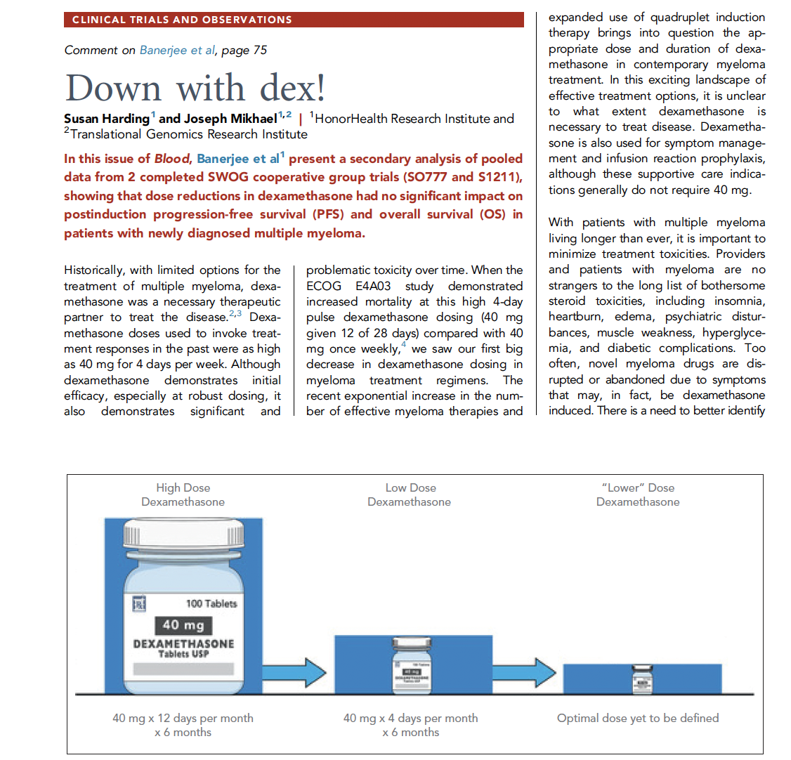
Down With Dex!
Dex De-escalation Protocol
Assess 40 mg vs 20 mg weekly starting dose
Limit starting dose to 2-3 mo
Then taper dose each mo over the course of 3-4 mo
Plan to stop dexamethasone at 6 mo
Regular assessments for toxicity and de-escalate sooner if clinically indicated
Harding. Blood. 2025;145:3.

Slide 18
Important Lessons in Transplant-Ineligible Patients
It is feasible to give quadruplets to most patients
Important to assess frailty
Optimal length of quadruplet is yet to be determined
Dosing was based on regulatory requirements; should be adapted
    Bortezomib weekly → every 2 wk
    Lenalidomide usually starting at 10-15 mg
    Dexamethasone starting at 20 mg, with rapid taper

Slide 19
Supportive Care in Frontline Therapy
Anti-CD38 monoclonal antibody (mAb)
Daratumumab
Isatuximab
Proteosome inhibitor (PI)
Bortezomib
Carfilzomib
Immunomodulatory drug (IMiD)
Lenalidomide
Pomalidomide
Steroid
Dexamethasone
Supportive medication:
Antiviral prophylaxis (ie, acyclovir or valacyclovir) to prevent viral infections, particularly shingles
Antibacterial agents (ie, sulfamethoxazole/trimethoprim, levofloxacin) to prevent bacterial infections
Aspirin or other anticoagulant therapy to reduce the risk of blood clots from IMiDs
Bone-strengthening agents (ie, zoledronic acid, denosumab) to strengthen bones and protect against fractures
Quadruplet therapy is preferred for nearly all patients with NDMM
NCCN. Clinical practice guidelines in oncology: multiple myeloma. v.5.2026. nccn.org.

Slide 20
Improving Safety and Patient Satisfaction Through Subcutaneous Administration of Anti-CD38 mAbs
 | Daratumumab (COLUMBA)¹ | Isatuximab (IRAKLIA)² | Isatuximab (IZALCO)³ | Isatuximab (ISASOCUT)⁴
Phase | III | III | II | II
Population | RRMM | RRMM | RRMM | NDMM (Transplant Ineligible)
Delivery method | Manual SC push | SC OBI vs IV | SC OBI vs manual SC | SC OBI
Combination | Monotherapy | Isa-Pd | Isa-Kd | Isa-VRd
Admin time, min | 3–5 | ~13 | ~10 | ~10
ORR, % | 43.7 | 71.1 | 79.7 | 88 (≥ VGPR at 8 mo)
Infusion reactions, % | 12.7 | 1.5 | 0 (with OBI) | 5 (mostly low grade)
Key takeaway | Standardized 5-min SC push | Proved OBI noninferiority to IV | Patients clearly preferred OBI over manual SC | Supports OBI-based quadruplets for older/TI patients
1. Usmani. Haematologica. 2022;107:2408. 2. Ailawadhi. JCO. 2025;43:2527. 3. Parmar. Blood Cancer J. 2025;16:16. 4. Bobin. ASH 2025. Abstr 2275.

Slide 21
Infection Prophylaxis Measures
Type of Infection Risk | Medication Recommendation
Viral: herpes simplex (HSV/VZV) | Acyclovir/valacyclovir prophylaxis
Bacterial: blood, pneumonia, and urinary tract infection | Consider prophylaxis with levofloxacin
PJP (P. jirovecii pneumonia) | Consider prophylaxis with trimethoprim-sulfamethoxazole
Fungal infections | Consider prophylaxis with fluconazole
COVID-19 and influenza | Antiviral therapy if exposed or positive for COVID per institution recommendations
IgG <400 mg/dL | Consider IVIG
ANC <1000 cells/μL | Consider G-CSF 2-3 times/wk (or as frequently as needed) to maintain ANC >1000 cells/μL and maintain treatment dose intensity
Raje. Lancet Haematol. 2022;9:143.

Slide 22
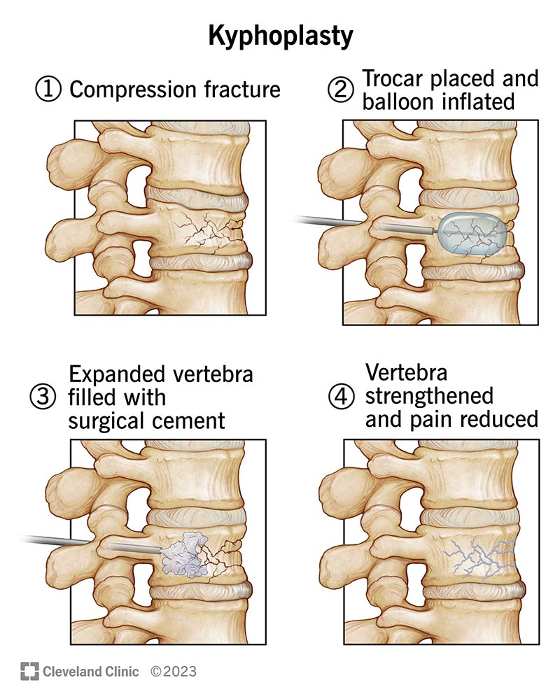
Bone-Modifying Therapy
Zoledronic acid: bisphosphonate
      $
      4 mg IV every 4-12 wk for 2 yr
      Requires renal dose adjustment
      Osteonecrosis of the jaw; avoid invasive dental procedures
Denosumab: RANKL inhibitor
      $$$
      120 mg SQ every 4-12 wk for 2 yr
      No renal adjustment = safe for CrCl <30 mL/min
      ONJ risk; avoid invasive dental procedures
Raje. Lancet Haematol. 2022;9:143.

Slide 23
Thrombosis: Managing DVT and PE Risk
Managing DVT/PE risk
      Adjusting medications and schedules
      Prescribing anticoagulant medications according to assessed risk (DOAC, aspirin)
      Balancing the risk of DVT and PE with that of bleeding with low platelets
Additional strategies to reduce risk of clots
      Antiembolism stockings (elastic stockings)
      Exercise regimen
      Moving frequently when sitting for long periods
      Travel precautions (foot/leg exercises, walking,
      aspirin)
Risk Factors
Family history
Obesity
Immobility
Smoking
Surgery
Rome. Clin J Oncol Nurs. 2008;12:21. Faiman. Clin J Oncol Nurs. 2016;20:E100. De Stefano. Hematol. 2022;107:2536. Yang. Front Med 2023;10:1153694.

Slide 24
Peripheral Neuropathy
Symptoms
      Numbness
      Tingling
      Prickling sensations
      Sensitivity to touch
      Burning and/or cold sensation
      Muscle weakness
Prevention/management
      Bortezomib once weekly and subcutaneous administration
      Neuroprotective supplements
        ie, B-complex vitamins (B1, B6, B12)
      Safe environment: rugs, furnishings, shoes
If neuropathy worsens, options include
      Dose adjustment
      Prescribe an oral or topical pain medication
      Suggest physical therapy
Early reporting of symptoms and intervention are critical
Faiman. Clin J Oncol Nurs. 2017;21:19. Tariman. Clin J Oncol Nurs. 2008;12:29. Zhao. Molecules. 2022;27:3909. Pinzon. J Assoc Physicians India 2023;71:11.

Slide 25
Additional Considerations: We Treat People, Not Myeloma . . .
Financial toxicity
Psychological and psychiatric services
Patient education: myeloma.org
Support groups
Care partner support
Nutrition services
Sleep support
Sexual and reproductive information
And more

Slide 26
Tenets of Frontline Therapy
We have transitioned to quadruplets in all patients eligible for frontline treatment
Especially in the transplant-ineligible population who are “quad eligible,” careful attention to toxicities is key
Optimal length of a quadruplet is still to be determined
MRD is becoming an increasingly important factor: a trial endpoint, a primary endpoint of trials, and soon (possibly) a treatment factor
It is very possible that quadruplets could lead to shorter times on therapy
Supportive care is a pillar to success and demands a holistic approach

Slide 27
Go Online for More Coverage of Multiple Myeloma!
Downloadable slides of all the key data
Podcast summarizing key clinical take-home points
ClinicalThought commentary featuring expert-authored responses to FAQs
Certified microlearning text modules on the latest evidence for anti-CD38–based treatment
deceraclinical.com/education

