Slide 1


Making Individualized ART Choices in Asia:
How HIV-ASSIST Can Help
A collaboration between Clinical Care Options, LLC
and Albert Einstein College of Medicine, in partnership with HIV-ASSIST
Supported by an educational grant from Gilead Sciences, Inc.

Slide 2

About These Slides
Please feel free to use and share some or all of these slides in your noncommercial presentations to colleagues or patients
When using our slides, please retain the source attribution:
These slides may not be published, posted online, or used in commercial presentations without permission. Please contact permissions@clinicaloptions.com for details
Slide credit: clinicaloptions.com
Notes:
Disclaimer: The materials published on the Clinical Care Options website reflect the views of the authors of the CCO material, not those of Clinical Care Options, LLC, the CME providers, or the companies providing educational grants. The materials may discuss uses and dosages for therapeutic products that have not been approved by the FDA. A qualified healthcare professional should be consulted before using any therapeutic product discussed. Readers should verify all information and data before treating patients or using any therapies described in these materials.

Slide 3
Faculty and Disclosures
Tanya Wansom, MD
Senior Infectious Diseases Consultant
Bangkok, Thailand
Tanya Wansom, MD, has no relevant financial relationships to disclose.
Maunank Shah, MD, PhD
Professor of Medicine
Infectious Diseases
Johns Hopkins University
Baltimore, Maryland, United States
Maunank Shah, MD, PhD has no relevant financial relationships to disclose.

Slide 4
Learning Objectives
Confidently make use of the HIV-ASSIST tool based on a solid understanding of its functionality and the data that validate its effectiveness in HIV decision support
Select evidence-based ART regimens in common clinical scenarios through appropriate use of HIV-ASSIST

Slide 5
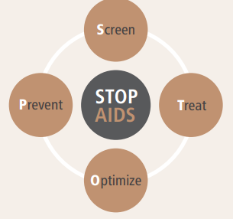
Individualization of ART is Important for Optimization
WHO recommends all people living with HIV are initiated on ART regardless of immune status or clinical presentation
Standardized ART has been preferred historically
Differentiated service delivery calls for an individualized approach that supports person-centered care
  Choice of agent with comorbidities, use in public vs private sector
who.int/teams/global-hiv-hepatitis-and-stis-programmes/hiv/treatment/hiv-treatment-for-adults. ncbi.nlm.nih.gov/books/NBK570389/.
Notes:
ART, antiretroviral therapy; WHO, World Health Organization.

Slide 6
ART Selection Is Increasingly Complex
ARV Resistance
CD4+ Cell Count
Treatment
History
HLA-B*5701 Status
Tropism
Comorbidities
Viral Load
Appropriate
ART Selection
Adverse Reactions
Drug Interactions
Food Interactions
Comedications
Pill Burden
Viral Suppression
Clinical Outcomes
Adherence
Tolerability
Viral Transmission
Notes:
ART, antiretroviral therapy; ARV, antiretroviral.

Slide 7
HIV Expert Guidelines and ART: Inherent Challenges
Guidelines¹
Do not help assess multiple clinical variables simultaneously
  Difficult to weigh competing goals or priorities
Advocate individualized considerations and patient preferences (many complex tables)
Do not inform the exact best regimen for a particular patient
ARVs
>30 ARVs in 8 mechanistic classes²
  Many theoretical ARV combinations
Polypharmacy is a common problem in all patients, but particularly in people living with HIV³
  Significant potential for drug–drug, drug–disease, drug–food interactions
Impact of comorbidities (eg, TB)
HIV resistance
1. ncbi.nlm.nih.gov/books/NBK570389/. 2. hivinfo.nih.gov/understanding-hiv/fact-sheets/fda-approved-hiv-medicines. 3. Ware. PLoS One. 2018;13:e0203890.
Notes:
ART, antiretroviral therapy; ARV, antiretroviral; TB, tuberculosis.

Slide 8
Can Multiple Criteria Decision Analysis Help?
Decision theory that covers any decision with multiple objectives
  Formal process to evaluate alternatives and priorities
Steps in an MCDA
  1: Define decision problem, eg, highest likelihood of viral suppression while minimizing pill burden, drug interactions, and other adverse events
  2: Select criteria/outcomes of interest: viral suppression, tolerability
  3: Weigh criteria
  4: Measure performance of ART options against each criterion
  5: Report and examine results, improvement by iteration
Thokala. Value Health. 2016;19:1.
Notes:
ART, antiretroviral therapy; MCDA, multiple criteria decision analysis.

Slide 9
HIV-ASSIST: Multiple Criteria Analysis–Based Decision Support for ART
Effectiveness/Viral Suppression
  ART combinations ranked on evidenced-based effectiveness
    Rankings adjusted for specific patient characteristics, input by HCP
  Evidence foundation:
    DHHS and IAS-USA guidelines
    Clinical trials database
    Scientific advisory panel
    Stanford HIV drug resistance database
    University of Liverpool HIV Drug Interactions
Tolerability/Adherence
  User preference inputs
  (eg, lower pill burden)
  Drug interactions evaluation
  (200+ drugs)
  Comorbidity considerations
    Based on national guidelines
hivassist.com.
Notes:
ART, antiretroviral therapy; DHHS, Department of Health and Human Services; HCP, healthcare professional; IAS-USA, International Antiviral Society‒USA.

Slide 10
HIV-ASSIST: Updated Resources in One Place
A novel method of clinical guideline delivery
  Evaluates all ART options against outcomes of interest for individualized patient circumstances in a transparent manner
  Assists HCPs in making individualized, patient-centered ART selection
A consolidated provider resource center
  Clinical trials data
  ARV-resistance mutations: Stanford HIV Drug Resistance Database
  Medication attributes and interactions: University of Liverpool HIV Drug Interaction Checker
Available as a mobile app
hivassist.com.
Notes:
ART, antiretroviral therapy; ARV, antiretroviral; HCP, healthcare professional.

Slide 11

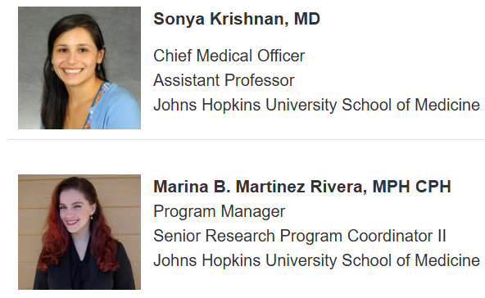

HIV-ASSIST Team: Update Algorithms and Content Iteratively and Routinely
Leadership Team

Slide 12




HIV-ASSIST Team: Update Algorithms and Content Iteratively and Routinely
Scientific Advisory Panel

Slide 13
HIV-ASSIST Endorsements in Asia
“With so many treatment choices accessible, it is vital to make evidence-based judgments that are tailored to each patient’s unique circumstances.”¹
“Because of its capacity to create customized treatment recommendations, optimize medication interactions and resistance analyses, assess tolerance and adverse effects, and enable treatment monitoring, HIV-ASSIST is a crucial tool in the battle against HIV.”²
“Individualization of antiretroviral treatment (ART) is recommended by current guidelines, which is a highly complex process . . . junior clinicians . . . are having difficulty making ART decisions in the field despite the increasing number of persons with HIV in all regions of our country [Turkey].”²
1. Akbulut. Int J STD AIDS. 2024;35:437. 2. Amin. Ann Med Surg (Lond). 2023;85:4653.
Notes:
ART, antiretroviral therapy.

Slide 14
Validation of HIV-ASSIST: Prospective Analysis of
Tool Concordance With Experienced HIV Providers
For 10 diverse hypothetical patient cases, HIV-ASSIST decision support output compared with expert provider ART selection
  Hypothetical patient cases included treatment naive (n = 4), treatment failure, viremia (n = 3), treatment experienced/suppressed (n = 3)
  Convenience sample of 17 experienced HIV providers from 4 large academic medical centers (Johns Hopkins University; Brigham and Women’s Hospital; Massachusetts General Hospital; University of California, San Francisco)
Primary outcome: concordance between expert provider regimen of choice and HIV-ASSIST top 5 regimens
Maddali. JAIDS. 2019;82:188.
Notes:
ART, antiretroviral therapy.

Slide 15
Concordance With HIV-Experienced Providers
Case # | Treatment Category
1 | ART naive
2
3
4
5 | ART, viremic
6
7
8 | ART, suppressed
9
10
No. of Unique Provider Regimens, n
2
2
2
4
8
5
7
6
3
8
Most Frequent Provider Regimen (HIV-ASSIST Rank)
BIC/TAF/FTC (1)
BIC/TAF/FTC (2)
BIC/TAF/FTC (1)
DTG + TDF/FTC (3)
DRV/c/TAF/FTC (2)
DTG + DRV/c/TAF/FTC (2)
DRV/c/TAF/FTC (1)
DTG/RPV (1)
BIC/TAF/FTC (2)
DRV/c + BIC/TAF/FTC (2)
Provider Choice = HIV-ASSIST First Ranked, n/N (%)
37/68 (54)
12/49 (24)
19/50 (38)
Provider Choice in HIV-ASSIST Top 5 Ranked, n/N (%)
67/68 (99)
41/49 (84)
44/50 (88)
Maddali. JAIDS. 2019;82:188.
Notes:
ART, antiretroviral therapy; BIC, bictegravir; c, cobicistat; DRV, darunavir; DTG, dolutegravir; FTC, emtricitabine; RPV, rilpivirine; TAF, tenofovir alafenamide; TDF, tenofovir disoproxil fumarate.

Slide 16
Validation of HIV-ASSIST: Retrospective Cohort Study
HIV-ASSIST Ranking of Prescribed ART
N = 106 patients from John Hopkins Bartlett HIV Clinic and San Francisco Veterans Affairs HIV Clinic
  16% female, 22% treatment naive
Overall, HIV-ASSIST top 5 ranking
was 91% (96/106) concordant with provider-selected regimen
In 9.4% (10/106) of individuals,
HIV-ASSIST considered ≥5 alternative regimens potentially “better” options than the provider-selected regimen
  eg, RPV + TAF/FTC in a patient with
  high HIV-1 RNA and transmitted M184V
100
%
30% (7)
11% (2)
12% (8)
44% (8)
39% (25)
80
70% (16)
60
48% (32)
40
44% (8)
20
0
Naive (23)
Experienced, Viremic (18)
Experienced, Suppressed (65)
Rank:
1
2-5
5+ (Discordant)
Ramirez. JGIM. 2020;35:1498.
Notes:
ART, antiretroviral therapy; FTC, emtricitabine; RPV, rilpivirine; TAF, tenofovir alafenamide.

Slide 17
HIV-ASSIST and ART Selection by Medical Trainees
Outcome = appropriate ART selection, defined as:
  Consistent with DHHS guidelines, or
  Concordant with regimens selected by 17 experienced HIV providers at 4 academic medical institutions:
    Johns Hopkins University; Brigham and Women’s Hospital; Massachusetts General Hospital; University of California, San Francisco
N = 118 medical trainees at Johns Hopkins University asked to select ART for 10 clinical vignettes
Trainees randomized to either:
  DHHS guidelines (with video tutorial), or
  HIV-ASSIST plus DHHS guidelines (with video tutorial)
Ramirez. Clin Infect Dis. 2021;72:1608. Maddali. JAIDS. 2019;82:188.
academic.oup.com/cid/advance-article-abstract/doi/10.1093/cid/ciaa302/5811413.
Notes:
ART, antiretroviral therapy; DHHS, Department of Health and Human Services.

Slide 18
HIV-ASSIST and US Medical Trainee ART Selection: Results
Significantly higher rate of appropriate ART selection with HIV-ASSIST added to DHHS guidelines (P < .001):
  DHHS guidelines alone:
  median 40% (Q1, Q3: 30%, 50%)
  HIV-ASSIST + DHHS guidelines:
  median 90% (Q1, Q3: 80%, 100%)
Consistent differences between guidelines ± HIV-ASSIST groups, and across trainee type and treatment category
Overall
Medical students
Medical residents
<25 patients with HIV
≥25 patients with HIV
Case: ART-naive
Case: ART, viremic
Case: ART, suppressed
0
20
40
60
80
100
Median Percent Appropriate ART Selection (Q1, Q3)
Guidelines alone
HIV-ASSIST
Ramirez. Clin Infect Dis. 2021;72:1608.
Notes:
ART, antiretroviral therapy; DHHS, Department of Health and Human Services.

Slide 19
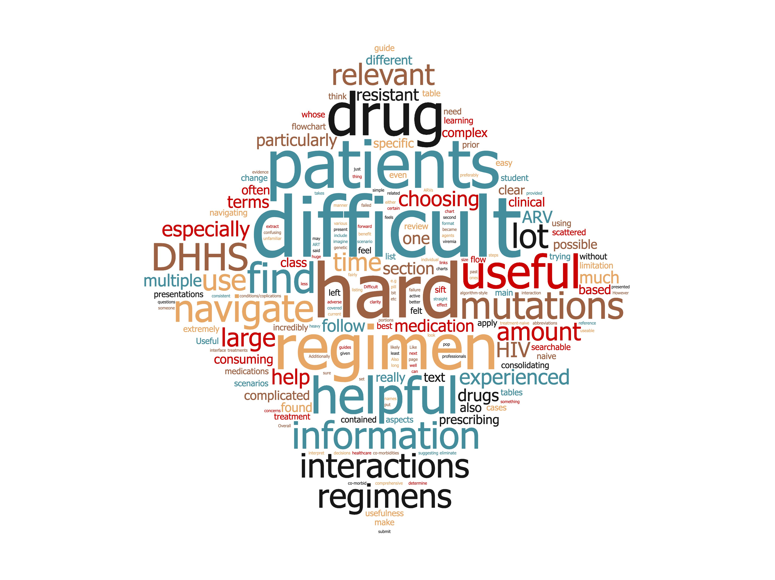
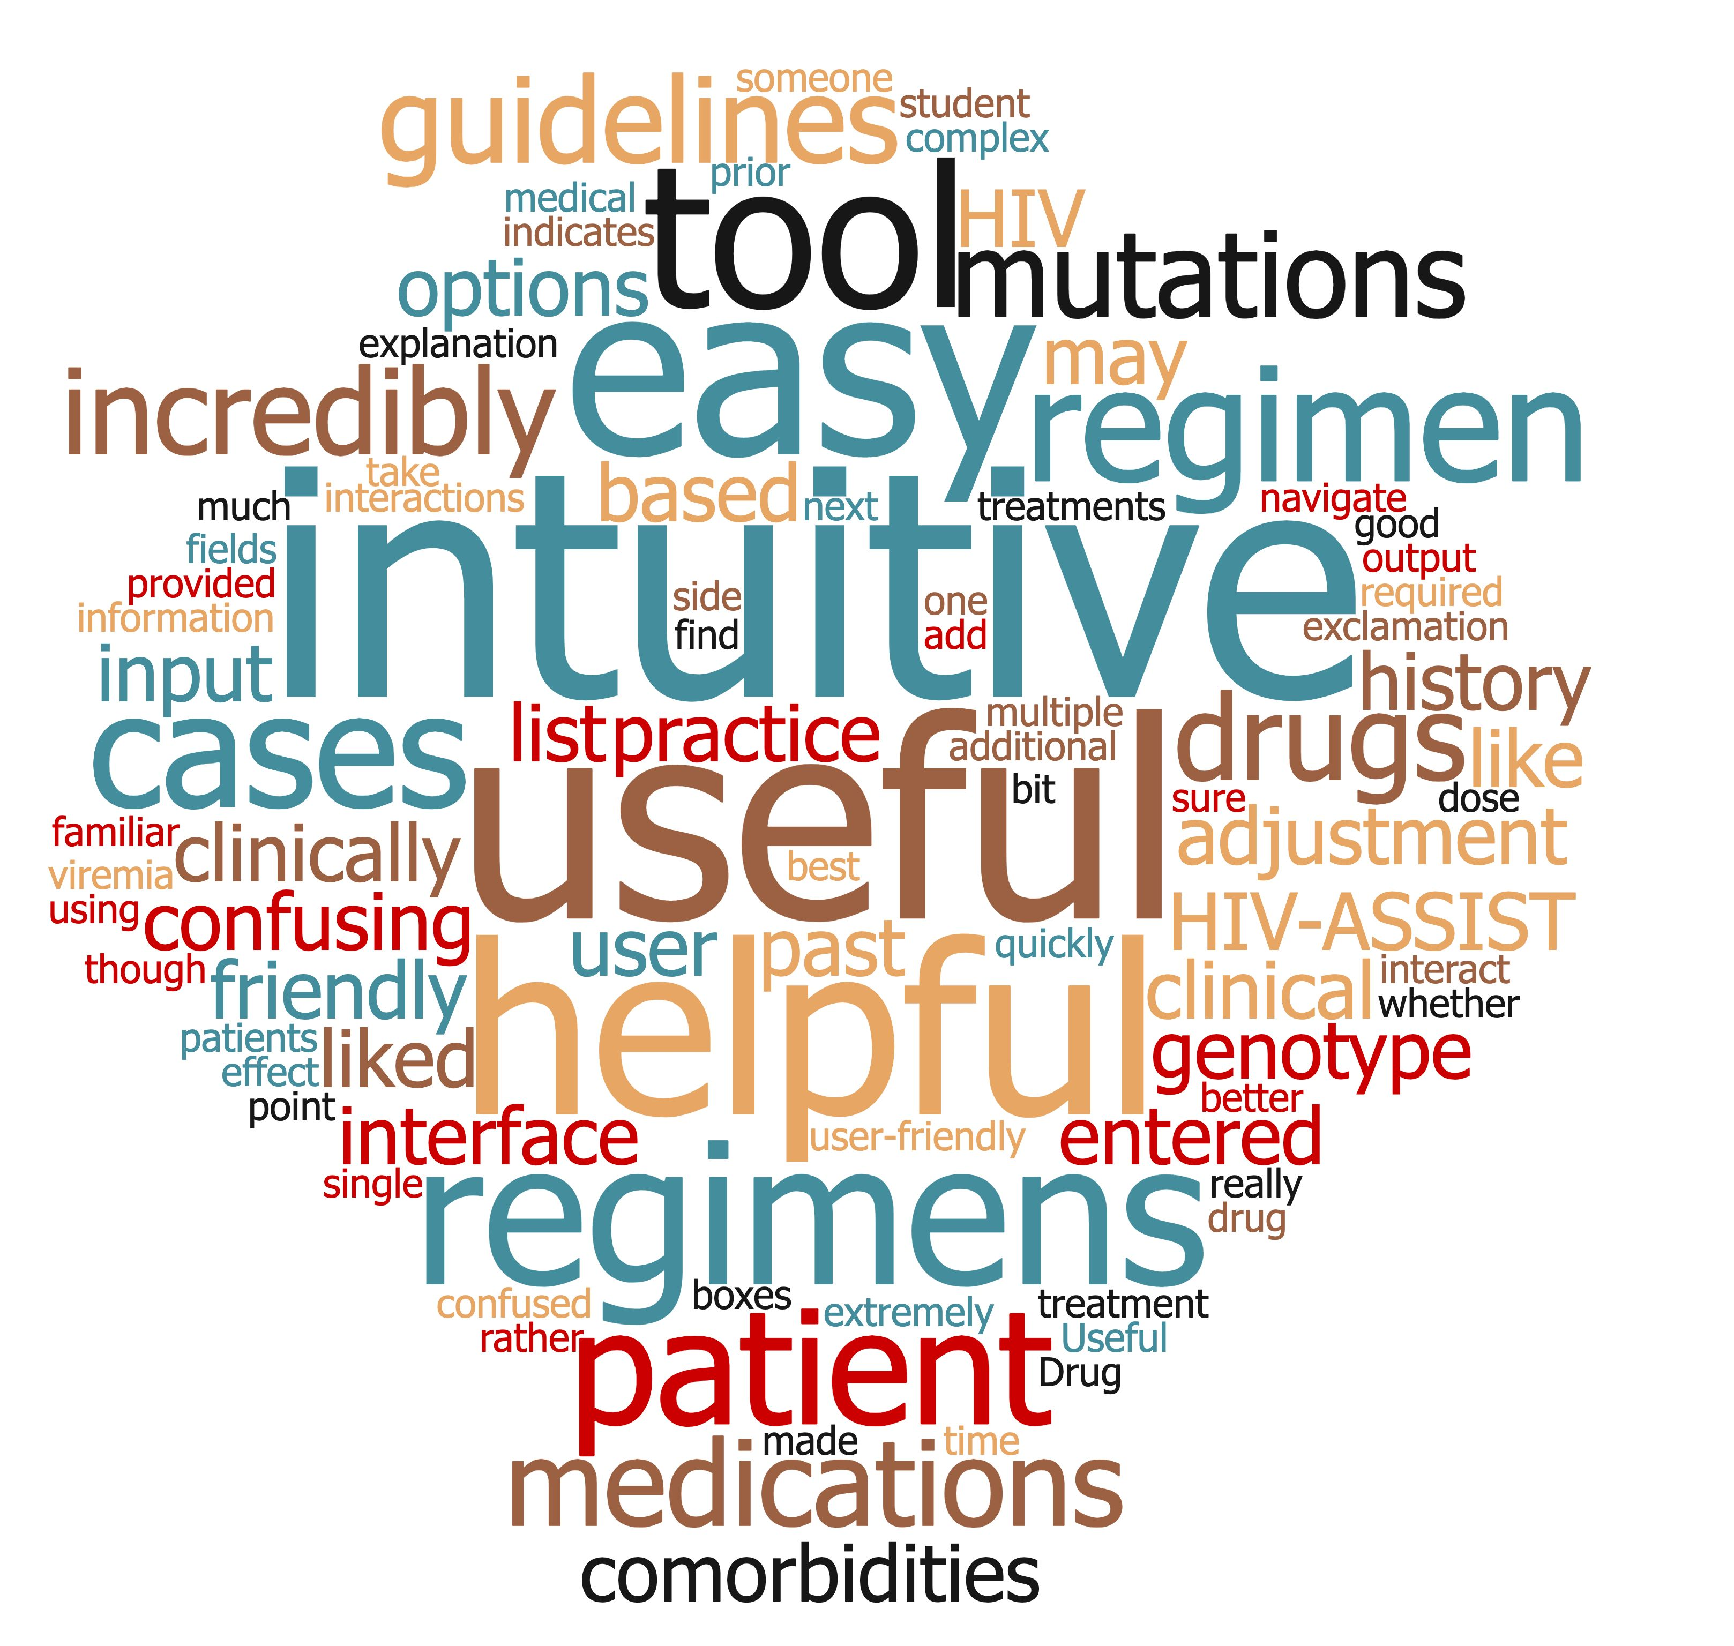
US Medical Trainee Qualitative Feedback
DHHS guidelines alone:
With HIV-ASSIST:
Ramirez. Clin Infect Dis. 2021;72(9):1608.
Notes:
DHHS, Department of Health and Human Services.

Slide 20







Key Points on HIV-ASSIST
HIV-ASSIST uses MCDA to rank guidelines-based ART regimens
Website and mobile app provide additional educational content; explains rankings
HIV-ASSIST supports rationale, guidelines-based ART selection
Consolidated resource center helps providers select appropriate ART
HIV-ASSIST provides individualized ART recommendations
84% to 99% concordant with HIV experts
hivassist.com.
Notes:
ART, antiretroviral therapy; MCDA, multiple criteria decision analysis.

Slide 21
How to Use the HIV-ASSIST Tool:
A Step-by-Step Guide for HCPs in Asia
Supported by an educational grant from Gilead Sciences, Inc.
Notes:
HCP, healthcare professional.

Slide 22


HIV-ASSIST: A Decision Support Tool for ARV Selection
www.hivassist.com
Also available as a mobile app
hivassist.com.
Notes:
ARV, antiretroviral.

Slide 23
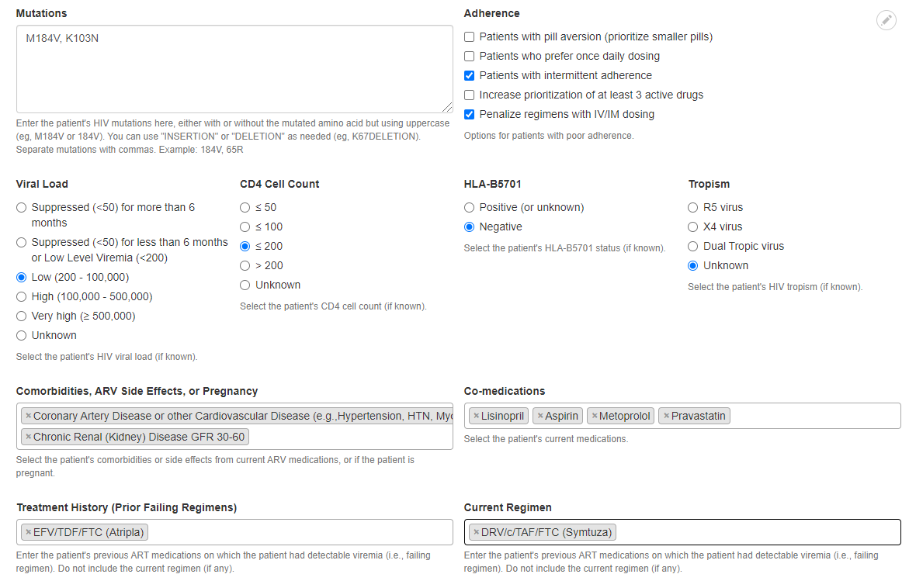
HIV-ASSIST: Input Key Viral and Patient Characteristics With a User-Friendly Web-Based Tool
hivassist.com.

Slide 24
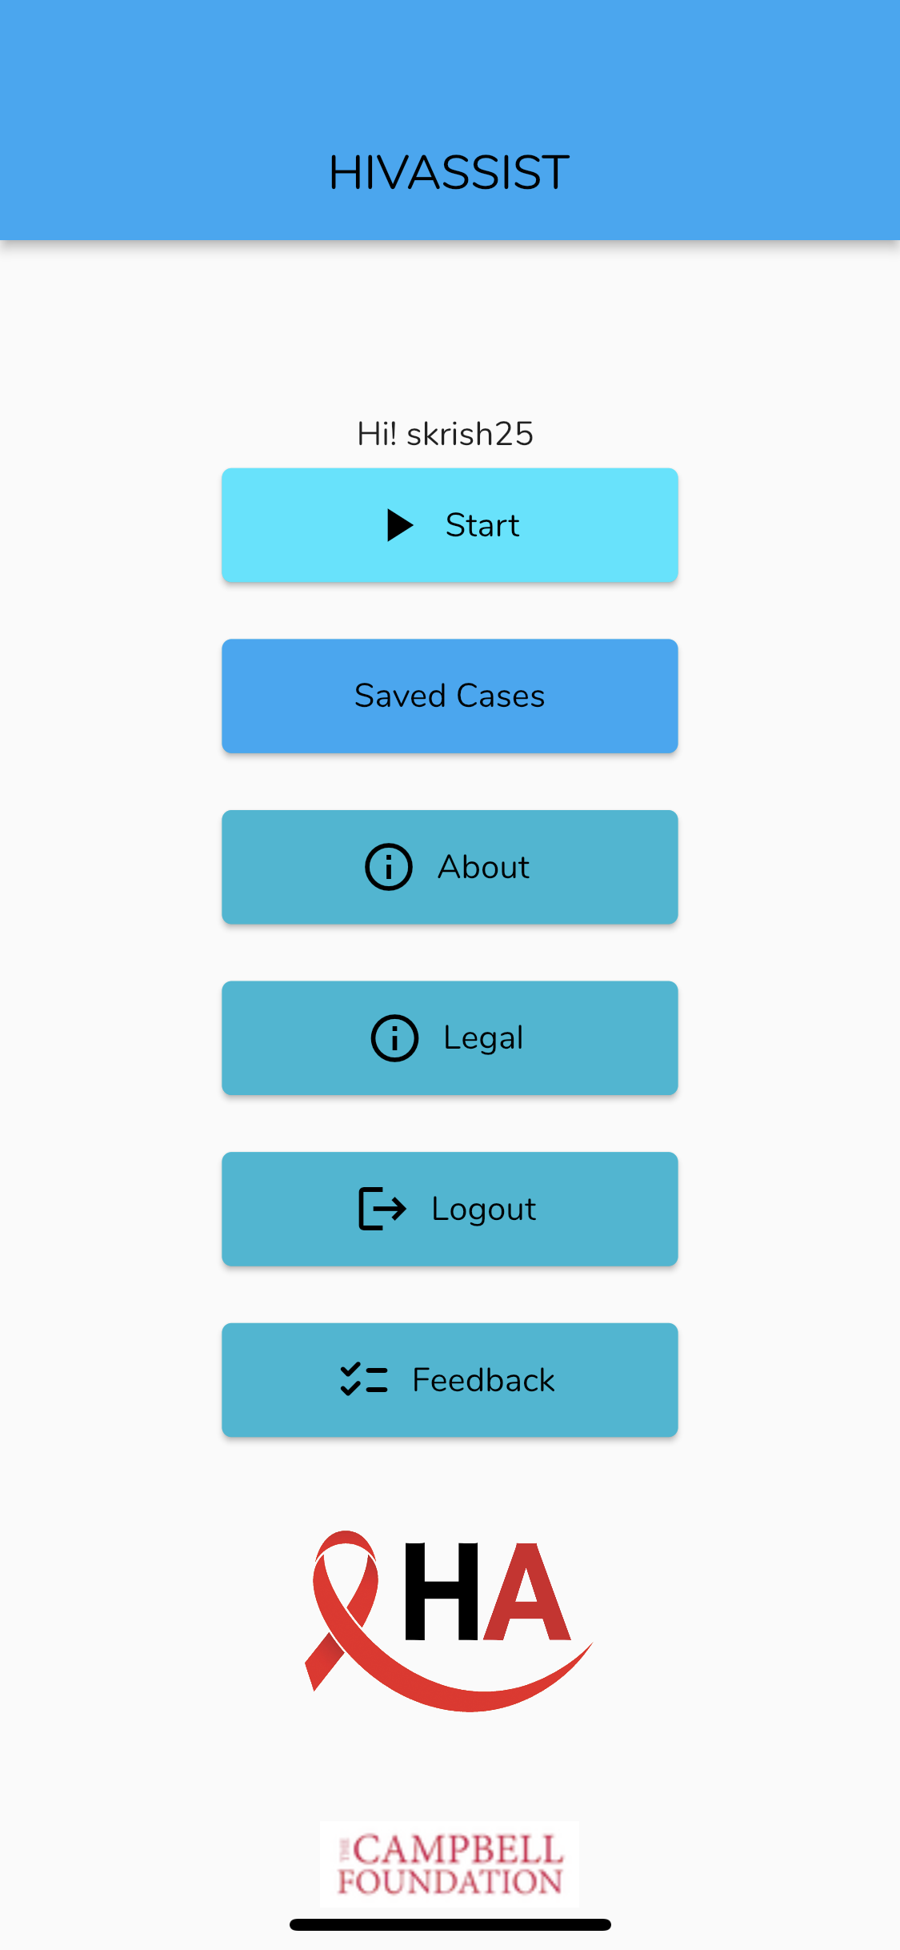
HIV-ASSIST: A Decision Support Tool for ARV Selection Available as a Mobile App
hivassist.com.
Notes:
ARV, antiretroviral.

Slide 25
HIV-ASSIST: Input Is Individualized for Each Patient’s Viral Attributes
User-Defined Attributes
User options for additional prioritization:
Patients with pill aversion (prioritize smaller pills)
Patients who prefer once-daily dosing
Patients with intermittent adherence
Increase prioritization of ≥3 active drugs
Penalize regimens with IV/IM dosing
Multidrug Regimen Aggregate HIV-ASSIST Weighted Score
Viral Attributes
Individual ARV
Utility Score
Viral load
Resistance mutations
ARV utility score
based on patient characteristics and anticipated efficacy and tolerability of selected ART combination
Mutation information from Stanford HIV Drug Resistance Database
Drug Interaction information from University of Liverpool HIV Drug Interaction Checker
Regimen activity or likelihood of viral suppression
Number of fully or partially active ARVs in the regimen
Efficacy, stratified by viral load, CD4+ cell count, and treatment experience
Suggested Interpretation of HIV-ASSIST Results
Tropism
Regiments ranked by
HIV-ASSIST weighted score
Score 0-2:
Stronger evidence for composite objective of efficacy and tolerability
Patient
Characteristics
Tolerability/Preference
Pill burden, dosing frequency
Individual ARV utility score (drug interactions, comorbidity consideration)
Adverse event profile
Intermediate Score:
Either reduced evidence for efficacy or reduced tolerability
Comorbidities
Comedications
Treatment history
Score 10+:
Poor efficacy, poor tolerability, or limited evidence for usage
CD4+ cell count
HLA-B*5701
Adherence
Maddali. JAIDS. 2019;82:188. hivassist.com.
Notes:
ART, antiretroviral therapy; ARV, antiretroviral.

Slide 26
HIV-ASSIST: Input Is Individualized for Each Patient’s Comorbidities, Comedications, and Characteristics
User-Defined Attributes
User options for additional prioritization:
Patients with pill aversion (prioritize smaller pills)
Patients who prefer once-daily dosing
Patients with intermittent adherence
Increase prioritization of ≥3 active drugs
Penalize regimens with IV/IM dosing
Multidrug Regimen Aggregate HIV-ASSIST Weighted Score
Viral Attributes
Individual ARV
Utility Score
Viral load
Resistance mutations
ARV utility score
based on patient characteristics and anticipated efficacy and tolerability of selected ART combination
Mutation information from Stanford HIV Drug Resistance Database
Drug Interaction information from University of Liverpool HIV Drug Interaction Checker
Regimen activity or likelihood of viral suppression
Number of fully or partially active ARVs in the regimen
Efficacy, stratified by viral load, CD4+ cell count, and treatment experience
Suggested Interpretation of HIV-ASSIST Results
Tropism
Regiments ranked by
HIV-ASSIST weighted score
Score 0-2:
Stronger evidence for composite objective of efficacy and tolerability
Patient
Characteristics
Tolerability/Preference
Pill burden, dosing frequency
Individual ARV utility score (drug interactions, comorbidity consideration)
Adverse event profile
Intermediate Score:
Either reduced evidence for efficacy or reduced tolerability
Comorbidities
Comedications
Treatment history
Score 10+:
Poor efficacy, poor tolerability, or limited evidence for usage
CD4+ cell count
HLA-B*5701
Adherence
Maddali. JAIDS. 2019;82:188. hivassist.com.
Notes:
ART, antiretroviral therapy; ARV, antiretroviral.

Slide 27
HIV-ASSIST: Provides Individual ARV Utility Scores
User-Defined Attributes
User options for additional prioritization:
Patients with pill aversion (prioritize smaller pills)
Patients who prefer once-daily dosing
Patients with intermittent adherence
Increase prioritization of ≥3 active drugs
Penalize regimens with IV/IM dosing
Multidrug Regimen Aggregate HIV-ASSIST Weighted Score
Viral Attributes
Individual ARV
Utility Score
Viral load
Resistance mutations
ARV utility score
based on patient characteristics and anticipated efficacy and tolerability of selected ART combination
Mutation information from Stanford HIV Drug Resistance Database
Drug Interaction information from University of Liverpool HIV Drug Interaction Checker
Regimen activity or likelihood of viral suppression
Number of fully or partially active ARVs in the regimen
Efficacy, stratified by viral load, CD4+ cell count, and treatment experience
Suggested Interpretation of HIV-ASSIST Results
Tropism
Regiments ranked by
HIV-ASSIST weighted score
Score 0-2:
Stronger evidence for composite objective of efficacy and tolerability
Patient
Characteristics
Tolerability/Preference
Pill burden, dosing frequency
Individual ARV utility score (drug interactions, comorbidity consideration)
Adverse event profile
Intermediate Score:
Either reduced evidence for efficacy or reduced tolerability
Comorbidities
Comedications
Treatment history
Score 10+:
Poor efficacy, poor tolerability, or limited evidence for usage
CD4+ cell count
HLA-B*5701
Adherence
Maddali. JAIDS. 2019;82:188. hivassist.com.
Notes:
ART, antiretroviral therapy; ARV, antiretroviral.

Slide 28
HIV-ASSIST: Multidrug Aggregate Score Informed by Guidelines and Scientific Advisory Panel
User-Defined Attributes
User options for additional prioritization:
Patients with pill aversion (prioritize smaller pills)
Patients who prefer once-daily dosing
Patients with intermittent adherence
Increase prioritization of ≥3 active drugs
Penalize regimens with IV/IM dosing
Multidrug Regimen Aggregate HIV-ASSIST Weighted Score
Viral Attributes
Individual ARV
Utility Score
Viral load
Resistance mutations
ARV utility score
based on patient characteristics and anticipated efficacy and tolerability of selected ART combination
Mutation information from Stanford HIV Drug Resistance Database
Drug Interaction information from University of Liverpool HIV Drug Interaction Checker
Regimen activity or likelihood of viral suppression
Number of fully or partially active ARVs in the regimen
Efficacy, stratified by viral load, CD4+ cell count, and treatment experience
Suggested Interpretation of HIV-ASSIST Results
Tropism
Regiments ranked by
HIV-ASSIST weighted score
Score 0-2:
Stronger evidence for composite objective of efficacy and tolerability
Patient
Characteristics
Tolerability/Preference
Pill burden, dosing frequency
Individual ARV utility score (drug interactions, comorbidity consideration)
Adverse event profile
Intermediate Score:
Either reduced evidence for efficacy or reduced tolerability
Comorbidities
Comedications
Treatment history
Score 10+:
Poor efficacy, poor tolerability, or limited evidence for usage
CD4+ cell count
HLA-B*5701
Adherence
Maddali. JAIDS. 2019;82:188. hivassist.com.
Notes:
ART, antiretroviral therapy; ARV, antiretroviral.

Slide 29
HIV-ASSIST: Includes User Options for Additional Prioritization
User-Defined Attributes
User options for additional prioritization:
Patients with pill aversion (prioritize smaller pills)
Patients who prefer once-daily dosing
Patients with intermittent adherence
Increase prioritization of ≥3 active drugs
Penalize regimens with IV/IM dosing
Multidrug Regimen Aggregate HIV-ASSIST Weighted Score
Viral Attributes
Individual ARV
Utility Score
Viral load
Resistance mutations
ARV utility score
based on patient characteristics and anticipated efficacy and tolerability of selected ART combination
Mutation information from Stanford HIV Drug Resistance Database
Drug Interaction information from University of Liverpool HIV Drug Interaction Checker
Regimen activity or likelihood of viral suppression
Number of fully or partially active ARVs in the regimen
Efficacy, stratified by viral load, CD4+ cell count, and treatment experience
Suggested Interpretation of HIV-ASSIST Results
Tropism
Regiments ranked by
HIV-ASSIST weighted score
Score 0-2:
Stronger evidence for composite objective of efficacy and tolerability
Patient
Characteristics
Tolerability/Preference
Pill burden, dosing frequency
Individual ARV utility score (drug interactions, comorbidity consideration)
Adverse event profile
Intermediate Score:
Either reduced evidence for efficacy or reduced tolerability
Comorbidities
Comedications
Treatment history
Score 10+:
Poor efficacy, poor tolerability, or limited evidence for usage
CD4+ cell count
HLA-B*5701
Adherence
Maddali. JAIDS. 2019;82:188. hivassist.com.
Notes:
ART, antiretroviral therapy; ARV, antiretroviral.

Slide 30
HIV-ASSIST: Score Is the Composite of Different Considerations, Not an Absolute Ranking
User-Defined Attributes
User options for additional prioritization:
Patients with pill aversion (prioritize smaller pills)
Patients who prefer once-daily dosing
Patients with intermittent adherence
Increase prioritization of ≥3 active drugs
Penalize regimens with IV/IM dosing
Multidrug Regimen Aggregate HIV-ASSIST Weighted Score
Viral Attributes
Individual ARV
Utility Score
Viral load
Resistance mutations
ARV utility score
based on patient characteristics and anticipated efficacy and tolerability of selected ART combination
Mutation information from Stanford HIV Drug Resistance Database
Drug Interaction information from University of Liverpool HIV Drug Interaction Checker
Regimen activity or likelihood of viral suppression
Number of fully or partially active ARVs in the regimen
Efficacy, stratified by viral load, CD4+ cell count, and treatment experience
Suggested Interpretation of HIV-ASSIST Results
Tropism
Regiments ranked by
HIV-ASSIST weighted score
Score 0-2:
Stronger evidence for composite objective of efficacy and tolerability
Patient
Characteristics
Tolerability/Preference
Pill burden, dosing frequency
Individual ARV utility score (drug interactions, comorbidity consideration)
Adverse event profile
Intermediate Score:
Either reduced evidence for efficacy or reduced tolerability
Comorbidities
Comedications
Treatment history
Score 10+:
Poor efficacy, poor tolerability, or limited evidence for usage
CD4+ cell count
HLA-B*5701
Adherence
Maddali. JAIDS. 2019;82:188. hivassist.com.
Notes:
ART, antiretroviral therapy; ARV, antiretroviral.

Slide 31
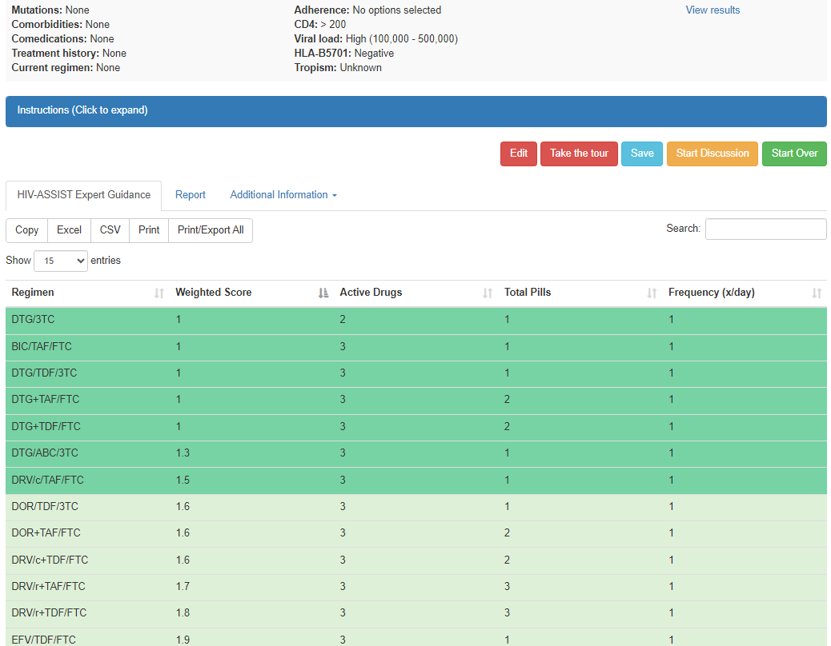
HIV-ASSIST Output: Potential Regimens
With Color-Coding and Weighted Scores
hivassist.com.

Slide 32
HIV-ASSIST Output: Expand Instructions Link to Access Explanation of Weighted Scoring and Color-Coding
hivassist.com.
Notes:
3TC, lamivudine; BIC, bictegravir; DTG, dolutegravir; FTC, emtricitabine; TAF, tenofovir alafenamide; TDF, tenofovir disoproxil fumarate.

Slide 33
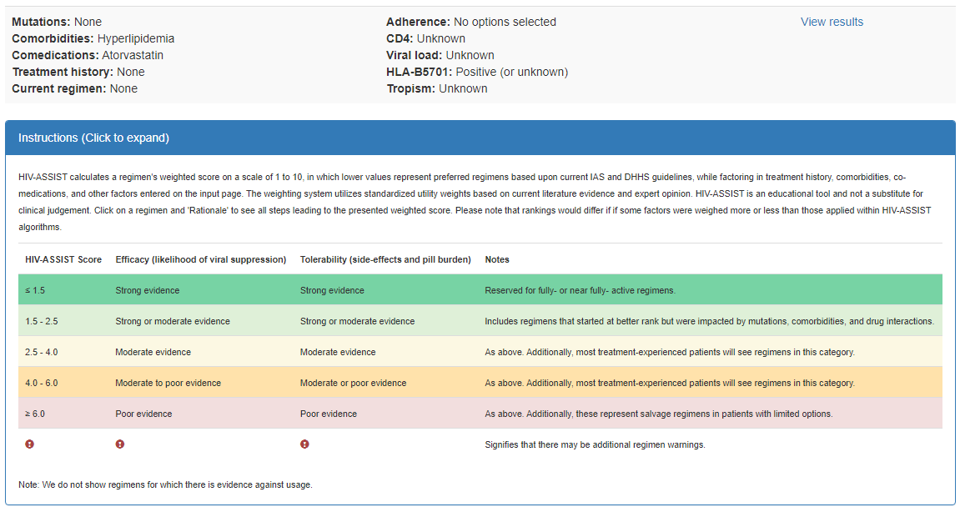
HIV-ASSIST Output: Lowest Scores Represent
Preferred Regimens Backed by Strong Clinical Evidence
Clicking on Instructions opened this explanation of how to interpret weighted scores and color-coding
Regimens for which there is evidence against use will not appear on list of individualized ART options
hivassist.com.
Notes:
ART, antiretroviral therapy.

Slide 34
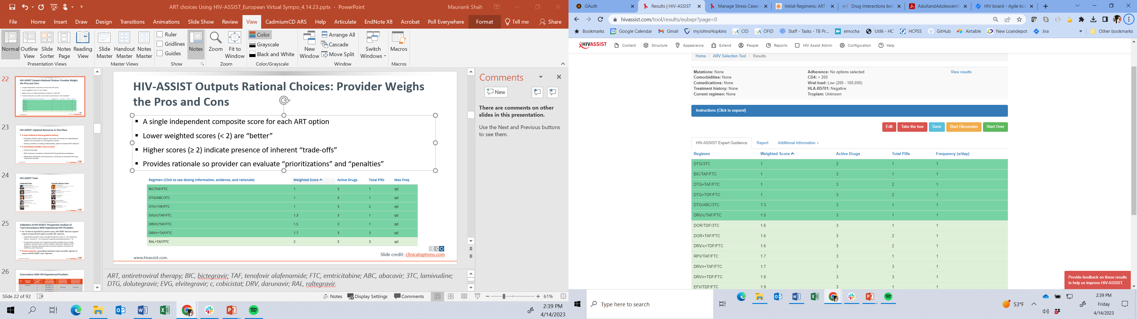
HIV-ASSIST Outputs Rational Choices: Provider Weighs the Pros and Cons
A single independent composite score for each ART option
Lower weighted scores (<2) are “better”: likelihood of viral suppression and ‘well-tolerated’
Higher scores (≥2) indicate presence of inherent “trade-offs”
Provides rationale so provider can evaluate “prioritizations” and “penalties”
hivassist.com.
Notes:
ART, antiretroviral therapy; BIC, bictegravir; TAF, tenofovir alafenamide; FTC, emtricitabine; ABC, abacavir; 3TC, lamivudine; DTG, dolutegravir; EVG, elvitegravir; c, cobicistat; DRV, darunavir; RAL, raltegravir.

Slide 35
Case 1:
Choosing Initial ART
Notes:
ART, antiretroviral therapy.

Slide 36
Case 1: Choosing Initial ART
52-yr-old man with no comorbidities or medications
Just tested positive for HIV for the first time
Parameter | Value
CD4+ cell count, cells/mm³ | 450
HIV-1 RNA, copies/mL | 557,000
HIV-1 genotype | No resistance
BMI, kg/m² | 25
CBC | Normal
SCr, mg/dL | 1.1
CrCl, mL/min | 84
HBV and HCV status | Negative
HLA-B*5701 | Unknown
Notes:
ART, antiretroviral therapy; CBC, complete blood count; CrCl, creatinine clearance; SCr, serum creatinine.

Slide 37
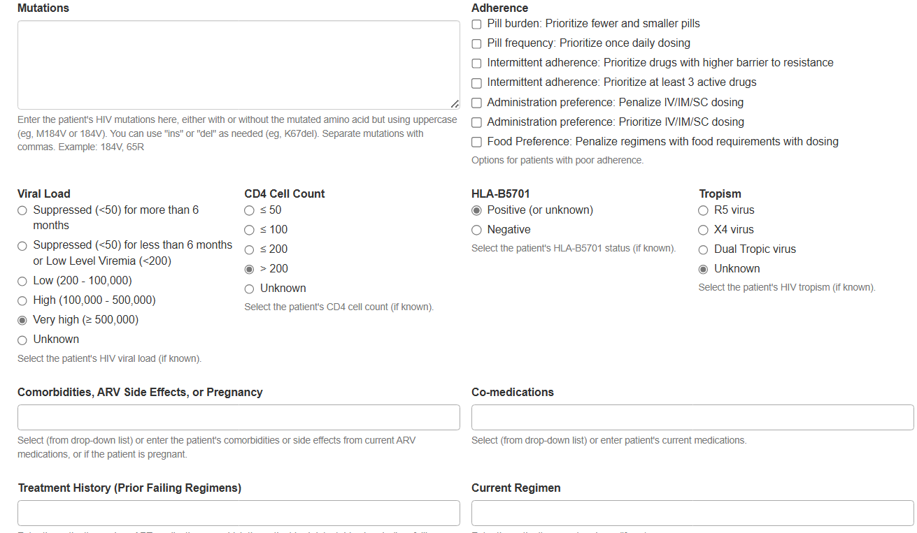
HIV-ASSIST: Input Key Viral and Patient-Specific Factors
hivassist.com.

Slide 38
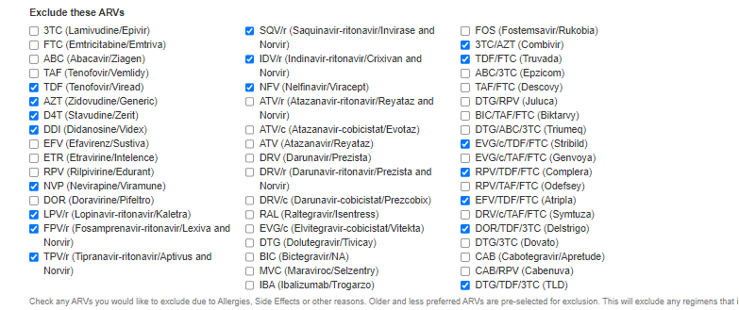
Tailoring to Local ARV Availability: Check Boxes to Exclude Any Drugs Unavailable in Your Region
Note: TLD is excluded by default because it is unavailable in US markets. For Asian markets, remove the checkbox in order to include it in the recommendations
hivassist.com.
Notes:
ARV, antiretroviral.

Slide 39
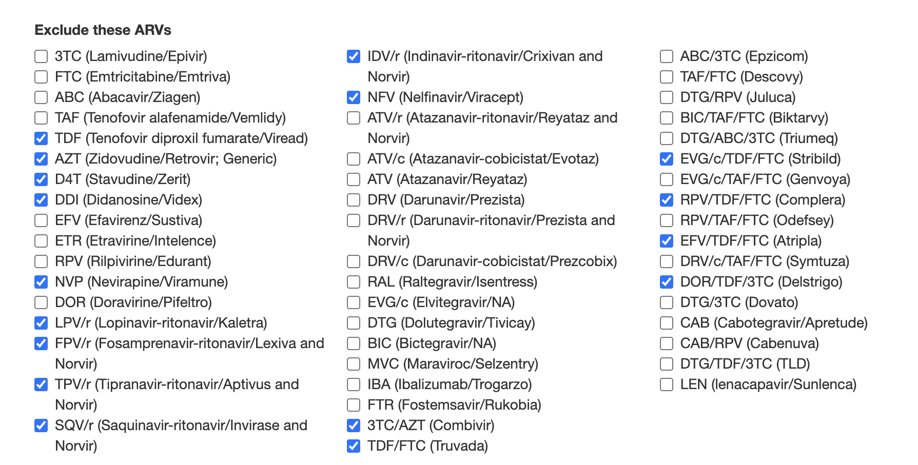
Tailor to Availability and Preferences
TDF and TDF combinations default to excluded to reduce the number of outputs, but can be unchecked based on local preference
Combination products can be excluded or included based on availability
hivassist.com.

Slide 40
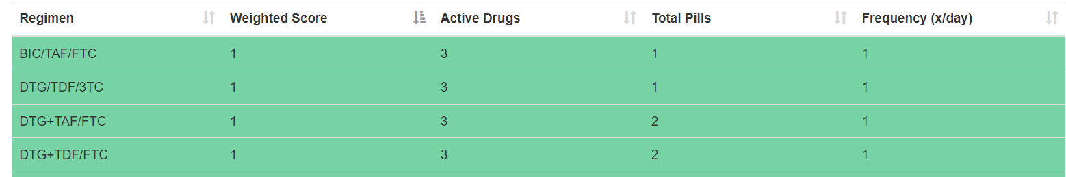
HIV-ASSIST Decision Support Is Guideline-Based
Top-ranked regimens
from
HIV-ASSIST
DHHS¹ | WHO² | NACO³
BIC/FTC/TAF DTG + XTC/TXF DTG/ABC/3TC if HLAB701 neg DTG/3TC† | DTG + NRTI backbone Low-dose EFV + NRTI backbone | NRTI backbone (Tenofovir + Lamivudine) + one INSTI (prefer DTG)
Regimens
from
guidelines ART initiation
†Except for individuals with HIV-1 RNA > 500,000 copies/mL, with HBV, or for whom results of HIV genotypic resistance testing or HBV testing are not yet available.
1. DHHS ART Guidelines. September 2024. 2. who.int/publications/i/item/9789240031593.
3. NACO. National Guidelines for HIV Care and Treatment, 2021.
Notes:
ART, antiretroviral therapy; BIC; bictegravir; CAB, cabotegravir; DHHS, US Department of Health and Human Services; DRV, darunavir; DTG, dolutegravir; EACS, European AIDS Clinical Society; FTC, emtricitabine; IAS-USA, International Antiviral Society‒USA; INSTI, integrase strand transfer inhibitor; LA, long-acting; PrEP, pre-exposure prophylaxis; TAF, tenofovir alafenamide; TDF, tenofovir disoproxil fumarate, TXF, tenofovir alafenamide or tenofovir disoproxil fumarate; XTC, emtricitabine or lamivudine.

Slide 41
HIV-ASSIST: Updated Resources in One Place
A novel method of clinical guideline delivery
  Evaluates all ART options against outcomes of interest for individualized patient circumstances in a transparent manner
  Assists providers in making individualized, patient-centered ART selection
A consolidated provider resource center
  Clinical trials data
  ARV-resistance mutations: Stanford HIV Drug Resistance Database
  Medication attributes and interactions: University of Liverpool HIV Drug Interaction Checker
hivassist.com.
Notes:
ART, antiretroviral therapy; ARV, antiretroviral.

Slide 42
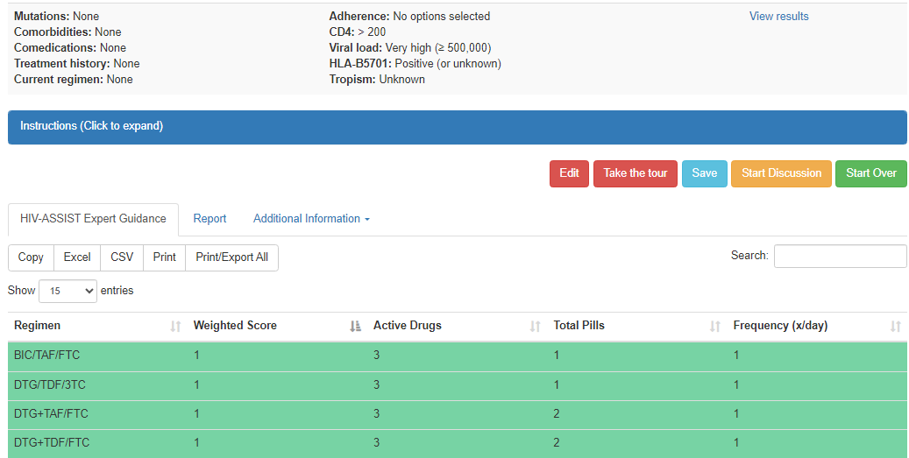
HIV-ASSIST Output: Clicking on Any Regimen Opens Relevant Education Sheets
Click to see more information
hivassist.com.
Notes:
3TC, lamivudine; BIC, bictegravir; DTG, dolutegravir; FTC, emtricitabine; TAF, tenofovir alafenamide; TDF, tenofovir disoproxil fumarate.

Slide 43
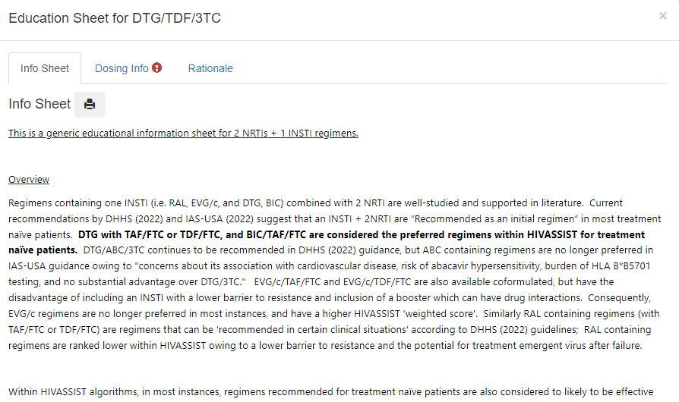
HIV-ASSIST Output: Clicking on Any Regimen Opens Relevant Education Sheets
hivassist.com.
Notes:
3TC, lamivudine; BIC, bictegravir; DTG, dolutegravir; FTC, emtricitabine; TAF, tenofovir alafenamide; TDF, tenofovir disoproxil fumarate.

Slide 44
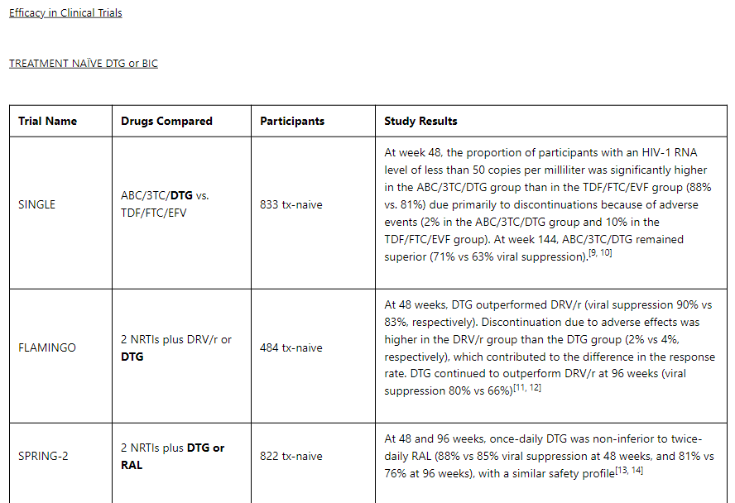
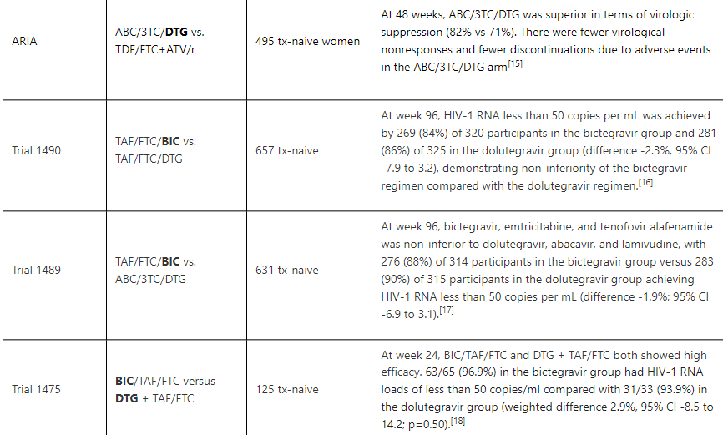
HIV-ASSIST Output: Education Sheets Include Summaries of Evidence From the Primary Literature
Continued down the page...
hivassist.com.

Slide 45
Case 2:
HIV-ASSIST Provides:
Dosing Information,
Drug-Drug Interactions, and
Assessment of Comorbidities

Slide 46
Patient Case 2: Navigating Drug Interactions and Comorbidities
52-yr-old man with hyperlipidemia, pulmonary tuberculosis and newly diagnosed HIV
PMH:
  Hyperlipidemia: on atorvastatin
  Tuberculosis: on Rifampin, isoniazid, pyrazinamide, ethambutol
Just tested positive for HIV for the first time
Team is ready to start ART for HIV
Viral load, CD4, and other information is unknown or unavailable
Notes:
ART, antiretroviral therapy; PMH, past medical history.

Slide 47
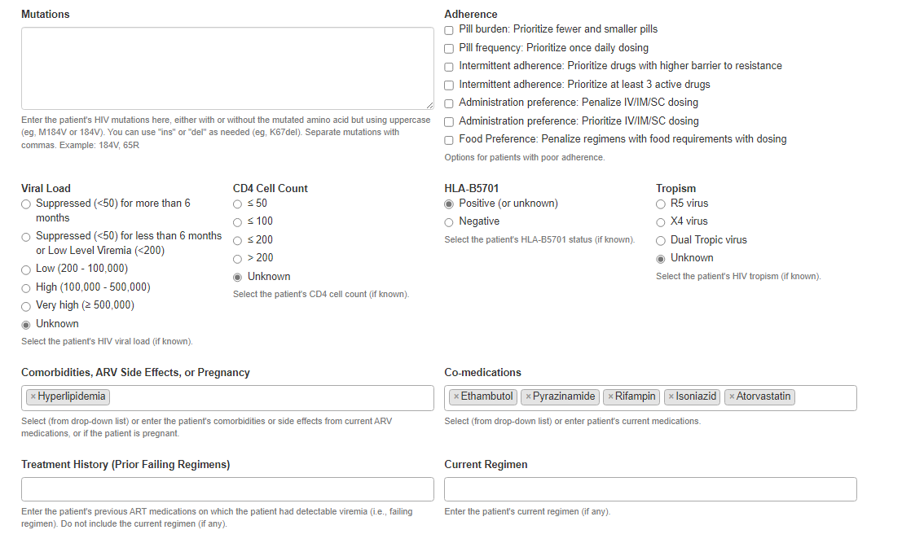
HIV-ASSIST Input: Comorbidities and Comedications
Pulls in drug–drug interaction information from
the University of Liverpool HIV Drug Interactions
(hiv-druginteractions.org)
hivassist.com. hiv-druginteractions.org.

Slide 48
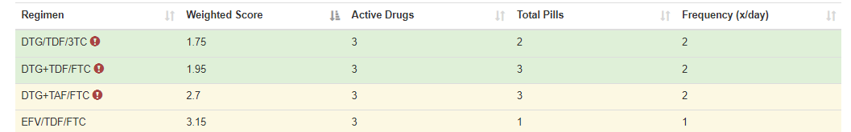
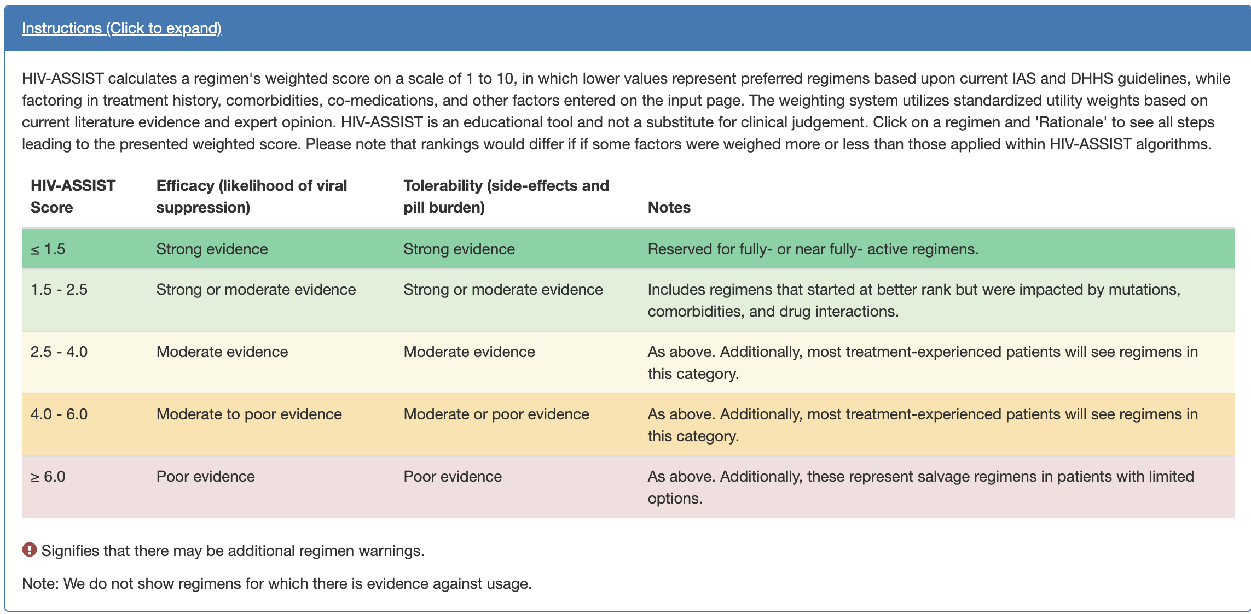
HIV-ASSIST Output: Potential Regimens
With Color-Coding and Weighted Scores
Note: scores reflect the trade-offs with drug-drug interactions (increased dosing frequency) for some ART such as DTG
hivassist.com.
Notes:
3TC, lamivudine; ART, antiretroviral therapy; DTG, dolutegravir; EFV, efavirenz; FTC, emtricitabine; TAF, tenofovir alafenamide; TDF, tenofovir disoproxil fumarate.

Slide 49
HIV-ASSIST Output: Potential Regimens
With Color-Coding and Weighted Scores
Click for dosing information and rationale leading to the HIV-ASSIST score
Note: scores reflect the trade-offs with drug-drug interactions (increased dosing frequency) for some ART such as DTG
hivassist.com.
Notes:
3TC, lamivudine; ART, antiretroviral therapy; DTG, dolutegravir; EFV, efavirenz; FTC, emtricitabine; TAF, tenofovir alafenamide; TDF, tenofovir disoproxil fumarate.

Slide 50
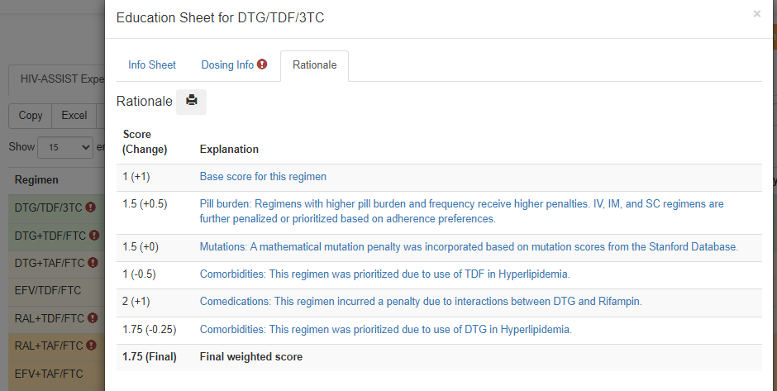
HIV-ASSIST Provides Transparent Explanations of All Rules Leading Final Score and Ranking (Rationale Tab)
Final score is modified due to
Drug interaction
Dosing frequency
hivassist.com.
Notes:
3TC, lamivudine; ART, antiretroviral therapy; DTG, dolutegravir; EFV, efavirenz; FTC, emtricitabine; TAF, tenofovir alafenamide; TDF, tenofovir disoproxil fumarate.

Slide 51
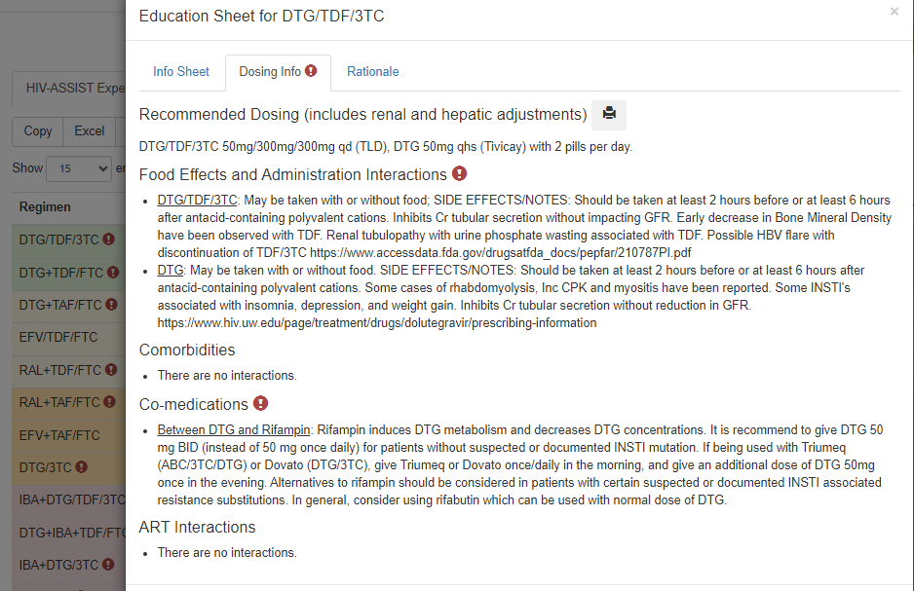
HIV-ASSIST Provides Dosing Information in the Dosing Tab after Clicking on the Regimen
Due to drug interaction, DTG must be given BID
hivassist.com.
Notes:
3TC, lamivudine; ART, antiretroviral therapy; DTG, dolutegravir; EFV, efavirenz; FTC, emtricitabine; TAF, tenofovir alafenamide; TDF, tenofovir disoproxil fumarate.

Slide 52
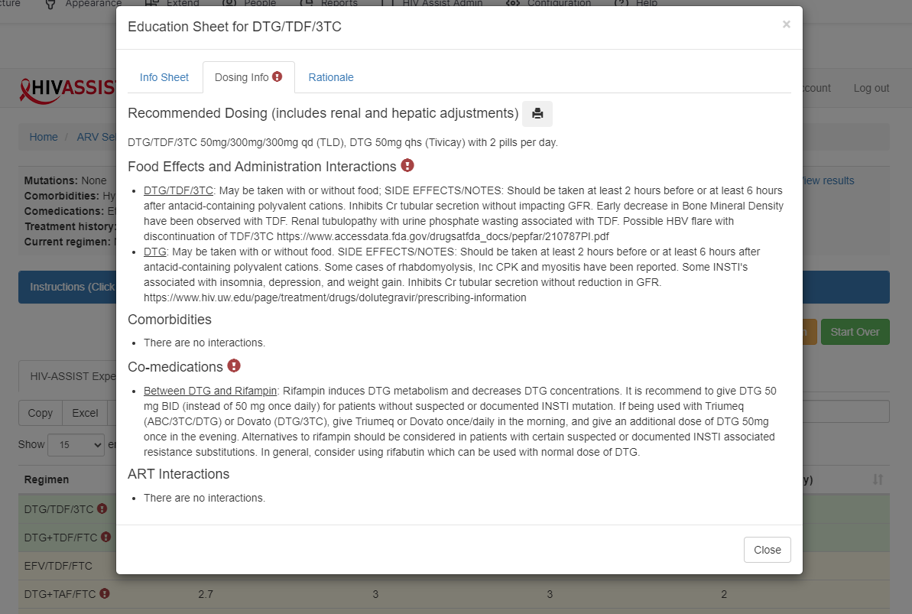
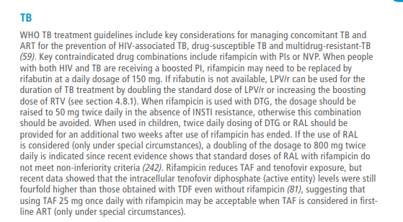
HIV-ASSIST Output: Dosing Information by Clicking on the Regimen
WHO guidelines
HIV-ASSIST is consistent with WHO guidance on DTG dosing
hivassist.com. who.int/publications/i/item/9789240031593.
Notes:
3TC, lamivudine; ART, antiretroviral therapy; DTG, dolutegravir; EFV, efavirenz; FTC, emtricitabine; TAF, tenofovir alafenamide; TDF, tenofovir disoproxil fumarate; WHO, World Health Organization.

Slide 53
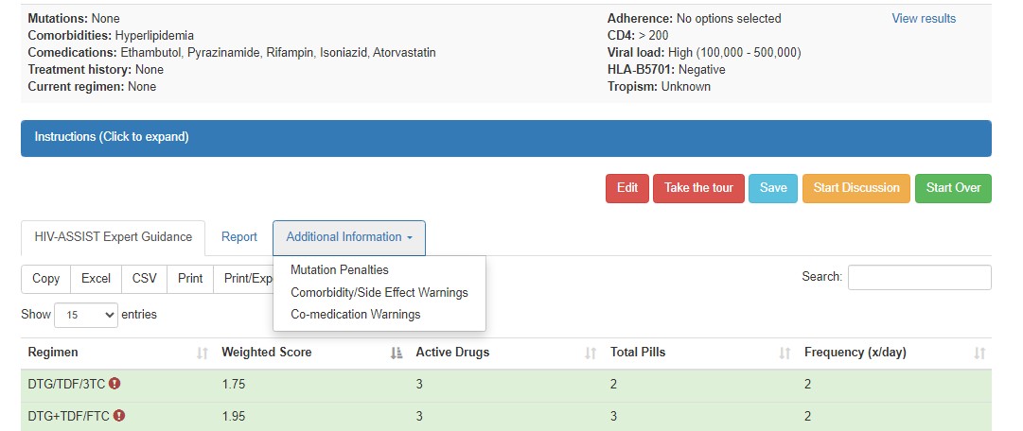
HIV-ASSIST: Additional Information Tab Provides Information on Mutations, Comorbidities, Drug Interactions
hivassist.com.
Notes:
3TC, lamivudine; ARV, antiretroviral; DHHS, Department of Health and Human Services; DTG, dolutegravir; FTC, emtricitabine; TDF, tenofovir disoproxil fumarate.

Slide 54
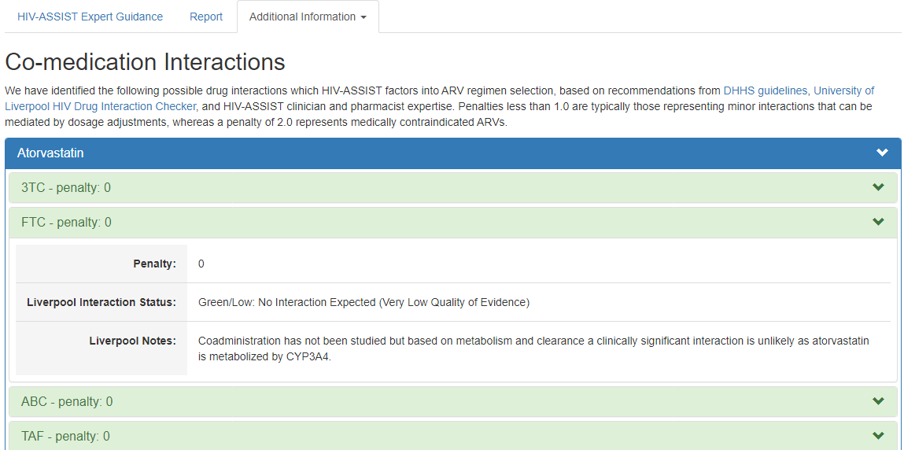
HIV-ASSIST: Additional Information Tab Explains Drug Interactions
Clicking the down arrow for individual ARVs shows an explanation of the interaction and penalty
hivassist.com.
Notes:
3TC, lamivudine; ABC, abacavir; ARV, antiretroviral; FTC, emtricitabine; TAF, tenofovir alafenamide.

Slide 55
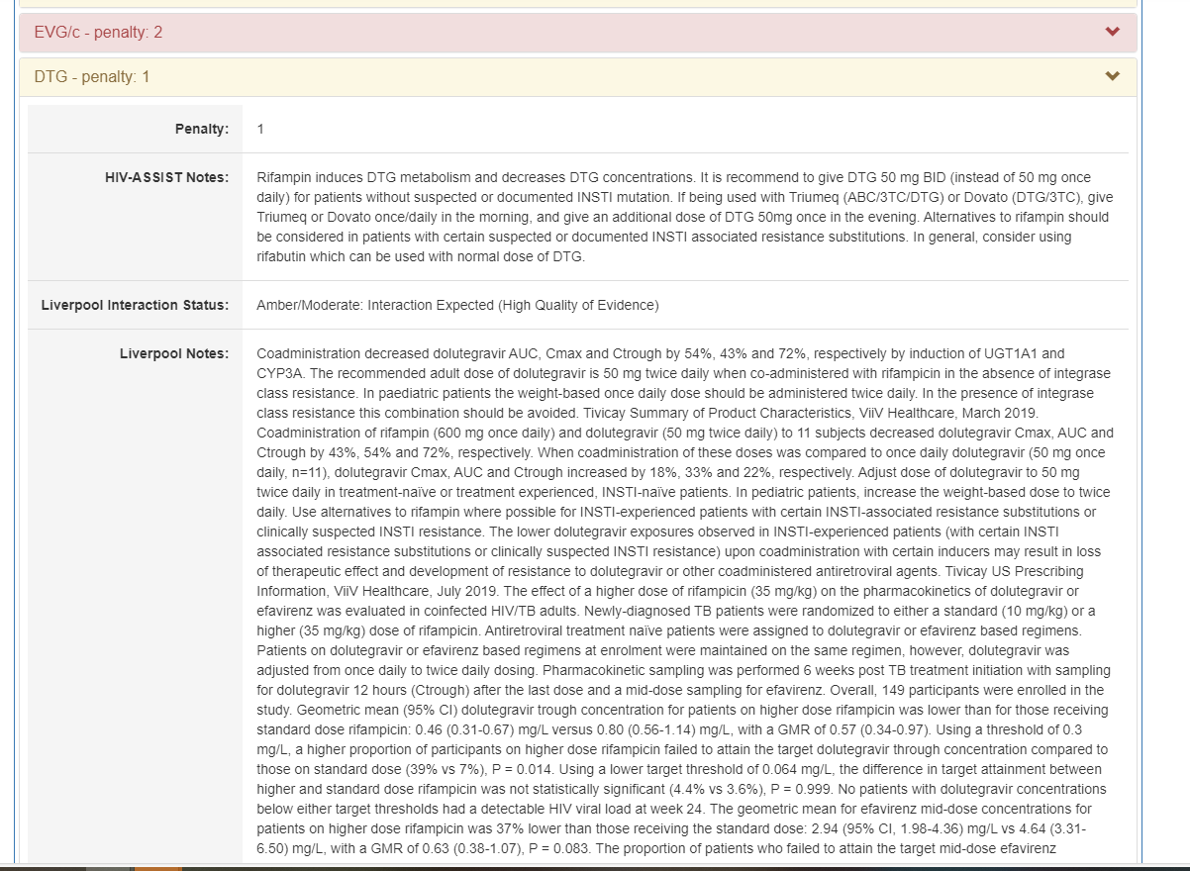

HIV-ASSIST: Additional Information Tab Explains Drug Interactions and Their Impact on Scores
Clicking the down arrow for individual ARVs shows an explanation of the interaction and penalty
HIV-ASSIST identifies the interaction between rifampin and dolutegravir with detailed explanations of available data
hivassist.com.
Notes:
ARV, antiretroviral.

Slide 56
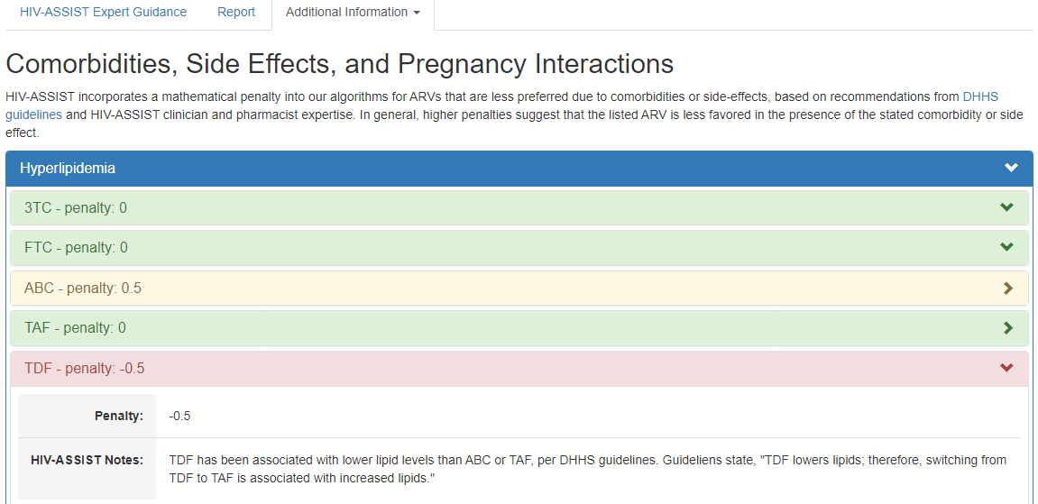
HIV-ASSIST: Additional Information Tab Explains
Scoring for Individual ARVs Based on Comorbidities
Clicking the down arrow for individual ARVs shows an explanation of the penalty
hivassist.com.
Notes:
3TC, lamivudine; ABC, abacavir; ARV, antiretroviral; FTC, emtricitabine; TAF, tenofovir alafenamide; TDF, tenofovir disoproxil fumarate.

Slide 57
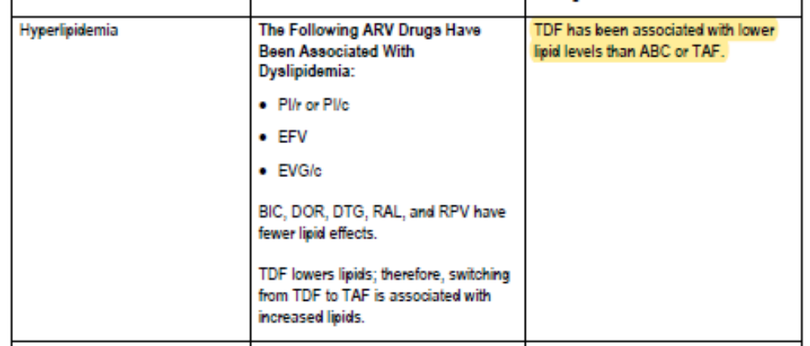
HIV-ASSIST: Additional Information Tab Explains
Scoring for Individual ARVs Based on Comorbidities
Clicking the down arrow for individual ARVs shows an explanation of the penalty
hivassist.com.
Notes:
3TC, lamivudine; ABC, abacavir; ARV, antiretroviral; FTC, emtricitabine; TAF, tenofovir alafenamide; TDF, tenofovir disoproxil fumarate.

Slide 58
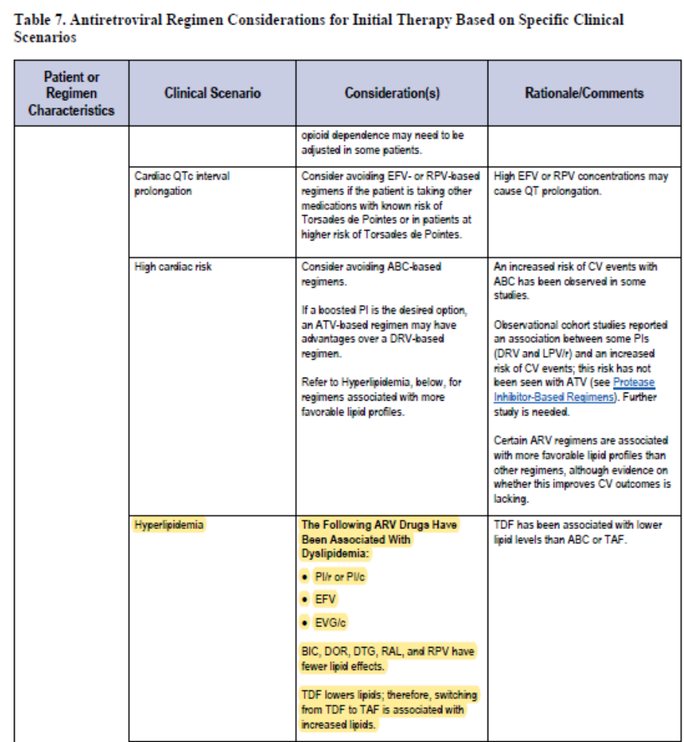
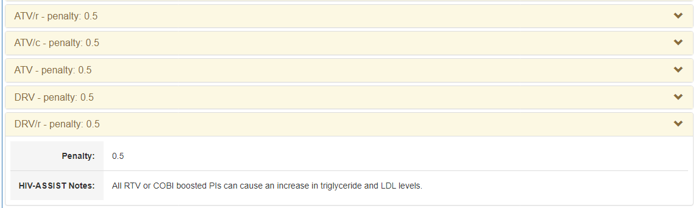
HIV-ASSIST: Additional Information Tab Explains
Scoring for Individual ARVs Based on Comorbidities
Clicking the down arrow for individual ARVs shows an explanation of the penalty
hivassist.com.
Notes:
ARV, antiretroviral; ATV, atazanavir; DRV, darunavir.

Slide 59
HIV-ASSIST: Additional Information Tab Also Provides Mutation and Resistance Information, if Present
hivassist.com.
Notes:
3TC, lamivudine; ARV, antiretroviral; DHHS, US Department of Health and Human Services; DTG, dolutegravir; FTC, emtricitabine; TDF, tenofovir disoproxil fumarate.

Slide 60
HIV-ASSIST Helps HCPs…
Select individualized ART regimens by providing free, online, guideline-based support
Make informed decisions by citing the primary literature underpinning the clinical guidelines
Take into consideration resistance mutations, comorbidities, and comedications when choosing ART regimens
Quickly identify clinical evidence for various options
  Although evidence-based efficacy is primary, the HIV-ASSIST algorithm also weighs tolerability factors, including patient preferences and adherence patterns, among others
Notes:
ART, antiretroviral therapy; HCP, healthcare professional.

Slide 61
Go Online for More CCO
Coverage of HIV!
Downloadable slides for self study or to share with colleagues
On-demand mixed-media modules featuring expert-led discussion
ClinicalThought commentaries with expert perspectives on HIV care
clinicaloptions.com

