Slide 1

Application of Precision Medicine Approaches in the Management of Cholangiocarcinoma: Education and Resources to Guide Clinical Practice
Provided by Clinical Care Options, LLC
Supported by educational grants from Bayer Healthcare Pharmaceuticals Inc. and Incyte Corporation.

Slide 2

About These Slides
Please feel free to use and share some or all of these slides in your noncommercial presentations to colleagues or patients
When using our slides, please retain the source attribution:
These slides may not be published, posted online, or used in commercial presentations without permission. Please contact permissions@clinicaloptions.com for details
Slide credit: clinicaloptions.com
Notes:
Disclaimer: The materials published on the Clinical Care Options website reflect the views of the authors of the CCO material, not those of Clinical Care Options, LLC, the CME providers, or the companies providing educational grants. The materials may discuss uses and dosages for therapeutic products that have not been approved by the United States Food and Drug Administration. A qualified healthcare professional should be consulted before using any therapeutic product discussed. Readers should verify all information and data before treating patients or using any therapies described in these materials.

Slide 3
Faculty
Christine Chio, PharmD, BCOP
Clinical Ambulatory GI Oncology Pharmacist
Department of Pharmacy
Massachusetts General Hospital
Boston, Massachusetts
Lipika Goyal, MD
Assistant Professor of Medicine
Division of Hematology/Oncology
Department of Medicine
Harvard Medical School
Attending Physician
Massachusetts General Hospital
Cancer Center
Boston, Massachusetts
Caroline Kuhlman, NP
Nurse Practitioner
GI Oncology
Massachusetts General Hospital
Cancer Center
Boston, Massachusetts
Notes:
This slide lists the faculty who were involved in the production of these slides.

Slide 4
Faculty Disclosures
Christine Chio, PharmD, BCOP, has no relevant conflicts of interest to report.
Lipika Goyal, MD, has disclosed that she has received consulting fees from Alentis Therapeutics, Black Diamond, Genentech, H3 Biomedicine, Incyte, Mefial, QED, Servier, Sirtex, and Taiho Oncology.
Caroline Kuhlman, NP, has no relevant conflicts of interest to report.
Notes:
This slide lists the disclosure information of the faculty and staff involved in the development of these slides.

Slide 5
Durvalumab and Gemcitabine + Cisplatin in
Patients With Advanced BTC (TOPAZ-1): Study Design
Double-blind, global, multicenter phase III study of durvalumab + Gem/Cis vs placebo + Gem/Cis in BTC
Stratified 1:1 by disease status, primary tumor location
Durvalumab 1500 mg Q3W
+ Gem/Cis* (up to 8 cycles)
Durvalumab 1500 mg Q4W
Locally advanced or metastatic BTC (ICC, ECC, GBC); previously untreated if unresectable or metastatic at initial diagnosis; recurrent disease >6 mo after curative surgery or adjuvant therapy; ECOG PS 0 or 1
(N = 685)
Until PD
Placebo Q3W
+ Gem/Cis* (up to 8 cycles)
Placebo Q4W
*Gem/Cis treatment: gemcitabine 1000 mg/m² and cisplatin 25 mg/m² on Days 1 and 8
Q3W administered up to 8 cycles.
Primary endpoint: OS
Secondary endpoints: PFS, ORR, DoR, efficacy by PD-L1 status, safety
Oh. ASCO GI 2022. Abstr 378.
Slide credit: clinicaloptions.com
Notes:
BTC, biliary tract cancer; DoR, duration of response; ECC, extrahepatic cholangiocarcinoma; ECOG, Eastern Cooperative Oncology Group; GBC, gallbladder cancer; Gem/Cis, gemcitabine and cisplatin; ICC, intrahepatic cholangiocarcinoma; ORR, overall response rate; OS, overall survival; PD, progressive disease; PFS, progression-free survival; PS, performance status.

Slide 6
TOPAZ-1: OS
Parameter | Durvalumab + Gem/Cis (n = 341) | Placebo + Gem/Cis (n = 344)
Median OS, mo (95% CI) | 12.8 (11.1-14.0) | 11.5 (10.1-12.5)
HR (96.02% CI) | 0.80 (0.66-0.97) | Yes
P value | .021 | Yes
100
80
12-Mo OS:
54.1%
48.0%
60
HR for Time Up to
6 Mo (95% CI):
0.91 (0.66-1.26)
18-Mo OS:
35.1%
25.6%
Probability of OS (%)
24-Mo OS:
24.9%
10.4%
40
HR for Time After
6 Mo (95% CI):
0.74 (0.58-0.94)
20
0
0
3
6
9
12
15
18
21
24
27
30
Mo From Randomization
Durvalumab + Gem/Cis Placebo + Gem/Cis
Patients at Risk, n
Durvalumab + Gem/Cis | 341 | 309 | 268 | 208 | 135 | 79 | 49 | 24 | 9 | 1
Placebo + Gem/Cis | 344 | 317 | 261 | 183 | 125 | 65 | 29 | 10 | 4 | 0
Oh. ASCO GI 2022. Abstr 378. Reproduced with permission.
Slide credit: clinicaloptions.com
Notes:
Gem/Cis, gemcitabine and cisplatin; OS, overall survival.

Slide 7
TOPAZ-1: Tumor Response
OR: 1.60
(95% CI: 1.11-2.31; P = .011)
Parameter | Durvalumab + Gem/Cis (n = 91) | Placebo + Gem/Cis (n = 64)
Median DoR†, mo (Q1-Q3) | 6.4 (4.6-17.2) | 6.2 (3.8-9.0)
Remaining in response, % ≥9 mo ≥12 mo | 32.6 26.1 | 26.1 15.0
40
35
30
25
ORR* (%)
26.7
20
15
18.7
†DoR analysis was based on patients with an objective response and measurable disease at baseline
10
5
0
Durvalumab + Gem/Cis
Placebo +
Gem/Cis
*By investigator assessments using RECIST v1.1 based on patients in final analysis who had measurable disease at baseline.
Oh. ASCO GI 2022. Abstr 378.
Slide credit: clinicaloptions.com
Notes:
DoR, duration of response; Gem/Cis, gemcitabine and cisplatin; OR, odds ratio; ORR, overall response rate; RECIST, Response Evaluation Criteria in Solid Tumors; Q, quartile.

Slide 8
TOPAZ-1: Safety Summary
AE | Durvalumab + Gem/Cis (n = 338) | Placebo + Gem/Cis (n = 342)
Median duration of exposure, mo (range) Durvalumab/placebo Gemcitabine Cisplatin | 7.33 (0.1-24.5) 5.19 (0.1-8.3) 5.13 (0.1-8.3) | 5.77 (0.2-21.5) 5.03 (0.2-8.6) 4.88 (0.2-8.5)
Any AE, n (%) | 336 (99.4) | 338 (98.8)
Any TRAE, n (%) | 314 (92.9) | 308 (90.1)
Any grade 3/4 AE, n (%) | 256 (75.7) | 266 (77.8)
Any grade 3/4 TRAE, n (%) | 212 (62.7) | 222 (64.9)
Any serious AE, n (%) | 160 (47.3) | 149 (43.6)
Any serious TRAE, n (%) | 53 (15.7) | 59 (17.3)
Any AE leading to discontinuation, n (%) | 44 (13.0) | 52 (15.2)
Any TRAE leading to discontinuation, n (%) | 30 (8.9) | 39 (11.4)
Any AE leading to death, n (%) | 12 (3.6) | 14 (4.1)
Any TRAE leading to death, n (%) | 2 (0.6) | 1 (0.3)
Any immune-mediated AE, n (%) | 43 (12.7) | 16 (4.7)
Oh. ASCO GI 2022. Abstr 378.
Slide credit: clinicaloptions.com
Notes:
AE, adverse event; Gem/Cis, gemcitabine and cisplatin; TRAE, treatment-related adverse event.

Slide 9
Incidence of Select Mutations in
Targetable Pathways in Cholangiocarcinoma
CGP Findings | Intrahepatic Cholangiocarcinoma | Extrahepatic Cholangiocarcinoma
Total GA/patient | 3.6 | 4.4
CRGA/patient | 2.0 | 2.1
ERBB2 amplifications, % | 3 | 11
BRAF substitutions, % | 5 | 3
FGFR1-3 fusions and amplifications, % | 11 | 0
IDH1/2 substitutions, % | 20 | 0
Tumor-agnostic aberrations:
NTRK fusions are found in <1% of patients with cholangiocarcinoma
Prevalence of MSI-H/dMMR tumors in BTC ranges from 1% to 5%
In BTC, TMB-H tumor prevalence is approximately 4%
Javle. Cancer. 2016;133:3838. Westphalen. NPJ Precision Oncology;5:69. Shao. JAMA Netw Open. 2020;3:e225109.
Slide credit: clinicaloptions.com
Notes:
BTC, biliary tract cancer; CGP, comprehensive genomic profiling; CRGA, clinically relevant genomic alteration; dMMR, mismatch repair deficient; GA, genomic alteration; MSI-H, microsatellite instability–high; TMB-H, high tumor mutational burden.

Slide 10
FIGHT-202: Pemigatinib in Previously Treated Cholangiocarcinoma With FGFR2 Fusions
A multicenter, open-label, multicohort, single-arm phase II trial
Primary endpoint: ORR in cohort A
Key secondary endpoints: ORR in cohorts B, A + B, and C; DoR; DCR; safety; PFS;
OS in all cohorts
Cohort A (FGFR2 Fusions/Rearrangements)
Pemigatinib 13.5 mg QD in 21-day cycles*
(n = 108)
Adult patients with histologically or cytologically confirmed locally advanced and/or metastatic cholangiocarcinoma and documented FGF/FGFR2 status; progressed on or after ≥1 prior line of systemic therapy; ECOG PS ≤2; adequate hepatic/renal function
(N = 145)
Until PD, intolerable toxicity, consent withdrawal, or investigator decision
Cohort B (Other FGF/FGFR Genetic Alterations)
Pemigatinib 13.5 mg QD in 21-day cycles*
(n = 20)
Cohort C (No FGF/FGFR Genetic Alterations)
Pemigatinib 13.5 mg QD in 21-day cycles*
(n = 17)
*2 weeks on, 1 week off
Abou-Alfa. Lancet Oncol. 2020;21:671. Abou-Alfa. ASCO 2021. Abstr 4086.
Slide credit: clinicaloptions.com
Notes:
DCR, disease control rate; DoR, duration of response; ECOG, Eastern Cooperative Oncology Group; ORR, overall response rate; OS, overall survival; PD, progressive disease; PFS, progression-free survival; PS, performance status.

Slide 11
Pemigatinib in Previously Treated Cholangiocarcinoma (FIGHT-202): Updated Safety and Efficacy Results
TEAE in ≥25%, n (%) | N = 147
 | All Grades | Grade 3/4
Hyperphosphatemia | 86 (58.5) | 0
Alopecia | 73 (49.7) | 0
Diarrhea | 69 (46.9) | 5 (3.4)
Fatigue | 64 (43.5) | 8 (5.4)
Nausea | 61 (41.5) | 3 (2.0)
Dysgeusia | 60 (40.8) | 0
Stomatitis | 55 (37.4) | 9 (6.1)
Constipation | 54 (36.7) | 1 (0.7)
Decreased appetite | 50 (34.0) | 3 (2.0)
Dry mouth | 50 (34.0) | 0
Vomiting | 43 (29.3) | 2 (1.4)
Dry eye | 41 (27.9) | 1 (0.7)
Arthralgia | 38 (25.9) | 9 (6.1)
Efficacy Outcome, Cohort A | N = 108
ORR, % (95% CI) CR, n (%) PR, n (%) SD, n (%) PD, n (%) NE, n (%) | 37.0 (27.9-46.9) 4 (3.7) 36 (33.3) 49 (45.4) 16 (14.8) 3 (2.8)
DCR, % (95% CI) | 82.4 (73.9-89.1)
Median DoR, mo (95% CI) | 8.1 (5.7-13.1)
Median PFS, mo (95% CI) | 7.0 (6.1-10.5)
Median OS, mo (95% CI) | 17.5 (14.4-23.0)
Other observed toxicities
  Nail changes (discoloration, breakage, separation from
  nail bed)
  Ocular disorder (including serious retinal detachment)
  Hand–foot syndrome (late toxicity)
  GI toxicities
Abou-Alfa. ASCO 2021. Abstr 4086.
Slide credit: clinicaloptions.com
Notes:
CR, complete response; DCR, disease control rate; DoR, duration of response; NE, not estimable; ORR, overall response rate; OS, overall survival; PD, progressive disease; PFS, progression-free survival; PR, partial response; SD, stable disease; TEAE, treatment-emergent adverse event.

Slide 12
Infigratinib for Advanced Cholangiocarcinoma
With FGFR2 Fusion/Rearrangement
Open-label, single-arm phase II trial
Current Analysis
Cohort 1
Patients with FGFR2 gene fusions or rearrangements, no prior selective FGFR inhibitors
(n = 108)
Infigratinib 125 mg QD x 21 days for 28-day cycles
Patients with unresectable locally advanced or metastatic cholangiocarcinoma and FGFR gene fusions or rearrangements who experienced progression on/intolerance to gemcitabine-based chemotherapy
Cohort 2
Patients with FGFR1 and FGFR3 gene fusions or rearrangements and/or FGFR mutations, no prior selective
FGFR inhibitors
(planned n = 20)
Primary endpoints: ORR per BICR (RECIST v1.1), DoR
Secondary endpoints: PFS,
DCR, best overall response,
OS, safety, PK
Cohort 3
Patients with FGFR2 gene fusions progressing following a selective FGFR inhibitor other than infigratinib
(planned n = 20)
Javle. Lancet Gastroenterol Hepatol. 2021;6:803. Javle. ASCO GI 2021. Abstr 265.
Slide credit: clinicaloptions.com
Notes:
BICR, blinded independent central review; DCR, disease control rate; DoR, duration of response; ORR, overall response rate; OS, overall survival; PFS, progression-free survival; PK, pharmacokinetics; RECIST, Response Evaluation Criteria in Solid Tumors.

Slide 13
Infigratinib in Advanced Cholangiocarcinoma
With FGFR2 Fusion/Rearrangement: Efficacy
Efficacy Outcome | Infigratinib (n = 108)
Confirmed ORR, % CR, n (%) PR, n (%) SD, n (%) PD, n (%) | 23.1* 1 (1) 24 (22) 66 (61) 11 (10)
Median TTR, mo (range) | 3.6 (1.8-3.8)
DCR, % (95% CI) | 84.3 (76.0-90.6)
Median DoR, mo (range) | 5.0 (3.7-9.3)
Median PFS, mo (range) | 7.3 (5.6-7.6)
Median OS, mo | 12.2 (10.7-14.9)
*ORR higher with ≤1 vs ≥2 prior lines (34.0% vs 13.8%).
Javle. Lancet Gastroenterol Hepatol. 2021;6:803. Javle. ASCO GI 2021. Abstr 265.
Slide credit: clinicaloptions.com
Notes:
CR, complete response; DCR, disease control rate; DoR, duration of response; ORR, overall response rate; OS, overall survival; PD, progressive disease; PFS, progression-free survival; PR, partial response; SD, stable disease; TTR, time to response.

Slide 14
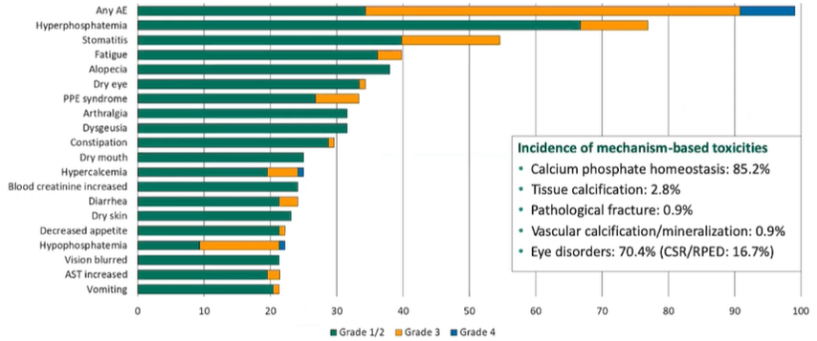
Infigratinib in Advanced Cholangiocarcinoma
With FGFR2 Fusion/Rearrangement: Safety
Javle. Lancet Gastroenterol Hepatol. 2021;6:803. Javle. ASCO GI 2021. Abstr 265.
Slide credit: clinicaloptions.com
Notes:
AE, adverse event; AST, aspartate aminotransferase; CSR, central serous retinopathy; PPE, palmar–plantar erythrodysesthesia; RPED, retinal pigment epithelial detachment.

Slide 15
ClarIDHy: Ivosidenib vs Placebo in Previously
Treated Cholangiocarcinoma With IDH1 Mutation
An international, double-blind, randomized phase III trial
Primary endpoint: PFS by blinded IRC
Key secondary endpoints: PFS by local review, OS, ORR, safety, QoL, PK/PD
Stratification by prior number of therapies
Ivosidenib 500 mg PO QD
in 28-day (± 2 days) cycles
(n = 126)
Adult patients with histologically confirmed cholangiocarcinoma and centrally confirmed IDH1 mutation status by NGS; 1-2 prior therapies
(≥1 gemcitabine- or 5-FU–containing regimen); ECOG PS 0/1 with adequate hematologic, hepatic, and renal function
(N = 187)
Crossover permitted at radiographic disease progression
2:1
Placebo
(n = 61)
Abou-Alfa. Lancet Oncol. 2020;21:796. Zhu. JAMA Oncol. 2021;e213836.
Slide credit: clinicaloptions.com
Notes:
5-FU, 5-fluororacil; ECOG, Eastern Cooperative Oncology Group; IRC, independent review committee; NGS, next-generation sequencing; ORR, overall response rate; OS, overall survival; PD, pharmacodynamics; PFS, progression-free survival; PK, pharmacokinetics; PS, performance status; QoL, quality of life.

Slide 16
Ivosidenib vs Placebo in IDH1+ Cholangiocarcinoma (ClarIDHy): PFS and OS
Outcome | Ivosidenib | Placebo
PFS by IRC | n = 124 | n = 61
Median, mo | 2.7 | 1.4
6-mo rate, % | 32 | 0
12-mo rate, % | 22 | 0
HR (95% CI) | 0.37 (0.25-0.54; P <.0001)
Final OS | n = 126 | n = 61
No. of events (%) | 100 (79) | 50 (82)
Median, mo | 10.3 | 7.5*
12-mo rate, % | 43 | 36
HR (95% CI) | 0.79 (0.56-1.12; P = .09)
RPSFT-adjusted HR (95% CI) | 0.49 (0.34-0.70; P <.001)
*Median OS for placebo after adjustment for crossover (RPSFT model): 5.1 mo
Abou-Alfa. Lancet Oncol. 2020;21:796. Zhu. JAMA Oncol. 2021;e213836.
Slide credit: clinicaloptions.com
Notes:
IRC, independent review committee; OS, overall survival; PFS, progression-free survival; RPSFT, rank-preserving structural failure time.

Slide 17
Ivosidenib vs Placebo in IDH1+ Cholangiocarcinoma (ClarIDHy): Safety
Any-Grade TEAE, n (%) | Ivosidenib* (n = 166) | Grade ≥3 | Placebo (n = 59) | Grade ≥3
Nausea | 63 (38) | 4 (2) | 17 (29) | 1 (2)
Diarrhea | 55 (33) | 1 (1) | 10 (17) | 0
Fatigue | 48 (29) | 5 (3) | 10 (17) | 1 (2)
Abdominal pain | 37 (22) | 4 (2) | 9 (15) | 1 (2)
Cough | 36 (22) | 0 | 5 (8) | 0
Decreased appetite | 36 (22) | 2 (1) | 11 (19) | 0
Ascites | 33 (20) | 15 (9) | 9 (15) | 4 (7)
Vomiting | 33 (20) | 4 (2) | 11 (19) | 0
Anemia | 30 (18) | 12 (7) | 3 (5) | 0
Peripheral edema | 25 (15) | 1 (1) | 6 (10) | 0
Constipation | 24 (14) | 0 | 11 (19) | 0
Asthenia | 20 (12) | 2 (1) | 8 (14) | 2 (3)
Back pain | 19 (11) | 1 (1) | 7 (12) | 2 (3)
Pyrexia | 19 (11) | 2 (1) | 6 (10) | 0
*Including crossover patients.
Abou-Alfa. Lancet Oncol. 2020;21:796. Zhu. JAMA Oncol. 2021;e213836.
Slide credit: clinicaloptions.com
Notes:
TEAE, treatment-emergent adverse event.

Slide 18
Dabrafenib + Trametinib for BRAF V600E–Mutated BTC: Tumor Size Change and Response Duration
Phase II ROAR study in patients with BRAF V600E–mutated, unresectable, metastatic locally advanced or recurrent BTC with previous systemic treatment (N = 43)
80
Best Confirmed Response
ORR (per IRC): 47%
(95% CI: 31%-62%)
Partial response
Stable disease
Progressive disease
Not evaluable
60
40
20
Maximum Target Lesion Diameter Reduction From Baseline (%)
0
Patients
-20
-40
-60
Ongoing study treatment
Disease progressed
First response
Treatment discontinuation (AE)
-80
*
*
-100
0
10
20
30
40
50
60
70
80
90
100
110
120
Patients
130
140
150
160
170
180
190
200
Time Since Treatment Initiation (Wk)
Subbiah. Lancet Oncol. 2020;21:1234.
Slide credit: clinicaloptions.com
Notes:
AE, adverse event; BTC, biliary tract cancer; IRC, independent radiology center; ORR, overall response rate.

Slide 19
MyPathway: Trastuzumab + Pertuzumab for
HER2-Positive BTC
MyPathway: Phase IIa study of 6 targeted regimens in patients with advanced solid tumors with potentially actionable molecular alterations¹
Current report: trastuzumab + pertuzumab in cohort with previously treated metastatic BTC and HER2 amplification, overexpression, or both (n = 39)²
50
Change in Target Lesion Size in HER2+ BTC
Efficacy Outcome | ICC (n = 7) | ECC (n = 7)
Confirmed ORR, % | 0 | 2 (29)
DCR, % (95% CI) | 2 (29) | 5 (71)
Median DoR, mo (range) | NA | 7.5 (4.2-NE)
Median PFS, mo (range) | 2.6 (1.0-5.3) | 6.8 (1.3-13.5)
Median OS, mo (range) | 3.9 (1.2-8.1) | 8.0 (2.0-NE)
25
0
-25
Target Lesion Change From Baseline (%)
-50
Best Overall Response
Partial response
Stable disease
Progressive disease
-75
-100
37
29
25
36
15
17
19
27
24
31
13
34
22
26
9
10
23
20
18
21
6
11
16
3
32
14
8
1
7
12
4
2
5
Patient
1. NCT02091141. 2. Javle. Lancet Oncol. 2021;22:1290.
Slide credit: clinicaloptions.com
Notes:
BTC, biliary tract cancer; DCR, disease control rate; DoR, duration of response; ECC, extrahepatic cholangiocarcinoma; ICC, intrahepatic cholangiocarcinoma; NA, not available; NE, not estimable; ORR, overall response rate; OS, overall survival; PFS, progression-free survival.

Slide 20
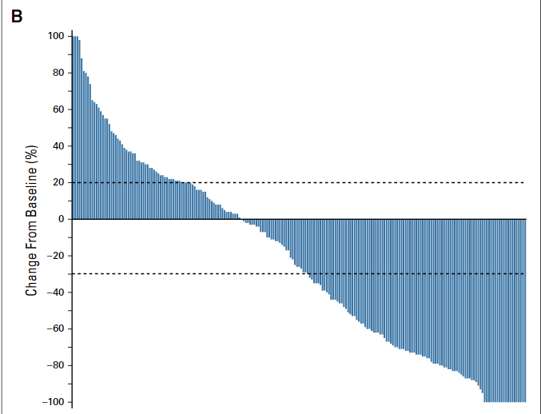
Phase II KEYNOTE-158: Pembrolizumab in
MSI-H/dMMR and TMB-H Noncolorectal Cancers
Phase II trial of pembrolizumab in patients with advanced solid tumors
Tumor Size Change From Baseline
(All Tumor Types; n = 233)
In patients with TMB-H tumors (n = 102):
  ORR: 29%
  mDoR: 33.1%
Cohort K enrolled patients with any noncolorectal solid tumor that is MSI-H
Investigator-assessed ORR: 34.3%
mDoR: NR
Updated Analysis: Cohort K
Parameter | n = 321
ORR, % (95% CI) | 30.8 (35.8-36.2)
DoR ≥36 mo, % | 70
mPFS (95% CI) | 3.5 (2.3-4.2)
mOS (95% CI) | 20.1 (14.1-27.1)
ORR in patients with MSI-H/dMMR cholangiocarcinoma (n = 22): 40.9%
1. Marabelle. JCO. 2020;38:1. 2. Marabelle. Lancet Oncol. 2020;21:1353. 3. Maio. ASCO 2021. Abstr 2565.
Slide credit: clinicaloptions.com
Notes:
dMMR, mismatch repair deficient; DoR, duration of response; mDoR, median duration of response; mOS, medial overall survival; mPFS, median progression-free survival; MSI-H, microsatellite instability–high; ORR, overall response rate; NR, not reached; TMB-H, high tumor mutational burden.

Slide 21
Phase I GARNET: Dostarlimab in
Nonendometrial Tumors, Cohort F
Multicohort, open-label phase I trial
Cohort F: patients with dMMR solid tumors and progressive disease following therapy with no alternative treatment options
  n = 69 evaluable patients with colorectal cancer
  n = 37 evaluable patients with noncolorectal cancer
Parameter | Cohort F (n = 106)
Median follow-up, mo | 16.7
ORR, % (95% CI) | 38.7 (29.4-48.6)
DCR, % (95% CI) | 63.2 (53.3-72.4)
Median DoR, mo | NR (5.59-30.13+)
Berton. ASCO 2021. Abstr 2564.
Slide credit: clinicaloptions.com
Notes:
DCR, disease control rate; dMMR, mismatch repair deficient; DoR, duration of response; NR, not reached; ORR, objective response rate.

Slide 22
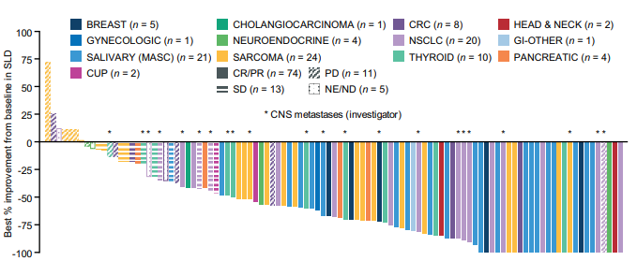
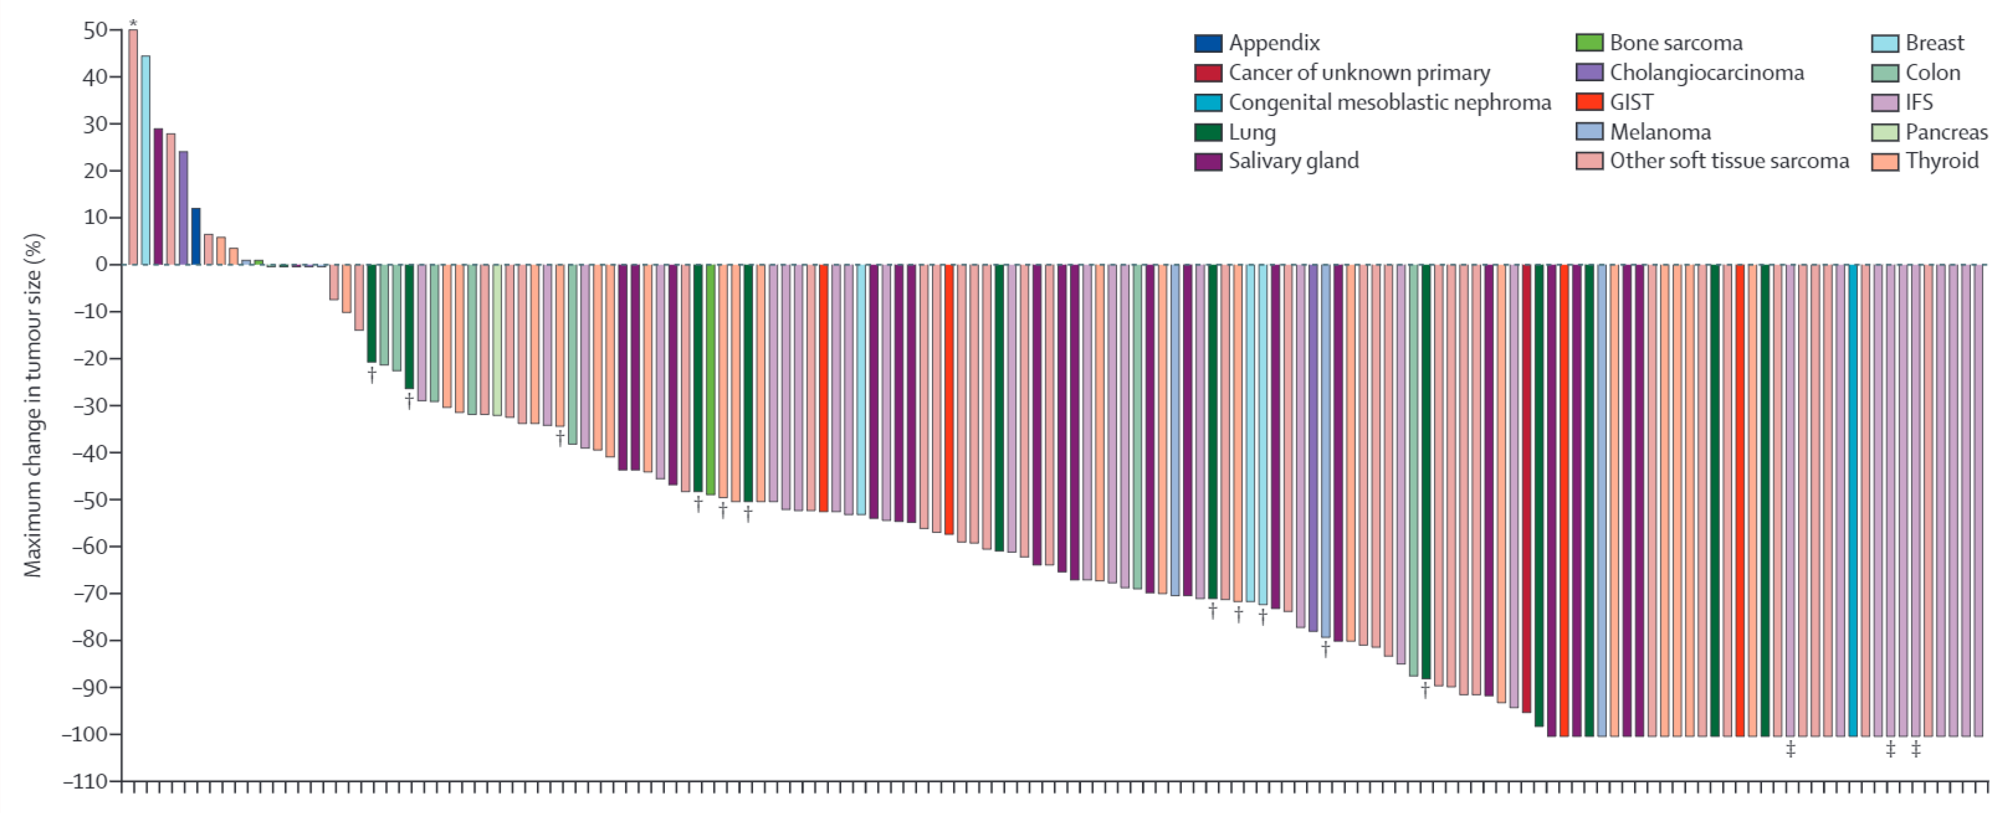
Activity of TRK Inhibitors in TRK Fusion–Positive Cancers
100
Best Improvement From BL in SLD: Entrectinib
Entrectinib¹ | N = 121
ORR, % (95% CI) | 61 (51.9-69.9)
Median DoR, mo | 20
Median PFS, mo | 13.8
Median follow-up, mo | 25.8
75
50
25
Best Improvement From BL in SLD (%)
*
*
*
*
*
*
*
*
*
*
*
*
*
*
*
*
*
*
*
*
0
*
*
-25
-50
Pooled analysis of 3 studies.
-75
*CNS metastases (investigator).
-100
50
*
40
Change in Tumor Size
With Larotrectinib
Larotrectinib² | N = 159
ORR, % (95% CI) | 79 (72-85)
Median DoR, mo | 35.2
Median PFS, mo | 28.3
Median follow-up, mo | 12.9
30
20
10
0
-10
Maximum change in tumor size (%)
-20
†
†
-30
†
-40
†
-50
†
†
-60
*Maximum change in tumor size: 93%.
†Patients with brain metastases.
‡Patients with pathological complete response.
Pooled analysis of 3 studies.
-70
†
†
†
†
-80
†
-90
‡
-100
‡
‡
1. Demetri. Clin Cancer Res. 2022;28:1302. 2. Hong. Lancet Oncol. 2020;21:531.
Slide credit: clinicaloptions.com
Notes:
BL, baseline; CNS, central nervous system; CR, complete response; CRC, colorectal cancer; DoR, duration of response; GIST, gastrointestinal stromal tumor; IFS, infantile fibrosarcoma; NSCLC, non-small-cell lung cancer; ORR, overall response rate; PD, progressive disease; PFS, progression-free survival; PR, partial response; SD, stable disease; SLD, sum of longest diameter.

Slide 23
Go Online for More CCO
Coverage of Cholangiocarcinoma!
Podcast on managing patients with cholangiocarcinoma
ClinicalThought Commentary on new developments in cholangiocarcinoma management
Capsule Summaries of key data from conferences
clinicaloptions.com/oncology

