Slide 1

Improving Transgender Patient Care: Understanding Bias and Addressing Unique Needs
Lauren Radziejewski, DNP, APRN
Medical Director
Galileo Health
New York, New York
Supported by an educational grant from Merck Sharp & Dohme Corp.

Slide 2

About These Slides
Please feel free to use, update, and share some or all of these slides in your noncommercial presentations to colleagues or patients
When using our slides, please retain the source attribution:
These slides may not be published, posted online, or used in commercial presentations without permission. Please contact permissions@clinicaloptions.com for details
Slide credit: clinicaloptions.com
Notes:
Disclaimer: The materials published on the Clinical Care Options Web site reflect the views of the authors of the CCO material, not those of Clinical Care Options, LLC, the CME providers, or the companies providing educational grants. The materials may discuss uses and dosages for therapeutic products that have not been approved by the United States Food and Drug Administration. A qualified healthcare professional should be consulted before using any therapeutic product discussed. Readers should verify all information and data before treating patients or using any therapies described in these materials.

Slide 3
Faculty
Lauren Radziejewski, DNP, APRN
Medical Director
Galileo Health
New York, New York
Lauren Radziejewski, DNP, APRN, has no relevant conflicts of interest to report.
Notes:
This slide lists the faculty who were involved in the production of these slides.

Slide 4

Care of Transgender Individuals:
Intersection of 4 Key Elements
Care of Transgender Individuals
1. Unique needs
2. Distinct cultural considerations
3. Appropriate language to use
in the clinic
4. Special considerations
Vermeir. Healthc Policy. 2018;14:11.
Slide credit: clinicaloptions.com

Slide 5
Unique Needs of Transgender Individuals
Marginalized Identity
Disease Burden
Economic Hardship
Bias and hate
Implicit bias
Microaggressions
Misinformation
Denial of care
Frequent office visits
Multiple medications
Surgery/recovery
Life disruption
Comorbidities
Unemployment or underemployment
Homelessness
Cost of care
Administrative burden associated with changing documentation
(eg, birth certificate)
CDC. Patient-centered care for transgender people: recommended practices for health care settings.
Slide credit: clinicaloptions.com

Slide 6

Homophobia in Public
Homophobia exists in an
overt form and a passive form
Experiences outside of the healthcare setting can affect an individual’s feelings and their experience when facing challenges at their doctor’s office
Image courtesy of Lauren Radziejewski, DNP, APRN.
Slide credit: clinicaloptions.com

Slide 7
Unique Needs of Transgender Individuals: Statistics
Reported by 6450 transgender or gender nonconforming individuals surveyed in 2011:¹
  19% have experienced outright refusal to give care in healthcare and 28% verbal harassment in
  medical settings
  41% have attempted suicide
  26% lost a job because of their gender identity
  50% reported harassment at work
  19% have experienced homelessness
  10% have experienced sexual assault
  26% have experienced physical assault or violence
Transgender women of color experience a disproportionate rate of HIV infection²
1. Grant. Injustice at every turn a report of the national transgender discrimination survey. 2011. 2. CDC. HIV infection, risk, prevention, and testing behaviors among transgender women—National HIV Behavioral Surveillance, 7 US Cities, 2019-2020. Published April 2021.
Slide credit: clinicaloptions.com
Notes:
HCP, healthcare professional; HIV, human immunodeficiency virus.

Slide 8
HCP Self Awareness:
Understanding and Overcoming Bias
It is incumbent upon all HCPs to care for all patients with equal compassion and respect and without regard for their personal attributes
Biases are preconceived views that favor toward or against individuals, groups, or ideas
  We all maintain biases despite our best intentions
Implicit bias: individuals are not aware of their preference for one group over another; includes evaluations of groups of people that may be favorable or unfavorable
  Implicit bias is corrosive and will harm your ability to give equitable care
  Learning about one’s own implicit biases is one method of neutralizing them
  Consider taking an implicit bias self assessment: https://implicit.harvard.edu/implicit/takeatest.html
Explicit bias: individuals have a conscious awareness of their preferences, beliefs, and attitudes about a group of people
If a provider feels unprepared to care for an individual, it is their ethical responsibility to refer them to an appropriate alternate resource
Vela. Annu Rev Public Health. 2022;43:477. Morrison. J Pediatr Surg. 2022;57:1315. Edgoose. Fam Pract Manag. 2019;26:29.
Slide credit: clinicaloptions.com
Notes:
HCP, healthcare professional.

Slide 9




Transgender Cultural Considerations
History
Role Models
Popular Culture
Stonewall
HIV/AIDS epidemic
  Shanti Project (shanti.org)
Marriage equality
Bathroom laws
Marsha P. Johnson
Sylvia Rivera
Janet Mock
TV/film representations
Images from Wikimedia Commons: left image under public domain; center image licensed under a Creative Commons Attribution-ShareAlike 4.0 International License; right image licensed under a Creative Commons Attribution 3.0 Unported License.
Slide credit: clinicaloptions.com
Notes:
AIDS, acquired immunodeficiency syndrome; HIV, human immunodeficiency virus.

Slide 10
Tips for LGBTQ+ Sensitive Care
Consider the impact that minority stress plays in care interactions
  Know where it comes from and how to address it
Transmit an atmosphere of acceptance in all areas
  Pronoun badges for all staff
  Poster near front desk demonstrating support for LBGTQ+ inclusivity
UCSF. Guidelines for the primary and gender-affirming care of transgender and gender nonbinary people. June 17, 2016.
Slide credit: clinicaloptions.com
Notes:
LGBTQ+, lesbian/gay/bisexual/transgender/queer or questioning/all other gender identities and sexual orientations.

Slide 11
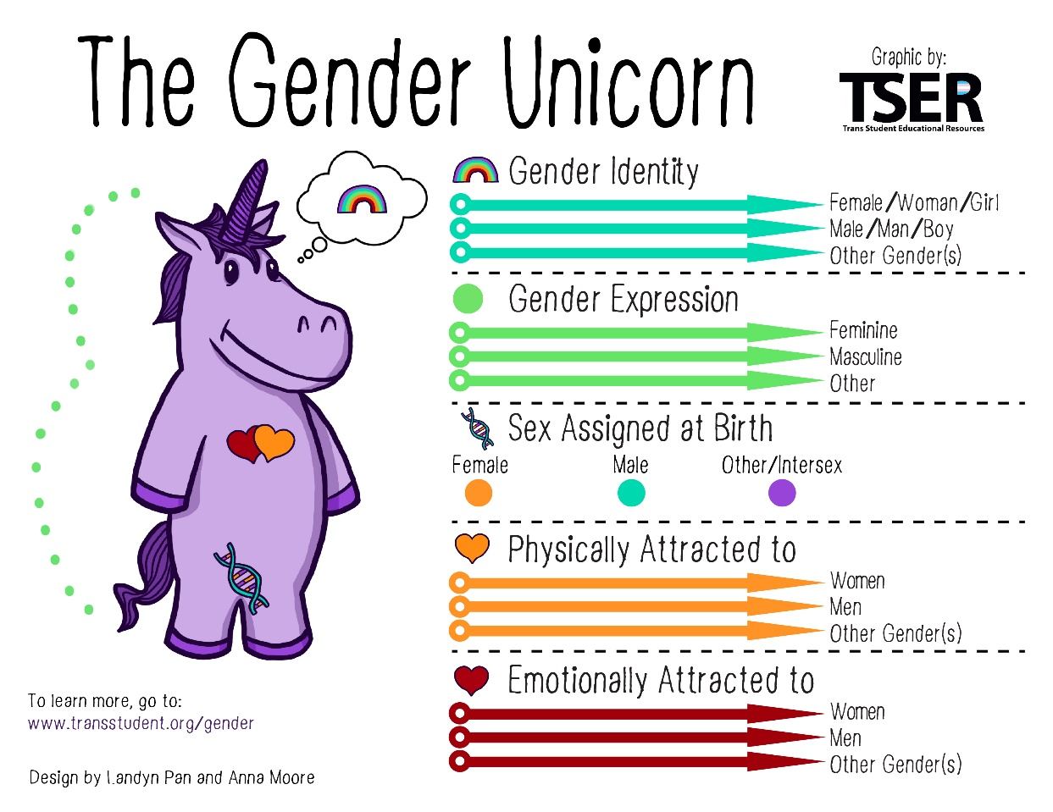
Language Matters: Overview of Key Terminology
Sex Assigned at Birth | Gender Identity
Female Male Intersex | Female Male Nonbinary Transgender Cisgender Other genders
Sexual Orientation | Pronouns
Gay Straight Bisexual Pansexual Asexual (ACE) | She/her He/him They/them Ze/zim
Labanca. Int J Gynecol Cancer. 2020;30:1990.
Trans Student Educational Resources, 2015. “The Gender Unicorn.” http://www.transstudent.org/gender.
Slide credit: clinicaloptions.com

Slide 12

Best Practices for Pronouns
Ask early, ask again
Offer multiple opportunities to
share (on paperwork, portal, etc)
Utilize pronouns consistently in
all documentation
Share your own pronouns
Display pronouns on or adjacent
to name badges
Place signage stating the importance of honoring pronouns
Ask Me My Pronouns
Slide credit: clinicaloptions.com

Slide 13
What to Do When You Have Made a Mistake
Mistakes are inevitable and happen to everyone
  Offer a sincere and direct apology
  Don’t dwell or try to explain
  Move on
If the mistake is happening all the time or many times, the HCP needs to reevaluate their own internal feelings and biases
CDC. Patient-centered care for transgender people: recommended practices for health care settings. February 18, 2022.
UCSF. Guidelines for the primary and gender-affirming care of transgender and gender nonbinary people. June 17, 2016.
Slide credit: clinicaloptions.com
Notes:
HCP, healthcare professional.

Slide 14
Medical History and Physical Exam
Taking a Medical History
Best Practices for Physical Exams
Be mindful to phrase questions in a sex- and gender-neutral way
Avoid making sex-/gender-related assumptions about personal details, particularly on forms
A better alternative is sex neutral intake forms that ask all questions of all people
Use an organ-based inventory approach to discussing reproductive organs
Save discussion about reproductive organs for the end of the appointment
Be prepared to discuss these topics at a later appointment to allow the patient time to mentally prepare
Preface questions with a warning statement and ask the patient if they would like to proceed
Maintain as much modesty as possible
Use a trauma-informed approach
        Ask permission to begin the exam; give warning before touching the patient
Ask the patient to tell you if they feel any physical or emotional discomfort and let them know that you will stop the exam immediately if they feel uncomfortable
Approach exams of private or sensitive areas with special care
If possible, schedule exams of private areas as a separate visit to allow the patient time to mentally prepare
Offer the opportunity to have the exam/procedure done by a different provider
Consider alternate testing for patients with significant reservations
CDC. Patient-centered care for transgender people: recommended practices for health care settings. February 18, 2022.
UCSF. Guidelines for the primary and gender-affirming care of transgender and gender nonbinary people. June 17, 2016.
Slide credit: clinicaloptions.com

Slide 15

Psychosocial Support
Rates of depression, anxiety, and attempted suicide are high among transgender individuals
Approximately 40% of transgender patients report attempted suicide in their lifetime
Patients should be screened for depression/suicidality with each visit
  A simple validated screening test for depression (eg, PHQ-2), can be administered with vital signs
  Any positives should be discussed further
Providers should be ready to address mental health concerns with referral to transgender-competent mental health providers, in-house management, and emergency resources
Witcomb. J Affect Disord. 2018;235:308. James. The report of the 2015 U.S. transgender survey. Washington, DC: National Center for Transgender Equality. 2016. Grant. Injustice at every turn a report of the national transgender discrimination survey. 2011.
Slide credit: clinicaloptions.com
Notes:
PHQ-2, patient health questionnaire-2.

Slide 16
Training to Increase HCP Awareness
Experiences with all staff at a medical facility affect patient care
Diversity, equity, and inclusion training should be a part of onboarding and annual compliance training
Basic transgender/nonbinary competency should be taught to and demonstrated by all forward-facing staff
CME opportunities are available for gaining added competency
UCSF. Guidelines for the primary and gender-affirming care of transgender and gender nonbinary people. June 17, 2016.
Slide credit: clinicaloptions.com
Notes:
CME, continuing medical education; HCP, healthcare professional.

Slide 17
Fostering Continued Awareness
Documentation of pronouns and preferred name in medical record if patient consents
Acknowledge important dates
  International Transgender Day of Visibility: March 31
  LGBTQ+ Pride Month: June
  Transgender Day of Remembrance: November 20
  World AIDS Day: December 1
Slide credit: clinicaloptions.com
Notes:
LGBTQ+, lesbian/gay/bisexual/transgender/queer or questioning/all other gender identities and sexual orientations.

Slide 18
Go Online for More CCO
Coverage of Transgender Care!
Video and audio podcasts of transgender patient experiences in the healthcare system
ClinicalThought commentaries with expert insight on optimizing transgender patient care
CME/CE/CPE-certified interactive text modules on best practices for transgender healthcare
clinicaloptions.com/oncology

