Slide 1
A Call to Action to Overcome Obstacles in the Optimal Testing and Treatment of
FLT3-Mutated AML
Provided by Clinical Care Options, LLC
Supported by an educational grant Daiichi Sankyo, Inc.

Slide 2

About These Slides
Please feel free to use and share some or all of these slides in your noncommercial presentations to colleagues or patients
When using our slides, please retain the source attribution:
These slides may not be published, posted online, or used in commercial presentations without permission. Please contact permissions@clinicaloptions.com for details
Slide credit: clinicaloptions.com
Notes:
Disclaimer: The materials published on the Clinical Care Options website reflect the views of the authors of the CCO material, not those of Clinical Care Options, LLC, the CME providers, or the companies providing educational grants. The materials may discuss uses and dosages for therapeutic products that have not been approved by the United States Food and Drug Administration. A qualified healthcare professional should be consulted before using any therapeutic product discussed. Readers should verify all information and data before treating patients or using any therapies described in these materials.

Slide 3
Faculty
Harry P. Erba, MD, PhD
Professor of Medicine
Director, Leukemia Program
Division of Hematologic Malignancies and Cellular Therapy
Duke University School of Medicine
Durham, North Carolina
Mark J. Levis, MD, PhD
Professor of Oncology
Director, Adult Leukemia Service
Sidney Kimmel Comprehensive Cancer Center
Johns Hopkins University
Baltimore, Maryland

Slide 4
Faculty
Eunice Wang, MD
Chief, Leukemia Service
Professor of Oncology
Department of Medicine
Roswell Park Comprehensive Cancer Center
Buffalo, New York
Alexander E. Perl, MD
Alexander E. Perl, MD
Member-Leukemia Program, Abramson Cancer Center
Associate Professor
Division of Hematology-Oncology
University of Pennsylvania
Philadelphia, PA
Notes:
Eunice Wang, MD

Slide 5
Faculty
Farhad Ravandi, MD
Farhad Ravandi, MD
Professor of Medicine
Dallas/Fort Worth Living Legend Chair for Cancer Research
Chief, Section of Acute Myeloid Leukemia
Department of Leukemia
The University of Texas - MD Anderson Cancer Center
Houston, Texas

Slide 6
Faculty Disclosures
The faculty reported the following relevant financial relationships or relationships to products or devices they have with ineligible companies related to the content of this educational activity:
Harry P. Erba, MD, PhD, consultant/advisor/speaker: AbbVie, Bristol Myers Squibb, Daiichi Sankyo, Glycomimetics, Incyte, Jazz, Kura Oncology, Pfizer, Servier, Stemline, Sumitomo Pharma, Syndax; researcher (paid to institution): Aptos, MacroGenics.
Mark J. Levis, MD, PhD, consultant/advisor/speaker: Astellas, Daiichi Sankyo; independent contractor: Novartis.
Farhad Ravandi, MD consultant/advisor/speaker: AbbVie, Astellas, AbbVie, Bristol Myers Squibb, Celgene, Senti Bioscience, Syndax, Syros; researcher (paid to institution): Astex/Taiho.
Alexander E. Perl, MD , consultant/advisor/speaker: Abbvie, Aptose, Astellas, BeatAML, Bristol Myers Squibb, Curis, Daiichi Sankyo, Foghorn, Genentech, Janssen, Rigel, Schroedinger, Syndax; researcher (paid to institution): Abbvie, Astellas, Daiichi Sankyo, Syndax.
Eunice Wang, MD , consultant/advisor/speaker: Abbvie, Astellas, Blueprint, Daiichi Sankyo, Dark Blue, Dava Oncology, GSK, Kite, Kura, Novartis, Pfizer, Qiagen, Rigel, Ryvu, Schrodinger, Servier, Stemline, Syndax, Takeda.
Notes:
This slide lists the disclosure information of the faculty and staff involved in the development of these slides.

Slide 7
Learning Objectives
Understand the significance of FLT3 mutations in AML and its association with disease progression and prognosis
Explain the significance of molecular profiling in guiding treatment decisions for patients with FLT3-mutated AML, emphasizing the impact of genetic alterations on therapy selection and patient outcomes
Assess patients receiving FLT3 inhibitors for potential adverse events and implement appropriate management strategies to provide optimal therapeutic outcomes while maintaining quality of life
Develop treatment plans that incorporate FLT3 inhibitors for patients with FLT3-mutated AML

Slide 8
Deciphering FLT3 in AML: Biological Underpinnings, Expression Patterns, and Molecular Profiling

Slide 9
FLT3 Is the Most Commonly Mutated Gene in AML
Driver Events in New AML Diagnoses (N = 1540)
500
ELN adverse risk
ELN intermediate-I risk
ELN intermediate-II risk
ELN favorable risk
ELN risk not available
20
400
15
10
300
No. of Unique Patients With Driver Mutation
5
200
0
MPL
Ƚ(6;9)
RB1
PTEN
SF1
MLL5
BRAF
CUX1
GNAS
U2AF2
CBLB
IKZF1
SF3A1
KDM6A
SH2B3
MLL2
MLL3
ZRSR2
JAK2
+11/11q
KDM5A
CREBBP
ATRX
FBXW7
PRPF40B
CDKN2A
100
0
KIT
-Ƴ
+21
+13
IDH2
-9q
CBL
-4/4q
ETV6
MYC
-7/7q
IDH1
STAG2
+22
TP53
SRSF2
inv(16)
MLL
WT1
CEBPA
KRAS
abn3q
SF3B1
RUNX1
U2AF1
BCOR
GATA2
FLT3
NF1
NPM1
PHF6
EZH2
-17/17p
-12/12p
-20/20q
-18/18q
EP300
PTPN11
ASXL1
-5/5q
Ƚ(15;17)
complex
+8/8q
Ƚ(8;21)
TET2
Ƚ(11q23;x)
NRAS
RAD21
DNMT3A
inv(3)/ Ƚ(3;3)
Papaemmanuil. NEJM. 2016;374:2209.

Slide 10
The General Pattern of AML Pathogenesis
1. A founder mutation
Often an epigenetic regulator:
DNMT3A
TET2
ASXL1
IDH1/2
WT1
2. A cooperating mutation
Usually another regulatory gene,
often a transcription factor:
RUNX1
CEBPα
NPM1
3. A signaling mutation
FLT3-ITD
RAS
PTPN11
CBL
Welch. Cell. 2012;150:264. Takahashi. J Hematol Oncol. 2011;4:36. Metzeler. Blood. 2016;128:686.
Lagunas-Rangel. Int J Hematol Oncol Stem Cell Res. 2017;11:328.

Slide 11
Activating FLT3 Mutations
Immunoglobulin-like loops
Transmembrane domain
Cell membrane
_{~25% of cases}
Tandem duplication (insertion of 3-400 bp)
Juxtamembrane domain
ITD Mutations
Kinase 1
Point mutations at D836 I836 insertions between S840 and N841
_{5% to 10% of cases}
Kinase 2
TKD Mutations
C-terminus
Litzow. Blood. 2005;106:3331. Almatani. Pharmacol Ther. 2021;225:107844.

Slide 12
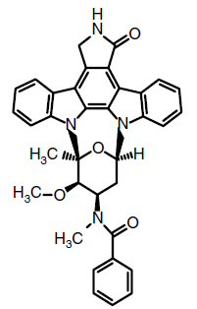
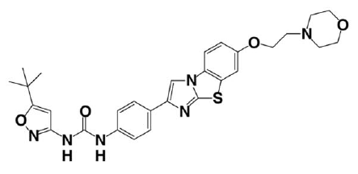
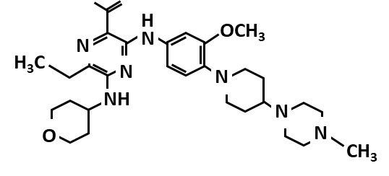
FDA Approved FLT3 Inhibitors for AML
First Generation
Second Generation
Midostaurin
Quizartinib
Gilteritinib
Type I FLT3 inhibitor: inhibits FLT3 ITD and TKD mutations
Type II FLT3 inhibitor: inhibits only FLT3 ITD mutations
Zhi. Int J Mol Sci. 2019;20:5739. Novatcheva. Clin Lymphoma Myeloma Leuk. 2022;22:e161.

Slide 13
AML Survival by FLT3 Mutation Type
OS by FLT3 Mutation Status in a
Study of German Patients¹
10-yr OS in a study of 1107 adult patients in the UK with AML and a median age of 42 yr²​
100
No FLT3 mutation (n = 125)
FLT3-TKD mutation (n = 28)
FLT3-ITD mutation (n = 67)
Mutation Status | Patients (n) | 10-yr OS, % | OR (95% CI)
FLT3-ITD | 257 | 24 | 0.53 (0.41-0.69) P <.001
FLT3-TKD | 100 | 51
FLT3-ITD/TKD | 27 | 37 | --
FLT3 WT | 723 | 36 | --
80
60
Survival Probability (%)
40
20
0
0
12
16
24
48
60
72
84
96
108
Mo
1. Fröhling. Blood. 2002;100:4372. 2. Mead. Blood. 2007;110:1262.

Slide 14
FLT3-ITD Affects Outcomes After Allogeneic HSCT
Adult patients with de novo AML and normal cytogenetics (n = 206) who underwent myeloablative allogeneic HSCT between 2000-2008¹
Patients had FLT3-ITD analysis available at diagnosis from the European Group for Blood and Marrow Transplantation
  Patients with FLT3-ITD mutations had a much higher relapse incidence than those without FLT3-ITD mutations (HR: 3.4; 95% CI: 1.46-7.94; P = .005)
A retrospective cohort study of 262 consecutive patients with AML who underwent allogeneic HSCT and had FLT3-ITD mutational testing²
P <.001
P = .334
P = .065
Estimated Event Rate at
3 Yr (%)
P <.05
In the context of allogeneic-HSCT, the presence of FLT3-ITD is correlated with poor outcomes
1. Brunet. JCO. 2012;30:735. 2. Song. Bone Marrow Transplant. 2016;51:511.

Slide 15
Impact of FLT3-ITD Allelic Ratio (FLT3-ITD/WT)
Prognosis is particularly poor for AML patients with a high FLT3-ITD/WT ratio
Outcome | FLT3-ITD/WT Allelic Ratio Quartile |  |  |  | P Value
 | Quartile 1 n = 81 | Quartile 2 n = 80 | Quartile 3 n = 81 | Quartile 4 n = 81
CR, % | 81.5 | 79.8 | 69.1 | 57.5 | .003
Resistant disease, % | 13.6 | 15.2 | 21.0 | 37.5 | .001
Median OS, yr | 2.19 | 2.15 | 1.20 | 0.90 | .0006
Median EFS, yr | 0.75 | 0.81 | 0.49 | 0.25 | .001
Schlenk. Blood. 2014;124:3441.

Slide 16
AML Risk by FLT3 Status in 2017 and 2022 ELN Risk Classifications
Risk Category | 2017¹ | 2022²
Favorable | Mutated NPM1 + FLT3-ITD^{low}
Intermediate | Mutated NPM1 + FLT3-ITD^{high} Wild-type NPM1 + FLT3-ITD^{low*} | Mutated NPM1 + FLT3-ITD Wild-type NPM1 + FLT3-ITD*
Adverse | Wild-type NPM1 + FLT3-ITD^{high}
FLT3-ITD^{low} allelic ratio (<0.5) and FLT3-ITD^{high} allelic ratio (≥0.5) are no longer relevant for risk stratification in 2022 classification
*Without adverse-risk genetic lesions.
1. Döhner. Blood. 2017;129:424. 2. Döhner. Blood. 2022;140:1345.

Slide 17
Real-world Data: Incidence of FLT3-ITD Mutations in AML Subtypes
Patients with newly diagnosed AML, admitted to Johns Hopkins adult leukemia service July 2021-June 2024
APL (7.6%)
FLT3-ITD: 24%
TP53/complex (16.3%)
FLT3-ITD: 3.7%
CBF (7.3%)
FLT3-ITD: 0%
MPN/AML (7.6%)
FLT3-ITD: 4.5%
MDS/AML (11.2%)
FLT3-ITD: 10.8%
FLT3 mutations are found in virtually every subtype of AML
AML, NOS (51.4%)
FLT3-ITD: 27.8%
Slide courtesy of Mark J. Levis, MD, PhD.

Slide 18
Guideline Recommendations for AML Molecular Testing
Preferred Sample
Method
Required
Recommended
AML
IDH1, IDH2, TET2, WT1, DNMT3A, and/or TP53 for prognosis and/or targeted therapy
Bone marrow
Peripheral
blood
FISH
Molecular genetics and/or NGS profile
FLT3-ITD, NPM1, CEBPA, RUNX1, KIT (when CBF AML is diagnosed) RUNX1::RUNX1T 1 or CBFB::MYH11
Test at diagnosis and progression/relapse
de Haas. JCO. 2018;37:239. NCCN. Acute myeloid leukemia. v2.2025. nccn.org.

Slide 19
Laboratory Testing for FLT3 Mutations
Internal tandem duplication (ITD) mutation
Tyrosine kinase domain (TKD) mutation
Detect by PCR
(Local diagnostic lab)
Detect by NGS
(Local diagnostic lab)
Companion assay
Turnaround time:
~3-5 days
Turnaround time:
~3-5 days
Turnaround time:
~1-3 wk

Slide 20
PCR Testing for FLT3-ITD Mutations
FLT3-wild type
330 bp
FLT3-ITD
375 bp
WT
ITD
Template bias results in reduced sensitivity
Size (bp)
330
375
Polz. Appl Environ Microbiol. 1998;64:3724. Murphy. J Mol Diagn. 2003;5:96.

Slide 21
Recommended Timelines for Initial AML Genetic Workup
Assessment | Timing
Cytogenetics* | Results preferably obtained within 5-7 days
Screening for gene mutations including (to establish diagnosis) FLT3,† IDH1, IDH2 (actionable therapeutic targets) NPM1 CEBPA,‡ DDX41, TP53; ASXL1, BCOR, EZH2, RUNX1, SF3B1, SRSF2, STAG2, U2AF1, ZRSR2 | Within 3-5 days Within first treatment cycle
Screening for gene rearrangements§ PML::RARA, CBFB::MYH11, RUNX1::RUNX1T1, KMT2A::R, BCR::ABL1, other fusion genes (if available) | Within 3-5 days
Additional genes recommended to test at diagnosis ANKRD26, BCORL1, BRAF, CBL, CSF3R, DNMT3A, ETV6, GATA2, JAK2, KIT, KRAS, NRAS, NF1, PHF6, PPM1D, PTPN11, RAD21, SETBP1, TET2, WT1 | Information can be used to monitor disease by NGS-based MRD analyses (except mutations consistent with premalignant clonal hematopoiesis)
*In case of no analyzable metaphases, fluorescence in situ hybridization is alternative method to detect genetic abnormalities such as RUNX1::RUNX1T1, CBFB::MYH11, KMT2A::R, and MECOM::R or myelodysplasia-related chromosome abnormalities (eg, loss of chromosome 5q, 7q, or 17p material).
†FLT3 mutational screening should include analysis of internal tandem duplications and tyrosine kinase domain mutations.
‡Report should specify type of mutation: Only in-frame mutations affecting basic leucine zipper region of CEBPA, irrespective whether they occur as monoallelic or biallelic mutations, have been associated with favorable outcome.
§Screening for gene rearrangements should be performed if rapid information is needed for recommendation of suitable therapy, if chromosome morphology is of poor quality, or if there is typical morphology but suspected cytogenetic abnormality is not present.
Döhner. Blood. 2022;140:1345.

Slide 22
Key Takeaways on Molecular Testing
Ensure adequate amounts of leukemia (blasts) in sample
Do not wait until patient is aplastic
Test results within a week
Ensure that testing method(s) can identify both FLT3-ITD and relevant FLT3-TKD mutations

Slide 23
Repeat FLT3 Mutation Testing Is Needed at Relapse
Differential sensitivity
Leukemia is not a static condition!
Repeat genomic analysis at relapse is necessary
Chemotherapy
Chemotherapy-induced mutagenesis
Kleppe. Nat Med. 2014;20:342. Grimwade. Blood. 2016;127:29.

Slide 24
New Frontiers in FLT3+ AML: Therapeutic Advances in FLT3 Inhibitor Therapy

Slide 25
FLT3 Inhibitors in Clinical Use for AML
Drug | Sorafenib | Midostaurin | Gilteritinib | Quizartinib
Chemical name | BAY43-9006 | PKC412 | ASP2215 | AC220
Generation | 1 | 1 | 2 | 2
Class type | II | I | I | II
Other targets | RAF, RET, KIT, VEGFR, PDGFR | PKC, KDR, KIT, VEGFR, PDGFR | AXL, LTK, ALK | KIT
FLT3 kinase inhibition IC₅₀ | 58 | 6.3 | 0.29 | 1.6
Dose | 400 mg BID | 50 mg BID | 120 mg QD | 60 mg QD
Major therapeutic use and approval (if applicable) | Monotherapy for posttransplant maintenance in FLT3-ITD AML (off-label) | In combination with std CT for ND FLT3-mutated AML | Monotherapy for R/R FLT3-mutated AML | In combination with std CT and as maintenance for ND FLT3-ITD AML
Major trial supporting therapeutic use | SORMAIN | RATIFY | ADMIRAL | QuANTUM-R
Notable toxicities | Fatigue, hypertension, diarrhea, rash, hand–foot syndrome | Severe cytopenias, N/V | Diarrhea, pancreatitis, peripheral neuropathy, headache | Severe cytopenias, QTc prolongation, nausea
Zhao. Blood Rev. 2021;52:100905. Midostaurin PI. Gilteritinib PI. Quizartinib PI.

Slide 26
Different Toxicity Profiles of FLT3 Inhibitors
Midostaurin
GI (diarrhea, N/V)
Fatigue
Infection
Pulmonary toxicities
Quizartinib
QTc prolongation
GI (diarrhea, N/V)
Myelosuppression
Toxicity Profiles
Gilteritinib
Myelosuppression
Liver toxicity
Infection
GI
Sorafenib
Hand–foot skin reaction
GI (diarrhea, nausea)
Infection, rash
Quizartinib PI. Midostaurin PI. Sorafenib PI. Gilteritinib PI. Wang. JCO. 2024;42:1776.

Slide 27
RATIFY: Midostaurin + Chemotherapy for FLT3-Mutated AML
Prospective, double-blind, placebo-controlled, randomized phase III trial
Stratified by ITD/TKD
Induction*
(1-2 Cycles)
Consolidation
(Up to 4 Cycles)
Maintenance
(12 Cycles)
7 + 3 (Cytarabine Daunorubicin) +
Midostaurin 50 mg PO BID Days 8-21
(n = 360)
High-Dose Cytarabine +
Midostaurin 50 mg PO BID Days 8-21
(n = 231)
Midostaurin 50 mg PO BID Days 1-28
(n = 120)
Patients ages 18-59 yr with previously untreated,
newly diagnosed,
FLT3-mutated AML
(N = 717)
CR
7 + 3 (Cytarabine Daunorubicin) +
Placebo
Days 8-21
(n = 357)
High-Dose Cytarabine +
Placebo
Days 8-21
(n = 210)
Placebo
Days 1-28
(n = 85)
CR
*Hydroxyurea allowed for 5 days prior to induction therapy.
Primary endpoint: OS (not censored for HCT)
Key secondary endpoints: EFS, OS (censored for HCT), CRR, DFS
Stone. NEJM. 2017;377:454.

Slide 28
RATIFY: Efficacy Data
Median Overall Survival
Posttransplant Outcomes
 | Mido SCT Outside CR1 | Mido SCT in CR1 | Pbo SCT Outside CR1 | Pbo SCT in CR1
Median survival, mo (95% CI) | 14.8 (9.1-31.6) | NE (69.8-NE) | 14.4 (10.0-22.7) | NE (21.8-NE)
 | Midostaurin (n = 360) | Placebo (n = 357)
mOS, mo (95% CI) | 74.7 (31.5-NR) | 25.6 (18.6-42.9)
CR, n (%) | 212 (59) | 191 (54)
 | P = .15
100
100
80
80
60
7.1% difference in 4-yr OS
60
Probability of Survival (%)
Proportion Survival
40
40
MIDO SCT outside CR1
MIDO SCT in CR1
PBO SCT outside CR1
PBO SCT in CR1
Midostaurin
Placebo
20
20
0
0
0
12
24
36
48
60
72
80
0
12
24
36
48
60
72
84
90
Patients at Risk, n
MIDO SCT Outside CR1
MIDO SCT in CR1
PBO SCT Outside CR1
PBO SCT in CR1
Mo
Patients at Risk, n
Midostaurin
Placebo
Mo
112
101
115
81
49
71
47
50
36
63
37
45
5
21
13
12
0
0
0
0
360
357
269
221
208
163
181
147
151
129
97
80
37
30
1
1
Best outcomes: Mido/7+3 followed by SCT in CR1
However, placebo/7+3 also benefited from SCT in CR1
Stone. NEJM. 2017;377:454.

Slide 29
QuANTUM-First: Quizartinib + 7+3 for FLT3-ITD AML
Double-blind, placebo-controlled, randomized phase III trial
Primary endpoint: OS
Secondary endpoints: EFS, CR/CRc, safety
Exploratory endpoints: RFS, DoCR
Stratified by region, patient age, WBC count
Induction
(Up to 2 Cycles)*
Consolidation
(Up to 4 Cycles)
Continuation
(Up to 36 Cycles)
Quizartinib 40 mg Days 8-21 +
Cytarabine Days 1-7 +
Daunorubicin or Idarubicin Days 1-3
(n = 268)
HiDAC +
Quizartinib 40 mg
and/or allo-HCT†
Quizartinib
30 mg, then 60 mg once daily
Patients aged 18-75 yr with newly diagnosed FLT3-ITD+ AML (≥3% FLT3-ITD allelic frequency); no APL with t(15;17); no BCR-ABL1+ leukemia; no AML secondary to previous CT or RT;
ECOG PS 0-2
(N = 539)
CR
Placebo Days 8-21 +
Cytarabine Days 1-7 +
Daunorubicin or Idarubicin Days 1-3
(n = 271)
HiDAC +
Placebo
and/or allo-HCT†
Placebo
once daily
CR
*For persistent leukemia, patients could receive second induction cycle with 7+3 or 5+2 plus quizartinib/placebo started on Day 8 or Day 6, respectively. †Per institutional policy.
Erba. Lancet. 2023;401:1571.

Slide 30
QuANTUM-First: OS (Primary Endpoint)
1.0
Median OS, Mo
Quizartinib 31.9
Placebo 15.1
0.8
HR: 0.78 (95% CI: 0.62-0.98; 2-sided P = .032)
0.6
OS Probability
0.4
∆mOS: 16.8 mo
0.2
Median follow-up: 39.2 mo
0
0
3
6
9
12
15
18
21
24
27
30
33
36
39
42
45
48
51
54
57
60
Mo
On July 20, 2023, FDA approved quizartinib for adults with newly diagnosed AML that is FLT3 ITD+ in combination with standard
cytarabine and anthracycline induction and cytarabine consolidation and as maintenance monotherapy after consolidation CT.
Erba. Lancet. 2023;401:1571. Quizartinib PI.

Slide 31
QuANTUM-First MRD Analysis: Association
Between FLT3-ITD MRD Decrease Over Time and OS
Time Point During Treatment | Median OS, Mo |  |  |  | FLT3-ITD VAF, %
Time Point During Treatment | MRD Cutoff: 10⁻⁴ |  | MRD Cutoff: 0 |  | MRD Cutoff: 0
 | MRD-* | MRD+* | MRD-* | MRD+* | Quiz | Pbo
CRc after induction (1-2 cycles) | NR (n = 138) | 29.4 (n = 183) | NR (n = 53) | 48.6 (n = 268) | 22.8 (n = 37) | 11.9 (n = 19)
 | HR: 0.562 (95% CI: 0.398-0.794) |  | HR: 0.722 (95% CI: 0.450-1.159) |  | P = .0122
CRc after 2 chemotherapy cycles (2 induction or 1 induction and 1 consolidation) | NR (n = 162) | 21.9 (n = 166) | NR (n = 83) | 40.4 (n = 245) | 31.7 (n = 52) | 21.7 (n = 35)
 | HR: 0.525 (95% CI: 0.376-0.731) |  | HR: 0.626 (95% CI: 0.419-0.935) |  | P = .0609
CRc after last consolidation cycle (up to 4 cycles) | NR (n = 218) | 14.8 (n = 119) | NR (n = 154) | 26.2 (n = 183) | 55.8 (n = 96) | 41.2 (n = 68)
 | HR: 0.458 (95% CI: 0.332-0.633) |  | HR: 0.470 (95% CI: 0.334-0.661) |  | P = .0089
*Combined quizartinib and placebo arms.
Across treatment course, quizartinib was more effective at eliminating detectable FLT3-ITD MRD
Perl. COSTEM 2024.

Slide 32
QuANTUM-First: QT Prolongation and
Select Cardiac AEs
Event | Quizartinib (n = 265) | Placebo (n = 268)
QTcF interval by central ECG data (ms), %
New >450 ms | 34.3 | 17.9
New >480 ms | 7.5 | 2.2
New >500 ms | 2.3 | 0.7
QTcF increase from baseline >30 ms | 55.1 | 32.5
QTcF increase from baseline >60 ms | 10.2 | 4.9
Select cardiac TEAEs, %
ECG QT prolonged | 13.6 | 4.1
Cardiac arrest/ventricular fibrillation | 0.8 | 0
Ventricular tachycardia | 0.4 | 0.4
2 patients (0.8%) who received quizartinib had cardiac arrest (grade 4, n = 1; grade 5, n = 1), with recorded ventricular fibrillation in setting of severe hypokalemia; 1 patient (0.4%) who received quizartinib died in sleep; 2 patients (0.8%) discontinued quizartinib due to QT prolongation
Erba. Lancet. 2023;401:1571. Erba. EHA 2022. Abstr S100.

Slide 33
FLT3 TKIs for Patients with FLT3-Mutated Newly Diagnosed AML Aged <60 Yr
FLT3-ITD mut AML: Quizartinib/7+3¹
FLT3-ITD/TKD mut AML: Midostaurin/7+3²
 | Quizartinib (n = 161) | Placebo (n = 162)
Events, n (%) | 63 (39.1) | 83 (51.2)
mOS, mo (95% CI) | NR (NE-NE) | 23.0 (13.0-NE)
 | Midostaurin (n = 360) | Placebo (n = 357)
mOS, mo (95% CI) | 74.7 (31.5-NR) | 25.6 (18.6-42.9)
100
100
80
80
60
60
OS Probability (%)
OS Probability (%)
40
40
Age 20-59 yr, FLT3-ITD mut,
Quiz maint up to 3 yr
Age 18-59 yr, FLT3-ITD/TKD mut,
Mido maint up to 1 yr
20
20
0
0
0
3
6
9
12
15
18
21
24
27
30
33
36
39
42
45
48
51
54
57
60
0
12
24
36
48
60
72
84
90
Patients at Risk, n
Quizartinib
Placebo
Mo
Patients at Risk, n
Midostaurin
Placebo
Mo
161
162
145
150
134
128
120
108
111
90
104
83
103
79
101
77
97
75
90
65
81
58
69
53
60
48
48
37
37
25
24
20
15
11
4
4
3
2
1
0
0
0
360
357
269
221
208
163
181
147
151
129
97
80
37
30
1
1
1. Erba. Lancet. 2023;401:1571. 2. Stone. NEJM. 2017;377:454.

Slide 34
What is the Best Therapy for Any Patient With
FLT3-Mutated AML?
FLT3i + Ven + HMA¹
Midostaurin/7+3²
 | FLT3i + Ven + LIC (n = 27) | FLT3i + LIC (n = 60)
mOS, mo | NR | 9.5
Median age, yr (range) | 69 (40-85) | 71 (51-83)
 | Midostaurin (n = 360) | Placebo (n = 357)
mOS, mo (95% CI) | 74.7 (31.5-NR) | 25.6 (18.6-42.9)
1.0
100
0.8
80
Median OS: NR
P < .01
0.6
60
OS
Probability of Survival (%)
0.4
FLT3i + Ven + LIC
FLT3i + LIC
40
Midostaurin
Placebo
0.2
20
0
0
0
6
12
18
24
30
36
42
48
54
60
66
72
0
12
24
36
48
60
72
84
90
Mo
Mo
1. Yilmaz. Blood Cancer J. 2022;12:77. 2. Stone. NEJM. 2017;377:454.

Slide 35
ADMIRAL: Gilteritinib in FLT3-Mutated R/R AML
International, controlled, randomized phase III trial
Stratified by response to previous therapy, chosen salvage chemotherapy*
Gilteritinib
120 mg/day
(n = 247)
HSCT
(n = 63)
Gilteritinib
120 mg/day
(n = 38)
Coprimary endpoints: OS, CR/CRh
Secondary endpoints: EFS, CR
Adults with FLT3-mutant AML refractory to initial induction or in first relapse after prior CR/CRi/CRp; ECOG PS ≤2; normal liver and renal function; prior frontline midostaurin or sorafenib allowed, but no other prior
FLT3 inhibitors
(N = 371)
Salvage Chemotherapy*
(n = 124)
HSCT
(n = 19)
*Salvage chemotherapy selected prior to randomization: MEC or FLAG-IDA (high intensity) for 1-2 cycles; low-dose cytarabine or azacitidine (low intensity) administered until intolerance or other discontinuation criteria.
Perl. NEJM. 2019;381;1728. Perl. Blood 2022;139:3366.

Slide 36
ADMIRAL: Gilteritinib Prolongs OS in FLT3-Mutated
R/R AML
OS Rate, % | Gilteritinib (n = 247) | Salvage CT (n = 124)
1 yr | 36.6 | 19.2
2 yr | 20.6 | 14.2
3 yr | 15.8 | 10.4
100
80
60
Median OS, Mo
9.3
5.6
OS (%)
Gilteritinib
Salvage chemotherapy
40
HR: 0.665 (95% CI: 0.518-0.853; P = .0013)
+ Censored
20
0
0
3
6
9
12
15
18
21
24
27
30
33
36
39
42
45
48
51
54
57
Patients at Risk, n
Mo
Gilteritinib
Salvage chemotherapy
247
124
206
84
158
52
121
34
87
20
73
18
63
15
52
14
49
14
41
11
38
10
34
7
22
7
18
1
10
1
6
0
4
0
2
0
1
0
0
0
Perl. Blood 2022;139:3366.

Slide 37
ADMIRAL: OS Based on Prior TKI
Tx Arm | Median OS, Mo (95% CI)
Gilteritinib with prior TKI | 8.7 (4.6-10.8)
Gilteritinib without prior TKI | 9.5 (7.7-11.0)
Salvage CT with prior TKI | 5.1 (1.6-7.8)
Salvage CT without prior TKI | 6.1 (4.7-7.4)
1.0
0.8
0.6
Survival Probability
0.4
0.2
0
Patients at Risk, n
Gilteritinib with prior TKI
Gilteritinib without prior TKI
Salvage CT with prior TKI
Salvage CT without prior TKI
0
3
6
9
12
15
18
21
24
27
30
33
36
Mo
33
214
15
109
28
178
10
74
19
138
5
47
10
96
2
27
6
58
1
12
4
40
1
11
4
27
1
7
2
12
1
6
2
9
1
4
0
4
1
2
0
1
0
1
0
0
0
0
0
0
0
0
Perl. Blood Cancer J. 2022;12:84.

Slide 38
ADMIRAL: Post-SCT Survival With Gilteritinib
Gilteritinib Arm Patients Who Were Without Relapse for 60 Days After HSCT
100
 | Median OS, Mo (95% CI)
Resumed gilteritinib | NE (10.6-NE)
Did not resume gilteritinib | 10.1 (2.8-19.3)
80
Censored
HR: 0.417 (95% CI: 0.197-0.883)
60
Survival Probability
40
20
0
Patients at Risk, n
Resumed gilteritinib
Did not resume gilteritinib
2
5
8
11
14
17
20
23
26
29
32
35
38
41
44
47
50
53
56
Time From HSCT (Mo)
36
17
34
12
30
10
28
9
23
7
23
6
20
5
20
3
20
3
17
3
13
2
10
1
7
1
4
0
2
0
2
0
1
0
0
0
0
0
26% (64/247) of patients treated with gilteritinib proceeded to HSCT
63% of patients in the gilteritinib arm resumed gilteritinib after transplant per protocol
Perl. Transplant Cell Ther 2023. 29(4):265.e1.

Slide 39
SORMAIN: Sorafenib Maintenance After AlloSCT in FLT3-ITD AML
International, double-blind, randomized phase II trial
Sorafenib 2 x 400 mg QD* for 24 mo
(n = 43)
Patients with FLT3-ITD+ AML who underwent alloHSCT; within
60-100 days post transplant;
in CHR with normal PB; ECOG PS 0/1; no grade 2-4 GvHD
(N = 83)
Follow-up
Placebo QD for 24 mo
(n = 40)
*Starting dose of 2 x 200 mg, increased every 14 days up to 2 x 400 mg as tolerated.
Primary endpoint: RFS rate, where RFS events were death from any cause or relapse of AML
Secondary endpoints: OS; RFS and OS in patients with NPM1-mutated vs wild-type disease; RFS and OS by FLT3-ITD ratio; safety; biomarker analysis
Burchert. JCO. 2020;38:2993.

Slide 40
SORMAIN: RFS and OS
RFS
OS
Censored +
Log-rank P = .013
HR: 0.39 (95% CI: 0.18-0.85)
Censored +
Log-rank P = .0855
HR: 0.516 (95% CI: 0.239-1.112)
100
Sorafenib
Placebo
100
Sorafenib
Placebo
80
80
60
60
RFS (%)
OS Probability (%)
40
24-Mo RFS
Sorafenib: 85.0% (95% CI: 70%-93%)
Placebo: 53.3% (95% CI: 36%-68%)
Log-rank P = .002
HR: 0.256 (95% CI: 0.10-0.65)
40
24-Mo OS
Sorafenib: 90.5% (95% CI: 77%-96%)
Placebo: 66.2% (95% CI: 49%-79%)
Log-rank P = .007
HR: 0.241 (95% CI: 0.08-0.74)
20
20
0
0
0
10
20
30
40
50
0
20
40
60
80
100
Mo
Mo
Median f/u: 41.8 mo
mRFS (sorafenib vs placebo): NR vs 30.9 mo
Median f/u: 55.1 mo
mOS NR in either treatment arm
Burchert. JCO. 2020;38:2993.

Slide 41
Sorafenib Maintenance in FLT3-ITD+ AML
After AlloSCT: 5-Yr Follow-up
Cumulative Incidence of Relapse
100
Open-label, randomized phase III trial at
7 hospitals in China comparing sorafenib 400 mg twice daily vs placebo at 30-60 days post transplant (N = 202)
Most common AEs: infection, GvHD, hematologic toxicities
80
Sorafenib
Placebo
60
5-yr HR: 0.33 (95% CI: 0.18-0.60; P = .0003)
Cumulative Incidence
of Relapse (%)
40
+
+
+
+
+
+
+
+
+
+
+
+
+
+
+
+
+
+
+
+
+
+
+
+
+
+
+
+
+
+
+
+
+
+
20
+
+
+
+
+
+
+
+
+
+
+
+
+
+
+
+
+
+
+
+
+
+
+
+
+
+
+
+
+
+
+
+
+
+
+
+
+
+
+
0
0
20
40
60
80
Overall Survival
Mo Since Transplant
100
Sorafenib
Placebo
Leukemia-Free Survival
100
+
+
+
+
+
+
+
+
+
+
+
+
80
+
+
+
+
+
+
+
+
+
+
+
+
+
+
+
+
+
+
+
+
+
+
+
+
+
+
+
+
+
+
+
+
+
+
+
+
+
+
+
+
+
+
+
+
80
+
+
+
+
+
+
+
+
+
+
+
+
+
+
+
+
+
+
+
+
+
+
+
+
+
+
+
+
+
+
+
+
+
+
+
+
+
+
+
+
+
+
+
+
+
+
60
+
+
+
+
+
+
+
+
+
+
+
+
+
+
+
+
+
+
+
+
+
+
+
+
+
+
+
+
+
+
+
+
+
+
+
+
+
60
+
+
+
+
+
+
+
+
+
+
+
+
+
+
+
+
+
+
+
+
+
+
+
+
+
+
+
+
+
+
+
+
+
+
+
Overall Survival (%)
+
40
Leukemia-Free Survival (%)
40
Sorafenib
Placebo
20
20
5-yr HR: 0.55 (95% CI: 0.34-0.88; P = .011)
5-yr HR: 0.47 (95% CI: 0.30-0.73; P = .0007)
0
0
0
20
40
60
80
0
20
40
60
80
Mo Since Transplant
Mo Since Transplant
Xuan. Lancet Oncol. 2020; 21:1201-12. Xuan. Lancet Hematol. 2023;10:600.

Slide 42
MORPHO: Gilteritinib vs Placebo as
Post-transplant Maintenance in FLT3-ITD+ AML
Multicenter, double-blind, placebo-controlled, randomized phase III trial
Primary endpoint: RFS
Key secondary endpoints: OS, EFS, GVHD incidence, safety, nonrelapse mortality
Stratified by conditioning regimen (myeloablative vs reduced intensity, time to transplant [30-60 days vs 61-90 days]), MRD ≥10⁻⁴ (presence or absence at registration)
24 mo
Gilteritinib 120 mg/day
Adults with FLT3-ITD+ AML with CR1
(N = 356)
Marrow samples for MRD analysis were collected pretransplant, prerandomization, and at 3, 6, 12, 18, and 24 mo postrandomization.
AlloHSCT*
Placebo
*Subjects in CR1 ≥30 to ≤90 days after alloHSCT with stable engraftment and without active grade II-IV acute GvHD
went on to randomization.
Levis. JCO. 2024;42:1766.

Slide 43
MORPHO: Safety
Grade ≥3 Adverse Event, n (%) | Gilteritinib (n = 178) | Placebo (n = 177) | Total (n = 355)
Hematologic
Neutrophil count decreased | 64 (36) | 23 (13) | 87 (24.5)
Platelet count decreased | 38 (21.3) | 20 (11.3) | 58 (16.3)
Anemia | 17 (9.6) | 14 (7.9) | 31 (8.7)
WBC count decreased | 18 (10.1) | 3 (1.7) | 21 (5.9)
Nonhematologic
ALT increased | 11 (6.2) | 8 (4.5) | 19 (5.4)
AST increased | 11 (6.2) | 6 (3.4) | 17 (4.8)
Hypertension | 11 (6.2) | 6 (3.4) | 17 (4.8)
Creatine phosphokinase increased | 14 (7.9) | 1 (0.6) | 15 (4.2)
Levis. JCO. 2024;42:1766.

Slide 44
MORPHO: RFS (Primary Endpoint)
1.0
0.8
RFS: Overall
RFS
MRD+
0.6
1.0
Probability of Survival
Events/N
26/89
43/91
0.4
Gilteritinib
Placebo
0.8
0.2
HR (95% CI): 0.515 (0.316-0.838; P = .0065)
0.6
0
0
12
24
36
48
60
72
Probability of Survival
Events/N
45/178
58/178
Mo
0.4
Gilteritinib
Placebo
1.0
0.8
0.2
HR (95% CI): 0.679 (0.459-1.005;
P = .0518)
RFS
MRD-
0.6
0
Probability of Survival
Events/N
19/89
15/87
0
12
24
36
48
60
72
0.4
Gilteritinib
Placebo
Mo
0.2
P = .5750
0
0
12
24
36
48
60
72
Mo
Levis. JCO. 2024;42:1766.

Slide 45
MORPHO: Impact of MRD on OS Regardless of
Treatment Arm Based on MRD6 Pre-SCT or Post-SCT
1.0
0.8
0.6
Probability Survival
MRD-
MRD+
0.4
Outcome | MRD- | MRD+ | HR (95% CI) | P Value
Events, n/N | 31/176 | 55/180 | 0.514 (0.331-0.798) | .0025
0.2
0
0
12
24
36
48
60
72
Mo
Levis. JCO. 2024;42:1766.

Slide 46
Clonal Evolution of FLT3-ITD–Mutant AML After Midostaurin
Midostaurin (n = 54)
D
R
32%
22%
46%
Identical FLT3-ITD clones at D/R
FLT3-ITD insertion site not available
Loss FLT3-ITD clones at R
Switch FLT3-ITD clones at R
Gain FLT3-ITD clones at R
FLT3-ITD negative at R
*
Control (n = 21)
 |  |  |  |  |  | * | * | * | *
D
R
48%
33%
19%
Schmalbrock. Blood. 2021;137:3093.

Slide 47
Survival Decreases With Sequential FLT3i-Based Therapy
Frontline Cohort (n = 96)
Salvage Cohort (n = 301)
1.0
1.0
Treatment Regimen
1st FLT3i
2nd FLT3i
3rd FLT3i
N = 96
56
32
8
Median OS
16.7 m
6.0 m
1.4 m
Treatment Regimen
1st FLT3i
2nd FLT3i
3rd FLT3i
N = 301
183
89
29
Median OS
7.9 m
4.0 m
4.1 m
0.8
0.8
0.6
0.6
OS
OS
P < .001
P < .001
0.4
0.4
0.2
0.2
0
0
0
12
24
36
48
60
0
12
24
36
48
Mo
Mo
Yilmaz. J Hematol Oncol. 2020;13:132.

Slide 48
FLT3 Mutations Associated With FLT3 Inhibitor Resistance
FLT3 Inhibitor | Class, Type | Mutation/Amino Acid Change
Midostaurin | First generation; type 1 | N676K 672E N676D F691L, G697R N676I, N676S, F691L
Sorafenib | First generation; type 2 | F691L A627P D835H D835V/F/I/del/Y/A F691I, Y842N Y842C
Quizartinib | Second generation; type 2 | F691L A627P D835V/F/I/del/Y D835H Y842C/H
Gilteritinib | Second generation, type 1 | F691L
FLT3 F691L mutation confers resistance to almost all known TKIs
Type 2 inhibitors (Sor, Quiz)
≥ FLT3 D835 TKD variants
Staudt. Int J Mol Sci. 2018;19:3198.

Slide 49
Optimizing FLT3 Inhibitors: Strategies for Early Detection and Management of Adverse Events

Slide 50
FLT3 Inhibitor Combination Therapy in FLT3-Mutated AML
Midostaurin and quizartinib are approved in the frontline setting in combination with intensive chemotherapy
Gilteritinib is approved as monotherapy in the R/R setting
Combination regimens (eg, with chemotherapy, venetoclax, or hypomethylating agents) are associated with increased myelosuppression, particularly in investigational triplet combinations
Regimen design should account for potential toxicities and may require ongoing adjustments to dose, schedule, or drug selection to maintain safety and tolerability
Midostaurin PI. Quizartinib PI. Gilteritinib PI. Wang. Blood. 2022;140:1845.
Erba. Lancet. 2023;401:1511. Short. JCO. 2024;42:1499.

Slide 51
Safety of FLT3 Inhibitors in AML
 | Midostaurin^{1,2} | Quizartinib^{3,4} | Gilteritinib^{5,6}
Trial | Phase III RATIFY | Phase III QuANTUM-First | Phase III ADMIRAL
Setting | Newly diagnosed FLT3-ITD AML | Newly diagnosed FLT3-ITD AML | R/R FLT3-ITD AML
Regimen | Midostaurin vs placebo + standard chemotherapy induction and consolidation | Quizartinib vs placebo + standard chemotherapy induction and consolidation, followed by continuation monotherapy | Gilteritinib vs salvage chemotherapy
Boxed Warnings | None | QT prolongation, torsades de pointes, and cardiac arrest (REMS Program) | Differentiation syndrome
Warnings/Precautions | Embryo-fetal toxicity Pulmonary toxicity (interstitial lung disease or pneumonitis) | Embryo-fetal toxicity QT prolongation, torsades de pointes, and cardiac arrest | Embryo-fetal toxicity PRES Prolonged QT interval Pancreatitis
Most Common Grade ≥3 AEs | Hematologic Thrombocytopenia (97% vs 97%) Neutropenia (95% vs 96%) Anemia (93% vs 88%) Febrile neutropenia (82% vs 82%) Nonhematologic Infection (52% vs 50%) Lymphopenia (19% vs 22%) | Hematologic Febrile neutropenia (43% vs 41%) Neutropenia (18% vs 9%) Thrombocytopenia (8% vs 10%) Nonhematologic Hypokalemia (19% vs 16%) Pneumonia (11% vs 11%) | Hematologic Febrile Neutropenia (46 % vs 37%) Anemia (41% vs. 30%) Thrombocytopenia (23% vs 17%) Nonhematologic Increased AST (15% vs 2%) Increased ALT (14% vs 5%) Hypokalemia (13% vs 11%)
1. Midostaurin PI. 2. Stone. NEJM. 2017;377:454. 3. Quizartinib PI. 4. Erba. Lancet. 2023;401:1571. 5.Gilteritinib PI. 6. Perl. NEJM. 2019;381:1728.

Slide 52
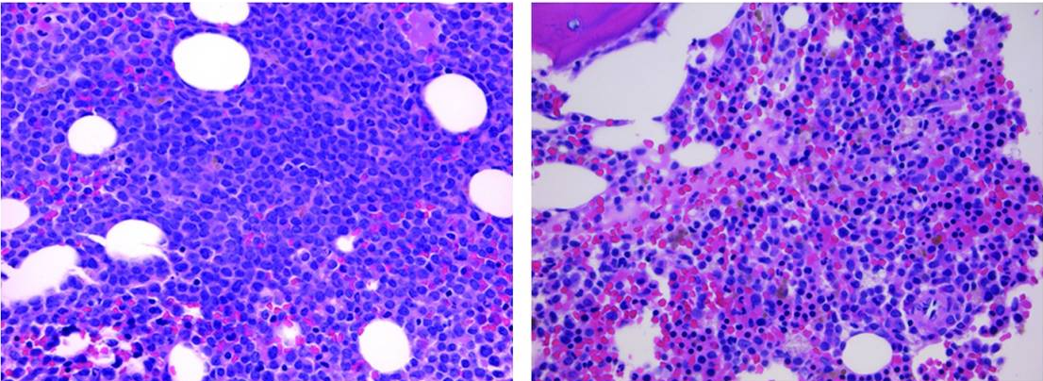
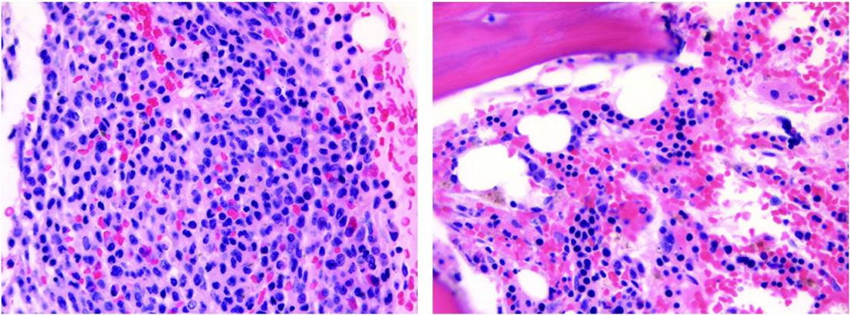
FLT3 Inhibitor–Associated Differentiation Syndrome
Rapid clearance of peripheral blasts, with reduction in marrow blast taking weeks to months
  Despite clinical response, many patients remain transfusion dependent with variable count recovery
Bone marrow remains cellular with granulocytic hyperplasia and stable FLT3-ITD allele burden, suggesting differentiation rather than cytotoxic clearance
Incidence may be higher in patients with concurrent NPM1 and/or DNMT3A mutations.
Risk of differentiation syndrome, particularly during the first 1-3 mo of single-agent therapy
Pre Gilteritinib
Post Gilteritinib
Differentiation Response
No Differentiation
McMahon. Blood Adv. 2019;3:1581. Levis. Blood Adv. 2020;4:1178. Gilteritinib PI.

Slide 53
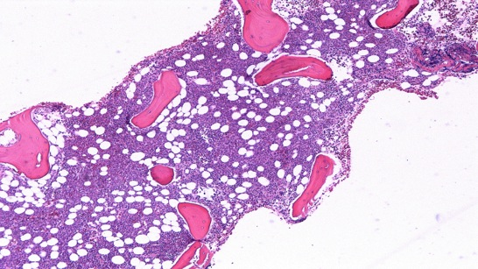
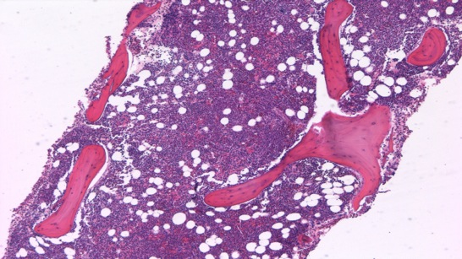
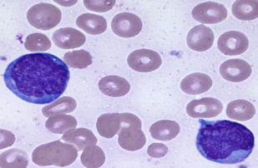
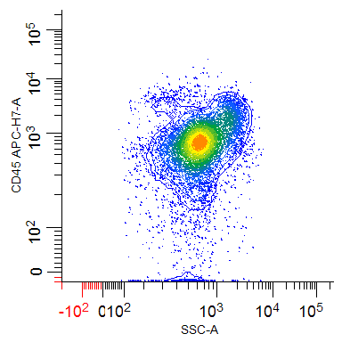
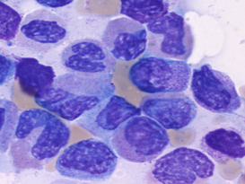
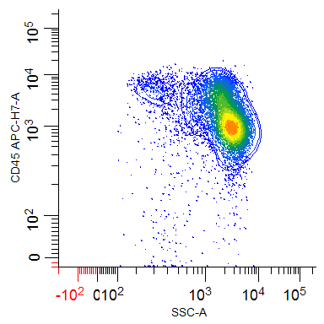
Differentiation Response in the Bone Marrow
Baseline
Best Response (Day 29)
50x
50x
80% blasts
<5% blasts
CD45 APC
CD45 APC
1000x
1000x
FLT3-ITD:WT = 0.45
FLT3-ITD:WT = 0.56
SSC-A
SSC-A
Nybakken. Leukemia. 2016;30:1422.

Slide 54
Managing Differentiation Syndrome During Gilteritinib Therapy
Onset is variable: Typically occurs 3-8 weeks after gilteritinib initiation but rarely can occur prior to or later than this time frame.
Monitor for fever, dyspnea, pleural effusion, pericardial effusion, pulmonary edema, hypotension, rapid weight gain, peripheral edema, rash, and renal dysfunction.
If differentiation syndrome is suspected, initiate systemic corticosteroids + hemodynamic monitoring. Continue steroids
≥3 days and taper after symptom resolution.
Interrupt gilteritinib if grade ≥3 symptoms persist >48 hr despite steroids. Resume when symptoms improve to grade ≤2.
Gilteritinib PI. Issa. Blood. 2025;145:1251.

Slide 55
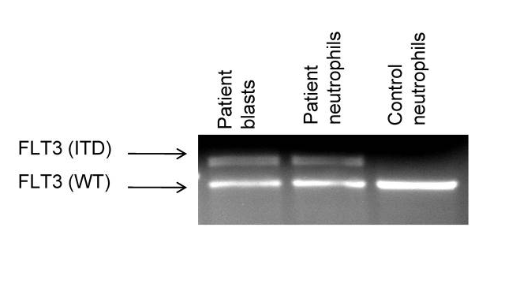
FLT3 Inhibitor–Associated Neutrophilic Dermatosis
Neutrophilic dermatosis during response to FLT3 inhibitor therapy
  Manifestation of differentiation of the leukemic blasts to neutrophils
  Biopsies show neutrophils are clonal and contain FLT3 mutations, which is not observed prior to therapy
  Management can include topical or systemic corticosteroids, depending on severity of symptoms and associated symptoms
Genomic DNA from pretreatment blasts, Day 60 neutrophils, and healthy donor neutrophils was analyzed by PCR for the FLT3-ITD mutation
Sexauer. Blood. 2012;120:4205. Varadarajan. JAMA Dermatol. 2016;152:480.

Slide 56
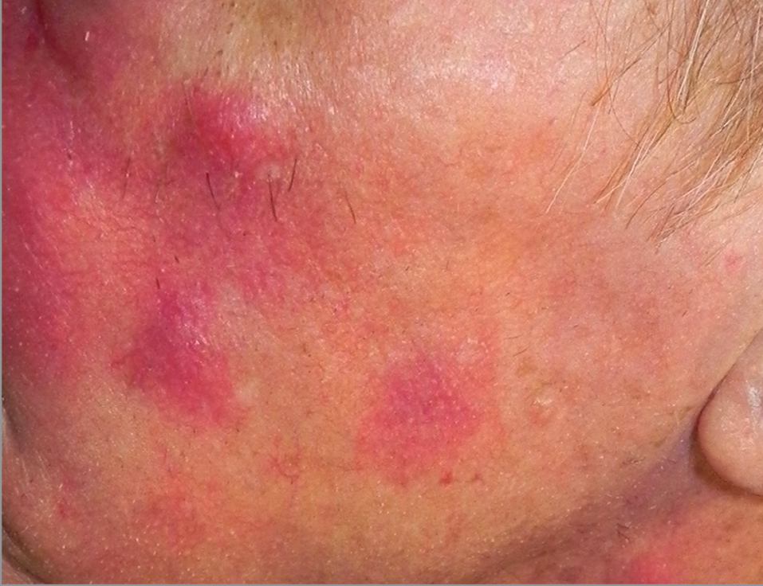

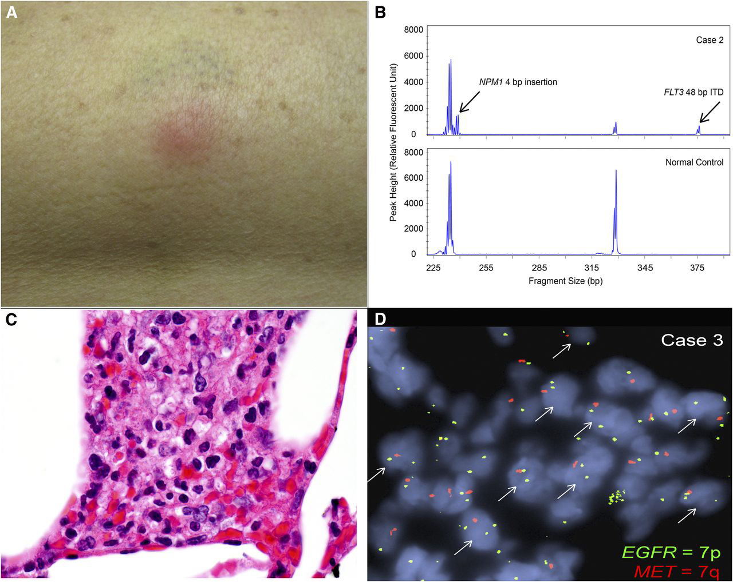
Clinical and Pathologic Findings in FLT3 Inhibitor–Associated Neutrophilic Dermatoses
Patient with R/R FLT3-ITD+ erythroleukemia started on gilteritinib monotherapy¹
After 2 mo, developed pustulonodules on face (A)
  Biopsy showed neutrophilic infiltrate + atypical mononuclear cells (B)
  Improved with topical steroids
Patient with R/R FLT3-ITD/NPM1-mutant AML started on quizartinib^{*2}
At Wk 6, developed pulmonary nodules and tender thigh lesion (C)
  Biopsy showed dermal and subcutaneous lobular neutrophilic infiltration (D)
  Skin nodule resolved rapidly with oral dexamethasone
A
B
C
D
Quizartinib is not FDA approved for use in the R/R setting.
1. Varadarajan. JAMA Dermatol. 2016;152:480. 2. Fathi. Blood. 2013;122:239.

Slide 57
QT Interval Prolongation With FLT3 Inhibitors
QT prolongation is a class effect of FLT3 inhibitors via the rapid delayed rectifier potassium current (I_{kr})
Quizartinib also inhibits the slow delayed rectifier potassium current (I_{ks})
  I_{ks} inhibition may further increase ventricular arrhythmia risk; FDA requires a REMS program
QT prolongation during quizartinib therapy is dose dependent*
  Compared with single agent maintenance, lower quizartinib doses are used during induction and consolidation
Trial | 2689-CL-2004 |  | AC220-002 (Cohort 2)
Quizartinib dose | 30 mg/day† | 60 mg/day | 90 mg/day | 135 mg/day | 200 mg/day
Maximum Value of QTcF (msec)
450 to ≤480 | 42% | 47% | 35% | 48% | 25%
>480 to ≤500 | 5% | 14% | 21% | 13% | 33%
>500 | 5% | 3% | 21% | 15% | 42%
Maximum change in QTcF from baseline (msec)
≤30 | 50% | 44% | 9% | 9% | 0%
>30 to ≤60 | 47% | 36% | 46% | 51% | 8%
>60 | 3% | 19% | 46% | 39% | 92%
*FDA-approved dose of quizartinib during induction and consolidation is 35.4 mg PO QD.
†Indicated doses show quizartinib hydrochloride, which is 13% higher than quizartinib free base.
Midostaurin PI. Quizartinib PI. Gilteritinib PI. Vaddady. Clin Transl Sci. 2024;17:e70065.
Cortes. Blood. 2018;132:598. Cortes. Lancet Oncol. 2018;19:889.

Slide 58
QuANTUM-First: QT Prolongation and
Select Cardiac AEs
Event | Quizartinib (n = 265) | Placebo (n = 268)
QTcF interval by central ECG data (ms), %
New >450 ms | 34.3 | 17.9
New >480 ms | 7.5 | 2.2
New >500 ms | 2.3 | 0.7
QTcF increase from baseline >30 ms | 55.1 | 32.5
QTcF increase from baseline >60 ms | 10.2 | 4.9
Select cardiac TEAEs, %
ECG QT prolonged | 13.6 | 4.1
Cardiac arrest/ventricular fibrillation | 0.8 | 0
Ventricular tachycardia | 0.4 | 0.4
2 patients (0.8%) who received quizartinib had cardiac arrest (grade 4, n = 1; grade 5, n = 1), with recorded ventricular fibrillation in setting of severe hypokalemia; 1 patient (0.4%) who received quizartinib died in sleep; 2 patients (0.8%) discontinued quizartinib due to QT prolongation
Erba. Lancet. 2023;401:1571. Erba. EHA 2022. Abstr S100.
Notes:
AE, adverse event; TEAE, treatment-emergent adverse event.

Slide 59
Managing Cardiac AEs With Quizartinib
Monitoring Recommendation | Monitoring Recommendation
Perform ECGs before start of induction and consolidation and then weekly during treatment or more frequently as clinically indicated Perform ECGs before start of maintenance, then weekly for at least first month after dose initiation and escalation, and after that as clinically indicated; escalate dose only if QTcF is <450 ms Correct electrolyte abnormalities (hypokalemia and hypomagnesemia); avoid concomitant use of drugs that prolong QT interval
AE | Management Strategy
QTcF, 450-480 ms (grade 1) | Continue quizartinib dose
QTcF, 481-500 ms (grade 2) | Reduce quizartinib dose without interruption Resume quizartinib at previous dose in next cycle if QTcF has decreased to <450 ms; monitor patient closely for QT prolongation during first cycle at increased dose
QTcF, >500 ms (grade 3) | Interrupt quizartinib Resume quizartinib at reduced dose when QTcF returns to <450 ms If QTcF >500 ms occurs during induction or consolidation, maintain reduced dose during maintenance
Recurrent QTcF, >500 ms (grade 3) | DISCONTINUE drug for recurrent QTcF >500 ms despite dose reduction and correction/elimination of risk factors (eg, serum electrolyte abnormalities, concomitant QT-prolonging medications)
Torsades de pointes, polymorphic VT, signs/symptoms of life-threatening arrhythmia (grade 4) | DISCONTINUE quizartinib
Quizartinib PI.
Notes:
AE, adverse event; VT, ventricular tachycardia.

Slide 60
Strategies to Minimize Risk of QT Prolongation
During Quizartinib Therapy
Regular ECG monitoring of QTcF interval, avoidance of nonessential QT prolonging meds
Monitor regularly for hypokalemia or hypomagnesemia and correct deficiencies
Increased ECG monitoring when essential concurrent QT prolonging meds are used (eg, azole antifungals, quinolones)
Reducing quizartinib dose when strong CYP3A4 inhibitors are coadministered
Quizartinib PI.

Slide 61
Hematologic Recovery After Cycle 1:
Triplet vs Doublet in FLT3-Mutated AML
Retrospective analysis of older/unfit patients with newly diagnosed FLT3^{mut} AML treated with doublet (LIC + FLT3 inhibitor) vs triplet (LIC + FLT3 inhibitor + venetoclax)
100
100
80
80
60
Doublet
Triplet
60
Doublet
Triplet
Percent of Patients With ANC Recovery (>500)
Percent of Patients With Platelet Recovery (>50k)
40
40
ANC recovery to
>0.5 x 10⁹/L
Platelet count recovery to >50 x 10⁹/L
20
20
0
0
0
20
40
60
80
0
20
40
60
80
Days
Days
Yilmaz. Blood Cancer J. 2022; 12:77.

Slide 62
Go Online for More CCO
Coverage of AML!
ClinicalThought commentary with expert perspectives on managing FLT3-mutated AML
Additional CME/CE-certified text modules on FLT3-mutated AML with expert faculty commentary on all the key studies
clinicaloptions.com

