Slide 1

Improving Provider Awareness About Healthcare Equity: Improving All Patients’ Access to Care in Ovarian Cancer
Provided by Clinical Care Options, LLC in partnership with Smart Patients
Supported by educational grants from Eisai; GSK; Karyopharm Therapeutics Inc.; Merck Sharp & Dohme, LLC; and Seagen and Genmab.

Slide 2

About These Slides
Please feel free to use, update, and share some or all of these slides in your noncommercial presentations to colleagues or patients
When using our slides, please retain the source attribution:
These slides may not be published, posted online, or used in commercial presentations without permission. Please contact permissions@clinicaloptions.com for details
Slide credit: clinicaloptions.com
Notes:
Disclaimer: The materials published on the Clinical Care Options website reflect the views of the authors of the CCO material, not those of Clinical Care Options, LLC, the CME providers, or the companies providing educational grants. The materials may discuss uses and dosages for therapeutic products that have not been approved by the United States Food and Drug Administration. A qualified healthcare professional should be consulted before using any therapeutic product discussed. Readers should verify all information and data before treating patients or using any therapies described in these materials.

Slide 3
Faculty and Disclosures
Shannon N. Westin, MD, MPH
Professor
Division of Surgery
Department of Gynecologic Oncology and Reproductive Medicine
University of Texas MD Anderson Cancer Center
Houston, Texas
Shannon N. Westin, MD, MPH: consultant/advisor/speaker: AstraZeneca, Caris, Clovis, Eisai, EQRX, Genentech/Roche, GlaxoSmithKline, ImmunoGen, Lilly, Merck, Mereo, Mersana, NGM Bio, Nuvectis, Seagen, Verastem, Vincerx, Zentalis;
researcher: AstraZeneca, AvengeBio, Bayer, Bio-Path, Clovis, Genentech/Roche, GlaxoSmithKline, Mereo, Novartis, Zentalis.

Slide 4
Ovarian Cancer: Overview
Fifth-leading cause of cancer deaths in women despite only 1.1% of all new cancer cases¹
  5-yr survival: 49% (overall),
  30% (distant metastasis)
  57% of women diagnosed have metastatic disease at diagnosis
Median age at diagnosis is 63 yr¹
19,880 estimated new cases in 2022¹
High rate of disease recurrence^{2,3}
  Women diagnosed with stage III: 70% to 90%
  Women diagnosed with stage IV: 90% to 95%
Black women may present
with more advanced disease compared with White women⁴
1. seer.cancer.gov/statfacts/html/ovary.html. 2. ocrahope.org/patients/about-ovarian-cancer/recurrence.
3. Hanker. Ann Oncol. 2012;23:2605. 4. Morris. Cancer Causes Control. 2010;21:1203.
Notes:
PFS, progression-free survival.

Slide 5
Ovarian Cancer: Healthcare Disparities
Suboptimal treatment and poorer survival rates have been reported in^{1,2}:
  Older women
  Black women
  Low-income women
  Women with public health insurance coverage or no insurance coverage
  And women of Hispanic/Latin descent
Psychosocial issues (eg, lack of support systems, inability to travel longer distances, language barriers, and living in rural areas) can affect patient adherence and ability to receive optimal care³
Women with Medicare or Medicaid may be less likely to receive germline and/or
somatic testing than women with private insurance⁴
1. Graham. Ann Cancer Epidemiol. 2019;3:10.21037. 2. Taylor. Gynecol Oncol. 2018;151:269.
3. Kaufman. J Cancer Metastasis Treat. 2019;5:13. 4. Huang. Gynecol Oncol. 2019;153:297.

Slide 6
Ovarian Cancer: Racial and Ethnic Differences Exist Regarding Risk and Survival for All Histologic Subtypes
All Types
Serous
Clear Cell
100
100
100
NHW
NHB
Hispanic
Asian
NHW
NHB
Hispanic
Asian
NHW
NHB
Hispanic
Asian
80
80
80
60
60
60
5-Yr OS Rate
5-Yr OS Rate
5-Yr OS Rate
40
40
40
20
20
20
0
0
0
Localized
Regional
Distant
Localized
Regional
Distant
Localized
Regional
Distant
Black women have a lower incidence of ovarian cancer but experience worse 5-yr survival outcomes
Park. Cancer Epidemiol Biomarkers Prev. 2017;26:1511.
Notes:
NHB, non-Hispanic Black; NHW, non-Hispanic White; OS, overall survival.

Slide 7
High-Volume Treatment Centers Are Associated With Better Outcomes for Black Patients With Ovarian Cancer
Ovarian Cancer Survival by
Hospital and Physician Volume
53.1% of patients with ovarian cancer treated in LV hospital by LV physician
Race and sociodemographic status independently associated with increased likelihood of receiving care in LV hospital by LV physician
  Black OR: 0.99
  Hispanic OR: 1.72
  Asian/Pacific Islander OR: 1.57
  Medicaid insurance OR: 2.51
  Low socioeconomic status OR: 2.84
100
80
60
P <.0001
OS Probability (%)
40
HV hospital and HV physician
LV hospital and HV physician
HV hospital and LV physician
LV hospital and LV physician
20
0
0
10
20
30
40
50
60
Mo
Bristow. Gynecol Oncol. 2014;132:403. Long. Am J Obstet Gynecol. 2015;212:468.e1.
Notes:
HV, high-volume; LV, low volume; OR, odds ratio.

Slide 8
Patients With Ovarian Cancer Who Do Not Receive Guideline-Recommended Care Have Poor Outcomes
56% of patients with ovarian cancer do not receive guideline-based care¹
  25% of patients with OC received care at low-volume centers
  Treatment at low volume centers was independent predictor of worse disease-specific OS
Black patients are likely to have reduction in dose of chemotherapy, delay in treatment, or early discontinuation of therapy²
Parameter, HR (95% CI) | HR for Disease-Specific OS
Deviation from NCCN guideline-recommended care | 1.33 (1.26-1.41)
Treatment at low-volume institution | 1.08 (1.01-1.16)
1. Chatterjee. Front Oncol. 2016;6:36. 2. Bandera. Clin Cancer Res. 2016;22:5909.
Notes:
NCCN, National Comprehensive Cancer Network; OC, ovarian cancer; OS, overall survival.

Slide 9
Expanded Participation in Clinical Trials
May Overcome Health Disparities in Ovarian Cancer
A retrospective study showed that White race was associated with significantly better OS but that more participation by underrepresented racial and ethnic minority women on clinical trials could overcome this health disparity
OS in Patients Never Enrolled on Clinical Trial
OS in Patients
Enrolled on ≥1 Clinical Trial
100
100
Median OS, Mo
Median OS, Mo
80
White 71.4
Underrepresented 24.5
80
White 53.5
Underrepresented 50.9
White
60
60
OS Probability (%)
White
OS Probability (%)
40
40
Underrepresented
20
20
Underrepresented
P = .0591
P = .6269
0
0
0
25
50
75
100
125
150
175
200
0
25
50
75
100
125
150
175
Mo
Mo
HR when controlling for age and commute distance
for White patients vs racial and ethnic minority patients: 0.398 (95% CI: 0.216-0.732)
HR when controlling for age and commute distance
for White patients vs racial and ethnic minority patients: 0.841 (95% CI: 0.505-1.401)
Patel. SGO 2018. Abstr 6.
Notes:
OS, overall survival.

Slide 10
Risk Factors, Screening, and
Molecular Testing in Ovarian Cancer

Slide 11
Genetic Testing in Ovarian Cancer:
Who Should Be Tested?
NCCN
SGO
ASCO
ESMO
Genetic counseling and testing should be considered in women with a history of ovarian carcinoma, fallopian tube cancer, or primary peritoneal cancer¹
Women diagnosed with epithelial ovarian, tubal, and peritoneal cancers should receive genetic counseling and be offered genetic testing, even in the absence of family history²
Genetic counseling and
testing should be considered in women with epithelial ovarian, fallopian tube, or primary peritoneal cancer even in the absence of family history³
Patients with
high-grade tumors should be tested
for a germline
BRCA mutation;
consideration should
be given to testing tumors for a somatic BRCA mutation⁴
Leading oncology societies recommend testing ALL women with ovarian cancer
Patients with Medicare or Medicaid may be less likely to receive
germline and/or somatic testing than patients with private insurance⁵
1. NCCN. Clinical practice guidelines in oncology: ovarian cancer. v.1.2023. nccn.org. 2. SGO. Clinical practice guidelines:
genetic testing for ovarian cancer. 2014. 3. ASCO genetics toolkit. 2021. 4. ESMO newly diagnosed and relapsed epithelial
ovarian carcinoma treatment recommendations. 2020. 5. Huang. Gynecol Oncol. 2019;153:297.
Notes:
ASCO, American Society of Clinical Oncology; ESMO, European Society for Medical Oncology; NCCN, National Comprehensive Cancer Network; SGO, Society of Gynecologic Oncology.

Slide 12
Genetic Testing in Ovarian Cancer: Current Guidelines
Epithelial ovarian cancer
  Germline testing for BRCA1, BRCA2, and other ovarian cancer susceptibility genes
    Recommended for all patients at disease diagnosis regardless of family history of ovarian/
    breast cancer
    If not performed at initial diagnosis, testing should be offered as soon as possible
  Somatic tumor testing for BRCA1, BRCA2, and likely pathogenic variants
    Recommended for patients without germline mutations
    At disease recurrence, offer somatic tumor testing (BRCA1, BRCA2) and consider dMMR testing
Clear cell, mucinous, or endometrioid ovarian cancer
  Offer somatic tumor testing for dMMR, particularly with recurrent disease
Konstantinopoulos. JCO. 2020;38:1222.
Notes:
dMMR, mismatch repair deficient.

Slide 13
Alterations in HR Repair Genes in
High-Grade Serous Ovarian Cancers
Other (some may be HR deficient via upregulation
of miRNAs or other mechanisms)
BRCA1 germline mutations 8%
HR Deficient
Other 21%
BRCA1 somatic mutations 3%
BRCA2 germline mutations 6%
50% of high-grade
serous ovarian cancers harbor alterations in
HR repair genes
  Mutations
  Deletions
  Amplifications, or
  Promoter methylation
BRCA2 somatic mutations 3%
NER mutations 4% to 8%
BRCA1 promoter methylation 10%
MMR mutations 3%
CDK12 mutations 3%
RAD51C promoter methylation 2%
FA gene mutations 2%
Cyclin E1 amplification 15%
Core RAD gene mutations 1.5%
EMSY amplification 6%
HR DNA-damage gene mutations 2%
HR Proficient
PTEN homozygous loss 7%
Possibly HR Deficient
Konstantinopoulos. Cancer Discov. 2015;5:1137.
Notes:
FA, Fanconi anemia; HR, homologous recombination; miRNA, microRNA; MMR mismatch repair; NER, nucleotide excision repair.

Slide 14
Suboptimal Adoption of Germline BRCA1/2 or
HRD Testing for All Patients With OC
Guideline-Recommended Genetic Testing in Women With OC According to Race
(Between 2013 and 2014)
100
80
60
Patients Tested (%)
40
20
0
Non-Hispanic White Patients
Black
Patients
Asian
Patients
Hispanic
Patients
Kurian. JCO. 2019;37:1305.
Notes:
HRD, homologous recombination deficiency; OC, ovarian cancer.

Slide 15
Guideline Recommendations for Management of Advanced or Recurrent Ovarian Cancer
Surgery and Adjuvant Chemotherapy¹
Targeted Therapy¹
Immunotherapy¹
  Platinum doublet
  Other options (single agents or combinations)
    – Gemcitabine
    – Liposomal doxorubicin
    – Topotecan
  Bevacizumab
  Niraparib
  Olaparib
  Rucaparib
  Entrectinib or larotrectinib (for NTRK fusion–positive solid tumors)
  Selpercatinib in RET gene fusion–positive tumors²
  Pembrolizumab
  (for MSI-H or dMMR solid tumors or TMB-H tumors ≥10 mutations/ megabase and no other treatment options)
  Dostarlimab
  (for dMMR advanced solid tumors)³
1. NCCN. Clinical practice guidelines in oncology: ovarian cancer. v.1.2023. nccn.org. 2. Selpercatinib PI. 3. Dostarlimab PI.
Notes:
dMMR, mismatch repair deficient; MSI-H, microsatellite instability‒high; TMB-H, tumor mutational burden‒high.

Slide 16
Current Updates and FDA Approvals for
PARP Inhibitors in Advanced Ovarian Cancer
Frontline Maintenance | Any BRCA or HRD mutation status, CR or PR to frontline platinum-based chemotherapy: Niraparib Germline or somatic BRCA mutated, CR or PR to frontline platinum-based chemotherapy: Olaparib HRD positive, CR or PR to frontline platinum-based chemotherapy: Olaparib + bevacizumab
Treatment of Recurrence | Deleterious BRCA mutation (germline and/or somatic) or HRD status, and platinum-sensitive (CR or PR) disease Olaparib (only if fewer than 3 previous chemotherapy regimens) Rucaparib (only if fewer than 2 previous chemotherapy regimens) Deleterious (or suspected) germline BRCA mutation and platinum-sensitive (CR or PR) disease Niraparib (only if fewer than 3 previous chemotherapy regimens)
Niraparib PI. Olaparib PI. Rucaparib PI.
Notes:
CR, complete response; HRD, homologous recombination deficiency; PR, partial response.

Slide 17
Clinical Data for PARP Inhibitors in Frontline and Recurrent Ovarian Cancer

Slide 18
Recent Advances With PARP Inhibitor Maintenance in Patients With Newly Diagnosed Ovarian Cancer
Parameter | PRIMA¹ | PRIME² (Study Performed Only in China) | SOLO-1³ 7-Yr Follow-up | ATHENA-MONO⁴ | ATHENA-MONO⁴ | PAOLA-1⁵
Treatment | Niraparib vs placebo | Niraparib vs placebo | Olaparib vs placebo | Rucaparib vs placebo | Rucaparib vs placebo | Olaparib-Bev vs Bev
BICR or investigator | BICR | BICR | Investigator | Investigator (primary) | BICR | Investigator
ITT, N Median PFS, mo (HR) (95% CI) | 733 13.8 vs 8.2 (0.62) (0.50-0.76) | 384 24.8 vs 8.3 (0.45)(0.34-0.60) | -- | 538 20.2 vs 9.2 (0.52) (0.40-0.68) | 538 25.9 vs 9.1 (0.47) (0.36-0.63) | 806 22.1 vs 16.6 (0.59) (0.49-0.72)
BRCAwt/HRP, n Median PFS, mo (HR) (95% CI) | 249 8.1 vs 5.4 (0.68) (0.49-0.94) | 127* 14.0 vs 5.5 (0.41) (0.25-0.65) | -- | 238 12.1 vs 9.1 (0.65) (0.45-0.95) | 238 12.0 vs 6.4 (0.60) (0.40-0.89) | 277 16.5 vs 16.2 (1.00) (0.75-1.35)*
BRCAwt/HRD, n Median PFS, mo (HR) (95% CI) | 150 19.6 vs 8.2 (0.50) (0.31-0.83) | 132† 24.8 vs 11.1 (0.58) (0.36-0.93) | -- | 119 20.3 vs 9.2 (0.58) (0.33-1.01) | 119 27.8 vs 9.1 (0.46) (0.26-0.81) | 152 28.1 vs 16.6 (0.43) (0.28-0.66)*
BRCAm/HRD, n Median PFS, mo (HR) (95% CI) | 223 22.1 vs 10.9 (0.40) (0.27-0.62) | 125‡ NR vs 10.8 (0.40) (0.23-0.68) | 391 56.0 vs 13.8 (0.33) (0.25-0.43) | 115 NR vs NR (0.48) (0.23-1.0) | 115 NR vs NR (0.48) (0.23-1.0) | 237 37.2 vs 21.7 (0.31) (0.20-0.47)*
Median duration of follow-up, mo | 13.8 | 27.5 | 57.6 | 26.1 | 26.1 | 22.9
*Non-gBRCAm/HRP. †Non-gBRCAm/HRD. ‡gBRCAm population.
1. Gonzalez-Martin. NEJM. 2019;381:2391. 2. Li. SGO 2022. Abstr 244.
3. Banerjee. Lancet Oncol. 2021;22:1721. 4. Monk. JCO. 2022;40:3952. 5. Ray-Coquard. NEJM. 2019;381:2416.
Notes:
Bev, bevacizumab; BICR, blinded independent central review; HRD, homologous recombination deficient; HRP, homologous recombination proficient; ITT, intention-to-treat; NR, not reached; OC, ovarian cancer; PARPi, PARP inhibitor; PFS, progression-free survival.

Slide 19
PARP Inhibitor AEs of Interest
SOLO1¹
Olaparib (n = 260)
Placebo (n = 130)
PAOLA-1²
Olaparib + Bevacizumab (n = 535)
Placebo + Bevacizumab (n = 267)
Nausea
0.8
Fatigue/Asthenia
53
5
1
32
Fatigue/Asthenia
3.8
1.5
Nausea
53
2
1
22
Vomiting
0.4
0.8
Hypertension
46
19
30
60
Anemia
21.5
1.5
Anemia
41
17
<1
10
Diarrhea
3.1
Lymphopenia
24
7
1
9
All grades (frequency ≥25%)
Arthralgia
22
1
1
24
All grades (frequency ≥15%)
Constipation
Grade ≥3 (frequency ≥5%)
Vomiting
22
1
2
11
Grade ≥3
Dysgeusia
All grades (frequency ≥25%)
Abdominal Pain
19
1
2
20
All grades (frequency ≥15%)
Arthralgia
Grade ≥3 (frequency ≥5%)
Diarrhea
18
2
2
17
4.6
Neutropenia
18
6
3
16
Grade ≥3
Neutropenia
8.5
Leukopenia
18
2
1
10
100
75
50
25
0
0
25
50
75
100
Urinary Tract Infection
15
<1
1
10
AEs (%)
100
75
50
25
0
0
25
50
75
100
Niraparib
AEs (%)
PRIMA³
Placebo
Anemia
63
31
18
31
1
1
Nausea
57
1
1
28
Thrombocytopenia
46
29
4
Constipation
39
19
Fatigue
2
<1
30
35
<1
Platelet Count Decreased
28
13
1
Neutropenia
7
All grades
26
13
1
Headache
26
<1
15
Grade ≥3
Insomnia
25
<1
14
All grades
<1
Grade ≥3
1. Moore. NEJM. 2018;379:2495.
2. Ray-Coquard. NEJM. 2019;381:2416. 3. González-Martín. NEJM. 2019;381:2391.
Vomiting
<1
12
22
<1
100
80
60
40
20
0
20
40
60
80
100
AEs (%)
Notes:
AE, adverse event; GI, gastrointestinal.

Slide 20
PARP Inhibitor AEs in Frontline Maintenance
AEs, % | SOLO-1¹ | PRIMA² | PAOLA-1³
Any AE | 98 | 99 | --
Grade >3 AE | 40 | 71 | --
Serious AE | 21 | 32 | 31*
AE leading to dose interruption | 52 | 80 | 54
AE leading to dose reduction | 29 | 71 | 41
AE leading to treatment discontinuation | 12 | 12 | 20
MDS/AML | 1 | 0.8⁴ | --
New primary malignancy | 3 | -- | --
*Serious AEs in >5% of patients included hypertension (19%) and anemia (17%).
1. Bradley. SGO 2021. Abstr 38. 2. Gonzalez-Martin. NEJM. 2019;381:2391. 3. Olaparib PI. 4. Niraparib PI.
Notes:
AE, adverse event; AML, acute myeloid leukemia; MDS, myelodysplastic syndromes.

Slide 21
General Principles for Managing Hematologic AEs
With PARP Inhibitors: Anemia, Neutropenia
AE | Grade 1 | Grade 2 | Grade 3/4
Anemia | Monitor and continue | Withhold for maximum of 28 days Monitor blood counts weekly until Hb ≥9 g/dL; then resume at reduced dose Discontinue if Hb has not returned to acceptable concentrations after 28 days | Consider transfusion Withhold for maximum of 28 days Resume at reduced dose; discontinue if already at lowest dose Discontinue if Hb has not returned to acceptable concentrations after 28 days
Neutropenia | Monitor and continue | Withhold for maximum of 28 days Monitor blood counts weekly until neutrophil counts ≥1500 cells/μL; then resume at reduced dose Discontinue if neutrophils have not returned to acceptable concentrations after 28 days | Withhold for maximum of 28 days Resume at reduced dose; discontinue if already at lowest dose Discontinue if neutrophils have not returned to acceptable concentrations after 28 days
LaFargue. Lancet Oncol. 2019;20:e15. Niraparib PI. Olaparib PI. Rucaparib PI.
Notes:
AE, adverse event; Hb, hemoglobin.

Slide 22
General Principles for Managing Hematologic AEs
With PARP Inhibitors: Thrombocytopenia
AE | Grade 1 | Grade 2 | Grade 3/4
Thrombocytopenia | First occurrence (PLT <100,000/μL) Monitor CBC at least weekly Withhold for maximum of 28 days until PLT ≥100,000/μL; resume at same or reduced dose If PLT <75,000/μL, resume at reduced dose Second occurrence (PLT <100,000/μL) Withhold for maximum of 28 days Monitor CBC weekly until PLT ≥100,000/μL; then resume at reduced dose Discontinue if PLTs have not returned to acceptable concentrations after 28 days or if already on lowest dose | Withhold for maximum of 28 days Monitor CBC weekly until PLT ≥100,000/μL; then resume at reduced dose If PLT <75,000/μL, reduce dose | Platelet transfusion if PLT <10,000/μL or bleeding Consider withholding anticoagulation and antiplatelet drugs Resume at reduced dose Discontinue if already at lowest dose
LaFargue. Lancet Oncol. 2019;20:e15. Niraparib PI. Olaparib PI. Rucaparib PI.
Notes:
AE, adverse event; CBC, complete blood count; PLT, platelets.

Slide 23
Therapy in Platinum-Refractory/Resistant
Ovarian Cancer

Slide 24
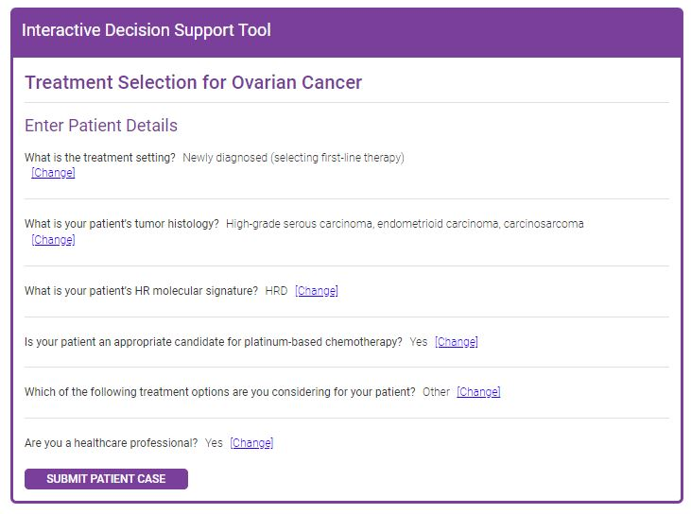


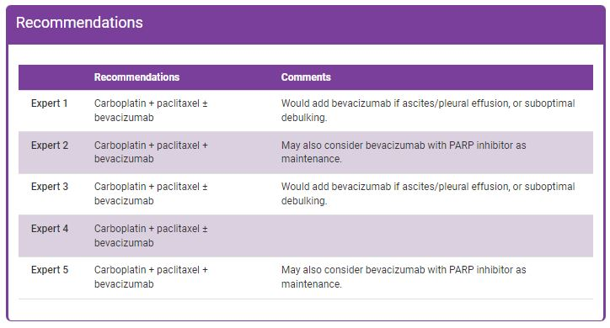
Interactive Decision Support Tools for
Advanced Gynecologic Cancers
Endometrial/
ovarian cancer Tool
Cervical cancer
Tool
HCP enters patient characteristics
Recommendations from 5 experts
Tool available at: https://www.clinicaloptions.com/GYNCI2022tool or as an app in your app store
Notes:
HCP, healthcare professional.
SPEAKER Notes:
Because of time constrains, we are not discussing patient cases in detail, if at all, we added this reference slide indicating where the attendees can go online to see what 5 expert recommend on some of the most common patient scenarios in advanced epithelial ovarian, endometrial, and cervical cancer.

Slide 25
Mirvetuximab Soravtansine in Platinum-Resistant OC With High FRα Expression (SORAYA): Study Design
FDA Accelerated Approval November 14, 2022
For adult patients with FRα-positive ovarian, fallopian tube, or primary peritoneal cancer refractory or resistant to platinum-based chemotherapy and 1-3 previous chemotherapies
Global, single-arm phase III study¹
Patients with platinum-resistant
ovarian cancer (recurrence within
6 mo after last platinum dose) with
1-3 prior regimens; high-grade serous; prior bevacizumab; tumors with high FRα membrane staining by IHC*
(N = 106)²
Mirvetuximab Soravtansine
6 mg/kg IV every 3 wk
Until PD, unacceptable toxicity, physician/patient decision
Mirvetuximab dosing adjusted
per ideal body weight
Meaningful Activity Seen in Patients With FRα-High PROC
*High expression defined as ≥75% of cells staining positive with ≥2+ staining intensity.
Outcome | By Investigator (N = 105) | BICR Assessed (N = 96)
ORR, n (%) (95% CI) | 34 (32.4) (23.6-42.2) | 30 (30.2) (21.3-41.4)
Median DoR, mo (95% CI) | 6.9 (5.6-9.7) | NR (5.0-NR)
Median PFS, mo (95% CI) | 4.3 (3.7-5.2) | 5.5 (3.8-6.9)
Primary endpoints: ORR by investigator
1. Moore. Ann Oncol. 2021;32:757. 2. Matulonis. JCO. 2023;[Epub].
Notes:
BICR, blinded independent central review; DoR, duration of response; FRα, folate receptor α; IHC, immunohistochemistry; NR, not reached; OC, ovarian cancer; ORR, overall response rate; PD, progressive disease; PFS, progression-free survival; PROC, platinum-resistant ovarian cancer.

Slide 26
Phase III SORAYA Study of Mirvetuximab Soravtansine: Safety Summary
TRAE, n (%) | Mirvetuximab Soravtansine
 | Any Grade | Grade 3-4
Patients with any event | 91 (86) | 31 (29)
Blurred vision | 43 (41) | 6 (6)
Keratopathy | 31 (29) | 9 (9)
Nausea | 31 (29) | 0 (0)
Dry eye | 26 (25) | 2 (2)
Fatigue | 25 (24) | 1 (1)
Diarrhea | 23 (22) | 2 (2)
Asthenia | 16 (15) | 1 (1)
Photophobia | 14 (13) | 0 (0)
Peripheral neuropathy | 14 (13) | 0 (0)
Decreased appetite | 14 (13) | 1 (1)
Vomiting | 12 (11) | 0 (0)
Neutropenia | 14 (13) | 2 (2)
Most ocular and GI AEs low grade and reversible
Grade ≥3 TRAEs
  Dose delay: 33%
  Dose reduction: 20%
  Discontinuation: 9%
1 death possibly related to study drug
  Respiratory failure
  Autopsy: no evidence of drug reaction; lung metastases
No appreciable myelosuppression and limited low-grade neuropathy
Matulonis. SGO 2022. Abstr 242. Matulonis. JCO. 2023;[Epub].
Notes:
AE, adverse event; GI, gastrointestinal; TRAE, treatment-related adverse event.

Slide 27
Recommended Use of Eye Drops in Patients
Receiving Mirvetuximab Soravtansine
Infusion Cycle | Day -1 | Days 1-4 | Days 5-8
Date | Before infusion | Infusion day | After infusion
1 drop (per eye) of topical steroid eye drops 6x/day |  |  | --
1 drop (per eye) of topical steroid eye drops 4x/day | -- | --
Preservative-free lubricating eye drops 4x/day as needed | As needed
Notes: Counsel patients to use topical steroids ≥10 min before lubricating eye drop use. Eye exams are recommended at baseline and before cycles 3, 5, 7. Counsel patients to avoid contact lenses.
S
S
L
HCPs should facilitate available resources to all patients, particularly those requiring financial assistance for molecular testing or treatment coverage
Mirvetuximab soravtansine PI.
Notes:
HCP, healthcare professional.

Slide 28
Mirvetuximab Soravtansine vs Investigator’s Choice of Chemotherapy in FRα-High PROC (MIRASOL): Study Design
Randomized, open-label phase III study using PS2+ scoring in patients with FRα-high PROC
Stratified by chemotherapy choice, no. of prior tx (1 vs 2 vs 3)
Mirvetuximab Soravtansine
6 mg/kg IV Q3W
Patients with platinum-resistant (<6 mo PFI), advanced, high-grade ovarian cancer; prior bevacizumab and
PARP inhibitor allowed; BRCAm
(N = 430)
Mirvetuximab dosing adjusted
per ideal body weight
Investigator’s Choice
of Chemotherapy
Paclitaxel: 80 mg/m² QW
PLD: 40 mg/m² Q4W
Topotecan: 4 mg/m² Days 1, 8, and 15 Q4W
or 1.25 mg/m² Days 1-5 Q3W
Statistical Assumptions
  2 sided α = .05; power = 90%; HR: 0.7;
  control arm median PFS: 3.5 mo
Primary endpoints: PFS by investigator (BICR for sensitivity analysis)
Secondary endpoints: ORR by investigator, OS, and PROs
NCT04209855.
Notes:
BICR, blinded independent review; FRα, folate receptor α; ORR, overall response rate; OS, overall survival; PFI, progression-free interval; PFS, progression-free survival; PLD, pegylated ribosomal doxorubicin; PRO, patient reported outcome; PROC, platinum-resistant ovarian cancer; tx, treatments.

Slide 29
Acknowledging Patient Preferences (Goals) and Promoting Enrollment on Clinical Trials

Slide 30
Lower Participation of Black vs White Patients on Clinical Trials
Participants in GOG Studies Based on Tumor Site | Race, n (%) |  |  | P Value
Stage | White (N = 37,617) | Black (N = 3686) | Other (N = 3956)
Ovary | 23,269 (87) | 1258 (5) | 2290 (8) | <.001
Endometrial | 9289 (87) | 850 (8) | 590 (5) | <.001
Cervix | 4421 (65) | 1340 (20) | 1038 (15) | <.001
Sarcoma | 638 (70) | 238 (26) | 38 (4) | <.010
Despite disproportionately higher rates of healthcare disparities, racial and
ethnic minority patients remain underrepresented on clinical trials
Scalici. Gynecol Oncol. 2015;138:441.
Notes:
GOG, Gynecologic Oncology Group.

Slide 31
Lower Enrollment of Black vs White Patients on Clinical Trials
Enrollment on GOG Studies Based on Tumor Site | White:Black Enrollment Ratios Based on Age-Adjusted Incidence of Each Cancer |  | Fold Difference in Ratios
Stage | Expected | Observed
Ovary | 1 to 0.74 | 1 to 0.05 | 14.8-fold
Endometrial | 1 to 0.90 | 1 to 0.09 | 9.8-fold
Cervix | 1 to 1.34 | 1 to 0.30 | 4.5-fold
Sarcoma | 1 to 1.94 | 1 to 0.37 | 5.2-fold
Increasing enrollment of underrepresented racial and ethnic minority patients is important for providing insight into objective racial differences in tumor biology, treatment responses, and survival
Scalici. Gynecol Oncol. 2015;138:441.
Notes:
GOG, Gynecologic Oncology Group.

Slide 32
Factors Affecting Willingness to
Participate in Clinical Trials
Need for better medical information, including:
  Direction/recommendations by HCP
  Information about risks/benefits and treatment alternatives
  Description of clinical trial process
Testimonials from patients like them who participated on clinical trials
Help with logistical barriers (eg, transportation, access to dependent care)
Emotional support
Patients often are not asked about participation in clinical trials
  Just ASK™ Increasing Diversity in Cancer Clinical Research program
Factors found not to be correlated with willingness to participate in clinical trials included:
  Race
  Psychological stressors
  (anxiety and depression)
Patel. Gynecol Oncol. 2020;157:323. Igwe. Gynecol Oncol. 2016;142:520. Esnaola. ASCO 2021. dukecancerinstitute.org/news/homegrown-just-ask-program-rolls-out-nationally.
Notes:
HCP, healthcare professional.

Slide 33
Patient Preferences and Treatment Goals in
Ovarian Cancer
Patient perceptions/preferences^{1,2}
  Perceived trade-off between quantity and quality of life
    Patients with ovarian cancer may feel that life during and after treatment may be worse
    Concerns for extra effects on their family
  Daily life considerations
    Inability to work or take time away from work
  Likelihood of benefit from the therapy
    Trial appropriateness for serious disease
Treatment goals¹
  Achieve MRD or complete tumor resection with surgery
  Extending disease remission and/or extending survival, but not at the cost of significant toxicity
Action Items
Provide patient education to address misconceptions about clinical trials
Identify patients who do not agree with treatment being chosen at random
Provide targeted education on likelihood of benefit to increase willingness to participate
Need to train clinical trial team to ask patients about considering a clinical trial
1. Oskay-Özcelik. Ann Oncol. 2018;29:910. 2. Nyakudarika. Cancer. 2021;127:3809.
Notes:
MRD, measurable residual disease.

Slide 34
Benefits of Diverse Enrollment on Clinical Trials: Better Data on Health Disparities and Access to SoC Treatments
SoC treatments are established in setting of clinical trials^{1,2}
Clinical trials may help ensure timely and equitable access to needed
healthcare services¹
  Increasing access to novel therapies
  Increasing adherence to diagnostics/follow-up care
Increased enrollment of underrepresented racial and ethnic minority patients on clinical trials is essential for adequately describing true racial difference in gynecologic malignancies^{1,3}
  Skepticism, lack of encouragement to participate in clinical trial by HCP, and lack of referral procedures for clinical staff remain barriers to enrollment of racial and ethnic minority patients on clinical trials
1. Scalici. Gynecol Oncol. 2015;138:441. 2. Igwe. Gynecol Oncol. 2016;142:520. 3. Durant. Cancer 2014;120:1097.
Notes:
HCP, healthcare professional; SoC, standard of care.

Slide 35
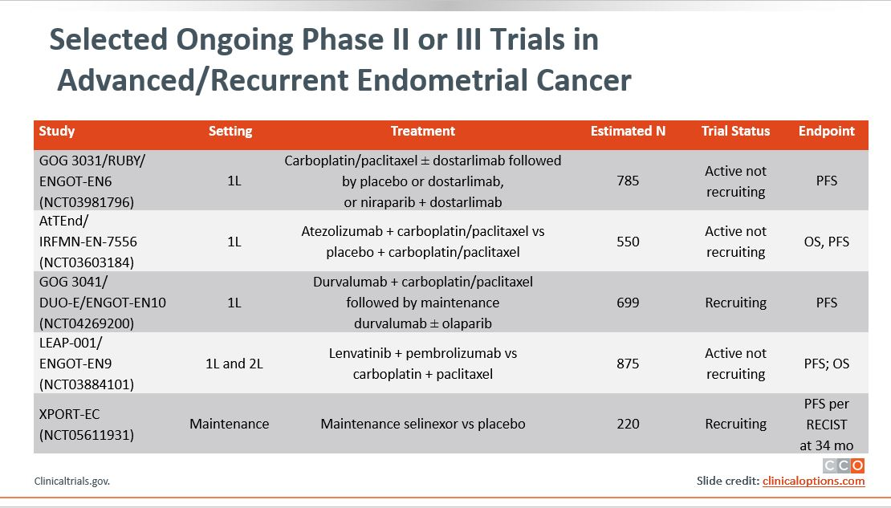
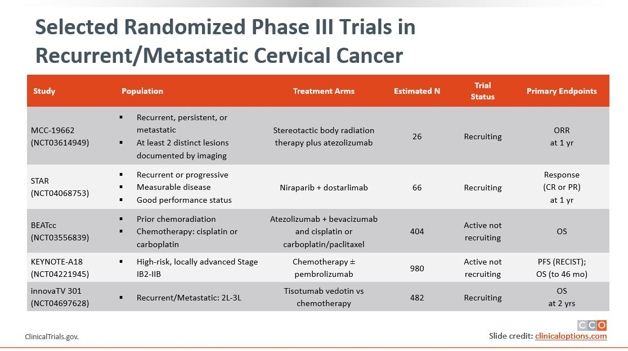
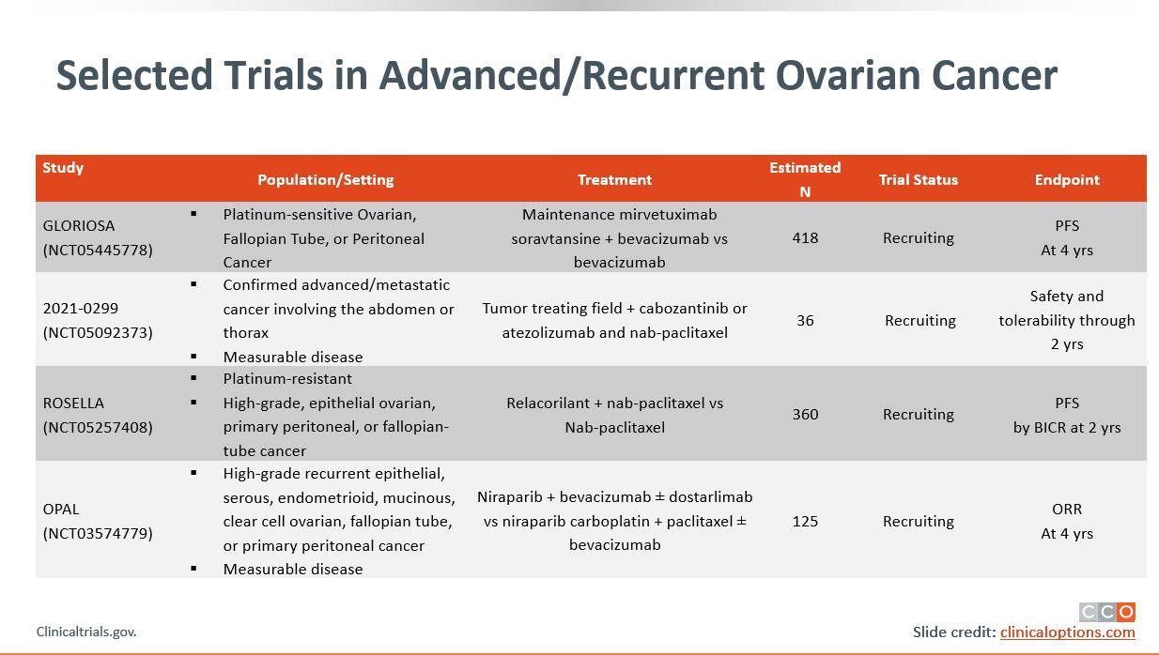
Addressing Potential Healthcare Disparities in
Clinical Trial Enrollment
To address potential disparities in care:
  Discuss patients’ satisfaction with treatment (AEs and symptom distress associated with poorer adherence)
  Discuss patients’ satisfaction with HCP communication
    Feeling understood and respected by their HCPs
    Being involved in shared decision-making
    Building trust and confidence in their HCPs
    Understanding disease and treatment
  Discuss patients’ resources, support system, and
  ability to get to and from clinic for visits
  Provide patients with help in navigating insurance claims and financial assistance programs for
  prescribed medications
Listen to and understand each patient’s goals to help develop manageable plans for achieving healthcare goals
Visit clinicaltrials.gov for available clinical trials near you
Pozzar. Gynecol Oncol. 2017;147:714. Patel. Gynecol Oncol. 2020;157:323.
Igwe. Gynecol Oncol. 2016;142:520. Nyakudarika. Cancer. 2021;127:3809.
Notes:
AE, adverse event; HCP, healthcare professional.

Slide 36



Navigating the Healthcare Ecosystem:
Addressing Potential Disparities
Cost
Reducing treatment costs with manufacturer grants and assistance programs
Providing grants to cover transportation costs
and dependent care
Communication
Improving patient–HCP communication
Acknowledging patient beliefs/values
Minimizing HCP bias
Increasing representation of underrepresented racial and ethnic minority HCPs
(MDs, NPs, PAs) in oncology workforce
Gaps in Outcomes Research
Increasing representation of underrepresented groups of patients on clinical trials
Evaluating genetic/molecular differences in tumor biology based on race
Oncology pharmacists, nurses, and patient navigators are integral to oncology treatment and patient care
  Have a key role in empowering patients and their families to take charge of their health
  Can provide education, resources, and healthcare planning advice
Esnaola. ASCO 2021. Chatterjee. Front Oncol. 2016;6:36. Binner. J Onc Nav Surviv. 2019;10.
Notes:
HCP, healthcare professional; NP, nurse practitioner; PA, physician associate/physician assistant.

Slide 37
Take-home Messages:
Achieving Health Equity in Ovarian Cancer
Inequality in ovarian cancer care leads to Black patients presenting with more advanced disease and receipt of non‒guideline-concordant care, including lower participation in clinical trials
Timely/equitable access to molecular testing may improve access to targeted therapies and improve outcomes for Black patients
New therapies, such as PARP inhibitors and the novel antibody‒drug conjugates,
have improved survival outcomes in frontline and relapsed settings, respectively
Healthcare professionals should implement strategies to mitigate toxicities associated
with newer therapies such as mirvetuximab soravtansine
Black patient education and receipt of treatment at high-volume centers may result
in improved outcomes, particularly educating patients on potential benefits of
clinical trial participation

Slide 38
Go Online for More CCO
Coverage of Gynecologic Malignancies!
CME/CPE/CNE-certified on-demand webcast (coming soon!)
ClinicalThought commentaries and PDF resources for gynecologic cancers that
may help increase awareness on health disparities and provide additional aid to
your patients
On-demand CME/CPE/CNE-certified text modules for endometrial and cervical cancer with healthcare professionals’ insight and commentary
clinicaloptions.com/oncology
clinicaloptions.com/GYNCI2022tool
clinicaloptions.com/immuneAETool
clinicaloptions.com/CervicalTool2022

