Slide 1

Starting in Care: Ensuring HIV Services
Are Inclusive and Equitable
Provided by Clinical Care Options, LLC in partnership with NMAC
Supported by an educational grant from Gilead Sciences, Inc.

Slide 2
Faculty and Disclosures
Ofole Mgbako, MD
Assistant Professor of Medicine and Population Health
NYU Grossman School of Medicine
Section Chief of Infectious Diseases, NYC Health and Hospitals/Bellevue
Clinical Pillar Lead, NYU Institute for Excellence in Health Equity
New York, New York
Ofole Mgbako, MD: consultant/advisor/speaker: Gilead.

Slide 3
Learning Objective
Recognize the challenges in initiating HIV care related to such issues as stigma, beliefs, communication, and financial burden, and develop strategies to optimize clinical practice to combat these barriers

Slide 4
Poll 1: For those providing patient care, how many people living with HIV do you provide care for in a typical week?
1-5
6-10
11-25
26-50
>50
Not applicable

Slide 5
Pretest 1: I am aware of strategies I can use to directly address stigma and other care barriers among people with HIV starting in care.
Strongly disagree
Disagree
Neither agree nor disagree
Agree
Strongly agree
Notes:
Answer:
LO: Recognize the challenges in initiating HIV care related to such issues as stigma, beliefs, communication, and financial burden, and develop strategies to optimize clinical practice to combat these barriers
Competence

Slide 6
Pretest 2: At every first visit with a person living with HIV, I ask them about their life before their diagnosis.
Strongly disagree
Disagree
Neither agree nor disagree
Agree
Strongly agree
Notes:
Answer:
LO: Recognize the challenges in initiating HIV care related to such issues as stigma, beliefs, communication, and financial burden, and develop strategies to optimize clinical practice to combat these barriers
Competence
Asking people about their life before their HIV diagnosis can actively addresses research where patients say they want to be seen as a person, not a diagnosis.

Slide 7
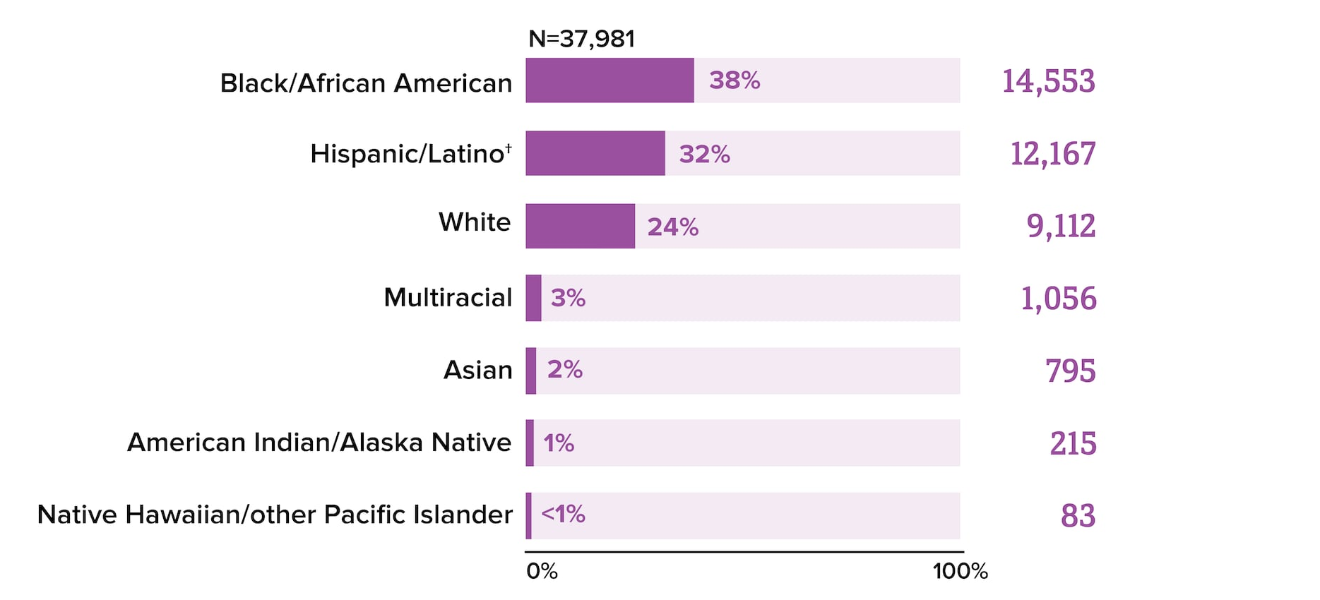
Racial Disparities in New HIV Diagnoses
In 2022, Black/African Americans made up approximately 12% of the US population, but represented 38% of new HIV diagnoses
Number of new
HIV diagnoses
N = 37,981
Black/African American
Hispanic/Latino
White
Multiracial
Asian
American Indian/Alaska Native
Native Hawaiian/other Pacific Islander
38%
14,553
12,167
9,112
1,056
795
215
83
32%
24%
3%
2%
1%
<1%
0
100
Percent of New HIV Diagnoses (%)
cdc.gov/hiv-data/nhss/hiv-diagnoses-deaths-prevalence.html.
hhs.gov/black-history-month/reading-list/index.html.

Slide 8
Social Determinants of Health for New HIV Diagnoses: US Data
POVERTY
INSURANCE
EDUCATION
HOUSEHOLD INCOME
12.6%
were living in poverty
10.3% (younger than
age 65) were uninsured
88.9% had at least a high school education
The median household income was $69,021
INCOME INEQUALITY
UNEMPLOYMENT
FOOD INSECURITY
UNSTABLE HOUSING
14.3%
experienced
unstable housing
in 2021
Gini Coefficient of
0.482
which is a measure of income inequality
5.3%
were unemployed
10.2%
were living with
food insecurity
aidsvu.org/resources/deeper-look-health-disparities-and-hiv/.

Slide 9
HIV ACEs Pyramid: Relationship Between Trauma, Oppression, Risk Behaviors, and Progression of HIV
Virally Unsuppressed, Opportunistic Infections, Poor Quality of Life
HIV Infection, Behavioral Health Disorders, Disability & Social Problems
Adoption of HIV-Related
Risk Behaviors
IMPLICIT BIAS
EPIGENETICS
Social, Emotional, and Cognitive Impairment
Micro and Macro Aggression, Complex Trauma, ACEs, International Homophobia and Transphobia, HIV-Related Stigma
Structural Racism, Heteronormativity, Sexism, Gender Binary
Intergenerational Transmission of Trauma
Historical Trauma
nastad.org/sites/default/files/2021-12/PDF-Trauma-Informed-Approaches.pdf.
Notes:
ACE, adverse childhood experience.

Slide 10
Stigma, Psychological Factors, and the HIV Care Continuum
Stigma
Depression
Fear of life-long disability
PRE-
DIAGNOSIS
DIAGNOSIS
EVER
LINKED
RETAINED
VIRALLY
SUPRESSED
HIV Care (invasive procedures, staff)
Systemic abuse and/or insensitivity
Cost of care and benefits navigation
Obstacles to care
Hypervigilance of labs, diet, etc
Medications for life—sometimes many pills
Anniversary dates
nastad.org/sites/default/files/2021-12/PDF-Trauma-Informed-Approaches.pdf.

Slide 11
Naming Discrimination
Try to name racism or discrimination because many patients have experienced it before and come in wary
  Ask up front if they have experienced racism before
  Ask if they feel this has been a racist experience
  Use a reparative approach if trust has been broken in the past

Slide 12

Trauma-Informed Approaches to HIV Services
nastad.org/sites/default/files/2021-12/PDF-Trauma-Informed-Approaches.pdf.

Slide 13
Inquire About HIV Diagnosis
People may have had traumatic experiences with HIV diagnosis
  Get a sense of their experience
Ask about disclosure and who is there to support them
  Especially important for younger people with HIV—ask if the people in their lives are supportive or are barrier
Screen for social isolation within the flow of the visit
  Data suggest social isolation; especially important in older adults
Ask about experiences with stigma or discrimination related to HIV (which can affect outcomes)
Determine person’s major risk factor for transmission (sexual intercourse, IV drug use)
Ellis. J Acquir Immune Defic Syndr. 2021;86:600. Marziali. AIDS Behav. 2021;25:377.
Mgbako. BMC Public Health. 2020;20:1247.

Slide 14
6 Ps for Sexual Behavior History Taking:
Important for All People, No Matter How Old
Partners
Practices
Could you tell me about your current relationships?
In the past 3 mo, have you had sex with someone you didn’t know or just met?
Have you ever been coerced or forced to have sex/sexual activity against your will?
Are you having any difficulties with your sexual relationships?
In the past 3 mo, what types of sex have you had? Anal? Vaginal? Oral?
Have you or any of your partners used alcohol or drugs when you have sex?
Have you ever exchanged sex for drugs or money?
Pregnancy Intentions
Are you planning pregnancy?
If not, what are you doing to prevent pregnancy?
Past History of STIs
Have you ever had an STI?
Have you ever been tested for HIV? How long ago?
Plus
Is the sex you’re having pleasurable for you?
Are you having any difficulties when you have sex?
Is support needed for sexual orientation or gender identity?
Are you experiencing any harassment or violence?
Protection From STIs
What do you do to protect yourself from STIs and HIV? With which partners?
Have you been vaccinated against HPV? HBV? HAV?
nationalcoalitionforsexualhealth.org/tools/for-healthcare-providers/asset/Sexual-Health-Questions-to-Ask-All-Patients.pdf.
Notes:
HAV, hepatitis A virus; HBV, hepatitis B virus; HPV, human papillomavirus; STI, sexually transmitted infection.

Slide 15
Standard of Care vs Rapid ART Models
HIV Diagnosis
Disclosure
HIV education
Counseling
Referral
Scheduling
1st Clinic Visit
Registered
Insurance
Assess housing, substance use, mental health needs
HIV education
Counseling
Labs
1st Primary Care Provider Visit
Medical evaluation
Assess preparedness
ART Start
Prescription
Pharmacy pick-up
ART Management
Viral load monitoring
Adherence
Retention
OLD:
Staged visits
RAPID Visit: ART Start
Disclosure, counseling
Registration
Insurance
Assess housing, substance use, mental health needs
Labs
HIV education
Primary Care Provider Visits:
ART Management
Viral load monitoring
ART management
Adherence
Retention
Counseling
Medical evaluation
Assess preparedness
ART dispensed
Telephone follow-up
NEW:
Rapid start
Pilcher. J Acquir Immune Defic Syndr. 2017;74:44.
Notes:
ART, antiretroviral therapy.

Slide 16
Improved Clinical Outcomes With Rapid ART Initiation
Systematic review¹ of ART initiation within 14 days of eligibility determination across
4 randomized clinical trials in Uganda,² South Africa,³ Haiti,⁴ and Lesotho⁵
Compared with standard of care, same-day ART increased the likelihood of ART initiation
in first 90 days, patient retention, and viral suppression at 12 mo
Characteristic
ART start within 90 days
Retained in care at 12 mo
Viral suppression at 12 mo
LTFU at 12 mo
Died by 12 mo
RR (95% CI)
1.35 (1.13-1.62)
1.11 (0.99-1.26)
1.17 (1.07-1.27)
0.66 (0.42-1.04)
0.53 (0.28-1.00)
.2
1
2
3
Standard of Care
Same-Day ART
1. Ford. AIDS. 2018;32:17. 2. Amanyire. Lancet HIV. 2016;3:e539. 3. Rosen. PLoS Med. 2016;13:e1002015.
4. Koenig. PLoS Med. 2017;14:e1002357. 5. Labhart. BMC Public Health. 2016;16:329.
Notes:
ART, antiretroviral therapy; LTFU, lost to follow-up; RR, relative risk.

Slide 17
Recommendations for Rapid ART
Guideline | Recommendation for Same-Day ART
DHHS¹ | Initiate ART immediately (or as soon as possible) after HIV diagnosis to increase uptake of ART and linkage to care, decrease time to viral suppression for individual patients, and improve rate of virologic suppression among people with HIV
IAS-USA² | Initiation of ART is recommended as soon as possible after diagnosis, ideally within 7 days, including on same day as diagnosis or at first clinic visit if patient is ready
EACS³ | Immediate (ie, same-day) start of ART should be considered, especially in the following situations: primary HIV infection, wish to start ART immediately, in a setting where loss to follow-up is more likely if ART is not started on same day
WHO⁴ | Rapid ART initiation should be offered to all people with HIV following confirmed HIV diagnosis and clinical assessment
1. DHHS ART Guidelines. February 2024. 2. Gandhi. JAMA. 2023;329:63.
3. EACS Guidelines. v12.0. October 2023. 4. WHO Guidelines. July 2021.
Notes:
ART, antiretroviral therapy; DHHS, Department of Health and Human Services; EACS, European AIDS Clinical Society; IAS-USA, International Antiviral Society‒USA; WHO, World Health Organization.

Slide 18
Non-HIV Medical History and Preventative Care
Consider medical implications of comorbidities with ART
Psychological implications of dealing with multimorbidity or syndemics
Mental health and substance use
  Ask in a nonstigmatizing way
Vaccination (some more time sensitive than others)
  eg, Mpox, meningococcal vaccine, age-based vaccines, cancer screenings for older adults
Notes:
ART, antiretroviral therapy.

Slide 19
Co-Creating a Treatment and Care Plan
Active goal setting and shared decision-making
Check in by phone a few days later to make sure meds were received from pharmacy and give lab results
Make sure they know what happens next

Slide 20
Post-test 1: I am aware of strategies I can use to directly address stigma and other care barriers among people with HIV starting in care.
Strongly disagree
Disagree
Neither agree nor disagree
Agree
Strongly agree
Notes:
Answer:
LO: Recognize the challenges in initiating HIV care related to such issues as stigma, beliefs, communication, and financial burden, and develop strategies to optimize clinical practice to combat these barriers
Competence

Slide 21
Post-test 2: Going forward, at every first visit with a person living with HIV, I plan to ask them about their life before their diagnosis.
Strongly disagree
Disagree
Neither agree nor disagree
Agree
Strongly agree
Notes:
Answer:
LO: Recognize the challenges in initiating HIV care related to such issues as stigma, beliefs, communication, and financial burden, and develop strategies to optimize clinical practice to combat these barriers
Competence

Slide 22
Poll 2: Do you plan to make any changes in your clinical practice based on what you learned in today’s program?
Yes
No
Uncertain

Slide 23
Go Online for More CCO
Coverage of You’re Welcome!
Clinical Focus modules on starting in care, persisting in care, and returning to care
Downloadable slides
ClinicalThought commentaries featuring case examples
Podcast narrations of the ClinicalThought commentary cases by expert faculty
clinicaloptions.com

