Slide 1
Future Applications in ES-SCLC: Targeting DLL3 and Emerging Evidence for T-Cell Engagers
Provided by Clinical Care Options, LLC
This activity is supported by an independent medical educational grant from Boehringer Ingelheim Pharmaceuticals, Inc.

Slide 2

About These Slides
Please feel free to use and share some or all of these slides in your noncommercial presentations to colleagues or patients
When using our slides, please retain the source attribution:
These slides may not be published, posted online, or used in commercial presentations without permission. Please contact permissions@clinicaloptions.com for details
Slide credit: clinicaloptions.com
Notes:
Disclaimer: The materials published on the Clinical Care Options Web site reflect the views of the authors of the CCO material, not those of Clinical Care Options, LLC, the CME providers, or the companies providing educational grants. The materials may discuss uses and dosages for therapeutic products that have not been approved by the United States Food and Drug Administration. A qualified healthcare professional should be consulted before using any therapeutic product discussed. Readers should verify all information and data before treating patients or using any therapies described in these materials.

Slide 3
Faculty Disclosures
Carl M. Gay, MD, PhD
Assistant Professor
Thoracic/Head & Neck Medical Oncology
The University of Texas MD Anderson Cancer Center
Houston, Texas
Carl M. Gay, MD, PhD: consultant/advisor/speaker: Abdera, Amgen, AstraZeneca, Catalyst, Daiichi Sankyo, G1 Therapeutics, Roche/Genentech.

Slide 4
Learning Objectives
Describe the mechanism of action of T-cell engager therapies targeting DLL3 and the biologic rationale for their investigation in SCLC to colleagues, patients, and caregivers
Evaluate ongoing clinical trial research investigating novel agents and treatment strategies that incorporate DLL3-targeting therapies for patients with SCLC
Identify patients for clinical trials investigating DLL3-targeting agents (T-cell engagers) in SCLC and other tumors

Slide 5
Small-Cell Lung Cancer
US Lung Cancer Incidence by Histology
2010-2014
SCLC accounts for ~13% of all lung cancers in the US
Most commonly associated with a history of significant tobacco use
Unique biology: rapid proliferation, abrupt presentation, hematogenous metastases at onset
Initially responsive to therapy but with overall poor outcomes
Unmet need for targeted and/or immune-based therapies
Large-cell carcinoma
Other
2%
Small-cell carcinoma
3%
Adenocarcinoma
Other
non-small-
cell carcinomas
Squamous and
transitional cell carcinoma
Oronsky. Neoplasia. 2017;19:842. Alvarado-Luna. Transl Lung Cancer Res. 2016;5:26.
Howlander. SEER Cancer Statistics Review, 1975-2014.
Slide credit: clinicaloptions.com
Notes:
SCLC, small-cell lung cancer.

Slide 6
What Is DLL3?
DLL3 is an inhibitory ligand of the Notch signaling pathway
The Notch pathway is thought to be involved in cell proliferation, malignant transformation, and epithelial-mesenchymal transformation
DLL3 expression is related to key neuroendocrine transcription factor ASCL1
Tumor
cell
Notch
Notch
DLL3
Proliferation
Survival
Tumor
cell
ASCL1
Yao. Oncologist. 2022;27:940. Leonetti. Cell Oncol (Dordr). 2019;42:261. Sahlgren. Regen Med. 2006;1:195.
Notes:
ASCL1, achaete-scute homolog 1; DLL3, delta-like ligand 3; SCLC, small-cell lung cancer.

Slide 7
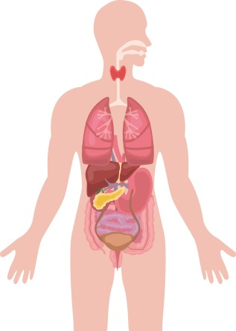


DLL3 Expression in Neuroendocrine Neoplasms
Representative Prevalence of DLL3 in NEN
In normal tissue, DLL3 expression is absent or low and confined to the cytoplasm
DLL3 overexpression is characteristic of NEN and is commonly found on the tumor cell surface
~85% of SCLC tumors overexpress DLL3
Respiratory
LCNEC: ~37-80% (~54%)
Typical Carcinoid: (12%*)
Atypical Carcinoid: (24%*)
Medullary thyroid carcinoma
80% (47%*)
Merkel cell (skin)
~90% (52-59%)
Stomach
29%
Pancreas
19%-50% (21%†)
Small intestine
22%
Bladder
68%
Gastroenteropancreatic
77%
Prostate
NEPC ~76%
CRPC-Adeno 13%
Cervix Uteri
81% (49%*)
*Prevalence of high DLL3 expression (ie, ≥50% of DLL3-expressing cells).
†Strongly positive for DLL3.
Yao. Oncologist. 2022;27:940. Leonetti. Cell Oncol (Dordr). 2019;42:261.
Notes:
CRPC, castration-resistant prostate cancer; DLL3, delta-like ligand 3; LCNEC, large cell neuroendocrine carcinoma; NEN, neuroendocrine neoplasms; NEPC, neuroendocrine prostate cancer.

Slide 8
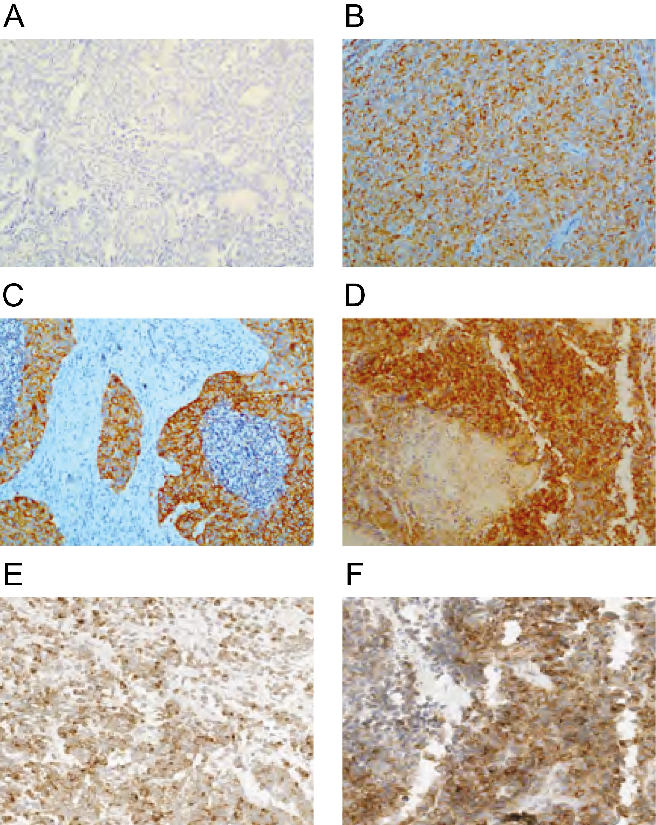
DLL3 IHC Staining by Site of Origin
Typical carcinoid
DLL3 negative
Atypical carcinoid
Moderate DLL3
Large-cell neuroendocrine carcinoma
Strong diffuse DLL3
SCLC
>50% positive cells
Adenocarcinoma with neuroendocrine component
80% positive cells
Neuroendocrine prostate cancer
90% positive cells
Yao. Oncologist. 2022;27:940.
Notes:
DLL3, delta-like ligand 3; IHC, immunohistochemistry; SCLC, small-cell lung cancer.

Slide 9
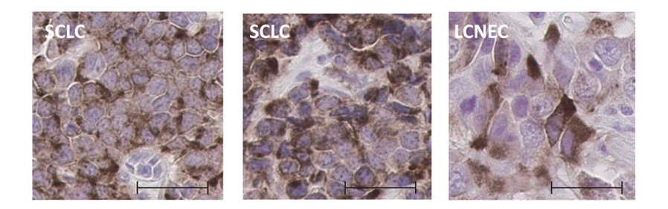
Elevated Expression of DLL3 in SCLC and LCNEC
DLL3 mRNA Expression by qPCR
DLL3 Surface Expression by IHC
10⁹
300
10⁷
250
200
10⁵
H-Score for
Membranous DLL3
Relative Expression
150
10³
100
10¹
50
10⁻¹
0
LCNEC PDX
Normal Lung
LCNEC
R/R SCLC
SCLC PDX
SCLC
Normal Tissues
Naive SCLC
NSCLC-Adeno
NSCLC-SqCC
Saunders. Sci Transl Med. 2015;7:302ra136.
Slide credit: clinicaloptions.com
Notes:
Adeno, adenocarcinoma; DLL3, delta-like 3 protein; IHC, immunohistochemistry; LCNEC, large-cell neuroendocrine; NSCLC, non-small-cell lung cancer; PDX, patient-derived xenograft; qPCR, quantitative polymerase chain reaction; R/R, relapsed/refractory; SCLC, small-cell lung cancer; SqCC, squamous cell carcinoma.

Slide 10
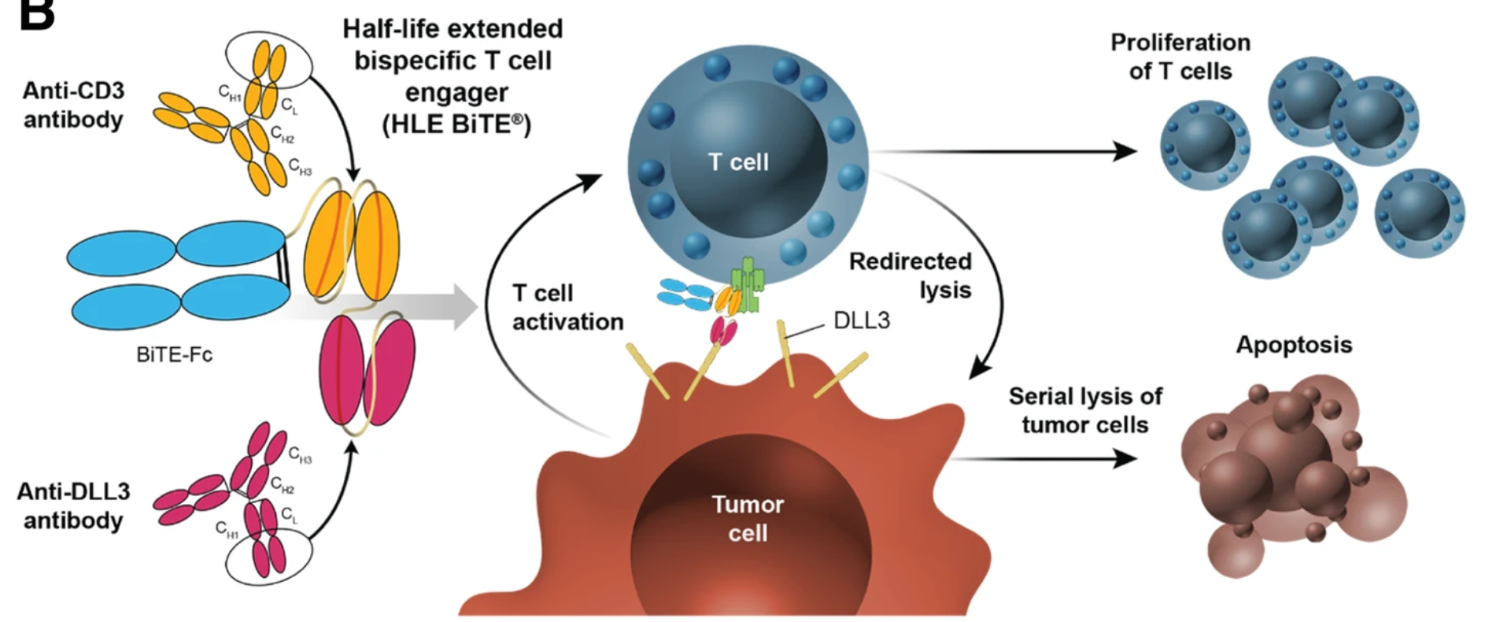
DLL3 T-Cell Engager Mechanism of Action
Giffin. Clin Cancer Res. 2021;27:1526. Owen. J Hematol Oncol. 2019;12:61. CC BY 4.0. No changes made.
Notes:
CD3, cluster of differentiation 3; DLL3, delta-like ligand 3; Fc, fragment crystallizable; SCLC, small-cell lung cancer.

Slide 11
DLL3 T-Cell Engagers in Development
Tarlatamab
BI 764532
MK-6070
(HPN 328)
QLS31904
RO7616789
Anti-DLL3 Fab
DLL3-binding
domains
CD3-targeting
region
DLL3-binding
region
DLL3-binding
domain
CD3- and CD137-
binding domain*
CD3-targeting
domains
CD3-targeting
domains
Anti-CD3 scFc
Anti-albumin
domain
Fc region
Fc region
Modified Fc region
DLL3-targeting
domain
*Engineered to avoid simultaneous binding of CD3 and CD137.
Rudin. J Hematol Oncol. 2023;16(1):66. Su. Mol Cancer. 2024;23:97.
Notes:
CD3, cluster of differentiation 3; DLL3, delta-like ligand 3; Fc, fragment crystallizable; SCLC, small-cell lung cancer.

Slide 12
DeLLphi-301: Tarlatamab in Relapsed ES-SCLC
Open-label phase II study
  Patients required to have received 1 platinum-based regimen and ≥1 other line of tx; median lines of tx: 2 (range: 1-8)
Part 1: Dose Evaluation
Part 2: Dose Expansion
Part 3: Reduced Inpatient Monitoring Period
Patients with ES-SCLC; ≥2 prior lines of tx, including
platinum-based CT; treated, stable
brain mets allowed; ECOG PS 0-1
(N = 222)
Tarlatamab 10 mg*
D8, D15, Q2W thereafter
(n = 88)
Tarlatamab 10 mg*
D8, D15, Q2W thereafter
(n = 12)
Tarlatamab 10 mg*
D8, D15, Q2W thereafter
(n = 34)
Tarlatamab 100 mg*
D8, D15, Q2W thereafter
(n = 88)
*1 mg on D1.
Primary endpoints: ORR per RECIST v1.1 by BICR
Secondary endpoints: DoR, DCR, PFS, OS, safety, drug serum concentration
Ahn. NEJM. 2023;389:2063. NCT05060016.
Notes:
BICR, blinded independent central review; CT, chemotherapy; DCR, disease control rate; DoR, duration of response; ECOG, Eastern Cooperative Oncology Group; ES-SCLC, extensive-stage small-cell lung cancer; mets, metastases; ORR, objective response rate; OS, overall survival; PFS, progression-free survival; PS, performance status; RECIST, Response Evaluation Criteria in Solid Tumors; SCLC, small-cell lung cancer; tx, therapy.

Slide 13
DeLLphi-301: Response
Outcome | Tarlatamab 10 mg (n = 100) | Tarlatamab 100 mg (n = 88)
ORR, % (97.5% CI) Confirmed CR, n (%) Confirmed PR, n (%) | 40 (29-52) 1 (1) 39 (39) | 32 (21-44) 7 (8) 21 (24)
SD, n (%) | 30 (30) | 27 (31)
PD, n (%) | 20 (20) | 13 (15)
Death before post-BL scan, n (%) | 6 (6) | 13 (15)
No post-BL scan, n (%) | 2 (2) | 3 (3)
Observed DoR, n/N (%) ≥3 mo ≥6 mo ≥9 mo | 35/40 (88) 23/40 (58) 10/40 (25) | 25/28 (89) 17/28 (61) 10/28 (36)
Median time to response, mo (range) | 1.4 (1.1-2.8) | 1.4 (1.2-9.6)
Ongoing response at data cutoff, n/N (%) | 22/40 (55) | 16/28 (57)
DCR, % (95% CI) | 70 (60-79) | 63 (52-73)
Median duration of disease control, mo (95% CI) | 6.9 (5.4-9.7) | 6.7 (4.2-NE)
Antitumor Activity With Tarlatamab 10 mg (n = 91)
Response
CR
PR
SD
PD
NE
DLL3 Expression
NE/unavailable
Undetectable
(All other detectable)
120
100
80
60
40
20
Best Change From BL in SoD (%)
0
-20
-40
-60
-80
-100
Ahn. NEJM. 2023;389:2063.
Notes:
BL, baseline; CR, complete response; DCR, disease control rate; DoR, duration of response; NE, not evaluable; ORR, objective response rate; PD, progressive disease; PR, partial response; SD, stable disease; SoD, sum of diameters.

Slide 14
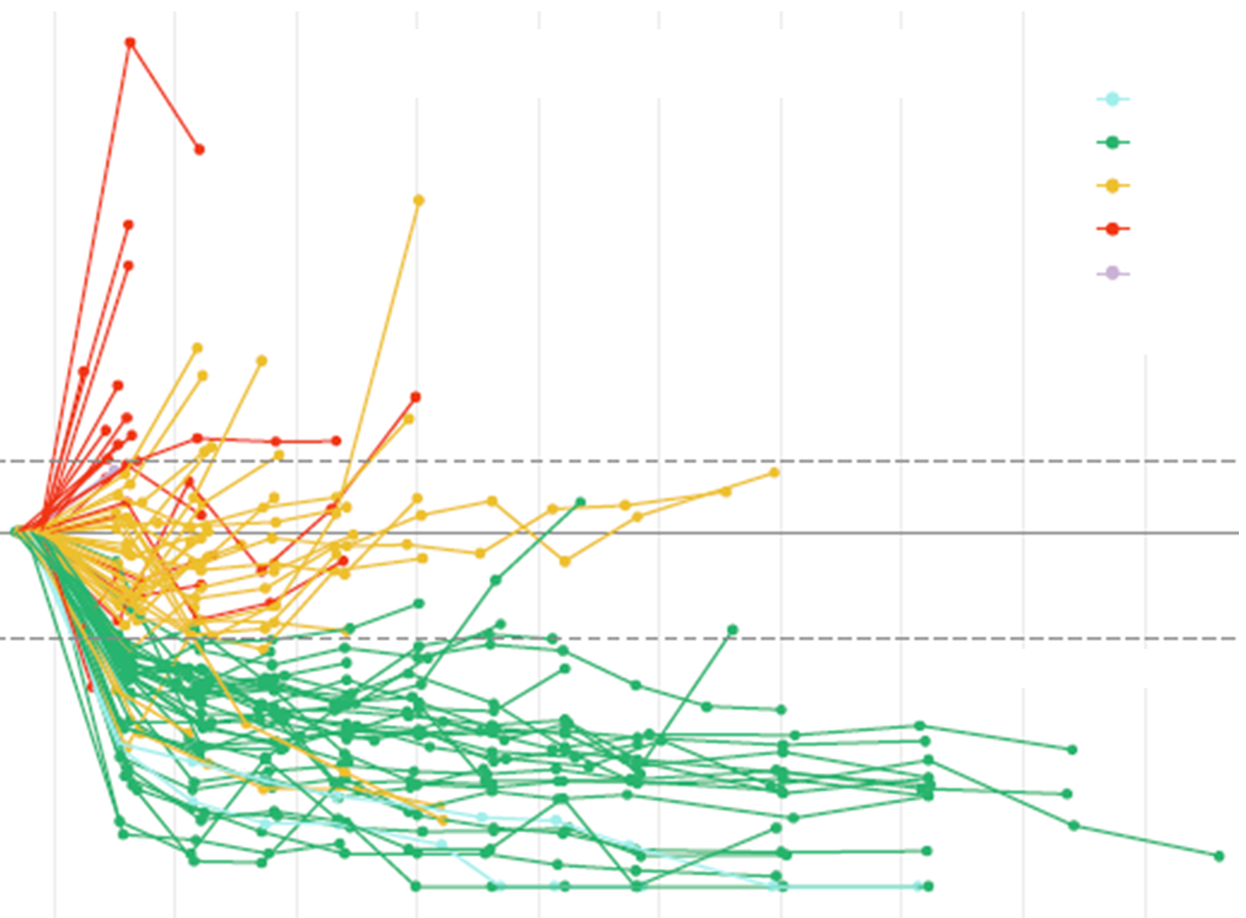
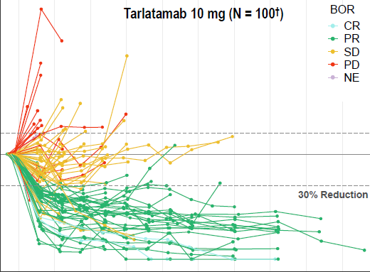
DeLLphi-301: Sustained Disease Control
150
72% of patients had tumor shrinkage
Median duration of disease control (95% CI): 6.9 mo (5.4-8.6)
  26% of patients for ≥52 wk (CR-3, PR-20, SD-3)
Tarlatamab 10 mg (N = 100)
BOR
CR
PR
SD
PD
NE
100
50
% Change From Baseline in Sum of Diameters
0
-50
30% Reduction
-100
0
10
20
30
40
50
60
70
80
90
Wk
Sands. WCLC 2024. Abstr OA10.03.
Notes:
AE, adverse event; BOR, best overall response; CR, complete response; CRS, cytokine release syndrome; ICANS, immune effector cell‒associated neurotoxicity syndrome; NE, not evaluable; PD, progressive disease; PR, partial response; SD, stable disease.

Slide 15
DeLLphi-301: Onset and Duration of Response
Tarlatamab 10 mg (n = 40)
First response (PR or CR)
Patients with a BOR or CR
Patients with a BOR or PR
Disease progression
Ongoing treatment
Death
0
6
12
18
24
24
Duration of Treatment (Mo)
Median TTR: 1.4 mo
Median DoR (95% CI): 9.7 mo (6.9-NE)
Sands. WCLC 2024. Abstr OA10.03.
Notes:
BOR, best overall response; CR, complete response; DoR, duration of response; NE, not estimable; PR, partial response; TTR, time to response

Slide 16
DeLLphi-301: Survival
100
Tarlatamab 10 mg (N = 100)
80
60
PFS (%)
6-mo PFS: 39.2%
40
12-mo PFS: 24.0%
mPFS: 4.3 mo
20
0
0
3
6
9
12
15
18
21
24
Mo
100
80
6-mo OS: 73.4%
mOS: 15.2 mo
OS (%)
12-mo OS: 57.0%
18-mo OS: 46.0%
60
40
20
0
0
3
6
9
12
15
18
21
24
27
Mo
Sands. WCLC 2024. Abstr OA10.03.
Notes:
mOS, median overall survival; mPFS, median progression-free survival; OS, overall survival; PFS, progression-free survival

Slide 17
DeLLphi-301: OS by Disease Control With Frontline Platinum-based Chemotherapy
Tarlatamab 10 mg (N = 100)
Progression-free Interval after 1L Platinum <90 days
Progression-free Interval after 1L Platinum ≥90 days
100
80
6-mo OS: 73.4%
12-mo OS: 57.0%
60
18-mo OS: 46.0%
OS (%)
40
20
0
0
3
6
9
12
15
18
21
24
27
Mo
Patients at risk
 | 100 | 84 | 67 | 62 | 52 | 46 | 36 | 18 | 3 | 0
 | 39 | 31 | 26 | 25 | 21 | 18 | 13 | 7 | 0
 | 55 | 48 | 39 | 35 | 29 | 23 | 21 | 9 | 2 | 0
Sands. WCLC 2024. Abstr OA10.03.
Notes:
1L, first-line; AE, adverse event; CRS, cytokine release syndrome; ICANS, immune effector cell‒associated neurotoxicity syndrome; OS, overall survival.

Slide 18
DeLLphi-301: CRS and ICANS
CRS and ICANS During Treatment With Tarlatamab 10 mg (n = 133)
Cycle 1
Cycle 2
Cycle 3
Tarlatamab Dose
Timing of AE
D1: 1 mg
D1-7
D8: 10 mg
D8-14
D15: 10 mg
D15-27
D1: 10 mg
D1-14
D15: 10 mg
D15-27
D1: 10 mg
D1-14
100
Patients (%)
50
45
40
Any grade
Grade 3 or 4
40
35
30
28
25
20
15
10
6
5
1
1
0
0
2
0
0
2
0
2
0
3
0
2
0
1
0
1
0
0
0
0
CRS
ICANS
CRS
ICANS
CRS
ICANS
CRS
ICANS
CRS
ICANS
CRS
ICANS
Event
Ahn. NEJM. 2023;389:2063.
Notes:
AE, adverse event; CRS, cytokine release syndrome; ICANS, immune effector cell‒associated neurotoxicity syndrome.

Slide 19
Phase I Study of BI 764532 (DLL3/CD3 Bispecific Antibody) in DLL3-Positive Tumors
First-in-human phase I dose escalation trial of BI 764532 IV
  Initially Q3W switched to QW1 based on emerging PK data, then finally included step-up dosing during first
  3 cycles to reduce risk of CRS and IRR
  Given until PD, clinical deterioration, or 36 mo
Primary endpoints: MTD, DLTs in MTD evaluation period
Key secondary endpoints: ORR by RECIST v1.1, PK parameters
Key inclusion criteria: patients with adv SCLC, epNEC, or LCNEC ineligible for or with relapse on standard tx (including ≥1 line of platinum CT for SCLC); DLL3 positive on tissue*; stable, asymptomatic brain mets allowed; ECOG PS 0/1 with adequate liver, bone marrow, renal function
Baseline Characteristic | All Patients (N = 168)
Median age, yr (range) | 61 (32-81)
Male/female, n (%) | 103 (61)/65 (39)
ECOG PS 0/1, n (%) | 159 (95)
Brain/liver metastases | 56 (33)/99 (59)
SCLC/epNEC/LCNEC, % | 49/42/8
Prior lines tx 1-2/≥3, n (%) | 111 (66)/55 (33)
Prior anti–PD-1/PD-L1, n (%) | 85 (51)
*Archived or in-study biopsy; Ventana DLL3 SP347 IHC by central review.
Wermke. WCLC 2023. Abstr OA01.05. NCT04429087. Wermke. ESMO 2024. Abstr 670P.
Notes:
Adv, advanced; CRS, cytokine release syndrome; CT, chemotherapy; DLT, dose-limiting toxicity; ECOG, Eastern Cooperative Oncology Group; epNEC, extrapulmonary neuroendocrine carcinoma; IRR, infusion-related reaction; LCNEC, large-cell neuroendocrine carcinoma; mets, metastases; MTD, maximum tolerated dose; ORR, objective response rate; PD, progressive disease; PK, pharmacokinetic; PS, performance status; RECIST, Response Evaluation Criteria in Solid Tumors; SCLC, small-cell lung cancer; tx, therapy.

Slide 20
Phase I Study of BI 764532: Overall Efficacy
120
Regimen A
Regimen B1
Regimen B2
Regimen B3
Ongoing
Response, n (%) | BI 764532
 | All (N = 154)*
ORR | 27 (18)
PR | 27 (18)
SD | 37 (24)
PD | 60 (39)
DCR | 64 (42)
80
40
Best % Change From Baseline
Sum of Dimensions
20
0
-30
*Efficacy population: >1 postbaseline tumor assessment or permanently discontinued prior to tumor assessment; responses evaluated per RECIST v1.1.
-40
-80
Wermke. ESMO 2024. Abstr 670P.
Notes:
DCR, disease control rate; NE, not evaluable; ORR, objective response rate; PD, progressive disease; PR, partial response; RECIST, Response Evaluation Criteria in Solid Tumors; SD, stable disease.

Slide 21
Phase I Study of BI 764532: Efficacy by Tumor Type
120
SCLC
epNEC
LCNEC-L
Confirmed BOR, n (%) | BI 764532 ≥90 µg/kg
 | SCLC (n = 65) | epNEC (n = 60) | LCNEC-L (n = 10)
ORR | 11 (17) | 12 (20) | 4 (40)
PR | 11 (17) | 12 (20) | 4 (40)
SD | 17 (26) | 15 (25) | 5 (50)
DCR | 28 (43) | 27 (45) | 9 (90)
80
40
Best % Change From Baseline
Sum of Dimensions†
20
0
-30
-40
*
*
*
* Confirmed PR
Ongoing treatment
*
*
*
*
*
*
*
-80
*
*
*
*
*
*
*
*
*
*
*
*
*
*
*
*
†Patients in regimens B2 and B3 only.
Wermke. ESMO 2024. Abstr 670P.
Notes:
BOR, best overall response; DCR, disease control rate; epNEC, extrapulmonary neuroendocrine carcinoma; LCNEC-L, large cell neuroendocrine carcinoma of the lung; ORR, overall response rate; PR, partial response; SCLC, small-cell lung cancer; SD, stable disease

Slide 22
Phase I Study of BI 764532: DoR
Treatment Duration and Response Among Responding Patients
A
+
Objective PD
Histology
SCLC
LCNEC-L
epNEC
Missing
B2
Objective PD
Regimen
Treatment Discontinuation Reason
Clinical PD
AE
Objective PD
Tumor response and status
SD
PD
PR
Death
Ongoing
B3
Objective PD
Objective PD
0
2
4
6
8
10
12
14
16
18
20
22
24
Treatment Duration (Mo)
Wermke. ESMO 2024. Abstr 670P.
Notes:
AE, adverse event; DoR, duration of response; epNEC, extrapulmonary neuroendocrine carcinoma; LCNEC-L, large cell neuroendocrine carcinoma of the lung; PD, progressive disease; PR, partial response; SCLC, small-cell lung cancer; SD, stable disease

Slide 23
Phase I Study of BI 764532: Safety Summary
DLT reported in 6 patients during step-in dosing with regimen B2
  Grade 3+ CRS (n = 2), grade 3+ ICANS (n = 2), grade 3 nervous system disorder (n = 1), grade 2 IRR (n = 1)
TRAE leading to dose reduction (n = 4) or discontinuation (n = 6)
CRS was the most frequent TRAE (57%); generally occurred during early treatment cycles and mostly grade 1/2 with a median duration of 2 days (range: 1-14)
Grade 5 events: ICANS with regimen B2 (n = 1) and confusional state with regimen B3 (n = 1)
Wermke. ESMO 2024. Abstr 670P.
Notes:
CRS, cytokine release syndrome; DLT, dose-limiting toxicity; ICANS, immune effector cell-associated neurotoxicity syndrome; TRAE, treatment-related adverse event.

Slide 24
First-in-Human Phase I/II Trial of MK-6070 in Patients With SCLC and Other Neuroendocrine Cancers
Adults >18 yr with SCLC R/R to >1 prior systemic therapy including platinum-based chemotherapy, NEPC that was R/R to standard therapy, or other high-grade NEN with demonstrated DLL3 expression that was R/R to standard therapy or for which standard therapy does not exist or was not considered appropriate; ECOG PS 0/1
(N = 97)
Monotherapy Fixed Dose Escalation (Cohorts 1-6)
MK-6070 IV
Dosing: 0.015-3.6 mg Q1W
n = 11
Monotherapy Early Step Dose Escalation (Cohorts 7-9)
MK-6070 IV
Priming dose: 2 mg or 3.6 mg
Dosing: 7.2-24 mg Q1W
N = 13
Monotherapy 1-mg Priming Step Dose Escalation and Optimization (Cohorts 10-14)
MK-6070 IV
Priming dose: 1 mg
Dosing: 6-24 mg Q1W
N = 73
Combination Therapy (SCLC only) 1-mg Priming Step Dose Escalation (Cohorts 1-2)
MK-6070 IV + Atezolizumab IV
1 mg → 12-24 mg Q2W
Atezolizumab Q4W
Primary endpoints: Safety and tolerability; RP2D, MTD; PK/PD; preliminary antitumor activity
Beltran. ASCO 2024. Abstr 8090.
Slide credit: clinicaloptions.com
Notes:
ECOG, Eastern Cooperative Oncology Group; MTD, maximum tolerated dose; NEN, neuroendocrine neoplasm; PD, pharmacodynamics; PK, pharmacokinetics; PS, performance status; R/R, relapsed/refractory; RECIST, Response Evaluation Criteria in Solid Tumors; RP2D, recommended phase II dose; SCLC, small-cell lung cancer; SoC, standard of care.

Slide 25
Phase I/II Trial of MK-6070: Response
Patient cohorts 10-14: 1 mg priming dose and 12-/24-mg target dose
SCLC
(n = 28)
Other NEN
(n = 12)
NEPC
(n = 9)
Response, n (%) | SCLC (n = 28) | SCLC (n = 28) | Other NEN (n = 13) | Other NEN (n = 13)
Overall
ORR | 11 (39) | 11 (39) | 6 (46) | 6 (46)
DCR | 20 (71) | 20 (71) | 6 (46) | 6 (46)
Extracranial
ORR |  | 14 (50) |  | 6 (46)
DCR |  | 21 (75) |  | 6 (46)
100
80
60
40
20
Best Change From Baseline (%)
0
-20
-40
-60
-80
-100
Beltran. ASCO 2024. Abstr 8090.
Notes:
DCR, disease control rate; NEN, neuroendocrine neoplasm; NEPC, neuroendocrine prostate cancer; ORR, overall response rate; RECIST, Response Evaluation Criteria in Solid Tumors; SCLC, small-cell lung cancer

Slide 26
Phase I/II Trial of MK-6070: Duration of Response
Target dose
Patient cohorts 10-14: 1 mg priming dose
12 mg Q1W
6 mg Q1W
24 mg Q1W
24 mg Q1W
24 mg Q2W
24 mg Q2W
12 mg Q2W
24 mg Q2W
12 mg Q2W
24 mg Q1W
24 mg Q1W
12 mg Q2W
6 mg Q1W
24 mg Q1W
24 mg Q2W
12 mg Q1W
24 mg Q2W
24 mg Q2W
12 mg Q1W
12 mg Q2W
24 mg Q1W
12 mg Q1W
24 mg Q1W
6 mg Q1W
6 mg Q1W
24 mg Q2W
6 mg Q1W
24 mg Q1W
6 mg Q1W
6 mg Q1W
12 mg Q1W
6 mg Q1W
12 mg Q2W
12 mg Q2W
24 mg Q2W
24 mg Q1W
6 mg Q1W
12 mg Q1W
24 mg Q2W
SCLC
(n = 40)
Treatment ongoing
Complete response
Partial response
Stable disease
Progressive disease
Discontinued due to clinical progression
Discontinued due to an AE
Withdrawal of consent
Withdrawal of treatment by investigator for reason other than an AE
0
5
10
15
20
25
30
35
40
45
50
55
60
65
Beltran. ASCO 2024. Abstr 8090.
Time on Treatment (Wk)
Notes:
AE, adverse event; NEC, neuroendocrine carcinoma; SCLC, small-cell lung cancer; SoC, standard of care.

Slide 27
Phase I/II Trial of MK-6070: Safety
TRAE, n (%) | All Cohorts (N = 97)
Any | 90 (93)
Grade >3 | 25 (26)
Serious | 28 (29)
Led to death | 2 (2)
Led to discontinuation | 4 (4)
Treatment-related AEs With Incidence >10% | Any Grade | Grade >3
CRS (%) | 61 (63) | 3 (3)
Fatigue (%) | 36 (37) | 2 (2)
Dysgeusia (%) | 35 (36) | 0
Nausea (%) | 22 (23) | 0
Vomiting (%) | 20 (21) | 0
Diarrhea (%) | 18 (19) | 2 (2)
Decreased appetite (%) | 17 (18) | 1 (1)
Neutropenia (%) | 14 (14) | 5 (5)
Thrombocytopenia (%) | 12 (12) | 1 (1)
Weight decreased (%) | 12 (12) | 1 (1)
Pruritus (%) | 10 (10) | 0
G3 CRS in 2 of 9 patients (22%) at 2-mg priming dose
G3 hyperuricemia in 1 of 73 patients (1%) at 1-mg priming dose
MTD (priming dose): 1 mg
No DLT at target doses; MTD (target dose) not reached
Beltran. ASCO 2024. Abstr 8090.
Slide credit: clinicaloptions.com
Notes:
AE, adverse event; CRS, cytokine release syndrome; DLT, dose-limiting toxicity; ECOG, Eastern Cooperative Oncology Group; MTD, maximum tolerated dose; NEN, neuroendocrine neoplasm; PK, pharmacokinetics; PS, performance status; RECIST, Response Evaluation Criteria in Solid Tumors; RP2D, recommended phase II dose; SCLC, small-cell lung cancer; SoC, standard of care.

Slide 28
Analysis of CNS Activity
Notes:
CNS, central nervous system.

Slide 29
DeLLphi-301: Intracranial Antitumor Activity
Tarlatamab 10 mg (n = 3) or 100 mg (n = 14) Q2W with Baseline CNS Lesions ≥10 mm
CNS Tumor Shrinkage ≥30%
Time From Radiotherapy to Nadir (Wk)
22
144
50
NA
21
34
29
33
9
9
10 mg (N = 3) 100 mg (N = 14)
Systemic BOR
CR
PR
PR
PR
PR
PR
PR
SD
SD
SD
mRANO-BM analyses (N = 17)
10/17 (59%) had ≥30% CNS tumor shrinkage
16/17 (94%) had intracranial disease control (95% CI: 71.3-99.9)
Median duration of intracranial disease control was NE (2.6-13.9+ mo)
3/17 (18%) had CNS disease progression per mRANO-BM
117 wk
WBRT
SBRT/SRS
Intracranial complete response
Time of nadir
Ongoing treatment
CNS Tumor Shrinkage <30%
PR
SD
PR
CR
SD
SD
SD
9
NA
120
12
8
8
11
91 wk
-40
-32
-24
-16
-8
0
8
16
24
32
40
48
56
64
72
Time Since Last Radiotherapy (Wk)
Duration of Tarlatamab Treatment (Wk)
Dingemans et al. ASCO 2024. Abstr 8015.
Notes:
BOR, best overall response; CR, complete response; CNS, central nervous system; mRANO-BM, modified Response Assessment in Neuro-Oncology Brain Metastases; NE, not estimable; PR, partial response; SBRT, stereotactic body radiation therapy; SD, stable disease; SRS, stereotactic radiosurgery; WBRT, whole-brain radiation therapy

Slide 30
Phase I/II Trial of MK-6070: CNS Antitumor Activity
History of brain metastases (n = 28)
  CNS progression in 9 patients (32%)
    Median time to CNS progression: 3.1 mo (0.3-8.1)
    Median time on treatment: 6.3 mo (2.1-16.3)
  PR (non-CNS) with CNS progression in 4 patients (14%)
    All received RT to the brain
    Median time on treatment: 7.4 mo (4.2-16.3)
      1 patient ongoing tx
  CR in the brain in 5 of 20 patients with brain metastases at baseline (25%)
No CNS progression in 24 patients without a history of brain mets
Participants With a History of Brain Metastases Who Had CNS Progression (n = 9)
BOR
PD
PR
SD
PR
PD
SD
SD
PD
PD
EC-BOR
PR
PR
PR
PR
SD
SD
PR
PR
PD
MK-6070 treatment
CNS progression
MK-6070 treatment ongoing
0
4
8
12
16
20
Time Since Study Start (Mo)
Choudhury et al. WCLC 2024. Abstr OA10.06.
Notes:
CNS, central nervous system; CR, complete response; mets, metastases; PD, progressive disease; PR, partial response; RT, radiation therapy; SD, stable disease

Slide 31
Select Trials of DLL3-Targeting T-Cell Engagers in SCLC
Agent | Trial | N (est) | Treatment | Primary Endpoint
Tarlatamab | DeLLphi-306 (NCT06117774) | 400 | Tarlatamab vs Placebo After CRT for LS-SCLC | PFS
Tarlatamab | DeLLphi-305 (NCT06211036) | 550 | Tarlatamab + Durvalumab vs Durvalumab Alone After 1L Plt-Based CT + Durvalumab for ES-SCLC | OS
BI 764532 | DAREON-8 (NCT06077500) | 60 | BI 764532 + Plt-based CT/anti-PD-L1 as 1L for ES-SCLC | DLT
BI 764532 | DAREON-9 (NCT05990738) | 54 | BI 764532 + CT monotherapy for R/R ES-SCLC | DLT, safety
QLS31904 | NCT05461287 | 290 | QLS31904 for previously treated ES-SCLC and other NECs | DLT, MTD, RP2D
RO7616789 | NCT05619744 | 168 | RO7616789 for previously treated ES-SCLC and other NECs | Safety, DLT, ORR, DCR, DoR, PFS, OS
Notes:
CT, chemotherapy; DCR, disease control rate; DLT, dose-limiting toxicity; DoR, duration of response; ES, early-stage; MTD, maximum tolerated dose; ORR, overall response rate; OS, overall survival; PFS, progression-free survival; Plt, platinum; R/R, relapsed/refractory; RP2D, recommended phase II dose; SCLC, small-cell lung cancer

Slide 32
DLL3-Targeted T-Cell Engagers in SCLC: Conclusions
The Notch inhibitor ligand DLL3 is highly expressed in small-cell lung cancer and other neuroendocrine neoplasms
Bispecific and trispecific T-cell engagers have demonstrated antitumor activity in small-cell lung cancer and other DLL3-positive malignancies
Tarlatamab is the first DLL3-targeting T-cell engager to be approved for standard-of-care use in relapsed SCLC
AEs such as CRS and ICANS have been observed with all DLL3-targeting T-cell engagers to date
Notes:
AE, adverse event; CRS, cytokine release syndrome; DLL3, delta-like ligand 3; ICANS, immune effector cell–associated neurotoxicity syndrome; SCLC, small-cell lung cancer.

Slide 33
Go Online for More CCO
Coverage of Lung Cancer!
CME-certified text module associated with this downloadable slideset
clinicaloptions.com

