Slide 1


Biomarker Testing in NSCLC
Provided by Clinical Care Options, LLC
in partnership with the Association for Molecular Pathology
Supported by educational grants from AstraZeneca; Bayer HealthCare Pharmaceuticals Inc.; Daiichi Sankyo, Inc; Genentech; Janssen Biotech, Inc., administered by Janssen Scientific Affairs, LLC; Lilly, and Novartis Pharmaceuticals Corporation.
Notes:
NSCLC, non-small-cell lung cancer.

Slide 2

About These Slides
Please feel free to use, update, and share some or all of these slides in your noncommercial presentations to colleagues or patients
When using our slides, please retain the source attribution:
These slides may not be published, posted online, or used in commercial presentations without permission. Please contact permissions@clinicaloptions.com for details
Slide credit: clinicaloptions.com
Notes:
Disclaimer: The materials published on the Clinical Care Options Web site reflect the views of the authors of the CCO material, not those of Clinical Care Options, LLC, the CME providers, or the companies providing educational grants. The materials may discuss uses and dosages for therapeutic products that have not been approved by the United States Food and Drug Administration. A qualified healthcare professional should be consulted before using any therapeutic product discussed. Readers should verify all information and data before treating patients or using any therapies described in these materials.

Slide 3
Faculty
Craig MacKinnon, MD, PhD
Professor Director, Division of Genomic Diagnostics and Bioinformatics
University of Alabama at Birmingham Birmingham, Alabama
Matthew Gubens, MD, MS
Associate Professor
Medical Director, Thoracic Medical Oncology
University of California, San Francisco
San Francisco, California
Notes:
This slide lists the faculty who were involved in the production of these slides.

Slide 4
Faculty Disclosures
Craig MacKinnon, MD, PhD, has no relevant financial relationships to disclose.
Matthew Gubens, MD, MS: consultant/advisor/speaker: AstraZeneca, Bristol-Myers Squibb, Genzyme/Sanofi, iTeos, Surface; research support: Amgen, Celgene, Johnson and Johnson, Merck, Novartis, Trizell.

Slide 5
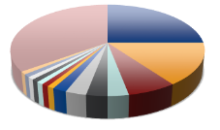
Evolution of Therapy in Lung Cancer
Not 1 disease, but many
Histologic Breakdown
(eg, SQ, NSQ: large cell, adenocarcinoma)
Molecular Pathology
(eg, EGFR, ALK, ROS1)
SCLC
PD-L1 Expression Level
<1%
Lung Cancer
≥1%-49%
NSCLC
≥50%
Traditional View
Present View
Cooper. Pathology. 2011;43:103. Langer. JCO. 2010;28:5311. Galon. Immunity. 2013;39:11.
Pao. Lancet Oncol. 2011;12:175. Krigsfeld. AACR 2017. Abstr CT143.
Notes:
NSCLC, non-small-cell lung cancer; NSQ, nonsquamous; SCLC, small-cell lung cancer; SQ, squamous.

Slide 6
Targetable Driver Mutations in Advanced Nonsquamous NSCLC
EGFR Other
4%
(EGFRex20ins
0.1%-4%)
METex14:
Capmatinib
Tepotinib
ALK:
Alectinib
Crizotinib
Ceritinib
Lorlatinib
Brigatinib
Ensartinib
EGFRex20ins:
Amivantamab*
Mobocertinib*
ALK
7%
MET 3%
HER2:
T-DXd
Poziotinib
EGFR Sensitizing
17%
ALK
7%
>1 Mutation 3%
HER2 2%
ROS1:
Crizotinib
Entrectinib
EGFR Sensitizing:
Osimertinib
Gefitinib
Erlotinib
Afatinib
Dacomitinib
ROS1 2%
KRAS
25%
(KRAS^{G12C}
14%)
BRAF 2%
BRAF V600E:
Dabrafenib‡
RET 2%
NTRK1 1%
PIK3CA 1%
RET fusion:
Selpercatinib
Pralsetinib
Unknown Oncogenic Driver Detected 31%
KRAS^{G12C}:
Sotorasib†
Adagrasib
MEK1 <1%
NTRK fusion:
Entrectinib
Larotrectinib
Li. JCO. 2013;31:1039. Tsao. JTO. 2016;11:613. Burnett.
PLoS One. 2021;16:e0247620. Nassar. NEJM. 2021;384:185.
*Approved after PD on platinum-based CT. †Approved after ≥1 prior systemic therapy.
‡Approved in combination with trametinib (MEK inhibitor) for BRAF V600E mutation.
Notes:
Adv, advanced; CT, chemotherapy; Nonsq, nonsquamous; NSCLC, non-small-cell lung cancer; PD, progressive disease.

Slide 7




Stages of Lung Cancer
Stage at Diagnosis, % | 5-Yr Relative Survival Rate
Stage at diagnosis | 2011-2017¹ | 2012-2018²
Localized | 60.0 | 61.2
Regional | 33.0 | 33.5
Distant | 6.0 | 7.0
Unknown | -- | 9.9
Stage 1: <3 cm (no mets)
Stage 2: <6 cm (single met seen)
5-yr survival rate for all stages: 22%¹ to 22.9%²
Tumors
Nonmetastatic lymph nodes
Stage 3: >6 cm (LN mets)
Stage 4: Tumor in other organs
Regional/local metastatic lymph nodes/distant metastases
1. ACS. Cancer Facts & Figures. 2022. 2. NIH SEER Database. 2022.
Slide credit: clinicaloptions.com
Notes:
LN, lymph node; mets, metastases.

Slide 8
IPASS: EGFR TKI Is Superior for Patients With
EGFR Mutations
EGFR Mutation Positive
EGFR Mutation Negative
PFS | Gefitinib (n = 132) | Carbo/Paclitaxel (n = 129)
HR (95% CI) | 0.48 (0.36-0.64)
P value | <.001
PFS | Gefitinib (n = 91) | Carbo/Paclitaxel (n = 85)
HR (95% CI) | 2.85 (2.05-3.98)
P value | <.001
1.0
1.0
0.8
Gefitinib
Carboplatin plus paclitaxel
0.8
Gefitinib
Carboplatin plus paclitaxel
0.6
0.6
Probability of PFS
Probability of PFS
0.4
0.4
0.2
0.2
0
0
0
4
8
10
16
20
24
0
4
8
10
16
20
24
Mo Since Randomization
Mo Since Randomization
Mok. NEJM. 2009;361:947.
Notes:
Carbo, carboplatin; PFS, progression-free survival; TKI, tyrosine kinase inhibitor.

Slide 9
The Importance of Biomarker Testing in NSCLC
Studies have shown that patients with identified actionable mutations who receive appropriate targeted therapy have improved outcomes
OS Among Patients With NSCLC With
Driver Alteration
1.00
+
+
+
+
+
+
+
+
+
Targeted therapy* (n = 575)
Median OS: 18.6 mo
+
+
+
+
+
+
+
+
+
+
+
+
+
+
No targeted therapy* (n = 560)
Median OS: 11.4 mo
+
0.75
+
+
+
+
+
+
+
+
+
+
+
+
+
+
+
+
+
+
+
+
+
+
+
+
+
+
+
+
+
+
+
+
+
+
P <.001
+
+
+
+
+
+
0.50
+
+
+
+
Probability of Survival
+
+
+
+
+
+
+
+
+
+
+
+
+
+
+
+
+
+
+
+
+
+
+
+
+
+
+
+
+
+
+
+
+
+
+
+
+
+
+
+
+
+
+
+
+
+
+
+
+
+
+
+
+
+
+
+
0.25
+
+
+
+
+
+
+
+
+
+
+
+
+
+
+
+
+
+
+
+
+
+
+
+
+
+
+
+
+
+
+
+
+
+
+
+
+
+
+
+
+
+
+
+
+
+
+
+
+
+
+
+
+
+
+
+
+
+
+
+
+
+
+
+
+
+
+
+
+
+
+
+
+
+
+
+
+
+
+
+
+
+
+
+
+
+
+
+
+
+
+
+
+
+
+
+
+
0
0
10
20
30
40
50
Mo
*Agents selected per NCCN recommendations for specific driver mutations
Singal. JAMA. 2019;321:1391.
Notes:
NCCN, National Comprehensive Cancer Center; NSCLC, non-small-cell lung cancer; OS, overall survival.

Slide 10
Molecular and PD-L1 Testing at Initial Diagnosis to Guide Treatment in NSCLC
Initial Diagnosis of NSCLC
Early Stage
Advanced
Neoadjuvant:
No molecular testing or
PD-L1 IHC required
Adjuvant:
Molecular testing (EGFR) and PD-L1 IHC following surgical resection
Molecular testing and PD-L1 IHC
Regardless of
PD-L1 status,
tumors ≥4 cm or N+
EGFR (classical) mutation PRESENT, stage IB-IIIA
PD-L1 IHC ≥1%,
stage II-IIIA
Targetable alteration
PRESENT
No targetable alteration
Platinum-doublet chemo +
nivolumab
± Chemo →
osimertinib
Chemo →
atezolizumab
Matched targeted therapy
PD-L1 low (1%-49%)
or neg (<1%)
PD-L1 high
(≥50%)
Notes:
IHC, immunohistochemistry; NSCLC, non-small-cell lung cancer.

Slide 11
Barriers to Universal Biomarker Testing
Oncology Team Members
Not enough tissue in small biopsies—up to 25% lack sufficient tumor
Turnaround time not fast enough— recommended <14 calendar/10 working days from biopsy
Poor communication—lack of reflex testing, differing sites for biopsy and treatment
Who pays?
Communication
Tissue Acquisition
Biomarker
Testing
Payment/
Reimbursement
Turnaround Time
Ferry-Galow. J Oncol Pract. 2018;14:JOP1800092. Pennell. ASCO Educ Book. 2019;39:531.

Slide 12
Biomarker Testing in Advanced NSCLC
Advanced NSCLC
(molecular biomarker positive)
EGFR
ALK
ROS1
BRAF V600E
NTRK
RET
METex14
skipping
KRAS G12C
Classical
(del19 or
L858R)
Uncommon
ex20ins
S768L, L861Q, G719X
Biomarker testing to identify optimal first-line targeted therapy has improved survival for patients with advanced NSCLC in recent years
NCCN. Clinical practice guidelines in oncology: NSCLC. v.3.2022. nccn.org. Howlader. NEJM. 2020;383:640.
Notes:
NSCLC, non-small-cell lung cancer.

Slide 13
EGFR Mutations in Advanced NSCLC: Overview
Efficacy for Common EGFR Mutations
Across Multiple Key Trials
~10% of patients with NSCLC in US
  More common in those who have never or minimally smoked, East Asians, women
EGFR mutation types in NSCLC
  Classical mutations: exon 19 deletions, L858R mutation
    Make up majority (85%-90%)
  Atypical EGFR mutations: G719X, L861Q, S768I
  Exon 20 insertions
TKI | ORR, % | mPFS, Mo | mOS, Mo
Osimertinib | 80 | 17.7 | 38.6
Afatinib | 70 | 11.0-13.6 | 23.6-31.6
Dacomitinib | 75 | 14.7 | 34.1
Erlotinib | 64-83 | 9.7-13.1 | 22.8-26.3
Gefitinib | 56-72 | 9.2-10.8 | 27.7-34.8
Key toxicities: rash and diarrhea, mostly minor to moderate
    Less common with osimertinib
    Proactive management may reduce severity
Shah. Clin Lung Cancer. 2020;21:e216.
Notes:
mOS, median overall survival; mPFS, median progression-free survival; NSCLC, non-small cell lung cancer; ORR, overall response rate.

Slide 14
ALK Rearrangements in Advanced NSCLC: Overview
ALK rearrangements present in ~4%-6% of NSCLC¹
  Younger on average, nonsmokers most common
5 TKIs approved, 3 are preferred in first-line setting²
  Alectinib, brigatinib, lorlatinib superior to crizotinib
  Also available: crizotinib, ceritinib superior to chemotherapy
Efficacy
TKI | ORR, % | mPFS, Mo | 1-Yr PFS, % | Toxicity
Alectinib^{3,4} | 83 | 34.8 | 68 | Myalgias
Brigatinib^{5,6} | 74 | 29.4 | 67 | Early pulmonary events
Lorlatinib^{7,8} | 77 | NR | 78 | Neurologic, lipids
Toxicity profiles vary between ALK TKIs
  Unique neurocognitive toxicities
  with lorlatinib
1. Chia. Clin Epidemiol. 2014;6:423. 2. NCCN. Clinical practice guidelines in oncology: NSCLC. v.3.2022. 3. Mok. Ann Oncol. 2020;31:1056. 4. Peters. NEJM. 2017;377:829. 5. Camidge. JCO. 2020;38:3592. 6. Camidge. NEJM. 2018;379:2027. 7. Shaw. NEJM. 2020;383:2018. 8. Solomon. AACR 2022. Abstr CT223 / 2.
Notes:
mOS, median overall survival; mPFS, median progression-free survival; NSCLC, non-small cell lung cancer; ORR, overall response rate; TKI, tyrosine kinase inhibitor.

Slide 15
ROS1 Rearrangements in Advanced NSCLC: Overview
ROS1 rearrangements present in 1%-2% of NSCLC¹
  Younger age, light or never-smokers
Crizotinib and entrectinib approved as first-line therapy²⁻⁴
  Entrectinib active with CNS disease
For progressive disease consider lorlatinib (off-label) or pemetrexed-based chemotherapy⁴
Efficacy
TKI | ORR, % | mPFS, mo | mOS, mo
Crizotinib² | 72 | 19.3 | 51.4
Entrectinib³ No BL CNS mets BL CNS mets | 67 70 63 | 15.7 19.0 11.8 | NR NR 28.3
Key safety findings^{2,3}
  Crizotinib: visual disturbances
  Entrectinib: weight gain
1. Almquist. JCO Oncol Pract. 2021;17:7. 2. Shaw. Ann Oncol. 2019;30:1121. 3. Dziadziuszko. JCO. 2021;39:1253.
4. NCCN. Clinical practice guidelines in oncology: NSCLC. v.3.2022.
Notes:
BL, baseline; CNS, central nervous system; mOS, median overall survival; mPFS, median progression-free survival; NR, not reached; NSCLC, non-small cell lung cancer; ORR, overall response rate; TKI, tyrosine kinase inhibitor.

Slide 16
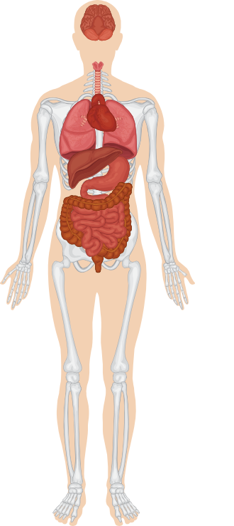

NTRK Rearrangements and TRK Fusions in Cancer
NTRK Fusions Are Rare Events:
0.21% Across 11,116 Patients With Tumors of All Types
Normal role in neuronal development in
utero and postnatal neuronal differentiation, survival, function; expression limited to CNS
In cancer, rearrangement of NTRK gene couples TK domain with a 5’ fusion partner to generate a chimeric TRK protein lacking LBD
Brain cancers (glioma, GBM, astrocytoma)
Salivary (MASC)
Thyroid cancer
Lung cancer (< 1%)
Secretory breast cancer
Pancreatic
GIST
Cholangiocarcinoma
Colon
NTRK1/2/3
Melanoma
Gliomas
DNA
Promoter
5’ partner
LBD
Kinase domain
Thyroid cancer
Sarcoma (multiple)
Infantile fibrosarcoma
Tyr
Tyr
Congenital nephroma
Fusion
Protein
5’ partner
TRK kinase domain
Spitz nevi
Sarcoma (multiple)
Leads to overexpression or
constitutive activation of kinase domain
Common cancer with low
TRK fusion frequency
Rare cancer with high
TRK fusion frequency
Cocco. Nat Rev Clin Oncol. 2018;15:731. Hyman. ASCO 2017. Abstr LBA2501. Gatalica. AACR-NCI-EORTC 2017. Abstr A047.
Notes:
CNS, central nervous system; GBM, glioblastoma; GIST, gastrointestinal stromal tumor; LBD, ligand binding domain; MASC, mammary analogue secretory carcinoma; TK, tyrosine kinase.

Slide 17
Entrectinib (N = 54)
Efficacy of Pan-TRK Inhibitors Regardless of Tumor Type
50
ORR: 57.4% (95% CI: 43.2%-70.8%)
40
30
ORR in NSCLC (n = 10): 70%
20
15
0
Best Change in Tumor SLD
From BL (%)
-10
-20
-30
-40
‡
-50
Sarcoma
NSCLC
MASC
Breast
50
Larotrectinib (N = 55)
-60
40
-70
Thyroid
CRC
Pancreatic
30
ORR: 79% (95% CI: 72%-85%)
-80
Neuroendocrine tumors
Gynecologic
Cholangiocarcinoma
-90
20
ORR in NSCLC (n = 12): 75%
-100
n = 6 excluded.
10
0
-10
-20
Maximum Change in Tumor Size (%)
†
-30
†
-40
†
-50
†
†
-60
†
-70
†
†
-80
†
Appendix Cancer of unknown primary Congenital mesoblastic nephroma Lung | Salivary gland Bone sarcoma Cholangiocarcinoma GIST | Melanoma Other soft tissue sarcoma Breast Colon | IFS Pancreas Thyroid
†
-90
†
-100
*
*
*
n = 10 excluded. *Patients with pathCR. †Patients with brain mets. ‡Max tumor size change: +93.2%.
DoR: 10.4 mo with entrectinib (n = 31); 35.2 mo with larotrectinib (n = 44)
Hong. Lancet Oncol. 2020;21:531. Doebele. Lancet Oncol. 2020;21:271.
Notes:
BL, baseline; CRC, colorectal cancer; DoR, duration of response; GIST, gastrointestinal stromal tumors; IFS, infantile fibrosarcoma; MASC, mammary analogue secretory carcinoma; mets, metastases; pathCR, pathologic complete response; SLD, sum of the longest diameters; ORR, objective/overall response rate.

Slide 18
cMET Receptor Tyrosine Kinase and MET Exon 14 Skipping Mutations in NSCLC
MET: Normal Splicing vs Aberrant Splicing and Exon 14 Skipping
Normal role in embryogenesis and wound healing
In cancer, METex14 skipping mutations cause in-frame deletion of juxtamembrane domain resulting in increased stability and constitutive kinase activation
  3%-4% of nonsquamous NSCLC
  20%-30% of sarcomatoid cancers
Majority of METex14 skipping mutations can be detected with DNA NGS but increased sensitivity with RNA NGS
Normal splicing
HGF
mRNA
Pre-mRNA
MET
CBL
binding
5’
3’
5’
3’
DNA
Intron 13
Intron 14
Downstream pathway activation
Exon 13
Exon 14
Exon 15
Degradation
Aberrant splicing and exon 14 skipping
mRNA
Pre-mRNA
5’ splice site mutation
Unbound
CBL
3’
DNA
Downstream pathway activation
3’ splice site mutation
Decreased
Degradation
Drilon. Clin Cancer Res. 2016;22:2832. Awad. JCO. 2016;34:721. Tong. Clin Cancer Res 2016;22:3048.
Notes:
NGS, next-generation sequencing; NSCLC, non-small-cell lung cancer.

Slide 19
Capmatinib and Tepotinib: Approved Selective
MET Inhibitors for METex14-Positive Advanced NSCLC
Incidence: 3% to 4% of nonsquamous NSCLC; 20% to 30% of sarcomatoid cancers
100
Phase II GEOMETRY Mono-1: Best Tumor Response With Capmatinib in Tx-Naive METex14+ Adv NSCLC (n = 57)
80
60
Response | Prior Plt-Based CT | Tx Naive
Capmatinib | (n = 100) | (n = 60)
ORR, % | 44.0 | 66.7
Median DoR, mo | 9.7 | 12.6
Median PFS, mo | 5.5 | 12.3
Tepotinib | (n = 83) | (n = 69)
ORR, % | 44.6 | 44.9
Median DoR, mo | 11.1 | 10.8
Median PFS, mo | 10.9 | 8.5
40
20
Best % Change From Baseline
*
*
*
*
*
*
*
*
*
0
*
*
-20
-40
CR
PR
SD
-60
-80
-100
*Patients still on treatment.
Phase II VISION: Best Tumor Response With Tepotinib in
Tx-Naive METex14+ Adv NSCLC (n = 69)
20
0
-20
Best % Change in Sum of
Target Lesion Diameters
FDA approvals for metastatic METex14+ NSCLC
  Capmatinib: May 2020
  Tepotinib: February 2021
-40
BOR (IRC)
CR
PR
SD
PD
NE
-60
-80
-100
Capmatinib PI. Le. Clin Cancer Res. 2022;28:1117. Paik. NEJM. 2020;383:931.
Tepotinib PI. Wolf. ASCO 2021. Abstr 9020. Wolf. ELCC 2022. Abstr 26P.
Notes:
Adv, advanced; CR, complete response; CT, chemotherapy; DoR, duration of response; IRC, independent review committee; NE, not evaluable; NSCLC, non-small-cell lung cancer; ORR, objective/overall response rate; PD, progressive disease; PFS, progression-free survival; Plt, platinum; PR, partial response; SD, stable disease; tx, treatment.

Slide 20
RET Receptor Tyrosine Kinase and RET Fusions in NSCLC
Wild-type RET
GFRα family
receptors/
GDNF family
ligands
Normal role in neural, genitourinary development
In cancer, RET gene rearrangements give rise to chimeric, cytosolic proteins with constitutively active RET kinase domain
  1%-2% of nonsquamous NSCLC
  10%-20% of papillary thyroid carcinoma
Majority of RET fusions can be detected by DNA NGS but increased sensitivity with RNA NGS
Heterodimerization of ligand–coreceptor complex and RET leads to autophosphorylation and downstream activation
Lipid raft
P
P
Most Common RET Translocation in Lung Adenocarcinoma: KIF5B-RET
KIF5B
575
713
P
KIF5B exon 15
RET exon 12
P
Gautschi. JCO. 2017;13:1403. Ferrara. J Thorac Oncol. 2018;13:27. Kato. Clin Cancer Res. 2017;23:1988. Wang . JCO. 2012;30:4352. Airaksinen. Nature Rev Neuroscience. 2002;3:383.
Notes:
NGS, next-generation sequencing; NSCLC, non-small-cell lung cancer.

Slide 21
Selpercatinib and Pralsetinib: Approved Selective
RET Inhibitors for RET Fusion–Positive Advanced NSCLC
Incidence: 1%-2% of nonsquamous NSCLC
Phase I/II LIBRETTO-001: Best Tumor Response With
Selpercatinib in Tx-Naive RET+ Adv NSCLC (n = 48)
40
Response | Prior Plt-Based CT | Tx Naive
Selpercatinib | (n = 247) | (n = 69)
ORR, % | 61.1 | 84.1
Median DoR, mo | 28.6 | 20.2
Median PFS, mo | 24.9 | 22.0
Pralsetinib | (n = 87) | (n = 27)
ORR, % | 61 | 70
Median DoR, mo | NR | 9.0
Median PFS, mo | 17.1 | 9.1
20
0
-20
% Change From BL by IRC
-40
-60
-80
-100
Phase I/II ARROW: Best Tumor Response With
Pralsetinib in Tx-Naive RET+ Adv NSCLC (n = 26)
100
20
0
-20
Maximum Change From BL in Target Lesions Diameter (%)
FDA approvals for metastatic RET+ NSCLC
  Selpercatinib: May 2020
  Pralsetinib: September 2020
-40
-60
KIF5B
CCDC6
Other
-80
-100
Patients
Besse. ASCO 2021. Abstr 9065. Selpercatinib PI. Gainor. Lancet Oncol. 2021;22:959. Drilon. ELCC 2022. Abstr 27P. Pralsetinib PI.
Notes:
Adv, advanced; BL, baseline; CT, chemotherapy; DoR, duration of response; IRC, independent review committee; NSCLC, non-small-cell lung cancer; NR, not reached; PFS, progression-free survival; Plt, platinum; Tx, treatment.

Slide 22
KRAS Mutations in Advanced NSCLC
Most common oncogenic driver in NSCLC
  Present in 37% nonsquamous,
  4% squamous
  Significant heterogeneity with specific mutations, comutations
KRAS G12C most common variant
  Comprise 40% of KRAS mutations overall; ~15% incidence in adenocarcinoma
  Only actionable KRAS mutations
Incidence of KRAS Mutation Variants
in Advanced NSCLC
G12 Other
Other
G12A
2%
4%
Q61 Any
6%
7%
G13 Any
G12C
7%
40%
G12D
15%
G12V
19%
Liu. ASCO 2020. Abstr 9544.
Notes:
NSCLC, non-small-cell lung cancer.

Slide 23
Phase II CodeBreaK100 Trial: Sotorasib in Pretreated Advanced KRAS G12C Mutation–Positive NSCLC
1.0
OS (N = 174)
1-3 prior tx; 81% with prior platinum CT and IO
TRAEs, % | Sotorasib 960 mg QD (N = 174)
Any grade | 70
Onset after 1 yr | 24
Grade 3/4 | 21*
TRAE in >10% of patients
Diarrhea | 31
Elevated liver enzymes | 18
Nausea | 16
Fatigue | 12
0.8
Median OS: 12.5 Mo (95% CI: 10.0-17.8)
0.6
Event-Free Probability
0.4
1 Yr OS:
50.8%
2 Yr OS:
32.5%
0.2
Median follow-up: 24.9 mo
0
0
2
4
6
8
10
12
14
16
18
20
22
24
26
28
30
32
34
36
Mo
Outcome | Sotorasib 960 mg QD (N = 174)
Confirmed ORR, % (95% CI)* | 40.7 (33.3-48.4)
DCR, % (95% CI) | 83.7 (77.3-88.9)
Median DoR, mo (95% CI) | 12.3 (7.1-15.0)
Median PFS, mo (95% CI) | 6.3 (5.3-8.2)
No fatal TRAEs
No TRAEs led to d/c after 1 yr
FDA approved in May 2021 for treatment of adults with locally advanced or metastatic KRAS G12C–mutated NSCLC who received ≥1 prior systemic treatment
Dy. AACR 2022. CT008.
*Onset after 1 yr observed in 1 patient (hemolytic anemia).
Notes:
CT, chemotherapy; d/c, discontinuation; DCR, disease control rate; DoR, duration of response; IO, immuno-oncology; NSCLC, non-small-cell lung cancer; OS, overall survival; TRAE, treatment-related adverse events; tx, treatment.

Slide 24
KRYSTAL-1: Adagrasib in Pretreated Advanced
KRAS G12C Mutation–Positive NSCLC
Best Tumor Change From Baseline
Select TRAE, n (%) | All Cohorts (N = 116)
Characteristic | Any Grade | Grade ≥3
Any | 116 (100) | 95 (81.9)
Diarrhea | 82 (70.7) | 1 (0.9)
Nausea | 81 (69.8) | 5 (4.3)
Fatigue | 69 (59.5) | 8 (6.9)
Vomiting | 66 (56.9) | 1 (0.9)
Dyspnea | 41 (35.3) | 12 (10.3)
Blood creatinine increased | 40 (34.5) | 1 (0.9)
Hyponatremia | 27 (23.3) | 10 (8.6)
Pneumonia | 18 (15.5) | 14 (12.1)
40
20
0
-20
Maximum % Change From Baseline
-40
-60
Responses
Complete response
-80
Partial response
Stable disease
-100
Progressive disease
Outcome | Phase II Cohort (n = 112)
ORR, n (%) | 48 (42.9)
DCR, n (%) | 89 (79.5)
Median PFS, mo (95% CI) | 6.5 (4.7-8.4)
Median OS, mo (95% CI) | 12.6 (9.2-19.2)
2 grade 5 TRAEs (pulmonary hemorrhage, cardiac failure)
Treatment discontinuation rate: 6.9%
Dose reduction rate: 51.7%
Janne. NEJM 2022;Online ahead of print.
Notes:
DCR, disease control rate; NSCLC, non-small-cell lung cancer; ORR, overall response rate; OS, overall survival; PFS, progression-free survival; TRAE, treatment-related adverse event.

Slide 25
EGFR Exon 20 Insertions in Advanced NSCLC
Frequency of EGFR Exon 20 Insertion
Mutations in Advanced NSCLC
rwPFS for EGFR Ex20ins+ vs EGFR L858R/Ex19del+
Adv NSCLC With First-line EGFR TKI Therapy (n = 2825)*
Common EGFR
(n = 2749)
EGFR
Ex20ins
(n = 76)
BRAF
5%
ROS1
1%
MET
5%
RET
1%
ALK
6%
100
Median rwPFS, mo
10.5
2.9
KRAS
23%
72%
Adjusted HR: 2.69
(95% CI: 2.1-3.6; P <.0001)
L858R
6%
Other
2%
ins20
1%
75
EGFR
19%
50
43%
G719X
1%
Patients (%)
25
25%
17%
del19
7%
S768I
1%
24%
0
13%
13%
9%
Driver negative
40%
L861Q
1%
0
6
12
18
24
Patients at Risk, n
Common EGFR
EGFR ex20ins
Mo
2749
76
1593
13
790
5
386
4
199
3
N = 3987
*Stratified by line of therapy.
EGFR exon 20 insertions account for 1% of actionable biomarkers in advanced NSCLC, ~10% of EGFR mutations
Meador. Cancer Discov. 2021;11:2145. Bazhenova. Lung Cancer. 2021;162:154.
Notes:
Adv, advanced; NSCLC, non-small cell lung cancer; rwPFS, real-world progression-free survival; TKI, tyrosine kinase inhibitor.

Slide 26
Recently Approved Second-line Therapies for Pretreated EGFR Ex20ins+ Advanced NSCLC
 | Amivantamab | Mobocertinib
MoA | Fully humanized, bispecific IgG1 Ab targeting EGFR mutations and MET mutations/amplifications via receptor degradation, immune cell–directing activity, inhibition of ligand binding | First-in-class, irreversible EGFR TKI that targets EGFR ex20ins mutations
Administration | IV | Oral
Efficacy ORR, % mDoR, mo mPFS, mo mOS, mo | (CHRYSALIS: N = 81; postplatinum population) 40 11.1 8.3 22.8 | (Study 101: N = 114; platinum-pretreated cohort) 28 17.5 7.3 24.0
Both agents FDA approved for treatment of adult patients with advanced NSCLC and EGFR ex20ins mutations whose disease has progressed on or after platinum-based chemotherapy
Park. JCO. 2021;39:3391. Amivantamab PI. Zhou. JAMA Oncol. 2021;7:e214761.
Notes:
MoA, mechanism of action; mDoR, median duration of response; mOS, median overall survival; mPFS, median progression-free survival; NSCLC, non-small cell lung cancer; ORR, objective/overall response rate; Ab, antibody; TKI, tyrosine kinase inhibitor.

Slide 27
What Is HER2-Positive NSCLC?
HER2 mutations: 2.6%, more common in
never-smokers (71%)¹
  n = 920 from LCMC tested for HER2 mutations
HER2 overexpression (2+/3+): 23% of NSCLC²
  High (3+) expression: 4%
HER2 gene amplification: 22%²
  High amplification: ~7%
Actionable target
  Pan-HER TKIs with efficacy
  Balanced by wt EGFR toxicity
Characteristic¹ | HER2+ Cohort (n = 24) | HER2- Cohort (n = 896)
Male/female, n (%) | 10 (41.7)/ 14 (58.3) | 364 (40.6)/ 532 (59.4)
Median age, yr (range) | 62 (37-73) | 61 (18-88)
Stage at diagnosis, n (%) I-IIIA IIIB IV Unknown | 4 (16.7) 3 (12.5) 17 (70.8) -- | 230 (25.7) 66 (7.4) 578 (64.5) 21 (2.3)
Tobacco use, n (%) Never Former Current Unknown | 17 (70.8) 6 (25) 1 (4.2) -- | 288 (32.1) 539 (60.2) 65 (7.3) 4 (0.4)
1. Pillai. Cancer. 2017;123:4099. 2. Pellegrini. Clin Cancer Res. 2003;9:3645.
Notes:
LCMC, Lung Cancer Mutation Consortium; NSCLC, non-small-cell lung cancer; TKI, tyrosine kinase inhibitor; wt, wild-type.

Slide 28
Targeting HER2 Exon 20 Insertions in NSCLC:
Several Agents Under Active Investigation
Drug | MoA | N | ORR, % | Median PFS, Mo
Poziotinib¹ | TKI | 90 | 27.8 | 5.5
T-DM1² | HER2-targeted ADC | 18 | 44.0 | 5.0
T-DXd in HER2 mutation³ | HER2-targeted ADC | 91 | 55.0* | 8.2
T-DXd in HER2 overexpressing⁴ | HER2-targeted ADC | 49 | 24.5 | 5.4
Tarloxotinib⁵ | Hypoxia activated pan-HER TKI | 9 | 44.0 | NR
*Median duration of response: 9.3 mo.
1. Le. JCO. 2022;40:710. 2. Li. JCO. 2018;36:2532. 3. Li. NEJM 2022;386:241.
4. Nakagawa. ESMO 2021. Abstr OA04.05. 5. Liu. ESMO 2020; Abstr LBA61.
Notes:
ADC, antibody-drug conjugate; MoA, mechanism of action; NSCLC, non-small-cell lung cancer; NR, not reported; ORR, objective/overall response rate; PFS, progression-free survival; T-DXd, trastuzumab deruxtecan; TKI, tyrosine kinase inhibitor.

Slide 29
2022 Treatment Paradigm for Molecular Biomarker–Positive Advanced NSCLC
Advanced NSCLC
(molecular biomarker positive)
EGFR
ALK
ROS1
BRAF V600E
NTRK
RET
METex14
skipping
KRAS G12C
Classical
(del19 or
L858R)
Uncommon
Alectinib, brigatinib, or lorlatinib (preferred);
ceritinib or crizotinib‡
Crizotinib
or
entrectinib
Dabrafenib/
trametinib†
Entrectinib
or
larotrectinib
Selpercatinib
or
pralsetinib
Capmatinib
or
tepotinib
First line
ex20ins
S768L, L861Q, G719X
Osimertinib (preferred),* erlotinib, afatinib, gefitinib, or dacomitinib†
Afatinib or osimertinib†
Progression
Amivantamab
or
mobocertinib
Alectinib,
brigatinib, ceritinib, or lorlatinib dependent on previous therapy
Second line+
Sotorasib
Follow treatment options for adenocarcinoma or squamous cell carcinoma without actionable biomarker (ie, chemotherapy ± immunotherapy)
*Osimertinib also approved as second-line therapy for EGFR T790M–positive disease after an earlier-generation EGFR TKI. †Afatinib, dacomitinib, erlotinib (alone or in combination with ramucirumab), gefitinib, and osimertinib approved for EGFR exon19del, exon 21 L858R; afatinib for EGFR G719X, S768I, L861Q. Osimertinib also a preferred option for EGFR G719X, S768I, L861Q per NCCN guidelines. ‡Or as second-line after CT.
Afatinib PI. Alectinib PI. Amivantamab PI. Capmatinib PI. Ceritinib PI. Crizotinib PI. Dabrafenib PI. Dacomitinib PI. Entrectinib PI. Erlotinib PI. Gefitinib PI. Lorlatinib PI. Larotrectinib PI. Mobocertinib PI. Osimertinib PI. Pralsetinib PI. Selpercatinib PI. Sotorasib PI. Trametinib PI. NCCN. Clinical practice guidelines in oncology: NSCLC. v.3.2022.
Notes:
CT, chemotherapy; NCCN, National Comprehensive Cancer Network; NSCLC, non-small-cell lung cancer; TKI, tyrosine kinase inhibitor.

Slide 30
Molecular and PD-L1 Testing Should Be Done at Initial Diagnosis of Advanced NSCLC to Guide 1L Tx Decisions
Initial Diagnosis of Advanced NSCLC
Molecular Testing and PD-L1 IHC
Targetable Alteration
PRESENT
No Targetable Alteration
Matched Targeted Therapy
PD-L1 Low (1%-49%)
or Negative (<1%)
PD-L1 High
(≥50%)
Notes:
1L, first line; IHC, immunohistochemistry; NSCLC, non-small-cell lung cancer; Tx, therapy.

Slide 31
2022 Paradigm for Immunotherapy in
Advanced NSCLC Without an Actionable Mutation
Advanced NSCLC w/o Actionable Mutation
ICI monotherapy: pembrolizumab,* atezolizumab, cemiplimab
ICI + chemotherapy
  Pembrolizumab/carboplatin or cisplatin/pemetrexed (Nsq)
  Atezolizumab/carboplatin/paclitaxel/ bevacizumab (Nsq)
  Atezolizumab/carboplatin/nab-paclitaxel (Nsq)
  Pembrolizumab/carboplatin/taxane (Sq)
  Nivolumab/ipilimumab + 2 cycles of CT (Sq/Nsq)
ICI combination: nivolumab/ipilimumab
PD-L1 ≥50%
PD-L1 1%-49%*
PD-L1 <1%
PD-1/PD-L1i
PD-1/PD-L1i + Chemotherapy
PD-1i + CTLA-4i + Chemotherapy
PD-1i + CTLA-4i
PD-1/PD-L1i + Chemotherapy
PD-1i + CTLA-4i + Chemotherapy
PD-1i + CTLA-4i
PD-1/PD-L1i + Chemotherapy
PD-1i + CTLA-4i + Chemotherapy
PD-1i + CTLA-4i†
Current first-line treatment paradigm based on PD-L1 expression in TC and/or IC
*Single-agent pembrolizumab also approved for ≥1% PD-L1 but not broadly recommended by experts; guideline-recommended for PD-L1
1%-49% if poor PS or contraindications to combining with CT. †Not an FDA-approved indication, but guideline recommended.
NCCN. Clinical practice guidelines in oncology: NSCLC. v.3.2022. nccn.org.
Notes:
CT, chemotherapy; i, inhibitor; IC, immune cell; ICI, immune checkpoint inhibitor; NSCLC, non-small-cell lung cancer; Nsq, nonsquamous; Sq, squamous; TC, tumor cell.

Slide 32
Moving Targeted Therapy and Immunotherapy
Earlier in the Disease Course
“Early Stage”
“Advanced”
Stage I
Stage II
Stage III
Stage IV
Tumors
Nonmetastatic lymph nodes
Regional/local metastatic lymph nodes/distant metastases

Slide 33
Phase III IMpower010 Trial: Adjuvant Atezolizumab vs
BSC in Resected Stage IB-IIIA NSCLC After Adjuvant CT
DFS benefit by PD-L1 status assessed by IHC: HR (95% CI)
  TC ≥50%: 0.43 (0.27-0.68)
  TC ≥1%: 0.66 (0.49-0.87)
  TC <1%: 0.97 (0.72-1.31)
DFS, Stage II-IIIA, PD-L1 TC ≥1%
(Primary Endpoint; n = 476)
100
+
+
+
+
80
+
+
+
+
+
74.6%
+
+
+
+
+
+
+
+
+
+
+
+
+
+
+
+
+
+
+
+
+
+
+
+
+
+
60.6%
+
+
+
+
+
+
60
+
+
+
+
+
+
+
+
+
+
+
+
+
+
+
61.0%
+
+
+
+
+
+
+
+
+
+
+
+
+
DFS (%)
+
+
+
+
+
+
+
+
+
+
+
+
+
+
+
+
+
+
+
+
+
+
+
+
+
+
+
+
+
+
+
+
40
48.2%
+
 | Atezo (n = 248) | BSC (n = 228)
Median DFS, mo (95% CI) | NE (36.1-NE) | 35.3 (29.0-NE)
Approved by the FDA in October 2021 for the adjuvant treatment following resection and adjuvant platinum-based CT for adults with stage II-IIIA NSCLC, PD-L1 TC ≥1%
20
Stratified HR: 0.66 (95% CI: 0.50-0.88; P = .004)
0
0
3
6
9
12
15
18
21
24
27
30
33
36
39
42
45
48
51
54
Mo
Median follow-up: 32.8 mo (range: 0.1-57.5).
Wakelee. ASCO 2021. Abstr 8500. Felip. Lancet. 2021;398;1344.
Notes:
BSC, best supportive care; CT, chemotherapy; DFS, disease-free survival; IHC, immunohistochemistry; NE, not estimable; NSCLC, non-small-cell lung cancer; TC, tumor cell.

Slide 34
Phase III ADAURA Trial: Adjuvant Osimertinib for
Early-Stage EGFR-Mutated NSCLC
International, randomized, double-blind phase III trial (data cutoff for interim analysis: 1/17/2020)
DFS in Overall Population (Stage IB/II/IIIA)
1.0
Median DFS,
Mo
24-Mo
DFS,%
0.8
Osimertinib
Placebo
NR
27.5
89
52
0.6
HR: 0.20 (99.12% CI: 0.14-0.30; P <.001)
Probability of DFS
Maturity: 33% (osimertinib: 11%; placebo: 55%)
0.4
Approved by the FDA in December 2020 for adjuvant treatment of adults with stage IB-IIIA EGFR+ (del19 or L585R) NSCLC following tumor resection ± adjuvant CT
0.2
Osimertinib
Placebo
0
0
6
12
18
24
20
36
42
48
54
Patients at Risk, n
Mo From Randomization
Osimertinib
Placebo
339 313 272 208 138 74 27 5 0
343 287 207 148 88 53 20 3 1 0
Wu. NEJM. 2020;383:1711. Osimertinib PI.
Notes:
CT, chemotherapy; DFS, disease-free survival; NR, not reached; NSCLC, non-small-cell lung cancer.

Slide 35
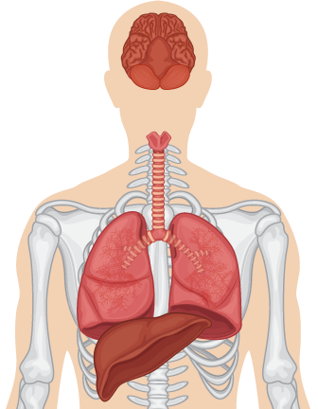

Sample Testing Platforms: Differences and Challenges
ID Genetic Alterations
Analytes
Platforms
Single Gene
Targeted
WES
WGS
WTS
IHC
FISH
Other
Biopsy needle
Trachea
DNA
RNA
Protein
Lung
Tumor
cell
Bronchi
Notes:
FISH, fluorescence in situ hybridization; ID, identity; IHC, immunohistochemistry; WES, whole exome sequencing; WGS, whole genome sequencing; WTS, whole transcriptome sequencing.

Slide 36

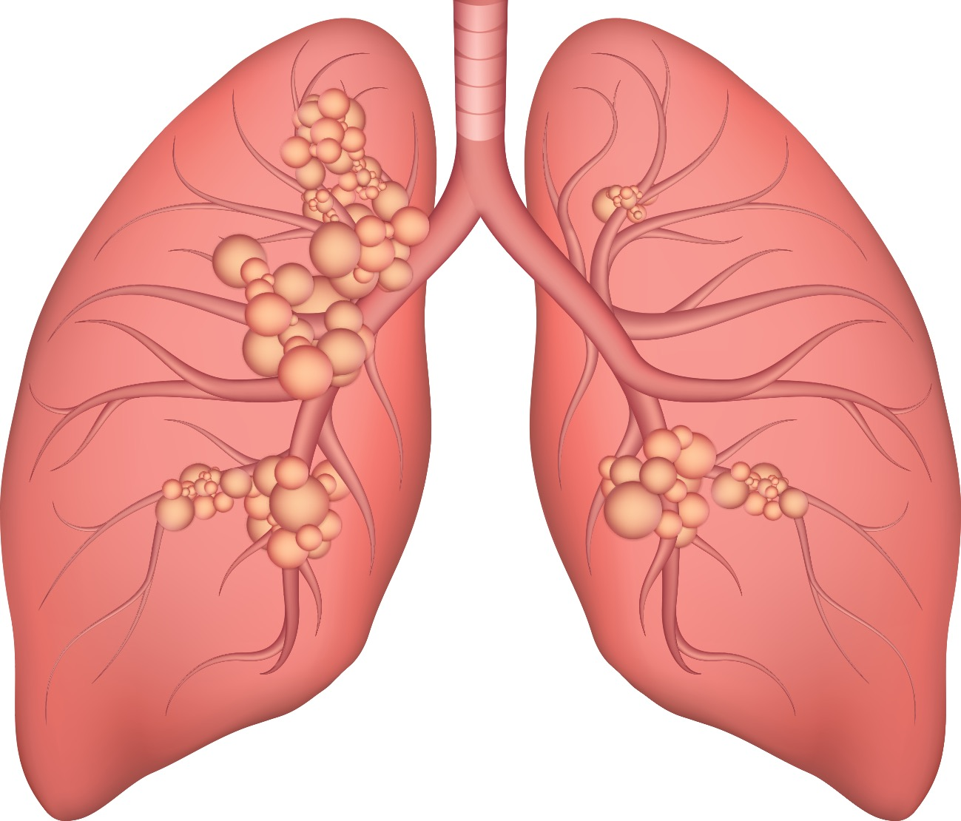
Personalized Medicine: Diagnosis, Prognosis, Treatment
Pain points
Long delay on molecular test results
Small samples fail testing
Repeat biopsy puts patient and hospital at risk
>1 laboratories involved in testing
Clinical decisions are not fully informed
46-yr-old woman → fine needle biopsy.
Waiting… for results and treatment plan.
As efficient as possible
Day 1 | 2 | 3 | 4 | 5 | 6 | 7 | 11-16 | 17
IHC, FISH
Treatment
Plan
Treatment
plans are not synchronized
Office visit
CT scan
Biopsy
Pathology
Diagnosis
Lung Cancer
Molecular Testing
Re-biopsies
($$$) delays
treatment
Quantity
insufficient
Treatment
Plan
Notes:
FISH, fluorescence in situ hybridization; IHC, immunohistochemistry.

Slide 37
Rapid Turnaround Time
Rapid TAT is a paradigm shift in molecular diagnosis
All results delivered at nearly the same time
Consolidation of wet laboratory processes
Fully informed clinical decision making
As efficient as possible
Day 1 | 2 | 3 | 4 | 5 | 6 | 7
IHC
Molecular & Cytogenetics
Office visit
CT scan
Biopsy
Pathology
Diagnosis
Treatment
Plan
Rebiopsies
($$$) delays
treatment
Synchronized Treatment
Plans
Faster TAT
Notes:
IHC, immunohistochemistry; TAT; turnaround time.

Slide 38
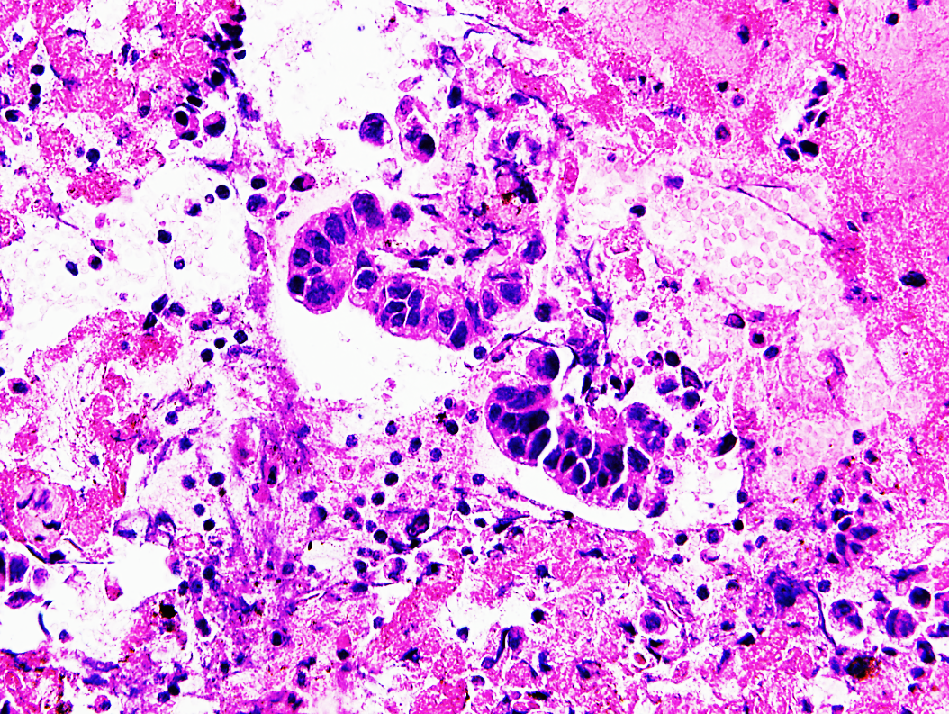
Requirements and Recommendations for
Molecular Testing
Metastatic or recurrent tissues are preferred
FFPE tissue is acceptable
Optimize tumor microdissection
Methods must detect 5% mutant allele frequency
Sufficient number malignant cells
Quantity DNA >10 ng
Malignant cells >10%
Courtesy of Dr. Alexander MacKinnon.
Notes:
FFPE, formalin-fixed paraffin-embedded.

Slide 39
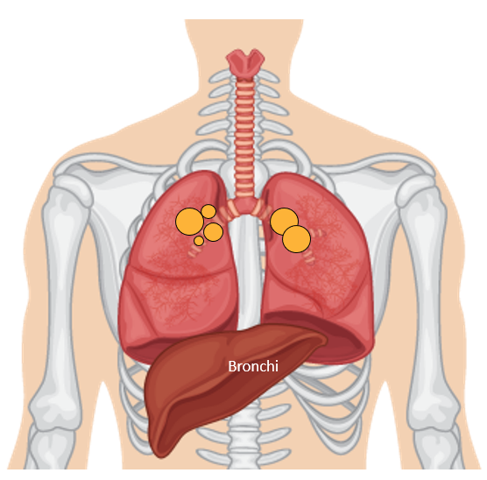

Tissue Journey: Biopsy to Analysis
Preliminary
diagnosis
Biopsy methods and specimen processing
Morphologic
assessment
Extraction
Analysis
Resection
Excision
Small tissue biopsies
FFPE block
Histology
Assessment methods
PCR
Cancer gene panels
MSI
NGS (WGS, WES, targeted hotspot panel)
RT-qPCR
Gene expression panels
RNA-seq NGS
Proteomics
FACS
Data analytics
TISSUE
DNA
FFPE block
Cytology
Fine-needle aspiration
Exfoliative cytology
(cells shed from body surfaces)
RNA
CYTOLOGY
Non–cell block slide
Parallel diagnostics
IHC (eg, PD-L1, dMMR)
ISH/FISH
Liquid biopsies
  Blood
  Cyst fluid
Protein
LIQUID
Ascierto. J Mol Diagn. 2019;21:756.
Notes:
dMMR, defective mismatch repair; FACS, fluorescence-activated cell sorting; FFPE, formalin-fixed, paraffin-embedded; FISH, fluorescence in situ hybridization; IHC, immunohistochemistry; MSI, microsatellite instability; NG, next-generation sequencing; PCR, polymerase chain reaction; RT-qPCR, reverse transcriptase quantitative polymerase chain reaction; WES, whole-exome sequencing; WGS, whole-genome sequencing.

Slide 40
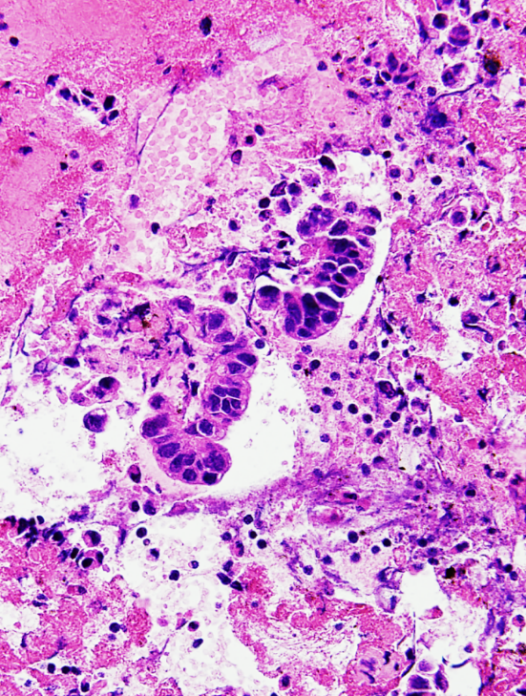
Availability of Tissue Specimens: Molecular Testing
Malignant cells
≤10%
# gene
Targeted Testing
Large NGS Panels
Tissue Input (DNA)
Minimum Quantity
DNA 1-10 ng
Not possible to run large,
comprehensive panels
Courtesy of Dr. Alexander MacKinnon.
Notes:
NGS, next-generation sequencing.

Slide 41
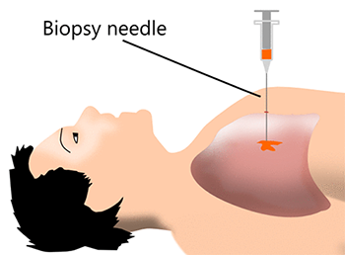
Tissue Testing in NSCLC: Benefits and Challenges
Benefits
Challenges
Tissue available from biopsy
Considered “gold standard” for biomarker testing
Lung cancer biopsies are less cellular than other solid tumors
  Limited tumor cellularity in small biopsy samples or cytology specimens can cause molecular testing failure
  Need 10%-20% of viable cancer cells in sample for reliable results
Bone biopsies yield poor samples due to decalcification which degrades DNA
Logistical: timing of DNA sequencing can take weeks; centralized vs sent to distant laboratory
Vanderlaan. Lung Cancer. 2014;84:39. Hiley. Lancet. 2016;388:1002.
Notes:
NSCLC, non-small-cell lung cancer.

Slide 42
Methods of Tissue Testing in NSCLC
Tissue Testing Method | Detection
DNA sequencing/NGS/PCR | Detects insertions, point mutations, deletions Detects aberrations in EGFR, KRAS, BRAF, HER2, MET Single-gene or full NGS panel
RNA sequencing panel | Detects fusion abnormalities More sensitive for ALK, ROS1, RET, NTRK
IHC/FISH | FISH: Detects ALK/ROS1, highly specialized, can be faster IHC: Detects ALK/ROS1, easy test, fast, but not reliable or sensitive enough to guide treatment Detects PD-L1
Vanderlaan. Lung Cancer. 2014;84:39. Hiley. Lancet. 2016;388:1002. Shim. J Path Trans Med. 2017;51:242.
Notes:
FISH, fluorescence in situ hybridization; IHC, immunohistochemistry; NGS, next-generation sequencing; NSCLC, non-small-cell lung cancer; PCR, polymerase chain reaction.

Slide 43
DNA-Based NGS: Overview
Considerations
Specialized technologist
DNA/RNA prep bottleneck
Turnaround times
Specialized LIMS/tracking
IT and data storage
Several Days Process
DNA Prep
Library Prep
Sequence
Staffing
Reagents
Equipment
Servers
Notes:
IT, information technology; LIMS, laboratory information management system; NGS, next-generation sequencing.

Slide 44
RNA-Based NGS: Overview
Agnostic to fusion partners and breakpoints; Multiplex testing of numerous targets
RNA-based NGS¹:
  Goal: to identify fusion genes
Approaches:
  Anchored multiplex PCR
  Whole transcriptome sequencing
Example: Ewing sarcoma gene fusion variants²
Extraskeletal myoxid chondrosarcoma
NR4A3
EWSR1
WT1
Desmoplastic small round cell tumor
Myoepithelial tumor of soft tissue and bone
POU5F1
PBX1
ZNF444
FLI1
ETV1
ETV4
NFATC2
PATZ1
SP3
ZSG
Ewing sarcoma/
Primitive neuroectodermal tumor
Pulmonary myoxid sarcoma
Clear cell sarcoma
CREB1
FUS
FEV
Malignant gastrointestinal neuroectodermal tumor
ATF1
Acute myeloid leukemia
ERG
Angiomatoid fibrous histiocytoma
Low grade fibromyxoid sarcoma
CREB3L1
Hyalinizing clear cell carcinoma of the salivary gland
DDIT3
CREB3L2
Subset of sclerosing epithelioid fibrosarcoma
Myxoid liposarcoma
DDIT3
WT1
EWSR1
CREB1
1. Barua. Pract Lab Med. 2020;21:e00173. 2. Jo. Cancer Cytopathology: Molecular minute. 2020: DOI:10.1002/cncy.22239.
Notes:
NGS, next-generation sequencing; PCR, polymerase chain reaction.

Slide 45
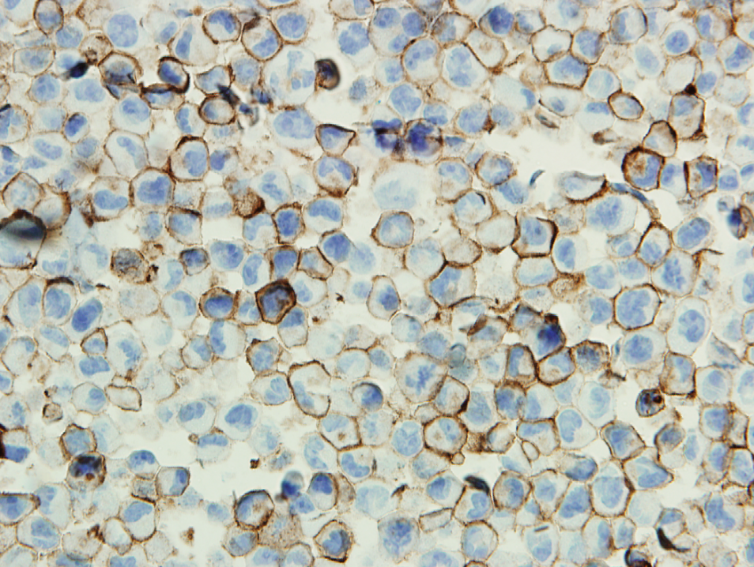
Analyzing PD-L1 Expression Levels With IHC
PD-L1
Y
Tumor
Y
PD-L1 expression level Negative for PD-L1 Low positive for PD-L1 High positive for PD-L1 | TPS <1% 1% to 49% >50%
Y
Courtesy of Dr. Alexander MacKinnon.
Notes:
IHC, immunohistochemistry; TPS, tumor proportion score.

Slide 46
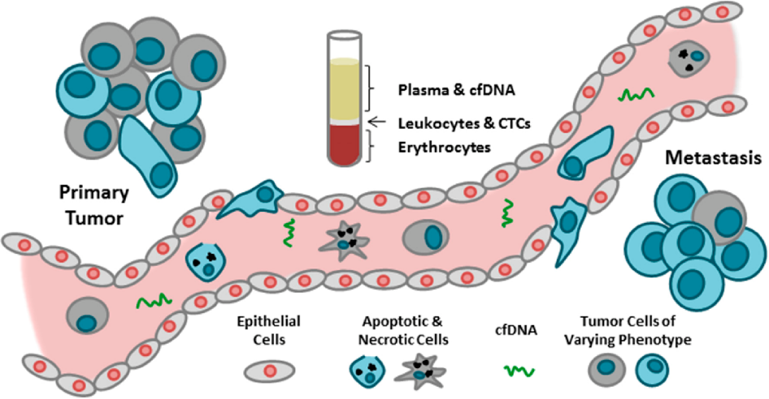
Evolving Role of Liquid Biopsy for Biomarker Detection in Advanced NSCLC
Blood sample containing cell-free DNA from multiple sources, including DNA shed from tumor
When do we use liquid biopsy?
  Plasma-first approach: for inadequate or no tissue biopsy—if negative, rebiopsy for tumor tissue
  Sequential approach: tumor tissue adequate for genotyping—follow with cfDNA testing only when results from tissue incomplete
  Complementary approach: increases rate of biomarker detection
  Resistance to TKIs
Advantages: minimally invasive, may overcome
tumor heterogeneity
Limitations: sensitivity (70%-80%), specificity
near 100%; negative result is noninformative; cannot assess histology or PD-L1
Leighl. Clin Cancer Res. 2019;25:4691. Rothwell. Nat Med. 2019;25:738. Bauml. Clin Cancer Res. 2018;24:4352. Figure 1 of Lowes. Int J Mol Sci. 2016:17:E1505 is used in its original form under the terms and conditions of the Creative Commons Attribution 4.0 International license (CC BY 4.0: https://creativecommons.org/licenses/by/4.0/).
Notes:
cfDNA, cell-free DNA; CTC, circulating tumor cell; TKI, tyrosine kinase inhibitor.

Slide 47
Go Online for More CCO
Coverage of NSCLC Biomarkers!
CME/ABIM MOC–certified and ABPath-certified text module associated with this downloadable slideset
CME/ABIM MOC–certified and ABPath-certified webinar featuring interactive presentations and discussions with expert pathologist and medical oncologist (coming soon)
Expert commentaries on NSCLC biomarkers (coming soon)
Conference Coverage of ASCO 2022 on NSCLC biomarkers with downloadable slides and CME-certified expert analyses of clinical implications
clinicaloptions.com/oncology

